Slide 1
BITE
Beyond Priors for Improved
Three-D Dog Pose Estimation
Nadine Rüegg · Shashank Tripathi · Konrad Schindler
Michael J. Black · Silvia Zuffi
Source: Paper, p.1
01
Notes:
講稿
這篇論文研究如何從單張犬隻影像重建三維形狀與姿態。報告會沿論文的主要章節，依序介紹研究動機、相關方法、BITE 的做法、實驗以及限制。
Source
Paper, p.1
Rüegg et al., BITE: Beyond Priors for Improved Three-D Dog Pose Estimation.

Slide 2
Outline
01
Introduction
03–05
Problem and contributions
02
Related Work
06–07
Prior work and missing evidence
03
Approach
08–17
D-SMAL, contact and refinement
04
Experiments
18–26
Data, evaluation and ablations
05
Conclusion
27–30
Findings and limitations
Source: Paper, pp.1–8
02
Notes:
講稿
目錄沿用論文的大章節。摘要與前言合併介紹，因兩者的主要動機與貢獻重疊。接著在方法章節拆解模型與接觸約束，再到實驗章節核對資料、評估與消融。
Source
Paper, pp.1–8
Rüegg et al., BITE: Beyond Priors for Improved Three-D Dog Pose Estimation.

Slide 3
01
Introduction
Monocular 3D reconstruction
and the limits of existing priors
Source: Paper, §1, pp.1–2
03
Notes:
講稿
先從問題設定開始：輸入只有一張照片，輸出是能呈現形狀與姿態的三維犬隻網格。這裡把摘要的貢獻概觀與前言合併，避免重複。
Source
Paper, §1, pp.1–2
Rüegg et al., BITE: Beyond Priors for Improved Three-D Dog Pose Estimation.

Slide 4
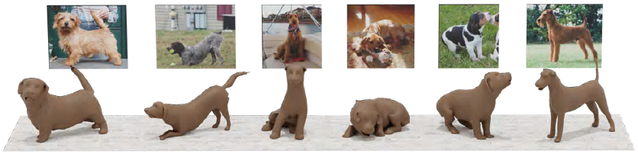
Why single-image 3D dog reconstruction is hard
Depth ambiguity
Many 3D bodies can project to similar 2D evidence.
Self-occlusion
Sitting and lying hide limbs and deform the body.
Limited training priors
Available canine 3D pose data favors standing and walking.
Paper Figure 1: input images and estimated 3D dogs
Source: Paper, pp.1–2, Fig.1
04
Notes:
講稿
單張影像把深度投影掉，因此二維輪廓吻合不保證三維形狀正確。坐姿和臥姿還會遮住腿部，讓估計更困難。舊有姿態先驗的資料主要涵蓋站立與行走，容易把少見姿態拉回熟悉範圍。
Source
Paper, pp.1–2, Fig.1
Rüegg et al., BITE: Beyond Priors for Improved Three-D Dog Pose Estimation.

Slide 5
BITE: four contributions
Dog-specific shape model
D-SMAL replaces a generic multi-species shape space.
Ground contact supervision
Contact and a local ground plane provide geometric evidence.
Refinement network
A coarse BARC+ prediction is refined beyond its pose prior.
3D evaluation
Rendered images of scanned dogs provide 3D reference geometry.
Source: Paper, §1, pp.1–2
05
Notes:
講稿
作者從四個方向處理問題：建立犬科專用的形狀空間、利用接觸資訊、設計可修正姿態的網路，以及建立可量測三維誤差的測試資料。這些貢獻互相配合，並非單純換一個姿態估計模型。
Source
Paper, §1, pp.1–2
Rüegg et al., BITE: Beyond Priors for Improved Three-D Dog Pose Estimation.

Slide 6
02
Related Work
Model-based, model-free
and contact-based reconstruction
Source: Paper, §2, pp.2–3
06
Notes:
講稿
相關工作主要分三類。模型式方法利用可動的形狀先驗；無模型方法有較大的表示彈性；接觸式方法則把人體和環境的互動加入推論。
Source
Paper, §2, pp.2–3
Rüegg et al., BITE: Beyond Priors for Improved Three-D Dog Pose Estimation.

Slide 7
Prior work and the gap BITE addresses
Model-based: SMAL and BARC
Priors help ambiguity, but generic shape and narrow poses limit dogs.
Model-free reconstruction
Flexible surfaces often require video or additional assumptions.
Contact-based human models
Contact has improved human reconstruction; BITE adapts ground contact to dogs.
BITE keeps an articulated prior while adding contact evidence for refinement.
Source: Paper, §2, pp.2–3
07
Notes:
講稿
SMAL 是多物種四足動物模型，BARC 利用犬種資訊從影像估計犬隻。作者認為前者的形狀空間不夠針對犬隻，後者的姿態先驗仍受訓練姿態限制。BITE 沿用可動模型，增加地面接觸作為另一條幾何線索。
Source
Paper, §2, pp.2–3
Rüegg et al., BITE: Beyond Priors for Improved Three-D Dog Pose Estimation.

Slide 8
03
Approach
D-SMAL, BARC+ refinement,
contact losses and optional optimization
Source: Paper, §3, pp.3–6
08
Notes:
講稿
方法依論文分成 D-SMAL、BITE 網路、損失函數和測試時最佳化。先看形狀表示，再理解初始估計和修正階段如何合作。
Source
Paper, §3, pp.3–6
Rüegg et al., BITE: Beyond Priors for Improved Three-D Dog Pose Estimation.

Slide 9
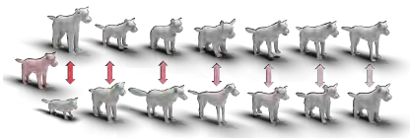
D-SMAL: a dog-specific shape space
Training shapes
39 scanned canine-family toy figurines: 5 prior + 34 new.
Registration and PCA
Register a common mesh and learn shape variations.
Additional controls
Variable limb lengths and ear articulation improve expressiveness.
Figure 2: mean shape and seven principal deformation modes
Source: Paper, §3.1, pp.3–4; Fig.2
09
Notes:
講稿
D-SMAL 由三十九個犬科玩偶的掃描建立，其中五個來自原 SMAL，其餘三十四個新增。作者配準共同網格後學習形狀空間，並加入肢體長度調整；耳朵角度也在配準階段處理。玩偶掃描數不能誤認為真犬掃描數。
Source
Paper, §3.1, pp.3–4; Fig.2
Rüegg et al., BITE: Beyond Priors for Improved Three-D Dog Pose Estimation.

Slide 10
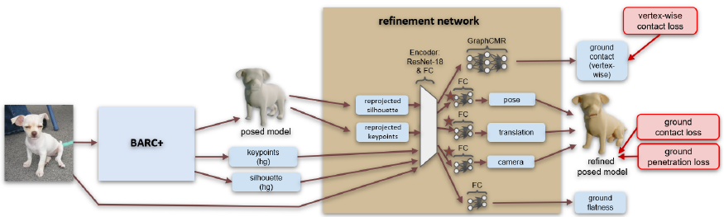
BITE network overview
Figure 3: BARC+ produces a coarse fit; BITE refines it using image and reprojection evidence.
Refinement predicts pose, camera, contact labels and ground flatness.
Source: Paper, §3.2, pp.4–5; Fig.3
10
Notes:
講稿
這張原始架構圖從左往右讀。BARC 加上 D-SMAL 形成 BARC+，先得到姿態、形狀和影像空間的預測。接著重投影，將影像與二維線索送進修正網路；不同輸出頭預測修正後的姿態、相機、逐頂點接觸及地面平坦程度。
Source
Paper, §3.2, pp.4–5; Fig.3
Rüegg et al., BITE: Beyond Priors for Improved Three-D Dog Pose Estimation.

Slide 11
BARC+: the coarse estimation stage
Input
2D evidence
3D parameters
D-SMAL
Single RGB
image
Keypoints +
silhouette
Shape, pose
and camera
Initial posed
dog mesh
BARC+ retains BARC’s architecture while replacing SMAL with D-SMAL.
Source: Paper, §3.2–3.3, p.4
11
Notes:
講稿
第一階段是 BARC 加上 D-SMAL，因此作者稱為 BARC+。網路先估計關鍵點和分割，再透過形狀、姿態分支以及相機參數形成初始網格。它仍使用原有姿態先驗，因此輸出可能偏向訓練資料中的常見姿態。
Source
Paper, §3.2–3.3, p.4
Rüegg et al., BITE: Beyond Priors for Improved Three-D Dog Pose Estimation.

Slide 12
Refinement uses 2D residual evidence
Inputs
RGB image, BARC+ keypoints and silhouette, plus projections of the coarse mesh.
Operation
A 2D encoder and prediction heads estimate differential corrections.
Outputs
Refined pose, translation and camera; contact and flatness predictions.
Network refinement keeps the coarse shape fixed; shape refinement is tested separately.
Source: Paper, §3.2, p.4; Fig.3 p.5
12
Notes:
講稿
修正階段同時接收初始網格投影和二維偵測結果，讓網路取得兩者之間的差異線索。它修正姿態與相機，另有接觸和地面平坦度輸出頭。這個階段不修正形狀參數；後面的消融會顯示原因。
Source
Paper, §3.2, p.4; Fig.3 p.5
Rüegg et al., BITE: Beyond Priors for Improved Three-D Dog Pose Estimation.

Slide 13
Ground-contact labels: training vs inference
Training annotations
Annotators mark ground flatness and contact on paws or mesh vertices.
Training losses
For flat-ground examples, contact and penetration losses supervise geometry.
Inference predictions
The network predicts per-vertex contact and ground flatness.
Optional optimization
Predicted contact and flatness guide test-time fitting.
Source: Paper, §3.2–3.4 and §4.1, pp.4–6
13
Notes:
講稿
請區分訓練與推論。訓練時作者收集接觸及地面平坦度標註；測試時不需要人工接觸標註，改由網路預測。可選的測試時最佳化再利用這些預測，並只在判斷地面平坦時啟用接觸約束。
Source
Paper, §3.2–3.4 and §4.1, pp.4–6
Rüegg et al., BITE: Beyond Priors for Improved Three-D Dog Pose Estimation.

Slide 14
Ground contact: fit a plane to contact points
c = (1/m) Σᵢ pᵢ A = [p₁ − c, …, pₘ − c]
A = U Σ Vᵀ Lplane = σ₃²
Input
m labeled contact points pᵢ on a uniformly remeshed surface.
Operation
Center points; the least-variance SVD direction defines the plane normal.
Output
Minimize squared contact-to-plane distances through σ₃².
Source: Paper, §3.3, pp.4–5, Eqs.1–3
14
Notes:
講稿
對接觸頂點先計算中心 c，再將去中心化座標組成三乘 m 的矩陣 A。SVD 最小奇異值對應的左奇異向量是最佳平面法向量，最小平方距離之和為最小奇異值平方。使用均勻重網格可避免原模型的臉與腳掌頂點密度過高，主導損失。
Source
Paper, §3.3, pp.4–5, Eqs.1–3
Rüegg et al., BITE: Beyond Priors for Improved Three-D Dog Pose Estimation.

Slide 15
Ground penetration and other losses
Penetration
Penalize non-contact vertices below the estimated ground plane.
Reprojection
Keypoint and silhouette losses maintain image alignment.
Auxiliary classification
Cross-entropy supervises vertex contact and ground flatness.
Joint regularizers
Discourage implausible limb torsion and sideways motion.
Source: Paper, §3.3, p.5
15
Notes:
講稿
僅讓接觸點共平面仍可能讓其他部位穿過地面，所以另加穿透損失。二維關鍵點與輪廓損失維持影像一致性，接觸及平坦度用分類損失監督，再用關節規則避免不合理的扭轉和側向姿態。
Source
Paper, §3.3, p.5
Rüegg et al., BITE: Beyond Priors for Improved Three-D Dog Pose Estimation.

Slide 16
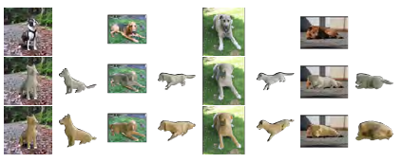
Beyond a restrictive pose prior
Start from BARC+
A prior trained on simple poses produces a plausible initial fit.
Predict a correction
Scale the additive pose update by a constant factor of 0.1.
Allow unfamiliar poses
No hard bound prevents larger deviations after training.
Figure 6: input, BARC+ with contact, then BITE
Source: Paper, §3.2–3.3, pp.4–5; Fig.6 p.8
16
Notes:
講稿
舊先驗提供穩定起點，卻可能限制坐姿與臥姿。BITE 不把先驗直接移除，而是在初始估計上預測差分修正；論文把修正乘上 0.1，以便訓練從小變化開始。這不是對最終修正量設置硬性上限。圖六展示接觸約束與修正網路的作用。
Source
Paper, §3.2–3.3, pp.4–5; Fig.6 p.8
Rüegg et al., BITE: Beyond Priors for Improved Three-D Dog Pose Estimation.

Slide 17
Optional test-time optimization
Optimize per image
Update translation, focal length, pose and shape.
Two stages
First use PCA shape and limb parameters; then allow symmetric vertex shifts.
Losses and condition
Use predicted 2D cues; activate contact losses when ground is predicted flat.
Trade-off
Further 3D improvement costs extra runtime.
BITE-ttopt includes this optional optimization; BITE is the network output.
Source: Paper, §3.4, pp.5–6
17
Notes:
講稿
BITE-ttopt 在網路預測之後，對每張測試圖做迭代最佳化，因此與單次前向推論的 BITE 是不同設定。前半使用形狀與肢體參數，後半允許左右對稱的頂點位移。測試圖沒有人工二維標註，使用的是網路自己的二維預測。
Source
Paper, §3.4, pp.5–6
Rüegg et al., BITE: Beyond Priors for Improved Three-D Dog Pose Estimation.

Slide 18
04
Experiments
Training data, 3D protocol,
comparisons and ablation studies
Source: Paper, §4, pp.6–8
18
Notes:
講稿
現在依論文實驗章節說明訓練資料、三維測試協定、主要比較和消融。這樣才能判讀數值是來自真實照片、半合成測試，還是哪一個網路設定。
Source
Paper, §4, pp.6–8
Rüegg et al., BITE: Beyond Priors for Improved Three-D Dog Pose Estimation.

Slide 19
StanfordExtra contact annotations
Training pose category | Images with contact labels
Standing or walking | 2,554
Lying | 795
Sitting | 867
Other | 89
Total | 4,305
Batch sampling balances pose and ground-flatness groups; 2D labels and breed labels are also used.
Source: Paper, §4.1, p.6; total calculated from reported counts
19
Notes:
講稿
作者在 StanfordExtra 的部分訓練影像補上接觸標註。四類加總為 4305 張，這不是整個 StanfordExtra 的總量。採樣器每批混合平坦與非平坦地面，並增加坐姿和臥姿，後續消融會顯示採樣器帶來的差異。
Source
Paper, §4.1, p.6; total calculated from reported counts
Rüegg et al., BITE: Beyond Priors for Improved Three-D Dog Pose Estimation.

Slide 20
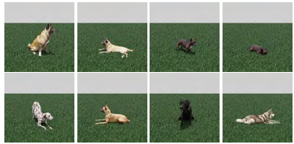
3D evaluation dataset and alignment
Semi-synthetic test set
26 textured scans of six dogs, rendered from seven views per dog.
Common inputs
Rendered 1080 × 1080 images with ground-truth bounding boxes.
Rigid alignment
Keypoint initialization, then scan-to-mesh alignment.
Figure 7: rendered scans used as test images
Source: Paper, §4.2, pp.6–7; Fig.7 p.8
20
Notes:
講稿
測試資料由六隻真犬的二十六個帶紋理掃描組成，再渲染不同視角，形成半合成影像。所有網路都使用真值邊界框；評估前先依少量對應關鍵點初始化，再做包含旋轉、平移和尺度的剛性對齊。原文寫每隻犬七個視角，未在此推算測試影像總數。
Source
Paper, §4.2, pp.6–7; Fig.7 p.8
Rüegg et al., BITE: Beyond Priors for Improved Three-D Dog Pose Estimation.

Slide 21
Why evaluate both 3D distances?
Scan → mesh
Mesh → scan
For each scan vertex, measure distance to the predicted surface.
Measure predicted surface points against the scan.
A low score alone can miss extraneous predicted regions.
Complements the first direction for deformable bodies.
Both errors are in centimeters after alignment; lower is better.
Source: Paper, §4.2, pp.6–7
21
Notes:
講稿
以二維 PCK 和輪廓 IoU 量測投影，深度方向的錯誤可能被掩蓋。三維評估則計算兩個方向的表面距離。掃描到預測網格不能充分懲罰多出來的預測表面，因此作者加入網格到掃描距離；兩者都在對齊後以公分報告。
Source
Paper, §4.2, pp.6–7
Rüegg et al., BITE: Beyond Priors for Improved Three-D Dog Pose Estimation.

Slide 22
BITE reduces 3D surface error
Method | Scan → mesh ↓ | Mesh → scan ↓
WLDO | 2.65 | 7.55
CTF | 2.59 | 6.17
BARC | 2.40 | 3.93
BITE | 2.07 | 3.15
BITE-ttopt | 2.03 | 2.84
Against BARC: BITE improves by 0.33 cm and 0.78 cm, respectively.
Semi-synthetic scan test; cm, lower is better. ttopt adds per-image optimization.
Source: Paper, §4.3, Table 1, p.7; differences calculated from table
22
Notes:
講稿
表一是在半合成掃描測試集的三維比較。相對 BARC，BITE 的掃描到網格誤差由 2.40 降為 2.07 公分，網格到掃描由 3.93 降為 3.15。BITE-ttopt 進一步降到 2.03 和 2.84，但使用了額外的測試時最佳化，因此不能忽略運算成本。
Source
Paper, §4.3, Table 1, p.7; differences calculated from table
Rüegg et al., BITE: Beyond Priors for Improved Three-D Dog Pose Estimation.

Slide 23
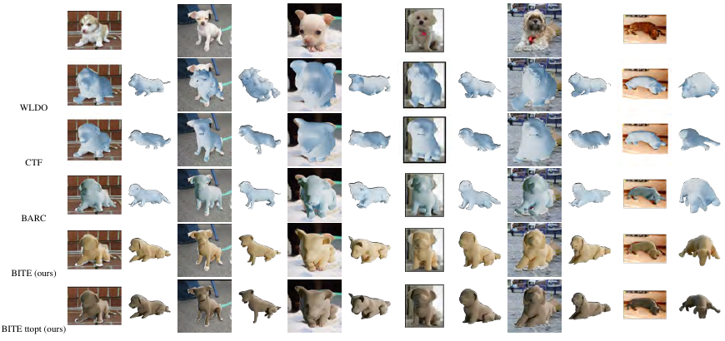
Qualitative comparison with prior methods
Rows: WLDO, CTF, BARC, BITE and BITE-ttopt; columns show different test images.
Inspect the estimated 3D pose from the input view and a second view.
Source: Paper, Fig.4, p.8
23
Notes:
講稿
圖四每一欄是不同輸入，每一列是不同方法。請同時看輸入影像視角和旁邊的另一個三維視角，因為只看原圖投影可能掩蓋深度錯誤。這些是定性範例，整體效能仍應以表一的雙向距離判斷。
Source
Paper, Fig.4, p.8
Rüegg et al., BITE: Beyond Priors for Improved Three-D Dog Pose Estimation.

Slide 24
Ablation: contact and refinement matter
Configuration | Scan → mesh ↓ | Mesh → scan ↓
BARC+ without contact | 2.32 | 3.92
BARC+ with contact | 2.13 | 3.48
BITE without contact | 2.30 | 4.16
BITE without sampler | 2.09 | 3.31
BITE | 2.07 | 3.15
For BITE, adding contact lowers error by 0.23 cm and 1.01 cm.
Same semi-synthetic test and cm metrics; sampler is the pose-balanced training sampler.
Source: Paper, §4.4, Table 2, p.7; differences calculated from table
24
Notes:
講稿
消融表說明哪個元件有作用。BITE 移除接觸後，兩個誤差為 2.30 和 4.16；加入接觸後降至 2.07 和 3.15。拿掉採樣器則只有小幅退步。這些差值是絕對公分，不是相對百分比，也不能把所有改善歸因於單一元件。
Source
Paper, §4.4, Table 2, p.7; differences calculated from table
Rüegg et al., BITE: Beyond Priors for Improved Three-D Dog Pose Estimation.

Slide 25
Refinement helps poses outside the prior
BARC+ with contact
A restrictive prior can still fit poses close to training examples.
BITE refinement
Adds flexibility for sitting and lying beyond the prior.
Interpretation
The examples illustrate behavior; Table 2 provides aggregate evidence.
Figure 6: top input; middle BARC+ with contact; bottom BITE
Source: Paper, §4.4, p.7; Fig.6 p.8
25
Notes:
講稿
圖六的三列依次是輸入、加入接觸的 BARC+，以及 BITE。某些姿態接近先驗時，初始模型已能處理；但偏離較大的姿態，需要修正網路的彈性。這是原文挑選的視覺案例，不宜將它當作單獨的整體成功率。
Source
Paper, §4.4, p.7; Fig.6 p.8
Rüegg et al., BITE: Beyond Priors for Improved Three-D Dog Pose Estimation.

Slide 26
Shape refinement can degrade 3D accuracy
Configuration | Scan → mesh ↓ | Mesh → scan ↓
BITE: shape fixed in refinement | 2.07 | 3.15
Allow shape updates in BARC+ | 2.12 | 3.17
Predict shape in refinement | 2.29 | 4.24
Changing shape during network refinement can satisfy contact by distorting anatomy.
The optional test-time optimization does allow shape changes; it is a distinct stage.
Source: Paper, §4.4, Table 2, p.7
26
Notes:
講稿
作者測試將形狀也放進修正網路，但表二顯示兩種做法都使三維誤差上升。可能的失敗例子是把腿縮短，來讓軀幹接近地面，而非修正姿態。要區分這裡的網路修正階段與另一個測試時最佳化；後者仍允許形狀改變。
Source
Paper, §4.4, Table 2, p.7
Rüegg et al., BITE: Beyond Priors for Improved Three-D Dog Pose Estimation.

Slide 27
05
Conclusion
Contributions, limitations
and next research questions
Source: Paper, §5, pp.7–8
27
Notes:
講稿
最後回到作者的結論，將已驗證的貢獻與尚未解決的問題分開。數值支持的是指定測試協定下的三維表面誤差改善，不代表所有情境均已解決。
Source
Paper, §5, pp.7–8
Rüegg et al., BITE: Beyond Priors for Improved Three-D Dog Pose Estimation.

Slide 28
Conclusions
D-SMAL
A dog-specific parametric model improves the available shape representation.
Contact-guided refinement
Ground constraints help move beyond the narrow pose prior.
3D evidence
BITE and BITE-ttopt improve both reported surface-distance metrics.
A useful prior is a starting point; additional geometry can guide refinement.
Source: Paper, §5, pp.7–8; Tables 1–2, p.7
28
Notes:
講稿
主要結論有三點。D-SMAL 提供犬科專用形狀空間；接觸幾何提供先驗之外的線索；在作者的半合成掃描測試上，BITE 的雙向表面誤差均低於比較方法。這些結論都必須放在該資料集與對齊協定下理解。
Source
Paper, §5, pp.7–8; Tables 1–2, p.7
Rüegg et al., BITE: Beyond Priors for Improved Three-D Dog Pose Estimation.

Slide 29
Limitations and future directions
Test-set scope
Six scanned dogs; rendered images and ground-truth boxes limit deployment realism.
Ground assumption
Contact optimization is enabled when the predicted ground is flat.
Shape and geometry
Symmetric shifts cannot capture asymmetry; self-intersections remain.
Future work
Expand the shape space and model pose-dependent deformation.
Reported 3D gains do not establish robustness across all breeds, scenes or poses.
Paper: Rüegg et al., BITE. https://bite.is.tue.mpg.de/
Template: Slidesgo; icons and images: Flaticon / Freepik.
Source: Paper, §3.4 and §5, pp.5–8
29
Notes:
講稿
評估只涵蓋六隻掃描犬，影像是渲染產生且使用真值邊界框，所以不能直接推論野外所有犬種與場景的效能。地面假設由平坦度預測控制；對稱頂點位移也無法表達不對稱細節。作者提出的後續方向包括自交問題、更豐富的形狀空間和姿態相關變形。
Source
Paper, §3.4 and §5, pp.5–8
Rüegg et al., BITE: Beyond Priors for Improved Three-D Dog Pose Estimation.

Slide 30
Thank you
30
Notes:
講稿
謝謝各位聆聽。
Source
Rüegg et al., BITE: Beyond Priors for Improved Three-D Dog Pose Estimation.

