Slide 1
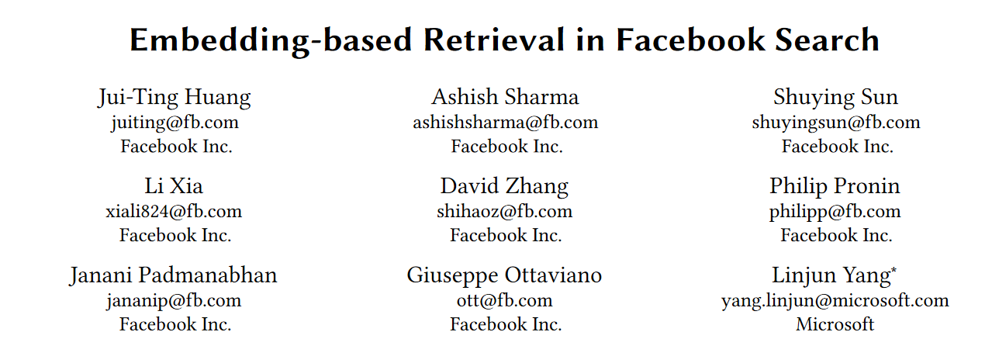

Slide 2

Challenges in Facebook search
Lack of semantic comprehension
​Lack of personalization

Slide 3
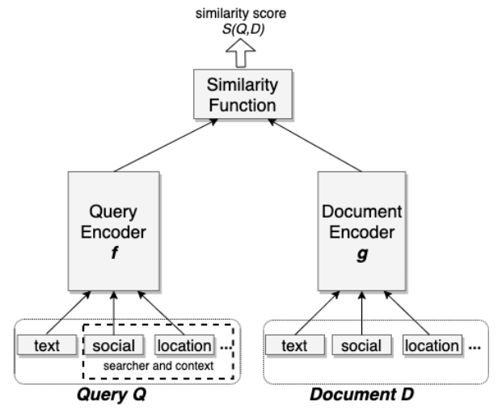
Unified Embedding Framework
Two-Sided Model
Training with Triplet Loss
Feature Engineering:
Text Features
Social Features
Location Features

Slide 4
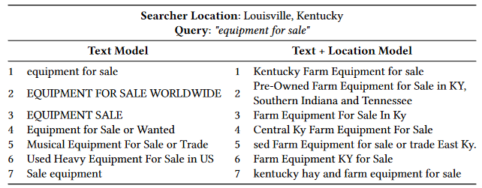
Example of Unified Embedding

Slide 5
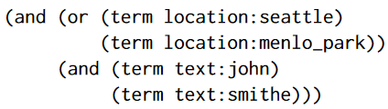
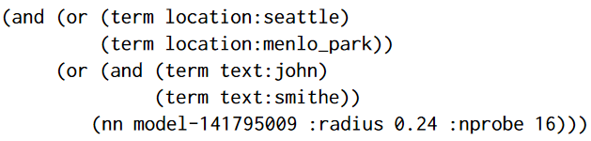
System Implementation and Optimization
ANN: Efficient Use of Resources
Integration with Existing Systems
Hybrid Retrieval

Slide 6
Conclusion
Increased Recall
Enhanced Personalization
Improved User Experience

