Slide 1
IN3120 week 12
Group 1

Slide 2
Agenda
2023 exam walkthrough
4 tasks, 14 sub-tasks
Shoutout

Slide 3
Task 1 – Vector spaces
Sparse vs. dense vector space
Cosine similarity
ANN indexes
List 5 types of ANN indexes

Slide 4
Sparse vs. dense vector space (a)
Two ways to think about vector space for text
Sparse high dimensional – dimension for each term
Dense low dimensional/embedding space – few hundred dimensions
Briefly discuss how a document could be placed in vector space (A). Outline pros and cons for this representation
Briefly and on a high level, what are the general ideas how a word is placed in this embedding space? How to place a document in this space? Outline pros and cons of representation (B)

Slide 5
1 (a) (i)
We can use TF-IDF
Boosts dimensions for terms often occurring in this document, and rarely in other documents. Value is 0 for terms not occurring in the document
Pro: Can often use linear techniques when classifying, since it often is easy to find a separating hyperplane
Con: Superficial term differences (synonyms etc.)

Slide 6
1 (a) (ii)
A word is known by the company it keeps
Words often semantically related
Capture context by considering co-occurrence
Can compute embeddings with a small neural network trying to predict a blanked-out word in a sequence, and read values from internal nodes to produce the embedding. Embeddings for words can be used as building blocks for longer text
Pro: Distances in the embedding space correlate with semantics. Can use this for simple reasoning
Con: Doesn’t preserve the contents of the document as well as sparse

Slide 7
Sparse vs. dense vector space (b)
We have the vectors [0.6, 0.2, 0.8] and [1.0, 0.1, 0.9]. Show how to compute the cosine similarity

Slide 8



1 (b)
Cosine similarity steps:
Calculate Dot product of the vectors
Calculate L₂-norm of the vectors
Divide dot product by the product of L₂-norm
Calcluations
$dot product\left(x,y\right)=\left(0.6∗1.0\right)+\left(0.2∗0.1\right)+\left(0.8∗0.9\right)=1.34$
$L_{2}\left(x\right)=\sqrt{{0.6}^{2}+{0.2}^{2}+{0.8}^{2}}=\sqrt{1.04}$
$L_{2}\left(y\right)=\sqrt{{1.0}^{2}+{0.1}^{2}+{0.9}^{2}}=\sqrt{1.82}$
$cosine\left(x,y\right)=\frac{1.34}{\sqrt{1.04}∗\sqrt{1.82}}=0.974$
$$Cosine\left(x,y\right)=\frac{dot_{product\left(x, y\right)}}{L_{2}norm\left(x\right)∗L_{2}norm\left(y\right)}$$
$$x=\left[0.6, 0.2, 0.8\right]$$
$$y=[1.0, 0.1, 0.9]$$

Slide 9
Sparse vs. dense vector space (c)
Explain what an ANN index is, and why it is useful

Slide 10
1 (c)
Closeness of vectors in an embedding space means «semantic similarity»
If we want to query this space, the docs close to the query vector are similar
An ANN index is an engine that allows for kNN lookups (finding the k closest documents), but scales better with larger dimensionality and number of vectors, because we sacrifice the exactness of kNN for speed
We aren’t guaranteed to find the exact k nearest neighbours, but we will find close nodes quickly

Slide 11
Sparse vs. dense vector space (d)
List at least 5 ANN index strategies, and explain the thinking behind each strategy
https://github.com/aohrn/in3120-2024/blob/main/slides/approximate-nearest-neighbours.pdf

Slide 12
1 (d)
Brute force: Scan through all vectors and assess their distance to the query vector (only works up to a certain point. Can be an option to split the search area with other algorithms first
Tree-based: Recursively build a tree by partitioning the embedding space. Leaf nodes are partitions. Only query the elements in the leaf node of the query (ANNOY)
Locality-sensitive hashing: Use hash functions to bucket elements together. If elements are in the same bucket, they are probably similar. Run query through the same hash functions and calculate distance to elements in the buckets of the query

Slide 13
1 (d)
Clustering-based (quantization): Cluster the vectors to reduce the size of the dataset. Replaces vectors with leaner, approximate representations. Use this reduced dataset to query
Graph-based: Create a layered structure of graphs. Each layer gets more detailed. Nodes are vectors and edges relate vectors close to each other. Intuitively: «skip-pointer graphs»

Slide 14
Task 2 – Measuring relevance
F_{β}-score
Precision-recall curve
MAP
Kandall’s tau distance

Slide 15
Measuring relevance (a)
Describe F_{β}-score and define it in terms of precision and recall. What does β control? What is the F₁-score if P=0.1 and R=0.5

Slide 16

2 (a)
F_{β}-score is the weighted harmonic mean of precision and recall
Great P and R is ideal, but we might have to compromise. F is a measure that collapses both into a single number, and is therefore often convenient
β controls how much we emphasize precision vs. recall. β < 1 emphasizes precision, β > 1 emphasizes recall
P=0.1 and R=0.5
$$F_{β=1}=\frac{2PR}{P+R}=\frac{\left(2∗0.1∗0.5\right)}{0.1+0.5}=\frac{1}{6}=0.167$$

Slide 17
Measuring relevance (b)
What is a precision-recall curve and how do we generate it? What is an interpolated precision-recall curve?

Slide 18
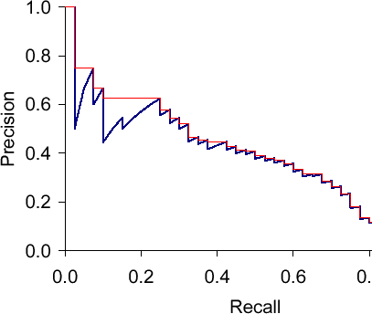
2 (b)
If we consider top k elements in a ranked result set. For each choice of k, we can calculate precision and recall. This is the precision-recall curve. This curve shows how precision often falls with increasing recall
Interpolated PR-curve is when we set precision as the highest P to the right of the current position in the curve (the red line)

Slide 19
Measuring relevance (c)
What is the MAP (Mean Average Precision) score of the results:
RRNRNNNR
RNRR

Slide 20



2 (c)
Average_precision(RRNRNNNR)
Average_precision(RNRR)
MAP
$$\frac{\frac{1}{1}+\frac{2}{2}+\frac{3}{4}++\frac{4}{8}}{4}=0.8125$$
$$\frac{\frac{1}{1}+\frac{2}{3}+\frac{3}{4}}{3}=\frac{29}{36}=0.8055$$
$$\frac{0.8215+0.8055}{2}=0.8090$$

Slide 21
Measuring relevance (d)
Describe how Kendall’s tau is calculated on a high level, and what is Kendall’s tau between
L = [A, C, B, D]
P = {(A, B), (A, C), (A, D), (B, C), (B, D), (C, D)}

Slide 22
2 (d)
A pair in P will either be in agreement or disagreement with the order of L. Given all pairs in P, we calculate KT by counting all agreements (X) and disagreements (Y), and consider their difference (X-Y) as a fraction of the total number of pairs in P (X+Y). This gives a value in the range [-1, 1] where the extremes represent perfect agreement/disagreement
KT=(X-Y)/(X+Y)
For L = [A, C, B, D], P = {(A, B), (A, C), (A, D), (B, C), (B, D), (C, D)}, we have 5 agreements and 1 disagreement:
KT = (5-1)/(5+1)=4/6=0.667

Slide 23
Task 3 – Mixed grill with carrots
Multinomial Naive Bayes
Postings list & inverted index
Gap encoding, VB-encoding elias-gamma encoding
Bloom filter

Slide 24
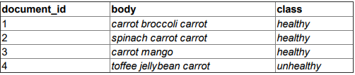
Mixed grill with carrots (a)
Based on the training data, how would a mulinomial naive Bayes classifier classify an unseen document d = «carrot carrot carrot toffee jellybean»?
Show how to estimate all required priors and conditionals. Show how to combine these to arrive at Pr(healthy | d) and Pr(unhealthy | d) respectively. Use add-one smoothing when calculating conditionals

Slide 25
3 (a)
Priors
Pr(healthy) = ¾
Pr(unhealthy) = ¼
Smoothed conditionals
Pr(carrot | healthy) = (5+1)/(8+6) = 3/7
Pr(toffee | healthy) = (0+1)/(8+6) = 1/14
Pr(jellybean | healthy) = (0+1)/(8+6) = 1/14
Pr(carrot | unhealthy) = (1+1)/(3+6) = 2/9
Pr(toffee | unhealthy) = (1+1)/(3+6) = 2/9
Pr(jellybean | unhealthy) = (1+1)/(3+6) = 2/9

Slide 26
3 (a)
d = carrot carrot carrot toffee jellybean
Pr(healthy | d) = 3/4 * (3/7)³ * 1/14 * 1/14 ≈ 0.0003
Pr(unhealthy | d) = 1/4 * (2/9)³ * 2/9 * 2/9 ≈ 0.0001

Slide 27
Mixed grill with carrots (b)
Imagine an inverted index made from the training data in task (a). Assume each posting contains (docId, term_frequency). List all posting lists

Slide 28
3 (b)
6 unique words → 6 posting lists
carrot → [{docId: 1, tf: 2}, {docId: 2, tf: 2}, {docId: 3, tf: 1}, {docId: 4, tf: 1}]
broccoli → [{docId: 1, tf: 1}]
spinach → [{docId: 2, tf: 1}]
mango → [{docId: 3, tf: 1}]
toffee → [{docId: 4, tf: 1}]
jellybean → [{docId: 4, tf: 1}]

Slide 29
Mixed grill with carrots (c)
Consider the same inverted index as (b)
How many bytes are necessary to compress the carrot posting list, when combining simple gap-encoding with VB-encoding? Explain your reasoning
How many bits would you need to store the compressed posting list for carrot, when combining simple gap-encoding with Elias gamma-encoding? Explain your reasoning

Slide 30
3 (c) (i)
There are 8 integers in the posting list
No matter if we store gaps or docId, all values are below 128, so we only need 1 byte per int
8 bytes in total

Slide 31
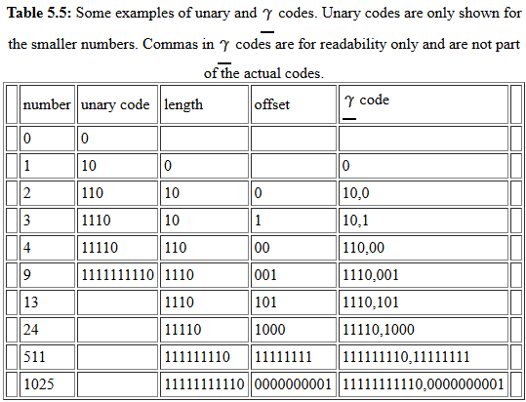
3 (c) (ii)
When gap-encoding the posting list for carrot, it will look like
[{gap: 1, tf: 2}, {gap: 1, tf: 2}, {gap: 1, tf: 1}, {gap: 1, tf: 1}]
1 can be encoded with 1 bit
2 can be encoded with 3 bits
6 * 1 + 2 * 3 = 12
Gap encoding: length of offset in unary + offset of binary number

Slide 32
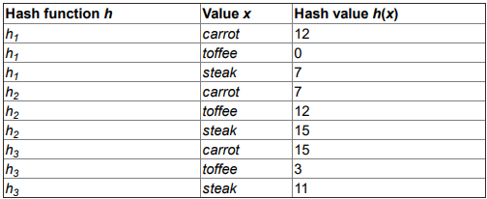
Mixed grill with carrots (d)
Given a 16 bit Bloom filter, 3 hash functions and the hash values in the table
What does the filter look like before inserting anything, after inserting carrot and after inserting carrot and toffee
Given carrot and toffee have been inserted, what will the filter answer when querying steak and carrot? Why?
How can the Bloom filter be modified to reduce the probability of false positives?

Slide 33
3 (d) (i)
Before inserting anything: []
After inserting carrot: [7, 12, 15]
After inserting carrot and toffee: [0, 3, 7, 12, 15]
0 | 0 | 0 | 0 | 0 | 0 | 0 | 0 | 0 | 0 | 0 | 0 | 0 | 0 | 0 | 0
0 | 0 | 0 | 0 | 0 | 0 | 0 | 1 | 0 | 0 | 0 | 0 | 1 | 0 | 0 | 1
1 | 0 | 0 | 1 | 0 | 0 | 0 | 1 | 0 | 0 | 0 | 0 | 1 | 0 | 0 | 1

Slide 34
3 (d) (ii)
Querying carrot returns true/«member» because 7, 12, 15 are all true/set
Querying steak returns false/«not member» because 11 is false/not set

Slide 35
3 (d) (iii)
To reduce false positives, we can
add more storage bits or
change the number of hash functions

Slide 36
Task 4 – Aproxximat matching
Finding similar terms in a trie
Edit distance with phonetic hashing

Slide 37
Aproxximat matching (a)
Given a trie encoding a string collection D and a query q, we want to find all strings in D, within k edits from q. We can assume k is a small number

Slide 38
4 (a)
Same as oblig b-2 (can read both paper and code on Github)
Perform recursive dfs search on trie
Whenever we traverse another layer in the trie, we check the distance between the current string and the query using Damerau-Levenshtein distance
If > k edits away or leaf node is reached, we stop
Whenever we find a match (final node within k edits), send to sieve and store for later

Slide 39
Aproxximat matching (b)
Propose a way to alter the (a) algorithm to combine edit distance with phonetic hashing. The algorithm should find all strings in D where the phonetic hashes between a string in D and q differ at least k edits

Slide 40
4 (b)
Use the same algorithm as (a), but extend trie to hold metadata along with each final state, and some pre- and post-processing
When making the trie: Instead of storing the original string, store the phonetic hash. Each final state holds metadata to trace backto the original string
When querying: Compute the phonetic hash of q, and find matches within k edits using the algorithm from (a)

Slide 41
Agenda
2023 exam walkthrough
4 tasks, 14 sub-tasks
Shoutout

Slide 42
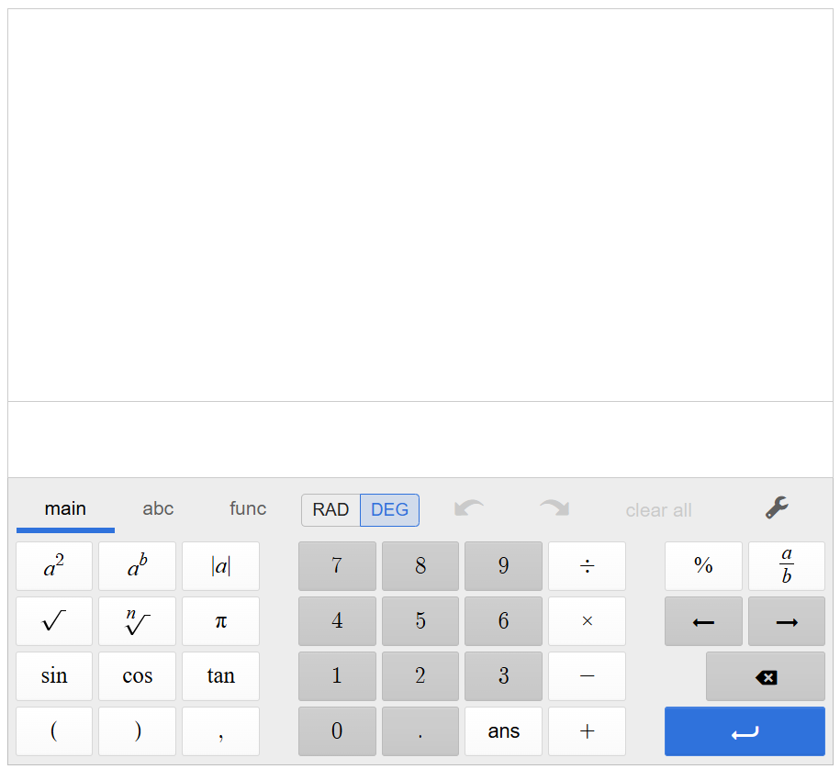
Shoutout of the week
Desmos (Inspera-kalkulatoren?)
https://www.desmos.com/scientific

Slide 43
15 min break

