Slide 1
IN3120 week 11
Group 1

Slide 2
Reminder
Aleksander ends next session with a Q&A. Ask questions!!
I will go through the 2023 exam next week
Try to solve it yourself first

Slide 3
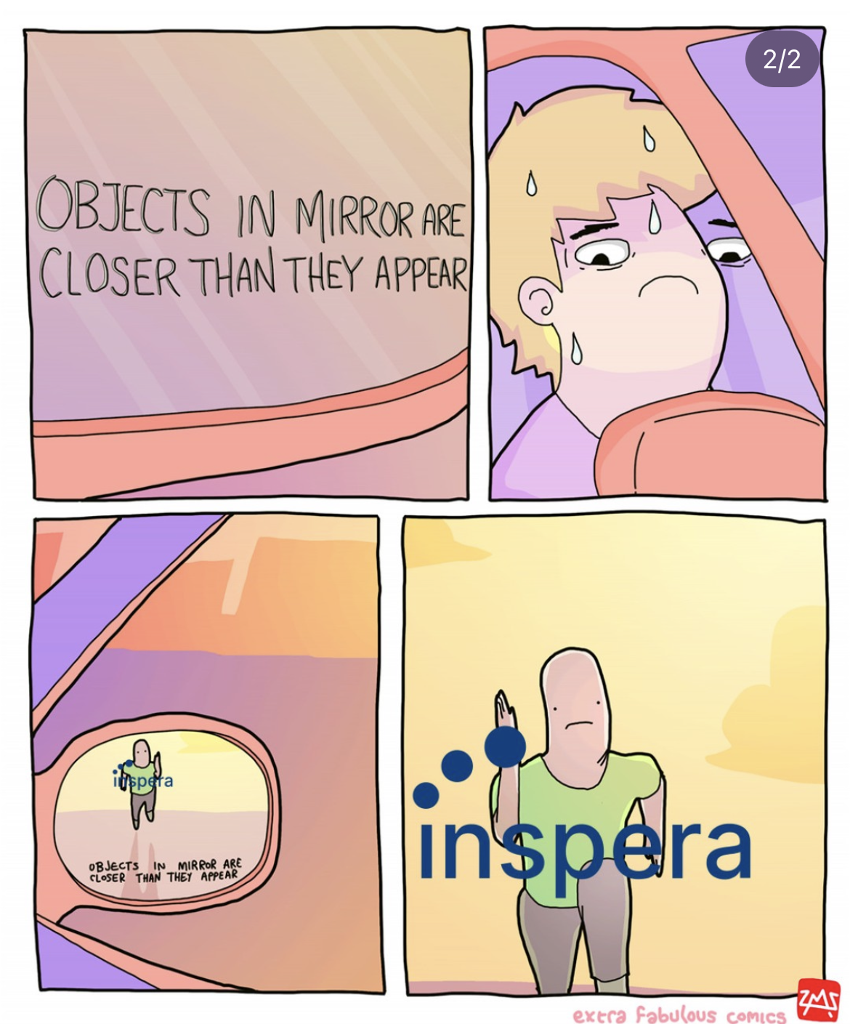
Tips for exam preparations|
Reading the curriculum
Start with most common exam topics (check excel sheet)
Prioritize what’s common in recent exams
Learn how to use the specific formulas!
Do the exams
Set a 4h timer, try the exam without tools
Do an exam early, so you know what to focus on
Creds: gangen_i_tredje

Slide 4
Today’s format
School exam topics occurring at least twice since 2018 (except TAAT)
Each topic split into 2 sections
Theory/explanation
Last exam question when the topic was relevant
Goal: explain the ideas without solving the exam questions
Look out for «the italic text» (explains the intuition)

Slide 5
Agenda
Recap of common exam topics
Suffix arrays
SVMs
MAP
Cosine similarity
Precision & recall, F1-score
Random surfer model
(Term-at-a-time)
Bloom filter
Kendall Tau
Shoutout of the week

Slide 6
Suffix array
Split the buffers on each term/character
The positions where we split are the offsets
Store as (docId, offset)-pairs
Sort lexicographically

Slide 7
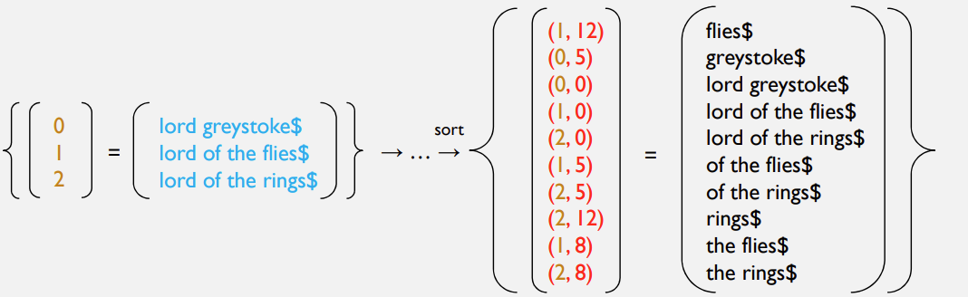
Suffix array

Slide 8
Why bother?
We can perform binary search (low complexity)
We don’t need to store the text buffers more than once, only the offset positions in the buffers
When the array is sorted and we’re performing binary search, we don’t care about the ‘other half’, since it won’t match
«If I know it’s a mismatch, I don’t need to read it»

Slide 9
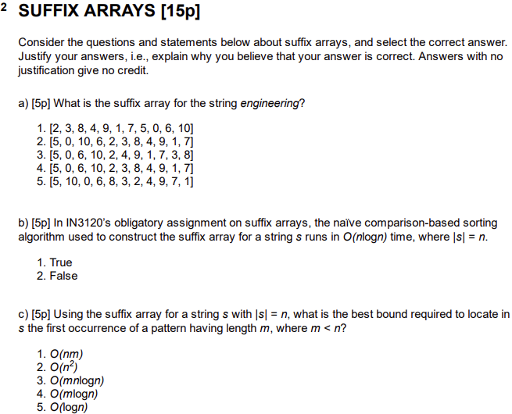
Suffix arrays – exam 2022

Slide 10
Agenda
Recap of common exam topics
Suffix arrays
SVMs
MAP
Cosine similarity
Precision & recall, F1-score
Random surfer model
Bloom filter
Kendall Tau
Shoutout of the week

Slide 11
Support vector machines
We need a decision boundary for classification
Idea: Create a hyperplane that maximizes the distance between the classes
Support vectors: The data points closest to the decision boundary
«The support vectors are the nodes closest to the other class»

Slide 12
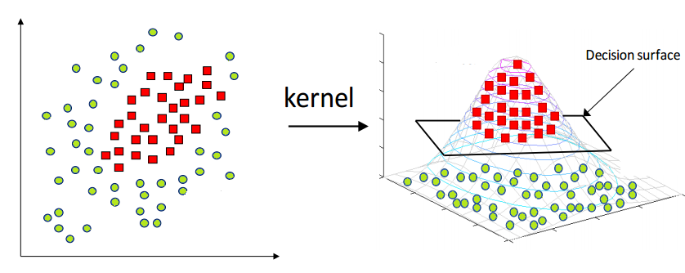
The Kernel trick
If the data is not linearly separable, use the Kernel trick
Raise the nodes into a higher dimension until the classes are linearly separable

Slide 13
Support vector machines – exam 2022

Slide 14
Agenda
Recap of common exam topics
Suffix arrays
SVMs
MAP
Cosine similarity
Precision & recall, F1-score
Random surfer model
Bloom filter
Kendall Tau
Shoutout of the week

Slide 15
Mean Average Precision
MAP: Average average precision
We want to measure search engine quality
A measure of how well the engine ranks relevant documents on average
«How well-placed are my relevant documents in an average query?»

Slide 16
MAP formula
Perform Precision@k for all relevant docs
Average of (1)
Average of (2) for for multiple queries

Slide 17
Example
Given 4 query results
q1: [R, N, R, N, N, R, R]
q2: [N, R, R, R, N, N, N]
q3: [R, R, R, R, N, R, N]
q4: [R, N, R, N, R, N, R]

Slide 18
Example – precision@k (1)
Given 4 query results
q1: [R, N, R, N, N, R, R] → [1/1, N, 2/3, N, N, 3/6, 4/7]
q2: [N, R, R, R, N, N, N] → [N, 1/2, 2/3, 3/4, N, N, N]
q3: [R, R, R, R, N, R, N] → [1/1, 2/2, 3/3, 4/4, N, 5/6, N]
q4: [R, N, R, N, R, N, R] → [1/1, N, 2/3, N, 3/5, N, 4/7]

Slide 19
Example – Average precision (2)
Given 4 query results
q1: [R, N, R, N, N, R, R] → 2.738 / 4 → 0.6845
q2: [N, R, R, R, N, N, N] → 1.917 / 3 → 0.639
q3: [R, R, R, R, N, R, N] → 4.833 / 5 → 0.9666
q4: [R, N, R, N, R, N, R] → 2.838 / 4 → 0.7095

Slide 20
Example – Mean average precision (3)
Given 4 query results
q1: [R, N, R, N, N, R, R] → 2.738 / 4 → 0.6845
q2: [N, R, R, R, N, N, N] → 1.917 / 3 → 0.639
q3: [R, R, R, R, N, R, N] → 4.833 / 5 → 0.9666
q4: [R, N, R, N, R, N, R] → 2.838 / 4 → 0.7095
MAP → (0.6845 + 0.639 + 0.9666 + 0.7095) / 4 = 0.7499

Slide 21
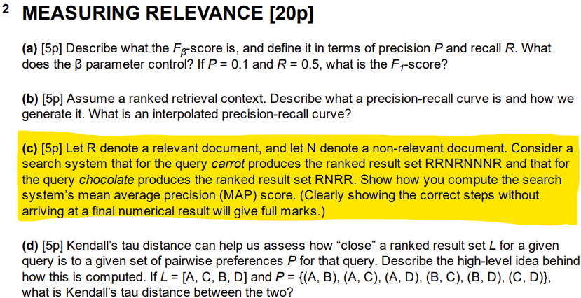
MAP – exam 2023

Slide 22
Agenda
Recap of common exam topics
Suffix arrays
SVMs
MAP
Cosine similarity
Precision & recall, F1-score
Random surfer model
Bloom filter
Kendall Tau
Shoutout of the week

Slide 23
Cosine similarity
Used for measuring similarity between text in a vector space
Why not measure by distance?
Repeating terms can make it look like documents are less similar
Use cosine of angles instead:
If cosine similarity is 1, documents are identical
If cosine similarity is 0, documents have nothing in common

Slide 24
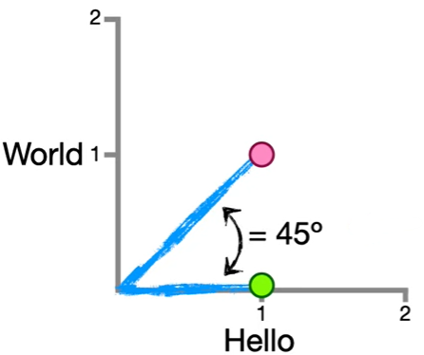
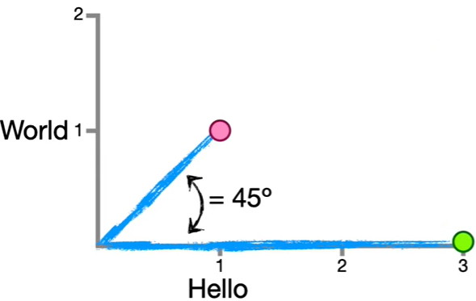
Cosine similarity vs. euclidean distance
Let’s say we have the documents
Hello World
Hello
Hello Hello Hello
Large distance, but the same degree between vectors
Check out StatQuest: https://www.youtube.com/watch?v=e9U0QAFbfLI&ab_channel=StatQuestwithJoshStarmer

Slide 25
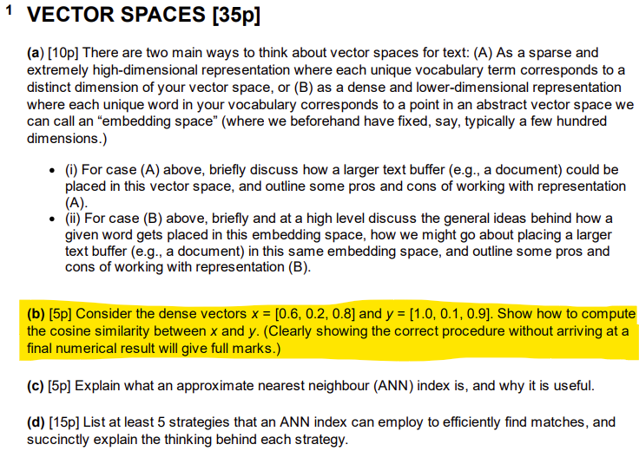
Cosine similarity – exam 2023

Slide 26
Agenda
Recap of common exam topics
Suffix arrays
SVMs
MAP
Cosine similarity
Precision & recall, F1-score
Random surfer model
Bloom filter
Kendall Tau
Shoutout of the week

Slide 27
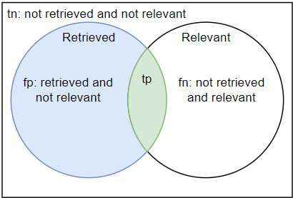
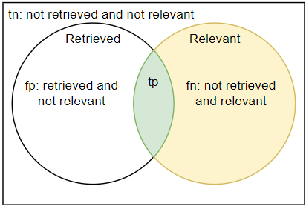


Precision & Recall
Precision: «Of all retrieved documents, how many are relevant?»
Recall: «Of all relevant documents, how many are retrieved?»
$$P=\frac{tp}{tp+fp}=P(relevant|retrieved)$$
$$R=\frac{tp}{tp+fn}=P(retrieved|relevant)$$

Slide 28


More Precision & Recall…
Precision: «If i pick a random retrieved document, what is the probability is is relevant»
Recall: «If i pick a random relevant document, what is the probability I retrieved it?»
$$P=P(relevant|retrieved)$$
$$R=P(retrieved|relevant)$$

Slide 29

F-score
Weighted harmonic mean of precision and recall
Use β to edit the priority of precision and recall
β < 1emphasizes precision, β > 1 emphasizes recall
section 8.5, 8.6: https://nlp.stanford.edu/IR-book/pdf/08eval.pdf

Slide 30



F-score edge-case example
β < 1emphasizes precision, β > 1 emphasizes recall
$$F_{β}=\frac{\left(β^{2}+1\right)PR}{β^{2}P+R}$$
$$P=0.10, R=0.90$$
$$F_{β=1000}=\frac{\left({1000}^{2}+1\right)∗0.10∗0.90}{{1000}^{2}∗0.10+0.90}=\frac{90 000.09}{100 000.9}=0.8999$$
$$F_{β=0.001}=\frac{\left({0.001}^{2}+1\right)∗0.10∗0.90}{{0.001}^{2}∗0.10+0.90}=\frac{0.09000009}{0.9000001}=0.10000008$$

Slide 31



F₁-score
Tip: learn F₁-score before F-score
But you should learn both!
F₁-Score is when p and r have equal emphasis
$$F=\frac{\left(β^{2}+1\right)PR}{β^{2}P+R} where β^{2}=\frac{1−α}{α}$$
$$if α=0.5 then β=1$$
$$F_{β=1}=\frac{\left(1^{2}+1\right)PR}{1^{2}P+R}=\frac{2PR}{P+R}$$

Slide 32
Confusion matrix
 | Actual
Predicted |  | Positive | Negative
 | Positive | True positive (tp) | False positive (fn)
 | Negative | False negative (fn) | True negative (tn)

Slide 33
Precision, recall & F1-score example
We have some values. What is the Precision, Recall and F₁-Score?
Let’s crunch come numbers!
 | Actual
Predicted |  | Positive | Negative
 | Positive | 210 | 30
 | Negative | 10 | 110

Slide 34



Precision, recall & F1-score example
$$P=\frac{tp}{tp+fp}=\frac{210}{210+30}=0.875$$
$$R=\frac{tp}{tp+fn}=\frac{210}{210+10}=0.955$$
$$F_{1}=\frac{2PR}{P+R}=\frac{2∗0.875∗0.955}{0.875+0.955}=\frac{1.671}{1.83}=0.913$$
 | Actual
Predicted |  | Positive | Negative
 | Positive | 210 | 30
 | Negative | 10 | 110

Slide 35
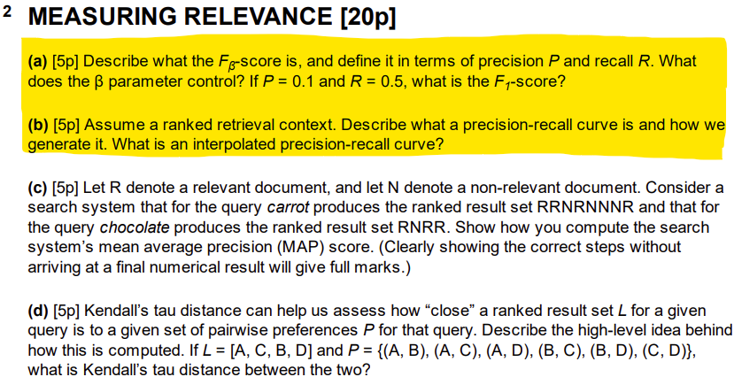
Precision & Recall, F1 – exam 2023

Slide 36
Agenda
Recap of common exam topics
Suffix arrays
SVMs
MAP
Cosine similarity
Precision & recall, F1-score
Random surfer model
Bloom filter
Kendall Tau
Shoutout of the week

Slide 37

Random Surfer model
Our imaginary web surfer will either
Follow a direct link, or
Teleport randomly
Used for calculating PageRank
The fraction of time spent on a website after infinite surfing

Slide 38

Surfing probabilities
Let’s define some probabilities using a teleportation rate $α$
Following any direct link: $(1−α)$
Performing any teleportation: $α$
Following a specific link: $\frac{1−α}{|direct links|}$
Performing specific teleportation: $\frac{α}{|websites not linked|}$
We will always either teleport or follow a direct link
$|direct links|$means the number of direct links
$$P\left(teleport\right)+P\left(direct link\right)=α+\left(1−α\right)=1$$

Slide 39

Let’s go surfing
Let’s say $α=0.1$ (10% chance of teleporting randomly)
We have 5 direct links and 10 pages not linked
Following any direct link: $\left(1−0.1\right)=0.9$
Performing any teleportation: $0.1$
Following a specific link: $\frac{1−0.1}{5}=0.18$
Performing specific teleportation: $\frac{0.1}{10}=0.01$
Summing the probabilites: $5 ∗ 0.18 + 10 ∗ 0.01 = 1$

Slide 40
Random Surfer model – exam 2022

Slide 41
Agenda
Recap of common exam topics
Suffix arrays
SVMs
MAP
Cosine similarity
Precision & recall, F1-score
Random surfer model
Bloom filter
Kendall Tau
Shoutout of the week

Slide 42
Bloom filter
Probabilistic way of searching for set membership
Can never guarantee that the set contains an element, but we can guarantee if it doesn’t
Uses k hash functions to load a bit vector with 1’s

Slide 43
Building the filter
Let’s say we have
2 hash functions, H₁ and H₂
The set {informatikk, er, gøy}

Slide 44
Building the filter
index
bit-vector
0 | 1 | 2 | 3 | 4 | 5 | 6 | 7 | 8 | 9 | 10 | 11 | 12 | 13 | 14 | 15 | 16 | 17 | 18 | 19
0 | 0 | 0 | 0 | 0 | 0 | 0 | 0 | 0 | 0 | 0 | 0 | 0 | 0 | 0 | 0 | 0 | 0 | 0 | 0

Slide 45
Keep in mind
In practice, it doesn’t make sense to have a 20-bit vector and 3 elements in the set
A bloom-filter is only useful if we have more terms than bits. Otherwise, we could assign 1 bit for each term

Slide 46
Building the filter
H₁(Informatikk) → 10
H₂(Informatikk) → 4

Slide 47
Building the filter
0 | 1 | 2 | 3 | 4 | 5 | 6 | 7 | 8 | 9 | 10 | 11 | 12 | 13 | 14 | 15 | 16 | 17 | 18 | 19
0 | 0 | 0 | 0 | 1 | 0 | 0 | 0 | 0 | 0 | 1 | 0 | 0 | 0 | 0 | 0 | 0 | 0 | 0 | 0

Slide 48
Building the filter
H₁(informatikk) → 10
H₂(Informatikk) → 4
H₁(er) → 6
H₂(er) → 7

Slide 49
Building the filter
0 | 1 | 2 | 3 | 4 | 5 | 6 | 7 | 8 | 9 | 10 | 11 | 12 | 13 | 14 | 15 | 16 | 17 | 18 | 19
0 | 0 | 0 | 0 | 1 | 0 | 1 | 1 | 0 | 0 | 1 | 0 | 0 | 0 | 0 | 0 | 0 | 0 | 0 | 0

Slide 50
Building the filter
H₁(informatikk) → 10
H₂(Informatikk) → 4
H₁(er) → 6
H₂(er) → 7
H₁(gøy) → 6
H₂(gøy) → 13

Slide 51
Building the filter
0 | 1 | 2 | 3 | 4 | 5 | 6 | 7 | 8 | 9 | 10 | 11 | 12 | 13 | 14 | 15 | 16 | 17 | 18 | 19
0 | 0 | 0 | 0 | 1 | 0 | 1 | 1 | 0 | 0 | 1 | 0 | 0 | 1 | 0 | 0 | 0 | 0 | 0 | 0

Slide 52
Testing the filter
H₁(Aleksander) → 3
H₂(Aleksander) → 13
Returns: Guaranteed not in the set
0 | 1 | 2 | 3 | 4 | 5 | 6 | 7 | 8 | 9 | 10 | 11 | 12 | 13 | 14 | 15 | 16 | 17 | 18 | 19
0 | 0 | 0 | 0 | 1 | 0 | 1 | 1 | 0 | 0 | 1 | 0 | 0 | 1 | 0 | 0 | 0 | 0 | 0 | 0

Slide 53
Testing the filter
H₁(Truls) → 6
H₂(Truls) → 10
Returns: Probably in the set
This is wrong! That’s why it’s probabilistic (probably correct)
0 | 1 | 2 | 3 | 4 | 5 | 6 | 7 | 8 | 9 | 10 | 11 | 12 | 13 | 14 | 15 | 16 | 17 | 18 | 19
0 | 0 | 0 | 0 | 1 | 0 | 1 | 1 | 0 | 0 | 1 | 0 | 0 | 1 | 0 | 0 | 0 | 0 | 0 | 0

Slide 54
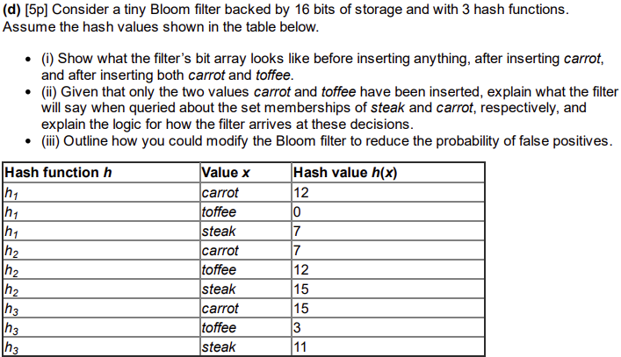
Bloom filter – exam 2023

Slide 55
Agenda
Recap of common exam topics
Suffix arrays
SVMs
MAP
Cosine similarity
Precision & recall, F1-score
Random surfer model
Bloom filter
Kendall Tau
Shoutout of the week

Slide 56

Kendall Tau distance
Measures the quality of pairwise preference in our search engine
«A document is either more or less relevant than any other document. How much does our search engine agree with this ranking?»
$$KT=\frac{X−Y}{X+Y}$$

Slide 57
Example (same as week 7)
Pairwise preference: {(1, 2), (1, 3), (1, 4), (2, 3), (2, 4), (3, 4)}
1 > 2 2 > 3 3 > 4
1 > 3 2 > 4
1 > 4

Slide 58

Example (same as week 7)
X: Agreements
Y: Disagreements
KT Distance examples
[1, 3, 2, 4]: (5 – 1) / (5 + 1) = 0,67
[4, 3, 2, 1]: (0 – 6) / (0 + 6) = -1.0
[1, 4, 3, 2]: (3 – 3) / (3 + 3) = 0
$$KT=\frac{X−Y}{X+Y}$$

Slide 59
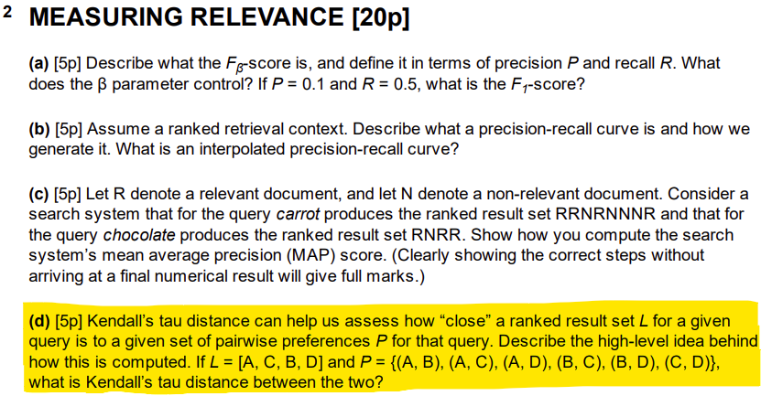
Kendall Tau distance – exam 2023

Slide 60
Agenda
Recap of common exam topics
Suffix arrays
SVMs
MAP
Cosine similarity
Precision & recall, F1-score
Random surfer model
Bloom filter
Kendall Tau
Shoutout of the week

Slide 61
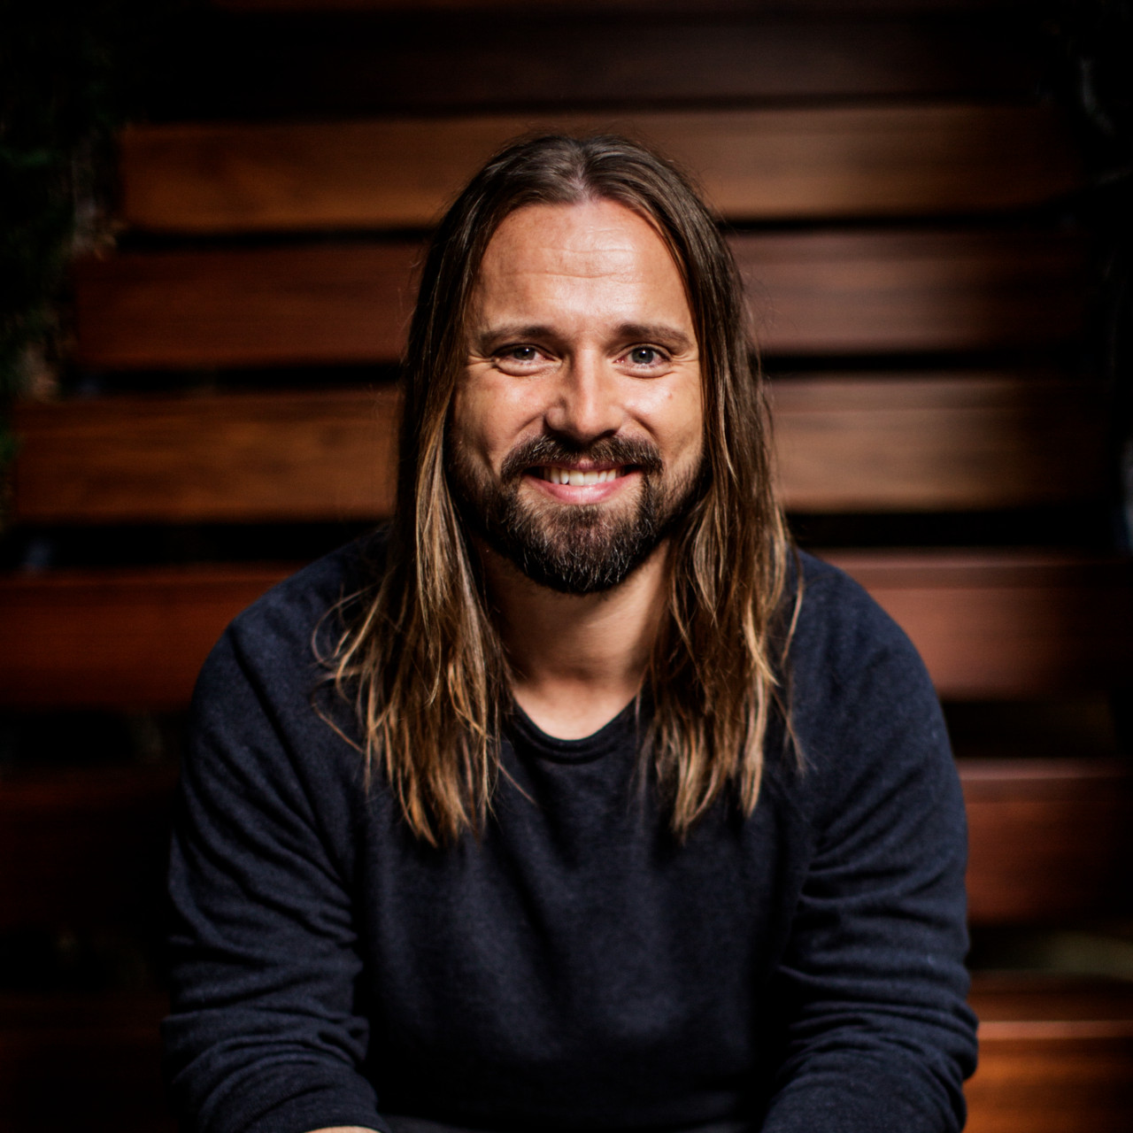
Shoutout: Max Martin
Swedish songwriter
Makes the worlds most famous pop songs
2nd most number-one singles ever
Has 30 songs on Spotify with > 1.000.000.000 streams

Slide 62
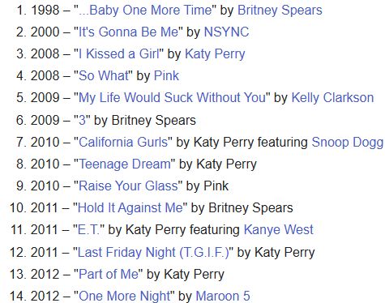
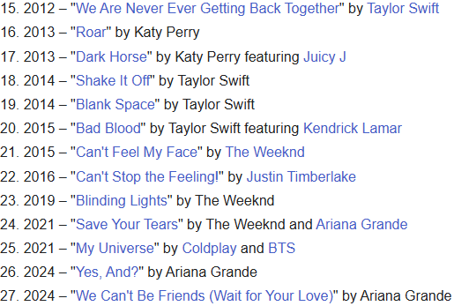
27 Billboard top 100 singles

Slide 63
15 min break

