Slide 1

Monády
Monady sú použiteľný nástroj pre programátora poskytujúci:
modularitu – skladať zložitejšie výpočty z jednoduchších (no side-effects),
flexibilitu – výsledný kód je ľahšie adaptovateľný na zmeny,
izoluje side-effect operácie (napr. IO) od čisto funkcionálneho zvyšku.
Štruktúra prednášok:
Monády - prvý dotyk
  Functor
  Applicative
  Monády – princípy a zákony
Najbežnejšie monády
  Maybe/Error monad
  List monad
  IO monad
  State monad
  Reader/Writer monad
  Continuation monad
Transformátory monád
Monády v praxi

Slide 2
Monády – úvod
Phil Wadler: http://homepages.inf.ed.ac.uk/wadler/topics/monads.html
Monads for Functional Programming In Advanced Functional Programming,
Springer Verlag, LNCS 925, 1995,
Noel Winstanley: What the hell are Monads?, 1999
http://www-users.mat.uni.torun.pl/~fly/materialy/fp/haskell-doc/Monads.html
Jeff Newbern's: All About Monads https://www.cs.rit.edu/~swm/cs561/All_About_Monads.pdf
A Gentle Introduction to Haskell,
https://www.haskell.org/tutorial/monads.html
https://wiki.haskell.org/All_About_Monads
Sujit Kamthe: Understanding Functor and Monad With a Bag of Peanuts
https://medium.com/beingprofessional/understanding-functor-and-monad-with-a-bag-of-peanuts-8fa702b3f69e
Functors, Applicatives, And Monads In Pictures
http://adit.io/posts/2013-04-17-functors,_applicatives,_and_monads_in_pictures.html
Monads in Haskell and Category Theory
https://www.diva-portal.org/smash/get/diva2:1369286/FULLTEXT01.pdf

Slide 3
Monads, Arrows, and Idioms
Philip Wadler, https://homepages.inf.ed.ac.uk/wadler/topics/monads.html
Články Phila Wadlera na stránke
Monads for functional programming
The essence of functional programming
Comprehending monads
The arrow calculus
Monadic constraint programming
Idioms are oblivious, arrows are meticulous, monads are promiscuous
The marriage of effects and monads
How to declare an imperative
Imperative functional programming

Slide 4
What the hell are Monads?
Noel Winstanley, https://www-users.mat.uni.torun.pl//~fly/materialy/fp/haskell-doc/Monads.html
Obsah:
Maybe
State
The Monad Class
Do notation
Monadic IO
Programming in the IO Monad

Slide 5
All About Monads
Jeff Newbern, https://www.cs.rit.edu/~swm/cs561/All_About_Monads.pdf
Obsah:
Part I - Understanding Monads
What is a monad? Meet the Monads. Doing it with class Monad support in Haskell
Part II - A Catalog of Standard Monads
Introduction. The Identity monad. The Maybe monad. The Error monad. The List monad. The IO monad. The State monad. The Reader monad. The Writer monad. The Continuation monad.
Part III - Monads in the Real
Combining monads the hard way. Monad transformers. Standard monad transformers. Anatomy of a monad transformer. More examples with monad transformers. Managing the transformer.

Slide 6
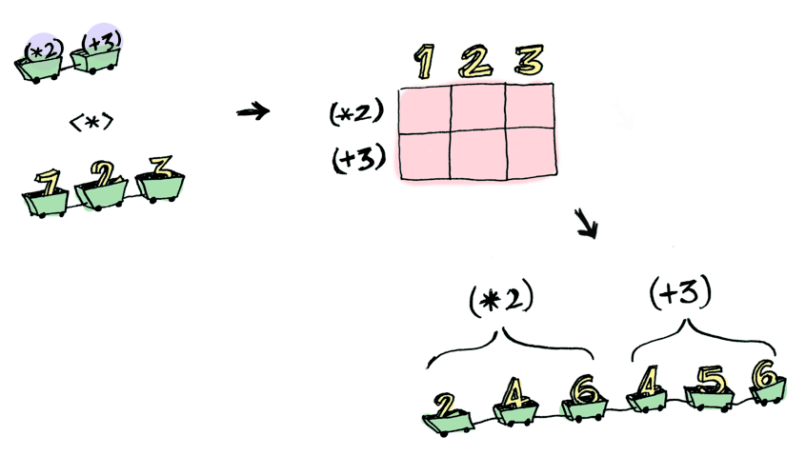
Roadmap
Když egyptský král Ptolemaios žádal slavného matematika Euklida o jednodušší cestu k pochopení matematiky (jako farao se nechtěl obtěžovat těžkou prací studenta), Euklides mu nekompromisně odpověděl:
"V matematice neexistuje žádná královská cesta."
Haskell má triedy, ale sú to vlastne konceptuálne interface (Java)
Haskell má podtriedy, čo je konceptuálne dedenie na interface (Java)
dedenie na interface ste určite v Jave videli, napr. na kolekciách
Relevantné triedy v Haskelli:
Functor
Applicatives
Monad
MonadPlus
...
Takže monáda nie je najjednoduchší
typ v tejto hierarchii
Alternatívny prístup:
Functors, Applicatives, And Monads In Pictures
http://adit.io/posts/2013-04-17-functors,_applicatives,_and_monads_in_pictures.html

Slide 7
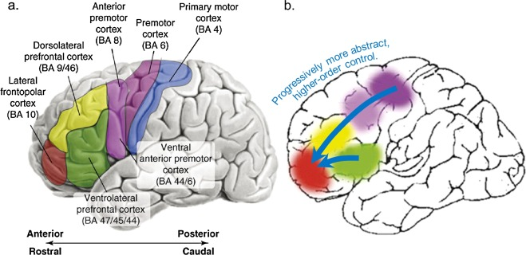
Functor prvotná idea
Development of abstract thinking during childhood and adolescence: The role of rostrolateral prefrontal cortex
double :: [Int] -> [Int]
double [] = []
double (x:xs) = (x+x):double xs
sqr :: [Int] -> [Int]
sqr [] = []
sqr (x:xs) = x*x: sqr xs
map :: (a->b) -> [a] -> [b]
map f [] = []
map f (x:xs) = f x : map f xs
map (*2)
map (^2)
fmap aplikuje funkciu f
na hodnoty zabalené do
typu, ktorý implementuje
interface Functor
class Functor f where
fmap :: (a->b) -> f a -> f b

Slide 8
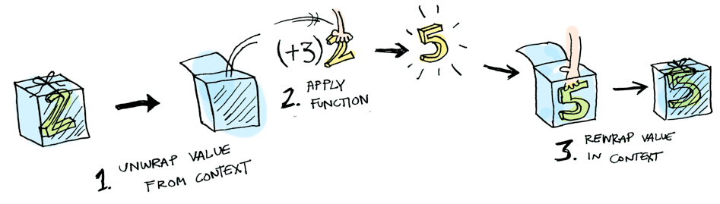
Functor
http://adit.io/posts/2013-04-17-functors,_applicatives,_and_monads_in_pictures.html
Zoberme jednoduchšiu triedu, z modulu Data.Functor je definovaná takto:
-- každý typ t, ak implementuje Funtor t,
class Functor t where -- musí mať funkciu fmap s profilom
fmap :: (a -> b) -> t a -> t b -- haskell class je podobne java interface
a každá jej inštancia musí spĺňať dve pravidlá (to je sémantika, mimo syntaxe)
fmap id = id -- identita
fmap (p . q) = (fmap p) . (fmap q) -- kompozícia
Cvičenie1: Príklad inštancie pre data M₁ a = Raise String | Return a,
overte, že platia obe sémantické pravidlá:
instance Functor M1 where
fmap f (Raise str) = Raise str
fmap f (Return x) = Return (f x)

Slide 9
Cvičenie
class Functor t where
fmap :: (a -> b) -> t a -> t b
Definícia:
fmap f (Raise str) = Raise str
fmap f (Return x) = Return (f x)
Dokázať:
fmap id = id
fmap (p . q) = (fmap p) . (fmap q)
Cvičenie1 (pokrač.):
fmap id =? id
  fmap id (Raise str) = Raise str
  fmap id (Return x) = Return (id x) = Return x
fmap (p.q) =? (fmap p) . (fmap q)
  Prípad Raise error:
  L.S. = fmap (p.q) (Raise str) = Raise str
  P.S. = ((fmap p) . (fmap q)) (Raise str) = (fmap p) ( (fmap q) (Raise str)) = Raise str
  Prípad Return hodnota:
  L.S. = fmap (p.q) (Return x) = Return ((p.q) x) = (Return (p (q x)))
  P.S. = ((fmap p) . (fmap q)) (Return x)
  = (fmap p) ( (fmap q) (Return x))
  = (fmap p) (Return (q x)) = (Return (p (q x)))…. q.e.d.

Slide 10
Functor
Maybe, List
class Functor t where
fmap :: (a -> b) -> t a -> t b
fmap id = id
fmap (p . q) = (fmap p) . (fmap q)
Cvičenie2: Definujte inštanciu triedy Functor pre typy:
data MyMaybe a = MyJust a | MyNothing deriving (Show) -- alias Maybe a
data MyList a = Null | Cons a (MyList a) deriving (Show) -- alias [a]
… a pochopíte, ako je Functor definovaný pre štandardné typy Maybe a [].
> fmap (even) (Cons 1 (Cons 2 Null)) -- f : Int->Bool
Cons False (Cons True Null)
> fmap (\s -> s+s) (Cons 1 (Cons 2 Null)) -- f : Int->Int
Cons 2 (Cons 4 Null)
> fmap (show) (Cons 1 (Cons 2 Null)) -- f : Int->String
Cons "1" (Cons "2" Null)
> fmap ((\t -> t++t) . (show)) (Cons 1 (Cons 2 Null)) -- f : (String->String).(Int->String)
Cons "11" (Cons "22" Null)
> fmap (\t -> t++t) (fmap (show) (Cons 1 (Cons 2 Null))) -- “overenie” vlastnosti kompozície
Cons "11" (Cons "22" Null)
> fmap id (Cons 1 (Cons 2 Null)) -- overenie vlastnosti identity
Cons 1 (Cons 2 Null)
Notes:
fmap (\s -> even s) (Cons 1 (Cons 2 Null))
fmap (\s -> s+s) (Cons 1 (Cons 2 Null))
fmap (\s -> show s) (Cons 1 (Cons 2 Null))
fmap ((\t -> t++t) . (\s -> show s)) (Cons 1 (Cons 2 Null))
fmap (\t -> t++t) (fmap (\s -> show s) (Cons 1 (Cons 2 Null)))

Slide 11
Functor
Maybe, List
class Functor t where
fmap :: (a -> b) -> t a -> t b
fmap id = id
fmap (p . q) = (fmap p) . (fmap q)
Cvičenie2 (pokrač.): Definujte inštanciu triedy Functor pre typy:
data MyMaybe a = MyJust a | MyNothing deriving (Show) -- alias Maybe a
data MyList a = Null | Cons a (MyList a) deriving (Show) -- alias [a]
instance Functor MyMaybe where
fmap f MyNothing = MyNothing
fmap f (MyJust x) = MyJust (f x)
instance Functor MyList where
fmap f Null = Null
fmap f (Cons x xs) = Cons (f x) (fmap f xs)
instance Functor [] where
fmap = map
... stále ale chýba dôkaz platnosti dvoch vlastností ...
> fmap even [1,2,3]
[False,True,False]
> fmap (*2) [1,2,3]
[2,4,6]
> fmap (show) [1,2,3]
["1","2","3"]
> fmap (\x->x++x) $ fmap (show) [1,2,3]
["11","22","33"]
> fmap ((\x->x++x). show) [1,2,3]
["11","22","33"]
Notes:
fmap (\s -> even s) (Cons 1 (Cons 2 Null))
fmap (\s -> s+s) (Cons 1 (Cons 2 Null))
fmap (\s -> show s) (Cons 1 (Cons 2 Null))
fmap ((\t -> t++t) . (\s -> show s)) (Cons 1 (Cons 2 Null))
fmap (\t -> t++t) (fmap (\s -> show s) (Cons 1 (Cons 2 Null)))

Slide 12
Functor – strom
class Functor t where
fmap :: (a -> b) -> t a -> t b
fmap id = id
fmap (p . q) = (fmap p) . (fmap q)
Cvičenie3: Binárny strom (skoro ako tradičný LExp, ale parametrizovaný typ):
data LExp a = ID a | APP (LExp a) (LExp a) | ABS a (LExp a) deriving (Show)
instance Functor LExp where
fmap f (ID x) = ID (f x)
fmap f (APP left right) = APP (fmap f left) (fmap f right)
fmap f (Abs x body) = ABS (f x) (fmap f body)
Cvičenie4: Ľubovoľne n-árny strom (prezývaný RoseTree alias Rhododendron):
data RoseTree a = Rose a [RoseTree a]
instance Functor RoseTree where
fmap f (Rose a bs) = Rose (f a) (map (fmap f) bs)
... opäť chýba dôkaz platnosti vlastností pre Cvičenie 3 aj 4 ...
omega = ABS "x" (APP (ID "x") (ID "x"))
> fmap (\t -> t++t) omega
ABS "xx" (APP (ID "xx") (ID "xx"))
> fmap (\t -> (length t)) omega
ABS 1 (APP (ID 1) (ID 1))
Notes:
fmap (\t -> t++t) omega
fmap (\t -> (length t)) omega
:t fmap (\t -> (length t)) omega

Slide 13

Functor zhrnutie
http://adit.io/posts/2013-04-17-functors,_applicatives,_and_monads_in_pictures.html
instance Functor [] where
-- fmap :: (a->b) -> [a] -> [b]
fmap = map
instance Functor Maybe where
-- fmap :: (a->b) -> Maybe a -> Maybe b
fmap _ Nothing = Nothing
fmap g (Just x) = Just (g x)
instance Functor IO where
-- fmap :: (a->b) -> IO a -> IO b
fmap g mx = do { x<-mx; return (g x) }
infixl 4 <$>
<$> = fmap
main :: IO ()
main = do res <- words <$> getLine
res <- fmap words getLine
putStrLn $ show res
double :: Functor f => f Int -> f Int
double = fmap (*2)
sqr :: Functor f => f Int -> f Int
sqr = fmap (^2)
double (Just 7) = Just 14
double [1,2,3,4] = [2,4,6,8]
double (Branch (Leaf 7) (Leaf 9)) =
Branch (Leaf 14) (Leaf 18)
double (Rose 3 [Rose 5 [], Rose 7 []]) =
Rose 6 [Rose 10 [],Rose 14 []]

Slide 14
Applicative prvotná idea
Functor predstavuje abstrakciu aplikácie unárnej funkcie na každý prvok “Functor-like” dátovej štruktúry, nech je akákoľvek komplikovaná…
Čo, ak by sme mali funkcie s veľa argumentami (nie len unárne):
  fmap0 :: a -> f a
  fmap1 :: (a->b) -> f a -> f b -- fmap
  fmap2 :: (a->b->c) -> f a -> f b -> f c
  fmap3 :: (a->b->c->d) -> f a -> f b -> f c -> f d -- ☹
riešenie = Currying je transformácia funkcie s mnohými argumentami na unárnu, ktorá vráti inú funkciu,ktorá skonzumuje všetky ďalšie argumenty
  pure :: a -> f a
  (<*>) :: f (a->b) -> f a -> f b infixl
  Napr. nech g chce “tri argumenty”
  pure g <*> x <*> y <*> z = ((pure g <*> x) <*> y) <*> z
Hierarchia -- x :: f a, y :: f b, z :: f c
  pmap0 g0 = pure g0 -- g0 je konštanta, lebo má 0-args.
  fmap1 g1 x = pure g1 <*> x -- g1 :: a->b, pure g1 :: f (a->b)
  fmap2 g2 x y = pure g2 <*> x <*> y -- g2 :: a->b->c, pure g2::f (a->b->c)
  fmap3 g3 x y z = pure g3 <*> x <*> y <*> z -- …

Slide 15
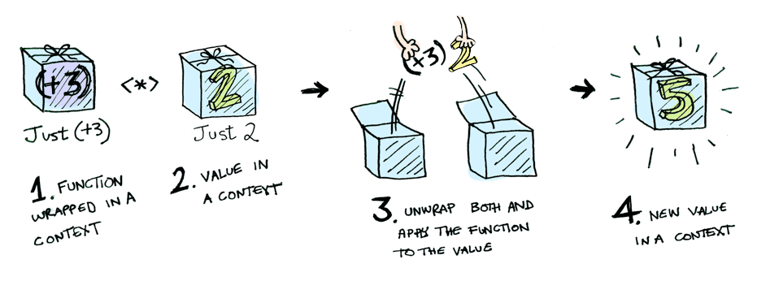
Applicative
http://adit.io/posts/2013-04-17-functors,_applicatives,_and_monads_in_pictures.html
class Functor f => Applicative f where -- Applicative je podtrieda Functor
pure :: a -> f a
(<*>) :: f (a -> b) -> f a -> f b (infixl 4)
a každá jej inštancia musí spĺňať pravidlá (to je sémantika, mimo syntaxe)
pure id <*> v = v -- identita
pure (.) <*> u <*> v <*> w = u <*> (v <*> w) -- kompozícia
pure f <*> pure x = pure (f x) -- homomorfizmus
u <*> pure y = pure ($ y) <*> u = pure (\g->g y) <*> u -- výmena
Príklad (pre M1):
Return id <*> Return 4 = Return 4
Return (.) <*> Return (+1) <*> Return (+2) <*> Return 4 = Return 7
Return (+1) <*> (Return (+2) <*> Return 4) = Return 7
Return (+4) <*> Return 3 = Return 7 -- pure f <*> pure x = pure (f x)
data M1 a = Raise String | Return a deriving(Show, Read, Eq)
Notes:
Return id <*> Return 4
Return (.) <*> Return (+1) <*> Return (+2) <*> Return 4
Return (+1) <*> (Return (+2) <*> Return 4)
Return (+4) <*> Return 3

Slide 16
Applicative
class Functor f => Applicative f where
pure :: a -> f a
(<*>) :: f (a -> b) -> f a -> f b
pure id <*> v = v -- identita
pure (.) <*> u <*> v <*> w = u <*> (v <*> w) -- kompozícia
pure f <*> pure x = pure (f x) -- homomorfizmus
u <*> pure y = pure ($ y) <*> u = pure (\g->g y) <*> u
Cvičenie5: definujte inštanciu M1 pre triedu Applicative a overte 4 pravidlá:
instance Applicative M1 where
pure a = Return a
(Raise e) <*> _ = Raise e -- e:: String, Raise e::M1 a
(Return f) <*> a = fmap f a -- f::a->b, Return f :: M1(a->b)
Príklad:
1) Return id <*> Return 4 = Return 4
2) L.S. = Return (.) <*> Return (+1) <*> Return (+2) <*> Return 4 = Return 7
P.S. = Return (+1) <*> (Return (+2) <*> Return 4) = Return 7
3) Return (+4) <*> Return 3 = Return 7 -- pure f <*> pure x = pure (f x)
4) Return (+2) <*> Return 7 = Return 9 = Return ($ 7) <*> Return (+2)
data M1 a = Raise String | Return a deriving(Show, Read, Eq)
Notes:
Return id <*> Return 4
Return (.) <*> Return (+1) <*> Return (+2) <*> Return 4
Return (+1) <*> (Return (+2) <*> Return 4)
Return (+4) <*> Return 3

Slide 17
Applicative
class Functor f => Applicative f where
pure :: a -> f a
(<*>) :: f (a -> b) -> f a -> f b
pure id <*> v = v -- identita
pure (.) <*> u <*> v <*> w = u <*> (v <*> w) -- kompozícia
pure f <*> pure x = pure (f x) -- homomorfizmus
u <*> pure y = pure ($ y) <*> u = pure (\g->g y) <*> u
Cvičenie5 (pokrač.): definujte inštanciu M1 pre Applicative a overte pravidlá:
instance Applicative M1 where
pure a = Return a
(Raise e) <*> _ = Raise e -- e:: String, Raise e::M1 a
(Return f) <*> a = fmap f a -- f::a->b, Return f :: M1(a->b)
Dôkaz:
1) (Return id) <*> v = fmap id v = v pravidlo identity pre Functors
3) pure f <*> pure x = (Return f) <*> (Return x) = fmap f (Return x) = Return (f x) = pure (f x)
2) (Return (.)) <*> (Return fu) <*> (Return fv) <*> (Return fw) =
(Return (.) fu) <*> (Return fv) <*> (Return fw) =
(Return ((.) fu) fv) <*> (Return fw) = (Return (fu . fv)) <*> (Return fw) =
(Return ((fu . fv) fw)) = Return (fu (fv (fw)))
4) L.S. = (Return f) <*> (Return y) = fmap f (Return y) = (Return (f y))
P.S. = (Return ($ y)) <*> (Return f) = fmap ($ y) (Return f) = Return (($ y) f) =
Return ((\g->g y) f) = Return (f y)
data M1 a = Raise String | Return a deriving(Show, Read, Eq)

Slide 18
Applicative
class Functor f => Applicative f where
pure :: a -> f a
(<*>) :: f (a -> b) -> f a -> f b
pure id <*> v = v -- identita
pure (.) <*> u <*> v <*> w = u <*> (v <*> w) -- kompozícia
pure f <*> pure x = pure (f x) -- homomorfizmus
u <*> pure y = pure ($ y) <*> u = pure (\g->g y) <*> u
Cvičenie5’’: definujte inštanciu Maybe pre triedu Applicative a overte pravidlá:
instance Applicative Maybe where
pure :: a -> Maybe a
pure = Just
pure x = Just x
(<*>) :: Maybe (a->b) -> Maybe a -> Maybe b
Nothing <*> _ = Nothing
(Just g) <*> a = fmap g a
Príklad:
pure (*2) <*> Just 7 = Just 14
pure (+) <*> Just 7 <*> Just 9 = Just 16
pure (+) <*> Nothing <*> Just 9 = Nothing
pure (\x y z->(x,y,z)) <*> Just 1 <*> Just 2 <*> Just 3 = Just (1,2,3)
data Maybe a = Just a | Nothing deriving(Show, Read, Eq)
Notes:
pure (*2) <*> Just 7
pure (+) <*> Just 7 <*> Just 9
pure (+) <*> Nothing <*> Just 9
pure (\x y z->(x,y,z)) <*> Just 1 <*> Just 2 <*> Just 3

Slide 19
Applicative
class Functor f => Applicative f where
pure :: a -> f a
(<*>) :: f (a -> b) -> f a -> f b
pure id <*> v = v -- identita
pure (.) <*> u <*> v <*> w = u <*> (v <*> w) -- kompozícia
pure f <*> pure x = pure (f x) -- homomorfizmus
u <*> pure y = pure ($ y) <*> u = pure (\g->g y) <*> u
Cvičenie6: definujte inštanciu [] pre triedu Applicative a overte pravidlá:
instance Applicative [] where
pure a = [a]
fs <*> xs = [ f x | f <- fs, x <- xs]
Príklad:
1) pure (+1) <*> [1..5] = [2,3,4,5,6]
pure (+) <*> [1,2] <*> [11,12] = [12,13,13,14]
pure (,) <*> [1,2] <*> [11,12] = [(1,11),(1,12),(2,11),(2,12)]
2) pure (.) <*> pure (+1) <*> pure (+3) <*> pure 9 = 13
pure (.) <*> pure (+1) <*> pure (+3) <*> [9] = [13]
pure (.) <*> pure (+1) <*> pure (+3) <*> Just 9 = Just 13
3) pure (+1) <*> pure 7 = 8
4) pure ($ 7) <*> pure (+1) = 8
type [a] = [] | a:[a]
Notes:
pure (+1) <*> [1..5]
pure (+) <*> [1,2] <*> [11,12]
pure (,) <*> [1,2] <*> [11,12]
pure (.) <*> pure (+1) <*> pure (+3) <*> pure 9
pure (.) <*> pure (+1) <*> pure (+3) <*> [9]
pure (.) <*> pure (+1) <*> pure (+3) <*> Just 9
pure (+1) <*> pure 7
pure ($ 7) <*> pure (+1)

Slide 20
Applicative
class Functor f => Applicative f where
pure :: a -> f a
(<*>) :: f (a -> b) -> f a -> f b
pure id <*> v = v -- identita
pure (.) <*> u <*> v <*> w = u <*> (v <*> w) -- kompozícia
pure f <*> pure x = pure (f x) -- homomorfizmusu <*> pure y = pure ($ y) <*> u = pure (\g->g y) <*> u
Cvičenie6: definujte inštanciu [] pre Applicative, a overte pravidlá:
instance Applicative [] where
pure a = [a]
fs <*> xs = [ f x | f <- fs, x <- xs]
Dôkaz:
1) (Return id) <*> v = [id] <*> v = v
2) [(.)] <*> [ui] <*> [vj] <*> [wk] =
[(.)ui] <*> [vj] <*> [wk] =
[ui . vj] <*> [wk] = [(ui . vj) wk] =
[(ui ( vj wk)]
3) pure f <*> pure x = [f] <*> [x] = [f x]
4) [f1,… fn] <*> [y] = [f1 y, … fn y]
Príklady:
[(*2), (+3)] <*> [1,2,3] = [2,4,6,4,5,6]
(,) <$> [1,2,3] <*> [4,5,6] = [(1,4),(1,5),(1,6),(2,4),(2,5),(2,6),(3,4),(3,5),(3,6)]
(\x y z -> (x,y,z)) <$> [1,2] <*> [3,4] <*> [5,6] = [(1,3,5),(1,3,6),(1,4,5),(1,4,6),(2,3,5),(2,3,6),(2,4,5),(2,4,6)]
pure (,,) <*> [1,2] <*> [3,4] <*> [5,6] = [(1,3,5),(1,3,6),(1,4,5),(1,4,6),(2,3,5),(2,3,6),(2,4,5),(2,4,6)]
https://adit.io/posts/2013-04-17-functors,_applicatives,_and_monads_in_pictures.html
Notes:
[(*2), (+3)] <*> [1,2,3]
(,) <$> [1,2,3] <*> [4,5,6]
(\x y z -> (x,y,z)) <$> [1,2] <*> [3,4] <*> [5,6]
pure (,,) <*> [1,2] <*> [3,4] <*> [5,6]

Slide 21
Kartézsky súčin domáca úloha
module KSucin where
cart :: [[t]] -> [[t]]
Príklad:
cart [ [1,2], [3,4], [5] ] = [[1,3,5],[1,4,5],[2,3,5],[2,4,5]]
cart [ [1,2], [3,4], [5,6,7] ] = [[1,3,5],[1,3,6],[1,3,7],[1,4,5],[1,4,6],[1,4,7],[2,3,5],[2,3,6],
[2,3,7],[2,4,5],[2,4,6],[2,4,7]]
cart [ [1,2], [3,4], [5,6] ] = [[1,3,5],[1,3,6],[1,4,5],[1,4,6],[2,3,5],[2,3,6],[2,4,5],[2,4,6]]
cart [ [1,2], [3,4], [] ] = []
cart [ ["janka", "danka"], ["misko", "palko"] ] = [ ["janka","misko"],["janka","palko"],["danka","misko"],
["danka","palko"]]

Slide 22
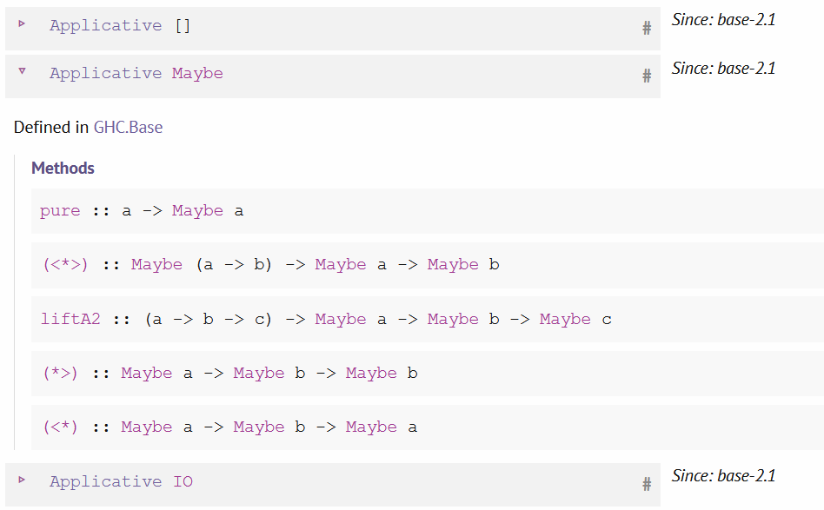
GHC.Base
https://hackage.haskell.org/package/base-4.15.0.0/docs/GHC-Base.html

Slide 23

Monáda
(class Monad)
monáda m je typ implementujúci dve funkcie:
class Applicative m => Monad m where -- interface predpisuje tieto funkcie
return :: a -> m a -- to bude pure z Applicatives
>>= :: m a -> (a -> m b) -> m b -- náš `bind`
ktoré spľňajú isté (sémantické) zákony:
neutrálnosť return:
return c >>= (\x->g) = g[x/c]
m >>= \x->return x = m
neutrálnosť asociativita:
m1 >>= (\x->m2 >>= (\y->m3)) = (m1 >>= (\x->m2)) >>= (\y->m3)
inak zapísané:
return c >>= f = f c -- ľavo neutrálny prvok
m >>= return = m -- pravo neutrálny prvok
(m >>= f) >>= g = m >>= (\x-> f x >>= g)
-- asocitativita >>=

Slide 24
Základný interpreter výrazov
  return :: a -> M a
  >>= :: M a -> (a -> M b) -> M b
Princíp fungovania monád sme trochu ilustrovali na type
data M result = Parser result = String -> [(result, String)]
return :: a->Parser a
return v = \xs -> [(v,xs)]
bind, >>= :: Parser a -> (a -> Parser b) -> Parser b
p >>= qf = \xs -> concat [ (qf v) xs' | (v,xs')<-p xs])
… len sme nepovedali, že je to monáda
dnes si vysvetlíme najprv na sérii evaluátorov aritmetických výrazov,
presnejšie zredukovaných len na konštrukcie pozostávajúce z Con a Div:
+-* je triviálne a len by odvádzalo pozeornosť
data Term = Con Int | Div Term Term | Add … | Sub … | Mult … deriving(Show, Read, Eq)
eval :: Term -> Int
eval(Con a) = a
eval(Div t u) = eval t `div` eval u
> eval (Div (Div (Con 1972) (Con 2)) (Con 23))
42
eval (Div (Div (Con 1972) (Con 0)) (Con 23))
*** Exception: divide by zero
Zdroj: http://homepages.inf.ed.ac.uk/wadler/papers/marktoberdorf/baastad.pdf
monad.hs
Notes:
eval (Div (Div (Con 1972) (Con 2)) (Con 23))
eval (Div (Div (Con 1972) (Con 0)) (Con 23))
*** Exception: divide by zero

Slide 25
Interpreter s výnimkami
Haskell má definované podobné typy
data Either a b = Left a | Right b
data Maybe a = Nothing | Just a
v prvej verzii interpretera riešime problém, ako ošetriť delenie nulou
Toto je výstupný typ nášho interpretra:
data M₁ a = Raise String | Return a deriving(Show, Read, Eq)
evalExc :: Term -> M₁ Int
evalExc (Con a) = Return a
evalExc (Div t u) = case evalExc t of
Raise e -> Raise e
Return a ->
case evalExc u of
Raise e -> Raise e
Return b ->
if b == 0
then Raise "div by zero"
else Return (a `div` b)
> evalExc (Div (Div (Con 1972) (Con 2)) (Con 23))
Retrun 42
> evalExc (Div (Con 1) (Con 0))
Raise "div by zero"
monad.hs
Notes:
evalExc (Div (Div (Con 1972) (Con 2)) (Con 23))
evalExc (Div (Con 1) (Con 0))

Slide 26
Interpreter so stavom
interpreter výrazov, ktorý počíta počet operácií div (má stav type State=Int):
M₂ a - reprezentuje výpočet s výsledkom typu a, lokálnym stavom State ako:
type M₂ a = State -> (a, State)
type State = Int
evalCnt :: Term -> M₂ Int
evalCnt (Con a) = \state ->(a,state)
evalCnt (Con a) state = (a,state)
evalCnt (Div t u) state = let (a,state1) = evalCnt t state in
let (b,state2) = evalCnt u state1 in
(a `div` b, state2+1)
naivne:
evalCnt :: (Term, State) -> (Int, State)
resp.:
evalCnt :: Term -> State -> (Int, State)
výsledkom evalCnt t
je funkcia, ktorá po
zadaní počiatočného
stavu povie výsledok
a konečný stav
> evalCnt (Div (Div (Con 1972) (Con 2)) (Con 23)) 0 (42,2)
> evalCnt (Div (Div (Con 1972) (Con 2)) (Div (Con 6) (Con 2))) 0 (328,3)
monad.hs
Notes:
evalCnt (Div (Div (Con 1972) (Con 2)) (Con 23)) 0
evalCnt (Div (Div (Con 1972) (Con 2)) (Div (Con 6) (Con 2))) 0

Slide 27
Interpreter s výstupom
tretia verzia je interpreter výrazov, ktorý vypisuje debug.informáciu do reťazca
type M₃ a = (Output, a)
type Output = String
evalOut :: Term -> M₃ Int
evalOut (Con a) = let out_a = line (Con a) a in (out_a, a)
evalOut (Div t u) = let (out_t, a) = evalOut t in
let (out_u, b) = evalOut u in
(out_t ++ out_u ++ line (Div t u) (a `div` b), a `div` b)
line :: Term -> Int -> Output
line t a = "eval (" ++ show t ++ ") <=" ++ show a ++ "\n"
> evalOut (Div (Div (Con 1972) (Con 2)) (Con 23))
("eval (Con 1972) <=1972
eval (Con 2) <=2
eval (Div (Con 1972) (Con 2)) <=986
eval (Con 23) <=23
eval (Div (Div (Con 1972) (Con 2)) (Con 23)) <=42",42)
> putStr$fst$evalOut (Div (Div (Con 1972) (Con 2)) (Con 23))
monad.hs
Notes:
evalOut (Div (Div (Con 1972) (Con 2)) (Con 23))
putStr $ fst $ evalOut (Div (Div (Con 1972) (Con 2)) (Con 23))

Slide 28

Monadický interpreter
(vízia)
máme 1+3 verzie interpretra (Identity/Exception/State/Output)
cieľom je napísať jednu, skoro uniformú verziu, z ktorej všetky existujúce vypadnú ako inštancia s malými modifikáciami
potrebujeme pochopiť typ/triedu/interface/des.pattern nazývaný monáda
class Monad m where
return :: a -> m a
>>= :: m a -> (a -> m b) -> m b
a potrebujeme pochopiť, čo je inštancia triedy (implementácia interface):
instance Monad M_{i} where
return = …
>>= …
Cieľ: ukážeme, ako v monádach s typmi M0, M1, M2, M3 dostaneme
požadovaný intepreter ako inštanciu všeobecného monadického interpretra

Slide 29
Monadický interpreter
monadický znamená, že je typu,
ktorá je inštanciou triedy Monad
class Monad m where
return :: a -> m a
>>= :: m a -> (a -> m b) -> m b
ukážeme, ako v monádach s typmi M0, M1, M2, M3 dostaneme požadovaný
intepreter ako inštanciu všeobecného monadického interpretra:
instance Monad M_{i} where return = … , >>= …
eval :: Term -> M_{i} Int
eval (Con a) = return a
eval (Div t u) = eval t >>= \valT ->
eval u >>= \valU ->
return(valT `div` valU)
čo vďaka do notácii zapisujeme:
eval (Div t u) = do { valT<-eval t; valU<-eval u; return(valT `div` valU) }
monad.hs

Slide 30
Identity monad
  return :: a -> M a
  >>= :: M a -> (a -> M b) -> M b
  Pre identity monad:
  return :: a -> a
  >>= :: a -> (a -> b) -> b
na verziu M₀ a = a sme zabudli, volá sa Identity monad, resp. M₀ = id:
type Identity a = a -- trochu zjednodušené oproti monad.hs
instance Monad Identity where
return v = v
p >>= f = f p
evalIdentM :: Term -> Identity Int
evalIdentM(Con a) = return a
evalIdentM(Div t u) = evalIdentM t >>= \valT->
evalIdentM u >>= \valU ->
return(valT `div` valU)
Cvičenie: dokážte, že platia vlastnosti:
return c >>= f = f c -- ľavo neutrálny prvok
m >>= return = m -- pravo neutrálny prvok
(m >>= f) >>= g = m >>= (\x-> f x >>= g)
> evalIdentM (Div (Div (Con 1972) (Con 2)) (Con 23))
42
monad.hs
Notes:
evalIdentM (Div (Div (Con 1972) (Con 2)) (Con 23))

Slide 31
Exception monad
  return :: a -> M a
  >>= :: M a -> (a -> M b) -> M b
  Pre Exception monad:
  return :: a -> Exception a
  >>= :: Exception a ->
  (a -> Exception b) ->
  Exception b
data M₁ = Exception a = Raise String | Return a deriving(Show, Read, Eq)
instance Monad Exception where
return v = Return v
p >>= f = case p of
Raise e -> Raise e
Return a -> Return (f a)
evalExceptM :: Term -> Exception Int
evalExceptM(Con a) = return a
evalExceptM(Div t u) = evalExceptM t >>= \valT->
evalExceptM u >>= \valU ->
if valU == 0 then Raise "div by zero"
else return(valT `div` valU)
evalExceptM (Div t u) = do valT <- evalExceptM t
valU <- evalExceptM u
if valU == 0 then Raise "div by zero"
else return(valT `div` valU)
> evalExceptM (Div (Div (Con 1972) (Con 2)) (Con 23))
Return 42
> evalExceptM (Div (Div (Con 1972) (Con 2)) (Con 0))
Raise "div by zero"
Cvičenie: dokážte, že platia 3 vlastnosti ...
monad.hs
Notes:
evalExceptM (Div (Div (Con 1972) (Con 2)) (Con 23))
evalExceptM (Div (Div (Con 1972) (Con 2)) (Con 0))

Slide 32
State monad
  return :: a -> M a
  >>= :: M a -> (a -> M b) -> M b
data M₂ = SM a = SM (State -> (a, State)) -- funkcia obalená v konštruktore SM
-- type State = Int
instance Monad SM where
return v = SM (\st -> (v, st)) typovacia pomôcka:
(SM p) >>= f = SM (\st ->let (a,st1) = p st in p::State->(a,State)
let SM g = f a in f::a->SM(State->(a,State))
g st1) g::State->(a,State)
evalSM :: Term -> SM Int -- Int je typ výsledku
evalSM(Con a) = return a
evalSM(Div t u) = evalSM t >>= \valT -> -- evalSM t :: SM Int
evalSM u >>= \valU -> -- valT :: Int, valU :: Int
incState >>= \_ -> -- ():()
return(valT `div` valU)
incState :: SM ()
incState = SM (\s -> ((),s+1))
monad.hs

Slide 33
do notácia
evalSM' :: Term -> SM Int
evalSM'(Con a) = return a
evalSM'(Div t u) = do { valT<-evalSM' t;
valU<-evalSM' u;
incState;
return(valT `div` valU) }
Problémom je, že výsledkom evalSM, resp. evalSM’, nie je stav, ale stavová monáda SM Int, t.j. niečo ako SM(State->(Int,State)).
Preto si definujme pomôcku, podobne ako (parse) pri parseroch:
goSM' :: Term -> State
goSM' t = let SM p = evalSM' t in
let (_,state) = p 0 in state
> goSM' (Div (Div (Con 1972) (Con 2)) (Con 23))
2
monad.hs
Notes:
goSM' (Div (Div (Con 1972) (Con 2)) (Con 23))
goSM' (Div (Div (Con 1972) (Con 2)) (Div (Con 6) (Con 2)))

Slide 34
State monad
  return :: a -> M a
  >>= :: M a -> (a -> M b) -> M b
data M₂ = SM a = SM (State -> (a, State)) -- funkcia obalená v konštruktore SM
-- type State = Int
instance Monad SM where
return v = SM (\st -> (v, st)) typovacia pomôcka:
(SM p) >>= f = SM (\st ->let (a,st1) = p st in p::State->(a,State)
let SM g = f a in f::a->SM(State->(a,State))
g st1) g::State->(a,State)
Cvičenie: dokážte, že platia vlastnosti:
return c >>= f = f c -- ľavo neutrálny prvok
m >>= return = m -- pravo neutrálny prvok
(m >>= f) >>= g = m >>= (\x-> f x >>= g)
monad.hs

Slide 35
Output monad
  return :: a -> M a
  >>= :: M a -> (a -> M b) -> M b
data M₃ = Out a = Out(String, a) deriving(Show, Read, Eq)
instance Monad Out where
return v = Out("",v)
p >>= f = let Out (str1,y) = p in
let Out (str2,z) = f y in
Out (str1++str2,z)
out :: String -> Out ()
out s = Out (s,())
evalOutM :: Term -> Out Int
evalOutM(Con a) = do { out(line(Con a) a); return a }
evalOutM(Div t u) = do { valT<-evalOutM t; valU<-evalOutM u;
out (line (Div t u) (valT `div` valU) );
return (valT `div` valU) }
> evalOutM (Div (Div (Con 1972) (Con 2)) (Con 23))
Out ("eval (Con 1972) <=1972
eval (Con 2) <=2
eval (Div (Con 1972) (Con 2)) <=986
eval (Con 23) <=23
eval (Div (Div (Con 1972) (Con 2)) (Con 23)) <=42",42)
let Out(s,_) = evalOutM (Div (Div (Con 1972) (Con 2)) (Con 23)) in putStr s
monad.hs
Notes:
evalOutM (Div (Div (Con 1972) (Con 2)) (Con 23))
let Out(s,_) = evalOutM (Div (Div (Con 1972) (Con 2)) (Con 23)) in putStr s

Slide 36
Monadic Prelude
class Monad m where -- definition:(>>=), return
return :: a -> m a
(>>=) :: m a -> (a -> m b) -> m b
(>>) :: m a -> m b -> m b -- zahodíme výsledok prvej monády
p >> q = p >>= \ _ -> q
sequence :: (Monad m) => [m a] -> m [a]
sequence [] = return []
sequence (c:cs) = do { x <- c; xs <- sequence cs; return (x:xs) }
-- ak nezáleží na výsledkoch
sequence_ :: (Monad m) => [m a] -> m ()
sequence_ = foldr (>>) (return ())
sequence_ [m₁,m₂,…m_{n}] = m₁ >>= \_ ->
m₂ >>= \_ ->
...
m_{n} >>= \_ ->
return ()
do { m₁ ;
m₂ ;
…
m_{n} ;
return ()
monad.hs

Slide 37


Slide 38
Kde nájsť v praxi monádu ?
> sequence [evalExceptM (Div (Div (Con 1972) (Con 2)) (Con 23)),
evalExceptM (Div (Con 8) (Con 4)),
evalExceptM (Div (Con 7) (Con 2))
]
Return [42,2,3] :: Exception [Int]
> sequence [evalExceptM (Div (Div (Con 1972) (Con 2)) (Con 23)),
evalExceptM (Div (Con 8) (Con 4)),
evalExceptM (Div (Con 7) (Con 0))
]
??? == Raise “div by 0”
:: Exception Int
:: Exception Int
monad.hs
Notes:
sequence [evalExceptM (Div (Div (Con 1972) (Con 2)) (Con 23)), evalExceptM (Div (Con 8) (Con 4)), evalExceptM (Div (Con 7) (Con 2)) ]
sequence [evalExceptM (Div (Div (Con 1972) (Con 2)) (Con 23)), evalExceptM (Div (Con 8) (Con 4)), evalExceptM (Div (Con 7) (Con 0)) ]

Slide 39
Kde nájsť v praxi monádu ?
Ďalší prvý pokus :-)
> sequence [[1..3], [1..4], [7..9]]
[[1,1,7],[1,1,8],[1,1,9],[1,2,7],[1,2,8],[1,2,9],[1,3,7],[1,3,8],[1,3,9],[1,4,7],[1,4,8],[1,4,9],[2,1,7],
[2,1,8],[2,1,9],[2,2,7],[2,2,8],[2,2,9],[2,3,7],[2,3,8],[2,3,9],[2,4,7],[2,4,8],[2,4,9],[3,1,7],[3,1,8],
[3,1,9],[3,2,7],[3,2,8],[3,2,9],[3,3,7],[3,3,8],[3,3,9],[3,4,7],[3,4,8],[3,4,9]]
Kartézsky súčin…
Takže [] je monáda, tzv. List-Monad, ale čo sú funkcie return a >>=
instance Monad [] where
return x = [x] :: a -> [a]
m >>= f = concat (map f m) :: [a] -> (a -> [b]) -> [b]
Podobný bind (>>=) ste videli v parseroch, tiež to bola analógia List-Monad
Cvičenie: dokážte, že platia 3 vlastnosti ...
monad.hs
Notes:
sequence [[1..3], [1..4], [7..9]]

Slide 40
IO monáda
Druhý pokus :-)
> :type print
print :: Show a => a -> IO ()
> print "Hello world!"
"Hello world!“
data IO a = ... {- abstract -} -- hack
getChar :: IO Char
putChar :: Char -> IO ()
getLine :: IO String
putStr :: String -> IO ()
echo :: IO ()
echo = getChar >>= putChar -- IO Char >>= (Char -> IO ()
do { c<-getChar; putChar c } -- do { c<-getChar; putChar c } :: IO ()
-- do { ch <-getChar; putStr [ch,ch] }
monad.hs
Notes:
print "Hello world!" :: IO ()
do { c<-getChar; putChar c }
getChar >>= (\ch -> putStr [ch,ch])

Slide 41
Interaktívny Haskell
main1 = putStr "Please enter your name: " >>
getLine >>= \name ->
putStr ("Hello, " ++ name ++ "\n")
main2 = do
putStr "Please enter your name: "
name <- getLine
putStr ("Hello, " ++ name ++ "\n")
> sequence [print 1 , print 'a' , print "Hello"]
1
'a'
"Hello"
[(),(),()]
> main2
Please enter your name: Peter
Hello, Peter
monad.hs
Notes:
sequence [print 1 , print 'a' , print "Hello"]
Sequence_ [print 1 , print 'a' , print "Hello"]

Slide 42
Maybe monad
sequence :: Monad m => [m a] -> m [a]
sequence [] = return []
sequence (c:cs) = do { x <- c;
xs <- sequence cs; return (x:xs) }
Maybe je podobné Exception (Nothing~~Raise String, Just a ~~Return a)
data Maybe a = Nothing | Just a
instance Monad Maybe where
return v = Just v -- vráť hodnotu
fail = Nothing -- vráť neúspech
Nothing >>= f = Nothing -- ak už nastal neúspech, trvá do konca
(Just x) >>= f = f x -- ak je zatiaľ úspech, závisí to na výpočte f
Cvičenie: dokážte, že platia vlastnosti:
> sequence [Just "a", Just "b", Just "d"]
Just ["a","b","d"]
> sequence [Just "a", Just "b", Nothing, Just "d"]
Nothing
monad.hs
Notes:
sequence [Just "a", Just "b", Just "d"]
sequence [Just "a", Just "b", Nothing, Just "d"]

Slide 43
Maybe MonadPlus
data Maybe a = Nothing | Just a
class Monad m => MonadPlus m where -- podtrieda, resp. podinterface
mzero :: m a -- Ø
mplus :: m a -> m a -> m a -- disjunkcia
instance MonadPlus Maybe where
mzero = Nothing -- fail...
Just x `mplus` y = Just x -- or
Nothing `mplus` y = y
> Just "a" `mplus` Just "b"
Just "a"
> Just "a" `mplus` Nothing
Just "a"
> Nothing `mplus` Just "b"
Just "b"
monad.hs
Notes:
Just "a" `mplus` Just "b“
Just "a" `mplus` Nothing
Nothing `mplus` Just "b"

Slide 44
Zákony monád a monádPlus
vlastnosti return a >>=:
return x >>= f = f x -- return ako identita zľava
p >>= return = p -- retrun ako identita sprava
p >>= (\x -> (f x >>= g))= (p >>= (\x -> f x)) >>= g -- “asociativita”
vlastnosti zero a `plus`:
zero `plus` p = p -- zero ako identita zľava
p `plus` zero = p -- zero ako identita sprava
p `plus` (q `plus` r) = (p `plus` q) `plus` r -- asociativita
vlastnosti zero, `plus` a >>= :
zero >>= f = zero -- zero ako identita zľava
p >>= (\x->zero) = zero -- zero ako identita sprava
(p `plus` q) >>= f = (p >>= f) `plus` (q >>= f) -- distribut.

Slide 45
List monad
List monad použijeme, ak simulujeme nedeterministický výpočet
data List a = Null | Cons a (List a) deriving (Show) -- alias [a]
instance Functor List where -- to je vlastne map
fmap f Nil = Nil
fmap f (Cons x xs) = Cons (f x) (fmap f xs)
instance Monad List where
return x = [x] :: a -> [a]
m >>= f = concat . map f m :: [a] -> (a -> [b]) -> [b]

Slide 46
List monad
  return :: a -> [a]
  >>= :: [a] -> (a -> [b]) -> [b]
type List a = [a]
instance Functor List where
fmap = map
instance Monad List where
return v = [x]
[] >>= f = []
(x:xs) >>= f = f x ++ (xs >>= f) -- concatMap f (x:xs)
instance MonadPlus List where
mzero = []
[] `mplus` ys = ys
(x:xs) `mplus` ys = x : (xs `plus` ys) -- mplus je klasický append

Slide 47
List monad - vlastnosti
Príklad, tzv. listMonad M a = List a = [a]
return x = [x] :: a -> [a]
m >>= f = concatMap f m :: [a] -> (a -> [b]) -> [b]
concatMap = concat . map f m
Cvičenie: overme platnosť zákonov:
return c >>= (\x->g) = g[x/c]
  [c] >>= (\x->g) = concatMap (\x->g) [c] = concat . map (\x->g) [c] =
  concat [ g[x/c] ] = g[x/c]
m >>= \x->return x = m
  [c₁, … ,c_{n}] >>= (\x->return x) = concatMap (\x->return x) [c₁, … ,c_{n}] =
  concat . map (\x->return x) [c₁, … ,c_{n}] = concat [ [c₁], … ,[c_{n}] ] = [c₁, … ,c_{n}]
m1 >>= (\x->m2 >>= (\y->m3)) = (m1 >>= (\x->m2)) >>= (\y->m3)
  ([c₁, … ,c_{n}] >>= (\x->[d₁, … ,d_{m}]) ) >>= (\y->m3) =
  ( concat [ [d₁[x/c₁], … ,d_{m}[x/ c₁]], … [d₁[x/ c_{n}], … ,d_{m}[x/ c_{n}]] ] ) >>= (\y->m3) =
  ( [ d₁[x/c₁], … ,d_{m}[x/ c₁], …, d₁[x/ c_{n}], … ,d_{m}[x/ c_{n}] ] ) >>= (\y->m3) =
  ( [ d₁[x/c₁], … ,d_{m}[x/ c₁], …, d₁[x/ c_{n}], … ,d_{m}[x/ c_{n}] ] ) >>= (\y->[e₁, … ,e_{k}]) = …
  [ e_{i}[y/d_{j}[x/c_{l}]] ]

Slide 48
Zákony monádPlus pre List
vlastnosti zero a `plus`:
zero `plus` p = p -- [] ++ p = p
p `plus` zero = p -- p ++ [] = p
p `plus` (q `plus` r) = (p `plus` q) `plus` r -- asociativita ++
vlastnosti zero `plus` a >>= :
zero >>= f = zero -- concat . map f [] = []
p >>= (\x->zero) = zero -- concat . map (\x->[]) p = []
(p `plus` q) >>= f = (p >>= f) `plus` (q >>= f)
-- concat . map f (p ++ q) =
concat . map f p
++
concat . map f q

