Slide 1

Prečo na FP záleží
Ako úvodnú – motivačnú prednášku reprodukujem prvú časť prednášky od John Hughes:
Why Functional Programming matters
z λ-days, Krakow 2017
https://www.youtube.com/watch?v=XrNdvWqxBvA
www.cse.chalmers.se/~rjmh/Papers/whyfp.pdf

Slide 2
true x y = x
false x y = y
ifte c t e = c t e
two f x = f (f x)
one f x = f x
zero f x = x
incr n f x = f (n f x)
add m n f x = m f (n f x)
mul m n f x = m (n f) x
isZero n = n (\_ -> false) true
decr n = n (\m f x -> f (m incr zero))
zero
(\x -> x)
zero
fact :: (forall a. (a->a)->a->a) -> (a->a) -> a -> a
fact n =
ifte (isZero n)
one
(mul n (fact (decr n)))
main =
-- print $ (decr (add (mul two two) one)) (+1) 0
-- print $ (fact (add (mul two two) one)) (+1) 0
print $ (fact (add two
(add (mul two two) (mul two two))))
(+1) 0
-- 3628800
-- (4.75 secs, 2,598,673,208 bytes)
https://github.com/Funkcionalne/Prednasky/blob/master/01/src/Church.hs

Slide 3

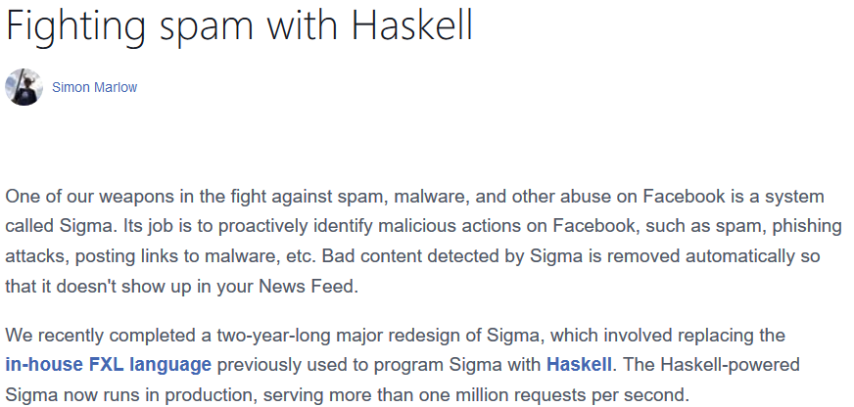
Haskell in FB spam filtering
https://code.facebook.com/posts/745068642270222/fighting-spam-with-haskell/

Slide 4
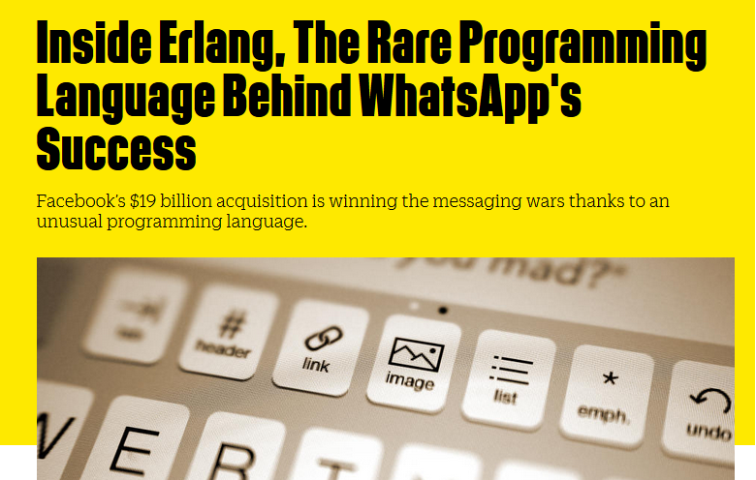
Elixir-Erlang
https://www.fastcompany.com/3026758/inside-erlang-the-rare-programming-language-behind-whatsapps-success

Slide 5
Referencie
Hughes: https://www.youtube.com/watch?v=XrNdvWqxBvA
Hughes: www.cse.chalmers.se/~rjmh/Papers/whyfp.pdf
Ladin: https://www.cs.cmu.edu/~crary/819-f09/Landin66.pdf
Backus: https://www.thocp.net/.../papers/backus_turingaward_lecture.pdf
Henderson: https://cs.au.dk/~hosc/local/HOSC-15-4-pp349-365.pdf
Hudak: haskell.cs.yale.edu/wp-content/.../03/HaskellVsAda-NSWC.pdf
FB: https://code.facebook.com/posts/745068642270222/fighting-spam-with-haskell/
WhatsApp: https://www.fastcompany.com/3026758/inside-erlang-the-rare-programming-language-behind-whatsapps-success
Hudak: https://ccrma.stanford.edu/~jos/pdf/FunctionalProgramming-p359-hudak.pdf

