Slide 1

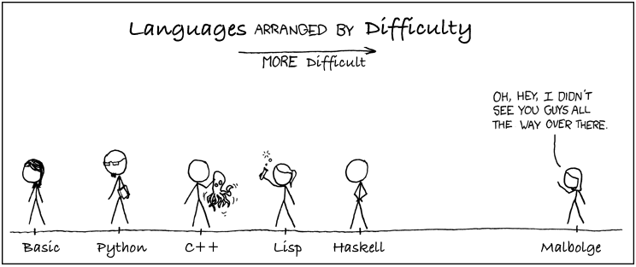
HaskellThon
https://en.wikipedia.org/wiki/Malbolge
https://medium.freecodecamp.org/what-programming-language-should-i-learn-first-%CA%87d%C4%B1%C9%B9%C9%94s%C9%90%CA%8C%C9%90%C9%BE-%C9%B9%C7%9D%CA%8Dsu%C9%90-19a33b0a467d

Slide 2
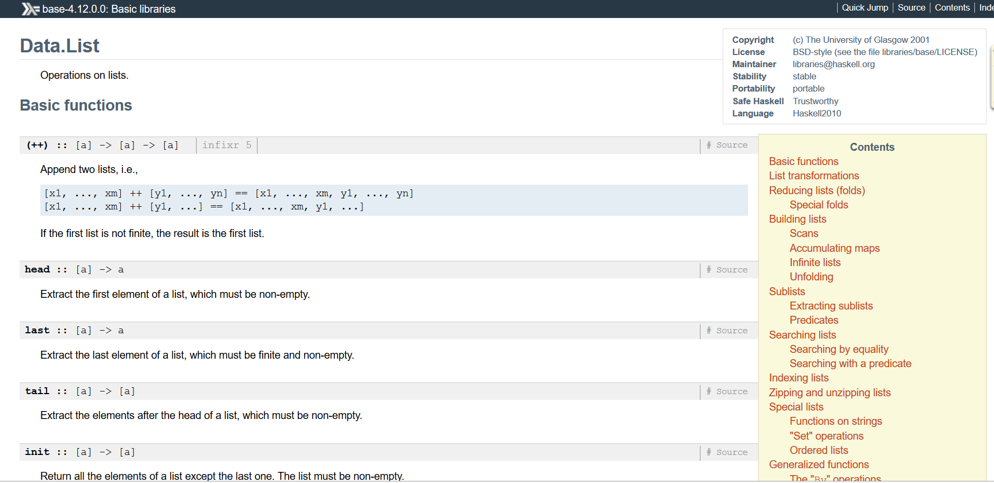
import Data.List http://hackage.haskell.org/package/base-4.12.0.0/docs/Data-List.html

Slide 3
Všetko,čo by ste chceli vediet o Haskelli, ale báli ste sa spýtať
že a b c d = (((a b) c) d)…lebo operátor aplikácie funkcie na argument je ľavo asociatívny, teda ak zabudnem zátvorky, tak ich chápe doľava
Int -> Int -> Int -> Char = Int -> (Int -> (Int -> Char)) … lebo operátor funkčného typu -> je pravo asociatívny, teda ak zabudnem zátvorky, tak ich chápe doprava. Explicitne, (Int->Int) -> (Int -> Int)
Int -> Int -> String != (Int, Int) -> String… lebo prvé je funkcia, ktorá vráti funkciu, ktorá vráti String. Vďaka currying ju volám takto f 4 5, čo je (f 4) 5. Druhé je funkcia, ktorá čaká dvojicu. Musím ju volať takto: g (4,5), a vyzerám, že som Javista, a na Haskelli prvý týždeň...
Int != Integer … lebo Int z interval minBound::Int ... maxBound::Int =9223372036854775807=2^63-1, ergo to je long. Integer je BigInteger
ako sa konvertuje Int, Integer, Float … to neviem ani ja, googlim…

Slide 4
Všetko,čo potrebujem vedieť, ma mali naučiť v materskej škôlke
Klauzálna definícia:
slova 0 = [ ]
slova 0 = [ [] ] -- to isté ako slova 0 = [ " " ]
slova k = [ ch:w | w <- slova (k-1), ch <- "ABCDEF" ]
Aritmetický pattern už nie je podporovaný:
slova (k+1) = [ ch:w | w <- slova k, ch <- "ABCDEF" ]
Guards alias bachari, či strážci:
slova k | k == 0 = [ [] ]
slova | otherwise = [ ch:w | w <- slova (k-1), ch <- "ABCDEF" ]
where patrí klauzule a nie je to výraz:
slova k | k == 0 = [ [] ]
slova | otherwise = [ ch:w | w <- ws, ch <- "ABCDEF" ]
where ws = slova (k-1)
slova.hs

Slide 5
Bojím sa spýtať, čo všetko ma nenaučili v materskej škôlke...
Na typoch záleží (aj keď ‘detstvo’ bez nich bolo krásne a jednoduché):
[[t]] nikdy nebude [t] (List<List<Integer>> nie je List<Integer>)
preto nemôžem napísať
[ch+(slova k) | ch <- "ABCDEF"]
>:type "ABCDEF"
"ABCDEF" :: [Char]
slova k :: [String] == [[Char]], … lebo type String = [Char]
ch+(slova k) znamená Char + [[Char]]
Okrem toho, zreťazenie zoznamov je (++) :: [t] -> [t] -> [t]
Ale ani ch++(slova k) nie je dobre, lebo je to Char ++ [[Char]], nepasuje…
Prilep ako hlavu k zoznamu je (:) :: t -> [t] -> [t]
Ale ani ch : (slova k) nie je dobre, lebo je to Char : [[Char]], nepasuje…
Píšte (si) typy (kdekoľvek sa dá), sú zdravé, a hlášky GHC potom čitateľnejšie
Píšte typy , sú zdravé

Slide 6
Slova, která jsem si přál napsat sám – Robert Fulghum
module Slova where
import Data.List -- pozrite si, koľko užitočných funkcií obsahuje
slova :: Int -> [String]
slova 0 = [[]]
slova k = [ ch:w | w <-slova (k-1), ch <- "ABCDEF"]
slova’ :: Int -> [String]
slova’ 0 = [[]]
slova’ k = slova' (k-1) ++ [ ch:w | w <-slova' (k-1), ch <- "ABCDEF"]
O(n^2). The nub function removes duplicates. The name nub means `essence’.)
koľko je 1+6+36+...+6^{k} (počet slov dĺžky najviac k) ?
[1,7,43,259,1555,9331,55987,335923,2015539,12093235,72559411, ...]
where:
slova'' k = ws ++ [ ch:w | w <-ws, ch <- "ABCDEF"] where ws = slova'' (k-1)
let:
slova''' k = let ws = slova''' (k-1) in ws ++ [ ch:w | w <-ws, ch <- "ABCDEF"]
length $ slova 3 = 216
length $ slova' 2 = 49 != 1+6+36 = 43
slova' 2 = ["","A","B","C","D","E","F","A","B","C","D","E","F","AA","BA","CA","DA","EA","FA","AB","BB","CB","DB","EB","FB","AC","BC","CC","DC","EC","FC","AD","BD","CD","DD","ED","FD","AE","BE","CE","DE","EE","FE","AF","BF","CF","DF","EF","FF"]
length $ nub $ slova' 2 = 43
slova.hs

Slide 7
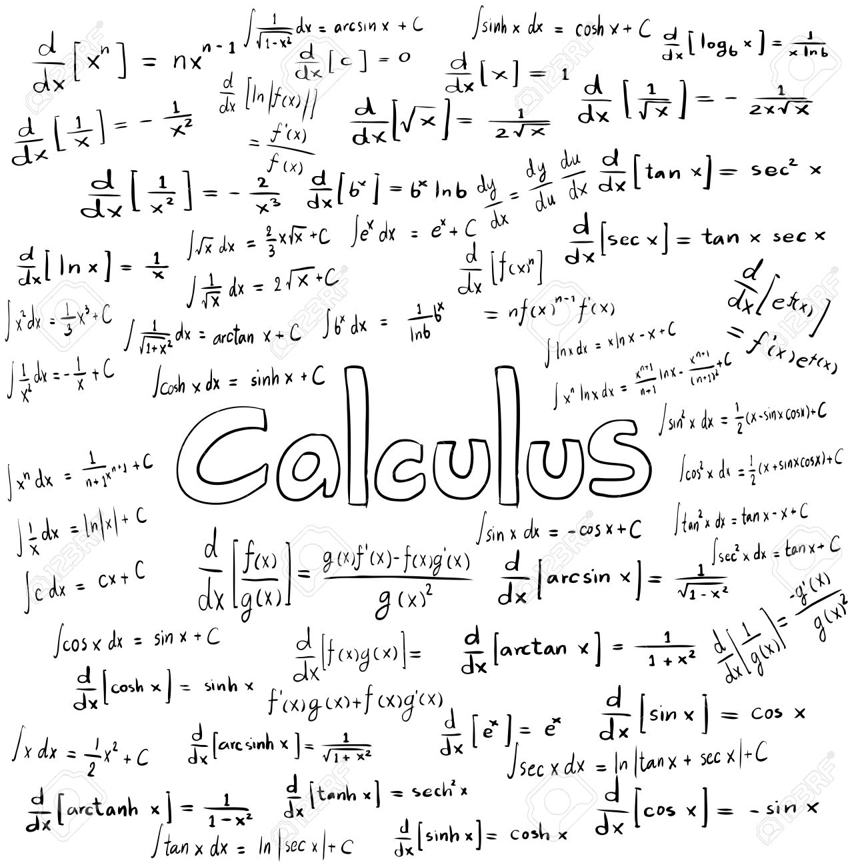
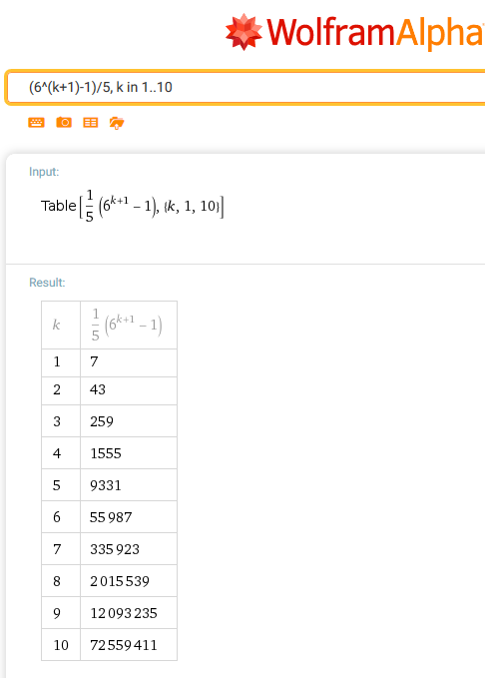
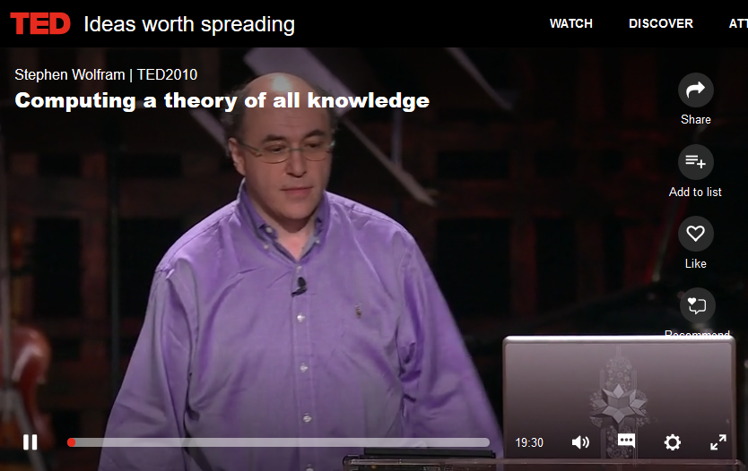
https://www.ted.com/talks/stephen_wolfram_computing_a_theory_of_everything

Slide 8
Všetko, čo ste chceli zmeniť, a nikdy sa vám to nepodarilo
zoznam (“pole”) xs vieme indexovať indexami i <- [0..length xs-1]
xs!!i -- getter
neexistuje setter xs[i] = value
set :: [t] -> Int -> t -> [t]
set xs i value | i < 0 = xs -- out of range
| i >= length xs = xs -- out of range
| otherwise = (if i == 0 then value else y):set ys (i-1) value
where (y:ys) = xs
| otherwise = let (y:ys) = xs in
(if i == 0 then value else y):set' ys (i-1) value
set'' :: [t] -> Int -> t -> [t]
set'' xs i value | i < 0 = xs -- out of range
| i >= length xs = xs -- out of range
| otherwise = [xs!!j | j <- [0.. i-1] ] ++ [value] ++
[xs!!j | j <- [i+1..length xs-1] ]
zoznam.hs

Slide 9
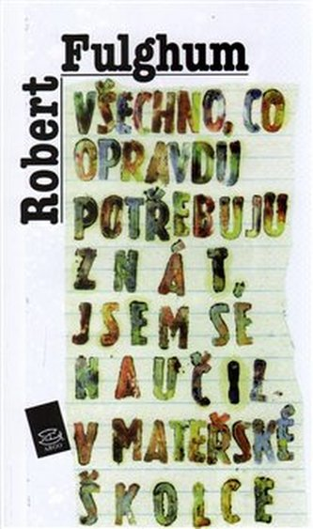
Haskell homework tu nevidím...
Share everything.
Play fair.
Don’t hit people.
Put things back where you found them.
Clean up your own mess.
Don’t take things that aren’t yours.
Say you’re sorry when you hurt somebody.
Wash your hands before you eat.
Flush.
Warm cookies and cold milk are good for you.
Live a balanced life—learn some and think some and draw and paint and sing and dance and play and work every day some.
Take a nap every afternoon.
https://sk.wikipedia.org/wiki/Robert_Fulghum

Slide 10
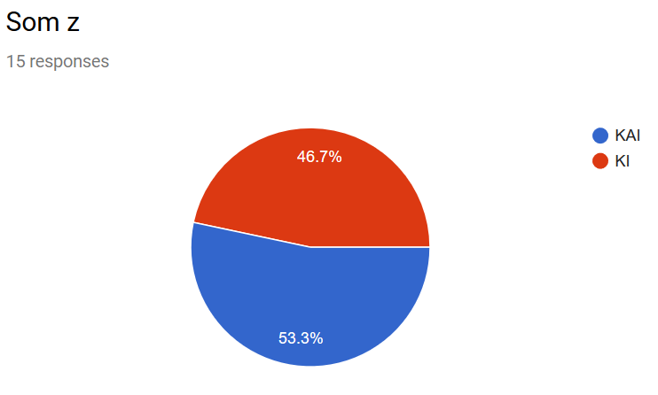
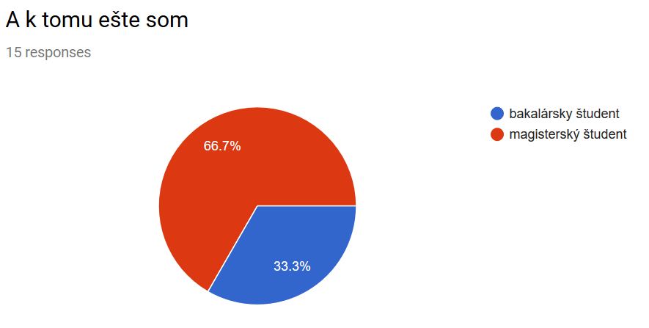
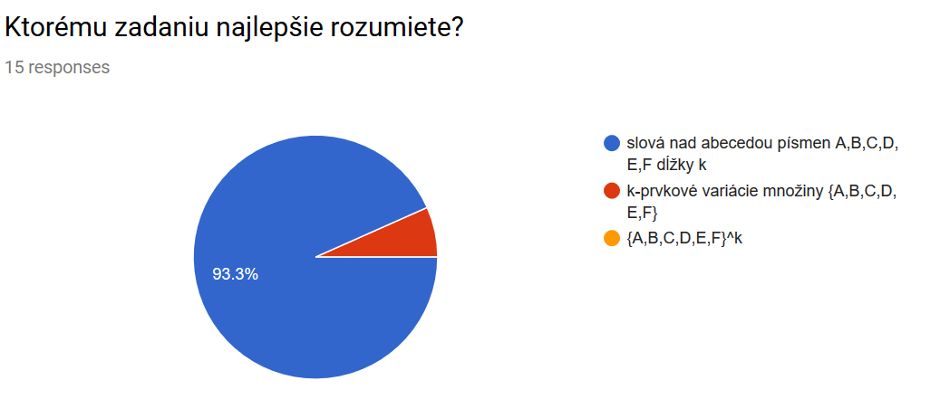
Anketa
(107%)

Slide 11
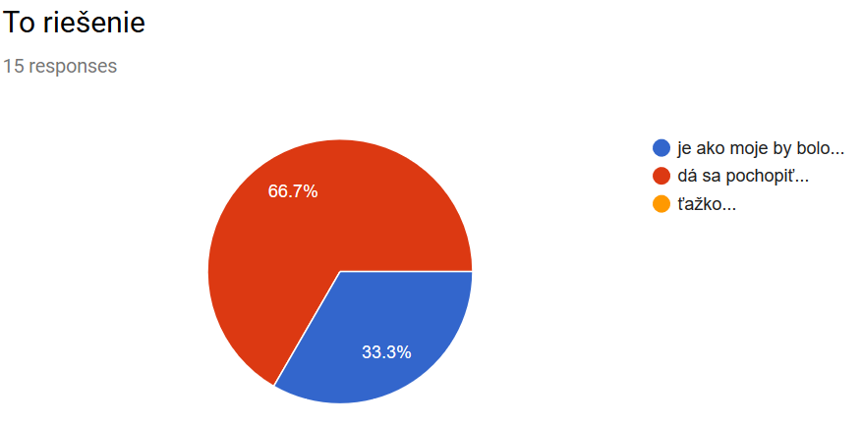
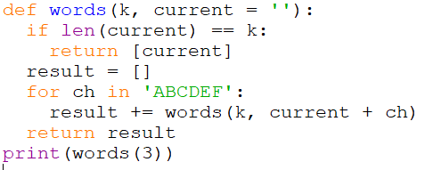
Anketa
(107%)

Slide 12
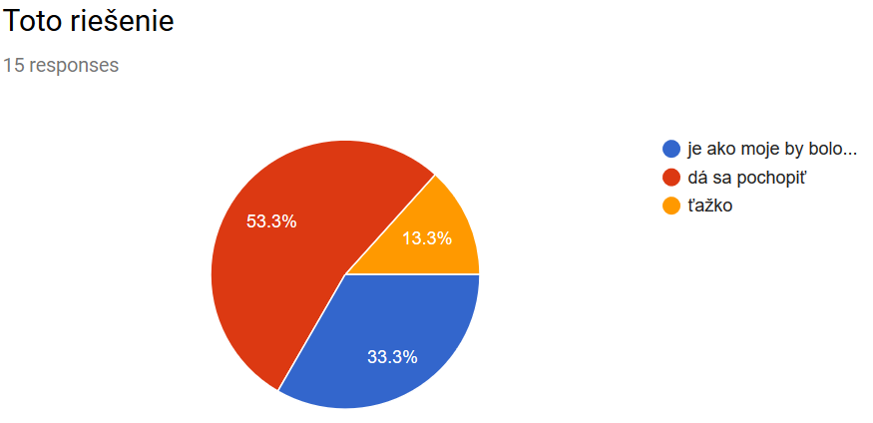
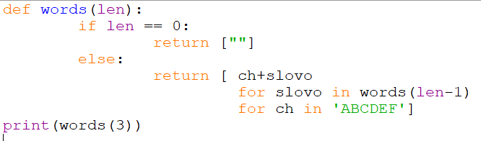
Anketa
(107%)

Slide 13
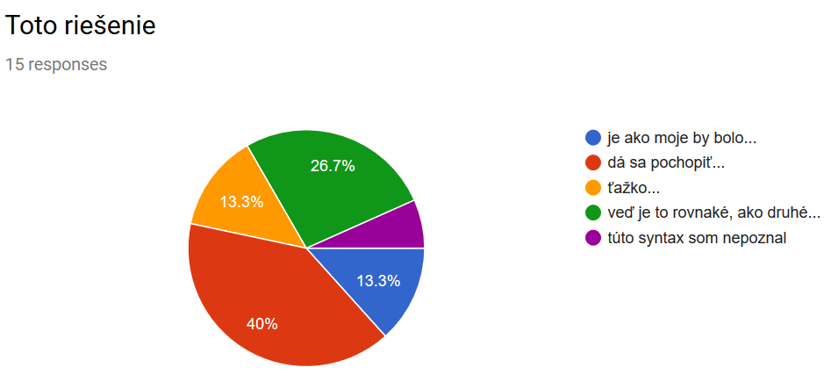
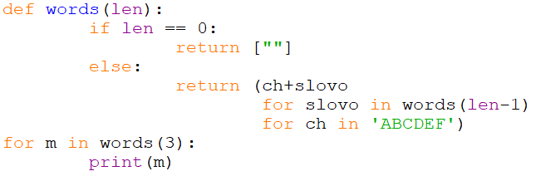
Anketa
(107%)

Slide 14
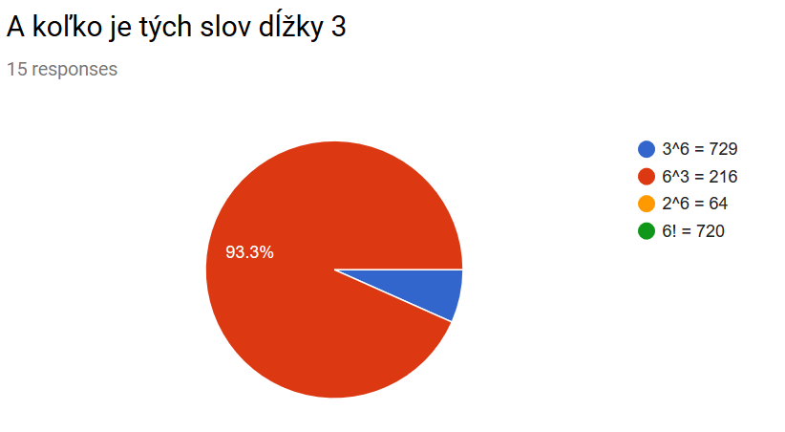
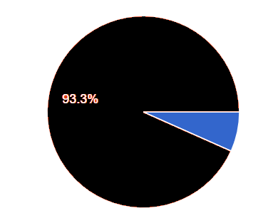
Anketa
Anketa / Rozcvička 1

Slide 15
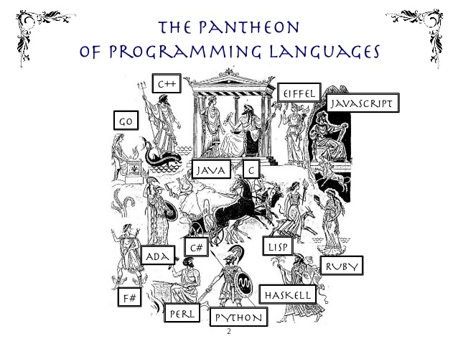
.js
  array-comprehension
  [for (x of iterable) if (condition) x]
  var numbers = [1, 2, 3, 21, 22, 30];
  [for (i of numbers) if (i % 2 === 0) i];
  iterátor/generátor
.py
  async/await (coroutines)
  destructor (destructor assignment)
  def foo(): return [1,2,3,4]
  (x, *xs) = [1,2,3,4] (x, *xs) = foo() x = 1, xs = [2,3,4]
  (x, y, *ys) = [1,2,3,4] (x, y, *ys) = foo() x = 1, y = 2, ys = [3,4]
  čo ak foo() je generátor ?
.hs
  lazy evaluation (generátory)
https://developer.mozilla.org/en-US/docs/Web/JavaScript/Guide/Iterators_and_Generators
https://docs.python.org/3/library/asyncio-task.html

Slide 16

All Things Pythonic
Guido van Rossum: The fate of reduce() in Python 3000, (r.2005)
Python aquired lambdas, reduce(), filter() and map() thanks a Lisp hacker
despite of the PR value, I think these features should be cut from Python 3
Update: lambda, filter and map will stay (the latter two with small changes, returning iterators instead of lists). Only reduce will be removed from the 3.0 standard library. You can import it from functools.
https://www.artima.com/weblogs/viewpost.jsp?thread=98196

Slide 17
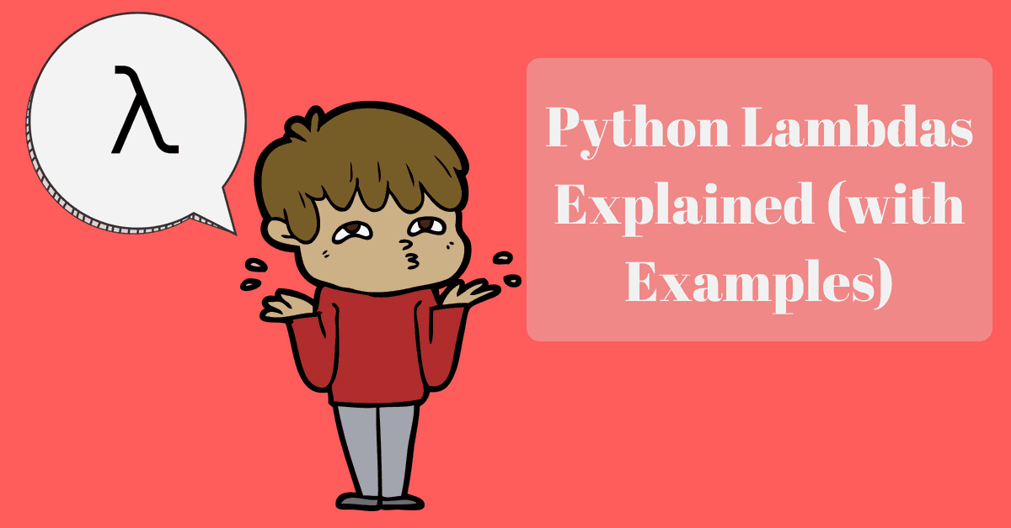
Python Kvíz
<map object at 0x03758930>
[1, 4, 9, 16, 25]
[16, 25]
24
10
-8
31
33
print(map(lambda x: x*x, [1,2,3,4,5]))
print(list(map(lambda x: x*x, [1,2,3,4,5])))
print(list(filter(lambda y:y>10,map(lambda x: x*x, [1,2,3,4,5]))))
from functools import reduce
print(reduce((lambda x, y: x * y), [1, 2, 3, 4]))
print(reduce((lambda x, y: x + y), [1, 2, 3, 4]))
print(reduce((lambda x, y: x - y), [1, 2, 3, 4]))
def compose(f, g):
return lambda x: f(g(x))
print(compose( lambda x: x+1, lambda x: x*3 )(10))
def composeMany(*fs):
return reduce(compose, fs)
print(composeMany(lambda x:x+1, lambda x:x+2, lambda x:x*3)(10))
lambdas.hs

Slide 18

Does not matter much…
for job: Better choice would be Scala (modern Java)
https://www.coursera.org/learn/progfun1
for school: Haskell

Slide 19
List-comprehension
Každý poriadny kurz FP začína funkcionálmi map a filter:
...ale my sme trénovali list-comprehension:
[ f x | x <- xs, p x] [ f(x) for x in xs if p(x)]
map :: (a -> b) -> [a] -> [b]
map f xs = [ f x | x <- xs]
filter :: (a -> Bool) -> [a] -> [a]
filter p xs = [ x | x <- xs, p x]

