Slide 1
A Closer Look at Conversational AI
Nahid Alam

Slide 2
Anatomy of a Conversational AI
Speech-to-Text
Domain Classification
Intent Classification
Entity Classification
Role Classification
Entity Resolution
Text-to-Speech
Dialog Management
Language Generation
Question Answering
Language Parsing
Notes:
H: xxx
B: yyy
H:zzz
B:yy
H:ppp
B:

Slide 3
Example
Book a flight from SFO to JFK from May 1st to May 10th
Domain: Travel
Intent: Booking/ordering
Entity: SFO, JFK
Role: May 1st – start, May 10th- end

Slide 4
Types of Conversational AI Frameworks
Rule-based
Botkit
Cloud-based
Dialogflow, Amazon ?, MS Luis
Somewhere in the middle?
Ability to customize
Control over your data
Example: MindMeld, Rasa.ai

Slide 5
How Intent and Entity Classification works?

Slide 6
Similarity
Word vector representation
Find the cosine similarity
Cosine similarity is very – we can do better with SVM

Slide 7
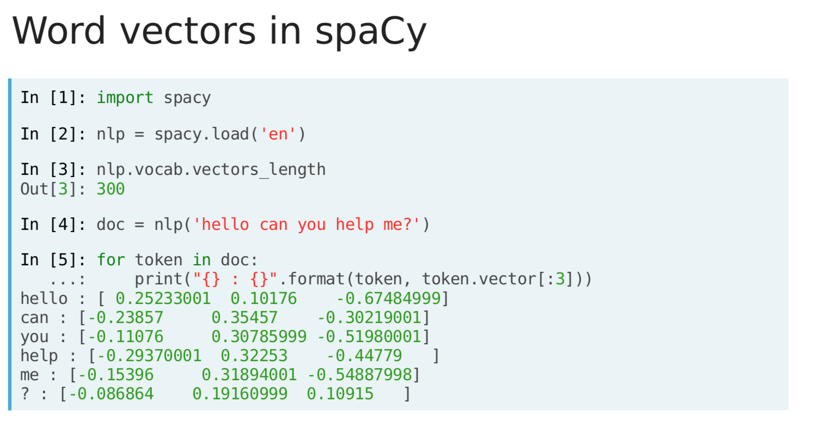
Intent Classification
Reference: Datacamp

Slide 8
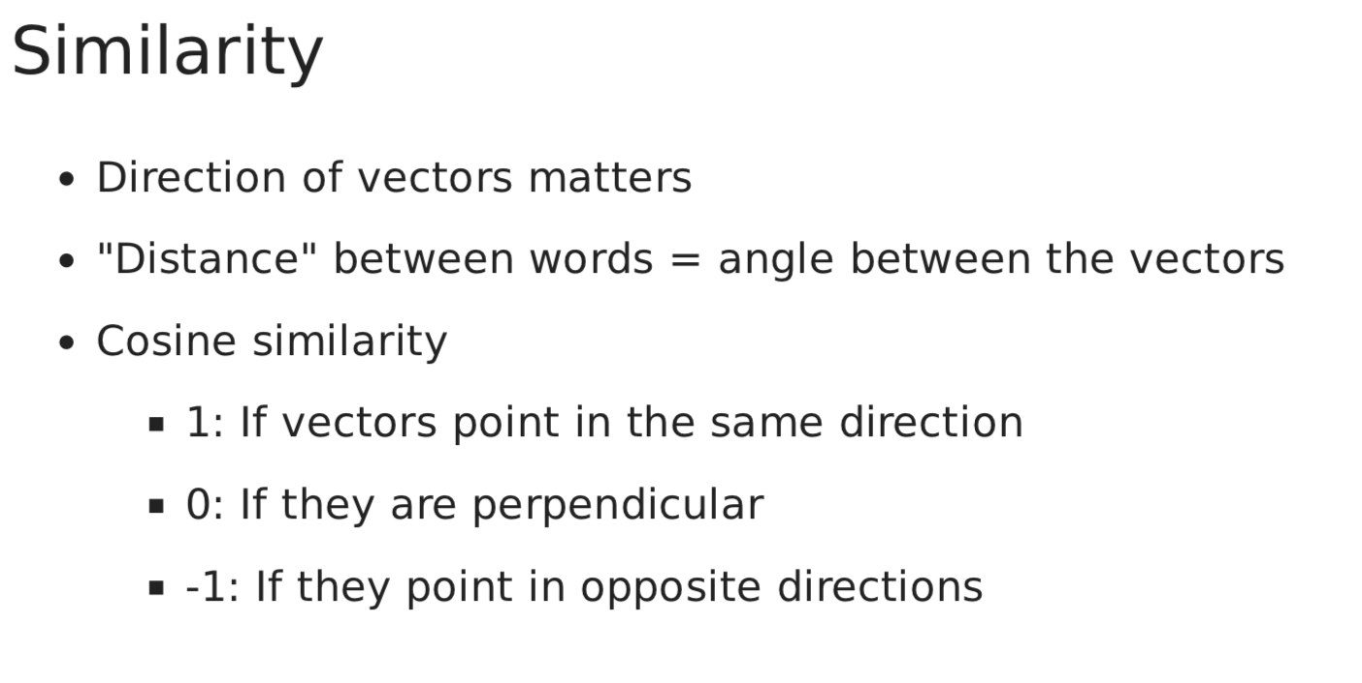
Intent Classification
Reference: Datacamp

Slide 9
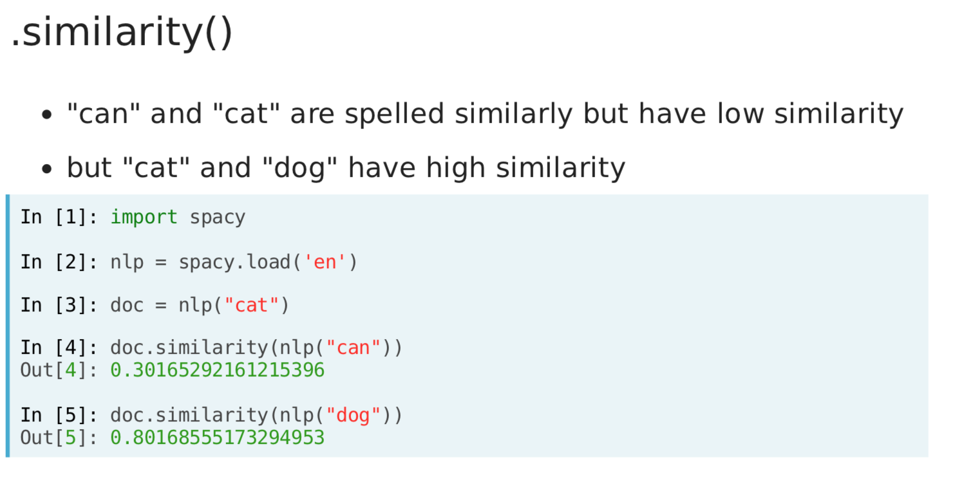
Intent Classification
Reference: Datacamp

Slide 10
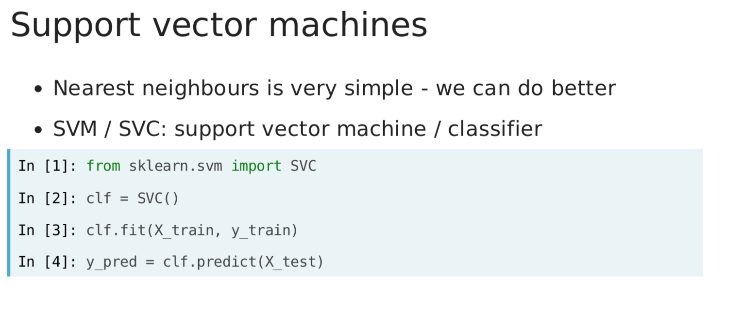
Intent Classification
Reference: Datacamp

Slide 11
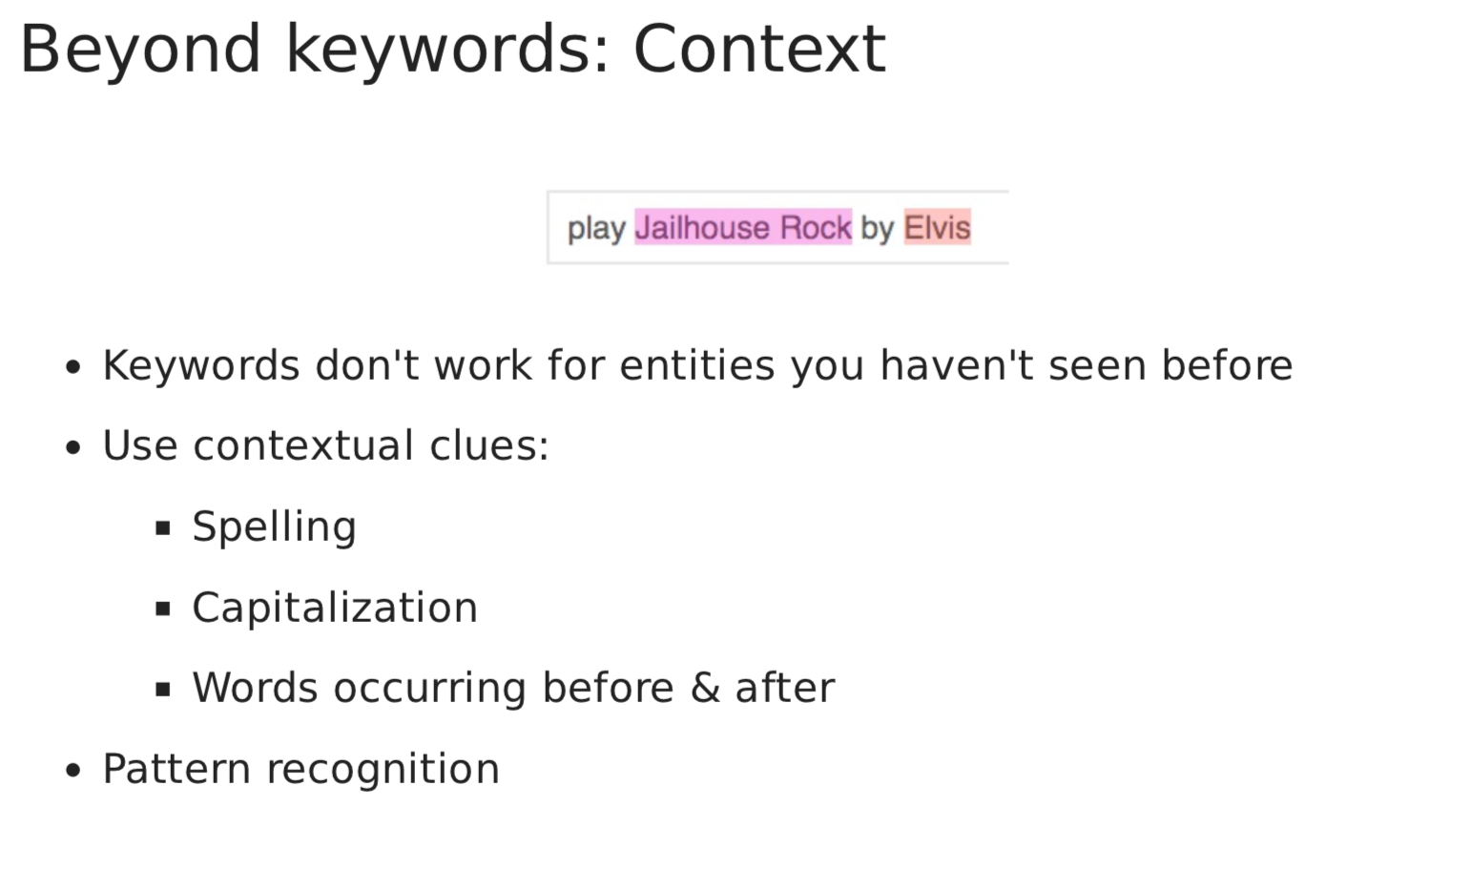
Entity Recognition
Reference: Datacamp

Slide 12
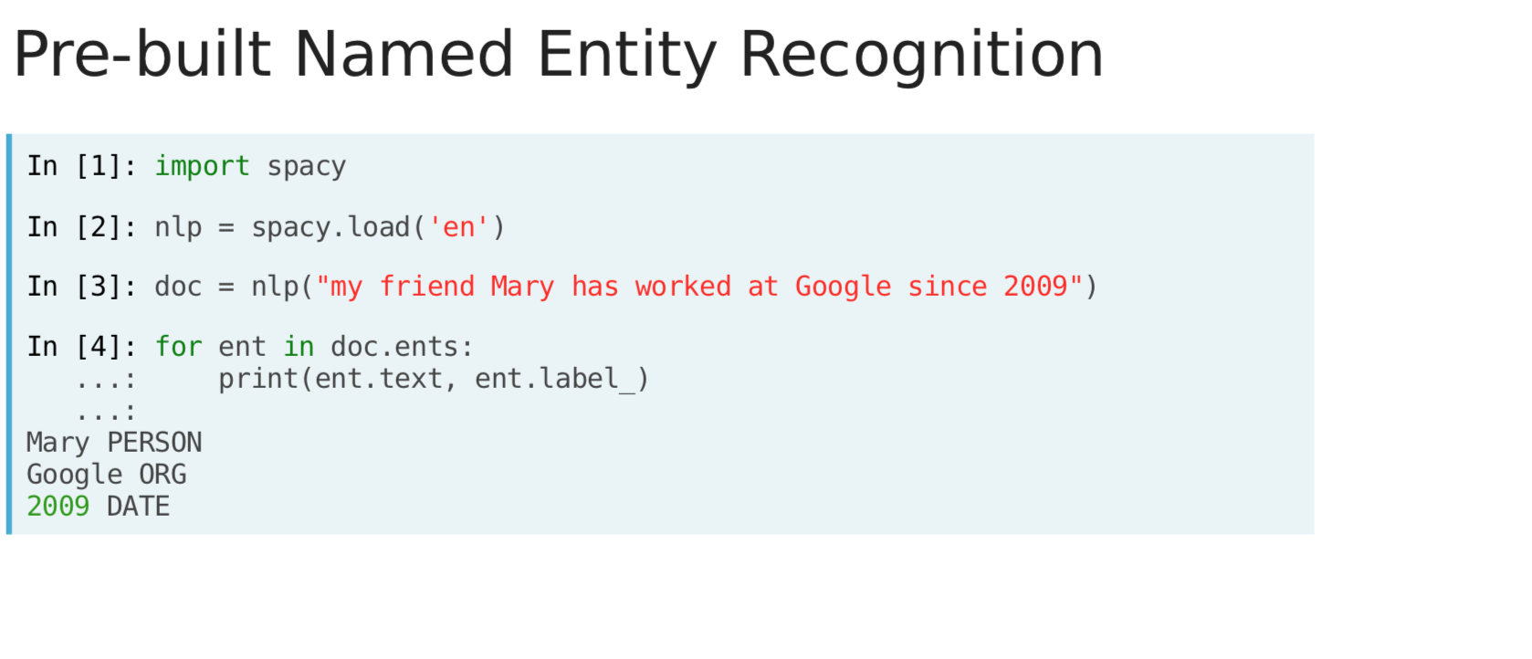
Entity Recognition
Reference: Datacamp

Slide 13
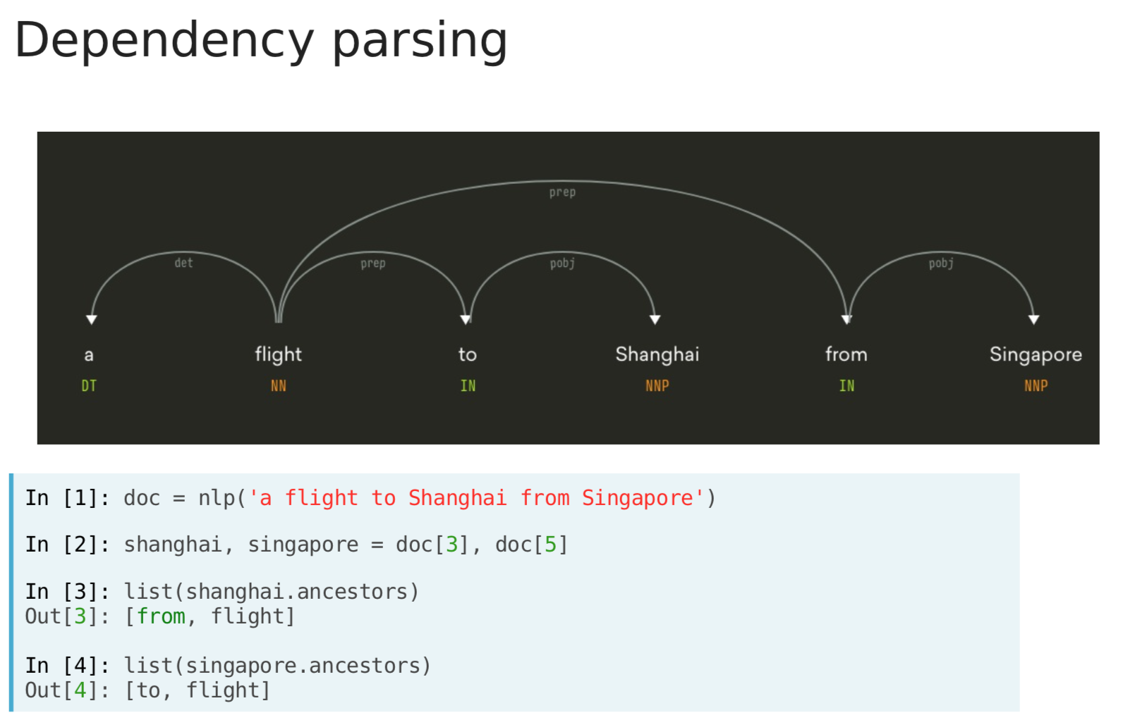
Entity Recognition
Reference: Datacamp

Slide 14
Coding Example

Slide 15
Next
Understand Rasa.ai to build a chatbot

