Slide 1
State-Based Programming
Presented by Aidan, Programming Lead for Team 1262
Thank you for listening/reading!

Slide 2
Small Bit Of Introduction
In the 2025 offseason, I began researching Team 2910’s robot code and really liked their code structure!
State-based programming turns each control into its own action, or state. Because each action is defined fully, unexpected behavior doesn’t easily happen at a software level.
For 2910, this allowed for easier automation, because each subsystem could be kept track of.
Code debugging is also made easier for the same reasons.

Slide 3
Subsystem Organization
Superstructure
Shooter
Intake
Indexer
Feeder
The superstructure is the orchestrator of every other subsystem.
Based on its own state machine(s), it will loop running different actions on each subsystems.
Subsystems can have their own state machines for more advanced logic.

Slide 4
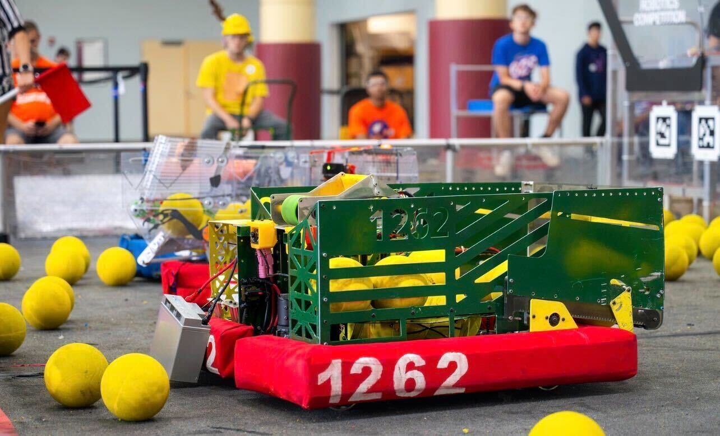
1262’s Robot, Blender

Slide 5
Superstructure
There are two state machines, each describing robot actions:
The WantedSuperState is the goal of the robot (for example, idling).
The CurrentSuperState is the action of the robot, which can be more specific as needed (holding a game piece like algae idly)
A method handleStateTransition() converts the wanted state into a current state, based on various conditions.
applyState() then reads that current state and runs code corresponding with it.
Both functions are run in periodic(), meaning that you can make your subsystems respond to events extremely easily!

Slide 6
Controlled Subsystems
In 2910’s code, each subsystem follows nearly identical structure to Superstructure (though they won’t have access to everything, naturally).
This means they have a wanted and system state, along with the two methods handleStateTransition() and applyState().
applyState() will run the logic corresponding to that state.
Think of it as a deeper level of control compared to what Superstructure has.
Intake.java in my example showcases this.

Slide 7
Utility
A big point that I mentioned a moment ago (hopefully) is that everything is being run on the periodic loop.
That allows for information to be checked constantly, allowing for easier automation (I feel) than command-based sometimes allows.
A great example is the shooting Current State. The shooter roller immediately begins firing. In every periodic() loop afterwards, the state machine checks if the shooter has reached its maximum velocity.
Once it has, both the feeder rollers and spindexer fire!

Slide 8
Adaptation #1
That’s a large amount of what I wanted to show today, but I do want to mention a few ways to adapt this to your team.
Not every team needs two state-machines per controlled subsystem, or even in Superstructure.
In many cases, especially for less complex control, you can have just a current state and an applyState() method, and you won’t really miss much.
This is what our team did in the 2025 offseason after testing some of this.
Shooter.java in my example showcases this.

Slide 9
Adaptation #2
Finally, you could decide to have Superstructure control everything. This means that you would have functions like runFeeder(), or even feed(), but the Superstructure would call them directly.
This can be found in both the Feeder.java and Spindexer.java files in my example.

Slide 10
Few Extra Things
I would recommend viewing 2910’s 2025 and 2026 codebases. These have been run on Einstein-level robots and showcase this concept better than I ever could.
Experiment! The best way to understand anything is to test it out, whether in a simulation on your device or on an actual robot.
Commands V3 is introducing a state machine class, so I would recommend looking at this as well.

Slide 11
Thank you for listening!

