Slide 1
Multimedia Retrieval Practical Assignment
Irina Kiefer, Ying-Kai Dang
1. July 2020

Slide 2
Encoder
leaky_relu(Conv2d(3, 13, kernel_size=(1, 1), stride=(1, 1)))
leaky_relu(Conv2d(13, 26, kernel_size=(2, 2), stride=(2, 2)))
leaky_relu(Conv2d(26, 38, kernel_size=(2, 2), stride=(2, 2)))
leaky_relu(Conv2d(38, 45, kernel_size=(2, 2), stride=(3, 3)))
flatten
leaky_relu(Linear(in_features=405, out_features=10, bias=True))

Slide 3
Decoder
leaky_relu(Linear(in_features=10, out_features=16, bias=True))
reshape((1, 1, 4, 4))
leaky_relu(ConvTranspose2d(1, 5, kernel_size=(2, 2), stride=(1, 1)))
leaky_relu(ConvTranspose2d(5, 9, kernel_size=(2, 2), stride=(2, 2)))
leaky_relu(ConvTranspose2d(9, 14, kernel_size=(3, 3), stride=(2, 2)))
leaky_relu(ConvTranspose2d(14, 19, kernel_size=(2, 2), stride=(1, 1)))
flatten
sigmoid(Linear(in_features=9196, out_features=3072, bias=True))
reshape((1, 3, 32, 32))

Slide 4
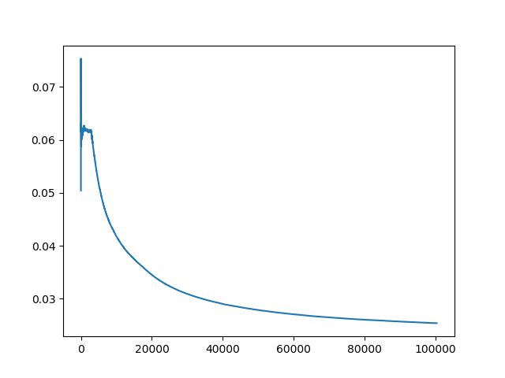
Performance
Trained on 50000 images over 2 epochs

Slide 5
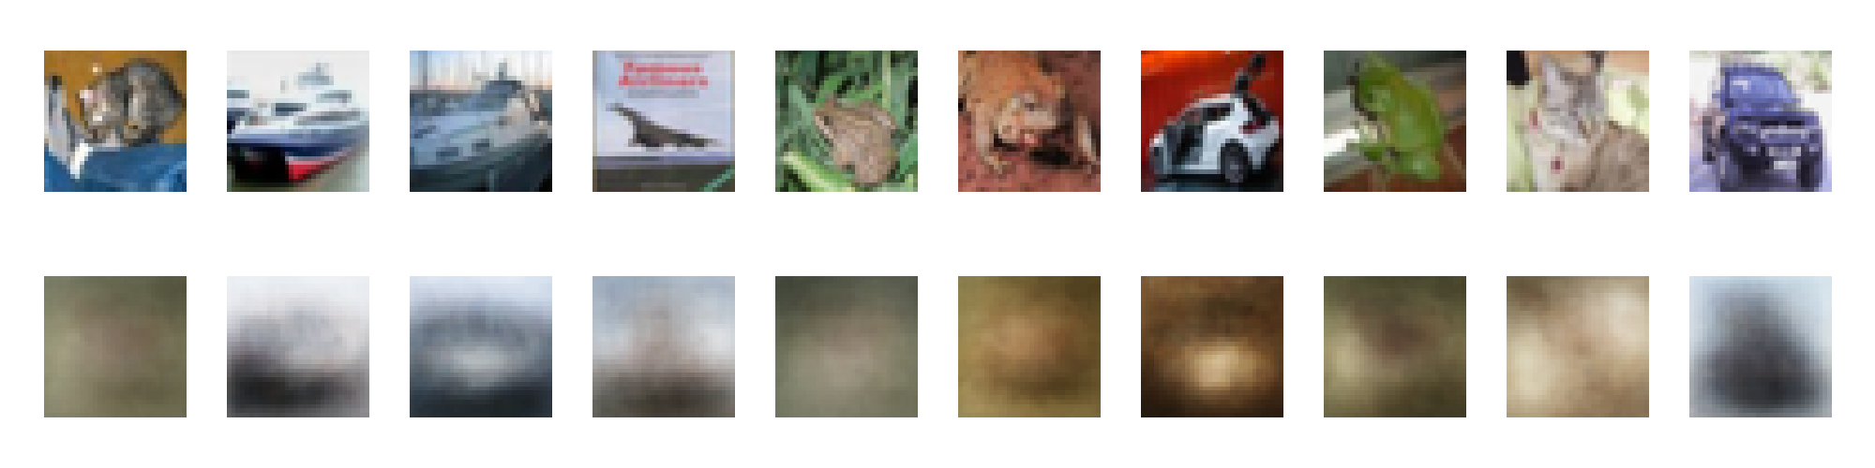

Slide 6
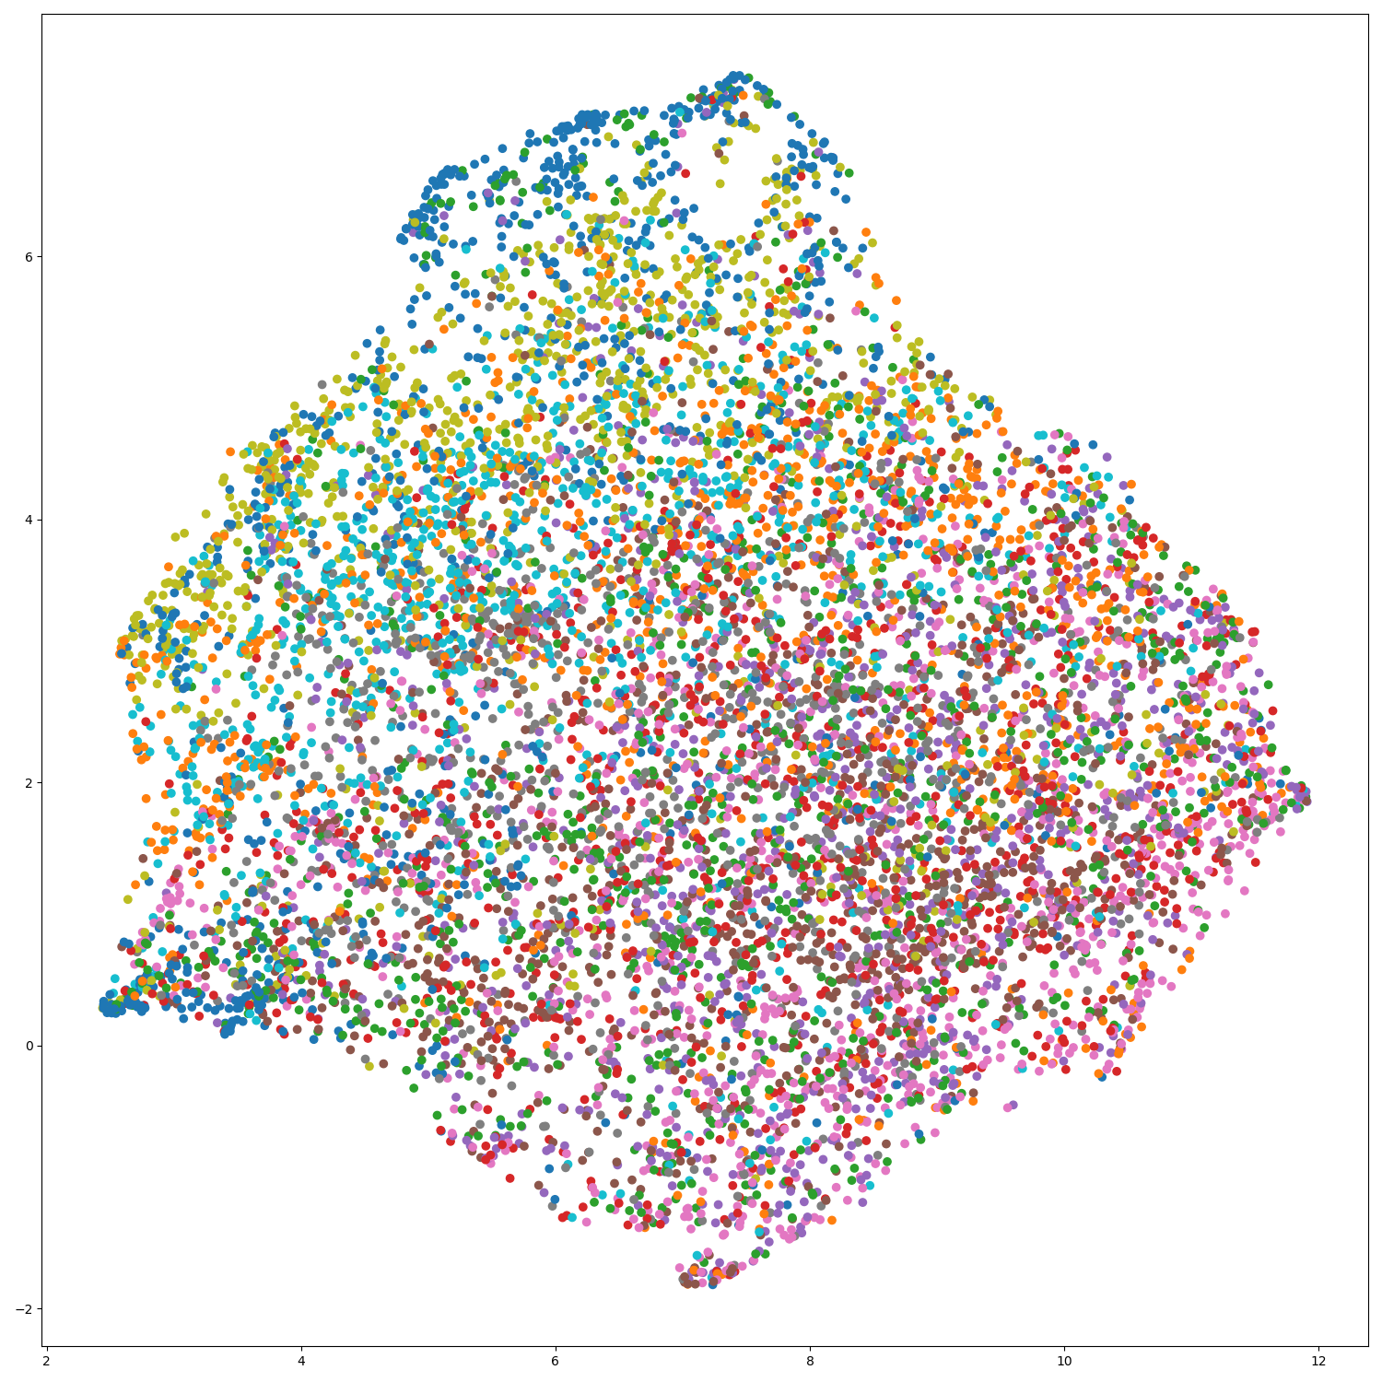
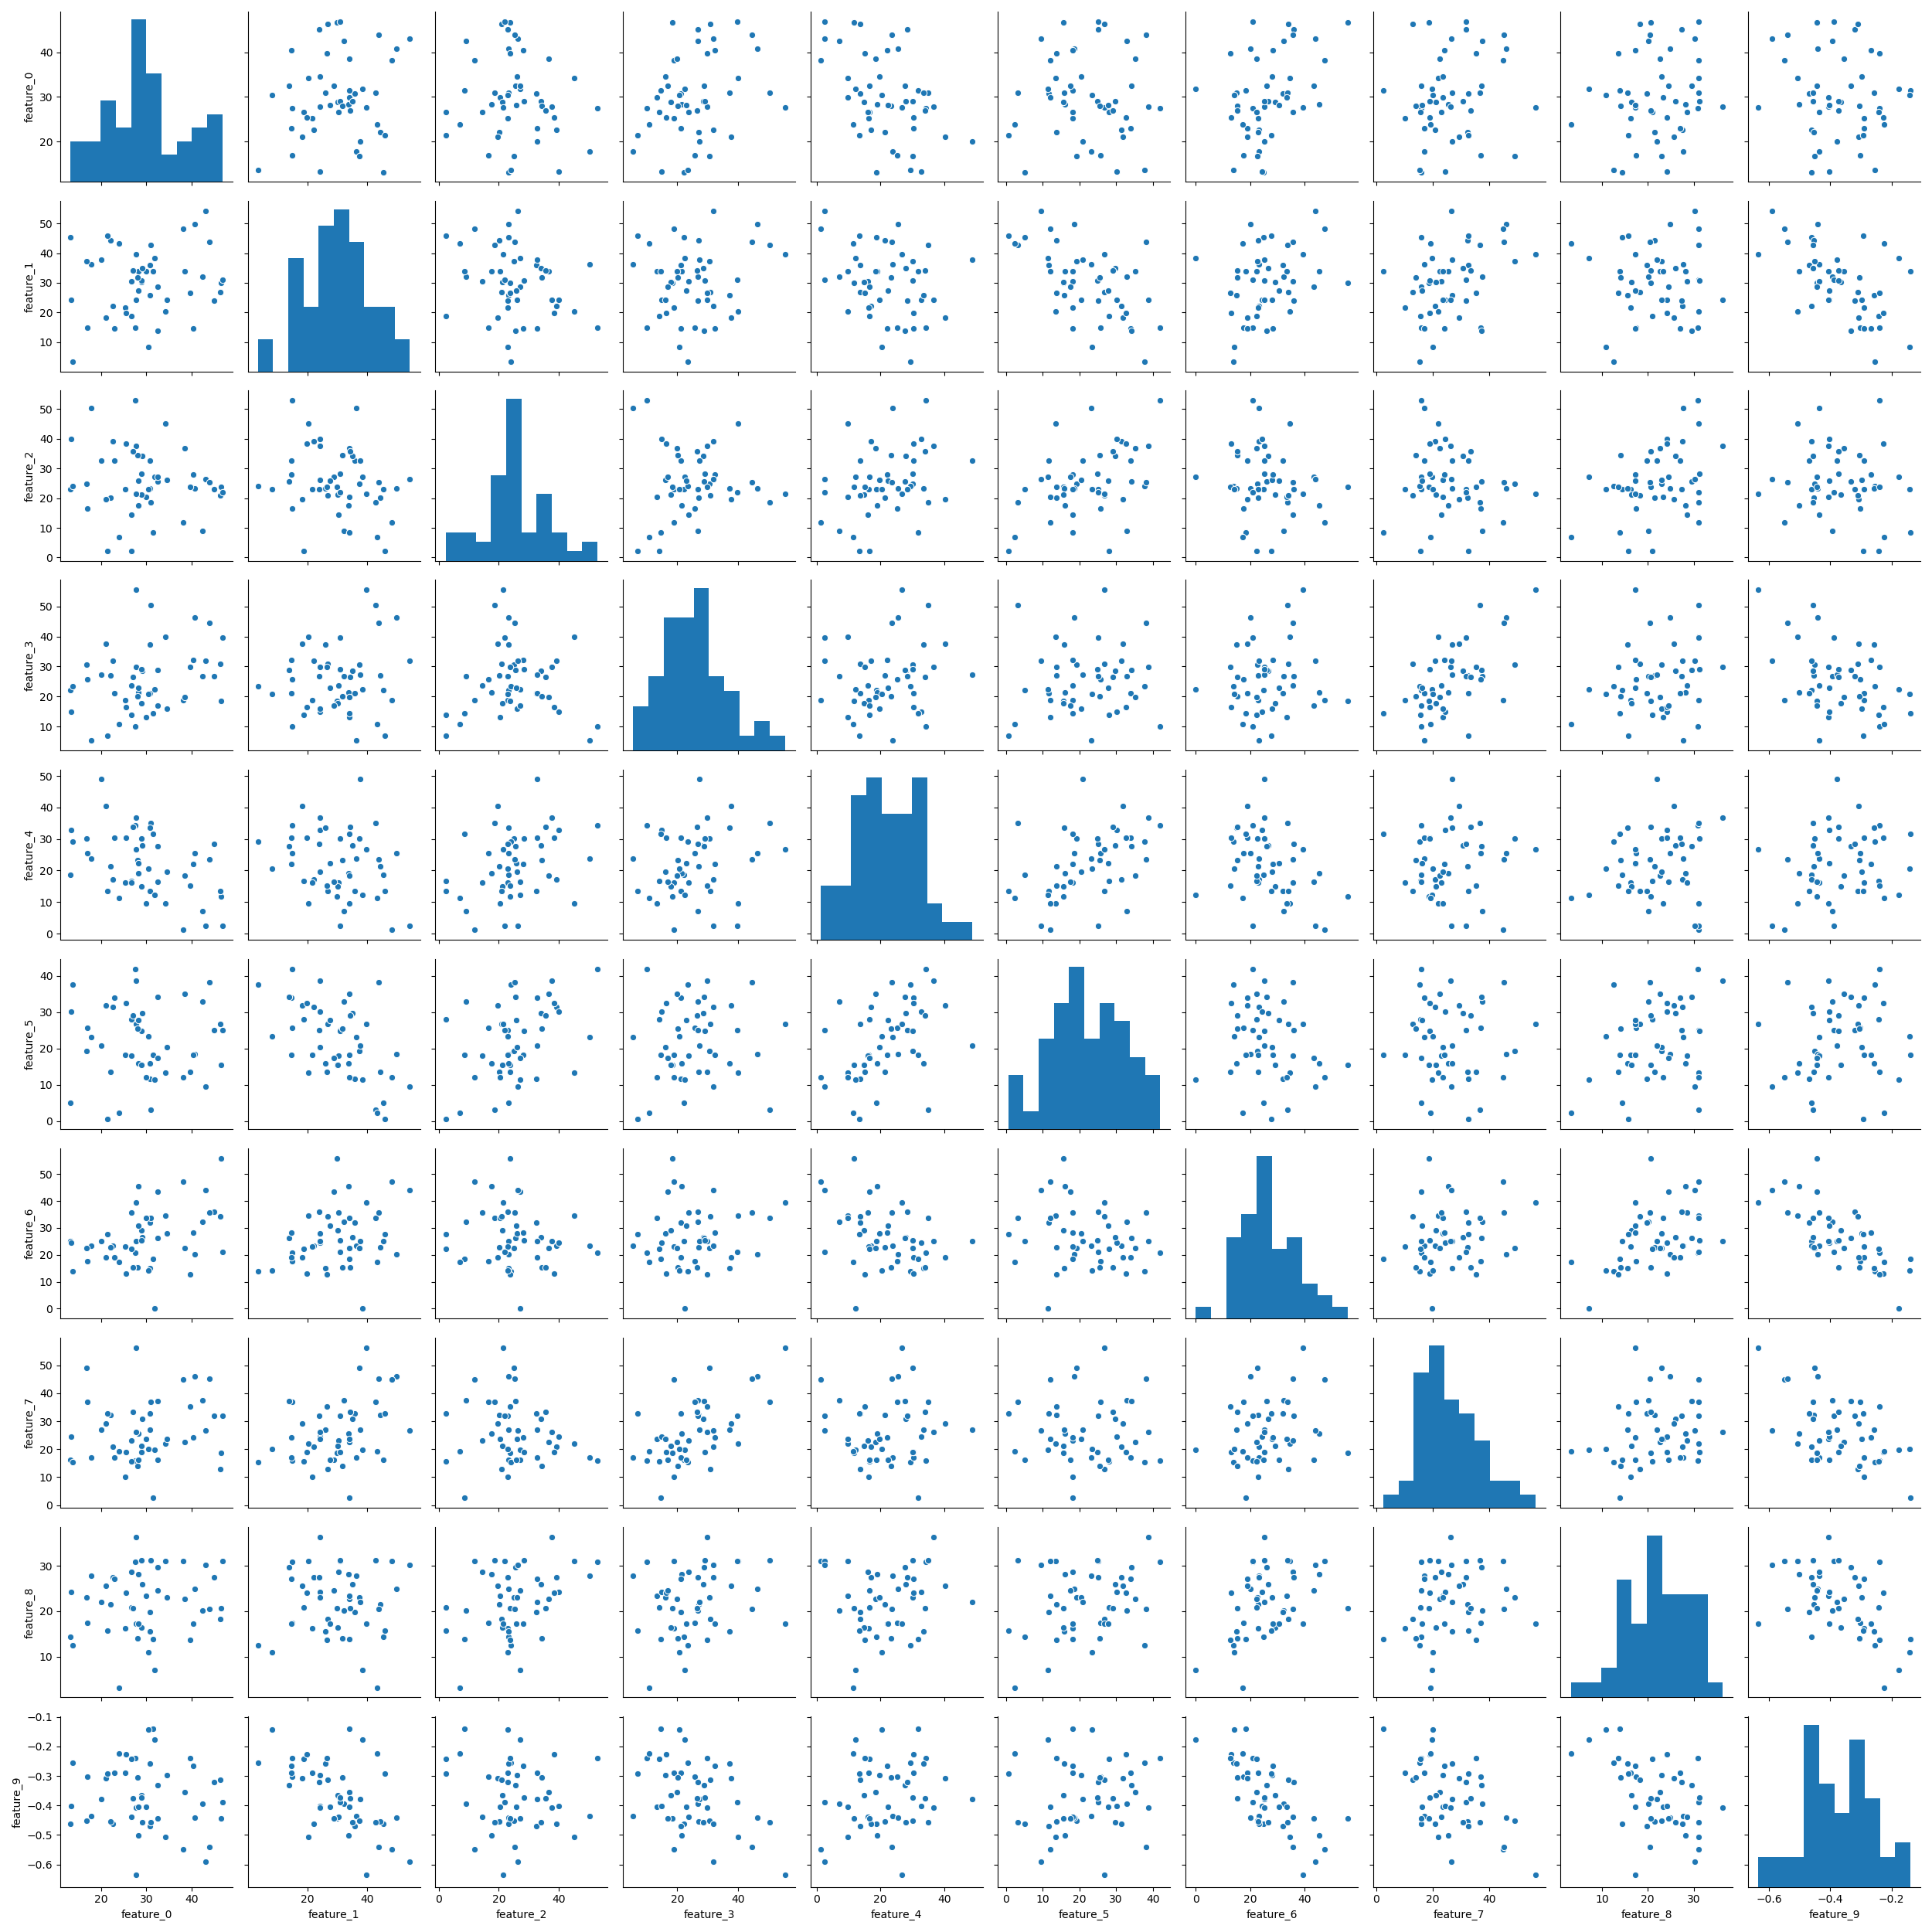
UMAP & SPLOM

