Slide 1


Capstone Project: Malware detection and Response
Funsho Igbasan

Slide 2
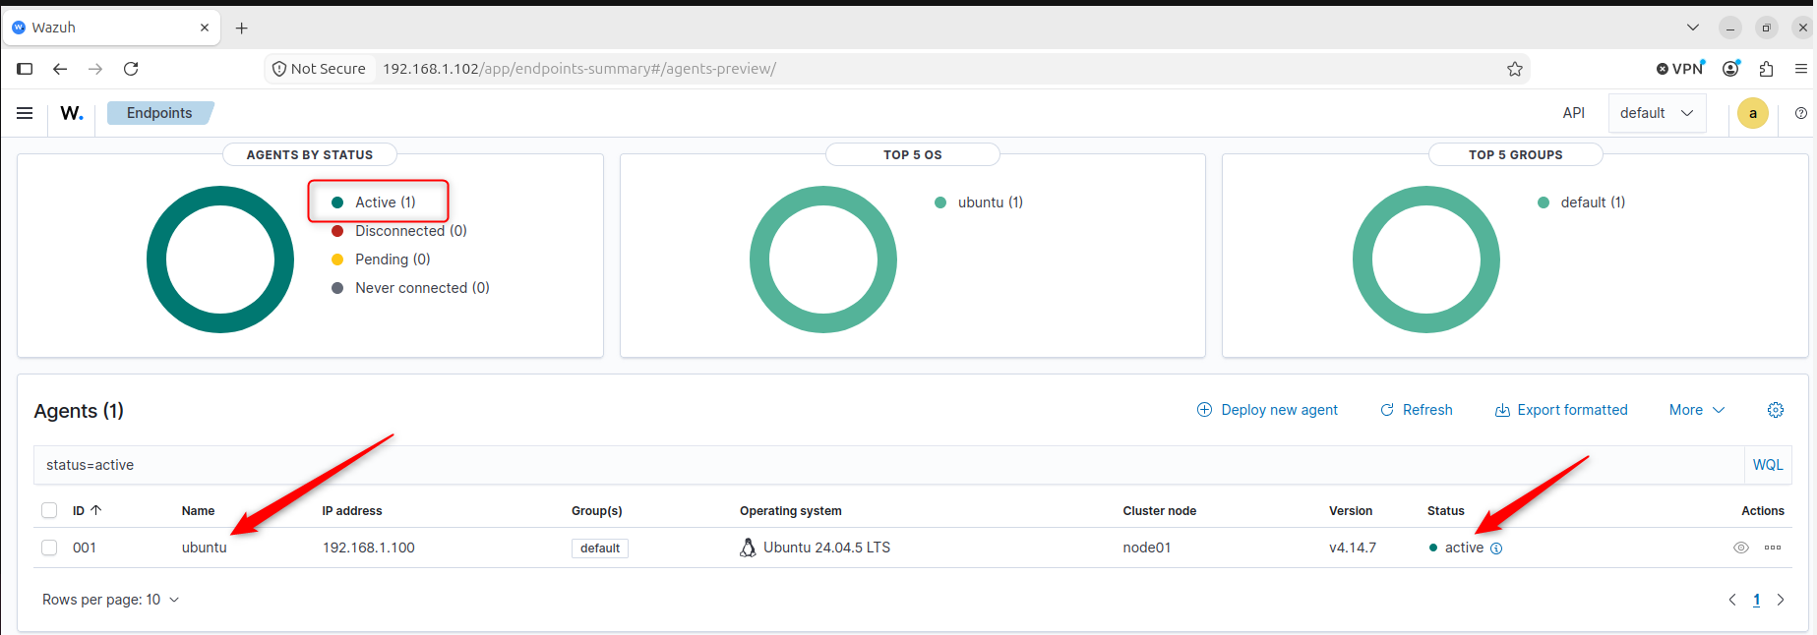
Step1 :
Ubuntu agent endpoint actively connected to Wazuh manager and screenshot confirms its active

Slide 3
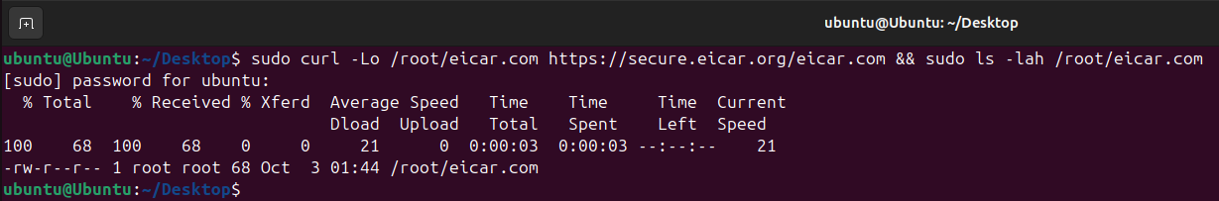
Step 2:
Run command in Ubuntu to create the file (see screenshot below)
The command successfully created the 68-byte EICAR test file.
File information
Filename: eicar.com
File path: /root/eicar.com
Endpoint: Ubuntu
Timestamp: October 3, 2026 @ 01:44:39.268

Slide 4
File hashes
Wazuh's File Integrity Monitoring captured the following hashes when the file was created:
MD5: 44d88612fea8a8f36de82e1278abb02f
SHA-1: 3395856ce81f2b7382dee72602f798b642f14140
SHA-256: 275a021bbfb6489e54d471899f7db9d1663fc695ec2fe2a2c4538aabf651fd0f

Slide 5
Wazuhfile Integrity Monitoring in real time:
Wazuh Rule ID: 100201
Rule Level: 7
Rule Description: File added to /root directory
FIM Event: added
Detection Mode: realtime
The Wazuh event confirmed: File '/root/eicar.com' added

Slide 6
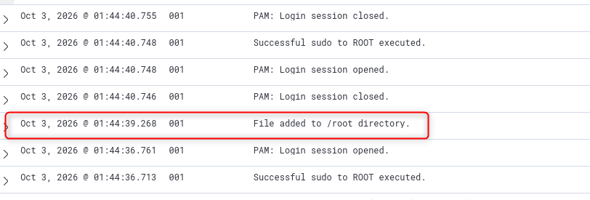
Step 3:
Check Wazuh for the alert

Slide 7
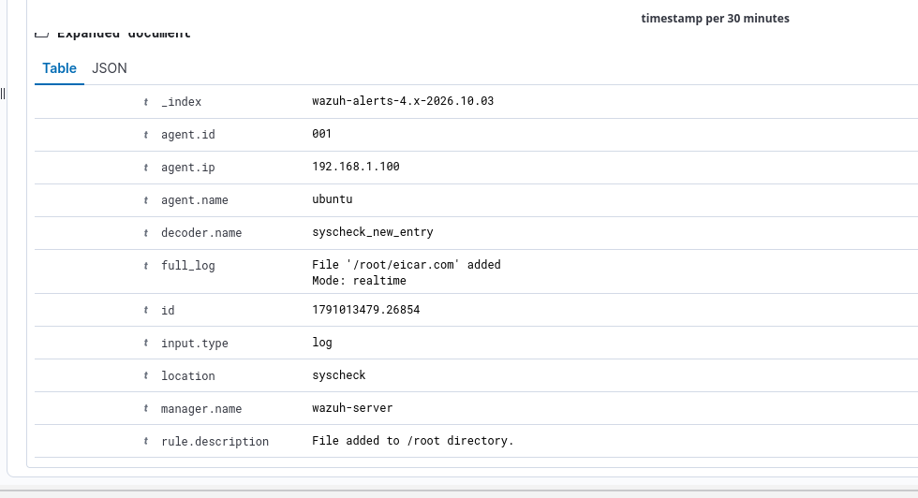
Flie created : Oct 3, 2026 @ 01:44:39.268
File path : /root/eicar.com
Endpoint generated the event: Ubuntu
User: Ubuntu
When it happened : Oct 3, 2026 @ 01:44:39.268
Wazuh rule: rule 100201, level 7
Rule description: file added to /root directory

Slide 8
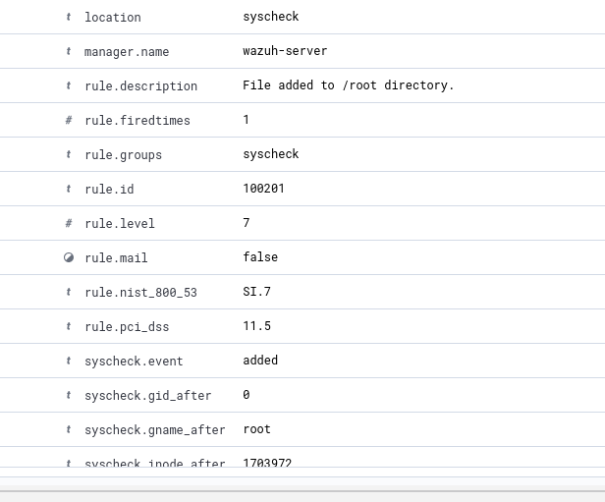
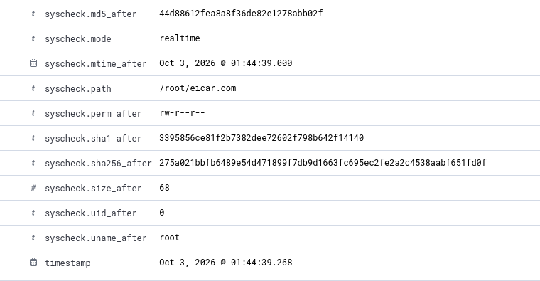
Wazuh alert details

Slide 9
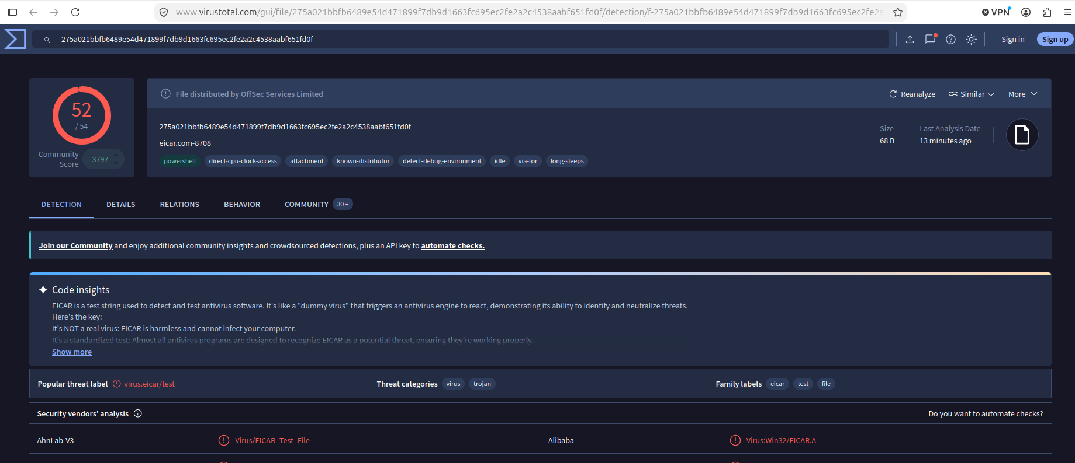
Step 4 :
File hash: 275a021bbfb6489e54d471899f7db9d1663fc695ec2fe2a2c4538aabf651fd0f
Virus Total Detection :52/54 security engines
Number of Security vendor: 26 vendors
Relevant threat classification: virus, trojan
Additional info :
1. Threat label: virus.eicar/test
2. First Seen In The Wild in 2012-06-14 17:16:14 UTC
3. Has pseudo names some of which are : eicar.com-8708 , eicar.com-4402 , eicar.com eicar.com.txt, eicar.com-48361

Slide 10
Step 5: VERDICT
File is MALICIOUS (Though it’s a test file)
Justification: Wazuh detected the creation of /root/eicar.com, and VirusTotal subsequently identified the matching hash with a 52/54 detection ratio. Multiple vendors specifically classified the file as an EICAR test file, supporting the conclusion that the artifact was the standardized EICAR malware-detection test file.

Slide 11
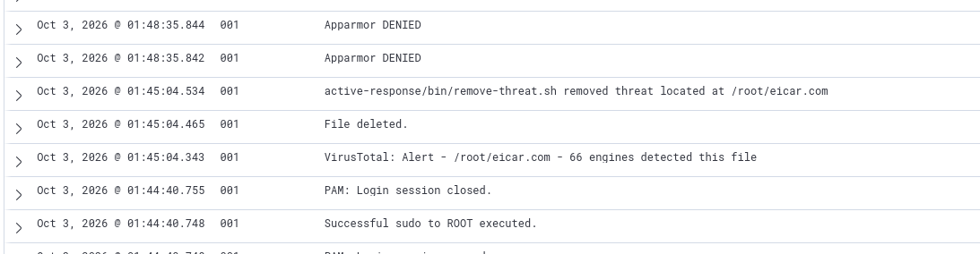
Step 6:
What response action was taken? Wazuh automatically removed the threat as indicated in the attached screenshot
Why was it appropriate? After VirusTotal enrichment identified the EICAR file as malicious, Wazuh's configured Active Response mechanism automatically executed remove-threat.sh to remove the detected file from the Ubuntu endpoint. Though this was a test file, in real scenario, Removal was the appropriate step to take
Was the file successfully removed/quarantined? Yes , and this is also noted in the wazuh log sequence
Did Wazuh record the response? Yes it recorded it as “active-response/bin/remove-threat.sh removed threat located at /root/eicar.com”
Did the suspicious activity stop? Yes Following the removal of /root/eicar.com, the detected maleware was no longer present on the machine, indicating that the immediate suspicious file activity had stopped.

Slide 12

Step 7
The suspicious file is gone.
The Ubuntu endpoint is still connected to Wazuh.
No additional related alerts are being generated.
The remediation event is visible.
Suspicious file is gone as seen in screenshot above and below

Slide 13
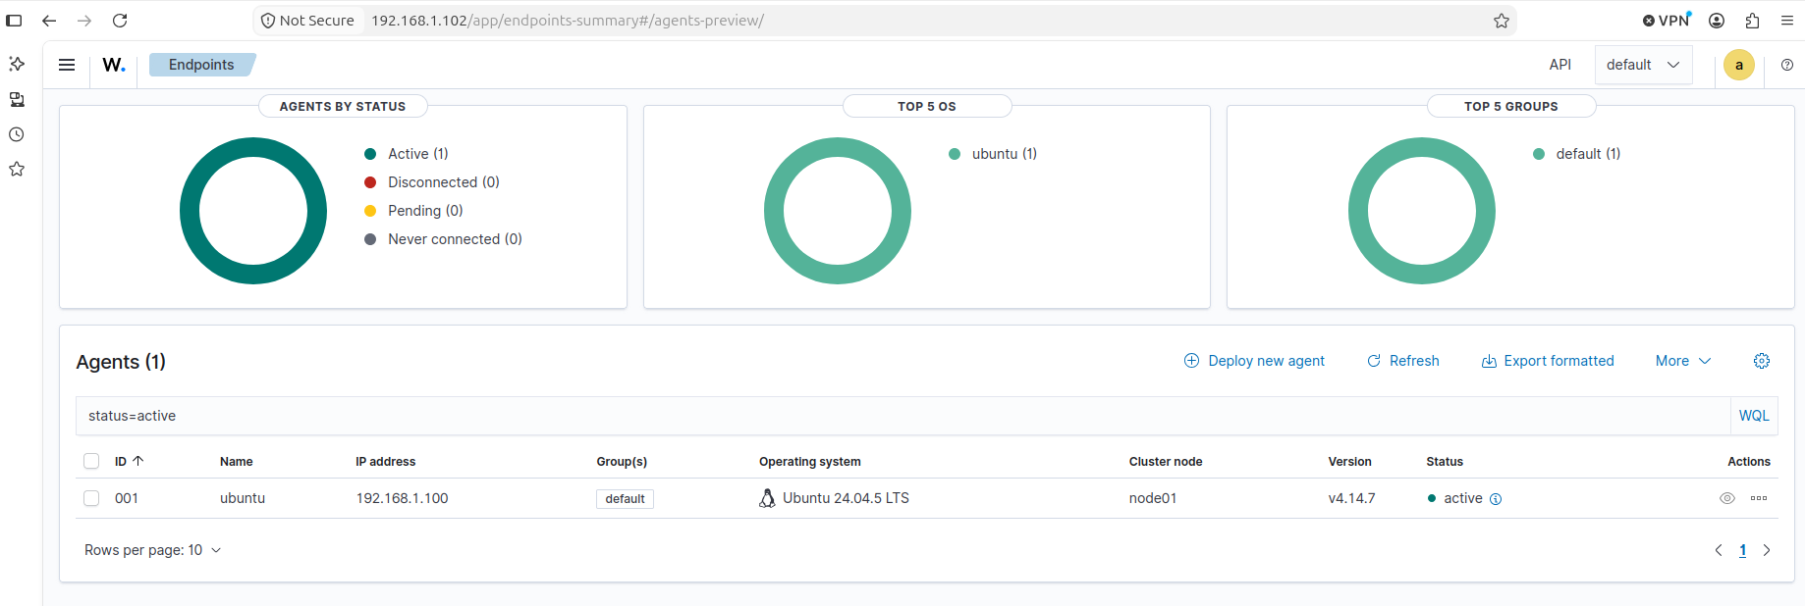
Agent is still connected and active
Agent is still connected and active just as it was at the beginning

Slide 14
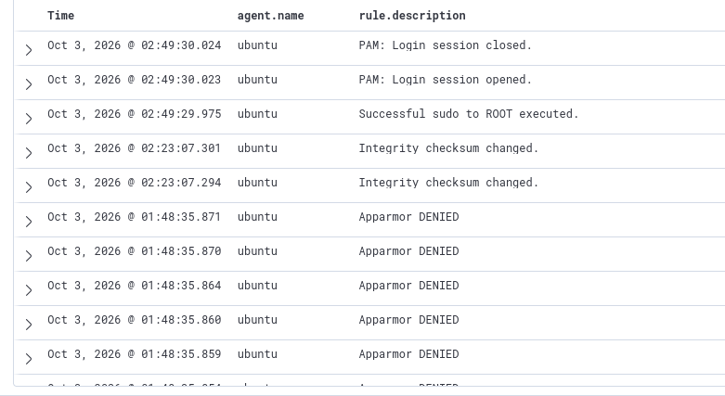
No Additional Related Alerts
No additional related alerts are being generated

Slide 15

4. Response/Remediation Event
The remediation was successfully verified. The /root/eicar.com file was no longer present on the Ubuntu endpoint following execution of Wazuh's Active Response.
The Ubuntu agent remained active and connected to the Wazuh manager after remediation.
Wazuh's event history confirmed the successful execution of remove-threat.sh and deletion of the file, with no subsequent EICAR-related detection observed after the removal event.

Slide 16
Thank you

