Slide 1
Hello! We are the “Исяновы” team! We took part in the DECENTRATHON 2023 hackathon. We chose task number 3. And today we will show what program we made and how it is better than others

Slide 2
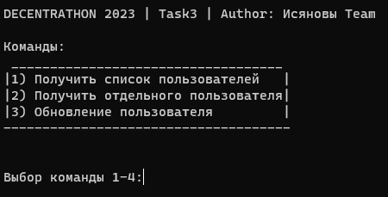
Our program has only 3 functions with which you can interact with Greenfield

Slide 3

The first command gives us information about the account

Slide 4

The second gives us detailed information about an individual user.

Slide 5

And the third one updates all user information

