Slide 1
Huda Beauty
Audience360 Post Campaign Report
27/11/2025

Slide 2

01
Campaign brief summary
02
Post campaign report
Overall campaign performance
Audience breakdown
Creative analysis
03
Learnings & Recommendations
04
Channels
Meta
TikTok

Slide 3
01
Campaign Brief Summary
OUR APPROACH

Slide 4
Campaign Summary
Brand:
Huda Beauty
Campaign:
Huda Beauty
Flight Dates:
27/11/2025
Channels:
Meta and TikTok
Objective
Not specified
Primary KPIs:
Secondary KPIs:
Further measurement:
N/A
Notes:
Updated

Slide 5

Unable to generate commentary: Connection error.
Objective: CTR
Unable to generate commentary: Connection error.
Objective: Sales, Revenue & ROI
Unable to generate commentary: Connection error.
Objective: CPM and Reach
Unable to generate commentary: Connection error.

Slide 6
02
Post Campaign Report
The following analysis is based on exposed audience.

Slide 7








Total Campaign Summary
Delivery Performance
GROSS
SPEND
IMPRESSIONS
UNIQUE REACH
FREQUENCY
CLICKS
CTR
Net CPM
£79,760.89
12,294,399
29,325
0.24%
£4.54
Estimated:
£0.00
Estimated:
0
Estimated:
N/A
Estimated:
3.11
Estimated:
0
Estimated:
0.00%
Estimated:
£0.00
Notes:
check on frequency

Slide 8
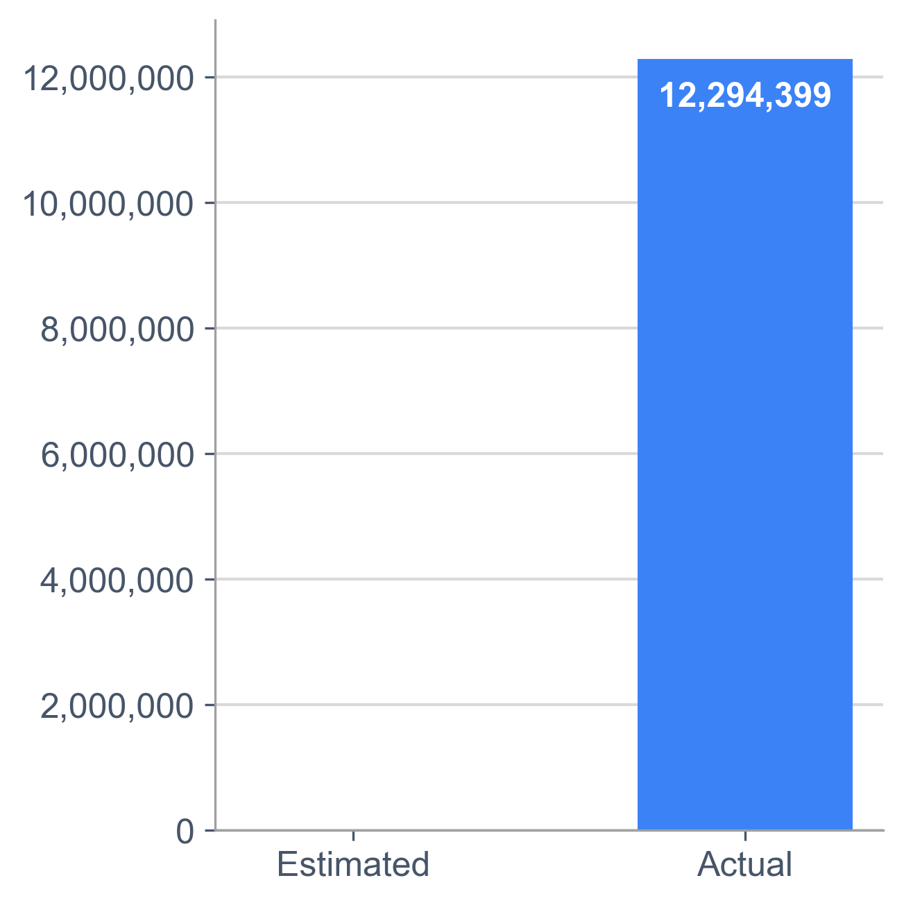
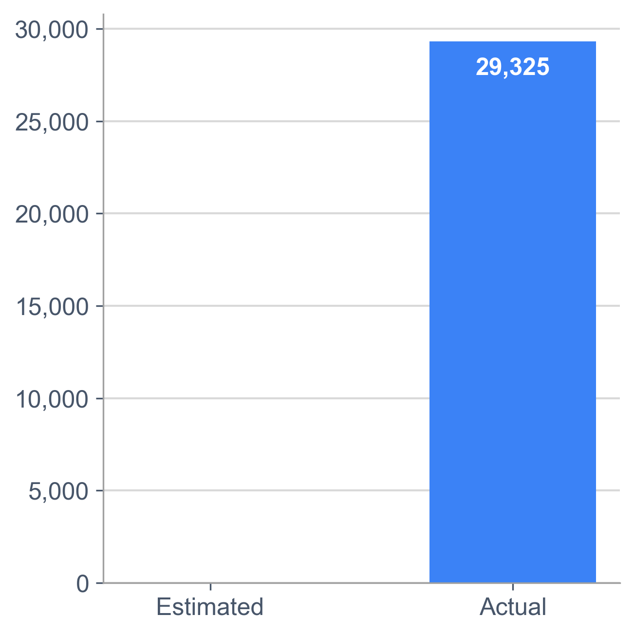



Unable to generate commentary: Connection error.
0.00%
0.00%
IMPRESSIONS
Reach
Clicks
Notes:
OK

Slide 9
Unable to generate commentary: Connection error.
Reach
Impressions
CTR
Net CPM
Link Clicks
Gross Spend
Brand Revenue
Product Revenue*
Overall
3,948,994
12,294,399
0.24%
£4.54
29,325
£79,760.89
£16,680.56
£0.30 ROAS
£0.21 ROI
£15,657.15
£0.28 ROAS
£0.20 ROI
Meta
2,746,242
6,833,434
0.21%
£6.12
14,687
£59,763.00
£16,680.56
£0.40 ROAS
£0.28 ROI
£15,657.15
£0.37 ROAS
£0.26 ROI
TikTok
1,202,752
5,460,965
0.27%
£2.56
14,638
£19,997.89
£0.00
£0.00 ROAS
£0.00 ROI
£0.00
£0.00 ROAS
£0.00 ROI
*Product measurement is only available on Meta.

Slide 10
Unable to generate commentary: Connection error.
Brand Units
693
Brand Revenue
£16,680.56
Brand ROAS
0.30
FSKU Units
545
FSKU Revenue
£15,657.15
FSKU ROAS
0.28
Notes:
Note this only considers Meta data since we cannot attribute TikTok sales

Slide 11
Unable to generate commentary: Connection error.
Online Unit Sales
306
Online Revenue
£7,117.86
Online AOV
£23.26
In Store Unit Sales
387
In Store Revenue
£7,117.86
In Store AOV
£24.71

Slide 12
Post-campaign Report: Meta
The following analysis is based on exposed audience.

Slide 13
Meta Campaign Summary
Delivery Performance
GROSS
SPEND
IMPRESSIONS
UNIQUE REACH
FREQUENCY
CLICKS
CTR
Net CPM
£59,763.00
6,833,434
£2,746,242
2.49
14,687
0.21%
£6.12
Estimated:
£N/A
Estimated:
£N/A
Estimated:
£N/A
Estimated:
£N/A
Estimated:
£N/A
Estimated:
N/A
Estimated:
£N/A

Slide 14
Unable to generate commentary: Connection error.
Strongest sales performance from brand-loyal customers
Unable to generate commentary: Connection error.
Broad category and competitor audiences helped drive awareness
Unable to generate commentary: Connection error.

Slide 15
Unable to generate commentary: Connection error.
IMPRESSIONS:
3,143,859
REACH:
901,472
SPEND:
£18,860.10
FREQ:
3.49
ROAS:
0.48
CPM:
£6.00
LINK CLICKS:
7,582
CTR:
0.24%
​
1.1 HUDA 2 EBSS PAID SOCIAL
​

Slide 16
Unable to generate commentary: Connection error.
IMPRESSIONS:
469,183
REACH:
278,138
SPEND:
£2,883.30
FREQ:
1.69
ROAS:
0.25
CPM:
£6.15
LINK CLICKS:
1,081
CTR:
0.23%
​
Carousel 1
​

Slide 17
Audience Performance breakdown
Audience Segment | Net Spend | Impressions | Reach | Frequency | Clicks | CTR | Net CPM | Brand Revenue | Brand ROI | Brand ROAS
NTB Setting Spray Shoppers L6M | £13,156.50 | 1,663,017 | 370,348 | 4.49 | 3,682 | 0.22% | £7.91 | £1,986.99 | N/A | 0.15
Current Huda Beauty Shoppers L12M | £8,521.80 | 964,830 | 231,276 | 4.17 | 2,935 | 0.30% | £8.83 | £10,619.28 | N/A | 1.25
Lapsed Huda Beauty Shoppers L12M-L24M | £4,739.00 | 533,291 | 116,536 | 4.58 | 1,369 | 0.26% | £8.89 | £1,870.01 | N/A | 0.39
NTB Premium Cosmetics Propensity Model | £3,422.30 | N/A | 483,444 | 1.77 | 1,436 | 0.17% | £4.01 | £160.81 | N/A | 0.05
Foundation Shoppers L24M | £3,182.90 | 674,711 | 461,665 | 1.46 | 1,185 | 0.18% | £4.72 | £177.66 | N/A | 0.06
NTB NPD Beauty Shoppers | £2,965.90 | 911,395 | 569,362 | 1.60 | 1,463 | 0.16% | £3.25 | £586.66 | N/A | 0.20
Video retargeting | £2,545.20 | 408,710 | 92,864 | 4.40 | 989 | 0.24% | £6.23 | £269.75 | N/A | 0.11
NTB Huda Beauty (Setting Spray) bespoke Competitor List L3M-L24M | £1,999.90 | 586,798 | 344,541 | 1.70 | 656 | 0.11% | £3.41 | £471.26 | N/A | 0.24
NTB Huda Beauty (Setting Spray) Competitor List L3M-L24M | £1,300.60 | 236,187 | 76,206 | 3.10 | 972 | 0.41% | £5.51 | £538.14 | N/A | 0.41

Slide 18
How many Brand sales did our Meta campaign drive?
Metrics | Total Issey Miyake
Gross Spend | £59,763.00
Brand revenue | £16,680.56
Brand ROAS | 0.40
Brand ROI | 0.28
Brand online revenue | £7,117.86
Brand instore revenue | £9,562.70
Brand online % of sales | 42.67
Brand instore % of sales | 57.33
Notes:
updated

Slide 19
How many Featured product sales did our Meta campaign drive?
Metrics | Total Issey Miyake FSKUs
Gross Spend | £59,763.00
FSKU revenue | £15,657.15
FSKU ROAS | 0.37
FSKU ROI | 0.26
FSKU online revenue | £0.00
FSKU instore revenue | £0.00
FSKU online % of sales | N/A
FSKU instore % of sales | {FSKU_instore_perc_sales_meta }
Notes:
updated

Slide 20
Post-campaign Report: TikTok
The following analysis is based on exposed audience.

Slide 21
TikTok Campaign Summary
Delivery Performance
GROSS
SPEND
IMPRESSIONS
UNIQUE REACH
FREQUENCY
CLICKS
CTR
Net CPM
£19,997.89
5,460,965
£1,202,752
4.54
14,638
0.27%
£2.56
Estimated:
£N/A
Estimated:
£N/A
Estimated:
£N/A
Estimated:
£N/A
Estimated:
£N/A
Estimated:
N/A
Estimated:
£N/A

Slide 22
Unable to generate commentary: Connection error.
Strongest sales performance from brand-loyal customers
Unable to generate commentary: Connection error.
Broad category and competitor audiences helped drive awareness
Unable to generate commentary: Connection error.

Slide 23
Unable to generate commentary: Connection error.
IMPRESSIONS:
399,497
REACH:
233,184
SPEND:
£920.70
FREQ:
1.71
ROAS:
0.00
CPM:
£2.30
LINK CLICKS:
1,020
CTR:
0.26%
​
UPDATED BOOTS 9.16 HUDA 2 EBSS PAID SOCIAL
​

Slide 24
Unable to generate commentary: Connection error.
IMPRESSIONS:
6,305
REACH:
3,502
SPEND:
£23.90
FREQ:
1.80
ROAS:
0.00
CPM:
£3.79
LINK CLICKS:
15
CTR:
0.24%
​
UPDATED BOOTS 9.16 HUDA 2 EBSS PAID SOCIAL
​

Slide 25
Audience Performance breakdown
Audience Segment | Net Spend | Impressions | Reach | Frequency | Clicks | CTR | Net CPM | Brand Revenue | Brand ROI | Brand ROAS
LAL Lapsed Huda Beauty Shoppers L12-24M | £7,193.18 | 2,908,084 | 876,072 | 3.32 | 7,980 | 0.27% | £2.47 | £0.00 | N/A | 0.00
NTBLAL Setting Spray Shoppers L6M | £3,853.09 | 1,383,275 | 543,100 | 2.55 | 3,514 | 0.25% | £2.79 | £0.00 | N/A | 0.00
LAL Current Huda Beauty Shoppers L12M | £1,904.74 | 856,275 | 337,558 | 2.54 | 2,327 | 0.27% | £2.22 | £0.00 | N/A | 0.00
NTB LAL NPD Beauty Shoppers | £553.16 | 168,119 | 112,055 | 1.50 | 453 | 0.27% | £3.29 | £0.00 | N/A | 0.00
NTB LAL Huda Beauty Setting Spray Competitor Shoppers L3M-L24M | £160.28 | 45,714 | 33,722 | 1.36 | 92 | 0.20% | £3.51 | £0.00 | N/A | 0.00
NTB NPD Beauty Shoppers | £105.16 | 29,564 | 11,965 | 2.47 | 81 | 0.27% | £3.56 | £0.00 | N/A | 0.00
NTBLAL Premium Cosmetics Propensity Model | £60.63 | 21,314 | 17,075 | 1.25 | 41 | 0.19% | £2.84 | £0.00 | N/A | 0.00
NTB Premium Cosmetics Propensity Model | £58.57 | 16,143 | 6,798 | 2.37 | 58 | 0.36% | £3.63 | £0.00 | N/A | 0.00
NTB Huda Beauty Setting Spray Competitor Shoppers L3M-L24M | £41.02 | 12,084 | 5,725 | 2.11 | 42 | 0.35% | £3.39 | £0.00 | N/A | 0.00
Current Huda Beauty Shoppers L12M | £38.99 | 11,459 | 4,029 | 2.84 | 28 | 0.24% | £3.40 | £0.00 | N/A | 0.00
NTB Setting Spray Shoppers L6M | £17.34 | 5,020 | 2,272 | 2.21 | 14 | 0.28% | £3.45 | £0.00 | N/A | 0.00
Lapsed Huda Beauty Shoppers L12-24M | £12.36 | 3,914 | 1,324 | 2.96 | 8 | 0.20% | £3.16 | £0.00 | N/A | 0.00

Slide 26
How many Brand sales did our TikTok campaign drive?
Metrics | Total Issey Miyake
Gross Spend | £19,997.89
Brand revenue | £0.00
Brand ROAS | 0.00
Brand ROI | 0.00
Brand online revenue | £0.00
Brand instore revenue | £0.00
Brand online % of sales | 0.00
Brand instore % of sales | 0.00
Notes:
updated

Slide 27
How many Featured product sales did our Tiktok campaign drive?
Metrics | Total Issey Miyake FSKUs
Gross Spend | £19,997.89
FSKU revenue | £0.00
FSKU ROAS | 0.00
FSKU ROI | 0.00
FSKU online revenue | £0.00
FSKU instore revenue | £0.00
FSKU online % of sales | N/A
FSKU instore % of sales | {tik_instore_perc_sales_meta }
Notes:
updated

Slide 28
The following analysis is based on exposed audience.

Slide 29
Learnings & recommendations for future activations
03

Slide 30
A recap on our objectives…
Not specified
Did we meet this objective?
Yes
Delivering 12m impressions across A360 campaign, and reaching 2m unique prime prospective Boots shoppers, we have successfully spread the news of the Huda Beauty Easy Bake Setting Spray to a wide audience of interested Boots shoppers.
Unable to generate commentary: Connection error.
Not specified
Did we meet this objective?
Work in progress We saw limited returns attributable to the A360 campaign, however strong engagement and consideration metrics, highlighting the campaign effectively drove brand interest and warmed leads for conversion.
Unable to generate commentary: Connection error.

Slide 31
Learnings & considerations to take forward into future campaign planning | Targeting, Phasing & Creative
Learning: Issey Miyake shoppers prefers to shop online across Boots.
Recommendation:
Consider this online purchase behaviour while planning for future campaign.
Continue to overlay of online active membership segment towards audiences.
Learning: ROI is yet to be positive this time. We need to build awareness among Boots prospective shoppers, and to build foundation for future sales campaigns.
Recommendation:
Consider following a phased approach with a longer overall campaign period. Phase 1 to drive awareness and warm leads and Phase 2 to drive sales. We have seen increase in sales performance on acquisitional audiences between Phase 1 & 2 in previous A360 campaigns.
Learning: There was only one set of creatives being included in this campaign. We couldn’t further optimise the campaign at creative level.
Also, Black Friday influenced our audience behaviour, who showed interest in browsing products, but not yet converting, proven by strong CTR.
Recommendation:
Include a variety of formats in future campaigns, including video and statics for link ads, carousels and collection ads.
Consider to incorporate event-specific messaging, such as Black Friday and other special occasions, into future campaigns to enhance relevance and engagement

Slide 32
Thank you.

