Slide 1
{Brand Name}
Audience360 Post Campaign Report
{Date_}

Slide 2
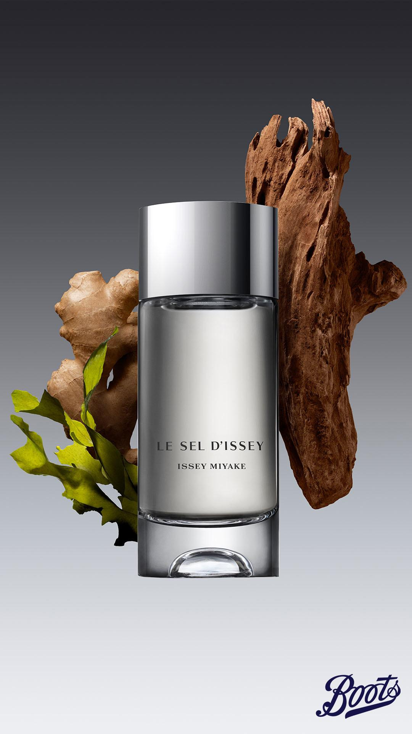
01
Campaign brief summary
02
Post campaign report
Overall campaign performance
Audience breakdown
Creative analysis
03
Learnings & Recommendations
04
Appendix
Meta performance
Pinterest performance

Slide 3
01
Campaign Brief Summary
OUR APPROACH

Slide 4
Campaign Summary
Brand:
{Brand Name}
Campaign:
{Campaign Name}
Flight Dates:
{Flight_dates}
Channels:
{Channels}
Objective
To drive consideration and conversion of Issey Miyake Le Sel NPD.
Primary KPIs:
Click Through Rate (CTR)
Cost Per Mille (CPM)
Secondary KPIs:
Return on Ad Spend (ROAS)
Return on Investment (ROI)
Sales volume
Further measurement:
New-to-brand & new-to-category measurement
Notes:
Updated

Slide 5

{overall campaign performance}
Objective: CTR
{overall engagement performance}
Objective: Sales, Revenue & ROI
{overall sales, revenue and ROI performance}
Objective: CPM and Reach
{overall reach performance}

Slide 6
02
Post Campaign Report
The following analysis is based on exposed audience.

Slide 7
Overall Campaign Performance
The following analysis is based on exposed audience.

Slide 8
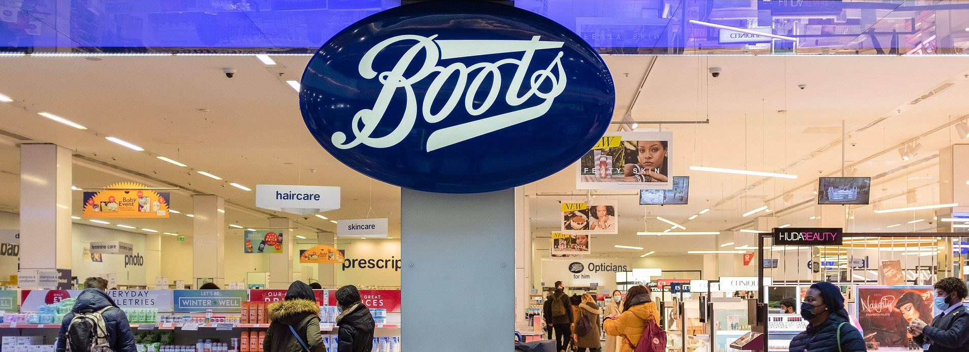







Total Campaign Summary
Delivery Performance
GROSS
SPEND
IMPRESSIONS
UNIQUE REACH
FREQUENCY
CLICKS
CTR
Net CPM
£{Gross_Spend}
{Impressions}
{N/A}
{N/A}
{Clicks}
{CTR}%
£{Net_CPM}
Estimated:
£{gross_est}
Estimated:
{imp_est}
Estimated:
{reach_est}
Estimated:
{freq_est}
Estimated:
{click_est}
Estimated:
{ctr_est}%
Estimated:
£{net_cpm_est}
Notes:
check on frequency

Slide 9
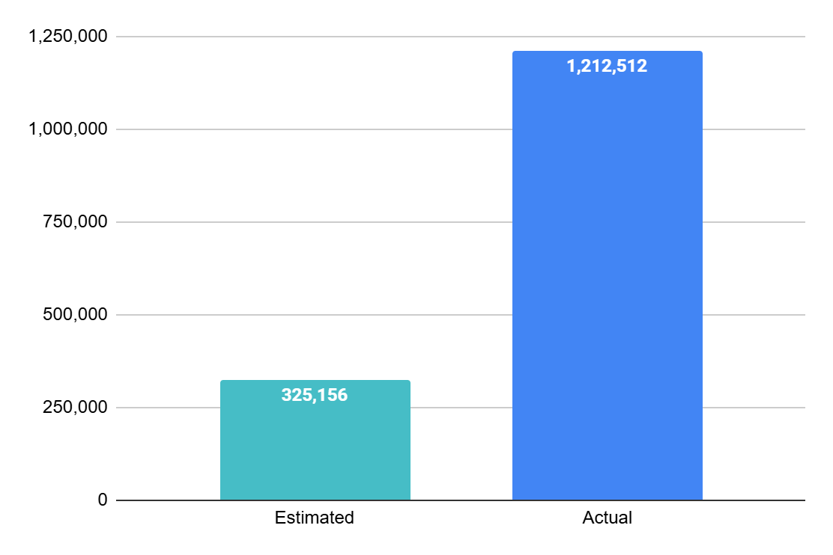
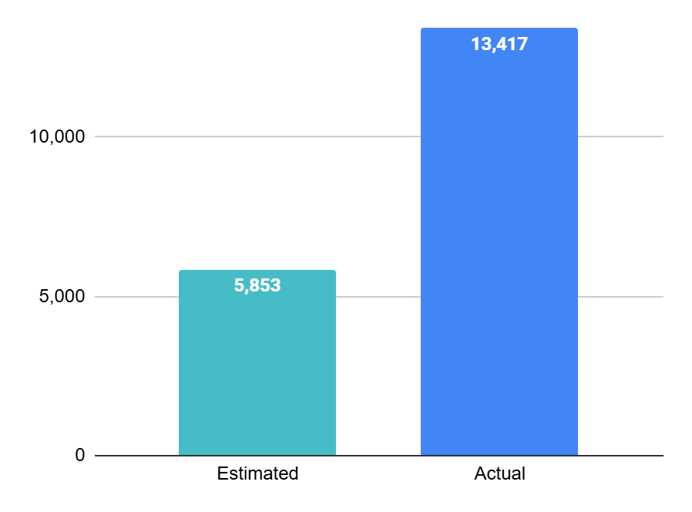
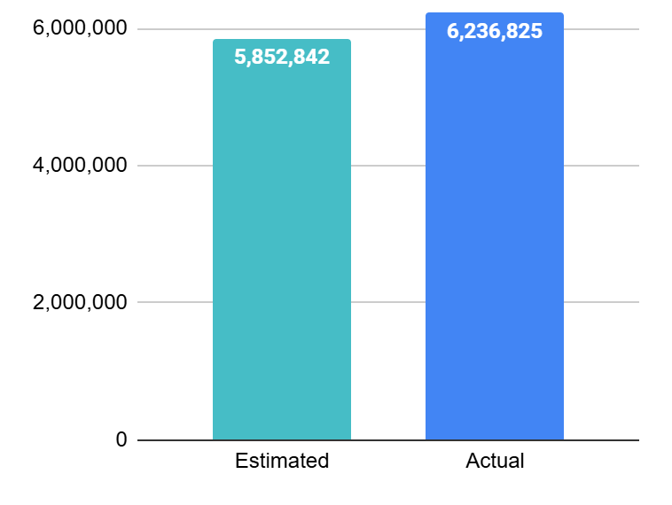
{unique and estimated values}
{perc_imp}%
N/A
{perc_clicks}%
IMPRESSIONS
Reach
Clicks
Notes:
OK

Slide 10
{channel_commentary}
Reach
Impressions
CTR
Net CPM
Link Clicks
Gross Spend
Brand Revenue
Product Revenue*
Overall
{Reach}
{Impressions}
{CTR}%
£{Net_CPM}
{Clicks}
£{Gross_Spend}
£{Brand Revenue}
£{Brand ROAS} ROAS
£{Brand ROI} ROI
£{FSKU Revenue}
£{FSKU ROAS} ROAS
£{FSKU ROI} ROI
Reach
Impressions
CTR
Net CPM
Link Clicks
Gross Spend
Brand Revenue
Product Revenue*
Meta
{Meta_Reach}
{Meta_Impressions}
{meta_ctr}%
£{Meta_Net_CPM}
{Meta_clicks}
£{Meta_Gross_Spend}
£{Meta_Revenue}
£{Meta_Brand_ROAS} ROAS
£{Meta_Brand_ROI} ROI
£{Meta_FSKU_Revenue}
£{Meta_FSKU_ROAS} ROAS
£{Meta_FSKU_ROI} ROI
Reach
Impressions
CTR
Net CPM
Link Clicks
Gross Spend
Brand Revenue
Product Revenue
Pinterest
{Pin_Reach}
{Pin_Impressions}
{Pin_CTR}%
£{Pin_Net_CPM}
{Pin_Clicks}
£{pin_gross_spend}
£{pin_brand_revenue}
£{pin_brand_ROS} ROAS
£{pin_brand_ROI} ROI
£{Pin_FSKU Revenue}
£{Pin_FSKU ROAS}
£{Pin_FSKU ROI}
*Product measurement is only available on Meta.

Slide 11
{online and instore comparison}
Metrics | Total Issey Miyake
Gross Spend | £{Gross_Spend}
Brand revenue | £{Brand Revenue}
Brand ROAS | £{Brand ROAS}
Brand ROI | £{Brand ROI}
Brand online revenue | £{Online_rev}
Brand instore revenue | £{Instore_rev}
Brand online % of sales | {perc_online_sales}%
Brand instore % of sales | {perc_instore_sales}%
Benchmark in premium fragrance category:
Online: 47%
Instore: 53%
Notes:
updated

Slide 12
Audience Breakdown
The following analysis is based on exposed audience.

Slide 13
Audience Performance breakdown
Audience Segment | Net Spend | Impressions | Reach | Frequency | Clicks | CTR | Net CPM | Brand Revenue | Brand ROAS
{aud_1} | £{Net_spend_1} | {Imp_1} | {Reach_1} | {Freq_1} | {Clicks_1} | {CTR_1} | £{NetCPM_1} | £{Revenue_1} | £{ROAS_1}
{aud_2} | £{Net_spend_2} | {Imp_2} | {Reach_2} | {Freq_2} | {Clicks_2} | {CTR_2} | £{NetCPM_2} | £{Revenue_2} | £{ROAS_2}
{aud_3} | £{Net_spend_3} | {Imp_3} | {Reach_3} | {Freq_3} | {Clicks_3} | {CTR_3} | £{NetCPM_3} | £{Revenue_3} | £{ROAS_3}
{aud_4} | £{Net_spend_4} | {Imp_4} | {Reach_4} | {Freq_4} | {Clicks_4} | {CTR_4} | £{NetCPM_4} | £{Revenue_4} | £{ROAS_4}
{aud_5} | £{Net_spend_5} | {Imp_5} | {Reach_5} | {Freq_5} | {Clicks_5} | {CTR_5} | £{NetCPM_5} | £{Revenue_5} | £{ROAS_5}
{aud_6} | £{Net_spend_6} | {Imp_6} | {Reach_6} | {Freq_6} | {Clicks_6} | {CTR_6} | £{NetCPM_6} | £{Revenue_6} | £{ROAS_6}
{aud_7} | £{Net_spend_7} | {Imp_7} | {Reach_7} | {Freq_7} | {Clicks_7} | {CTR_7} | £{NetCPM_7} | £{Revenue_7} | £{ROAS_7}
{aud_8} | £{Net_spend_8} | {Imp_8} | {Reach_8} | {Freq_8} | {Clicks_8} | {CTR_8} | £{NetCPM_8} | £{Revenue_8} | £{ROAS_8}
{aud_9} | £{Net_spend_9} | {Imp_9} | {Reach_9} | {Freq_9} | {Clicks_9} | {CTR_9} | £{NetCPM_9} | £{Revenue_9} | £{ROAS_9}
{aud_10} | £{Net_spend_10} | {Imp_10} | {Reach_10} | {Freq_10} | {Clicks_10} | {CTR_10} | £{NetCPM_10} | £{Revenue_10} | £{ROAS_10}
{aud_11} | £{Net_spend_11} | {Imp_11} | {Reach_11} | {Freq_11} | {Clicks_11} | {CTR_11} | £{NetCPM_11} | £{Revenue_11} | £{ROAS_11}
{aud_12} | £{Net_spend_12} | {Imp_12} | {Reach_12} | {Freq_12} | {Clicks_12} | {CTR_12} | £{NetCPM_12} | £{Revenue_12} | £{ROAS_12}

Slide 14
36%
of Issey Miyake shoppers were new to brand
The campaign succeeded in driving both New-To-Brand (NTB) and New-To-Category (NTC) shoppers across our targeted audiences
7%
of Issey Miyake shoppers were new to category

Slide 15
{overall audience performance}
Current & Lapsed Brand Shoppers
{current brand shoppers' performance​}
Acquisitional Shoppers
{acquisitional shoppers' performance​}
​
Online purchase behavior
{online purchase behaviour​}

Slide 16
Creative Analysis
The following analysis is based on exposed audience.

Slide 17

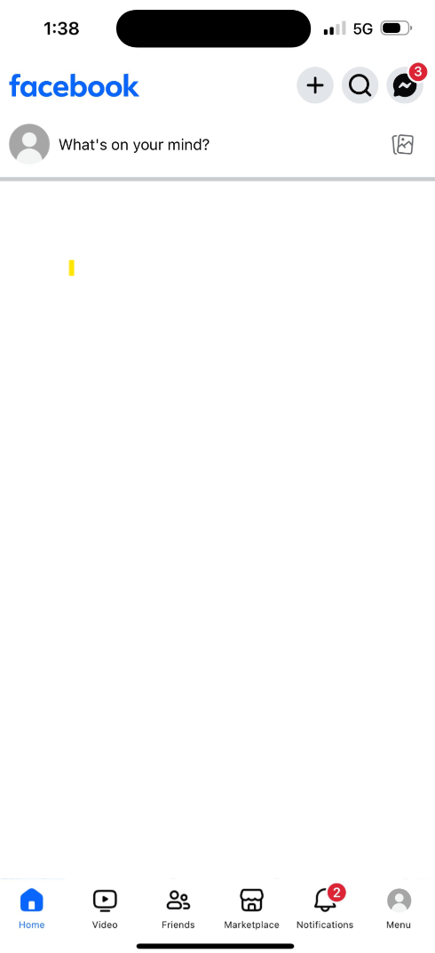
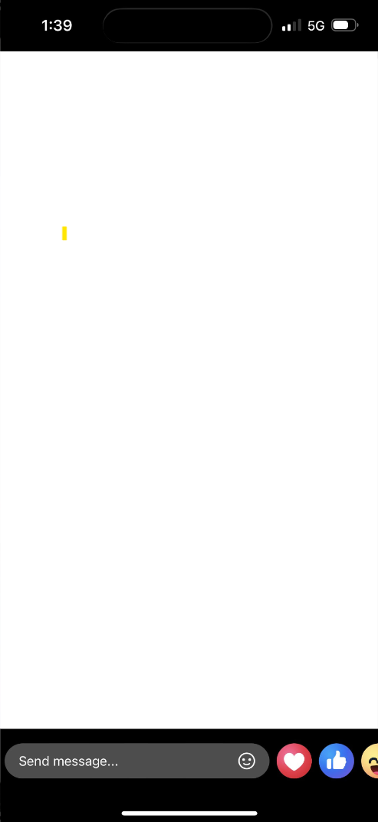
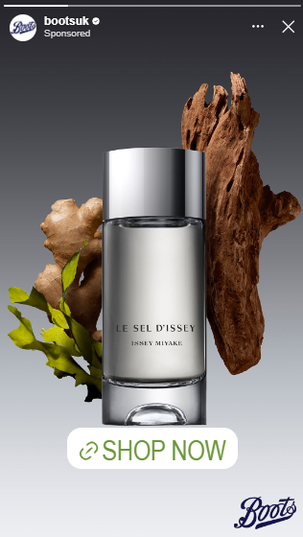
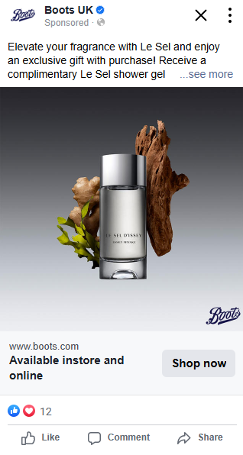
Creatives Analysis
There was only one set of creatives being included in this campaign. Therefore, there is limited creative learnings from this campaign.
Recommendation for future campaigns:
Include a variety of formats in future campaigns, including video and statics for link ads, carousels and collection ads.
For future NPD campaigns, we recommend supplying assets that highlight product benefits and USPs.
Consider to incorporate event-specific messaging, such as Black Friday and other special occasions, into future campaigns to enhance relevance and engagement
In-feed ad
1:1
Story ad
9:16

Slide 18
Learnings & recommendations for future activations

Slide 19
Learnings & considerations to take forward into future campaign planning | Targeting, Phasing & Creative
Learning: Pinterest drove a stronger ROI performance, whilst Meta saw a stronger CTR and more cost-efficient CPM. This performance is a consistent trend across A360 premium fragrance campaigns.
Recommendation:
Given the channels’ different strengths for premium fragrance campaigns, continue activating a multi-channel approach for future campaigns with a similar campaign objective.
Learning: Issey Miyake shoppers prefers to shop online across Boots.
Recommendation:
Consider this online purchase behaviour while planning for future campaign.
Continue to overlay of online active membership segment towards audiences.
Learning: ROI is yet to be positive this time. We need to build awareness among Boots prospective shoppers, and to build foundation for future sales campaigns.
Recommendation:
Consider following a phased approach with a longer overall campaign period. Phase 1 to drive awareness and warm leads and Phase 2 to drive sales. We have seen increase in sales performance on acquisitional audiences between Phase 1 & 2 in previous A360 campaigns.
Learning: There was only one set of creatives being included in this campaign. We couldn’t further optimise the campaign at creative level.
Also, Black Friday influenced our audience behaviour, who showed interest in browsing products, but not yet converting, proven by strong CTR.
Recommendation:
Include a variety of formats in future campaigns, including video and statics for link ads, carousels and collection ads.
Consider to incorporate event-specific messaging, such as Black Friday and other special occasions, into future campaigns to enhance relevance and engagement

Slide 20
Appendix

Slide 21
Meta Campaign Performance
The following analysis is based on exposed audience.

Slide 22
Meta Campaign Summary
Delivery Performance
GROSS
SPEND
IMPRESSIONS
UNIQUE REACH
FREQUENCY
CLICKS
CTR
Net CPM
£{Meta_Gross_Spend}
{Meta_Impressions}
£{Meta_Reach}
{Meta_freq}
{Meta_clicks}
{meta_ctr}%
£{Meta_Net_CPM}
Estimated:
£{meta_est_spend}
Estimated:
£{meta_est_imp}
Estimated:
£{meta_est_reach}
Estimated:
£{meta_est_freq}
Estimated:
£{meta_est_clicks}
Estimated:
{meta_est_CTR}
Estimated:
£{meta_est_CPM}

Slide 23
How many Brand sales did our Meta campaign drive?
Metrics | Total Issey Miyake
Gross Spend | £{Meta_Gross_Spend}
Brand revenue | £{Meta_Revenue}
Brand ROAS | £{Meta_Brand_ROAS}
Brand ROI | £{Meta_Brand_ROI}
Brand online revenue | £{Meta_brand_online_revenue}
Brand instore revenue | £{Meta_brand_instore_revenue}
Brand online % of sales | {brand_online_perc_sales_meta}%
Brand instore % of sales | {brand_instore_perc_sales_meta }%
Notes:
updated

Slide 24
How many Featured product sales did our Meta campaign drive?
Metrics | Total Issey Miyake FSKUs
Gross Spend | £{Meta_Gross_Spend}
FSKU revenue | £{Meta_FSKU_Revenue}
FSKU ROAS | £{Meta_FSKU_ROAS}
FSKU ROI | £{Meta_FSKU_ROI}
FSKU online revenue | £{FSKU_online_revenue_meta}
FSKU instore revenue | £{FSKU_instore_revenue_meta}
FSKU online % of sales | {FSKU_online_perc_sales_meta}%
FSKU instore % of sales | {FSKU_instore_perc_sales_meta }%
*Featured product: Le Sel 50ml & Le Sel 100ml
Notes:
updated

Slide 25
Audience Performance breakdown
Audience Segment | Net Spend | Impressions | Reach | Frequency | Clicks | CTR | Net CPM | Brand Revenue | Brand ROI
{m_aud_1} | £{m_Net_spend_1} | {m_Imp_1} | {m_Reach_1} | {m_Freq_1} | {m_Clicks_1} | {m_CTR_1} | £{m_NetCPM_1} | £{m_Revenue_1} | £{m_ROAS_1}
{m_aud_2} | £{m_Net_spend_2} | {m_Imp_2} | {m_Reach_2} | {m_Freq_2} | {m_Clicks_2} | {m_CTR_2} | £{m_NetCPM_2} | £{m_Revenue_2} | £{m_ROAS_2}
{m_aud_3} | £{m_Net_spend_3} | {m_Imp_3} | {m_Reach_3} | {m_Freq_3} | {m_Clicks_3} | {m_CTR_3} | £{m_NetCPM_3} | £{m_Revenue_3} | £{m_ROAS_3}
{m_aud_4} | £{m_Net_spend_4} | {m_Imp_4} | {m_Reach_4} | {m_Freq_4} | {m_Clicks_4} | {m_CTR_4} | £{m_NetCPM_4} | £{m_Revenue_4} | £{m_ROAS_4}
{m_aud_5} | £{m_Net_spend_5} | {m_Imp_5} | {m_Reach_5} | {m_Freq_5} | {m_Clicks_5} | {m_CTR_5} | £{m_NetCPM_5} | £{m_Revenue_5} | £{m_ROAS_5}
{m_aud_6} | £{m_Net_spend_6} | {m_Imp_6} | {m_Reach_6} | {m_Freq_6} | {m_Clicks_6} | {m_CTR_6} | £{m_NetCPM_6} | £{m_Revenue_6} | £{m_ROAS_6}
{m_aud_7} | £{m_Net_spend_7} | {m_Imp_7} | {m_Reach_7} | {m_Freq_7} | {m_Clicks_7} | {m_CTR_7} | £{m_NetCPM_7} | £{m_Revenue_7} | £{m_ROAS_7}
{m_aud_8} | £{m_Net_spend_8} | {m_Imp_8} | {m_Reach_8} | {m_Freq_8} | {m_Clicks_8} | {m_CTR_8} | £{m_NetCPM_8} | £{m_Revenue_8} | £{m_ROAS_8}
{m_aud_9} | £{m_Net_spend_9} | {m_Imp_9} | {m_Reach_9} | {m_Freq_9} | {m_Clicks_9} | {m_CTR_9} | £{m_NetCPM_9} | £{m_Revenue_9} | £{m_ROAS_9}
{m_aud_10} | £{m_Net_spend_10} | {m_Imp_10} | {m_Reach_10} | {m_Freq_10} | {m_Clicks_10} | {m_CTR_10} | £{m_NetCPM_10} | £{m_Revenue_10} | £{m_ROAS_10}
{m_aud_11} | £{m_Net_spend_11} | {m_Imp_11} | {m_Reach_11} | {m_Freq_11} | {m_Clicks_11} | {m_CTR_11} | £{m_NetCPM_11} | £{m_Revenue_11} | £{m_ROAS_11}
{m_aud_12} | £{m_Net_spend_12} | {m_Imp_12} | {m_Reach_12} | {m_Freq_12} | {m_Clicks_12} | {m_CTR_12} | £{m_NetCPM_12} | £{m_Revenue_12} | £{m_ROAS_12}

Slide 26
Pinterest Campaign Performance
The following analysis is based on exposed audience.

Slide 27
Pinterest Campaign Summary
Delivery Performance
GROSS
SPEND
IMPRESSIONS
UNIQUE REACH
FREQUENCY
CLICKS
CTR
Net CPM
£{pin_gross_spend}
{Pin_Impressions}
{Pin_Reach}
{Pin_Freq}
{Pin_Clicks}
{Pin_CTR}%
£{Pin_Net_CPM}
Estimated:
£{pin_est_spend}
Estimated:
{pin_est_imp}
Estimated:
{pin_est_reach}
Estimated:
{pin_est_freq}
Estimated:
{pin_est_clicks}
Estimated:
{pin_est_CTR}%
Estimated:
£{pin_est_CPM}

Slide 28
How many Brand sales did our Pinterest campaign drive?
Metrics | Total Drunk Elephant
Gross Spend | £{pin_gross_spend}
Brand revenue | £{pin_brand_revenue}
Brand ROAS | £{pin_brand_ROS}
Brand ROI | £{pin_brand_ROI}
Brand online revenue | £{pin_brand_online_revenue}
Brand instore revenue | £{pin_brand_instore_revenue}
Brand online % of sales | {brand_online_perc_sales_pin}%
Brand instore % of sales | {brand_instore_perc_sales_pin }%

Slide 29
Audience Performance breakdown
Audience Segment | Net Spend | Impressions | Reach | Frequency | Clicks | CTR | Net CPM | Brand Revenue | Brand ROI
{p_aud_1} | £{p_Net_spend_1} | {p_Imp_1} | {p_Reach_1} | {p_Freq_1} | {p_Clicks_1} | {p_CTR_1} | £{p_NetCPM_1} | £{p_Revenue_1} | £{p_ROI_1}
{p_aud_2} | £{p_Net_spend_2} | {p_Imp_2} | {p_Reach_2} | {p_Freq_2} | {p_Clicks_2} | {p_CTR_2} | £{p_NetCPM_2} | £{p_Revenue_2} | £{p_ROI_2}
{p_aud_3} | £{p_Net_spend_3} | {p_Imp_3} | {p_Reach_3} | {p_Freq_3} | {p_Clicks_3} | {p_CTR_3} | £{p_NetCPM_3} | £{p_Revenue_3} | £{p_ROI_3}
{p_aud_4} | £{p_Net_spend_4} | {p_Imp_4} | {p_Reach_4} | {p_Freq_4} | {p_Clicks_4} | {p_CTR_4} | £{p_NetCPM_4} | £{p_Revenue_4} | £{p_ROI_4}
{p_aud_5} | £{p_Net_spend_5} | {p_Imp_5} | {p_Reach_5} | {p_Freq_5} | {p_Clicks_5} | {p_CTR_5} | £{p_NetCPM_5} | £{p_Revenue_5} | £{p_ROI_5}
{p_aud_6} | £{p_Net_spend_6} | {p_Imp_6} | {p_Reach_6} | {p_Freq_6} | {p_Clicks_6} | {p_CTR_6} | £{p_NetCPM_6} | £{p_Revenue_6} | £{p_ROI_6}
{p_aud_7} | £{p_Net_spend_7} | {p_Imp_7} | {p_Reach_7} | {p_Freq_7} | {p_Clicks_7} | {p_CTR_7} | £{p_NetCPM_7} | £{p_Revenue_7} | £{p_ROI_7}
{p_aud_8} | £{p_Net_spend_8} | {p_Imp_8} | {p_Reach_8} | {p_Freq_8} | {p_Clicks_8} | {p_CTR_8} | £{p_NetCPM_8} | £{p_Revenue_8} | £{p_ROI_8}
{p_aud_9} | £{p_Net_spend_9} | {p_Imp_9} | {p_Reach_9} | {p_Freq_9} | {p_Clicks_9} | {p_CTR_9} | £{p_NetCPM_9} | £{p_Revenue_9} | £{p_ROI_9}
{p_aud_10} | £{p_Net_spend_10} | {p_Imp_10} | {p_Reach_10} | {p_Freq_10} | {p_Clicks_10} | {p_CTR_10} | £{p_NetCPM_10} | £{p_Revenue_10} | £{p_ROI_10}
{p_aud_11} | £{p_Net_spend_11} | {p_Imp_11} | {p_Reach_11} | {p_Freq_11} | {p_Clicks_11} | {p_CTR_11} | £{p_NetCPM_11} | £{p_Revenue_11} | £{p_ROI_11}
{p_aud_12} | £{p_Net_spend_12} | {p_Imp_12} | {p_Reach_12} | {p_Freq_12} | {p_Clicks_12} | {p_CTR_12} | £{p_NetCPM_12} | £{p_Revenue_12} | £{p_ROI_12}

Slide 30
Thank you.

