Slide 1

REGIONAL INSTITUTE OF SCIENCE & TECHNOLOGY, MEGHALAYA Run by: ERDF Foundation - Guwahati Approved by AICTE, New Delhi & Affiliated to NEHU - Shillong
Software Engineering Lab Presentation on CAR SHOWROOM MANAGEMENT SYSTEM
Guided by
Mr. Abdul K Ali Sir
Presented by
Bikram Tripathi 21RISTCSE004

Slide 2
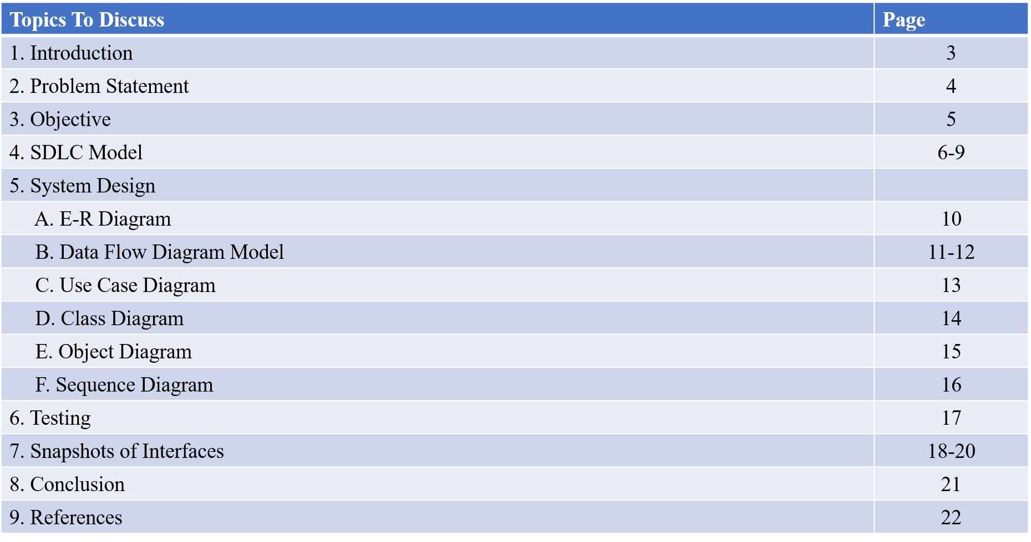
Table of Contents

Slide 3
Introduction
Overview of the Car Showroom Management System: Begin by explaining what a car showroom management system entails. Highlight its purpose in helping showrooms manage daily operations, such as customer registration, inventory management, and sales tracking.
Technology and Tools Used: Mention that you are using Visual Basic for the programming component and MySQL as the database management system. Explain why these technologies were chosen, perhaps for their compatibility, ease of use, or robustness.
Importance of Automation in Showrooms: Discuss how digital solutions can reduce errors, save time, and enhance customer satisfaction. Emphasize that the system can automate routine tasks, ensure data consistency, and improve the decision-making process by providing real-time data access.

Slide 4
Problem Statement
Manual operations in a car showroom are complex and time-consuming.
Inefficient car inventory, order processing, and employee management lead to errors and delays.
Sales reports and critical data are cumbersome to generate, affecting decision-making.
Poor resource management impacts customer satisfaction and showroom productivity.
Lack of streamlined communication with manufacturers causes procurement delays.
Employee performance tracking is challenging without a centralized system.

Slide 5
Objective
Automate Inventory Management: Track and update car availability in the inventory.
Streamline Customer Order Processing: Simplify registration, orders, and billing to reduce errors.
Centralize Employee Management: Manage employee details, roles, and performance.
Enhance Reporting: Generate sales, inventory, and activity reports for better decision-making.
Improve Manufacturer Collaboration: Manage manufacturer info and streamline communication for procurement.
Boost Customer Satisfaction: Automate processes to reduce delays and improve service.
Provide Secure Access: Implement secure logins for restricted access and data confidentiality.
Ensure Scalability: Design for future upgrades like online bookings and analytics.

Slide 6
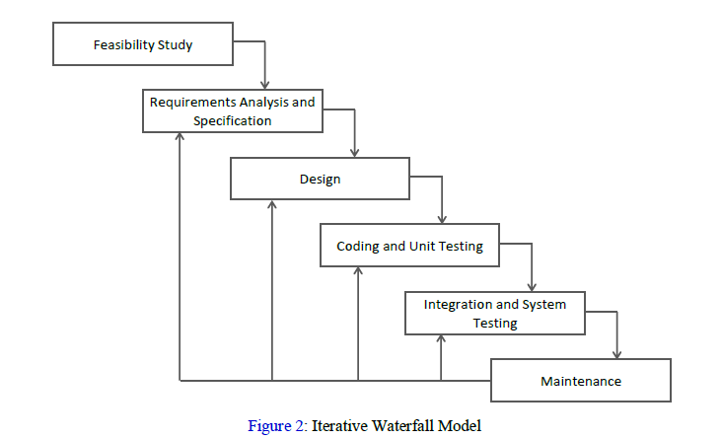
SDLC Model
Fig 1: Iterative Waterfall Model

Slide 7
1. Feasibility Study
Objective: Determine the project's practicality and assess its technical, economic, and operational feasibility.
Activities:
Conducted an analysis of the existing manual processes in the showroom.
Assessed the available resources, including hardware, software, and workforce.
Estimated the costs of development and maintenance against potential benefits like reduced errors and improved efficiency.
Output: A feasibility report confirming that the project is viable and beneficial to the showroom.
2. Requirement Analysis and Specification
Objective: Gather and document the functional and non-functional requirements of the system.
Activities:
Engaged with stakeholders (e.g., showroom managers, employees) to understand their needs.
Identified key requirements like managing car inventory, processing customer orders, and generating invoices.
Documented requirements in a clear and detailed Software Requirements Specification (SRS).
Output: The SRS document outlining all system requirements.

Slide 8
3. System Design
Objective: Create a blueprint for the system that fulfills the specified requirements.
Activities:
Designed the database schema, including tables for cars, customers, orders, employees, and manufacturers.
Developed diagrams such as Data Flow Diagrams (DFDs) and Entity-Relationship Diagrams (ERDs) to represent system processes and data relationships.
Defined the user interface design for functionalities like adding cars, processing orders, and billing.
Output: Design documents, including database structure, process workflows, and UI mockups.
4. Coding and Unit Testing
Objective: Develop the system's modules and ensure their correctness individually.
Activities:
Wrote code for core functionalities using Visual Basic for the frontend and MySQL for the backend.
Developed individual modules like "Add Car," "Process Customer Order," and "Generate Bill."
Conducted unit testing to verify the correctness of each module.
Output: Functional and tested software modules.

Slide 9
5. Integration and System Testing
Objective: Combine all modules and test the system as a whole.
Activities:
Integrated modules like inventory management, customer order processing, and billing into a single system.
Performed system testing to identify bugs and ensure the system worked as intended.
Validated the system against the SRS to confirm it met all specified requirements.
Output: A fully integrated and tested Car Showroom Management System.
6. Maintenance
Objective: Ensure the system remains operational and evolves to meet new requirements.
Activities:
Addressed bugs and issues reported by end-users.
Added new features, such as advanced sales analytics and enhanced inventory reporting.
Upgraded the system for compatibility with newer technologies when needed.
Output: An updated and robust system that adapts to the changing needs of the showroom.

Slide 10
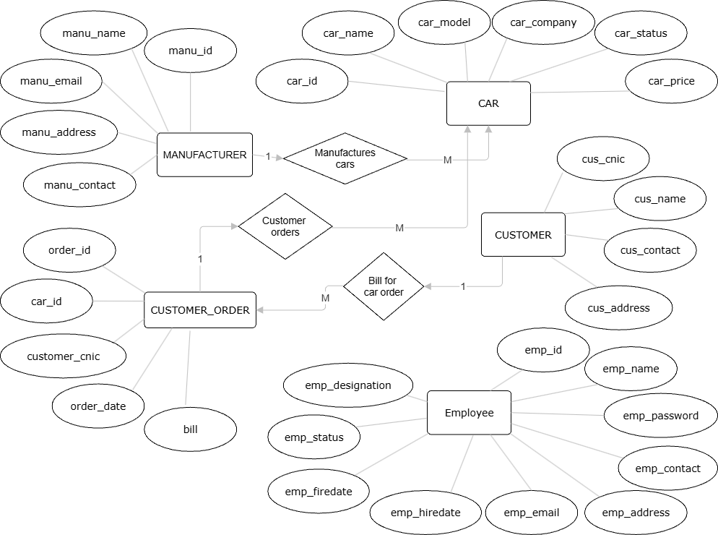
System Design
E-R Diagram
Fig 2: E-R Diagram

Slide 11
DFD
DFD Level 0
Fig 3: DFD Level 0

Slide 12
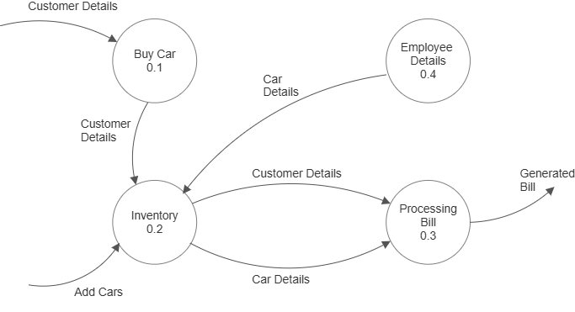
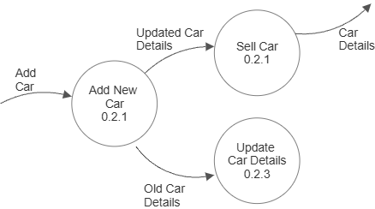
C.2 DFD Level 1
Fig 4: DFD Level 1
C.3 DFD Level 2
Fig 5: DFD Level 2

Slide 13
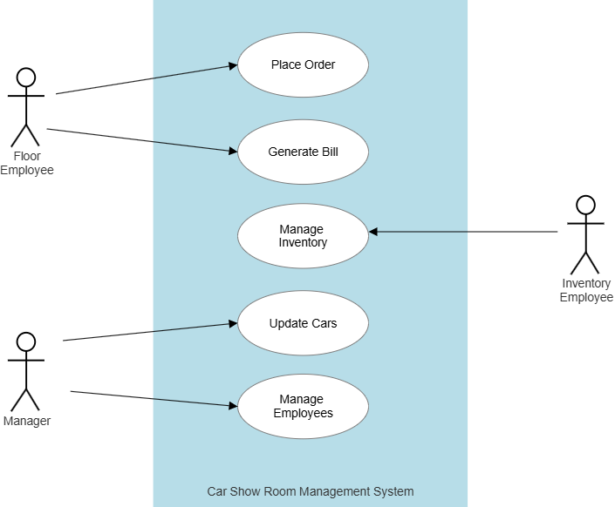
Use Case Diagram
Fig 6: Use Case Diagram

Slide 14
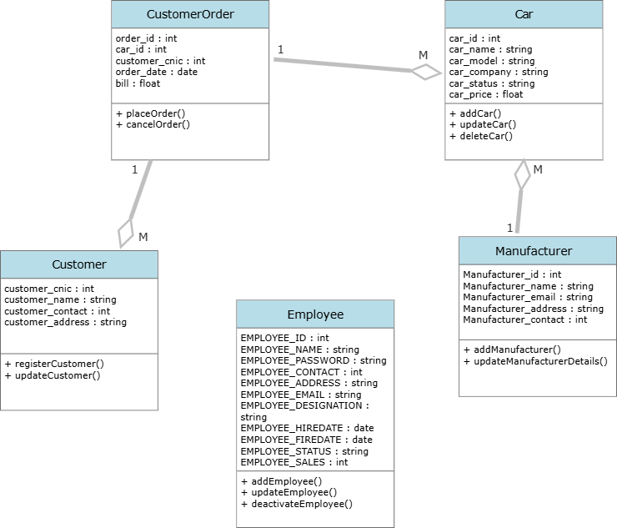
Class Diagram
Fig 7: Class Diagram

Slide 15
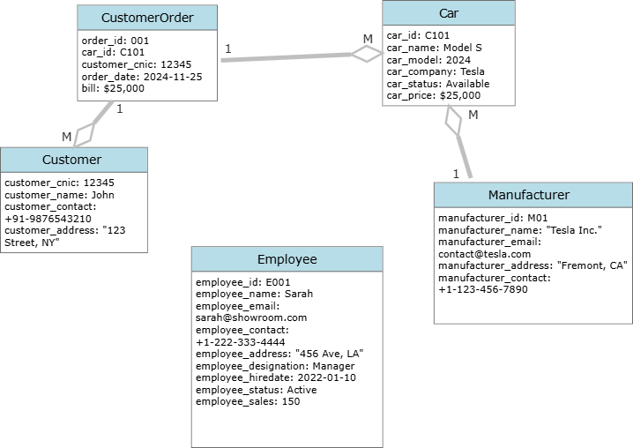
Object Diagram
Fig 8: Object Diagram

Slide 16
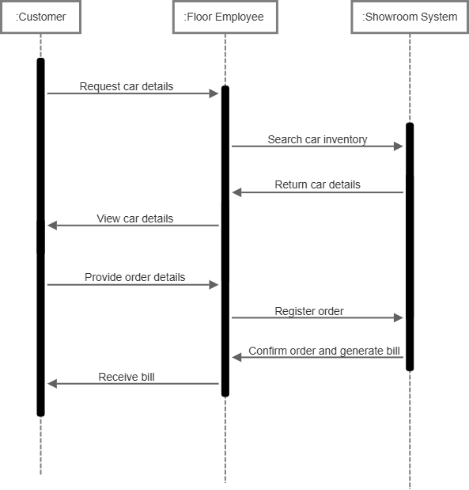
Sequence Diagram
Sequence Diagram for “Buy Car” Event
Fig 9: Sequence Diagram

Slide 17
Testing

Slide 18
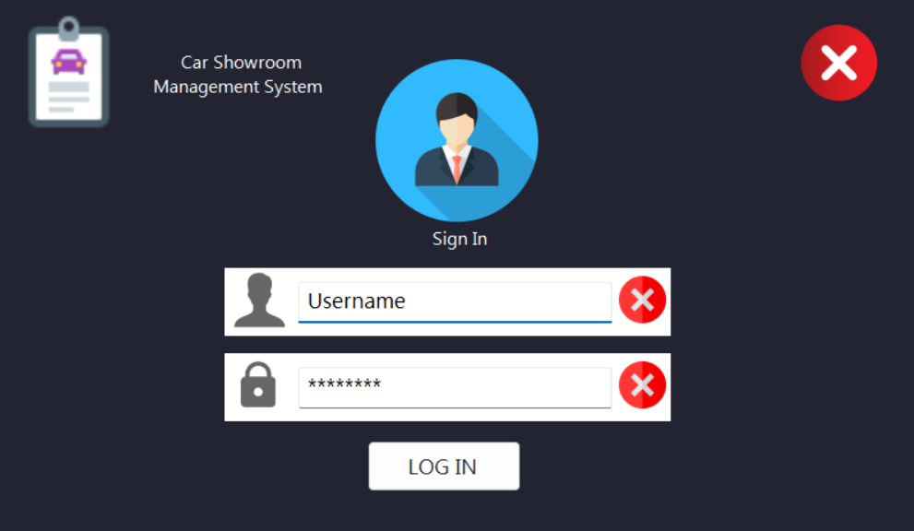
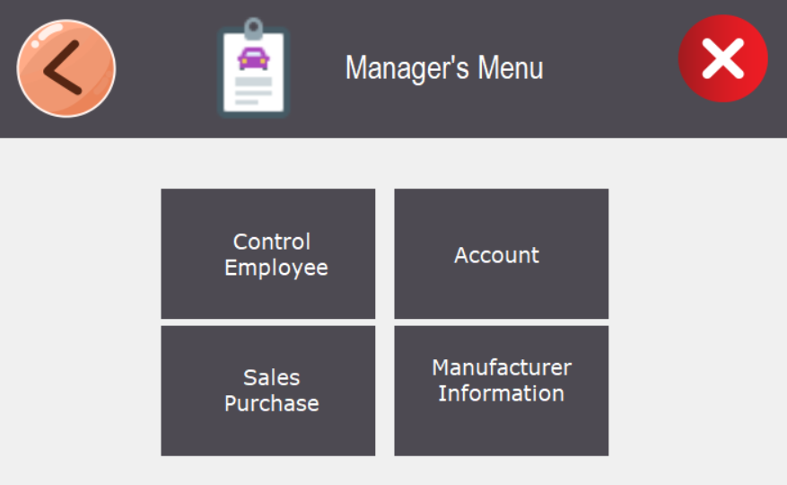
Snapshots of Interfaces
Login Form
Manager Dashboard

Slide 19
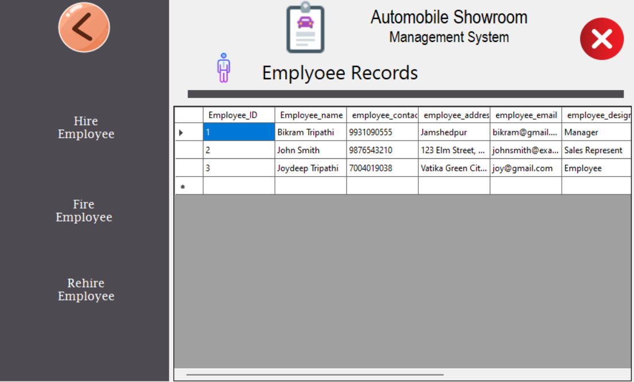
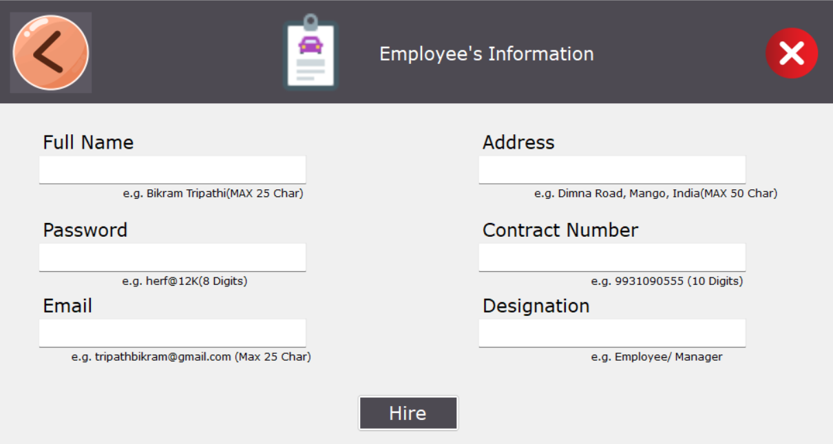
Control Employee
Hire Employee

Slide 20
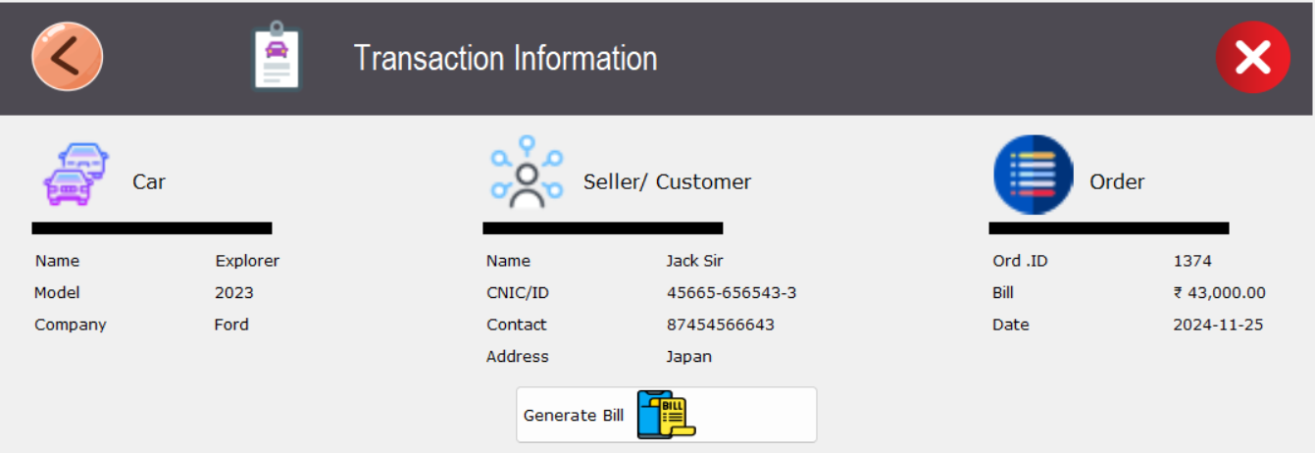
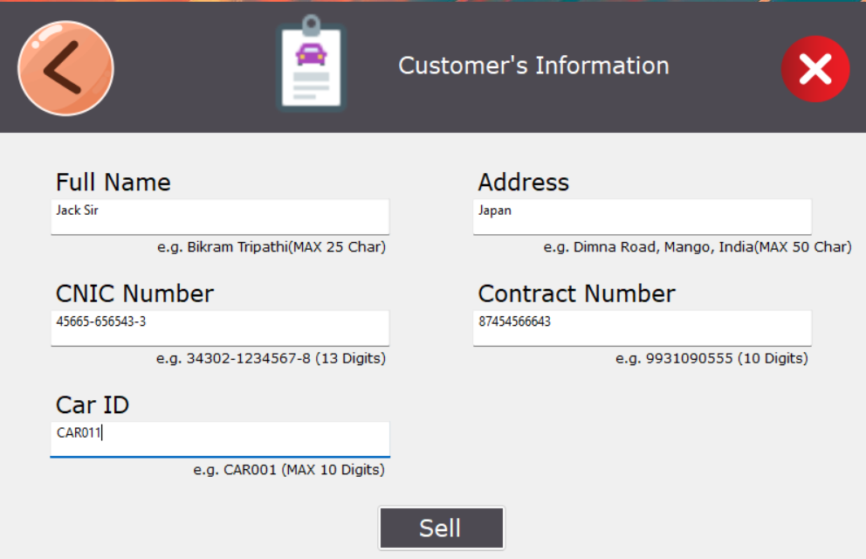
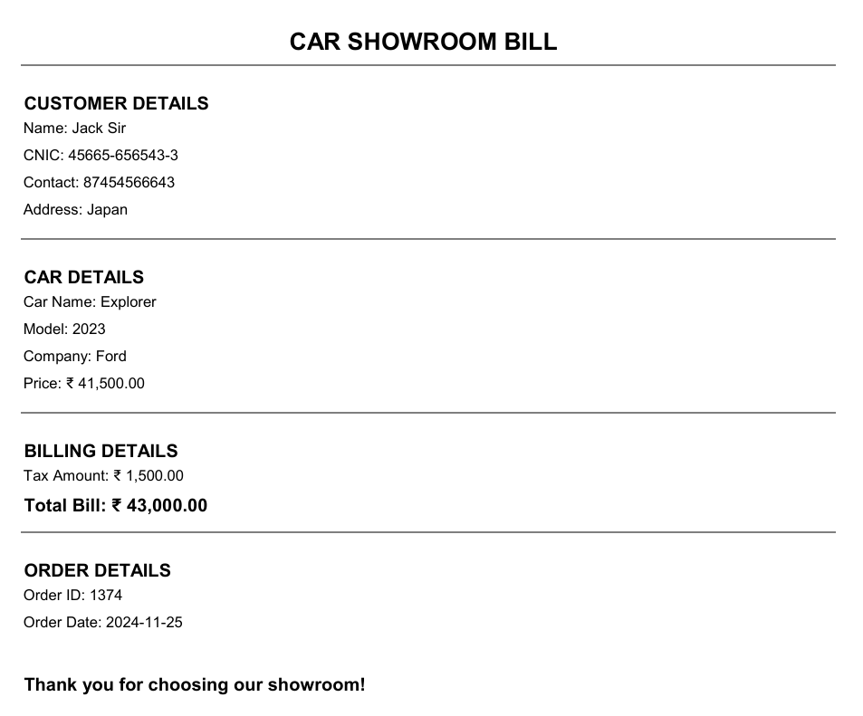
Transaction Information
Sell Car
Generated Bill

Slide 21
Conclusion
The Car Showroom Management System was developed to streamline operations at a car dealership.
It provides solutions for managing inventory, customer orders, employee roles, and generating reports.
The development followed the iterative waterfall model for careful planning, execution, and testing.
The system addresses challenges such as inventory tracking, automated billing, and role-based employee access.
Comprehensive testing confirmed the system's functionality, reliability, and seamless integration of modules.
The project demonstrates the practical application of software engineering principles.
The system is scalable and adaptable to the future needs of the organization.

Slide 22
References
Sommerville, I. (2011). Software Engineering (9th Edition). Addison-Wesley.
Pressman, R. S. (2014). Software Engineering: A Practitioner's Approach. McGraw-Hill Education.
IEEE Standard for Software Testing Documentation (IEEE 829).
Visual Basic for Applications Guide. Available at: https://learn.microsoft.com/
Godfrey, M. (2008). Practical Database Design. Wiley.
Agile Alliance. Iterative Waterfall vs. Agile Development. Available at: https://www.agilealliance.org

