Slide 1
Music-Library
PA165 project 2016/17
Team Salmon
Konečný Oldřich 433418
Kulíšek Martin 433504
Pribula Dávid 396575
Štourač Jan 113869

Slide 2
Business Logic:
Music library – web page, used for managing albums, songs and musicians.
Project is divided into five major modules
API
Facades, DTOs
DAO
Entities, dao
Service
Services, FacadeImpl
REST
Rest facades
MVC
Controllers, JSPs

Slide 3
Application allows user to:
create new albums, songs, musicians and genres
edit and delete all of these above
add songs to album
rate albums and songs
select from different search filters
show detail of each album, song, musician or genre.

Slide 5
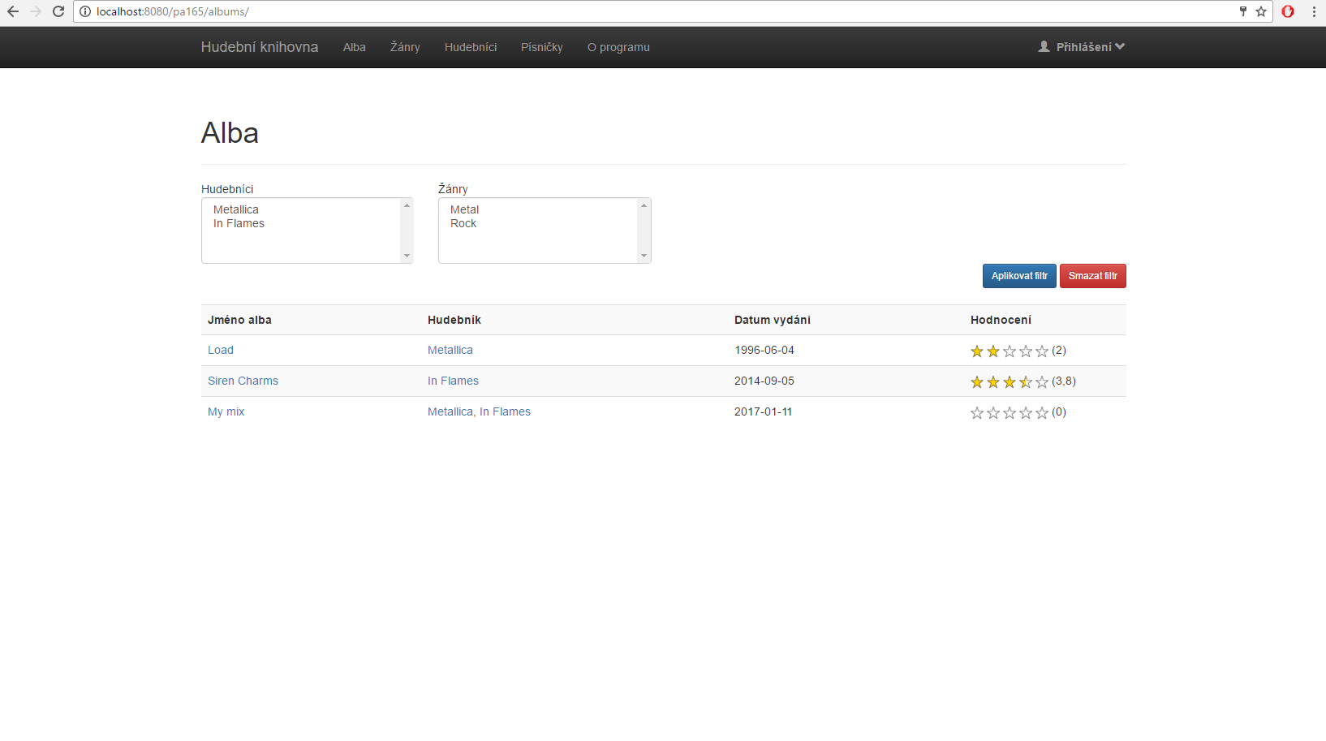

Slide 6
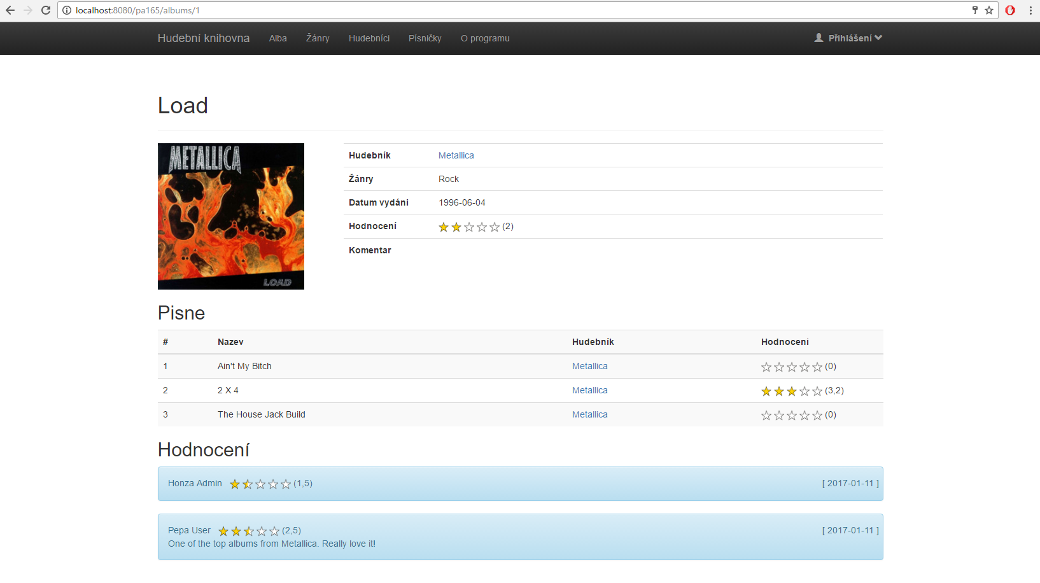

Slide 7
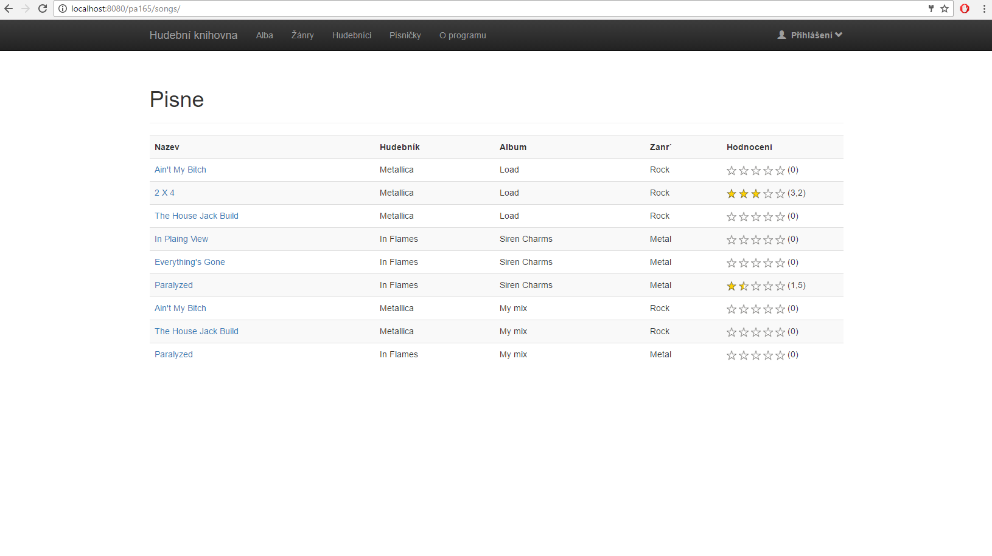

Slide 8
Technologies:
JAVA8
Maven
Spring
Spring MVC
Hibernate
Apache Tomcat
Derby
Mockito
Dozer
Log4j
Git
Travis
Trello

Slide 9
Cooperation:
Each member of the team did at least one entity, DAO class, test for entity and DAO, service class and test for service, facade and test facade class, MVC controller and few JSPs
No problem in communication
Each milestone on time
Code review
GitHub
Trello

Slide 10
Feedback:
Working on our own project
New technologies
Example project was helpful
Evaluation from others
No official milestone evaluation

