Slide 1
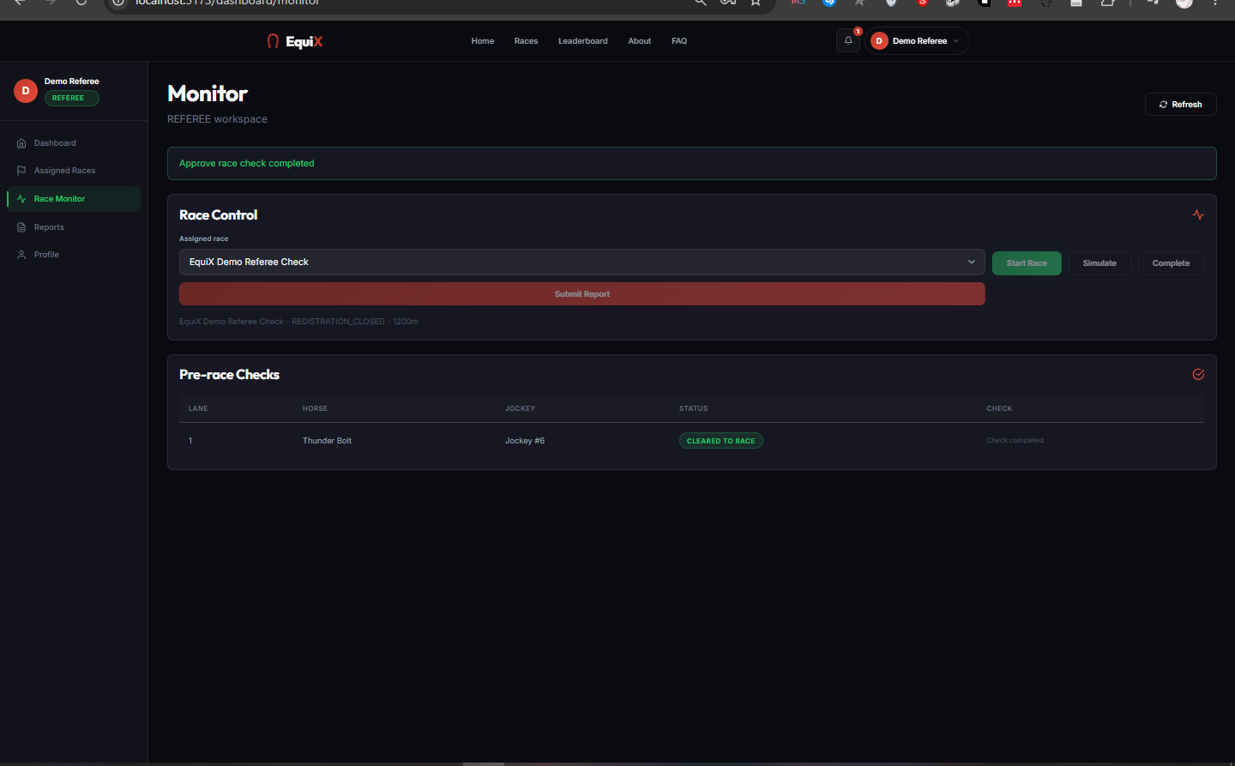
EQUIX
Horse Racing
Tournament Management
An end-to-end, role-based workflow from registration and pairing to race operations, official results, and rewards.
SWP391 PROJECT · FPT UNIVERSITY
EquiX Team · Business Logic V4
React · Spring Boot · SQL Server · JWT
Notes:
EquiX is an SWP391 project that models the complete lifecycle of horse racing tournament management.
The product is not only a user interface; its main value is an integrated workflow across five business roles.
This presentation focuses on the architecture, V4 rules, result governance, and test evidence.

Slide 2
A race succeeds only when every role acts at the right time
Business challenge
How EquiX addresses it
When data is fragmented or permissions are unclear, a system may accept invalid registrations, start a race too early, allow prediction edits after lock, or publish unverified results.
A single platform uses explicit business states, JWT-based API authorization, and a mandatory approval chain so every role acts in the correct sequence.
Primary risks
✓
State-driven workflow control
• Incorrect authorization
• Lost data integrity
• Unverified results
✓
Each role receives only required permissions
✓
Every result becomes official through two steps
EQUIX · SWP391
02
Notes:
Open with the coordination problem instead of listing features.
Emphasize that the backend enforces the rules; the frontend reflects state and guides the user.

Slide 3
The platform covers the full race operations chain
Guests and five business roles have dedicated screens, permissions, and actions.
User group
Primary responsibility
Representative actions
Guest
Explore the platform
View races and leaderboard; create an account
Horse Owner
Manage horses and entries
Create horses, invite jockeys, submit race pairs
Jockey
Confirm collaboration
Accept or reject invitations; view assignments
Referee
Operate the race
Run fitness checks, start, simulate, and report
Spectator
Follow and engage
Predict with points; claim and redeem rewards
Administrator
Govern and control
Approve accounts/pairs, create events, publish results
EQUIX · SWP391
03
Notes:
Referees have no public registration flow; only an Administrator can create a referee account.
Horse Owners and Jockeys require Administrator verification, while Spectators are activated immediately to reduce friction.

Slide 4
Three layers keep business rules independent of the UI
Every request passes through the API and authorization checks before SQL Server is updated.
PRESENTATION
BUSINESS LOGIC
DATA ACCESS
ReactJS SPA
Spring Boot REST
SQL Server 2019+
Role-based routing
Shared components
Real-time race tracking
RBAC + JWT
Workflow services
Transaction validation
Spring Data JPA
Foreign keys + indexes
Transaction integrity
Security flow
Sign in → JWT carries user/role → Spring Security authenticates → Service validates rules → JPA commits transaction
EQUIX · SWP391
04
Notes:
JWT supports stateless REST; the backend never trusts a role supplied by the frontend.
SQL Server is the production runtime. H2 is used only by automated tests.

Slide 5
Five roles form a system of mutual control
01
02
03
04
05
Horse Owner
Jockey
Referee
Spectator
Administrator
Own horse records
Invite jockeys
Register for races
Decide invitations
Maintain pairings
Track performance
Run pre-race checks
Operate live races
Sign reports
Watch races
Predict with points
Claim rewards
Create events and races
Approve data
Publish results
ISOLATED SCOPE
ISOLATED SCOPE
ASSIGNED ONLY
ISOLATED SCOPE
ISOLATED SCOPE
EQUIX · SWP391
05
Notes:
An Administrator cannot start a race; that permission belongs only to the assigned Referee.
This separation of responsibilities prevents one role from controlling the entire process.

Slide 6
A pairing can race only after six validation steps
The one-to-one constraint is stored as a pairing contract, not as temporary UI state.
1
2
3
4
5
6
Select horse
Send invitation
Jockey accepts
Submit entry
Admin approves
Referee checks
Horse must be
AVAILABLE
Owner selects a race
and jockey
Create pairing
contract
Move to
PENDING_
ADMIN
Eligible for
READY_FOR_
CHECK
FIT →
CLEARED_TO_
RACE
Core rule: one horse ↔ one jockey in an active pairing; registration is blocked until the pair exists.
EQUIX · SWP391
06
Notes:
If registration is disabled, check the horse status, invitation, pairing, deadline, and Administrator approval in that order.
This workflow prevents incomplete race entries without a horse or jockey.

Slide 7
The race lifecycle is the backbone of the platform
Each state enables valid actions and locks operations that are no longer allowed.
DRAFT
REGISTRATION_OPEN
REGISTRATION_CLOSED
STANDBY
Draft
Registration open
Registration closed
Awaiting start
IN_PROGRESS
COMPLETED
REPORT_READY
OFFICIAL
Live
Provisional result
Report ready
Official
Administrator: Draft / Open / Close
Referee: Standby → Complete → Submit report
Administrator: Report → Official
EQUIX · SWP391
07
Notes:
Predictions lock when the race reaches STANDBY.
The Administrator manages registration states, but only the assigned Referee can start or complete a race.
Special branch: REPORT_READY ↔ REVISION_REQUIRED; a race that has not started may become CANCELLED.

Slide 8
V4 rules are enforced on the server, not only in the UI
The business document defines 25 hard rules. These five rules preserve the consistency of the demo workflow and address key review questions.
Each race requires 6–18 pairs
✓
✓
Registration closes one week before race time
✓
Each spectator gets one prediction per race
Design principle
✓
Only the assigned referee can start a race
The UI guides the user.
The server decides whether an action is valid.
The database preserves relationships and transactions.
✓
Results require a report + Administrator approval
EQUIX · SWP391
08
Notes:
Additional rules include: all races use Turf, the prize pool cannot be negative, referees cannot have schedule conflicts, and disqualification requires a reason.
Critical validations live in the service layer so direct API calls cannot bypass the UI.

Slide 9
Predictions engage spectators without real-money betting
Spectators use points; rewards are issued only after results become OFFICIAL.
01
02
03
Predict
Lock
Reward
Choose a horse–jockey pair
and place points before STANDBY
Race reaches STANDBY
→ prediction cannot be edited
Administrator publishes OFFICIAL
→ settle points and issue rewards
Digital: ISSUED → CLAIMED → REDEEMED
Goods: CLAIMED → PROCESSING → SHIPPED → FULFILLED
EQUIX · SWP391
09
Notes:
Under V4, first place receives horse goods, second place a voucher, and third place a drink coupon.
The prize pool is display data allocated 60/30/10; it does not represent a real-money transaction.

Slide 10
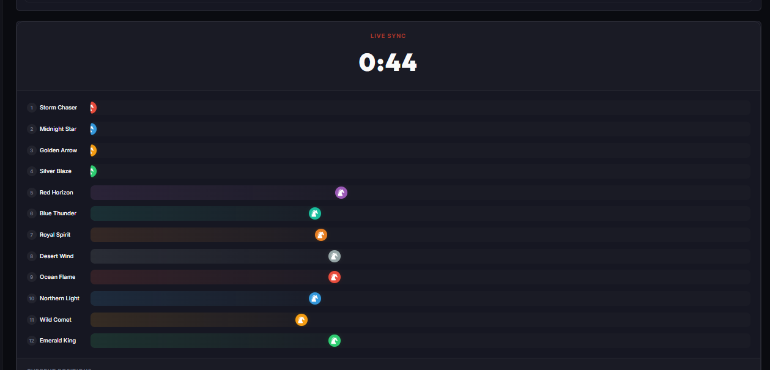
Simulation starts only after the workflow is valid
The live race view synchronizes time and lane positions. Final positions remain provisional until the report is submitted and approved.
✓
At least 6 pairs are FIT
✓
Race is in STANDBY
✓
The assigned referee is operating
✓
Predictions are locked before the start
12 SYNCHRONIZED LANES
EQUIX · SWP391
10
Notes:
For the demo, select a prepared race with enough FIT entries before moving it to STANDBY.
RaceTrack keeps horseId separate from registrationId so every horse receives the correct real-time update.

Slide 11
Official results require two-person control
This chain prevents one role from both operating and publishing the entire race.
REFEREE
ADMINISTRATOR
OFFICIAL
Complete simulation
Record incidents / DNF / DQ
Sign and submit report
Review the report
Apply valid rank changes
Publish or request revision
Update leaderboard
Allocate prizes 60/30/10
Settle predictions + rewards
If the report fails review: REPORT_READY → REVISION_REQUIRED → referee revises and resubmits
EQUIX · SWP391
11
Notes:
This is the most important separation of duties in the project.
Even a clean race requires a minimally signed report; there is no shortcut to OFFICIAL.

Slide 12
Quality evidence was rerun before presentation
Test run completed on July 19, 2026.
52
40
12
TOTAL TESTS PASSED
BACKEND INTEGRATION TESTS
FRONTEND TESTS
No failures, errors, or skipped tests
Authentication, notifications, workflows, extensions, and rewards
Role routing, avatars, race mapping, and localization
✓ Maven BUILD SUCCESS ✓ ESLint passed ✓ Vite production build succeeded
EQUIX · SWP391
12
Notes:
Backend tests use the test profile and temporary H2 database; they do not replace the SQL Server runtime.
Frontend tests and the production build were run independently to validate logic and packaging.

Slide 13
A 12–15 minute demo follows the business workflow
This order reduces risk and shows how data moves across multiple roles.
Step
Role
Demo activity
Duration
1
Guest
Public pages, race list, leaderboard, and registration
1 min
2
Spectator
Place one prediction before the race reaches STANDBY
1 min
3
Owner + Jockey
Manage horses; send and accept an invitation
3 min
4
Administrator
Approve a pair; create and manage race schedules
2 min
5
Referee
Fitness check → STANDBY → Start → Simulate → Report
3 min
6
Administrator
Review and publish the result as OFFICIAL
2 min
7
Spectator + Admin
Claim/redeem rewards or process goods fulfillment
2 min
EQUIX · SWP391
13
Notes:
Do not cancel the race used for the demo flow.
If a step already changed state, use another prepared race instead of editing SQL directly.
Back up the database before the presentation.

Slide 14
V4 closes the main gaps; deployment is the next step
Completed in V4
Development roadmap
✓
Password reset and verified email change
01 Production SMTP email service
02 Containerization and CI/CD
03 Real-time monitoring and advanced audit logs
04 Frontend bundle optimization and data pagination
05 Cloud deployment + automated backups
✓
Notification center and fixed-position toasts
✓
DNF, dead heat, and disqualification
✓
Referee reassignment, rescheduling, and cancellation
✓
Reward codes, QR, and fulfillment queue
EQUIX · SWP391
14
Notes:
Clearly distinguish completed project capabilities from future development.
Local email currently uses a logging adapter; real SMTP is required for production deployment.

Slide 15
CONCLUSION
EquiX turns complex business logic
into a controlled workflow.
Full-stack · 5 roles · SQL Server · JWT/RBAC · 52 tests passed
Ready for a live demonstration and discussion.
QUESTIONS & DISCUSSION
EQUIX · SWP391 TEAM
15
Notes:
Close with three points: the cross-role workflow, two-step result control, and test evidence.
Invite questions from the lecturer or move directly to the live demonstration.

