Slide 1
SE1916 • GROUP 06 • SWP391
FINAL PRESENTATION 2026
EQUIX
HORSE RACING
MANAGEMENT SYSTEM
REACT 19 • SPRING BOOT 3.5 • SQL SERVER
Two-presenter delivery
Notes:
Presenter A — Slide 1
Key message: Introduce EquiX, the five-role horse-racing management system and the SWP391 full-stack scope.

Slide 2
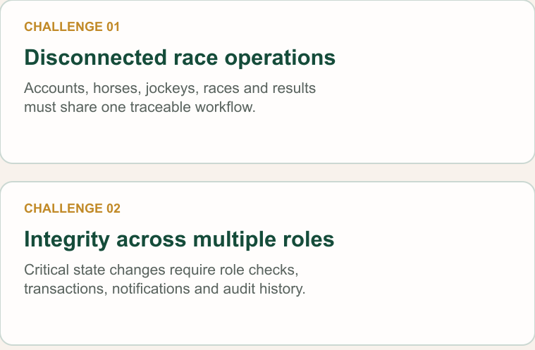
Problem &
Scope
EquiX replaces fragmented race coordination with one governed workflow for accounts, horses, jockeys, tournaments, registrations, referee operations, results and spectator engagement.
The SWP391 scope covers a complete academic full-stack product: requirements, architecture, implementation, database integrity, testing and a repeatable demonstration flow.
Notes:
Presenter A — Slide 2
Key message: Explain the coordination problem and why a single governed workflow is necessary.

Slide 3
System Actors
Governs accounts, tournaments and races; assigns referees, approves registrations and declares official results.
Referee
Clears registrations, starts and completes races, records incidents and submits the signed race report.
Admin
Horse Owner
Creates horses, invites jockeys, manages pairings and registers eligible horse–jockey pairs into open races.
Enforces JWT/RBAC, state transitions, transactions, notifications, point settlement and audit history.
EquiX Core
Jockey
Spectator
Browses races, places one point-based prediction per race, receives rewards and redeems one-time gift codes.
Reviews invitations, accepts or declines pairings, and follows assigned horses and race schedules.
Notes:
Presenter A — Slide 3
Key message: Clarify the responsibility boundary of every role and EquiX Core.

Slide 4

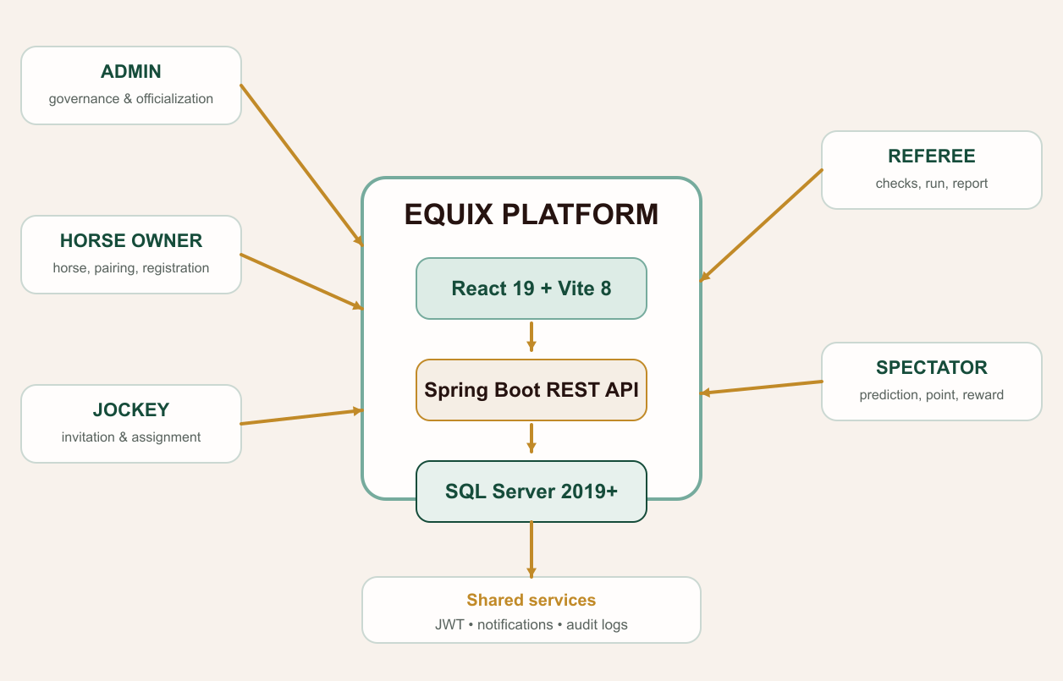
System Context
Notes:
Presenter A — Slide 4
Key message: Show the three-tier context and SQL Server as the only database.

Slide 5
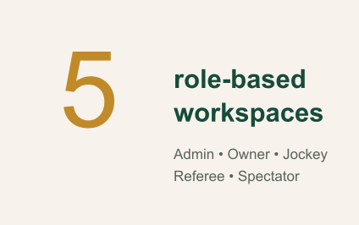
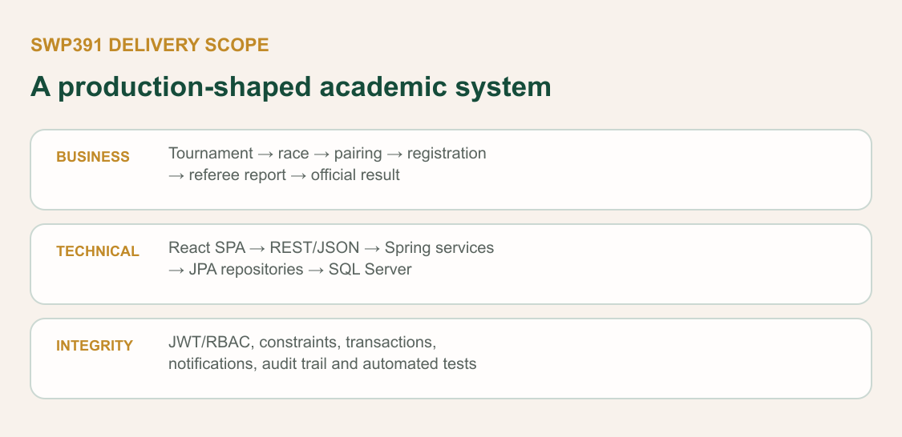
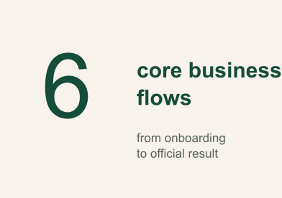
SWP Delivery Scope
Notes:
Presenter A — Slide 5
Key message: Frame the delivery scope before entering implementation details.

Slide 6
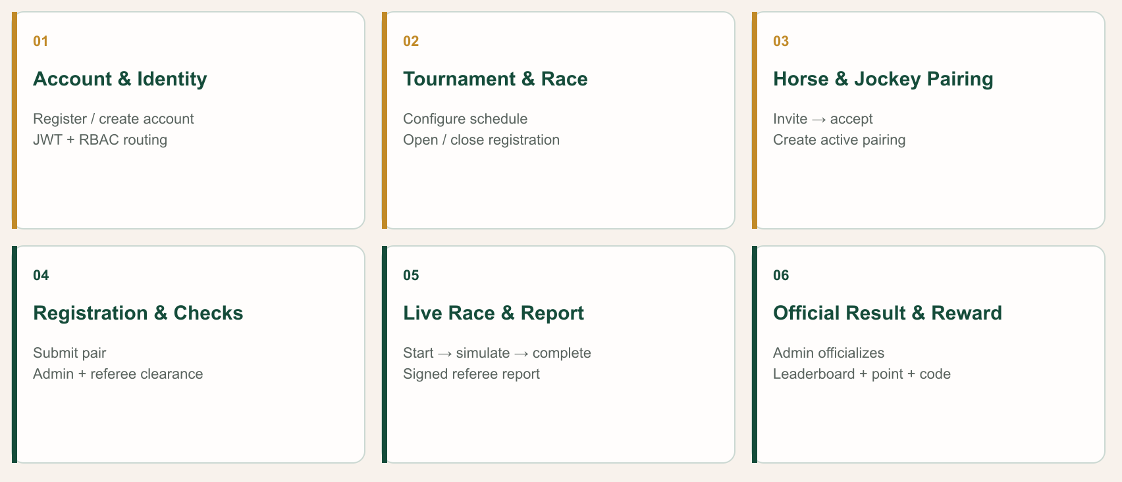
Six Core Business Flows
Notes:
Presenter A — Slide 6
Key message: Walk through the six business flows from onboarding to official result.

Slide 7
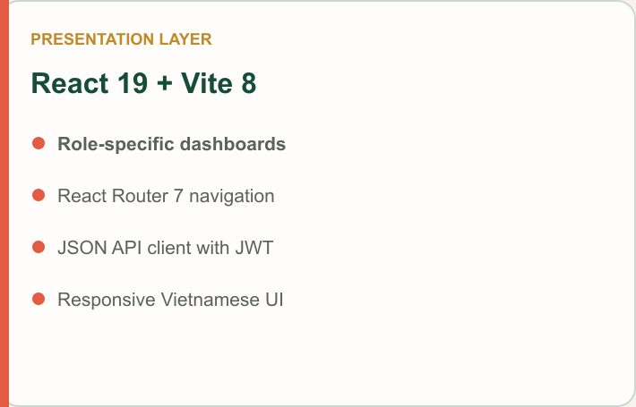
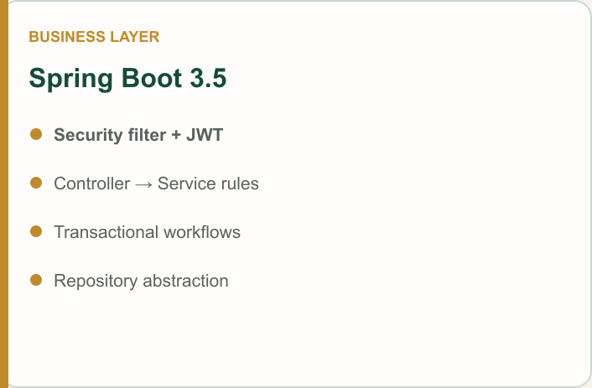
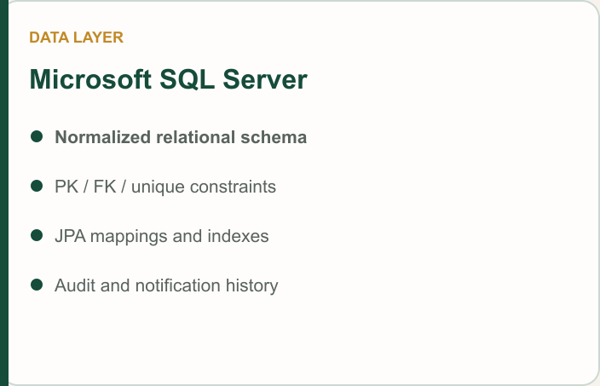
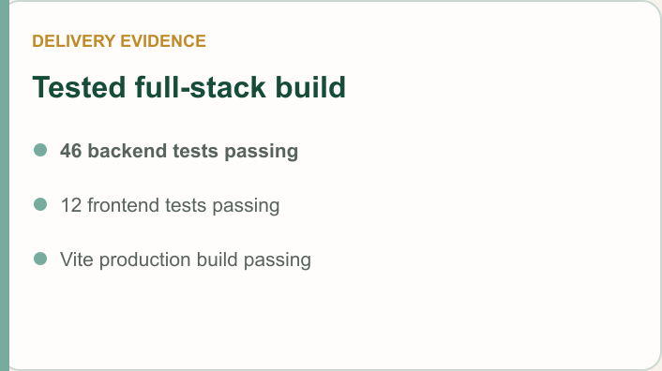
Notes:
Presenter A — Slide 7
Key message: Explain how React, Spring Boot and SQL Server divide responsibilities.

Slide 8
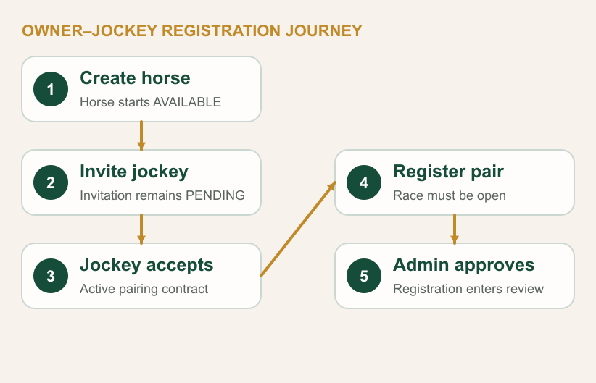
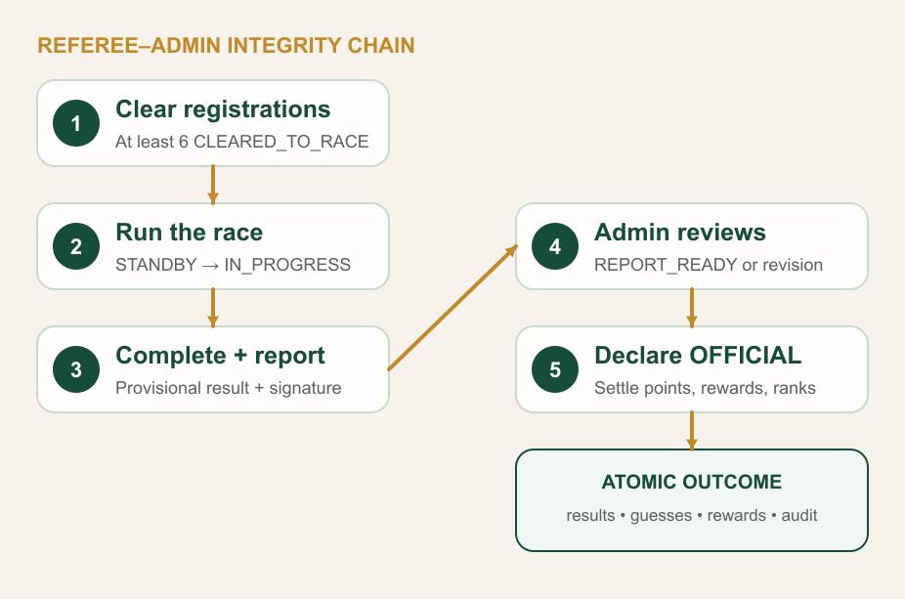
Notes:
Presenter A — Slide 8
Key message: Tell the two critical journeys: pairing/registration and officialization.

Slide 9
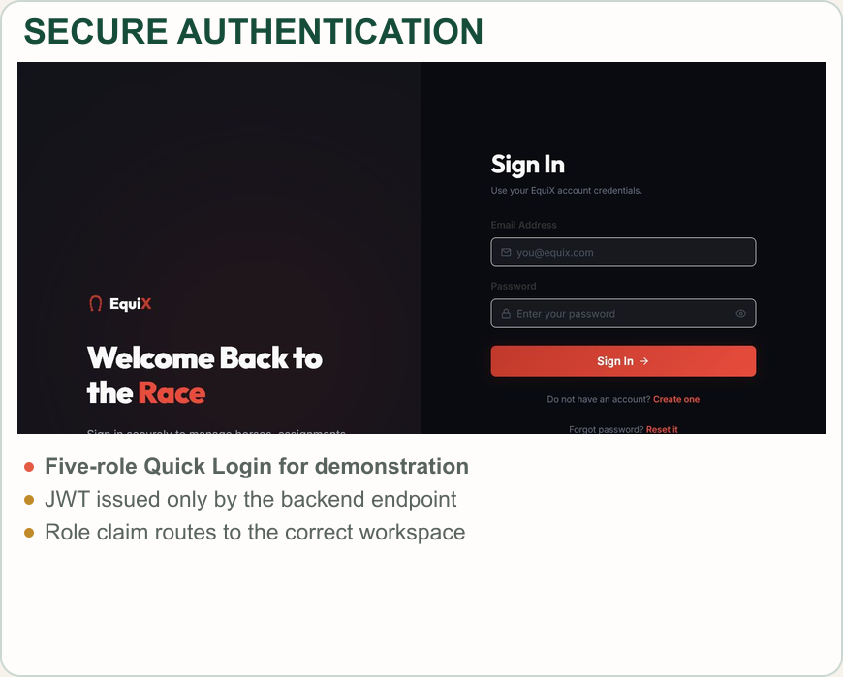
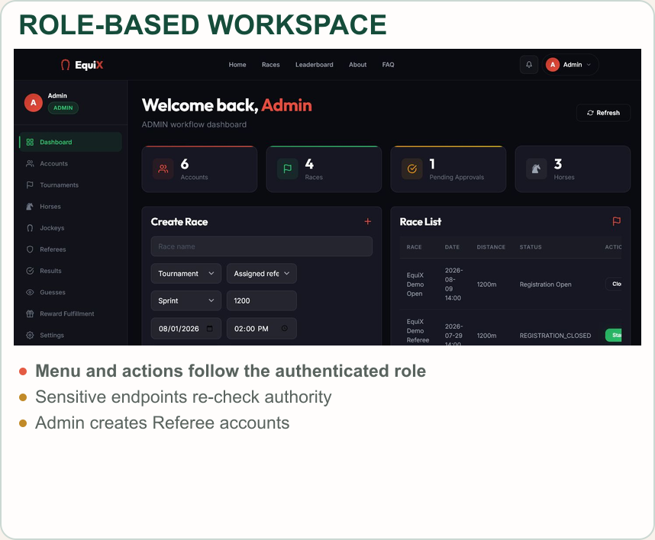
Account, Identity & RBAC
Notes:
Presenter A — Slide 9
Key message: Explain JWT authentication, RBAC and role-specific navigation.

Slide 10
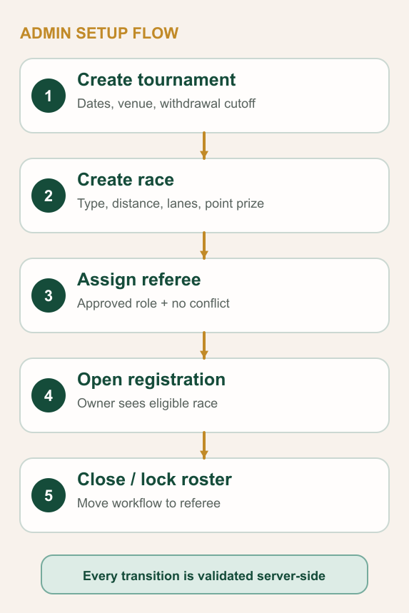
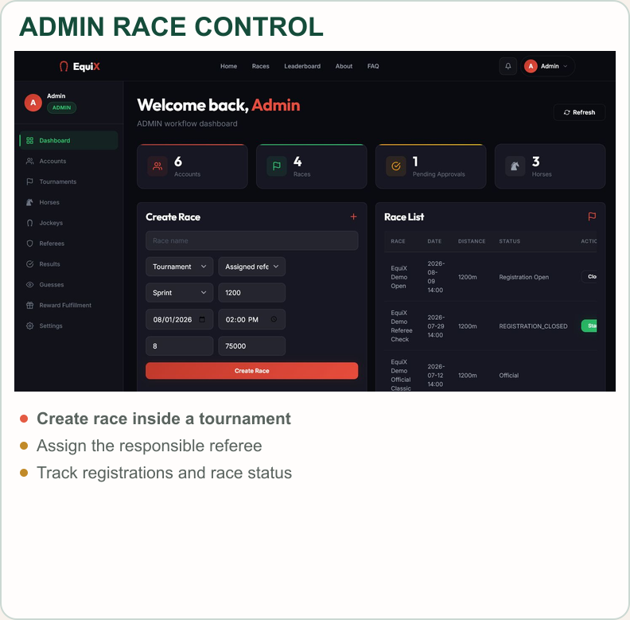
Tournament & Race Setup
Notes:
Presenter A — Slide 10
Key message: Demonstrate how Admin configures tournament, race and referee ownership.

Slide 11
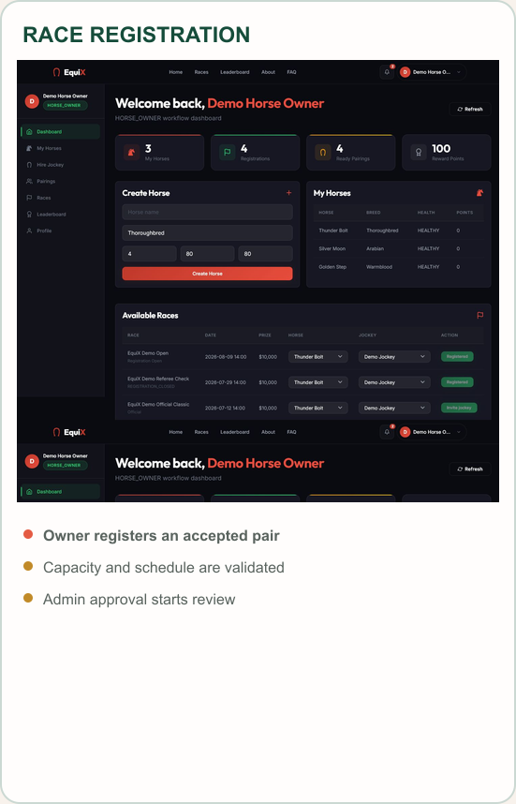
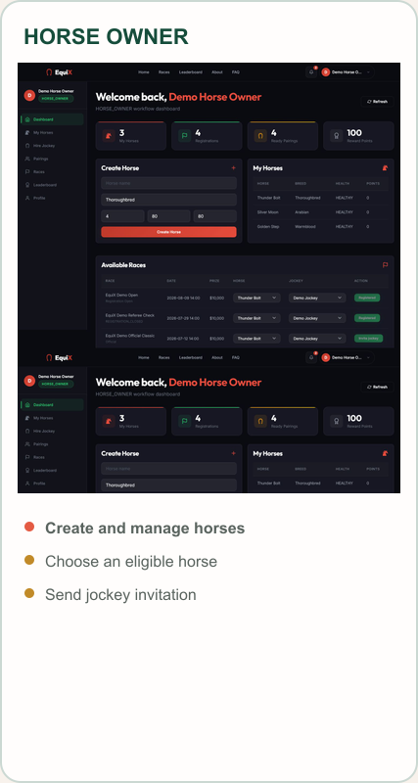
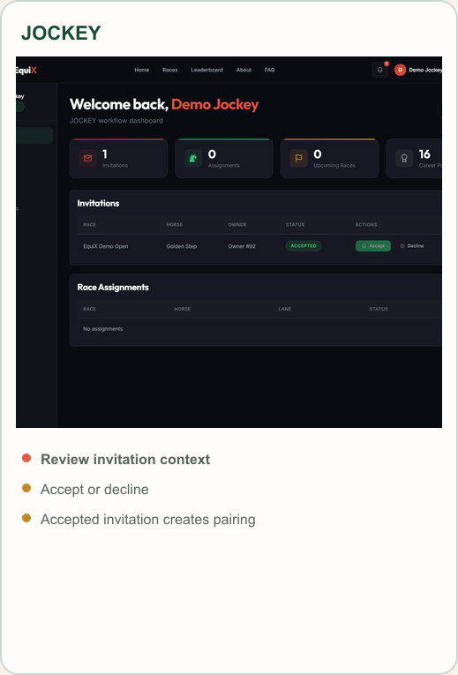
Horse–Jockey Pairing & Registration
Notes:
Presenter B — Slide 11
Key message: Explain why invitation acceptance must precede race registration.

Slide 12
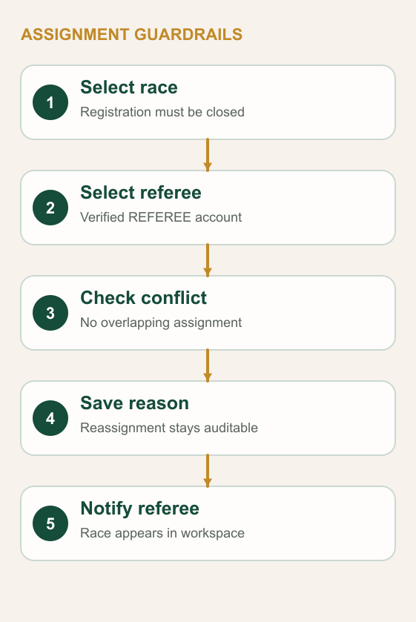
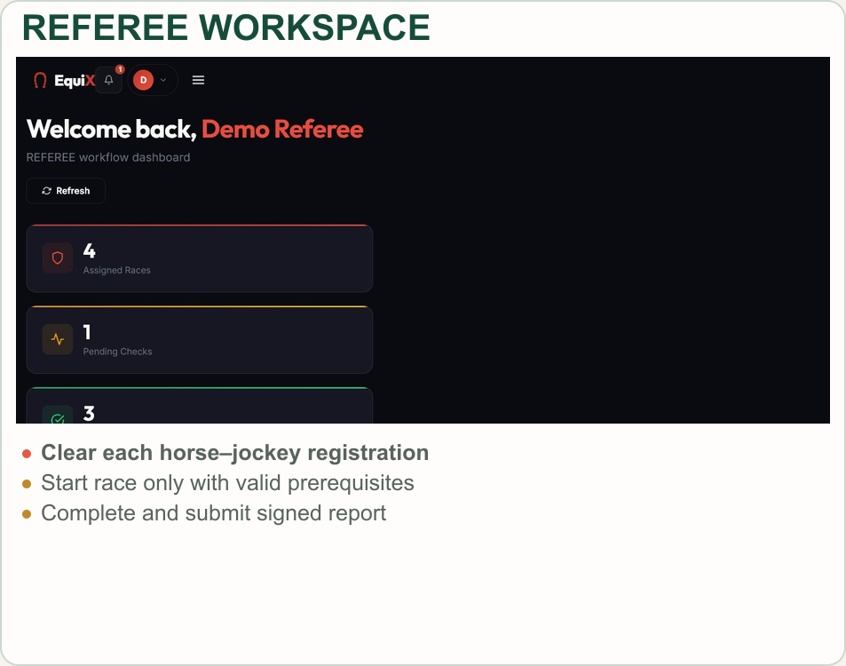
Referee Assignment & Controls
Notes:
Presenter B — Slide 12
Key message: Describe assignment conflicts, pre-race clearance and referee authority.

Slide 13
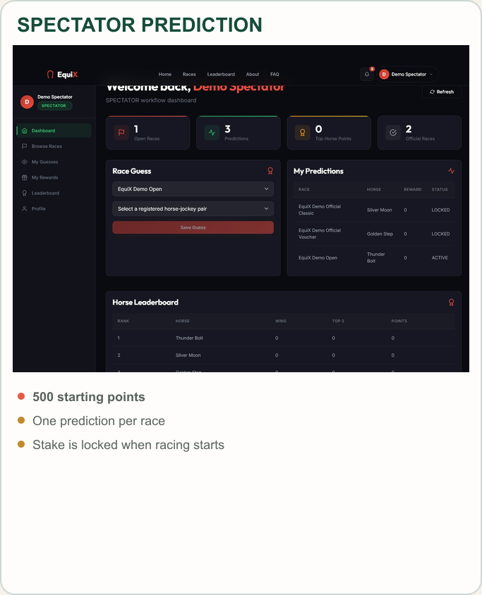
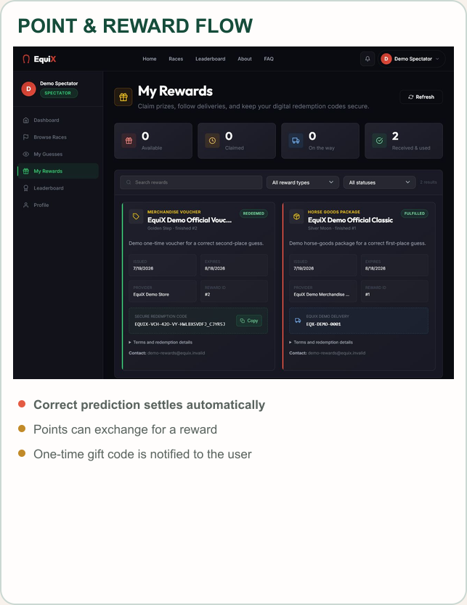
Prediction, Point & Reward
Notes:
Presenter B — Slide 13
Key message: Explain 500 starting points, prediction locking and one-time gift codes.

Slide 14
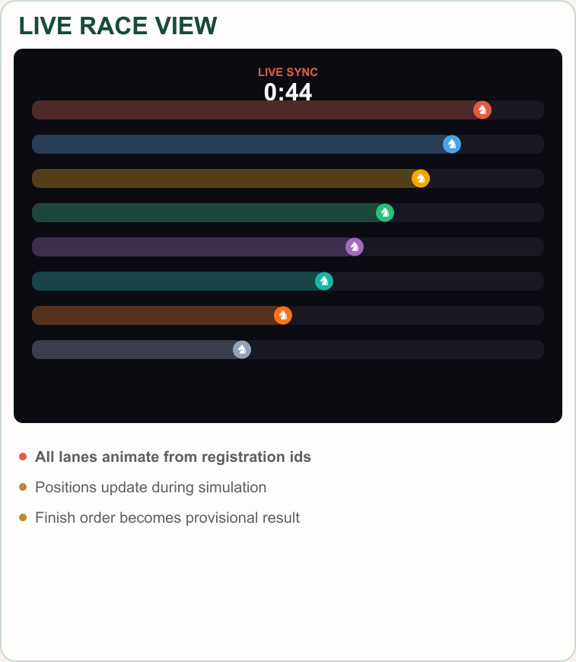
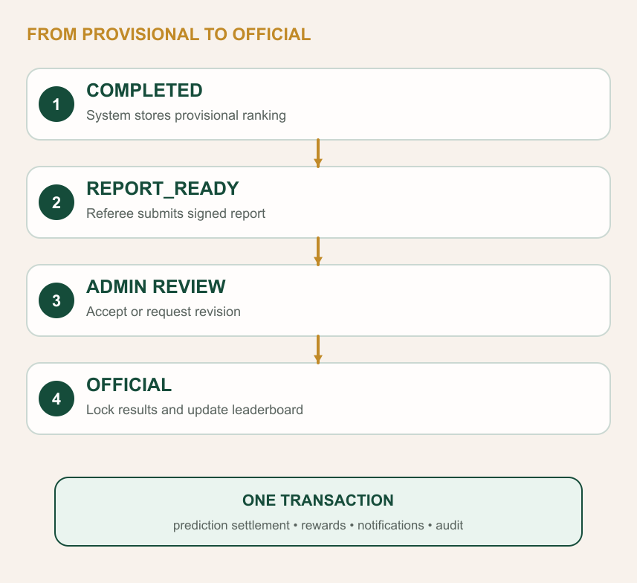
Live Race & Official Result
Notes:
Presenter B — Slide 14
Key message: Show live simulation, provisional results, signed report and Admin officialization.

Slide 15
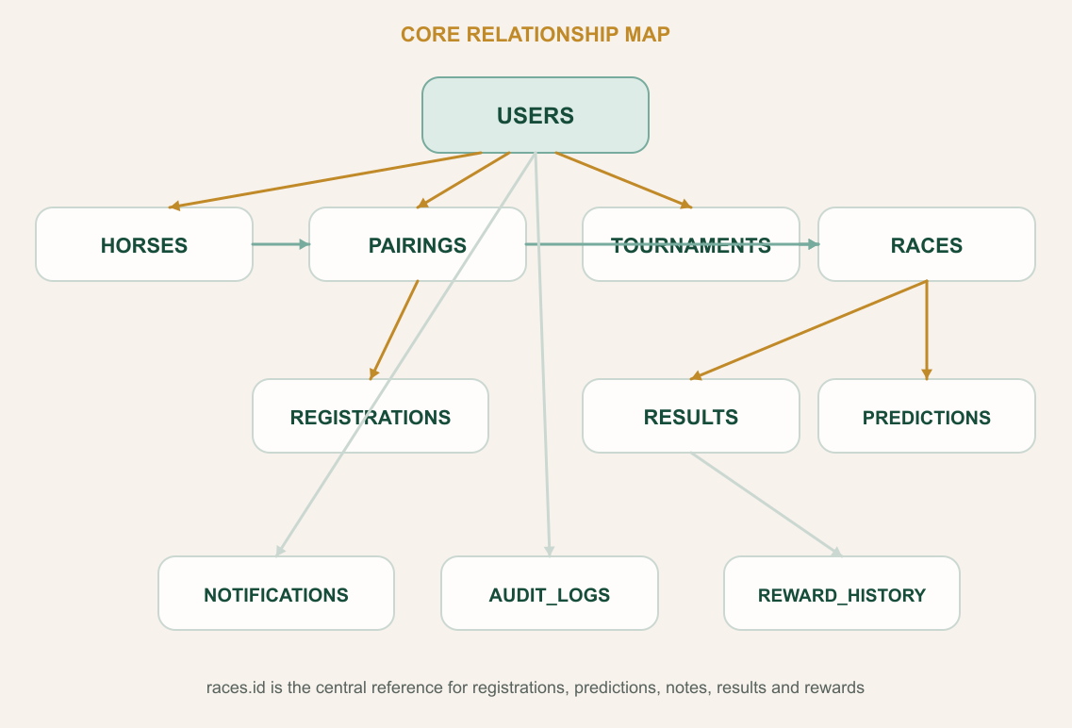
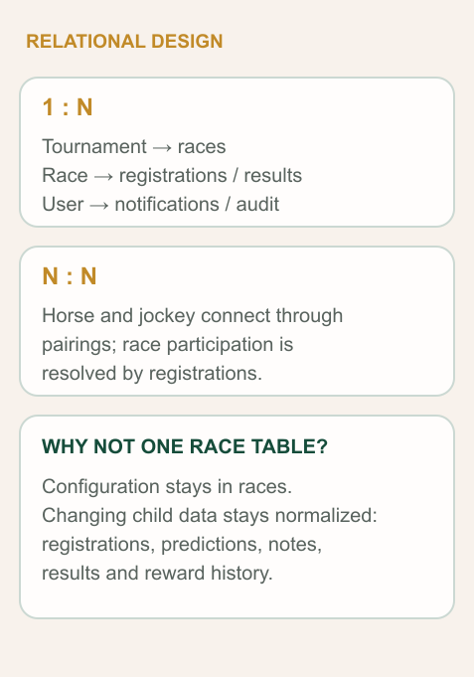
Conceptual Data Model
Notes:
Presenter B — Slide 15
Key message: Answer the database question: races stores configuration/state; child tables store outputs.

Slide 16
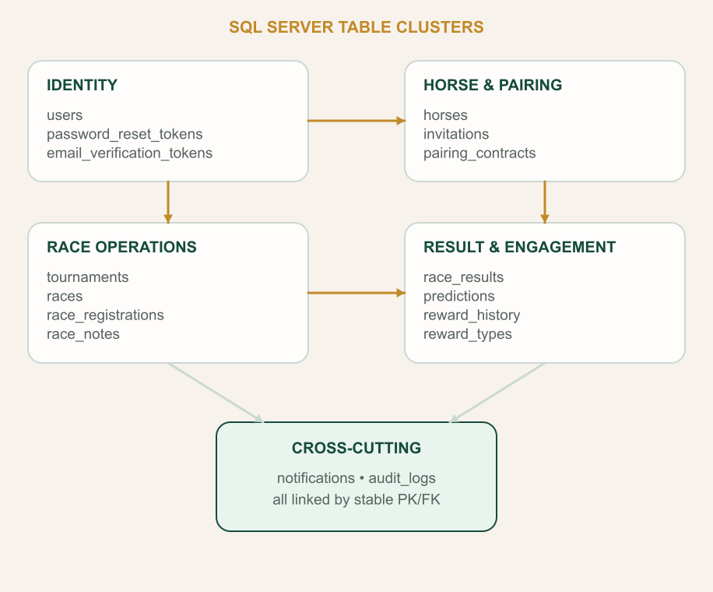
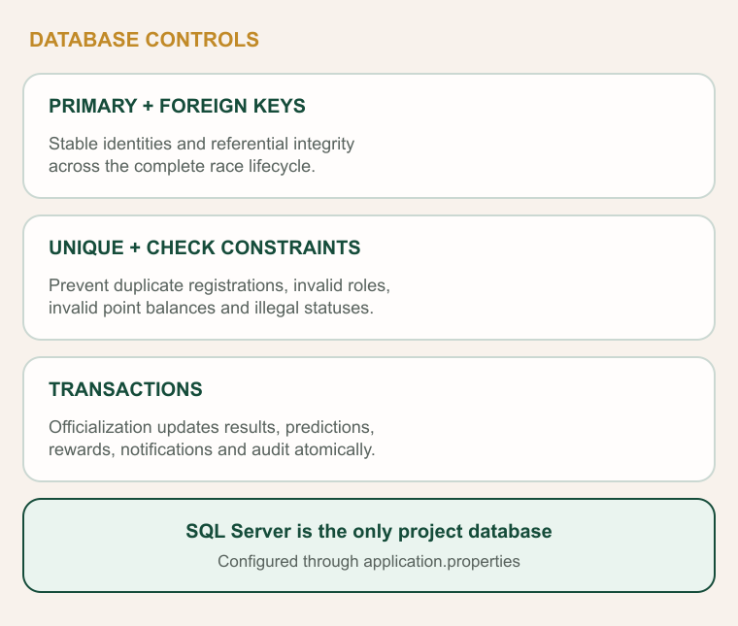
Logical SQL Server Model
Notes:
Presenter B — Slide 16
Key message: Explain table clusters, constraints and transaction boundaries in SQL Server.

Slide 17
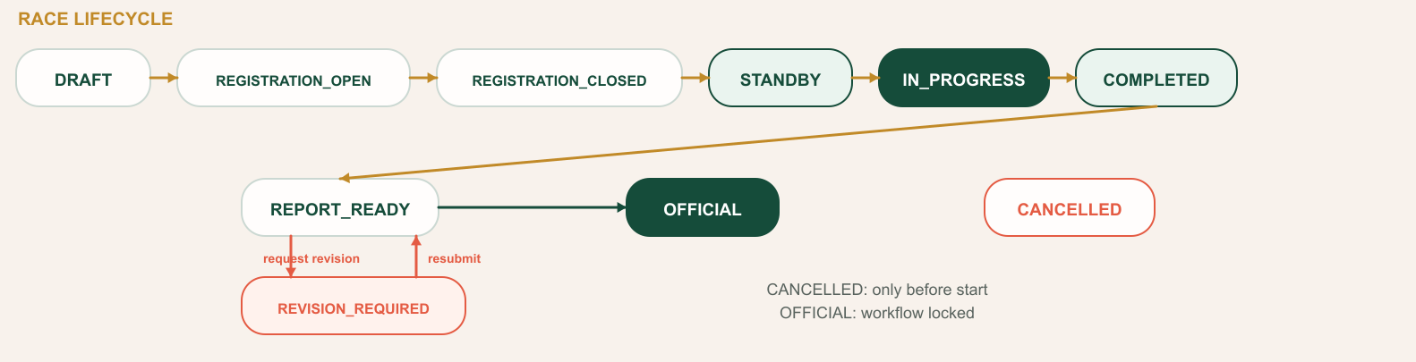
Race Lifecycle State Machine
Notes:
Presenter B — Slide 17
Key message: Walk through the exact race state machine and the revision loop.

Slide 18
Quality & Verification
01
Security & Access Control
JWT authentication, five-role RBAC, hashed passwords and backend authorization on sensitive endpoints.
02
Workflow Integrity
State-aware services block illegal transitions; a referee needs at least six cleared registrations to start.
03
Database Integrity
SQL Server PK/FK/unique constraints and Spring transactions protect multi-table business operations.
04
Automated Verification
46 backend tests and 12 frontend tests pass with zero failures; role, race and localization rules are covered.
05
Delivery Readiness
The Vite production build passes; the 531.7 KB main chunk is documented for future code-splitting.
Notes:
Presenter B — Slide 18
Key message: Present test evidence honestly and mention the known bundle optimization item.

Slide 19
EquiX connects business rules, code and data in one traceable workflow.
5 Roles
React 19
Spring Boot 3.5
SQL Server
JWT / RBAC
58 Tests
A race row stores configuration and workflow state. Related tables capture registrations, predictions, notes, results, rewards, notifications and audit history. That separation makes every stage explainable, testable and reviewable.
Notes:
Presenter B — Slide 19
Key message: Summarize why the system is traceable from UI to business rule to database.

Slide 20
Q & A
Thank you
We are ready for your questions.
SE1916 • GROUP 06 • EQUIX
SWP391 • Two-presenter final presentation
Notes:
Presenter B — Slide 20
Key message: Invite questions and hand off to the live demo when requested.

