Slide 1
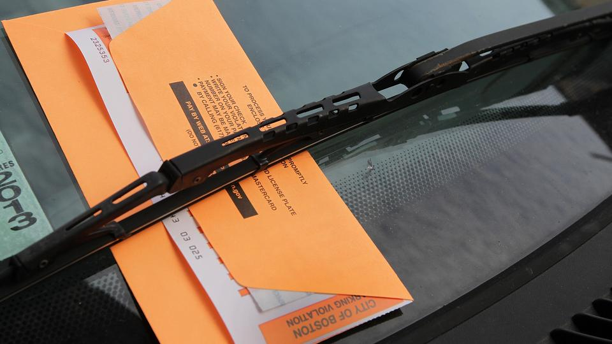
Parking Tickets

Slide 2
A general view of my project
Hypothesis: Boston police/ticket agents have a regular patrol schedule and route that we can predict.
dataset used(online dataset):
Parking tickets dataset
https://data.cityofboston.gov/dataset/Parking-Tickets/qbxx-ev3s
Street sweeping schedule of Boston
https://data.cityofboston.gov/City_Service/Street-Sweeping-Schedules/755x.x44q
Api used(google map api, to translate location to latitude and longitude)

Slide 3
Sample parsed dataset
Location | Time | Latitude | Longitude
1 BROOK MARSHALL RD | 11:51:00 AM | 42.231 | -71.1621
1 BEACON ST | 9:27:00 AM | 42.3585 | -71.0608
1 CENTER PLAZA | 5:30:00 PM | 42.3605 | -71.0608
1 COMMONWEALTH AVE | 9:02:00 AM | 42.354 | -71.0721
1 FEDERAL ST | 11:50:00 AM | 42.3561 | -71.057
1 FEDERAL ST | 11:49:00 AM | 42.3561 | -71.057
1 GLOUCESTER ST | 6:43:00 AM | 42.3517 | -71.0852

Slide 4
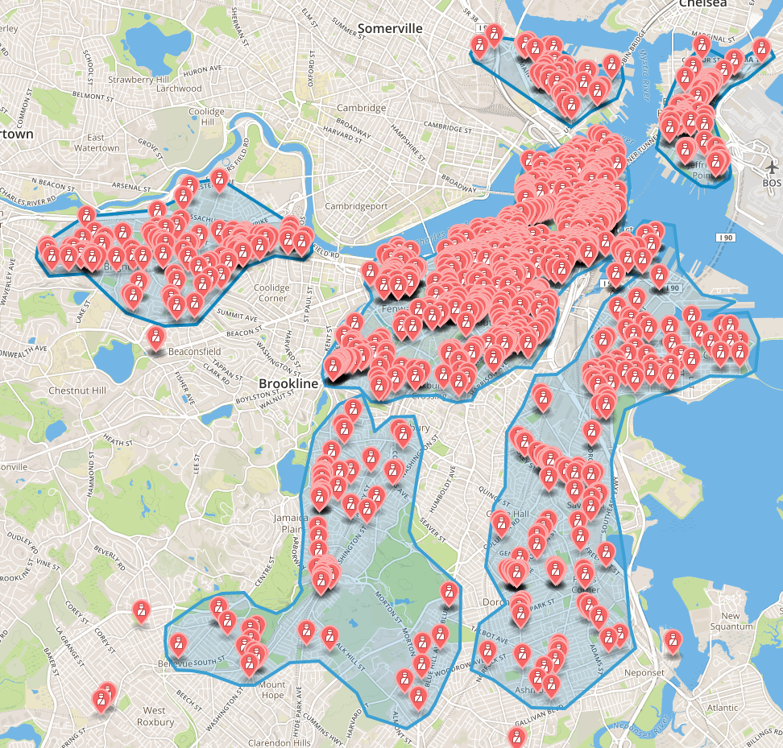
Total tickets issued on Friday

Slide 5
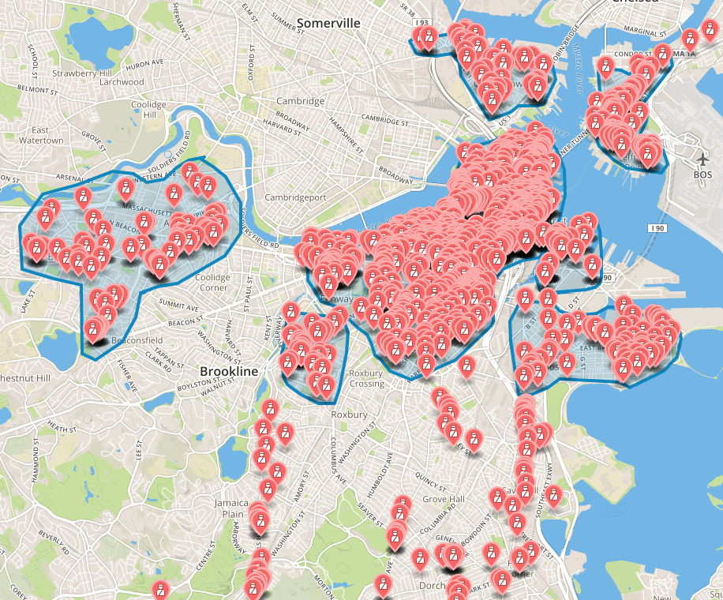
Total tickets issued on Saturday

Slide 6
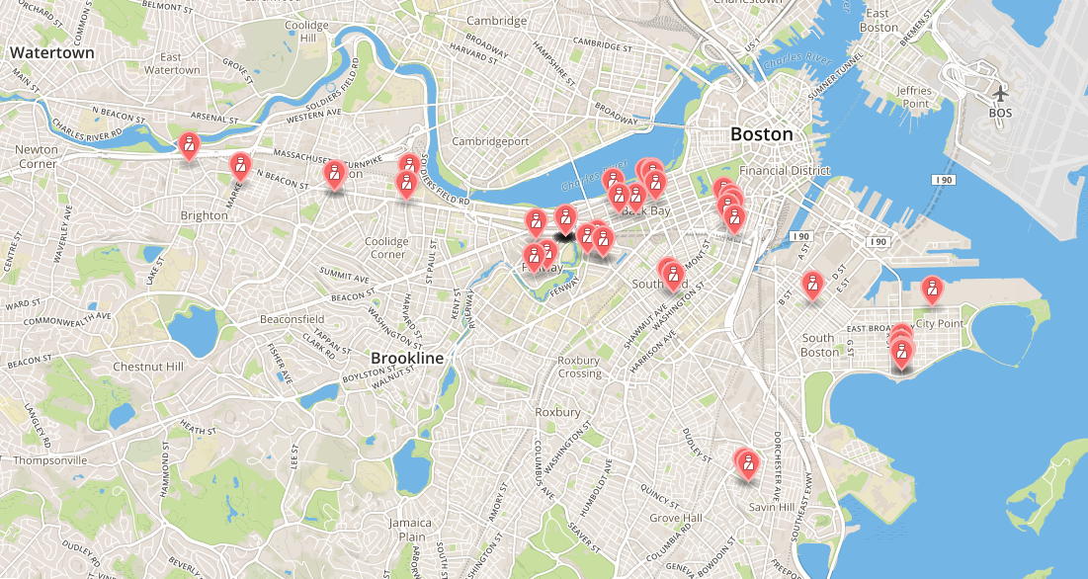
Total tickets issued on Sunday(Few!)

Slide 7
So the except for Sunday, all clusters on weekdays looks similar.
Hence the weekday ticketing schedule from Monday to Saturday must be similar.
But what about their daily schedule?

Slide 8
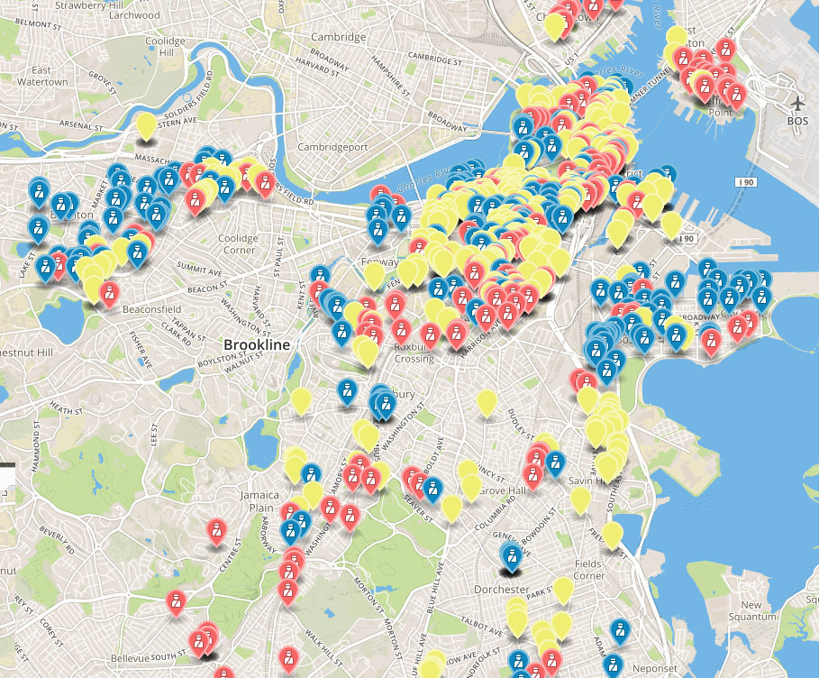
Monday Shchedule
Red:tickets issued in the morning
Yellow:tickets issued in the afternoon
Blue: tickets issued at night

Slide 9
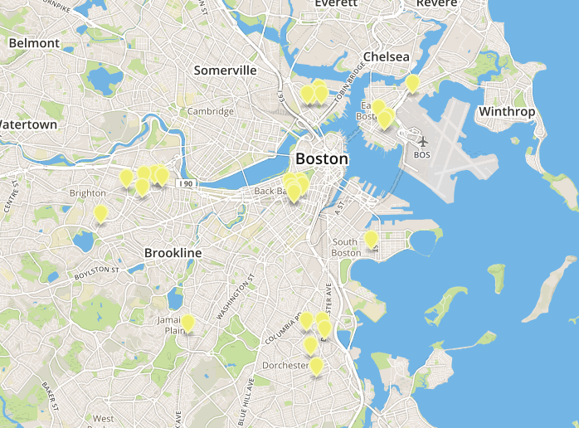
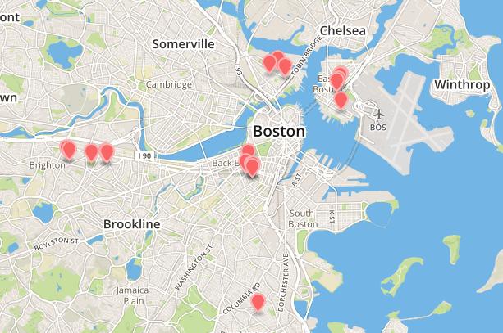
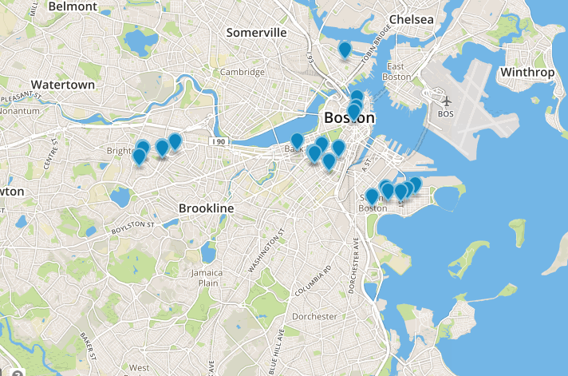
Morning
Afternoon
Night

Slide 10
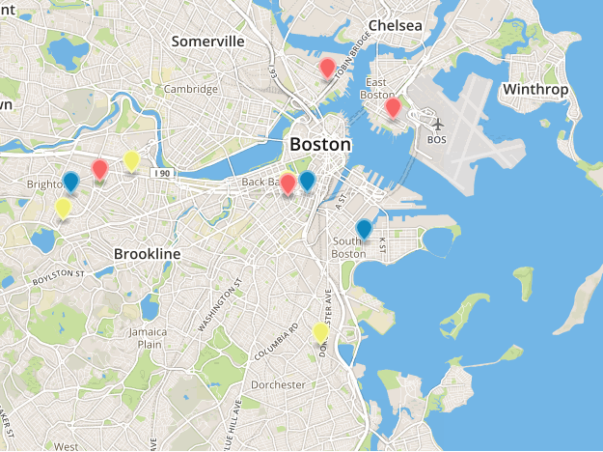

Slide 11
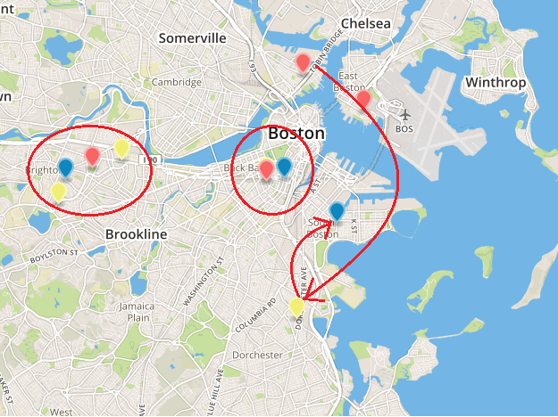

Slide 12
Conclusion:
1.There are always agents in Brighton and Back bay area.(So be careful with the parking rules there!)
2. Agents have a moving trend from east to south:
they start from east boston in the morning, go to central boston at afternoon, finally end at south boston.

