Slide 1
Linear Regression with
Gradient Descent
Car Selling Price Prediction
Machine Learning Project 1

Slide 2
Problem & Dataset
Objective
Dataset
• Predict car prices using linear regression
• Implement gradient descent from scratch
• Compare different learning rates
Features:
• year, km_driven, owner
• fuel type
• seller type
• transmission type
Target: Selling price
Data Preprocessing: Ordinal encoding → One-hot encoding → MinMax scaling [0,1]

Slide 3
Data Preprocessing Steps
1. Encoding
2. Feature Removal
3. Scaling
• Ordinal for owner
• Binary for transmission
• One-hot for fuel & seller
• Dropped 'name' column
• Not useful for prediction
• Reduces noise
• MinMax to [0,1]
• Prevents instability
#Binary for Transmission
df['transmission'] = df['transmission'].map({'Manual': 0, 'Automatic': 1}).fillna(0)
# One-hot encoding
for cat in FUEL_CATEGORIES:
df[f'fuel_{cat}'] = (df['fuel'] == cat).astype(int)
# MinMax Scaling - Essential for Gradient Descent!
for col in ['year', 'km_driven', 'owner']:
mn, mx = df[col].min(), df[col].max()
df[col] = (df[col] - mn) / (mx - mn + 1e-8)

Slide 4
Model Architecture
Linear Regression Hypothesis
h(x) = Xθ = θ₀x₀ + θ₁x₁ + ... + θₙxₙ
Cost Function (Mean Squared Error)
J(θ) = 1/(2m) Σ(h(x⁽ⁱ⁾) - y⁽ⁱ⁾)²
Gradient Descent Update Rule
θ := θ - α · ∇J(θ) where ∇J(θ) = 1/m · Xᵀ(Xθ - y)
α = learning rate | m = number of samples | θ = parameters | y = real price | i = iteration

Slide 5
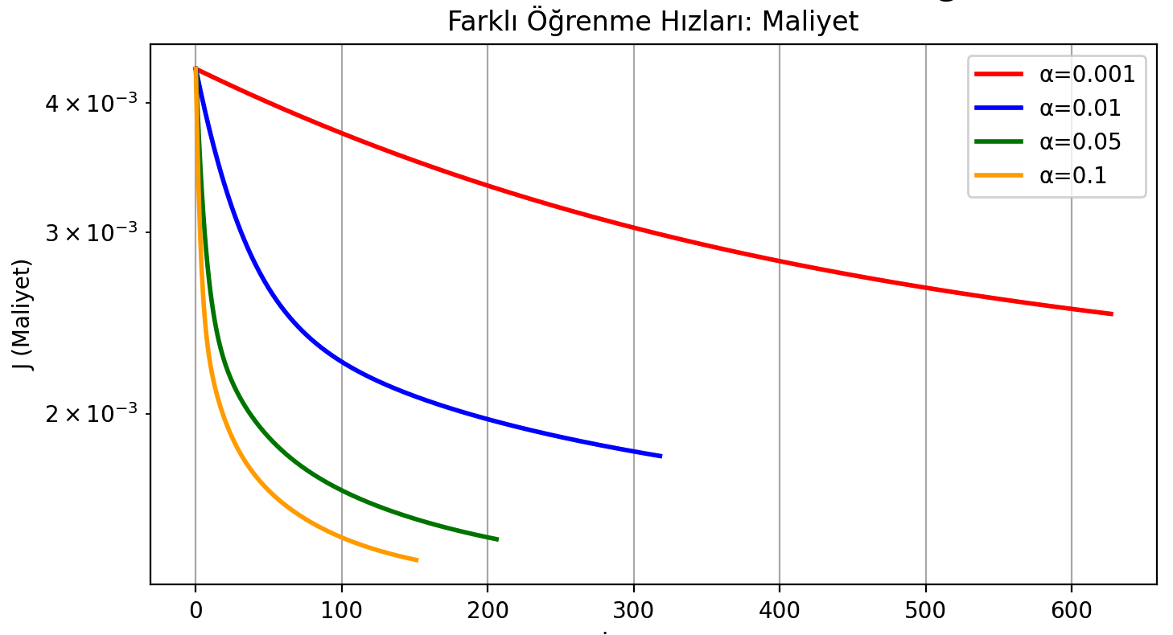
Training: Learning Rate Comparison
α | Iterations | Final Cost | Test MSE
0.001 | 628 | 0.002499 | 0.004896
0.01 | 319 | 0.001819 | 0.003789
0.05 | 207 | 0.001511 | 0.003353
0.1 | 152 | 0.001443 | 0.003246

Slide 6
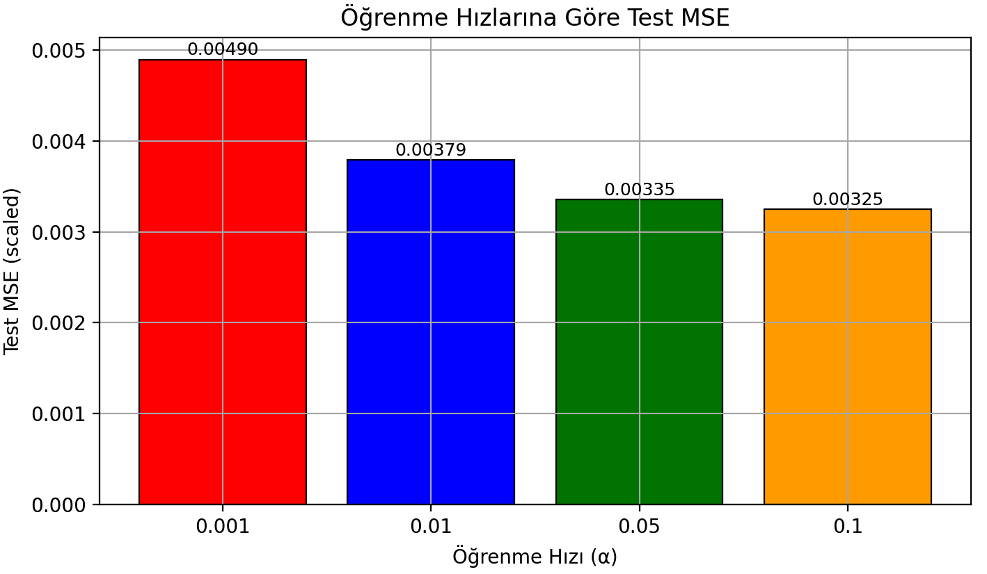
Convergence Analysis
Key Observations
✓ All learning rates converge to similar final cost
✓ Higher α = faster convergence (10,000 vs 450 iterations)
✓ α = 0.1 achieved best balance: fast + stable + low test error

Slide 7
Results & Evaluation
Best Model: α = 0.1 (converged in 152 iterations)
Metric | Value (Scaled) | Value (Real INR) | Meaning
MSE | 0.003246 | ~1.2M | Avg squared error
RMSE | 0.057 | ~463,000 | Typical error
MAE | 0.029 | ~232,000 | Avg absolute error
R² Score | — | 0.3415 | 34% variance explained
Performance Summary
✓ Moderate predictive power: R² = 0.34 (explains 34% of price variance)
✓ Average prediction error: 232,000 (MAE) on unseen test data
✓ Efficient training: converged in only 152 iterations

Slide 8
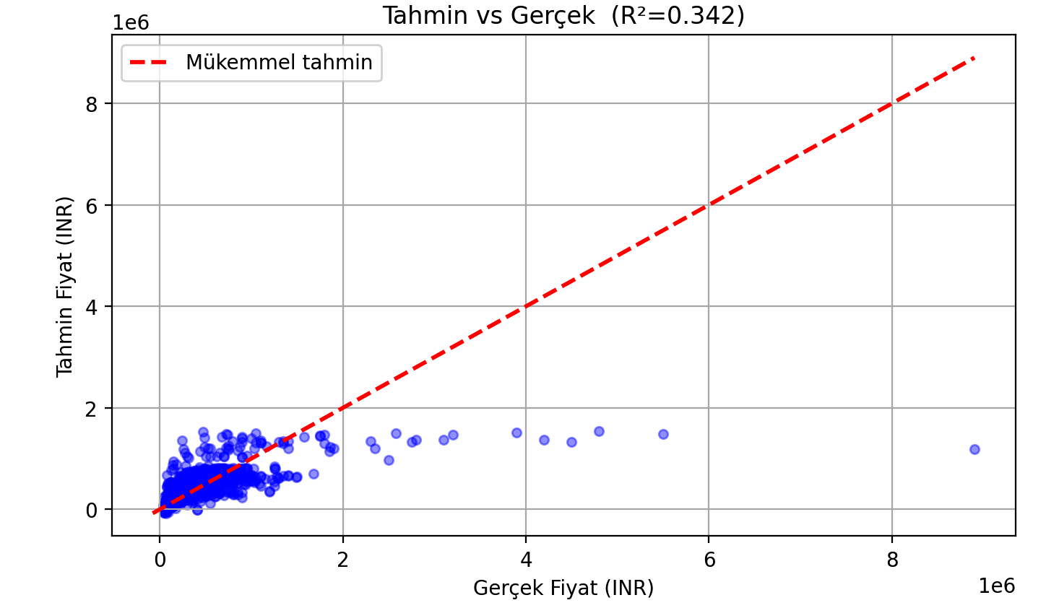
Prediction Quality
Points cluster around diagonal = good predictions | Some outliers exist but overall fit is strong (R²=0.34)

Slide 9
Most Important Features
Feature | θ Value | Impact on Price
year | +0.0591 | ↑ Newer cars cost more
km_driven | -0.0085 | ↓ Higher mileage slightly reduces price
fuel_Diesel | +0.0324 | ↑ Diesel has slight premium
fuel_Petrol | -0.0047 | ↓ Petrol has small discount
owner | -0.0156 | ↓ More owners = slight reduction
Key Insights from Parameters
1. Transmission is the strongest predictor
Automatic transmission adds premium (θ = +0.086)
2. Vehicle age has moderate impact
Newer cars cost more (θ = +0.059)
3. Fuel and other features have minor effects
Small differences: Diesel +0.032, mileage -0.009

Slide 10
Conclusion
Thank You!
✓ Achievements
Questions & Discussion
• Implemented linear regression from scratch
• Gradient descent converged in 152 iterations
• Achieved R² = 0.34
• Identified key price drivers

