Slide 1


SQL FOR DATA ANALYSTS · LECTURE 2
DDL & DML, Procedures, Variables
Denis Boldin

Slide 2

Contents
2.1 Creating and updating tables
2.2 Materializations: views and materialized views
2.3 Procedures
2.4 Variables
Summary

Slide 3

LECTURE 2. DDL & DML, PROCEDURES, VARIABLES
Contents
Lecture 1 was about reading data. This lecture is about changing it — the structure of the database, its contents, and the code that lives inside the database itself.
Everything runs against the same course database, in the live playground. This time you will be modifying it, which is exactly why the playground is worth having: refresh the page and you get a clean database back. Nothing you do here can break anything.
Rather than mutate tracks and artists, most of this lecture builds something new on top of them — a playlists table, the feature every music service has and this dataset lacks.

Slide 4

2.1 Creating and updating tables
SQL statements are traditionally split into groups by what they act on:
CREATE
ALTER
TRUNCATE
DROP
INSERT
UPDATE
DELETE
DELETE vs TRUNCATE
A note on safety

Slide 5
LECTURE 2. DDL & DML, PROCEDURES, VARIABLES
2.1 Creating and updating tables
Group | Statements | Acts on
DDL — Data Definition Language | CREATE, ALTER, DROP, TRUNCATE | the structure: tables, indexes, constraints, sequences
DML — Data Manipulation Language | INSERT, UPDATE, DELETE | the data inside the tables
TCL — Transaction Control Language | BEGIN, COMMIT, ROLLBACK | transactions (see ACID, Lecture 1 §1.6)
DCL — Data Control Language | GRANT, REVOKE | access rights
This section covers the first two.

Slide 6
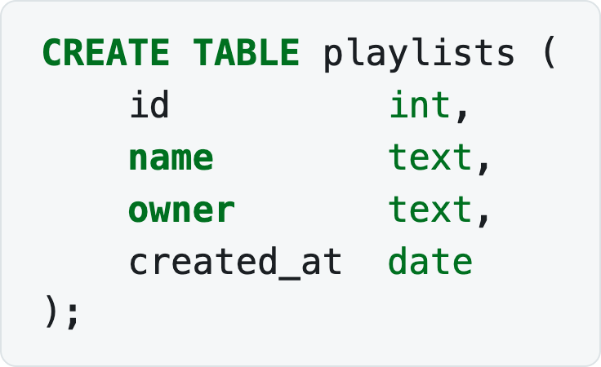
2.1 CREATING AND UPDATING TABLES · DDL — DATA DEFINITION LANGUAGE
CREATE
Creating a table in its simplest form:
Notes:
CREATE TABLE playlists (
id int,
name text,
owner text,
created_at date
);

Slide 7
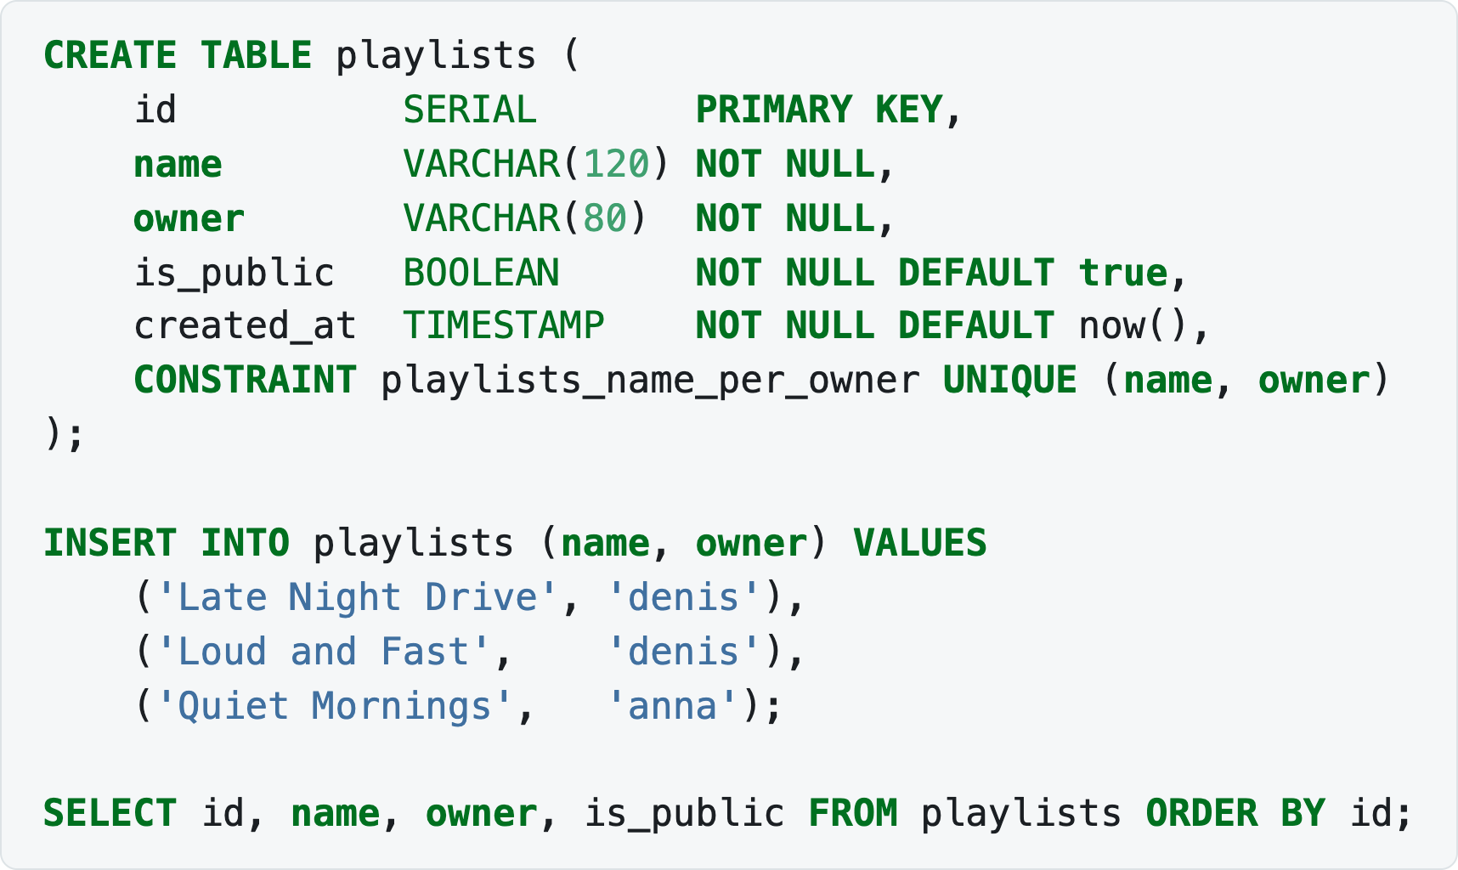
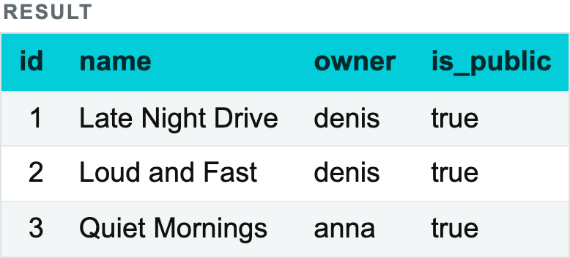
2.1 CREATING AND UPDATING TABLES · DDL — DATA DEFINITION LANGUAGE
CREATE
That works, but it says nothing about what is valid. In practice you also declare keys, length limits and constraints. The same table, written the way you would actually write it in PostgreSQL:
Notes:
CREATE TABLE playlists (
id SERIAL PRIMARY KEY,
name VARCHAR(120) NOT NULL,
owner VARCHAR(80) NOT NULL,
is_public BOOLEAN NOT NULL DEFAULT true,
created_at TIMESTAMP NOT NULL DEFAULT now(),
CONSTRAINT playlists_name_per_owner UNIQUE (name, owner)
);
INSERT INTO playlists (name, owner) VALUES
('Late Night Drive', 'denis'),
('Loud and Fast', 'denis'),
('Quiet Mornings', 'anna');
SELECT id, name, owner, is_public FROM playlists ORDER BY id;

Slide 8
2.1 CREATING AND UPDATING TABLES · DDL — DATA DEFINITION LANGUAGE
CREATE
id is not a plain INT but a SERIAL PRIMARY KEY — an auto-incrementing surrogate key, which is why the INSERT never mentions id;
name is a VARCHAR limited to 120 characters instead of an unbounded TEXT;
owner carries a NOT NULL constraint;
is_public and created_at have DEFAULTs, so the INSERT did not have to supply them;
the table-level UNIQUE constraint spans two columns: one owner may not have two playlists with the same name, but two owners may.

Slide 9
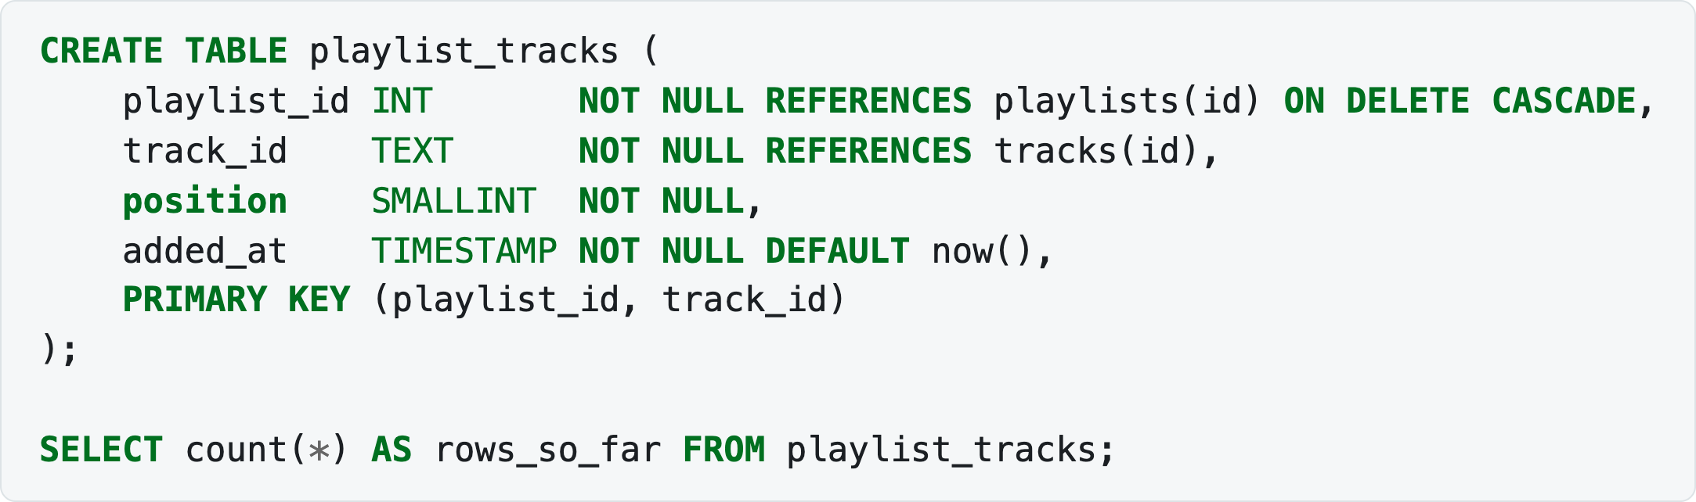
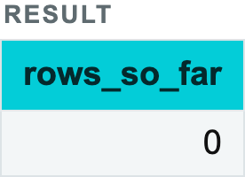
2.1 CREATING AND UPDATING TABLES · DDL — DATA DEFINITION LANGUAGE
CREATE
💡 DDL syntax differs considerably between DBMSs — ClickHouse, for example, additionally requires a table engine, a sort key and ON CLUSTER for a distributed rollout. Always consult the documentation of the system you are working with. Everything in this course is PostgreSQL.
Now the table that connects playlists to the catalogue — a bridge table, exactly like track_artists from Lecture 1:
Notes:
CREATE TABLE playlist_tracks (
playlist_id INT NOT NULL REFERENCES playlists(id) ON DELETE CASCADE,
track_id TEXT NOT NULL REFERENCES tracks(id),
position SMALLINT NOT NULL,
added_at TIMESTAMP NOT NULL DEFAULT now(),
PRIMARY KEY (playlist_id, track_id)
);
SELECT count(*) AS rows_so_far FROM playlist_tracks;

Slide 10
2.1 CREATING AND UPDATING TABLES · DDL — DATA DEFINITION LANGUAGE
CREATE
PRIMARY KEY uniquely identifies a row; there is exactly one per table, and it is NOT NULL by definition. Here it spans two columns — the same track cannot be added to the same playlist twice.
REFERENCES (a foreign key) guarantees that the value exists in the referenced table — this is the "Consistency" of ACID being enforced for you.
ON DELETE CASCADE says what to do when the parent goes: delete a playlist and its entries go with it. Without it, PostgreSQL would refuse the delete.
UNIQUE forbids repeated values.
DEFAULT supplies a value when the INSERT does not.

Slide 11
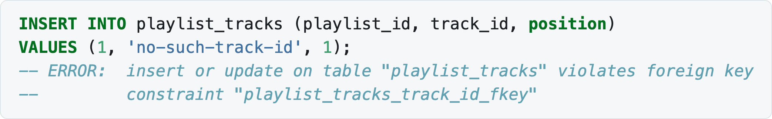
2.1 CREATING AND UPDATING TABLES · DDL — DATA DEFINITION LANGUAGE
CREATE
The foreign key is not decoration. Try to add a track that does not exist and the database refuses:
Notes:
INSERT INTO playlist_tracks (playlist_id, track_id, position)
VALUES (1, 'no-such-track-id', 1);
-- ERROR: insert or update on table "playlist_tracks" violates foreign key
-- constraint "playlist_tracks_track_id_fkey"

Slide 12
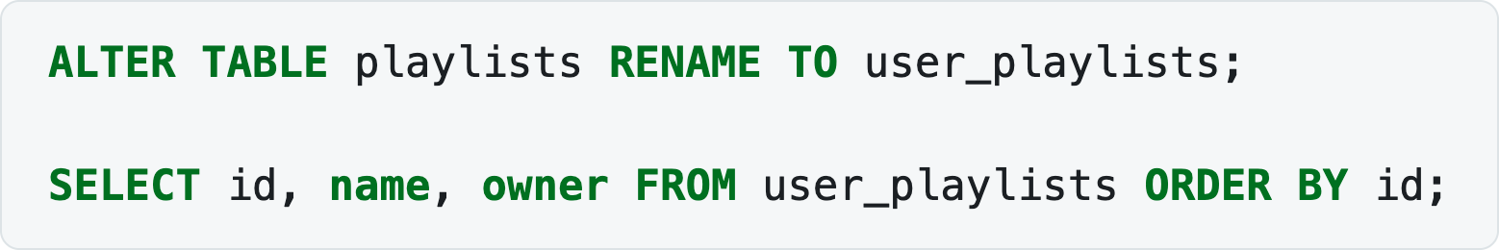
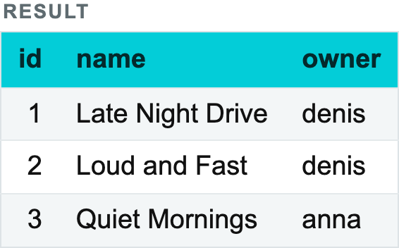
2.1 CREATING AND UPDATING TABLES · DDL — DATA DEFINITION LANGUAGE
ALTER
ALTER TABLE renames tables and adds, modifies and removes fields.
Renaming a table:
Renaming is usually fast: no new table is created and no data is copied — one name is simply replaced by another in the DBMS's catalogue.
Notes:
ALTER TABLE playlists RENAME TO user_playlists;
SELECT id, name, owner FROM user_playlists ORDER BY id;

Slide 13
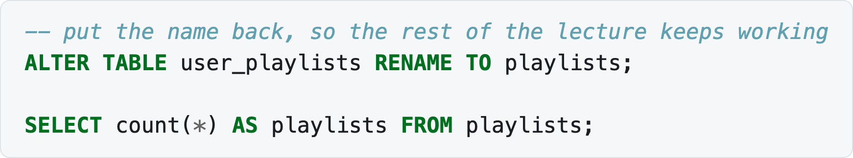
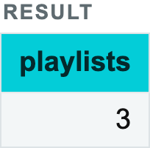
2.1 CREATING AND UPDATING TABLES · DDL — DATA DEFINITION LANGUAGE
ALTER
Notes:
-- put the name back, so the rest of the lecture keeps working
ALTER TABLE user_playlists RENAME TO playlists;
SELECT count(*) AS playlists FROM playlists;

Slide 14
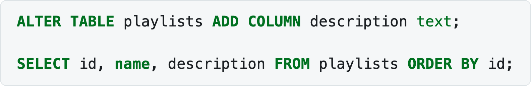
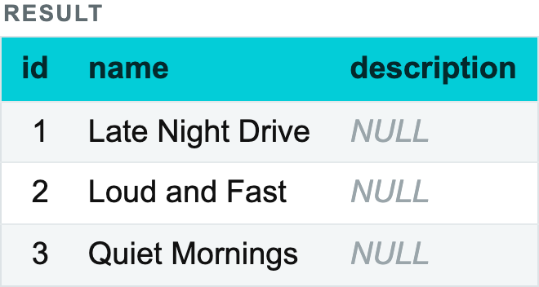
2.1 CREATING AND UPDATING TABLES · DDL — DATA DEFINITION LANGUAGE
ALTER
Adding a new field. In all existing rows the new field takes the value NULL:
Notes:
ALTER TABLE playlists ADD COLUMN description text;
SELECT id, name, description FROM playlists ORDER BY id;

Slide 15
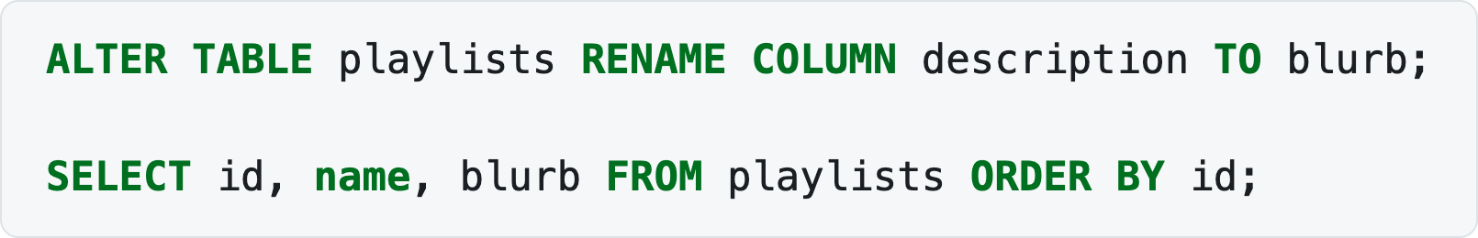
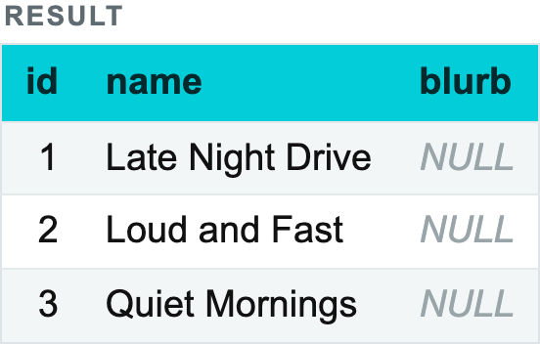
2.1 CREATING AND UPDATING TABLES · DDL — DATA DEFINITION LANGUAGE
ALTER
Renaming a field:
Notes:
ALTER TABLE playlists RENAME COLUMN description TO blurb;
SELECT id, name, blurb FROM playlists ORDER BY id;

Slide 16
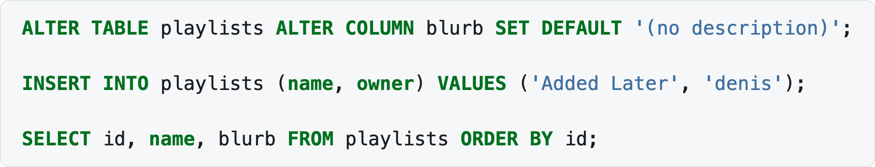
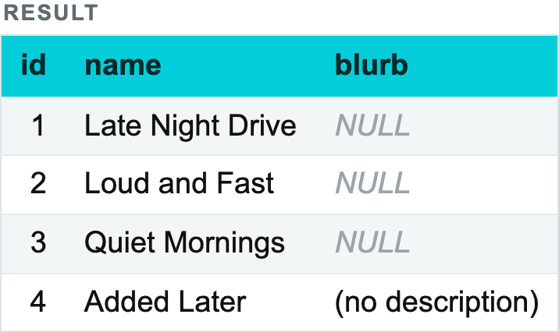
2.1 CREATING AND UPDATING TABLES · DDL — DATA DEFINITION LANGUAGE
ALTER
Setting a default value for a field:
Notes:
ALTER TABLE playlists ALTER COLUMN blurb SET DEFAULT '(no description)';
INSERT INTO playlists (name, owner) VALUES ('Added Later', 'denis');
SELECT id, name, blurb FROM playlists ORDER BY id;

Slide 17
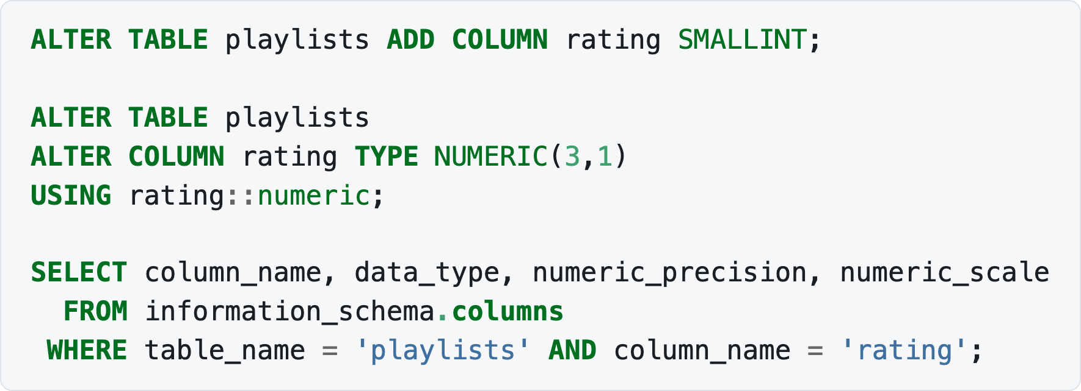
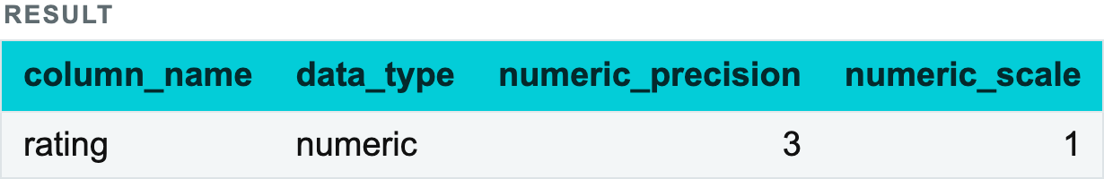
2.1 CREATING AND UPDATING TABLES · DDL — DATA DEFINITION LANGUAGE
ALTER
💡 The default value applies only to new rows. Rows added earlier keep their NULL — look at the first three rows above.
Changing a column's type. USING tells PostgreSQL how to convert the existing values:
Notes:
ALTER TABLE playlists ADD COLUMN rating SMALLINT;
ALTER TABLE playlists
ALTER COLUMN rating TYPE NUMERIC(3,1)
USING rating::numeric;
SELECT column_name, data_type, numeric_precision, numeric_scale
FROM information_schema.columns
WHERE table_name = 'playlists' AND column_name = 'rating';

Slide 18
2.1 CREATING AND UPDATING TABLES · DDL — DATA DEFINITION LANGUAGE
ALTER
information_schema is how you ask PostgreSQL about its own structure — useful whenever you are not sure what a table actually looks like.

Slide 19
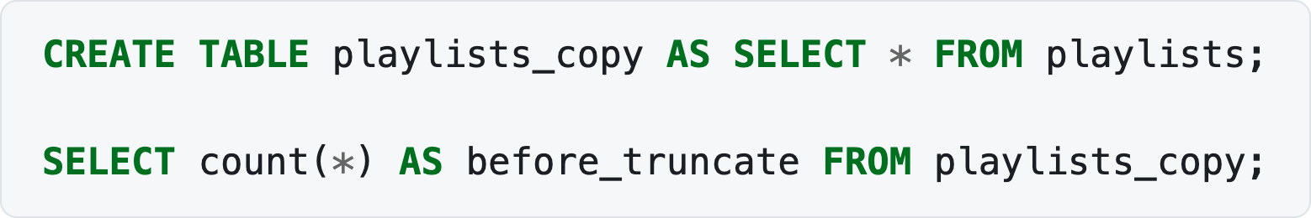
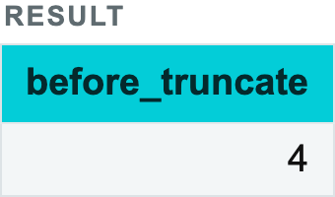
2.1 CREATING AND UPDATING TABLES · DDL — DATA DEFINITION LANGUAGE
TRUNCATE
TRUNCATE TABLE removes all rows very quickly — much faster than DELETE FROM table, because it does not delete rows one by one. The table structure stays in place.
Notes:
CREATE TABLE playlists_copy AS SELECT * FROM playlists;
SELECT count(*) AS before_truncate FROM playlists_copy;

Slide 20
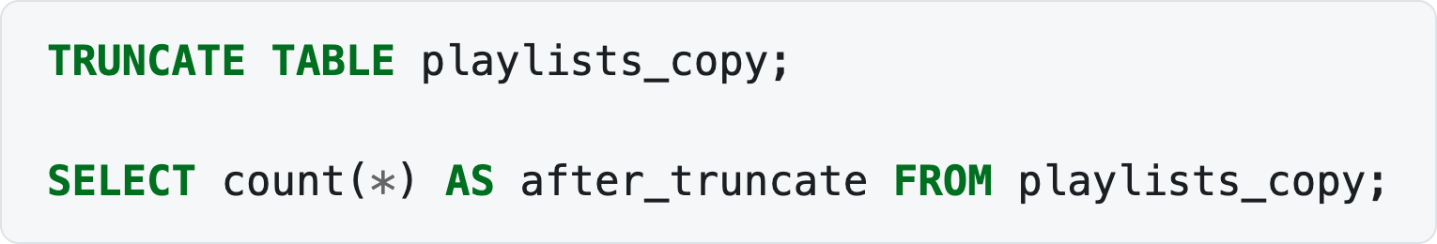
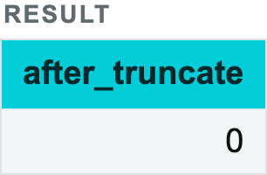
2.1 CREATING AND UPDATING TABLES · DDL — DATA DEFINITION LANGUAGE
TRUNCATE
CREATE TABLE … AS SELECT above is worth noting in its own right: it creates a table and fills it from a query in one statement, inferring the column types.
Notes:
TRUNCATE TABLE playlists_copy;
SELECT count(*) AS after_truncate FROM playlists_copy;

Slide 21
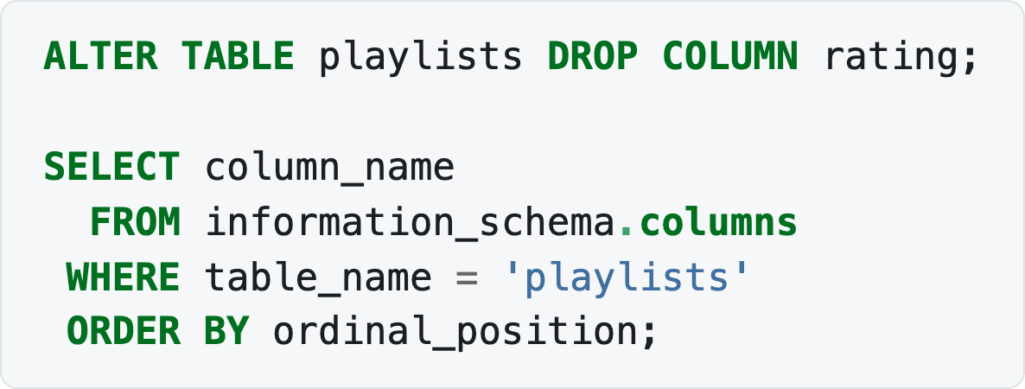
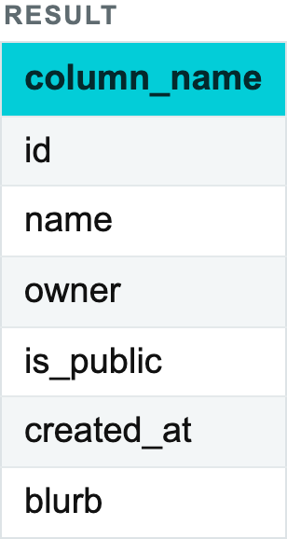
2.1 CREATING AND UPDATING TABLES · DDL — DATA DEFINITION LANGUAGE
DROP
Dropping a column:
Notes:
ALTER TABLE playlists DROP COLUMN rating;
SELECT column_name
FROM information_schema.columns
WHERE table_name = 'playlists'
ORDER BY ordinal_position;

Slide 22
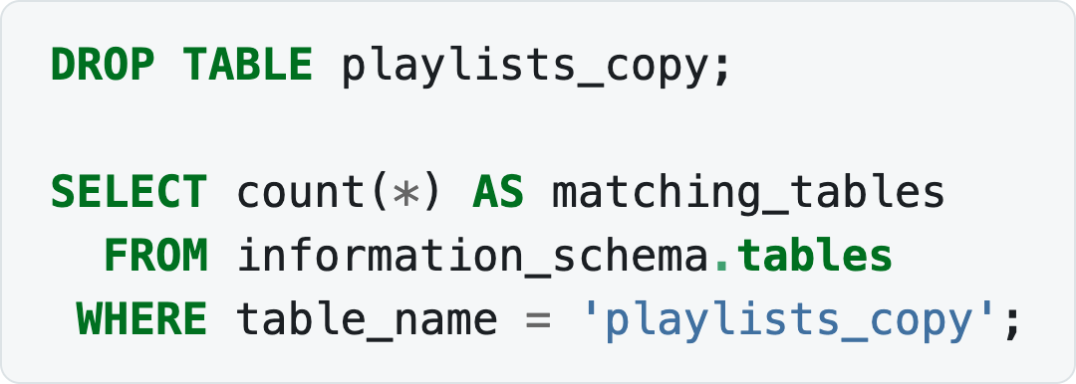
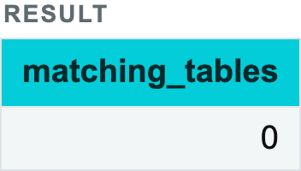
2.1 CREATING AND UPDATING TABLES · DDL — DATA DEFINITION LANGUAGE
DROP
Dropping a table:
💡 Be careful with dropping a table — restoring it from a backup will be very hard. DROP TABLE IF EXISTS avoids an error when the table may not be there, which is what you want in a script; it does not make the drop any less permanent.
Notes:
DROP TABLE playlists_copy;
SELECT count(*) AS matching_tables
FROM information_schema.tables
WHERE table_name = 'playlists_copy';

Slide 23
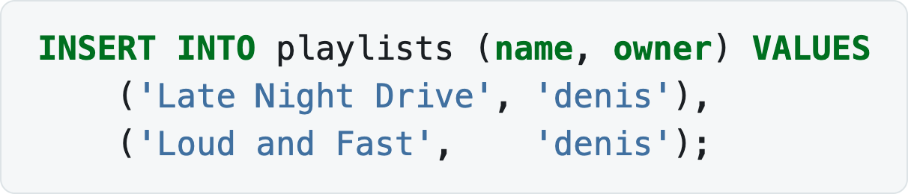
2.1 CREATING AND UPDATING TABLES · DML — DATA MANIPULATION LANGUAGE
INSERT
Adding records from literal values — we did this above:
Notes:
INSERT INTO playlists (name, owner) VALUES
('Late Night Drive', 'denis'),
('Loud and Fast', 'denis');

Slide 24
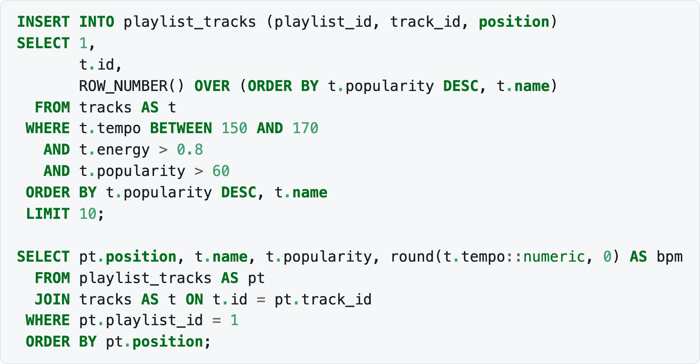
2.1 CREATING AND UPDATING TABLES · DML — DATA MANIPULATION LANGUAGE
INSERT
Adding rows from a query is where it gets interesting. Filling a playlist from the catalogue — energetic tracks at a running tempo, most popular first:
Notes:
INSERT INTO playlist_tracks (playlist_id, track_id, position)
SELECT 1,
t.id,
ROW_NUMBER() OVER (ORDER BY t.popularity DESC, t.name)
FROM tracks AS t
WHERE t.tempo BETWEEN 150 AND 170
AND t.energy > 0.8
AND t.popularity > 60
ORDER BY t.popularity DESC, t.name
LIMIT 10;
SELECT pt.position, t.name, t.popularity, round(t.tempo::numeric, 0) AS bpm
FROM playlist_tracks AS pt
JOIN tracks AS t ON t.id = pt.track_id
WHERE pt.playlist_id = 1
ORDER BY pt.position;

Slide 25
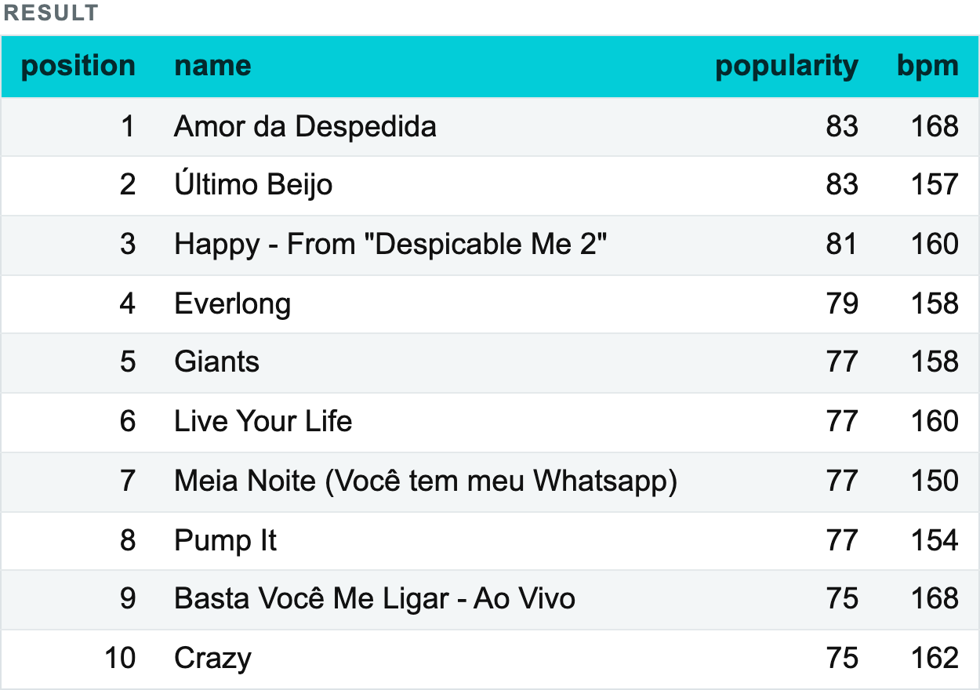
2.1 CREATING AND UPDATING TABLES · DML — DATA MANIPULATION LANGUAGE
INSERT
Notes:
INSERT INTO playlist_tracks (playlist_id, track_id, position)
SELECT 1,
t.id,
ROW_NUMBER() OVER (ORDER BY t.popularity DESC, t.name)
FROM tracks AS t
WHERE t.tempo BETWEEN 150 AND 170
AND t.energy > 0.8
AND t.popularity > 60
ORDER BY t.popularity DESC, t.name
LIMIT 10;
SELECT pt.position, t.name, t.popularity, round(t.tempo::numeric, 0) AS bpm
FROM playlist_tracks AS pt
JOIN tracks AS t ON t.id = pt.track_id
WHERE pt.playlist_id = 1
ORDER BY pt.position;

Slide 26
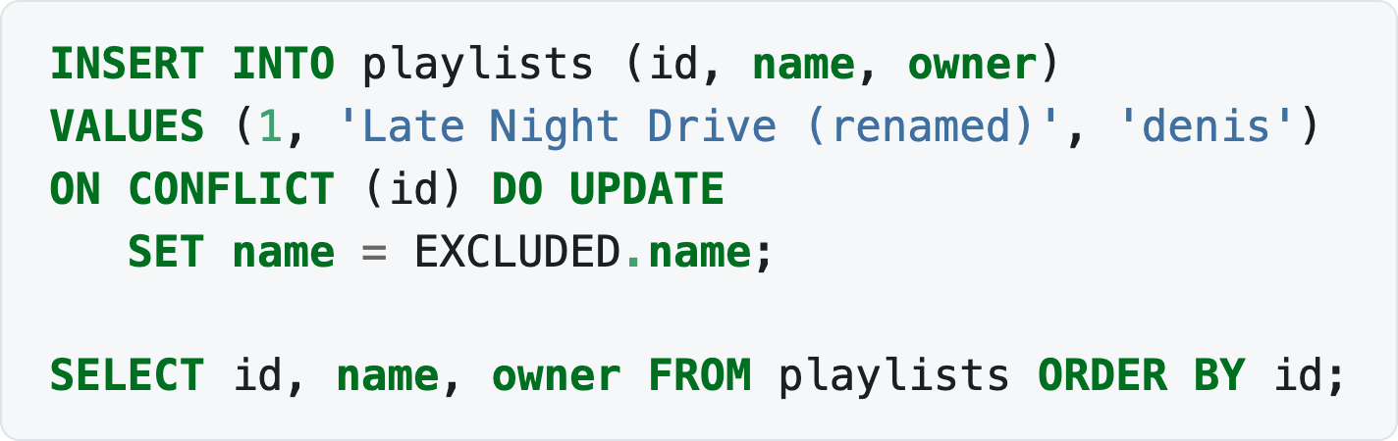
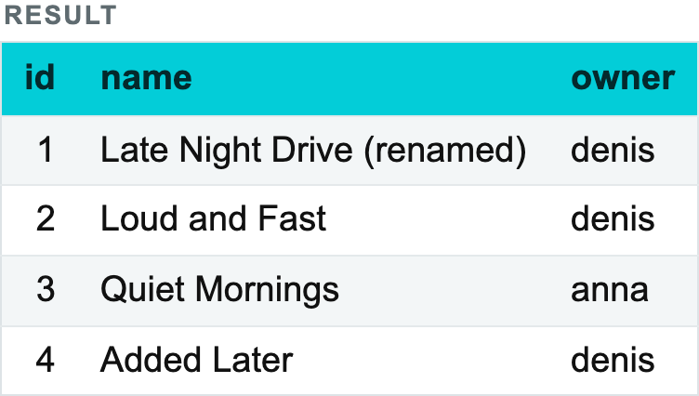
2.1 CREATING AND UPDATING TABLES · DML — DATA MANIPULATION LANGUAGE
INSERT
The fields selected in SELECT must match, in order and in type, the fields listed for the target table. If a field has no source, put something explicit — a constant, or NULL — in its place, as we did with the literal 1 for playlist_id.
ON CONFLICT handles the case where the row is already there. Without it, re-running the insert above would fail on the primary key:
EXCLUDED is the row that would have been inserted. This "insert, or update if it exists" pattern is called an upsert, and it is everywhere in data loading.
Notes:
INSERT INTO playlists (id, name, owner)
VALUES (1, 'Late Night Drive (renamed)', 'denis')
ON CONFLICT (id) DO UPDATE
SET name = EXCLUDED.name;
SELECT id, name, owner FROM playlists ORDER BY id;

Slide 27
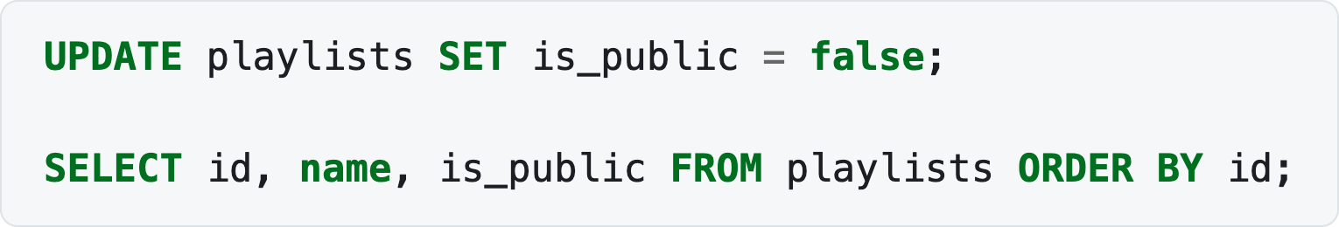
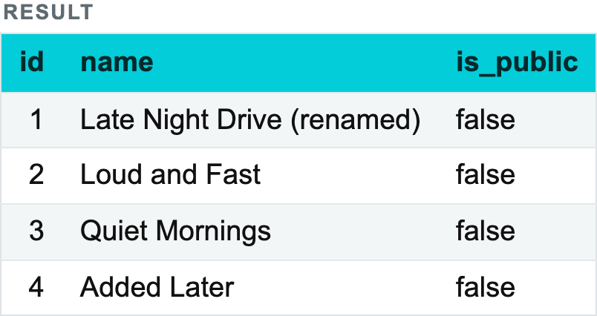
2.1 CREATING AND UPDATING TABLES · DML — DATA MANIPULATION LANGUAGE
UPDATE
Changing data in all records of a column:
Notes:
UPDATE playlists SET is_public = false;
SELECT id, name, is_public FROM playlists ORDER BY id;

Slide 28
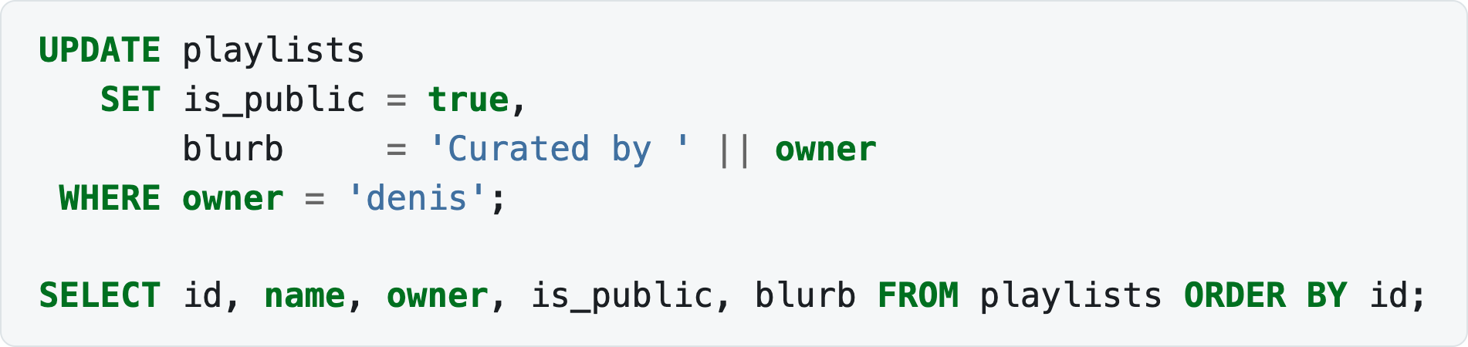
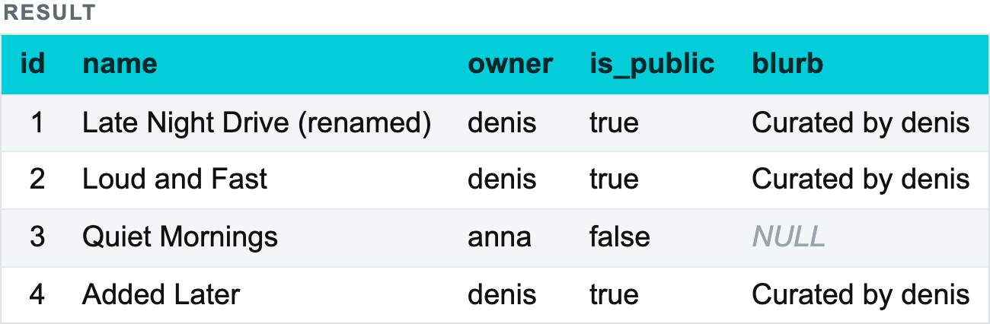
2.1 CREATING AND UPDATING TABLES · DML — DATA MANIPULATION LANGUAGE
UPDATE
Changing data in filtered records:
Notes:
UPDATE playlists
SET is_public = true,
blurb = 'Curated by ' || owner
WHERE owner = 'denis';
SELECT id, name, owner, is_public, blurb FROM playlists ORDER BY id;

Slide 29
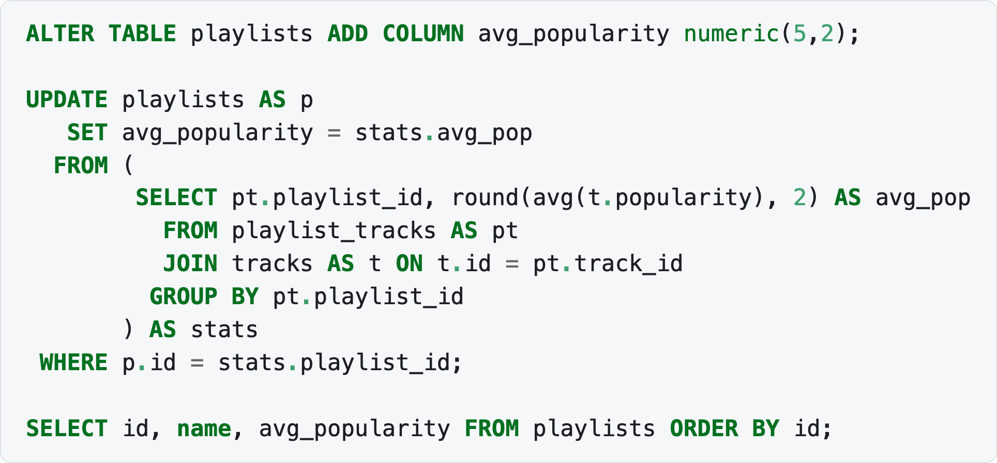
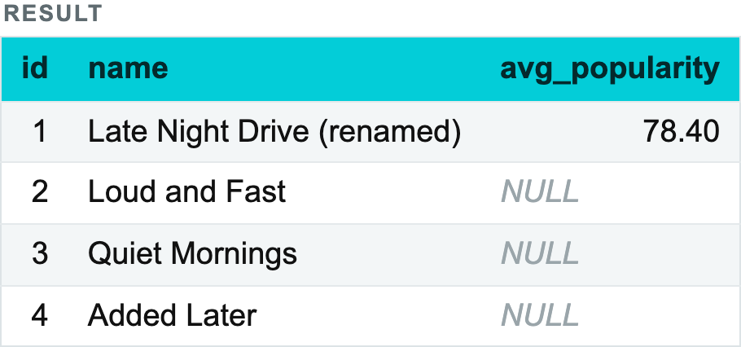
2.1 CREATING AND UPDATING TABLES · DML — DATA MANIPULATION LANGUAGE
UPDATE
An UPDATE can also draw its new values from another table. Storing each playlist's average track popularity:
UPDATE … FROM is PostgreSQL's way of writing "update these rows using a join". Playlists with no tracks keep NULL, which is correct: the average of nothing is not zero.
Notes:
ALTER TABLE playlists ADD COLUMN avg_popularity numeric(5,2);
UPDATE playlists AS p
SET avg_popularity = stats.avg_pop
FROM (
SELECT pt.playlist_id, round(avg(t.popularity), 2) AS avg_pop
FROM playlist_tracks AS pt
JOIN tracks AS t ON t.id = pt.track_id
GROUP BY pt.playlist_id
) AS stats
WHERE p.id = stats.playlist_id;
SELECT id, name, avg_popularity FROM playlists ORDER BY id;

Slide 30
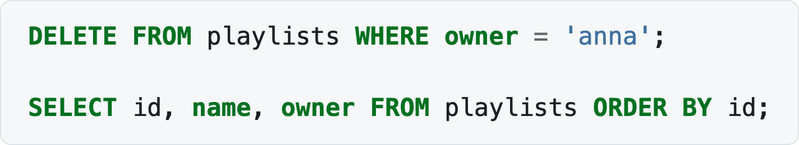
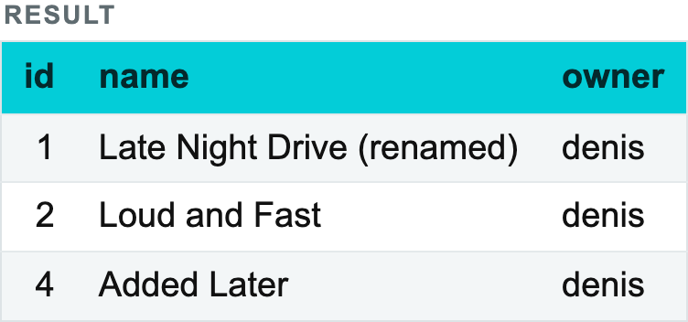
2.1 CREATING AND UPDATING TABLES · DML — DATA MANIPULATION LANGUAGE
DELETE
Notes:
DELETE FROM playlists WHERE owner = 'anna';
SELECT id, name, owner FROM playlists ORDER BY id;

Slide 31
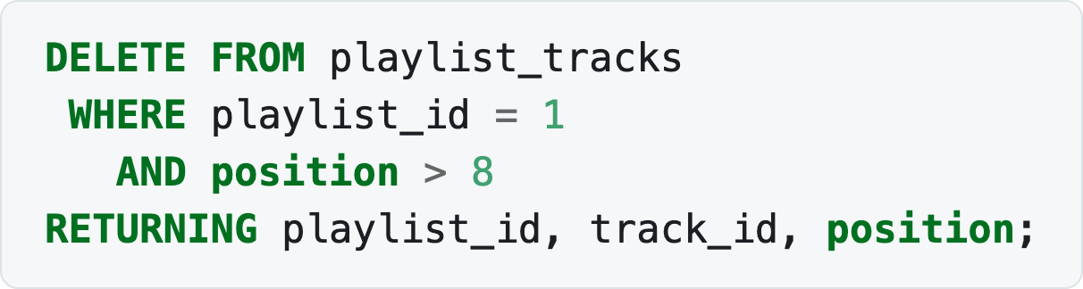
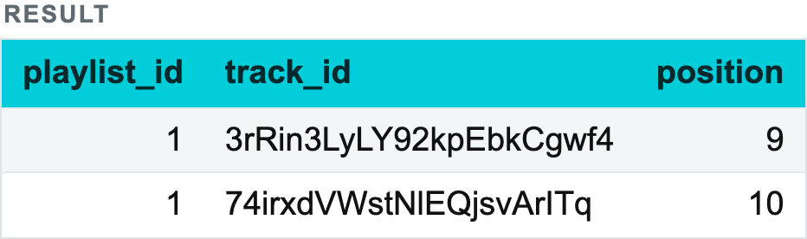
2.1 CREATING AND UPDATING TABLES · DML — DATA MANIPULATION LANGUAGE
DELETE
💡 DELETE should always have a condition. If you mean to delete everything, TRUNCATE is the right statement.
DELETE … RETURNING gives back the rows it removed — useful when you want to log or archive them:
Notes:
DELETE FROM playlist_tracks
WHERE playlist_id = 1
AND position > 8
RETURNING playlist_id, track_id, position;

Slide 32
2.1 CREATING AND UPDATING TABLES · DML — DATA MANIPULATION LANGUAGE
DELETE
RETURNING works on INSERT and UPDATE too, and it is the cheapest way to find out what a statement actually did.

Slide 33
2.1 CREATING AND UPDATING TABLES · DML — DATA MANIPULATION LANGUAGE
DELETE vs TRUNCATE
DELETE removes rows one by one and is normally used with a filter condition. It can clear a whole table, but slowly, since every row is processed separately. It can be rolled back.
TRUNCATE clears the whole table at once. It is much faster, because no row-by-row deletion happens — at the cost of not being able to delete selectively.

Slide 34
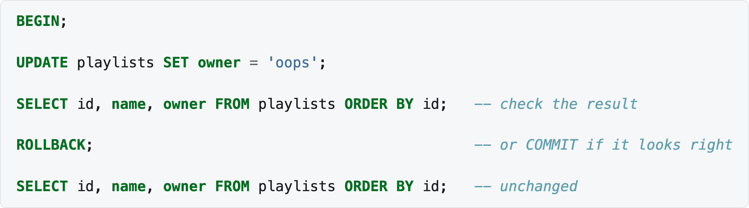
2.1 CREATING AND UPDATING TABLES · DML — DATA MANIPULATION LANGUAGE
A note on safety
Every DML statement in this section changes data. Two habits worth forming now:
Write the SELECT first, check what it returns, and only then convert it into a DELETE or an UPDATE with the same WHERE.
Wrap risky changes in a transaction, so a mistake can be undone:
Notes:
BEGIN;
UPDATE playlists SET owner = 'oops';
SELECT id, name, owner FROM playlists ORDER BY id; -- check the result
ROLLBACK; -- or COMMIT if it looks right
SELECT id, name, owner FROM playlists ORDER BY id; -- unchanged

Slide 35
2.1 CREATING AND UPDATING TABLES · DML — DATA MANIPULATION LANGUAGE
A note on safety
Note the missing WHERE on that UPDATE — the classic accident. Inside a transaction it costs nothing.
Notes:
BEGIN;
UPDATE playlists SET owner = 'oops';
SELECT id, name, owner FROM playlists ORDER BY id; -- check the result
ROLLBACK; -- or COMMIT if it looks right
SELECT id, name, owner FROM playlists ORDER BY id; -- unchanged

Slide 36
2.2 Materializations: views and materialized views
When several source tables are joined, filtered and aggregated, and the result is needed again and again, writing the query out repeatedly becomes laborious. Instead, give the query a name.
Views
Materialized views
Check yourself

Slide 37
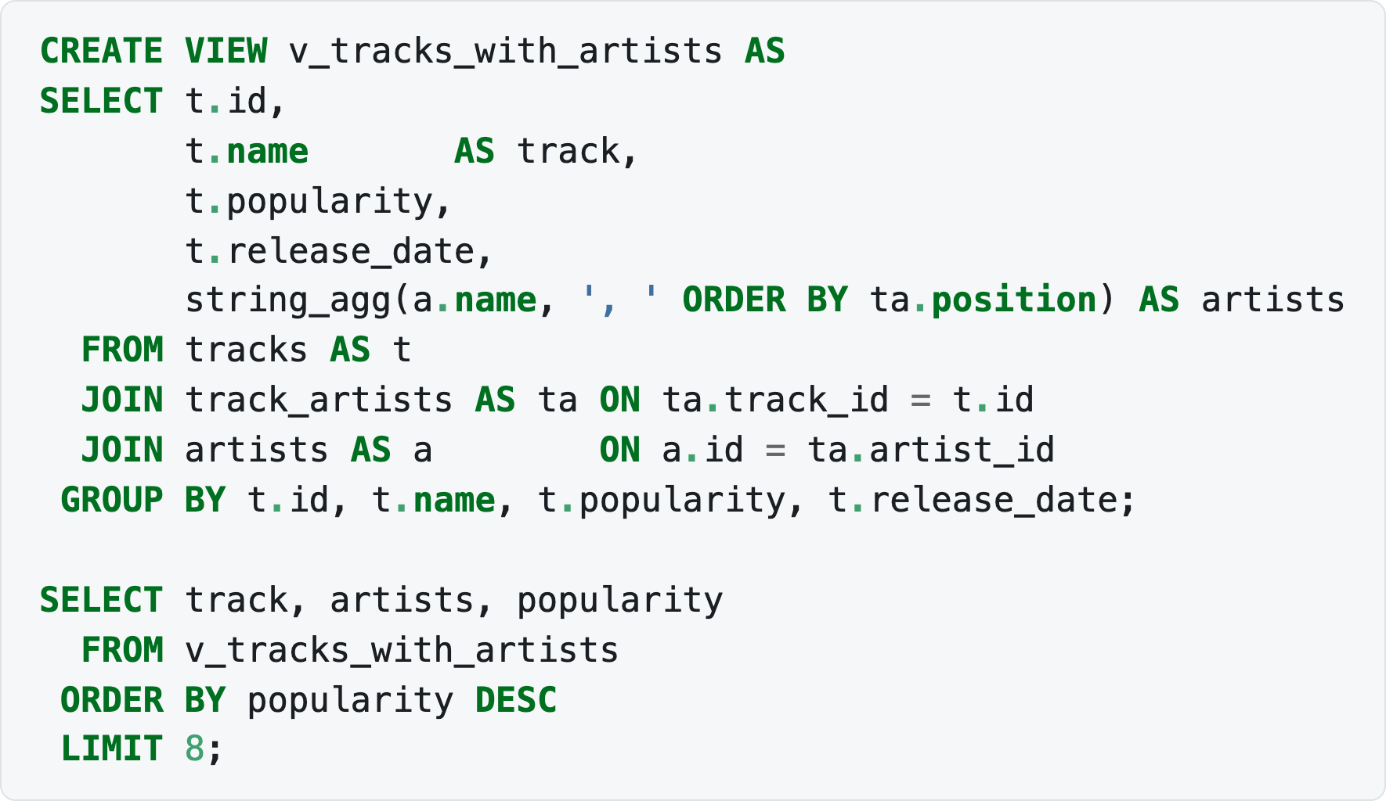
2.2 MATERIALIZATIONS: VIEWS AND MATERIALIZED VIEWS
Views
A view (VIEW) is a named query. You address it as if it were a table — but it is not a table: the data stays in the source tables, and every time the view is addressed the same query is executed anew.
Lecture 1 kept re-writing the three-table join between tracks and artists. A view retires that repetition for good:
Notes:
CREATE VIEW v_tracks_with_artists AS
SELECT t.id,
t.name AS track,
t.popularity,
t.release_date,
string_agg(a.name, ', ' ORDER BY ta.position) AS artists
FROM tracks AS t
JOIN track_artists AS ta ON ta.track_id = t.id
JOIN artists AS a ON a.id = ta.artist_id
GROUP BY t.id, t.name, t.popularity, t.release_date;
SELECT track, artists, popularity
FROM v_tracks_with_artists
ORDER BY popularity DESC
LIMIT 8;

Slide 38
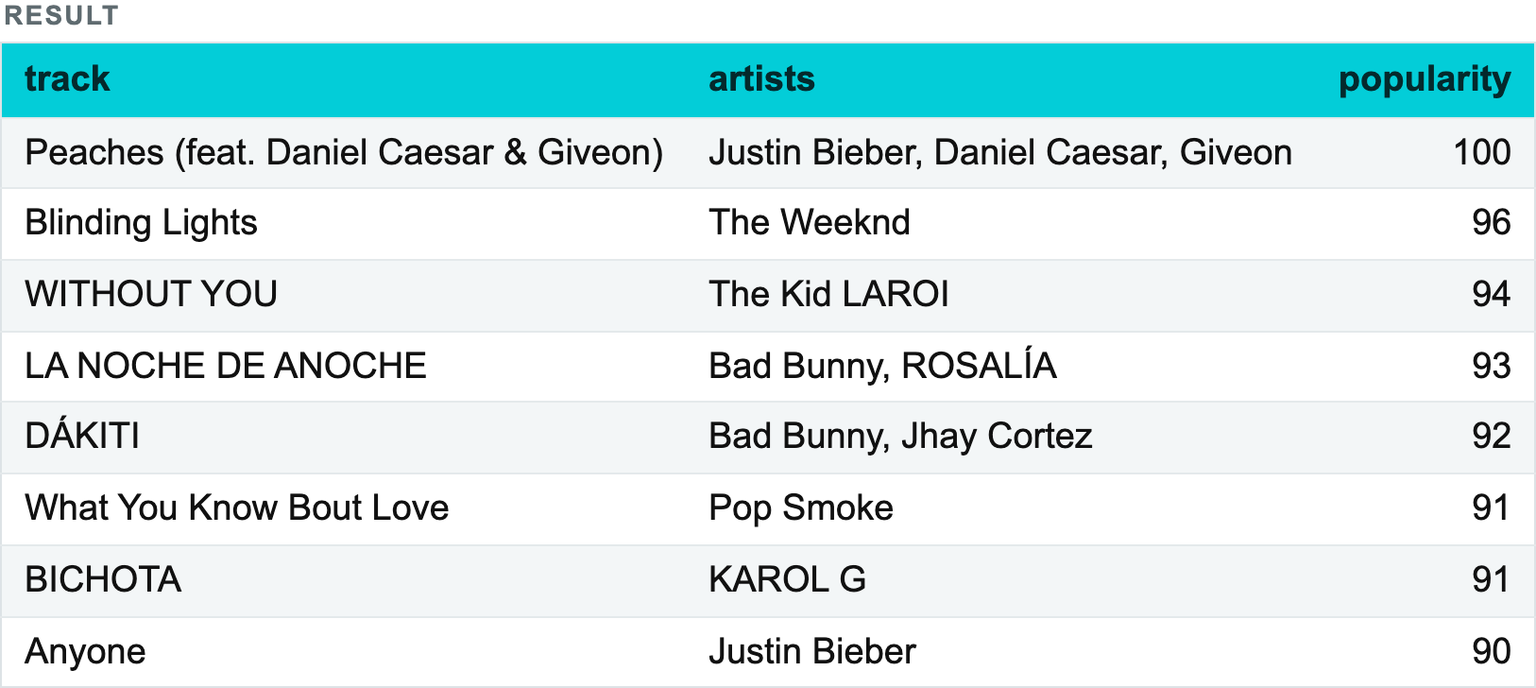
2.2 MATERIALIZATIONS: VIEWS AND MATERIALIZED VIEWS
Views
Notes:
CREATE VIEW v_tracks_with_artists AS
SELECT t.id,
t.name AS track,
t.popularity,
t.release_date,
string_agg(a.name, ', ' ORDER BY ta.position) AS artists
FROM tracks AS t
JOIN track_artists AS ta ON ta.track_id = t.id
JOIN artists AS a ON a.id = ta.artist_id
GROUP BY t.id, t.name, t.popularity, t.release_date;
SELECT track, artists, popularity
FROM v_tracks_with_artists
ORDER BY popularity DESC
LIMIT 8;

Slide 39
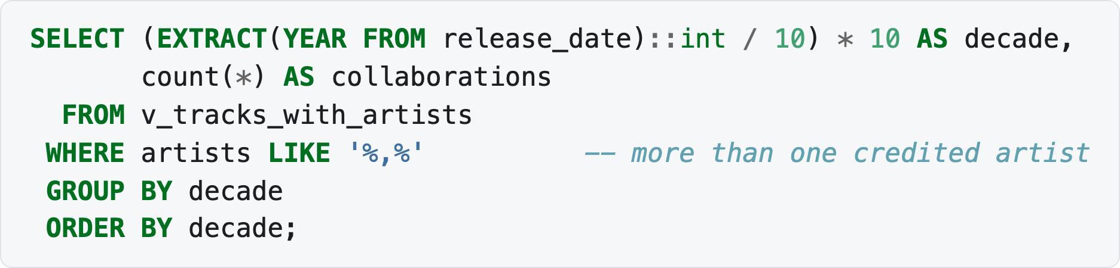
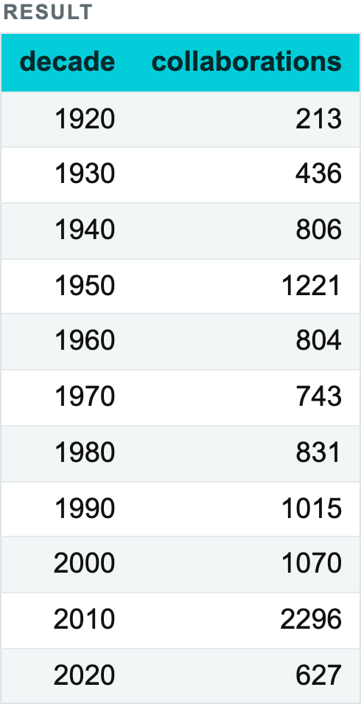
2.2 MATERIALIZATIONS: VIEWS AND MATERIALIZED VIEWS
Views
Now the view can be filtered, joined and aggregated like any table:
Notes:
SELECT (EXTRACT(YEAR FROM release_date)::int / 10) * 10 AS decade,
count(*) AS collaborations
FROM v_tracks_with_artists
WHERE artists LIKE '%,%' -- more than one credited artist
GROUP BY decade
ORDER BY decade;

Slide 40
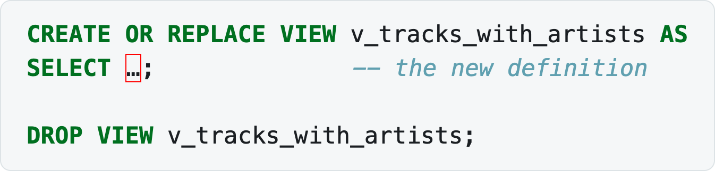
2.2 MATERIALIZATIONS: VIEWS AND MATERIALIZED VIEWS
Views
Replacing and dropping a view:
CREATE OR REPLACE can add columns to the end of a view but cannot rename or remove existing ones — for that you must DROP and re-create.
Notes:
CREATE OR REPLACE VIEW v_tracks_with_artists AS
SELECT …; -- the new definition
DROP VIEW v_tracks_with_artists;

Slide 41
2.2 MATERIALIZATIONS: VIEWS AND MATERIALIZED VIEWS
Views
Advantages:
simplifies work with frequently used queries — a view can be reused in different queries;
improves readability and is convenient when providing data to stakeholders;
restricts access — users can be granted access to particular views that expose only the data they are allowed to see, without exposing the whole database.
💡 Data is not stored in a view. Every time it is addressed, the source tables are joined, filtered and aggregated again. Using a view does not save computing resources.
View vs CTE:
A view is a permanent object in the database and can be used by other queries, by other people, tomorrow. A CTE lives within a single query and disappears with it.
A CTE can be part of a view. That matters, for example, for recursive queries, which are impossible without a CTE.

Slide 42
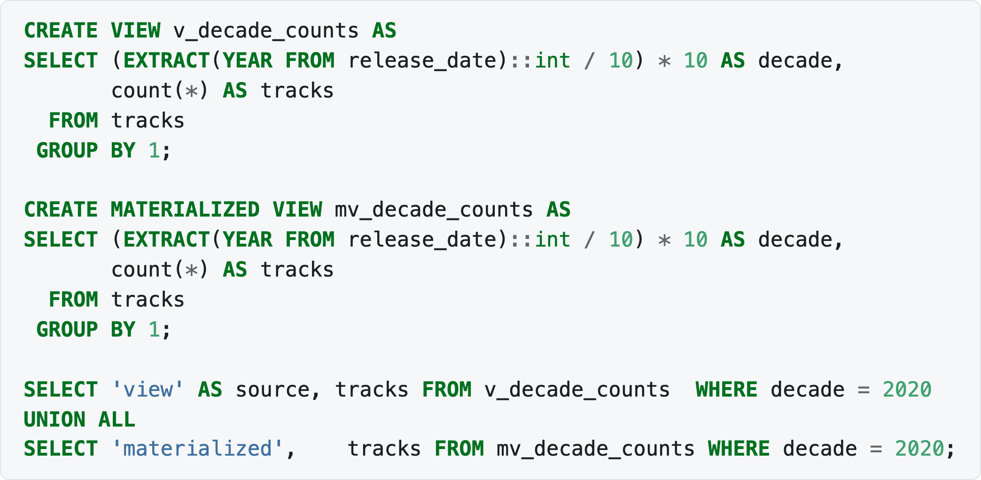
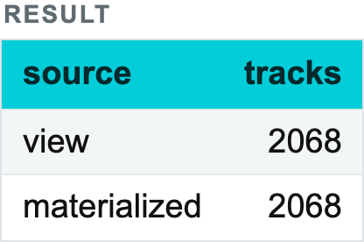
2.2 MATERIALIZATIONS: VIEWS AND MATERIALIZED VIEWS
Materialized views
A materialized view looks like an ordinary one, but the result of the query is saved into a physical table stored on disk. That is the trade-off: reads become cheap, but the data is a snapshot and can go stale.
Notes:
CREATE VIEW v_decade_counts AS
SELECT (EXTRACT(YEAR FROM release_date)::int / 10) * 10 AS decade,
count(*) AS tracks
FROM tracks
GROUP BY 1;
CREATE MATERIALIZED VIEW mv_decade_counts AS
SELECT (EXTRACT(YEAR FROM release_date)::int / 10) * 10 AS decade,
count(*) AS tracks
FROM tracks
GROUP BY 1;
SELECT 'view' AS source, tracks FROM v_decade_counts WHERE decade = 2020
UNION ALL
SELECT 'materialized', tracks FROM mv_decade_counts WHERE decade = 2020;

Slide 43
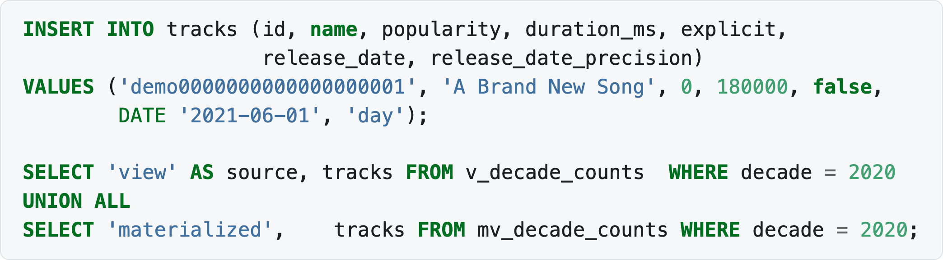

2.2 MATERIALIZATIONS: VIEWS AND MATERIALIZED VIEWS
Materialized views
Identical, so far. Now add a track and ask both again — without refreshing:
Notes:
INSERT INTO tracks (id, name, popularity, duration_ms, explicit,
release_date, release_date_precision)
VALUES ('demo0000000000000000001', 'A Brand New Song', 0, 180000, false,
DATE '2021-06-01', 'day');
SELECT 'view' AS source, tracks FROM v_decade_counts WHERE decade = 2020
UNION ALL
SELECT 'materialized', tracks FROM mv_decade_counts WHERE decade = 2020;

Slide 44
2.2 MATERIALIZATIONS: VIEWS AND MATERIALIZED VIEWS
Materialized views
There it is: the view re-ran the query and saw the new row; the materialized view returned its stored snapshot and did not. That is the whole concept in one result.

Slide 45


2.2 MATERIALIZATIONS: VIEWS AND MATERIALIZED VIEWS
Materialized views
Notes:
REFRESH MATERIALIZED VIEW mv_decade_counts;
SELECT 'view' AS source, tracks FROM v_decade_counts WHERE decade = 2020
UNION ALL
SELECT 'materialized', tracks FROM mv_decade_counts WHERE decade = 2020;

Slide 46


2.2 MATERIALIZATIONS: VIEWS AND MATERIALIZED VIEWS
Materialized views
In PostgreSQL the refresh is explicit — REFRESH MATERIALIZED VIEW, run manually or on a schedule. Other DBMSs differ substantially: some refresh in real time, some by a trigger, and some have no such functionality at all. Always consult the documentation.
A materialized view can be indexed, which an ordinary view cannot:
Notes:
CREATE UNIQUE INDEX mv_decade_counts_decade ON mv_decade_counts(decade);
SELECT indexname, indexdef
FROM pg_indexes
WHERE tablename = 'mv_decade_counts';

Slide 47
2.2 MATERIALIZATIONS: VIEWS AND MATERIALIZED VIEWS
Materialized views
A unique index also unlocks REFRESH MATERIALIZED VIEW CONCURRENTLY, which rebuilds it without locking readers out.

Slide 48
2.2 MATERIALIZATIONS: VIEWS AND MATERIALIZED VIEWS
Materialized views
 | View | Materialized view | Table
Stores data | no | yes | yes
Cost of reading | the full query, every time | a read of stored rows | a read of stored rows
Freshness | always current | as of the last refresh | always current
Occupies disk | no (only the definition) | yes | yes
Can be indexed | no | yes | yes

Slide 49


2.2 MATERIALIZATIONS: VIEWS AND MATERIALIZED VIEWS
Materialized views
Notes:
-- tidy up the demo row
DELETE FROM tracks WHERE id = 'demo0000000000000000001';
REFRESH MATERIALIZED VIEW mv_decade_counts;
SELECT tracks FROM mv_decade_counts WHERE decade = 2020;

Slide 50
2.2 MATERIALIZATIONS: VIEWS AND MATERIALIZED VIEWS
Check yourself
What are views used for? — to simplify collecting data from the same source tables and reduce duplicated code.
How does a materialized view differ from an ordinary one? — a materialized view stores the result physically and must be refreshed; an ordinary view is simply a named query, always current.
When is a materialized view the wrong choice? — when the data must always be current, or when it changes far more often than it is read.
What happens if the schema of the table a view is built on changes? — the view breaks; drop and re-create it.

Slide 51
2.3 Procedures
Views name a query. Procedures and functions name a sequence of statements — logic that lives inside the database and can contain variables, conditions and loops. In PostgreSQL this code is written in PL/pgSQL.
Function or procedure?
A function
A procedure
Parameters
Control flow
Error handling
Dropping a routine

Slide 52
2.3 PROCEDURES
Function or procedure?
PostgreSQL has both, and the difference matters:
 | FUNCTION | PROCEDURE
Called with | SELECT my_func(…) | CALL my_proc(…)
Returns | a value or a set of rows | nothing (only INOUT parameters)
Usable inside a query | yes | no
Can manage transactions | no | yes (COMMIT / ROLLBACK inside)
Rule of thumb: if you need a value, write a function; if you need an action, write a procedure.

Slide 53


2.3 PROCEDURES
A function
The decade expression has appeared in nearly every query so far. It belongs in a function:
Notes:
CREATE OR REPLACE FUNCTION decade_of(d date)
RETURNS int
LANGUAGE sql
IMMUTABLE
AS $$
SELECT (EXTRACT(YEAR FROM d)::int / 10) * 10;
$$;
SELECT decade_of(release_date) AS decade, count(*) AS tracks
FROM tracks
GROUP BY 1
ORDER BY 1;

Slide 54


2.3 PROCEDURES
A function
That one was LANGUAGE sql — a single expression, no procedural logic needed. IMMUTABLE promises the same input always gives the same output, which lets the planner cache and even index it.
For anything with variables or branching, use LANGUAGE plpgsql:
Notes:
CREATE OR REPLACE FUNCTION track_count(artist_name text)
RETURNS integer
LANGUAGE plpgsql
AS $$
DECLARE
result integer;
BEGIN
SELECT count(*)
INTO result
FROM artists AS a
JOIN track_artists AS ta ON ta.artist_id = a.id
WHERE a.name = artist_name;
RETURN result;
END;
$$;
SELECT track_count('David Bowie') AS bowie,
track_count('Bob Dylan') AS dylan,
track_count('Nobody') AS nobody;

Slide 55


2.3 PROCEDURES
A function
Because a function returns a value, it can be used anywhere a value is expected — including inside another query:
Notes:
SELECT name, track_count(name) AS tracks
FROM artists
ORDER BY followers DESC
LIMIT 5;

Slide 56
2.3 PROCEDURES
A function
💡 That query is elegant and slow: the function runs once per row, each time executing its own join. A single GROUP BY would do the same work in one pass. Convenience and performance pull in opposite directions here — Lecture 3 returns to the theme.

Slide 57
2.3 PROCEDURES
A function
Note the structure, which is the same for every PL/pgSQL routine:
$$ … $$ — dollar quoting. The body is a string; dollar quoting saves you from escaping every quote inside it.
DECLARE — the block where local variables are declared.
BEGIN … END; — the executable block. (This BEGIN is a block delimiter, not the transaction BEGIN from §2.1.)

Slide 58

2.3 PROCEDURES
A procedure
A procedure performs an action. Rebuilding a summary table:
Notes:
CREATE TABLE decade_summary (
decade int PRIMARY KEY,
tracks int NOT NULL,
avg_popularity numeric(5,2)
);
CREATE OR REPLACE PROCEDURE rebuild_decade_summary()
LANGUAGE plpgsql
AS $$
DECLARE
affected integer;
BEGIN
DELETE FROM decade_summary;
INSERT INTO decade_summary (decade, tracks, avg_popularity)
SELECT decade_of(release_date),
count(*),
round(avg(popularity), 2)
FROM tracks
GROUP BY 1;
GET DIAGNOSTICS affected = ROW_COUNT;
RAISE NOTICE 'decade_summary rebuilt with % rows', affected;
END;
$$;
CALL rebuild_decade_summary();
SELECT * FROM decade_summary ORDER BY decade;

Slide 59

2.3 PROCEDURES
A procedure
Notes:
CREATE TABLE decade_summary (
decade int PRIMARY KEY,
tracks int NOT NULL,
avg_popularity numeric(5,2)
);
CREATE OR REPLACE PROCEDURE rebuild_decade_summary()
LANGUAGE plpgsql
AS $$
DECLARE
affected integer;
BEGIN
DELETE FROM decade_summary;
INSERT INTO decade_summary (decade, tracks, avg_popularity)
SELECT decade_of(release_date),
count(*),
round(avg(popularity), 2)
FROM tracks
GROUP BY 1;
GET DIAGNOSTICS affected = ROW_COUNT;
RAISE NOTICE 'decade_summary rebuilt with % rows', affected;
END;
$$;
CALL rebuild_decade_summary();
SELECT * FROM decade_summary ORDER BY decade;

Slide 60
2.3 PROCEDURES
A procedure
GET DIAGNOSTICS … = ROW_COUNT reads how many rows the previous statement touched; RAISE NOTICE prints a message to the client — the closest thing PL/pgSQL has to print. The playground shows notices above the result grid.

Slide 61

2.3 PROCEDURES
Parameters
Parameters have three modes:
Notes:
-- a working copy, so the demo leaves the catalogue alone
CREATE TABLE tracks_pool AS
SELECT id, name, popularity FROM tracks;
CREATE OR REPLACE PROCEDURE archive_unpopular(
IN threshold integer DEFAULT 5,
INOUT moved integer DEFAULT 0
)
LANGUAGE plpgsql
AS $$
BEGIN
CREATE TABLE IF NOT EXISTS tracks_archive (LIKE tracks_pool);
WITH moved_rows AS (
DELETE FROM tracks_pool
WHERE popularity < threshold
RETURNING *
)
INSERT INTO tracks_archive SELECT * FROM moved_rows;
GET DIAGNOSTICS moved = ROW_COUNT;
END;
$$;
CALL archive_unpopular(1, NULL);

Slide 62

2.3 PROCEDURES
Parameters
Notes:
-- a working copy, so the demo leaves the catalogue alone
CREATE TABLE tracks_pool AS
SELECT id, name, popularity FROM tracks;
CREATE OR REPLACE PROCEDURE archive_unpopular(
IN threshold integer DEFAULT 5,
INOUT moved integer DEFAULT 0
)
LANGUAGE plpgsql
AS $$
BEGIN
CREATE TABLE IF NOT EXISTS tracks_archive (LIKE tracks_pool);
WITH moved_rows AS (
DELETE FROM tracks_pool
WHERE popularity < threshold
RETURNING *
)
INSERT INTO tracks_archive SELECT * FROM moved_rows;
GET DIAGNOSTICS moved = ROW_COUNT;
END;
$$;
CALL archive_unpopular(1, NULL);

Slide 63


2.3 PROCEDURES
Parameters
IN (the default) — an input parameter;
OUT — an output parameter;
INOUT — both; this is how a procedure returns anything at all.
CALL on a procedure with an INOUT parameter returns a row, which is why the result above has a column. Check what it did:
Notes:
SELECT (SELECT count(*) FROM tracks_pool) AS left_in_pool,
(SELECT count(*) FROM tracks_archive) AS archived,
(SELECT count(*) FROM tracks) AS catalogue_untouched;

Slide 64
2.3 PROCEDURES
Parameters
DELETE … RETURNING feeding an INSERT through a CTE is the idiomatic way to move rows between tables in one statement — atomic, and a single pass.

Slide 65

2.3 PROCEDURES
Control flow
Conditions:
Notes:
IF track_cnt > 100 THEN
RAISE NOTICE 'prolific';
ELSIF track_cnt > 10 THEN
RAISE NOTICE 'established';
ELSE
RAISE NOTICE 'occasional';
END IF;

Slide 66

2.3 PROCEDURES
Control flow
Loops:
Notes:
-- a counted loop
FOR i IN 1..5 LOOP
RAISE NOTICE 'decade %', 1960 + i * 10;
END LOOP;
-- a loop over the rows of a query
FOR rec IN SELECT name, popularity FROM tracks LIMIT 10 LOOP
RAISE NOTICE '% scores %', rec.name, rec.popularity;
END LOOP;
-- a conditional loop
WHILE cnt < 10 LOOP
cnt := cnt + 1;
END LOOP;

Slide 67

2.3 PROCEDURES
Control flow
All three, in a routine that classifies artists:
Notes:
CREATE OR REPLACE FUNCTION artist_tier(artist_name text)
RETURNS text
LANGUAGE plpgsql
AS $$
DECLARE
cnt integer;
BEGIN
cnt := track_count(artist_name);
IF cnt = 0 THEN
RETURN 'unknown artist';
ELSIF cnt > 100 THEN
RETURN 'prolific';
ELSIF cnt > 10 THEN
RETURN 'established';
ELSE
RETURN 'occasional';
END IF;
END;
$$;
SELECT name, track_count(name) AS tracks, artist_tier(name) AS tier
FROM artists
WHERE name IN ('David Bowie', 'Bob Dylan', 'Johann Sebastian Bach', 'Nobody At All')
ORDER BY tracks DESC;

Slide 68

2.3 PROCEDURES
Control flow
💡 Row-by-row loops are the slowest way to work with a relational database. If the same result can be expressed as a single set-based UPDATE or INSERT … SELECT, write that instead — the loop is for the cases where it genuinely cannot.
Notes:
CREATE OR REPLACE FUNCTION artist_tier(artist_name text)
RETURNS text
LANGUAGE plpgsql
AS $$
DECLARE
cnt integer;
BEGIN
cnt := track_count(artist_name);
IF cnt = 0 THEN
RETURN 'unknown artist';
ELSIF cnt > 100 THEN
RETURN 'prolific';
ELSIF cnt > 10 THEN
RETURN 'established';
ELSE
RETURN 'occasional';
END IF;
END;
$$;
SELECT name, track_count(name) AS tracks, artist_tier(name) AS tier
FROM artists
WHERE name IN ('David Bowie', 'Bob Dylan', 'Johann Sebastian Bach', 'Nobody At All')
ORDER BY tracks DESC;

Slide 69


2.3 PROCEDURES
Error handling
An EXCEPTION block catches errors so that a routine can continue instead of aborting the whole transaction:
Notes:
CREATE OR REPLACE FUNCTION safe_add_playlist(p_name text, p_owner text)
RETURNS text
LANGUAGE plpgsql
AS $$
BEGIN
INSERT INTO playlists (name, owner) VALUES (p_name, p_owner);
RETURN 'created';
EXCEPTION
WHEN unique_violation THEN
RETURN 'already exists, skipped';
WHEN others THEN
RETURN 'unexpected error: ' || SQLERRM;
END;
$$;
SELECT safe_add_playlist('Brand New Mix', 'denis') AS first_call,
safe_add_playlist('Brand New Mix', 'denis') AS second_call;

Slide 70
2.3 PROCEDURES
Error handling
The second call hit the UNIQUE (name, owner) constraint from §2.1 and was caught instead of blowing up. SQLERRM holds the error message, SQLSTATE the error code.

Slide 71


2.3 PROCEDURES
Dropping a routine
The argument types are part of the identity of a routine — PostgreSQL allows overloading, so DROP needs the signature, not just the name.
Notes:
DROP FUNCTION safe_add_playlist(text, text);
SELECT count(*) AS still_there
FROM information_schema.routines
WHERE routine_name = 'safe_add_playlist';

Slide 72
2.4 Variables
There are two quite different things called "variables" in PostgreSQL. Do not mix them up.
1. Variables inside PL/pgSQL
An anonymous block: DO
2. Session variables
3. psql client variables
Which one to use

Slide 73

2.4 VARIABLES
1. Variables inside PL/pgSQL
Declared in the DECLARE block of a function, procedure or anonymous block, and living only for the duration of the call.
Notes:
DECLARE
track_cnt integer; -- no initial value → NULL
threshold integer := 10; -- with an initial value
label text := 'prolific';
decade constant int := 1970; -- cannot be reassigned
rec record; -- a row of any shape
t tracks%ROWTYPE; -- a row of the tracks table
nm tracks.name%TYPE; -- the type of one column
BEGIN
...
END;

Slide 74
2.4 VARIABLES
1. Variables inside PL/pgSQL
Assignment uses :=, and a query result is assigned with SELECT … INTO.
%TYPE and %ROWTYPE are worth the habit: they tie the variable to the column or table definition, so the code keeps working if the column type changes.

Slide 75

2.4 VARIABLES
An anonymous block: DO
You do not have to create a routine to run PL/pgSQL. A DO block executes it once, immediately — ideal for one-off maintenance scripts:
Notes:
DO $$
DECLARE
cutoff constant int := 80;
hits integer;
total integer;
oldest tracks%ROWTYPE;
BEGIN
SELECT count(*) INTO hits FROM tracks WHERE popularity >= cutoff;
SELECT count(*) INTO total FROM tracks;
SELECT * INTO oldest FROM tracks ORDER BY release_date LIMIT 1;
-- '%' is the placeholder, so a literal percent sign has to be doubled.
-- Writing them adjacent is ambiguous, so keep the word instead.
RAISE NOTICE 'Tracks at popularity >= %: % of % (% percent)',
cutoff, hits, total, round(100.0 * hits / total, 2);
RAISE NOTICE 'Oldest track: "%" from %', oldest.name, oldest.release_date;
END;
$$;

Slide 76

2.4 VARIABLES
An anonymous block: DO
A DO block takes no parameters and returns nothing — it acts. Its output goes to the notice channel, which the playground displays above the results.
Looping over a query, with a variable accumulating as it goes:
Notes:
DO $$
DECLARE
rec record;
running_total integer := 0;
BEGIN
FOR rec IN
SELECT decade_of(release_date) AS decade, count(*) AS tracks
FROM tracks
GROUP BY 1
ORDER BY 1
LOOP
running_total := running_total + rec.tracks;
RAISE NOTICE '% → % tracks (running total %)',
rec.decade, rec.tracks, running_total;
END LOOP;
END;
$$;

Slide 77
2.4 VARIABLES
An anonymous block: DO
💡 Everything that loop does, SUM(…) OVER (ORDER BY decade) from Lecture 1 §1.3 does in one statement and far faster. Reach for the window function first.

Slide 78


2.4 VARIABLES
2. Session variables
These live in the connection, not in a block, and are visible to every statement until the session ends.
Notes:
SET my.decade = '1970';
SELECT current_setting('my.decade') AS the_setting;

Slide 79


2.4 VARIABLES
2. Session variables
Notes:
SELECT count(*) AS tracks_in_my_decade
FROM tracks
WHERE decade_of(release_date) = current_setting('my.decade')::int;

Slide 80


2.4 VARIABLES
2. Session variables
Note the cast: current_setting always returns text, whatever you put in.
SET LOCAL limits the setting to the current transaction:
Notes:
BEGIN;
SET LOCAL my.decade = '1990';
SELECT current_setting('my.decade') AS inside_transaction;
COMMIT;
SELECT current_setting('my.decade') AS after_commit;

Slide 81


2.4 VARIABLES
2. Session variables
The same mechanism configures the server's own behaviour:
💡 A custom session variable must contain a dot (my.decade, not decade) — that is how PostgreSQL distinguishes user settings from its own configuration parameters.
Notes:
SET work_mem = '256MB';
SHOW work_mem;

Slide 82

2.4 VARIABLES
3. psql client variables
Strictly speaking these belong to the psql client rather than to the server, so they will not run in the browser playground — but they are what people usually reach for in scripts:
:name substitutes the value, :'name' substitutes it quoted as a string literal, and :"name" as an identifier.
Notes:
\set decade 1970
SELECT count(*) FROM tracks WHERE decade_of(release_date) = :decade;

Slide 83
2.4 VARIABLES
Which one to use
Need | Use
A temporary value inside a routine or block | a PL/pgSQL variable in DECLARE
A value shared by several statements in one connection | SET / current_setting()
A parameter for a script run through the psql client | \set and :name
A value passed from an application | a query parameter ($1, $2), never string concatenation
The last row is a security point, not a style point: building SQL by concatenating user input is how SQL injection happens. Pass parameters.

Slide 84

2.4 VARIABLES
Which one to use
Notes:
-- never do this
'SELECT * FROM tracks WHERE name = ''' || user_input || ''''
-- do this: the value can never be parsed as SQL
SELECT * FROM tracks WHERE name = $1

Slide 85
LECTURE 2. DDL & DML, PROCEDURES, VARIABLES
Summary
DDL describes the structure of the data — tables, indexes, constraints, sequences:
CREATE TABLE — creates a table; declare PRIMARY KEY, NOT NULL, UNIQUE, CHECK, REFERENCES and DEFAULT while you are there;
ALTER TABLE — renames a table, and adds, renames, retypes and drops fields;
DROP COLUMN / DROP TABLE — removes a field or the whole table;
TRUNCATE TABLE — removes all records fast, keeping the structure;
CREATE TABLE … AS SELECT — creates and fills a table from a query in one go.

Slide 86
LECTURE 2. DDL & DML, PROCEDURES, VARIABLES
Summary
DML manipulates the data in the tables:
INSERT INTO — adds records, from VALUES or from a SELECT; ON CONFLICT turns it into an upsert;
UPDATE — changes data, with or without a filter; UPDATE … FROM draws new values from another table;
DELETE — deletes data; always give it a condition, and use TRUNCATE when you mean "everything";
RETURNING reports what any of the three actually changed.
Materializations name a query:
a view stores only the query — it is always current, occupies no space, and costs a full re-execution on every read;
a materialized view stores the result — reads are cheap and it can be indexed, but the data is only as fresh as the last REFRESH MATERIALIZED VIEW;
unlike a CTE, both persist in the database and can be used by other queries.

Slide 87
LECTURE 2. DDL & DML, PROCEDURES, VARIABLES
Summary
Procedures and functions put logic in the database, written in PL/pgSQL:
a FUNCTION returns a value and can be called inside a query (SELECT f(x));
a PROCEDURE performs an action, is called with CALL, and can manage transactions;
both support IN/OUT/INOUT parameters, IF, FOR/WHILE loops, and EXCEPTION blocks;
prefer set-based statements to row-by-row loops.
Variables come in three kinds, at three different scopes:
PL/pgSQL variables — declared in DECLARE, assigned with := or SELECT … INTO, alive for one call; %TYPE and %ROWTYPE tie them to the schema;
session variables — SET / SET LOCAL, read with current_setting(), alive for the connection or the transaction;
psql client variables — \set and :name, for scripts.
Values coming from an application belong in query parameters, never in concatenated SQL.

Slide 88

TBC Explorers
Q & A

Slide 89

Thank you

