Slide 1

TBC Explorers
1
SQL
basics
From basic queries to window functions and joins.
Denis Boldin

Slide 2
TBC Explorers
2
What is
SQL?
SQL is a language for working with data in relational databases. It lets you ask questions, filter, transform and combine data from different tables. You write a query, the database processes it and returns a result set.
Business
question
SQL query
Result set
Which artists
are most popular?
→
SELECT artist_name,
COUNT(tracks) AS tracks
FROM tracks
GROUP BY artist_name
ORDER BY COUNT(tracks) desc;
→
artist_name tracks
Taylor Swift 120
Drake 95
The Weeknd 85
01 · INTRODUCTION

Slide 3
TBC Explorers
3
SQL
dialects
SQL has a common core, but database systems add their own syntax, functions and extensions.
Database system
SQL dialect
What to know
PostgreSQL
PostgreSQL SQL
Reference dialect for this course
Greenplum
PostgreSQL dialect
PostgreSQL-based analytical DBMS
Microsoft SQL Server
T-SQL
Microsoft SQL extensions
MySQL
MySQL SQL
MySQL-specific syntax and functions
Oracle Database
Oracle SQL / PL/SQL
Oracle SQL + procedural PL/SQL
01 · INTRODUCTION

Slide 4
TBC Explorers
4
What we'll
cover today
From basic queries to window functions and joins. With real examples.
1
2
3
4
5
6
7
Working
with data
Filtering
and sorting
Aggregates
and groups
Window
functions
Subqueries
and CTEs
Joins, unions
and other stuff
Wrap-up
and Q&A
Dataset
Data types
Operators and functions
WHERE
ORDER BY
LIMIT
Aggregate functions
GROUP BY
Running total
Ranking
Moving average
Subqueries
CTEs
Real examples
JOINS
UNION
Transactions
Key takeaways
Practice ideas
Your questions
ROADMAP

Slide 5


The database we’ll use
A Spotify catalogue sample, 1922–2021. We’ll work with four related tables.
track_artists
artists
74,624 rows
tracks
27,385 rows
60,000 rows
artists ──< track_artists >── tracks
artist_related
Each table has its own grain. Bridge tables store relationships between entities.
210,844 rows
0 · PRELIMINARIES
5

Slide 6
Data types affect query results
NUMERIC
TEXT
TIME
FLAG
INTEGER · BIGINT · REAL
VARCHAR · TEXT
DATE · TIMESTAMP · INTERVAL
BOOLEAN
Cast explicitly when the result depends on the data type.
duration_ms / 60000 -- 4
duration_ms / 60000.0 -- 4.175...
explicit::int -- true → 1
CAST(duration_ms) as int
CAST(duration_ms) as varchar(100)
duration_ms :: int
0 · PRELIMINARIES
6

Slide 7
0. PRELIMINARIES
Data types
Types matter because they:
ensure data integrity — a numeric column will not accept string values;
optimize storage — an integer takes less space than the same value as text;
optimize performance — comparison and sorting are faster on numeric types than on character ones;
simplify working with data — the schema becomes readable and self-documenting.
Types differ between DBMSs, so always check the documentation of the database you are working with.

Slide 8
0. PRELIMINARIES
Operators and functions
A function is a subroutine that takes arguments, performs an operation and returns a result. Functions can be nested — the result of one becomes the argument of the next.
Numeric operators and functions:
Operation | Operator | Examples
Addition | + | 3 + 2 → 5 · 3 + 2.0 → 5.0
Subtraction | - | 3 - 2 → 1
Multiplication | * | 3 * 2 → 6
Division | / | 3 / 2 → 1 · 3 / 2.0 → 1.50
Remainder | % | 3 % 2 → 1
Exponentiation | ^ | 3 ^ 2 → 9
Absolute value | @ | @ -3 → 3

Slide 9
0. PRELIMINARIES
Operators and functions
Purpose | Function | Examples
Remainder of division | mod(numerator, denominator) | mod(5, 2) → 1
Rounding | round(number) | round(1.54) → 2
Nearest larger integer | ceil(number) | ceil(1.54) → 2
Nearest smaller integer | floor(number) | floor(1.54) → 1
Exponentiation | power(number, power) | power(3, 3) → 27
Square root | sqrt(number) | sqrt(1.5) → 1.22

Slide 10
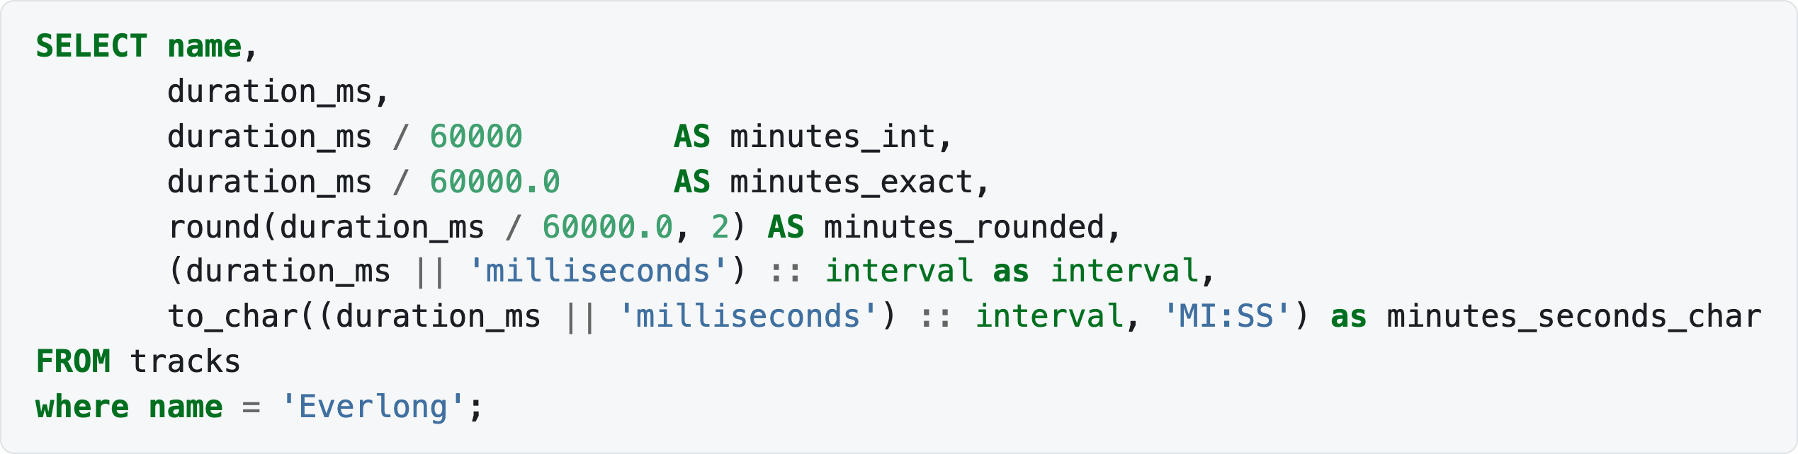
0. PRELIMINARIES
Operators and functions
If you use only integers, the result is an integer. If one argument is fractional, the result is fractional too.
That rule bites immediately on this data. duration_ms / 60000 gives whole minutes and throws away the rest; duration_ms / 60000.0 keeps the fraction:
Notes:
SELECT name,
duration_ms,
duration_ms / 60000 AS minutes_int,
duration_ms / 60000.0 AS minutes_exact,
round(duration_ms / 60000.0, 2) AS minutes_rounded,
(duration_ms || 'milliseconds') :: interval as interval,
to_char((duration_ms || 'milliseconds') :: interval, 'MI:SS') as minutes_seconds_char
FROM tracks
where name = 'Everlong';

Slide 11
0. PRELIMINARIES
Operators and functions
String functions:
Purpose | Function | Examples
Concatenation | concat(a, b, c) | concat('Valya had ', 2, ' oranges') → 'Valya had 2 oranges'
String length | length(string) | length('123') → 3
Trimming spaces | trim(string) | trim(' text ') → 'text'
Substring search | position(substring in string) | position('4' in '123') → 0
Upper / lower case | upper(text), lower(text) | upper('text') → 'TEXT'

Slide 12
0. PRELIMINARIES
Operators and functions
Date and time functions:
Purpose | Function | Examples
Current date and time | now() | now() → 2026-05-04 12:44:00
Addition | date + number | date '2001-09-28' + 7 → date '2001-10-05'
Subtraction | date - number | date '2001-09-28' - 7 → date '2001-09-21'
Difference | date - date | date '2001-10-01' - date '2001-09-28' → 3
Part of a date | extract(part from date) | extract(year from date '2001-10-01') → 2001

Slide 13
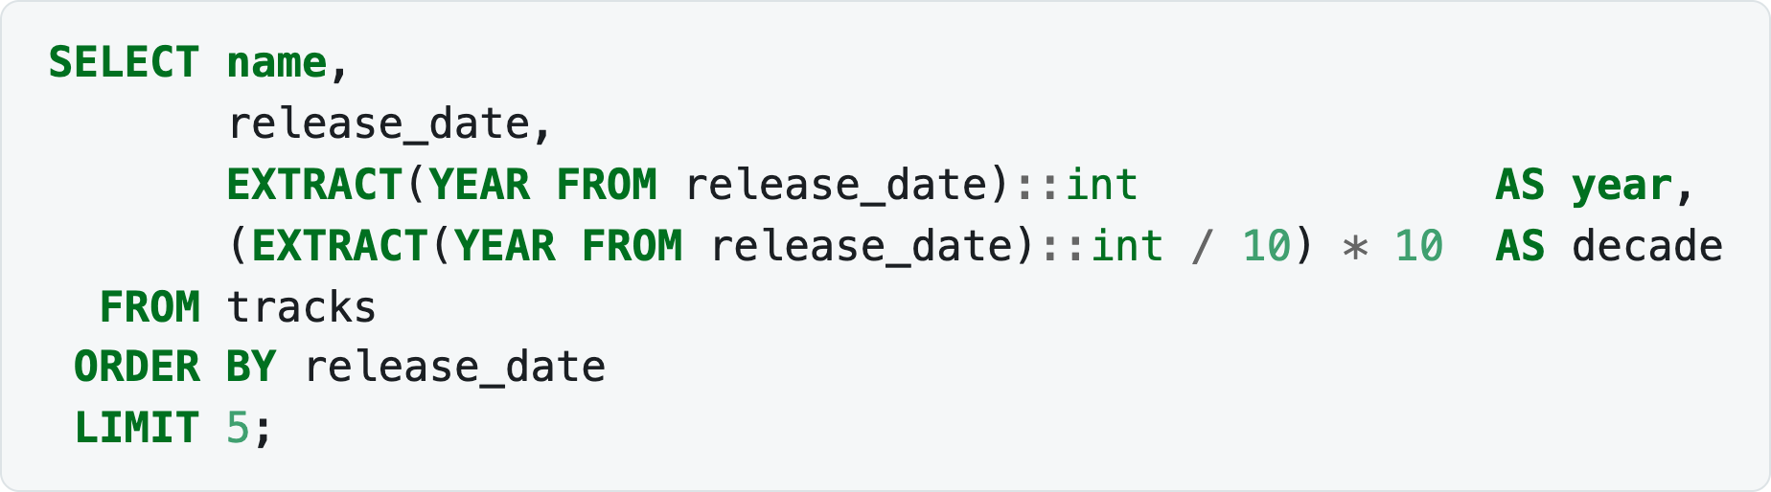
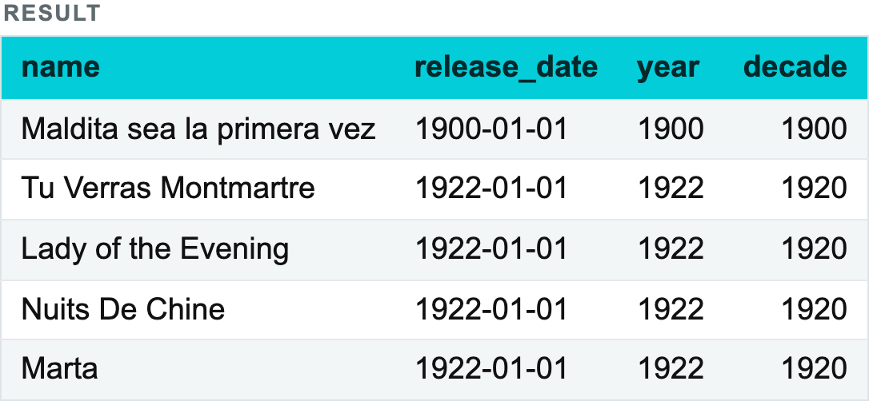
0. PRELIMINARIES
Operators and functions
extract is the workhorse of this lecture — it is how we get a year or a decade out of release_date:
Notes:
SELECT name,
release_date,
EXTRACT(YEAR FROM release_date)::int AS year,
(EXTRACT(YEAR FROM release_date)::int / 10) * 10 AS decade
FROM tracks
ORDER BY release_date
LIMIT 5;

Slide 14
0. PRELIMINARIES
Operators and functions
Boolean and comparison operators:
Purpose | Operator | Examples
Logical NOT / AND / OR | NOT, AND, OR | true AND false → false
Comparison | =, >, >=, <, <=, <> | 7 > 5 → true
Range | BETWEEN | 5 BETWEEN 3 AND 7 → true
Operator precedence: comparison operators are evaluated first, then NOT, then AND, and OR last.

Slide 15
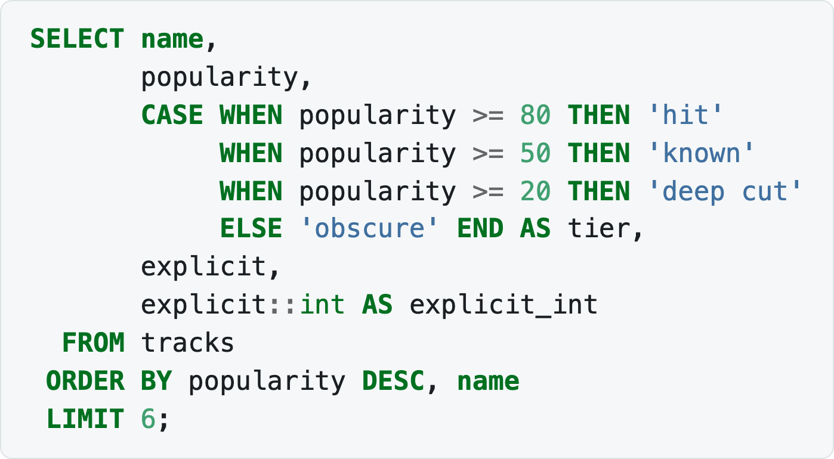
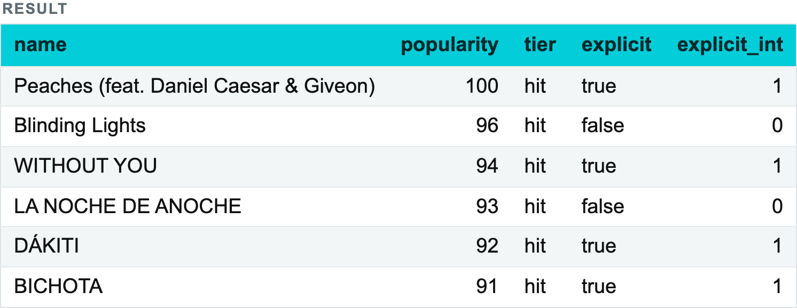
0. PRELIMINARIES
The CASE operator
Bucketing tracks by how popular they are:
Note explicit::int — a boolean cast to an integer gives 1 or 0, which is handy for summing later.
Notes:
SELECT name,
popularity,
CASE WHEN popularity >= 80 THEN 'hit'
WHEN popularity >= 50 THEN 'known'
WHEN popularity >= 20 THEN 'deep cut'
ELSE 'obscure' END AS tier,
explicit,
explicit::int AS explicit_int
FROM tracks
ORDER BY popularity DESC, name
LIMIT 6;

Slide 16

Filtering and sorting
Filtering (WHERE)
Filtering text
Filtering by a computed field
Sorting (ORDER BY)
Limiting the result set (LIMIT, OFFSET)
Missing data (NULL)
Check yourself

Slide 17
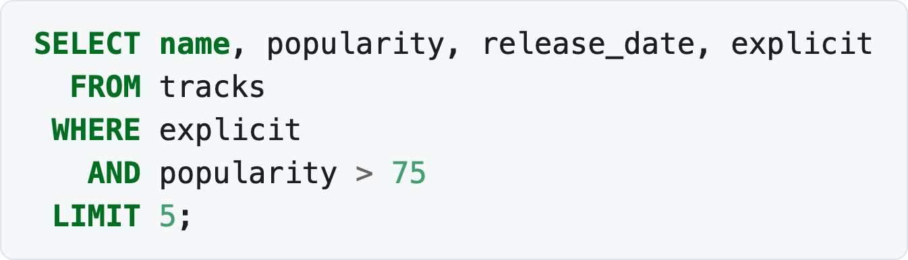
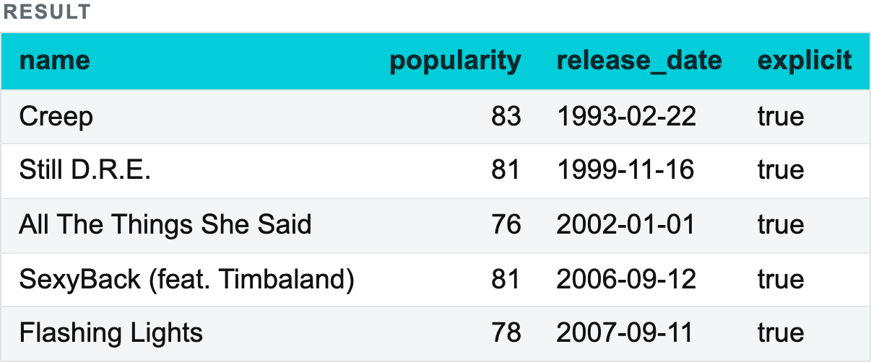
1.1 FILTERING AND SORTING
Filtering (WHERE)
Several conditions are combined with AND and OR; AND binds tighter than OR.
Notes:
SELECT name, popularity, release_date, explicit
FROM tracks
WHERE explicit
AND popularity > 75
LIMIT 5;

Slide 18
TBC Explorers
18
FILTERING DATA
Combine several filters
in one WHERE clause
track_name
popularity
release_date
WHERE keeps only the rows that match your condition.
Blinding Lights
90
2019-11-29
Starboy
90
2016-09-21
SQL
1 SELECT name, popularity, release_date
2 FROM tracks
3 WHERE popularity >= 80
4 AND explicit = false
5 AND release_date >= DATE '2010-01-01'
6 AND release_date < DATE '2020-01-01'
7 ORDER BY popularity DESC;
Shape of You
90
2017-01-06
Believer
90
2017-02-01
HUMBLE.
90
2017-03-30
1.1 - FILTERING & SORTING

Slide 19
Text filters, NULLs, sorting and limits
Text
= · LIKE · ILIKE
Missing
IS NULL · IS NOT NULL · COALESCE
Sort
ORDER BY … ASC / DESC
Slice
LIMIT · OFFSET
NULL ≠ 0 ≠ empty string
SELECT name, popularity
FROM tracks
WHERE name ILIKE '%love%'
ORDER BY popularity DESC NULLS LAST
LIMIT 5;
NULL means “unknown / absent”. Comparisons with = do not work the way you might expect.
1.1 · FILTERING & SORTING
19

Slide 20
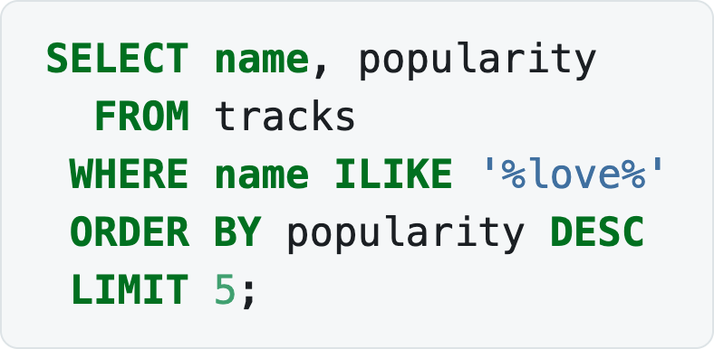
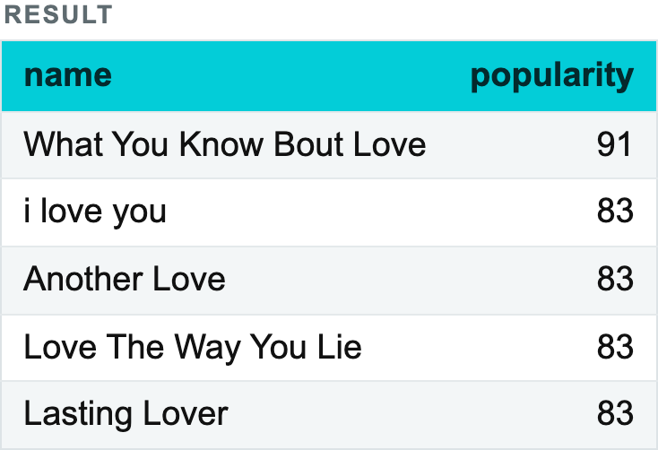
1.1 FILTERING AND SORTING
Filtering text
ILIKE — the case-insensitive version (PostgreSQL). Track titles are typed by humans, so case is never reliable:
Notes:
SELECT name, popularity
FROM tracks
WHERE name ILIKE '%love%'
ORDER BY popularity DESC
LIMIT 5;

Slide 21
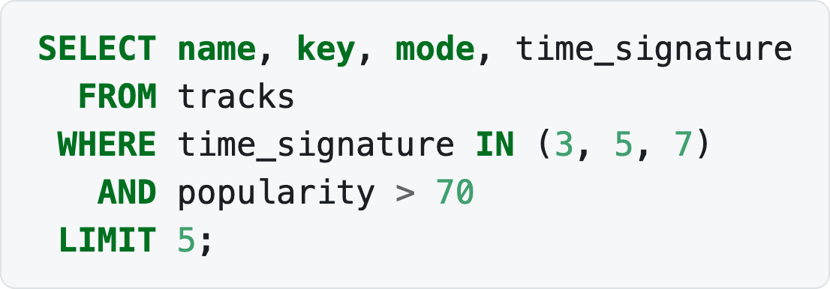
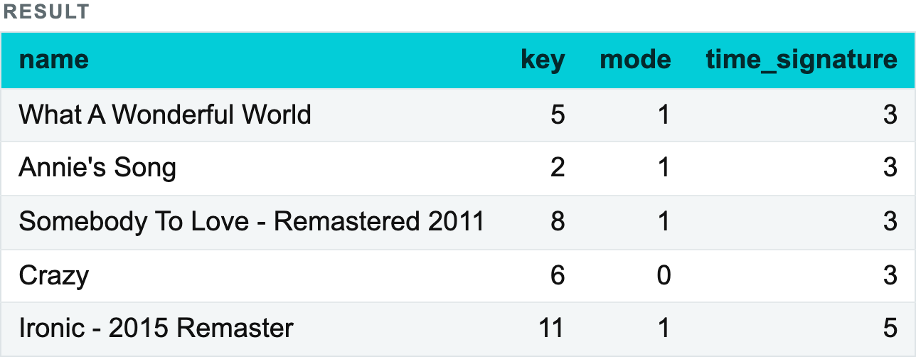
1.1 FILTERING AND SORTING
Filtering text
IN — matches one of a list of values:
Notes:
SELECT name, key, mode, time_signature
FROM tracks
WHERE time_signature IN (3, 5, 7)
AND popularity > 70
LIMIT 5;

Slide 22
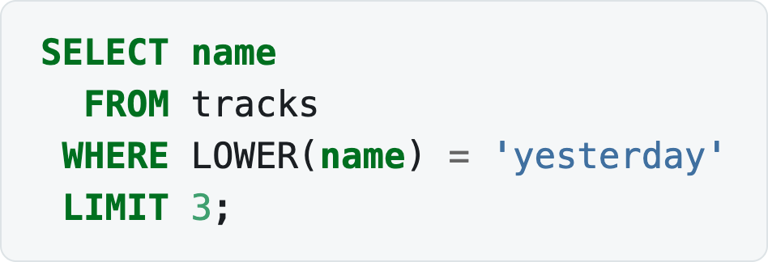
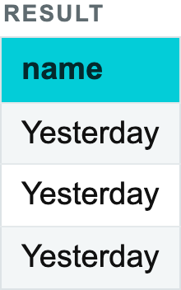
1.1 FILTERING AND SORTING
Filtering text
Text functions in the filter — LOWER(), UPPER(), TRIM(), SUBSTRING():
Notes:
SELECT name
FROM tracks
WHERE LOWER(name) = 'yesterday'
LIMIT 3;

Slide 23
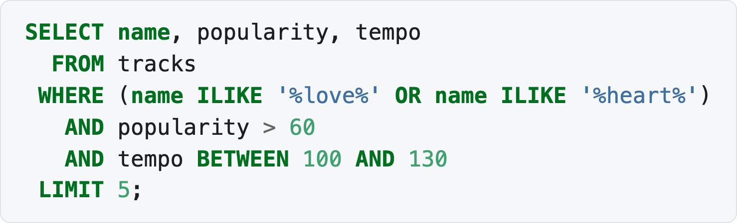
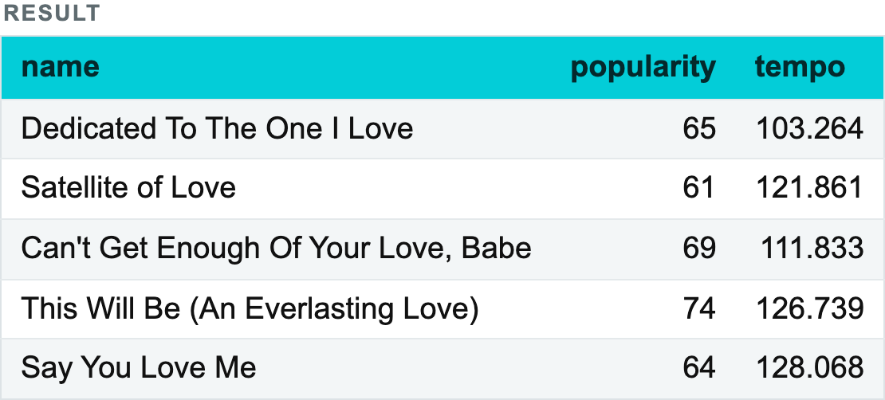
1.1 FILTERING AND SORTING
Filtering text
💡 Wrapping a column in a function stops PostgreSQL using an ordinary index on it. LOWER(name) = 'yesterday' cannot use an index on name. That does not matter on 60,000 rows; it matters a great deal on 60,000,000. Lecture 3 returns to this.
Conditions combine freely:
Notes:
SELECT name, popularity, tempo
FROM tracks
WHERE (name ILIKE '%love%' OR name ILIKE '%heart%')
AND popularity > 60
AND tempo BETWEEN 100 AND 130
LIMIT 5;

Slide 24
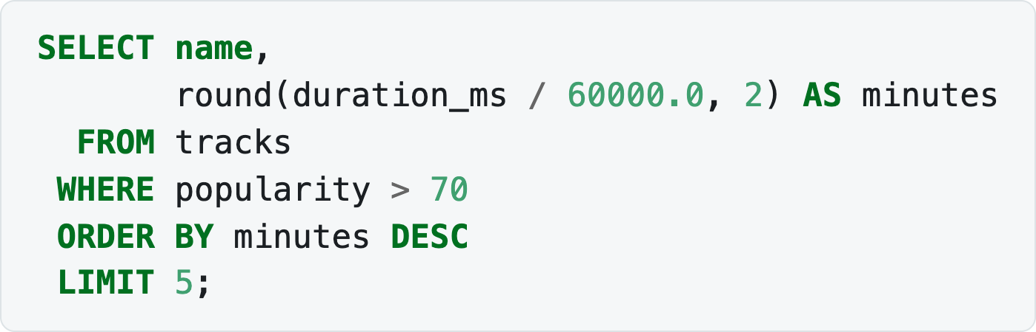
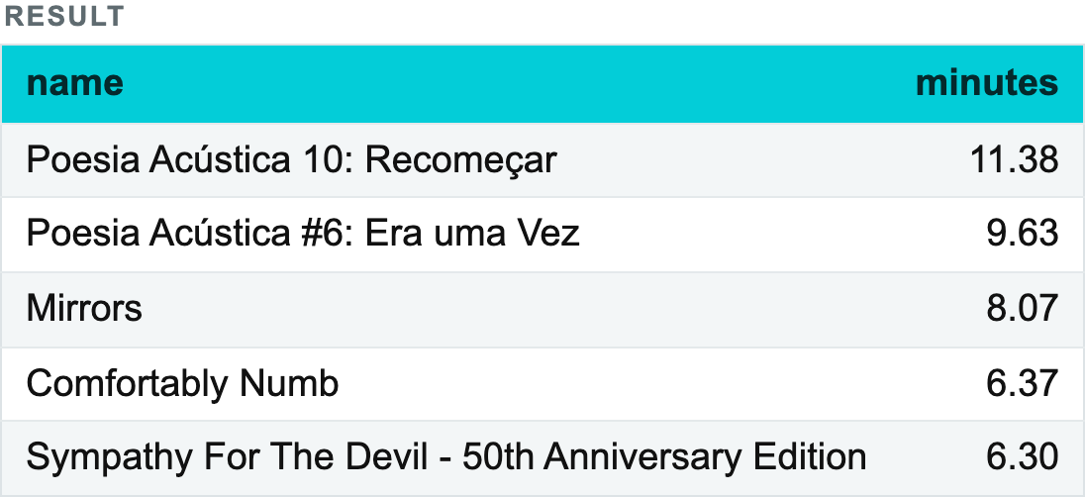
1.1 FILTERING AND SORTING
Sorting (ORDER BY)
The sort field can be given by name, by alias, or by its ordinal number among the output fields (starting from 1). Numbers sort numerically, character types lexicographically.
Unlike WHERE, ORDER BY can see a SELECT alias, because sorting happens after the columns are computed (see the order of execution):
Notes:
SELECT name,
round(duration_ms / 60000.0, 2) AS minutes
FROM tracks
WHERE popularity > 70
ORDER BY minutes DESC
LIMIT 5;

Slide 25
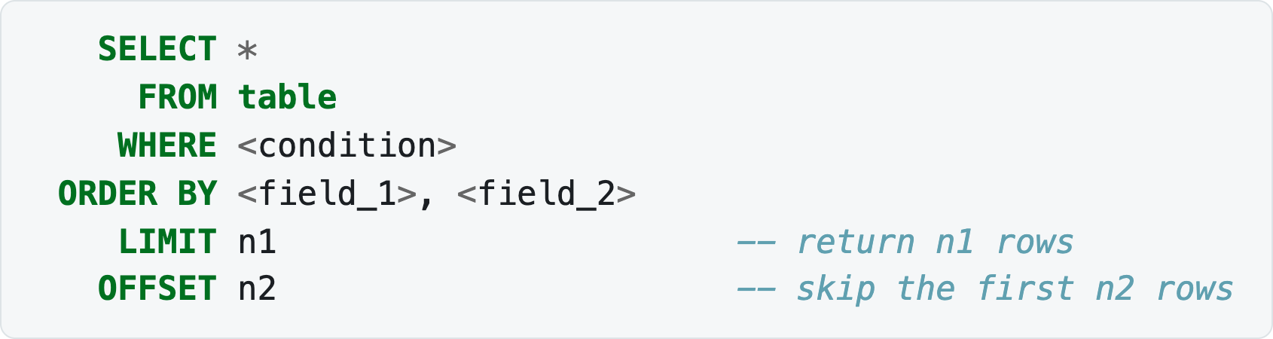
1.1 FILTERING AND SORTING
Limiting the result set (LIMIT, OFFSET)
LIMIT restricts the number of rows returned; combined with OFFSET it gives pagination.
Notes:
SELECT *
FROM table
WHERE <condition>
ORDER BY <field_1>, <field_2>
LIMIT n1 -- return n1 rows
OFFSET n2 -- skip the first n2 rows

Slide 26

Aggregate functions
Aggregate functions perform a calculation over a set of values and return a single value — the aggregate. They are used to analyse and summarise data: the sum of today's purchases, the number of people in a department, the average length of a song.
Specifics of COUNT
Counting several things in one pass
Grouping data (GROUP BY)
Filtering by aggregates (HAVING)
Check yourself

Slide 27
LECTURE 1. SQL BASICS
1.2 Aggregate functions
Purpose | Function | Example
Count | COUNT(<field>) | SELECT COUNT(*) FROM tracks
Sum | SUM(<field>) | SELECT SUM(duration_ms) FROM tracks
Average | AVG(<field>) | SELECT AVG(popularity) FROM tracks
Minimum | MIN(<field>) | SELECT MIN(release_date) FROM tracks
Maximum | MAX(<field>) | SELECT MAX(tempo) FROM tracks

Slide 28
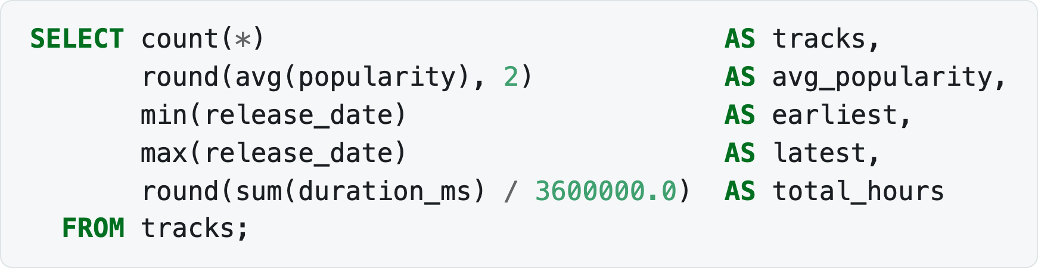
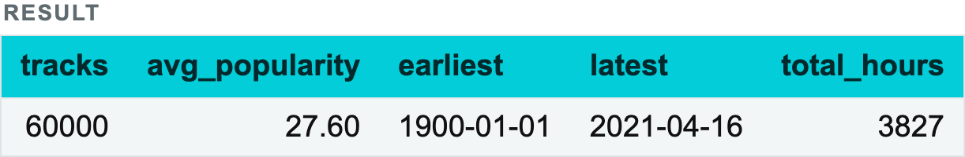
LECTURE 1. SQL BASICS
1.2 Aggregate functions
Notes:
SELECT count(*) AS tracks,
round(avg(popularity), 2) AS avg_popularity,
min(release_date) AS earliest,
max(release_date) AS latest,
round(sum(duration_ms) / 3600000.0) AS total_hours
FROM tracks;

Slide 29
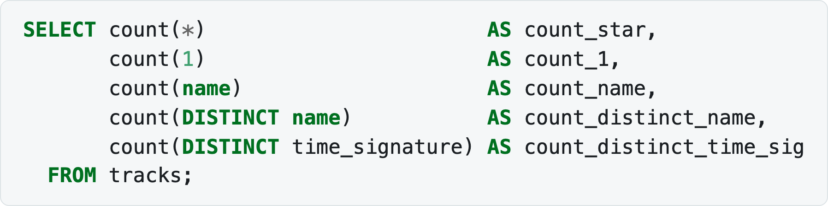
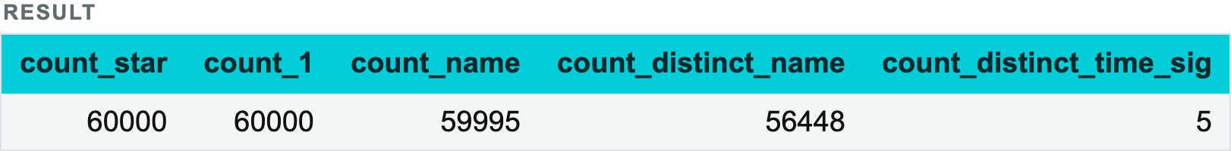
1.2 AGGREGATE FUNCTIONS
Specifics of COUNT
COUNT(*) — the number of rows in the table (or in the filtered table, if WHERE is used);
COUNT(1) — the same as COUNT(*), but the DBMS does not read the values of every field, using a constant instead;
COUNT(<field>) — the number of non-empty values in the field;
COUNT(DISTINCT <field>) — the number of unique non-empty values in the field.
The five nameless tracks make the difference visible:
Notes:
SELECT count(*) AS count_star,
count(1) AS count_1,
count(name) AS count_name,
count(DISTINCT name) AS count_distinct_name,
count(DISTINCT time_signature) AS count_distinct_time_sig
FROM tracks;

Slide 30
1.2 AGGREGATE FUNCTIONS
Specifics of COUNT
count_star and count_name differ by exactly the five NULL titles. count_distinct_name is far lower still — the catalogue is full of remasters, live versions and re-releases sharing a title.

Slide 31
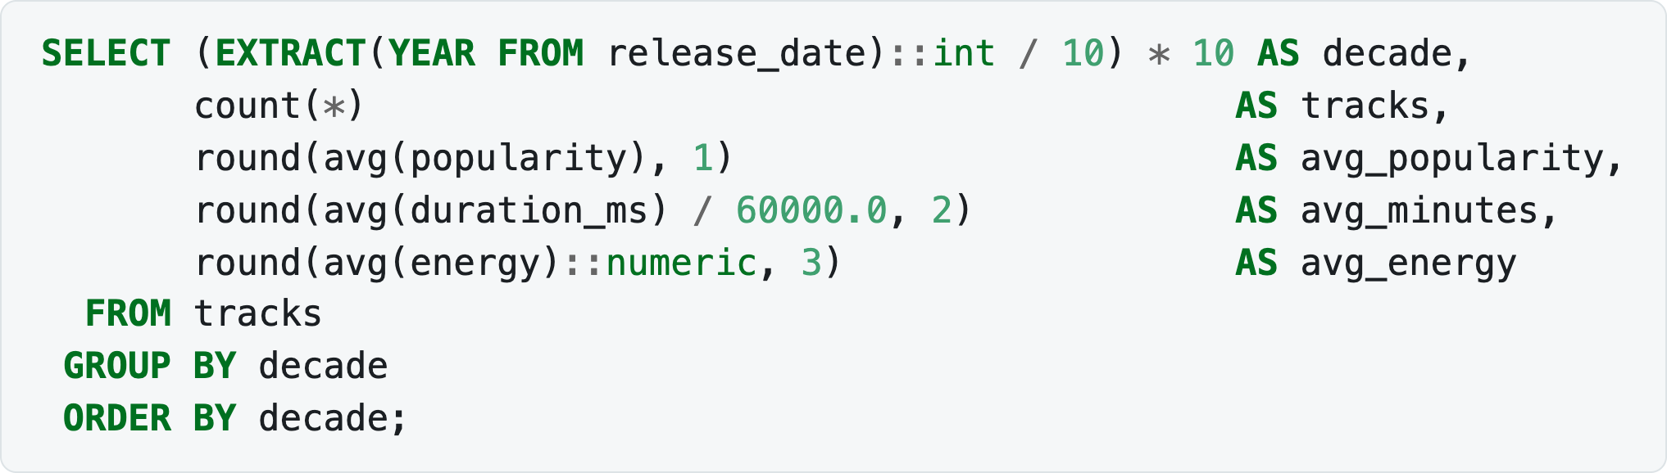
1.2 AGGREGATE FUNCTIONS
Grouping data (GROUP BY)
The single most useful grouping on this data is by decade:
Notes:
SELECT (EXTRACT(YEAR FROM release_date)::int / 10) * 10 AS decade,
count(*) AS tracks,
round(avg(popularity), 1) AS avg_popularity,
round(avg(duration_ms) / 60000.0, 2) AS avg_minutes,
round(avg(energy)::numeric, 3) AS avg_energy
FROM tracks
GROUP BY decade
ORDER BY decade;

Slide 32
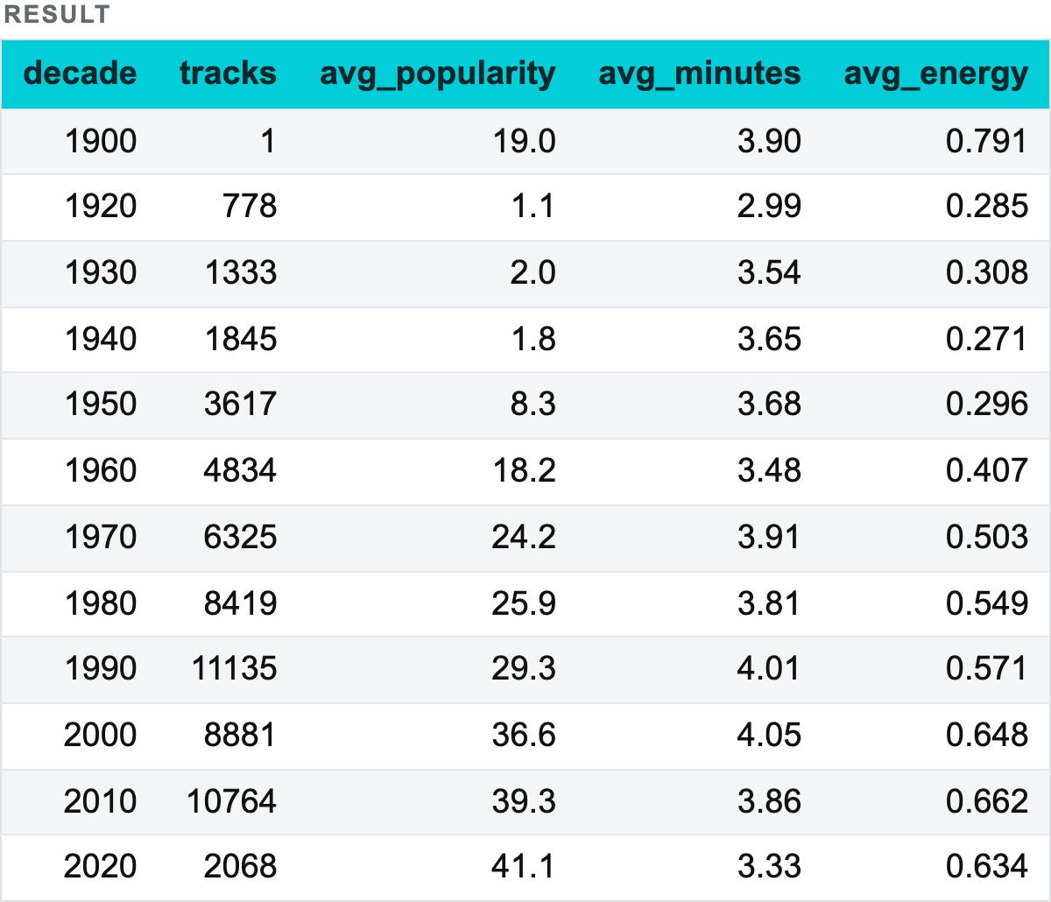
1.2 AGGREGATE FUNCTIONS
Grouping data (GROUP BY)
Notes:
SELECT (EXTRACT(YEAR FROM release_date)::int / 10) * 10 AS decade,
count(*) AS tracks,
round(avg(popularity), 1) AS avg_popularity,
round(avg(duration_ms) / 60000.0, 2) AS avg_minutes,
round(avg(energy)::numeric, 3) AS avg_energy
FROM tracks
GROUP BY decade
ORDER BY decade;

Slide 33
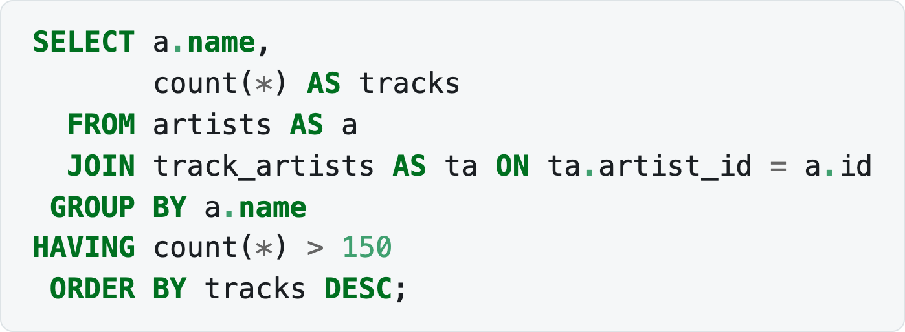
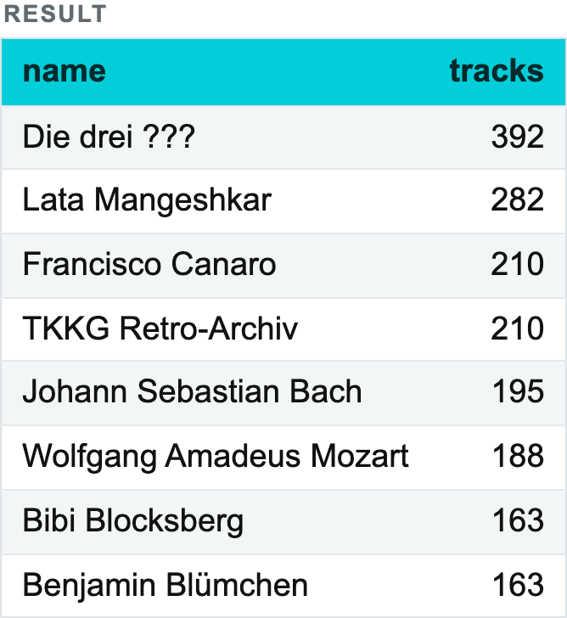
1.2 AGGREGATE FUNCTIONS
Filtering by aggregates (HAVING)
Notes:
SELECT a.name,
count(*) AS tracks
FROM artists AS a
JOIN track_artists AS ta ON ta.artist_id = a.id
GROUP BY a.name
HAVING count(*) > 150
ORDER BY tracks DESC;

Slide 34

TBC Explorers
34
10-minute
break
We'll continue with
window functions.

Slide 35
Window functions
An analytic (window) function performs calculations over a set of records forming a window (partition) and returns a single value per row.
Syntax
The base query for the examples
The three groups of analytic functions
Aggregate window functions
Offset functions
Ranking functions
Frames
WINDOW — a named window
Check yourself

Slide 36
GROUP BY vs window functions
GROUP BY
WINDOW
track 1
+ context
→
1 row
track 2
+ context
track 3
+ context
track 4
+ context
4 rows
avg(popularity) OVER (
PARTITION BY decade
)
1.3 · WINDOW FUNCTIONS
36

Slide 37
1.3 WINDOW FUNCTIONS
Syntax
function — the window function over the chosen field;
partition — the field or set of fields defining the group;
sorting — the field or fields by which rows are ordered inside the partition;
frame — the set of rows inside the window we operate on (optional).
First the data is split into partitions, then sorted, and only then is the function applied to each record inside the partition.
Notes:
<function>(<field>) OVER (PARTITION BY <partition> ORDER BY <sorting> <frame>)

Slide 38
1.3 WINDOW FUNCTIONS
The three groups of analytic functions
AGGREGATION | OFFSET | RANKING
AVG() | FIRST_VALUE() | ROW_NUMBER()
COUNT() | LAST_VALUE() | RANK()
MAX() | LAG() | DENSE_RANK()
MIN() | LEAD() | NTILE()
SUM() | NTH_VALUE() | CUME_DIST()
 |  | PERCENT_RANK()

Slide 39
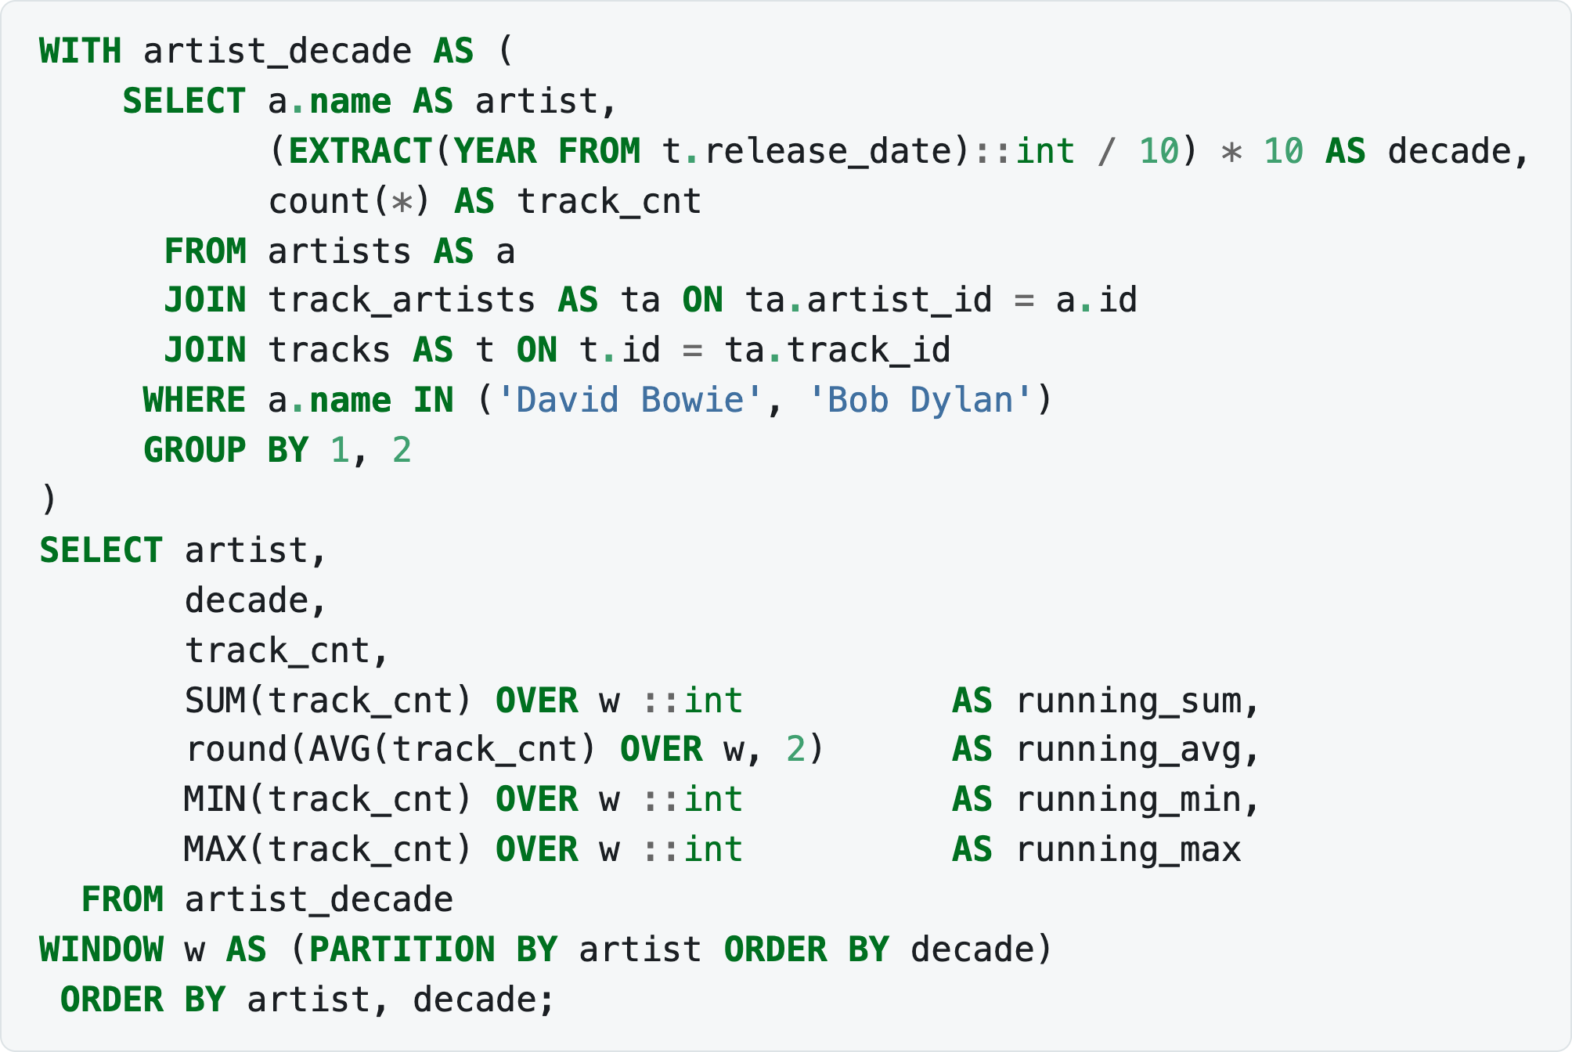
1.3 WINDOW FUNCTIONS
Aggregate window functions
AVG, COUNT, MAX, MIN, SUM — cumulative values inside a window:
Notes:
WITH artist_decade AS (
SELECT a.name AS artist,
(EXTRACT(YEAR FROM t.release_date)::int / 10) * 10 AS decade,
count(*) AS track_cnt
FROM artists AS a
JOIN track_artists AS ta ON ta.artist_id = a.id
JOIN tracks AS t ON t.id = ta.track_id
WHERE a.name IN ('David Bowie', 'Bob Dylan')
GROUP BY 1, 2
)
SELECT artist,
decade,
track_cnt,
SUM(track_cnt) OVER w ::int AS running_sum,
round(AVG(track_cnt) OVER w, 2) AS running_avg,
MIN(track_cnt) OVER w ::int AS running_min,
MAX(track_cnt) OVER w ::int AS running_max
FROM artist_decade
WINDOW w AS (PARTITION BY artist ORDER BY decade)
ORDER BY artist, decade;

Slide 40
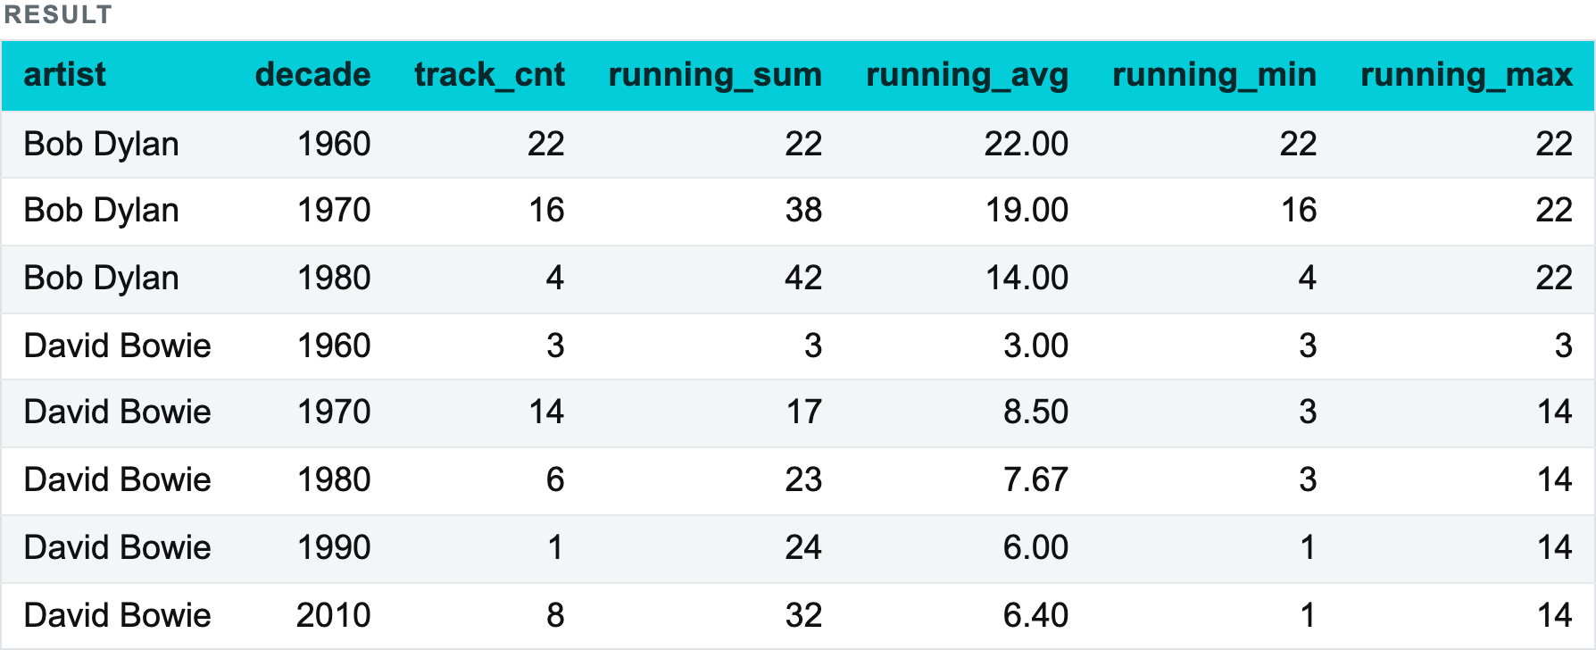
1.3 WINDOW FUNCTIONS
Aggregate window functions
Notes:
WITH artist_decade AS (
SELECT a.name AS artist,
(EXTRACT(YEAR FROM t.release_date)::int / 10) * 10 AS decade,
count(*) AS track_cnt
FROM artists AS a
JOIN track_artists AS ta ON ta.artist_id = a.id
JOIN tracks AS t ON t.id = ta.track_id
WHERE a.name IN ('David Bowie', 'Bob Dylan')
GROUP BY 1, 2
)
SELECT artist,
decade,
track_cnt,
SUM(track_cnt) OVER w ::int AS running_sum,
round(AVG(track_cnt) OVER w, 2) AS running_avg,
MIN(track_cnt) OVER w ::int AS running_min,
MAX(track_cnt) OVER w ::int AS running_max
FROM artist_decade
WINDOW w AS (PARTITION BY artist ORDER BY decade)
ORDER BY artist, decade;

Slide 41
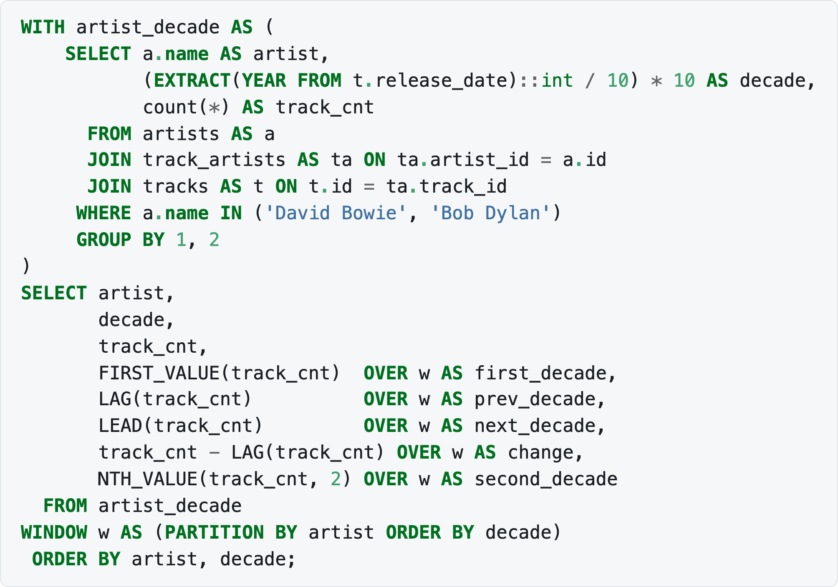
1.3 WINDOW FUNCTIONS
Offset functions
Offset functions reach into neighbouring rows:
FIRST_VALUE — the first row in the frame
LAST_VALUE — the last row in the frame
LAG — the value in the previous row of the partition
LEAD — the value in the next row of the partition
NTH_VALUE — the value in row number N (the second argument)
Notes:
WITH artist_decade AS (
SELECT a.name AS artist,
(EXTRACT(YEAR FROM t.release_date)::int / 10) * 10 AS decade,
count(*) AS track_cnt
FROM artists AS a
JOIN track_artists AS ta ON ta.artist_id = a.id
JOIN tracks AS t ON t.id = ta.track_id
WHERE a.name IN ('David Bowie', 'Bob Dylan')
GROUP BY 1, 2
)
SELECT artist,
decade,
track_cnt,
FIRST_VALUE(track_cnt) OVER w AS first_decade,
LAG(track_cnt) OVER w AS prev_decade,
LEAD(track_cnt) OVER w AS next_decade,
track_cnt - LAG(track_cnt) OVER w AS change,
NTH_VALUE(track_cnt, 2) OVER w AS second_decade
FROM artist_decade
WINDOW w AS (PARTITION BY artist ORDER BY decade)
ORDER BY artist, decade;

Slide 42
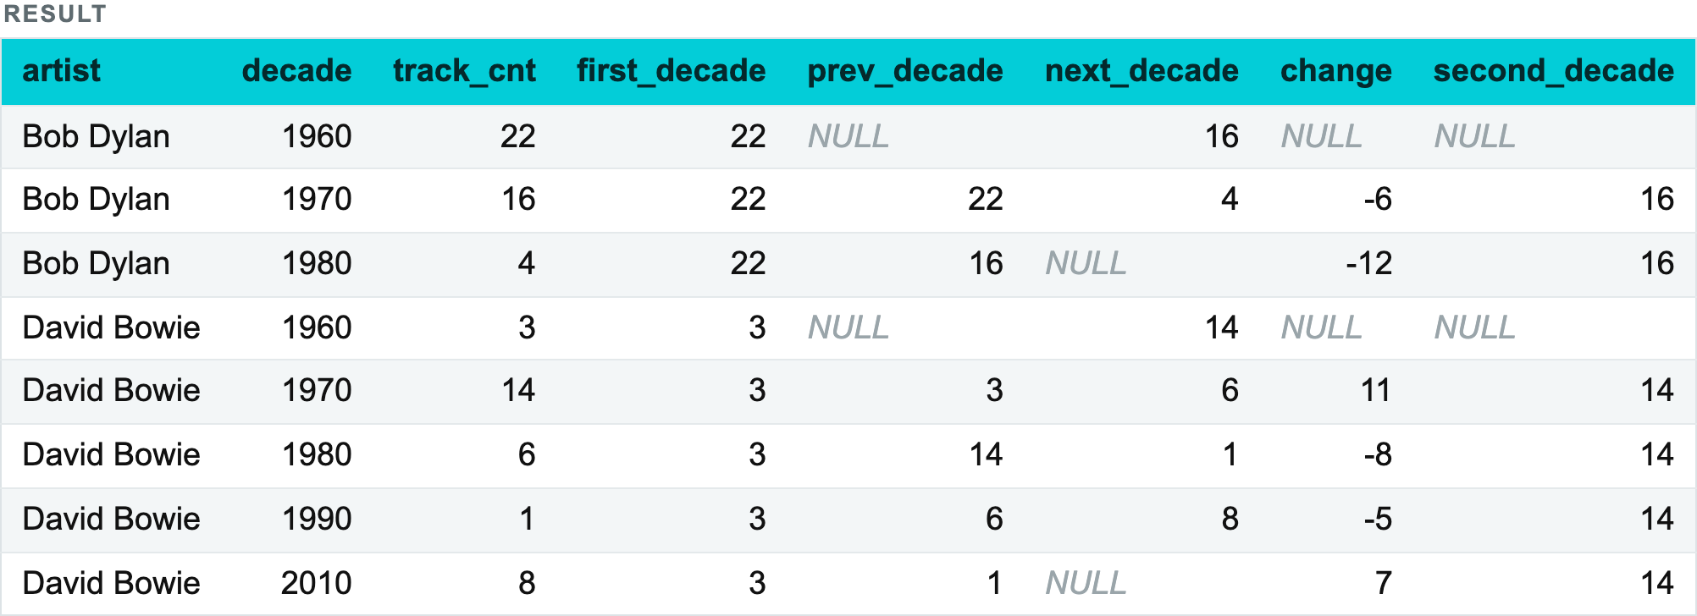
1.3 WINDOW FUNCTIONS
Offset functions
LAG is how you compute any change-over-time: the value minus the previous value. Note the NULL in the first row of each partition — there is no previous row, so the difference is unknown, not zero.
Notes:
WITH artist_decade AS (
SELECT a.name AS artist,
(EXTRACT(YEAR FROM t.release_date)::int / 10) * 10 AS decade,
count(*) AS track_cnt
FROM artists AS a
JOIN track_artists AS ta ON ta.artist_id = a.id
JOIN tracks AS t ON t.id = ta.track_id
WHERE a.name IN ('David Bowie', 'Bob Dylan')
GROUP BY 1, 2
)
SELECT artist,
decade,
track_cnt,
FIRST_VALUE(track_cnt) OVER w AS first_decade,
LAG(track_cnt) OVER w AS prev_decade,
LEAD(track_cnt) OVER w AS next_decade,
track_cnt - LAG(track_cnt) OVER w AS change,
NTH_VALUE(track_cnt, 2) OVER w AS second_decade
FROM artist_decade
WINDOW w AS (PARTITION BY artist ORDER BY decade)
ORDER BY artist, decade;

Slide 43
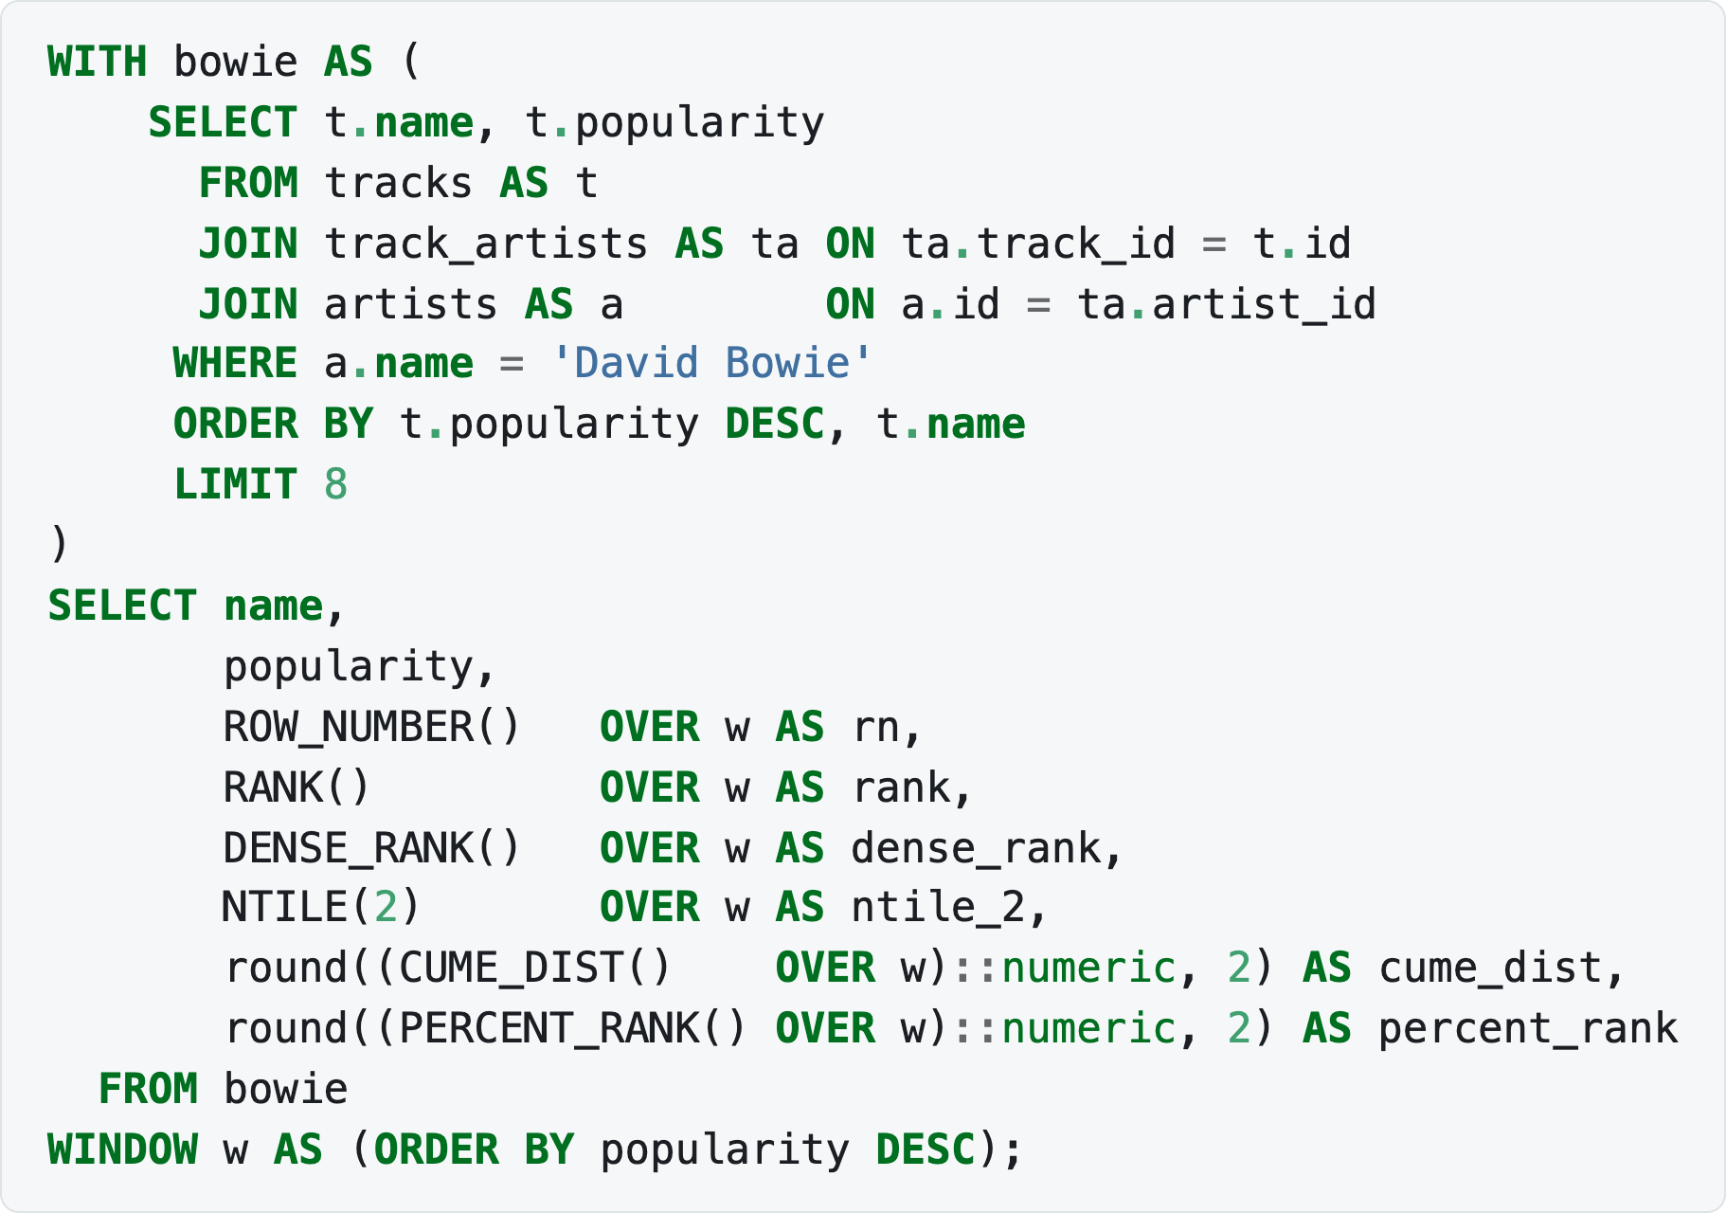
1.3 WINDOW FUNCTIONS
Ranking functions
ROW_NUMBER — the row number inside the partition
RANK — the rank within the partition, skipping the next rank when values repeat
DENSE_RANK — the rank without gaps when values repeat
NTILE — splits the window into the given number of groups and returns the group number
CUME_DIST — the cumulative distribution, RANK/COUNT
PERCENT_RANK — the relative rank, (RANK-1)/(COUNT-1)
Ties are what separate these functions, and popularity scores are full of ties:
Notes:
WITH bowie AS (
SELECT t.name, t.popularity
FROM tracks AS t
JOIN track_artists AS ta ON ta.track_id = t.id
JOIN artists AS a ON a.id = ta.artist_id
WHERE a.name = 'David Bowie'
ORDER BY t.popularity DESC, t.name
LIMIT 8
)
SELECT name,
popularity,
ROW_NUMBER() OVER w AS rn,
RANK() OVER w AS rank,
DENSE_RANK() OVER w AS dense_rank,
NTILE(2) OVER w AS ntile_2,
round((CUME_DIST() OVER w)::numeric, 2) AS cume_dist,
round((PERCENT_RANK() OVER w)::numeric, 2) AS percent_rank
FROM bowie
WINDOW w AS (ORDER BY popularity DESC);

Slide 44
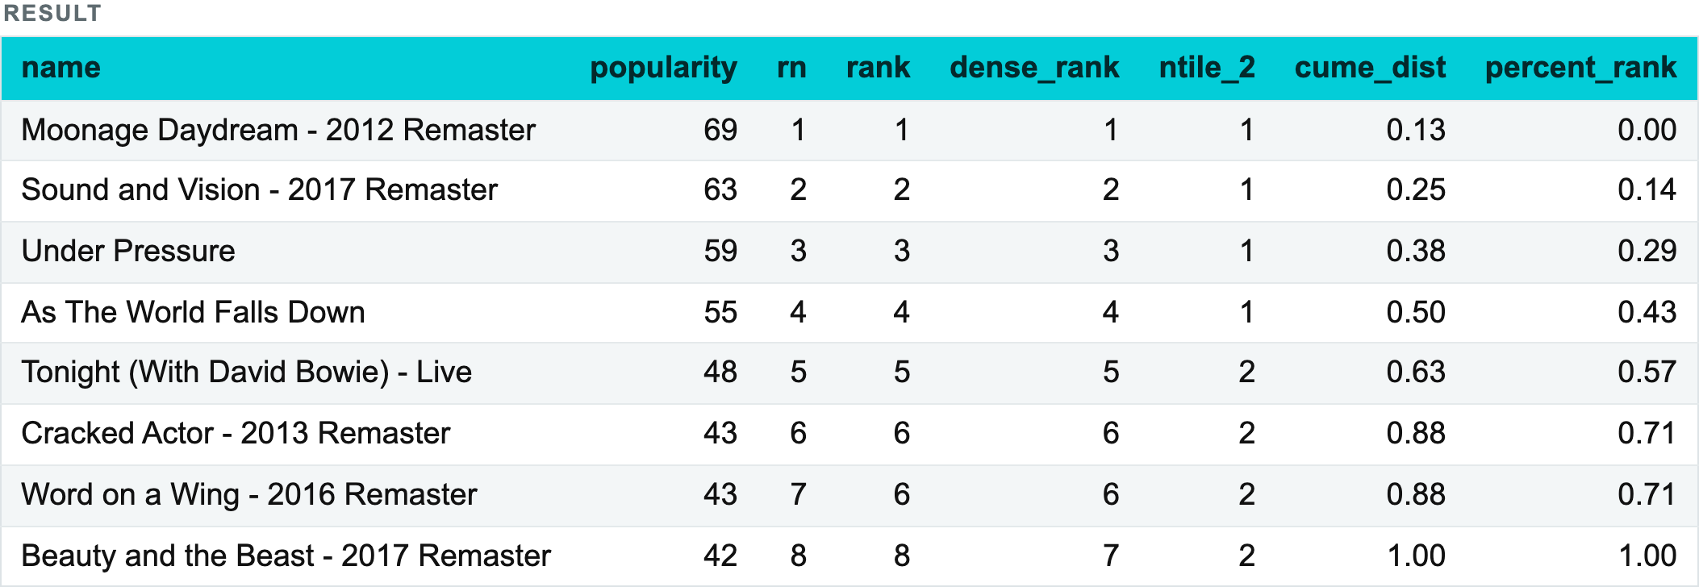
1.3 WINDOW FUNCTIONS
Ranking functions
Notes:
WITH bowie AS (
SELECT t.name, t.popularity
FROM tracks AS t
JOIN track_artists AS ta ON ta.track_id = t.id
JOIN artists AS a ON a.id = ta.artist_id
WHERE a.name = 'David Bowie'
ORDER BY t.popularity DESC, t.name
LIMIT 8
)
SELECT name,
popularity,
ROW_NUMBER() OVER w AS rn,
RANK() OVER w AS rank,
DENSE_RANK() OVER w AS dense_rank,
NTILE(2) OVER w AS ntile_2,
round((CUME_DIST() OVER w)::numeric, 2) AS cume_dist,
round((PERCENT_RANK() OVER w)::numeric, 2) AS percent_rank
FROM bowie
WINDOW w AS (ORDER BY popularity DESC);

Slide 45
1.4
Subqueries and CTEs
Use them when a query is easier to solve in steps.
45

Slide 46
Subqueries: use one query inside another
Find tracks more popular than the catalogue average.
1. inner query
average popularity
SELECT name, popularity
FROM tracks
WHERE popularity > (
SELECT avg(popularity)
FROM tracks
)
ORDER BY popularity DESC;
↓
2. outer query
compare every track
Correlated subqueries run with values from the outer row; scalar subqueries return one value.
1.4 · SUBQUERIES & CTE
46

Slide 47

TBC Explorers
47
SUBQUERIES AND CTES
CTEs: split a query
into readable steps
CTEs (Common Table Expressions) let you break a query
into smaller parts, making it easier to read and maintain.
SQL
WITH top_artists AS (
SELECT artist_name, AVG(popularity) AS avg_pop
FROM tracks
GROUP BY artist_name
HAVING AVG(popularity) > 70
)
SELECT *
FROM top_artists
ORDER BY avg_pop DESC;

Slide 48
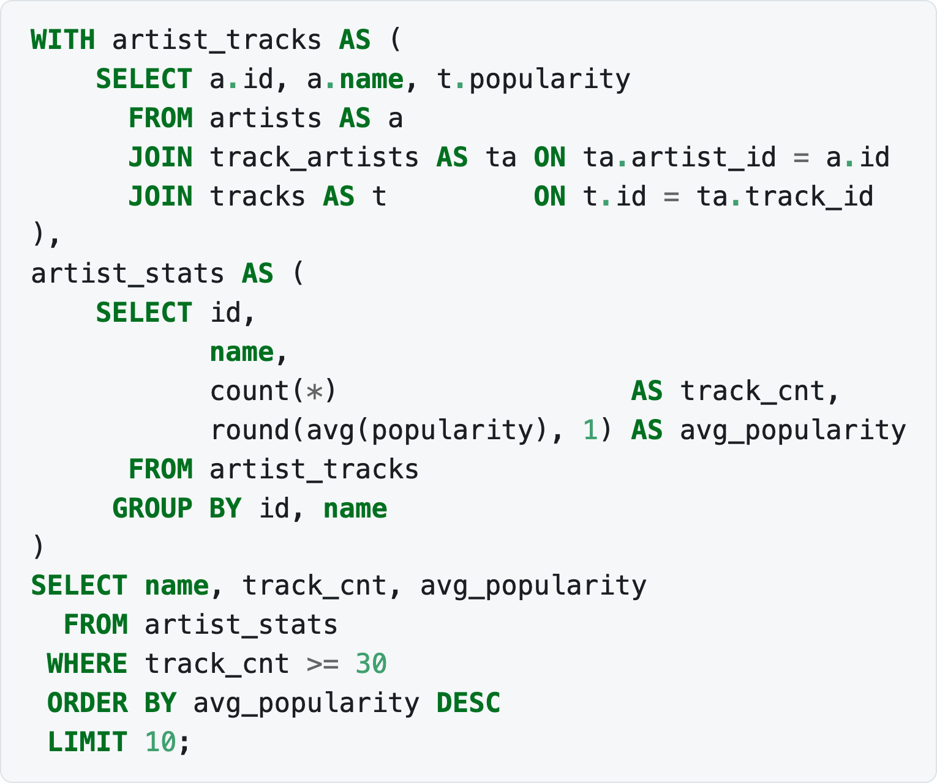
1.4 SUBQUERIES AND CTE
Common Table Expression (CTE)
Advantages:
Improved readability — a complex query is split into understandable parts.
Reuse — the CTE's result can be referenced several times without repeating the text of the subquery.
There can be several CTEs in one query: WITH is written once and the CTEs are listed separated by commas. A later CTE may reference an earlier one:
Notes:
WITH artist_tracks AS (
SELECT a.id, a.name, t.popularity
FROM artists AS a
JOIN track_artists AS ta ON ta.artist_id = a.id
JOIN tracks AS t ON t.id = ta.track_id
),
artist_stats AS (
SELECT id,
name,
count(*) AS track_cnt,
round(avg(popularity), 1) AS avg_popularity
FROM artist_tracks
GROUP BY id, name
)
SELECT name, track_cnt, avg_popularity
FROM artist_stats
WHERE track_cnt >= 30
ORDER BY avg_popularity DESC
LIMIT 10;

Slide 49
Joins and unions
DISTINCT
UNION and UNION ALL
JOIN
Joins on the real data
Special types of JOIN
Venn diagrams
Joining and aggregating together
Check yourself

Slide 50
1.5 JOINS AND UNIONS
DISTINCT
DISTINCT removes duplicate rows from the query result:
DISTINCT is written once, right after SELECT. The DBMS has to remember every unique value and compare it with the following ones, which can slow the query down.
Notes:
SELECT DISTINCT column1 FROM table_name;
SELECT DISTINCT column1, column2 FROM table_name; -- unique combinations

Slide 51
1.5 JOINS AND UNIONS
UNION and UNION ALL
UNION and UNION ALL combine the results of two or more queries vertically:
UNION combines the results, excluding duplicate rows;
UNION ALL does the same but keeps duplicates.

Slide 52

TBC Explorers
52
JOINS
Combining tables
with JOIN
JOIN lets you combine related data from multiple tables
using a matching key.
tracks
artists
JOIN
track_id
artist_id
track_name
artist_name
artist_id
ON tracks.artist_id
= artists.artist_id
followers
album_id
genres
popularity

Slide 53
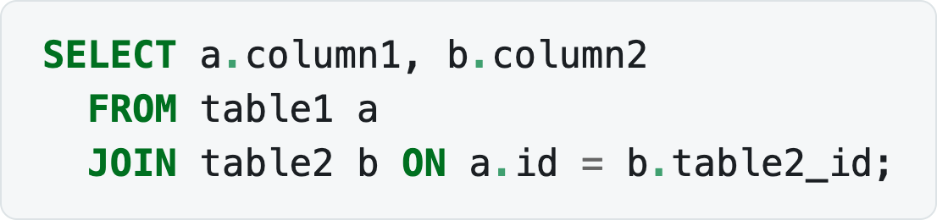
1.5 JOINS AND UNIONS
JOIN
JOIN enriches data from one table with data from another — a horizontal combination. Every row in one table is matched against the second by some condition, and matching rows are combined.
Tables can be given aliases so that you do not have to write their names out in full; AS may be omitted here.
Notes:
SELECT a.column1, b.column2
FROM table1 a
JOIN table2 b ON a.id = b.table2_id;

Slide 54
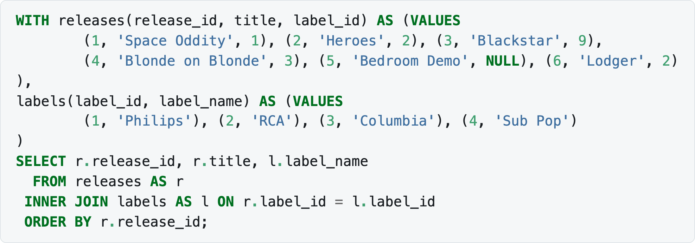
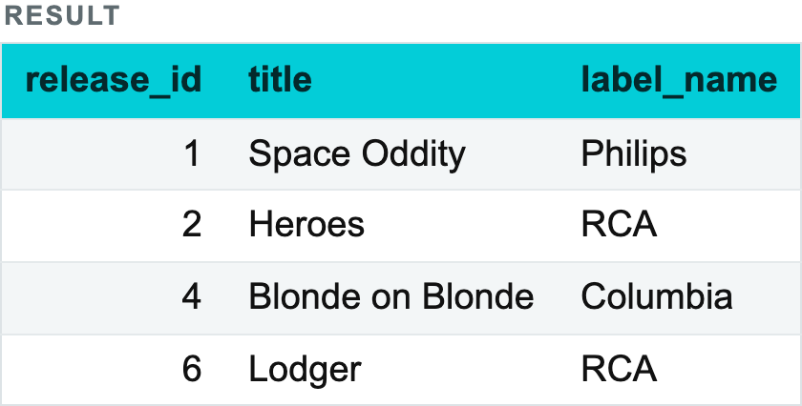
1.5 JOINS AND UNIONS
JOIN
INNER JOIN returns the rows that have a match in both tables:
Notes:
WITH releases(release_id, title, label_id) AS (VALUES
(1, 'Space Oddity', 1), (2, 'Heroes', 2), (3, 'Blackstar', 9),
(4, 'Blonde on Blonde', 3), (5, 'Bedroom Demo', NULL), (6, 'Lodger', 2)
),
labels(label_id, label_name) AS (VALUES
(1, 'Philips'), (2, 'RCA'), (3, 'Columbia'), (4, 'Sub Pop')
)
SELECT r.release_id, r.title, l.label_name
FROM releases AS r
INNER JOIN labels AS l ON r.label_id = l.label_id
ORDER BY r.release_id;

Slide 55
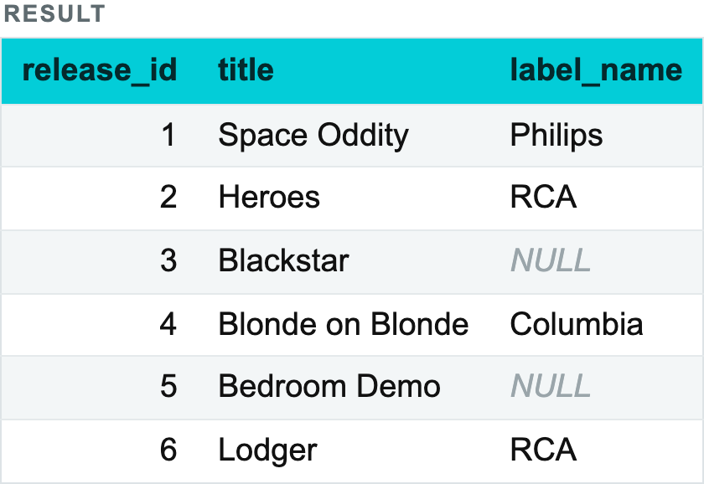
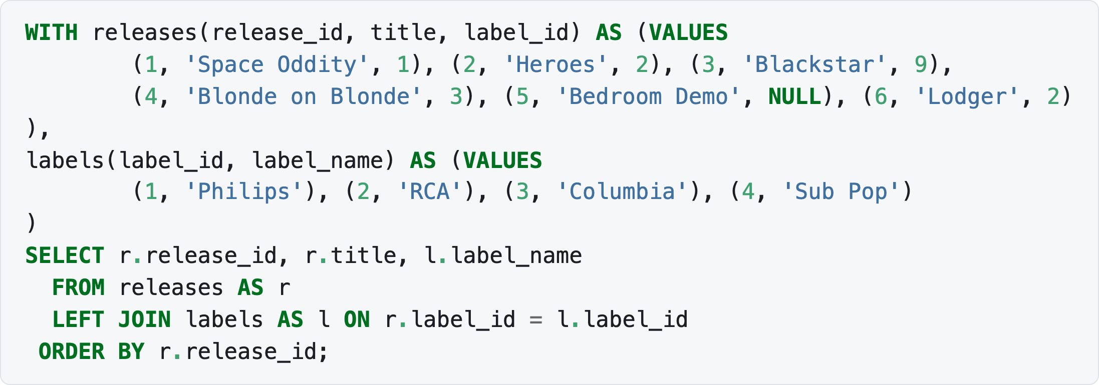
1.5 JOINS AND UNIONS
JOIN
LEFT JOIN returns all rows from the left table and the matching rows from the right one; where there is no match, NULL:
Notes:
WITH releases(release_id, title, label_id) AS (VALUES
(1, 'Space Oddity', 1), (2, 'Heroes', 2), (3, 'Blackstar', 9),
(4, 'Blonde on Blonde', 3), (5, 'Bedroom Demo', NULL), (6, 'Lodger', 2)
),
labels(label_id, label_name) AS (VALUES
(1, 'Philips'), (2, 'RCA'), (3, 'Columbia'), (4, 'Sub Pop')
)
SELECT r.release_id, r.title, l.label_name
FROM releases AS r
LEFT JOIN labels AS l ON r.label_id = l.label_id
ORDER BY r.release_id;

Slide 56
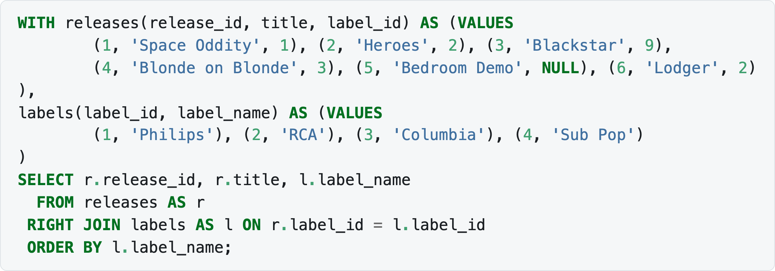
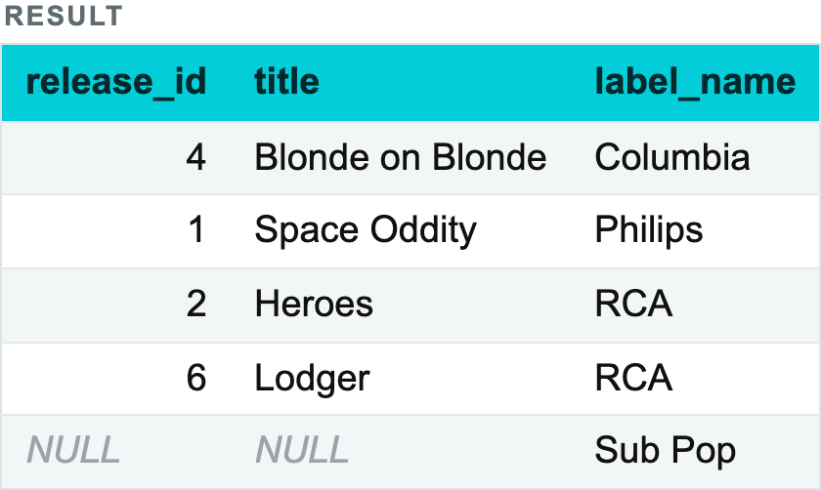
1.5 JOINS AND UNIONS
JOIN
RIGHT JOIN is the mirror image — all rows from the right table plus matches from the left. It shows which labels exist even if they have no releases:
Notes:
WITH releases(release_id, title, label_id) AS (VALUES
(1, 'Space Oddity', 1), (2, 'Heroes', 2), (3, 'Blackstar', 9),
(4, 'Blonde on Blonde', 3), (5, 'Bedroom Demo', NULL), (6, 'Lodger', 2)
),
labels(label_id, label_name) AS (VALUES
(1, 'Philips'), (2, 'RCA'), (3, 'Columbia'), (4, 'Sub Pop')
)
SELECT r.release_id, r.title, l.label_name
FROM releases AS r
RIGHT JOIN labels AS l ON r.label_id = l.label_id
ORDER BY l.label_name;

Slide 57
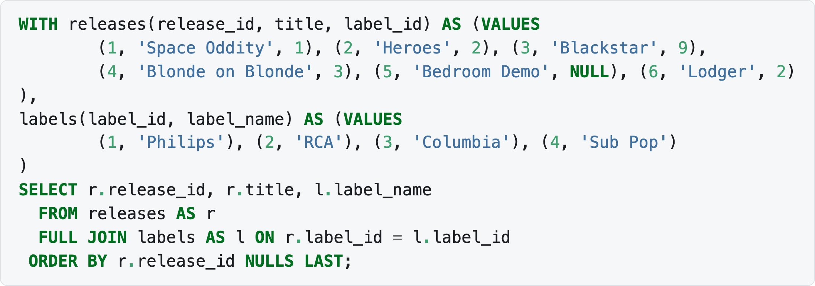
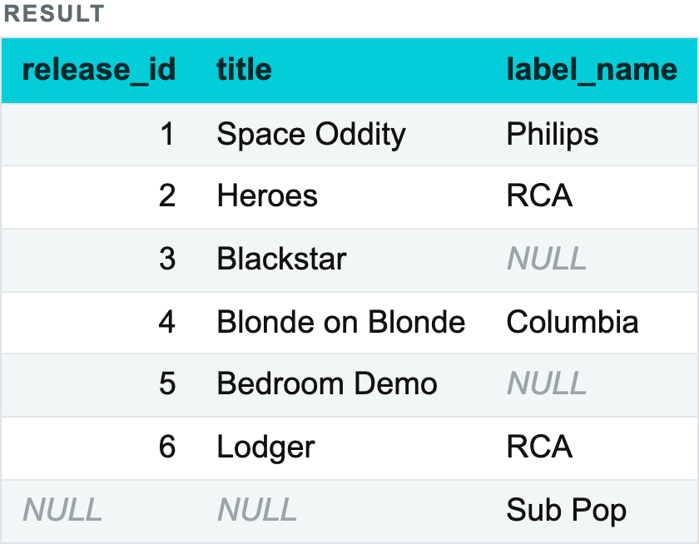
1.5 JOINS AND UNIONS
JOIN
FULL JOIN returns all rows from both tables, filling the missing values with NULL — every release and every label, matched where possible:
Notes:
WITH releases(release_id, title, label_id) AS (VALUES
(1, 'Space Oddity', 1), (2, 'Heroes', 2), (3, 'Blackstar', 9),
(4, 'Blonde on Blonde', 3), (5, 'Bedroom Demo', NULL), (6, 'Lodger', 2)
),
labels(label_id, label_name) AS (VALUES
(1, 'Philips'), (2, 'RCA'), (3, 'Columbia'), (4, 'Sub Pop')
)
SELECT r.release_id, r.title, l.label_name
FROM releases AS r
FULL JOIN labels AS l ON r.label_id = l.label_id
ORDER BY r.release_id NULLS LAST;

Slide 58
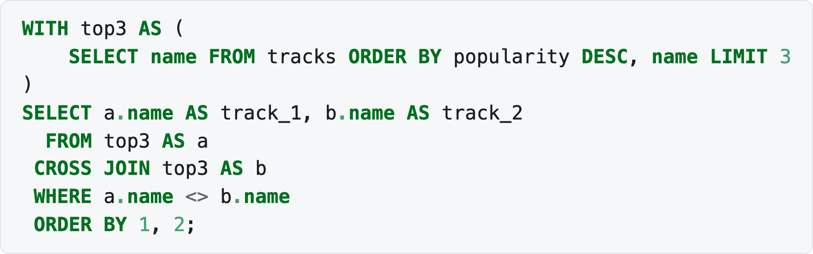
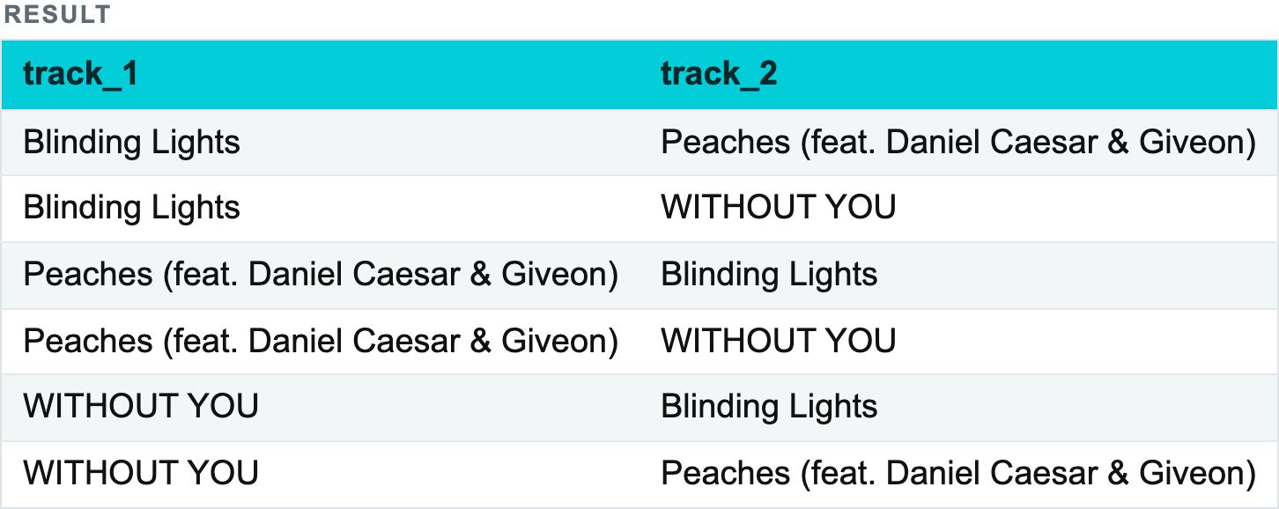
1.5 JOINS AND UNIONS
Special types of JOIN
CROSS JOIN — a join without a condition, producing the Cartesian product of two tables. Useful when every row of one table must be matched with every row of another, but dangerous: the row count grows multiplicatively.
Notes:
WITH top3 AS (
SELECT name FROM tracks ORDER BY popularity DESC, name LIMIT 3
)
SELECT a.name AS track_1, b.name AS track_2
FROM top3 AS a
CROSS JOIN top3 AS b
WHERE a.name <> b.name
ORDER BY 1, 2;

Slide 59
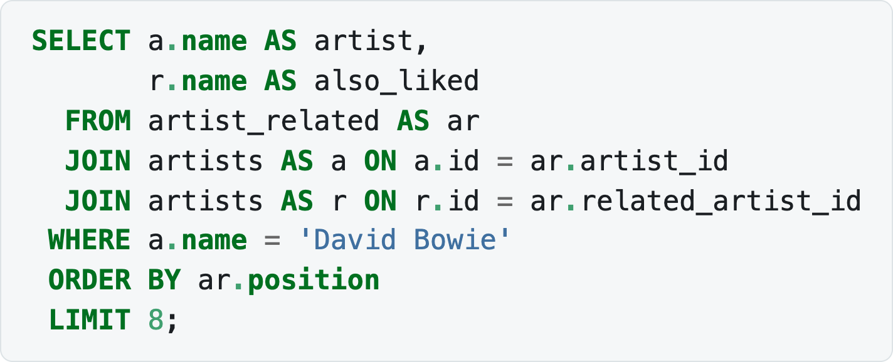
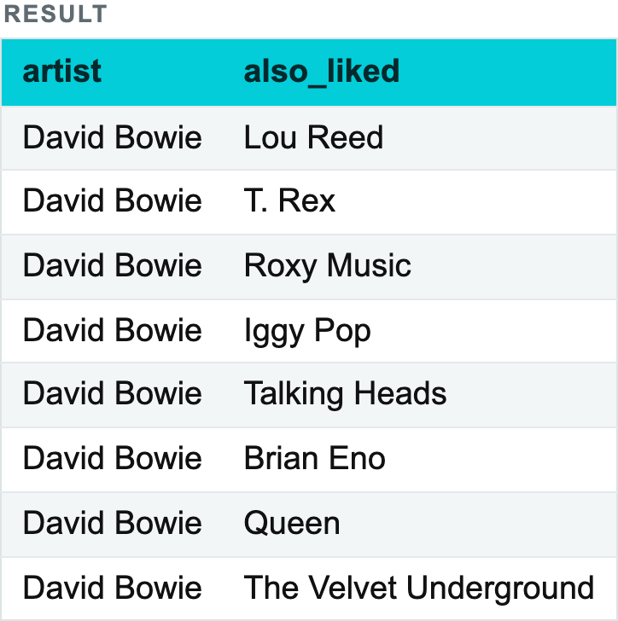
1.5 JOINS AND UNIONS
Special types of JOIN
Three rows crossed with three rows give nine, less the three where a track meets itself. Do this to tracks unfiltered and you ask for 3.6 billion rows.
SELF JOIN — joining a table with itself. artist_related links artists to artists, so reading it means joining artists twice:
Notes:
SELECT a.name AS artist,
r.name AS also_liked
FROM artist_related AS ar
JOIN artists AS a ON a.id = ar.artist_id
JOIN artists AS r ON r.id = ar.related_artist_id
WHERE a.name = 'David Bowie'
ORDER BY ar.position
LIMIT 8;

Slide 60
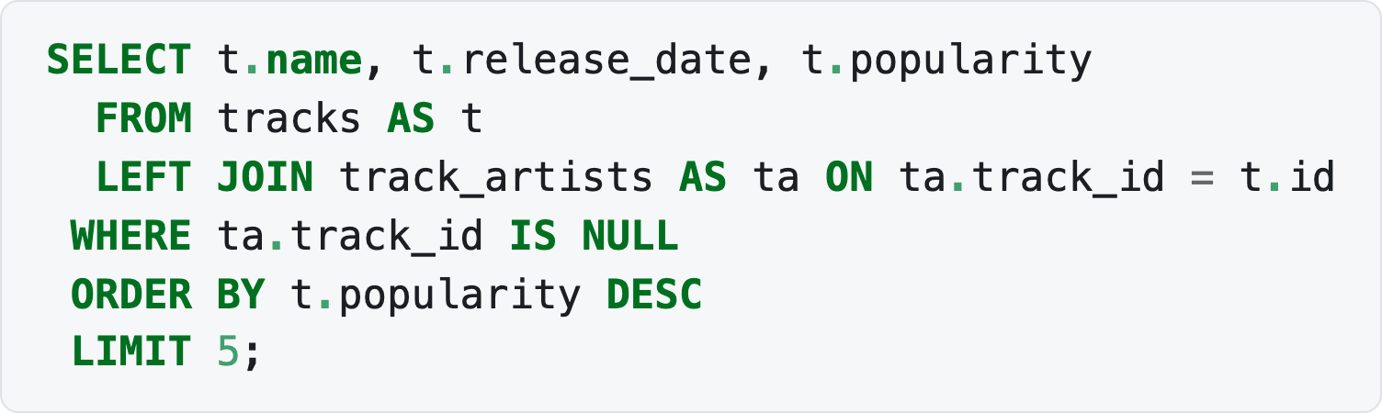
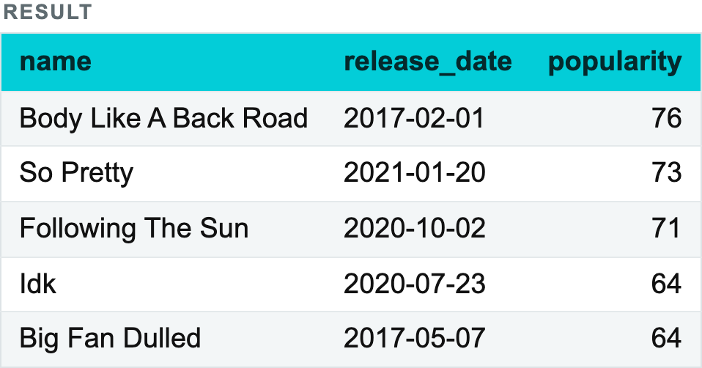
1.5 JOINS AND UNIONS
Special types of JOIN
Anti-join — not an official join type, but a common pattern: rows in one table with no match in another. Our sample has 1,099 tracks whose credited artist was missing from the source, and this is how you find them:
Notes:
SELECT t.name, t.release_date, t.popularity
FROM tracks AS t
LEFT JOIN track_artists AS ta ON ta.track_id = t.id
WHERE ta.track_id IS NULL
ORDER BY t.popularity DESC
LIMIT 5;

Slide 61
ACID and the execution plan
ACID
Order of execution of clauses
The execution plan

Slide 62
1.6 ACID AND THE EXECUTION PLAN
ACID
ACID is the set of four guarantees a transactional DBMS gives:
Atomicity — a transaction is all-or-nothing. There is no state in which half of its statements have been applied.
Consistency — a transaction moves the database from one valid state to another; all constraints (primary and foreign keys, CHECK, NOT NULL) hold before and after it. Our track_artists.artist_id has a foreign key to artists, so the database will simply refuse a credit for an artist that does not exist.
Isolation — concurrent transactions do not see each other's intermediate results. How strictly is governed by the isolation level: READ UNCOMMITTED, READ COMMITTED (the PostgreSQL default), REPEATABLE READ, SERIALIZABLE. The stricter the level, the fewer the anomalies (dirty reads, non-repeatable reads, phantom reads) and the higher the cost in concurrency.
Durability — once COMMIT returns, the data survives a crash or a power failure, because it has been written to the transaction log on disk.

Slide 63
1.6 ACID AND THE EXECUTION PLAN
Order of execution of clauses
We write an SQL query in one order and the DBMS executes it in another. The logical order of execution is:
FROM — the engine determines which tables the data will be taken from.
ON — the join conditions are processed; filtering happens before the join itself.
JOIN — the tables are joined on the specified conditions.
WHERE — the rows satisfying the query's conditions are filtered.
GROUP BY — the rows are grouped by the specified columns.
HAVING — the aggregated data is filtered; groups that fail the condition are cut off.
SELECT — the columns given in the query are computed and extracted.
DISTINCT — duplicates are removed from the result, if required.
ORDER BY — the data is sorted.
LIMIT / OFFSET — the rows for output are finally determined.

Slide 64
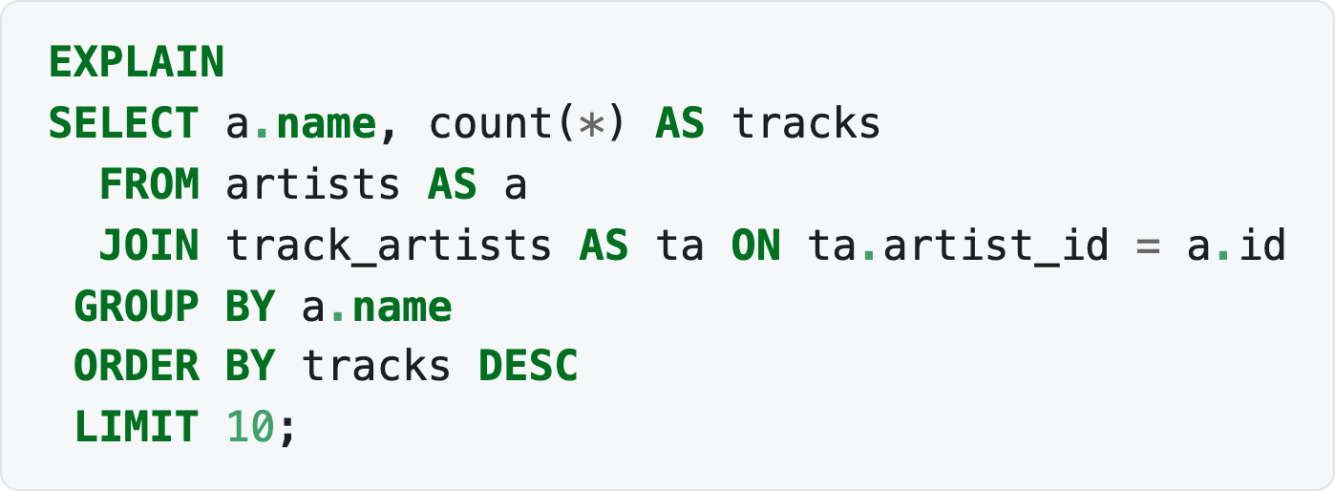
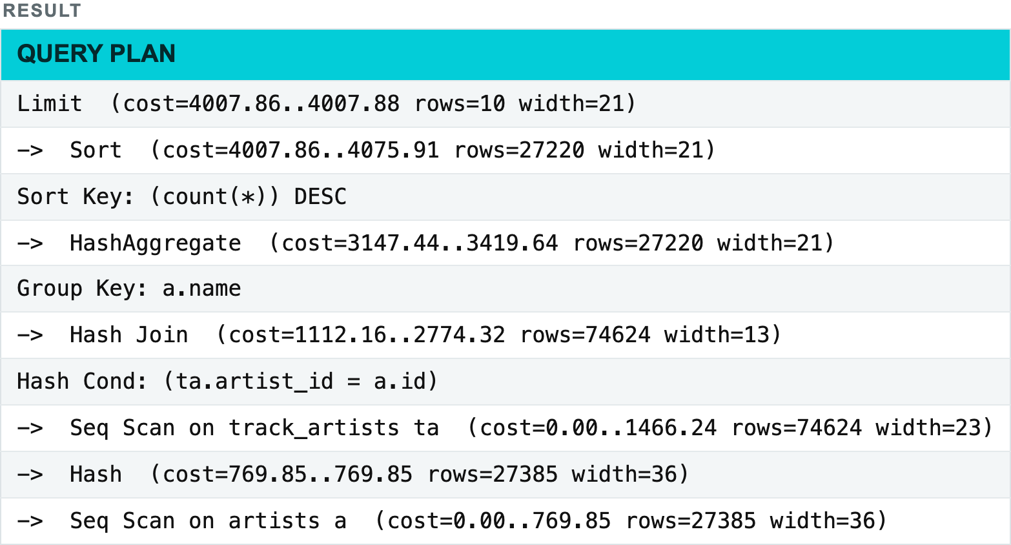
1.6 ACID AND THE EXECUTION PLAN
The execution plan
The logical order above says what the DBMS computes. The execution plan says how — which physical operations it will perform, in what order, and at what cost. The plan is produced by the optimizer, which analyses table statistics and chooses access methods and join algorithms.
EXPLAIN shows the plan without running the query:
Notes:
EXPLAIN
SELECT a.name, count(*) AS tracks
FROM artists AS a
JOIN track_artists AS ta ON ta.artist_id = a.id
GROUP BY a.name
ORDER BY tracks DESC
LIMIT 10;

Slide 65
TBC Explorers
65
WRAP-UP
How to approach a SQL query
Before writing SQL, define what the result should represent.
Population
Which rows do I need?
WHERE
Grain
What does one row represent?
GROUP BY
1
2
Metric
What do I calculate?
AVG / COUNT
Context
Do rows need comparison?
WINDOW
3
4
Structure
Would steps make it clearer?
CTE
Sanity
Could NULLs or duplicates break it?
CHECK
5
6
Good SQL starts with a clear definition of the rows, grain and metric you need.

Slide 66
LECTURE 1. SQL BASICS
Summary
Filtering and sorting. WHERE selects rows by a condition; AND and OR combine conditions, with AND binding tighter — set precedence explicitly with parentheses. Text is filtered with =, LIKE, ILIKE, IN and string functions. ORDER BY sorts (ASC/DESC), LIMIT and OFFSET paginate. NULL means the absence of data: compare it with IS NULL / IS NOT NULL, replace it with COALESCE, and place it explicitly in sorts with NULLS FIRST / NULLS LAST.
Aggregate functions. SUM, MIN, MAX, AVG, COUNT compute a single value over a set of rows. COUNT(*) counts rows, COUNT(field) counts non-NULL values. GROUP BY applies aggregates per group, HAVING filters the groups afterwards, and FILTER (WHERE …) conditions a single aggregate. Filter non-aggregated data in WHERE, before grouping.
Window functions. <function>(<field>) OVER (PARTITION BY … ORDER BY … <frame>) computes over a window while returning every input row. Three groups: aggregate (SUM, AVG, MIN, MAX, COUNT), offset (LAG, LEAD, FIRST_VALUE, LAST_VALUE, NTH_VALUE) and ranking (ROW_NUMBER, RANK, DENSE_RANK, NTILE, CUME_DIST, PERCENT_RANK). Frames (ROWS, RANGE) fix the exact set of rows; WINDOW names a window for reuse. To filter on a window function, compute it in a CTE and filter outside.

Slide 67
LECTURE 1. SQL BASICS
Summary
Subqueries and CTE. A subquery is a query inside another query — non-correlated, correlated or scalar — usable in SELECT, FROM, JOIN, WHERE, HAVING and ORDER BY, with IN, EXISTS, ANY/SOME and ALL. A CTE (WITH) lifts a subquery out of the main query, improving readability and letting one result be reused. WITH RECURSIVE walks graphs and hierarchies. A CTE lives only for the duration of the query; a temporary table lives until the end of the session.
Joins and unions. DISTINCT removes duplicate rows. UNION/UNION ALL combine results vertically (UNION deduplicates, UNION ALL is faster). JOIN combines them horizontally: INNER, LEFT, RIGHT, FULL, CROSS, plus the SELF JOIN and anti-join patterns. A many-to-many needs a bridge table — here, track_artists.

Slide 68
LECTURE 1. SQL BASICS
Summary
ACID and execution. Transactions guarantee Atomicity, Consistency, Isolation and Durability. Clauses execute in the order FROM → ON → JOIN → WHERE → GROUP BY → HAVING → SELECT → DISTINCT → ORDER BY → LIMIT/OFFSET; EXPLAIN shows the physical plan the optimizer chose.
By the end of this lecture you can write an SQL query using the following clauses:
Clause | Description
SELECT | Queries data from one or several tables; selects specific columns and expressions
DISTINCT | Removes duplicate rows from the query result
FROM | Points to the table (or tables) the query addresses
JOIN | Joins rows from two or more tables on a related column: INNER, LEFT, RIGHT, FULL, CROSS
WHERE | Specifies the conditions by which rows are selected
GROUP BY | Groups rows with the same values in the specified columns for aggregation
HAVING | Filters the groups created by GROUP BY
OVER / WINDOW | Defines the window a window function is computed over
WITH | Declares a CTE — a named subquery used within the query; WITH RECURSIVE for graphs
ORDER BY | Orders the rows of the result (ASC / DESC)
LIMIT and OFFSET | LIMIT restricts the number of rows returned; OFFSET skips rows before returning the rest
UNION and UNION ALL | Combine the results of several SELECT queries; UNION removes duplicates

Slide 69

Q & A
Denis Boldin · SQL Basics

Slide 70

Thank you

