Slide 1

Cross Selling Analysis
Virtual Internship
Furkan Ay
15-Nov-2024

Slide 2
Background/Problem
Employment Analysis
Age Range Of Customers
Customer Activity at the beginning of the month
Top 25 Channels Used
Bottom 25 Channel usage
Deceased Index
Activity Index In General
Segmentation
Overall Correlations
Model Recommendations
Conclusion
Content

Slide 3
Background –Cross Selling
Soluna Credit Union in Latin America is performing very well in selling the Banking products (eg: Credit card, deposit account, retirement account, safe deposit box etc) but their existing customer is not not buying more than 1 product which means bank is not performing good in cross selling (Bank is not able to sell their other offerings to existing customer). Soluna Credit Union decided to approach ABC analytics to solve their problem.

Slide 4
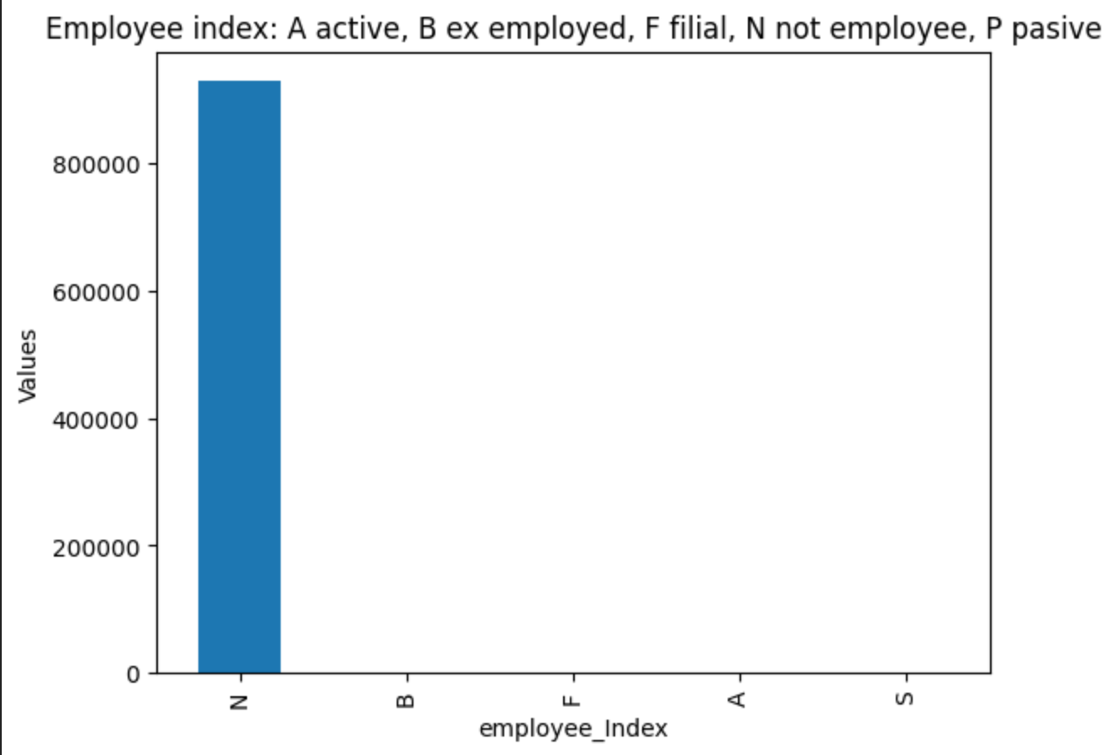
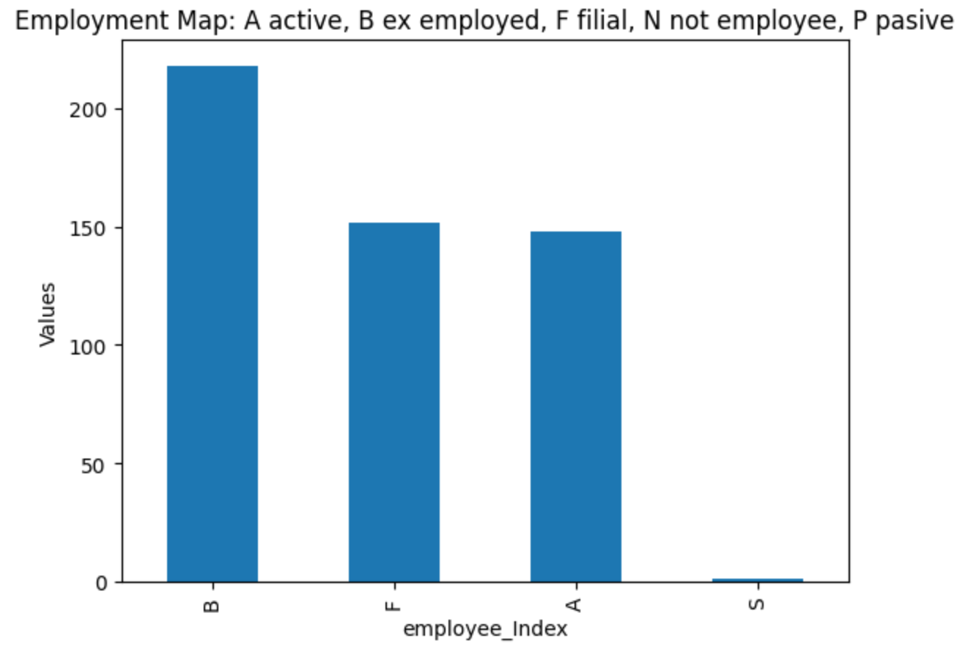
Employment analysis (Employment Map: A active, B ex employed, F filial, N not employee, P passive')
From the distribution we can see that the largest value from the customers are unemployed. If your main demographic is unemployed this can explain why customers are only buying a few products.

Slide 5
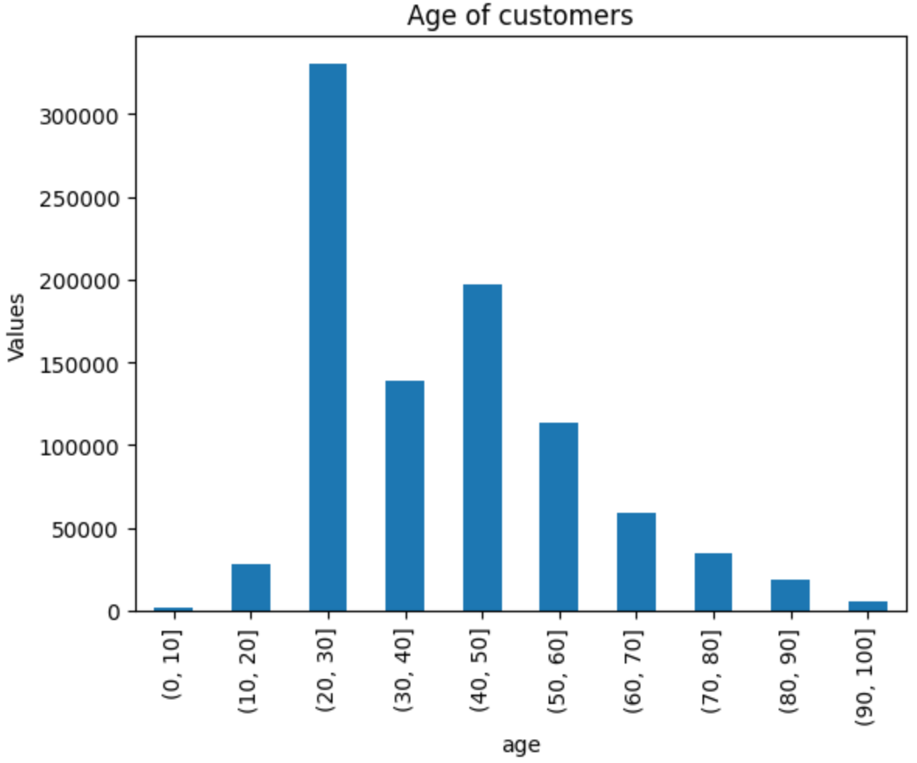
Age Range
From the data we can see that there are more younger people using the Banks products more specifically the 20,30 age range if there are specific benefits tailored to the retired and elderly there will be a boost in products purchased.

Slide 6
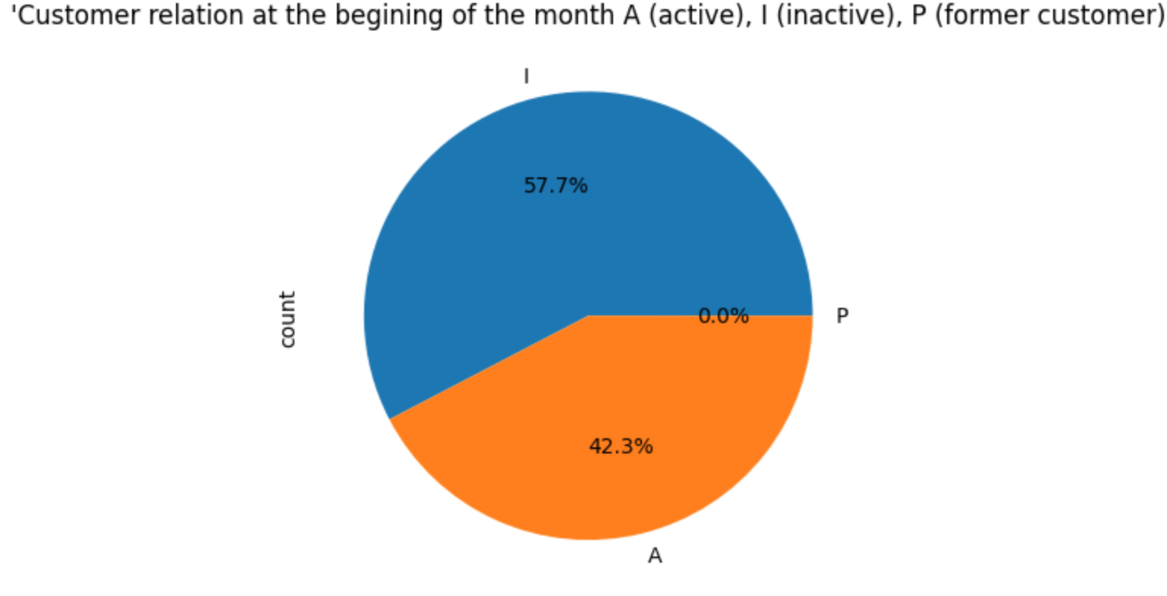
Customer Activity at the beginning of the month
More than half the customers are inactive at the beginning of the month. This can lead to a decline of the sales of your products

Slide 7
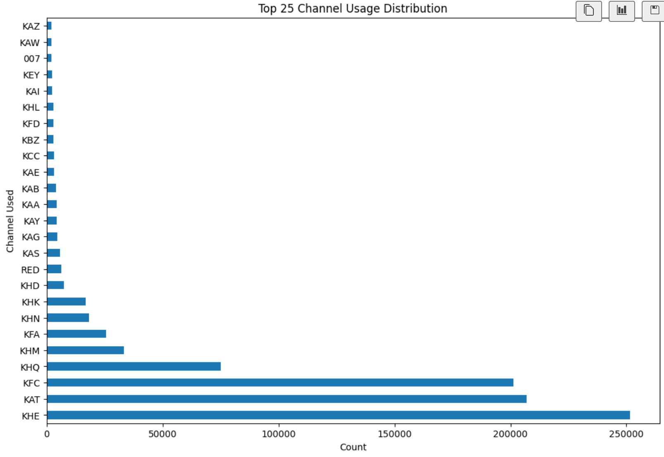
Top 25 Channels Used
These are the top channels your customers use.Keep using the same strategies for these companies

Slide 8
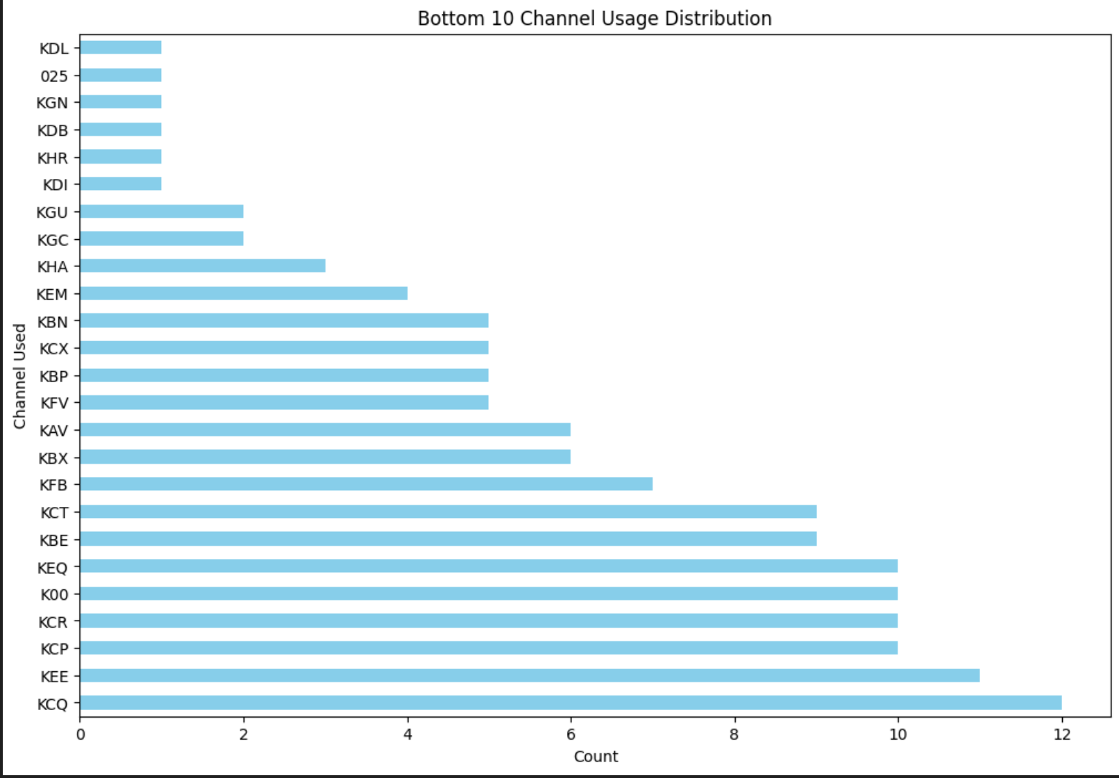
Bottom 25 Channel usage
These are the bottom 25 channels your customers use. The company should market towards these channels so the company has more customers coming from these channels

Slide 9
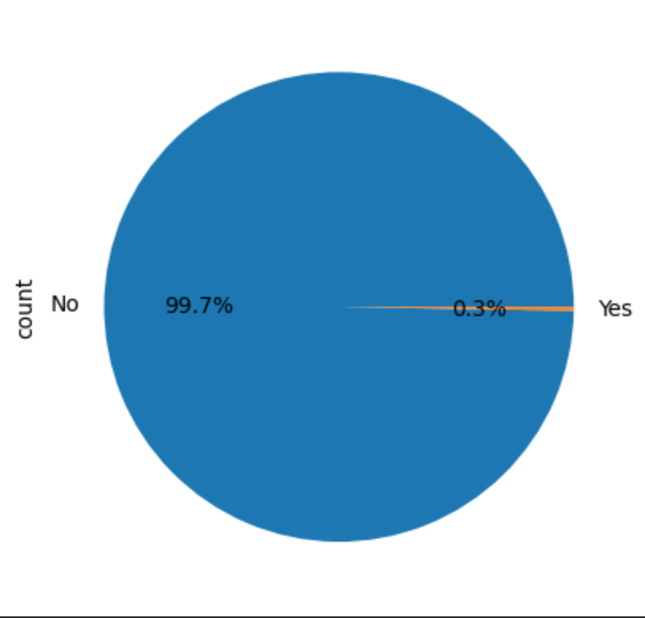
Deceased Index
.3% of your customers are deceased the total number are 2400 accounts these accounts should be taken out of your databases and focus on customers that can purchase more products.

Slide 10
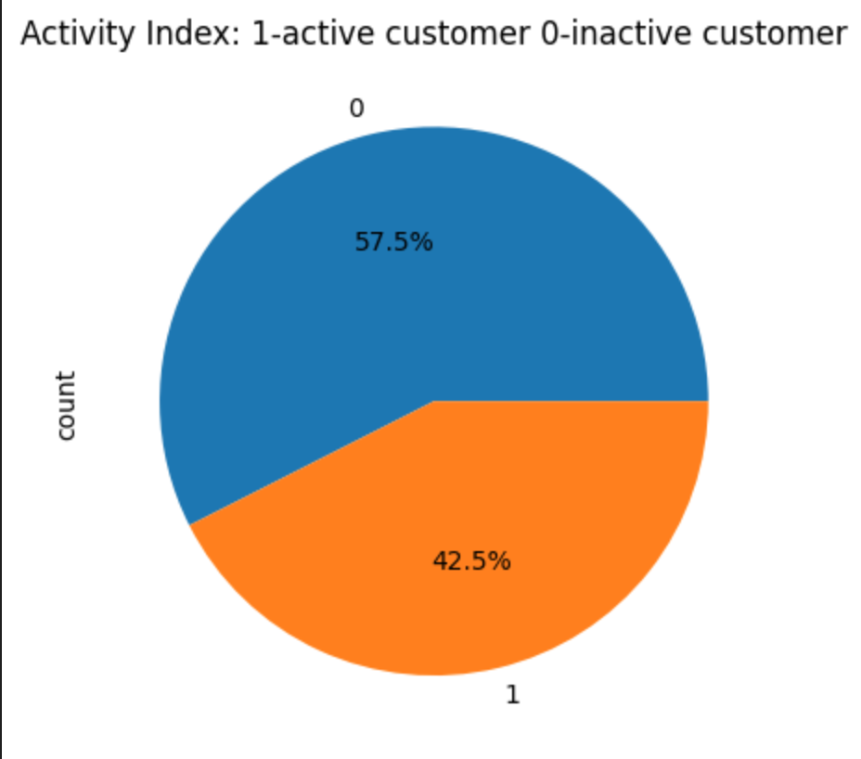
Activity Index In General
In general there are 42.5% accounts inactive in total this makes up 395339 accounts these accounts should be taken out of the database and focused upon the accounts that are generally active.

Slide 11
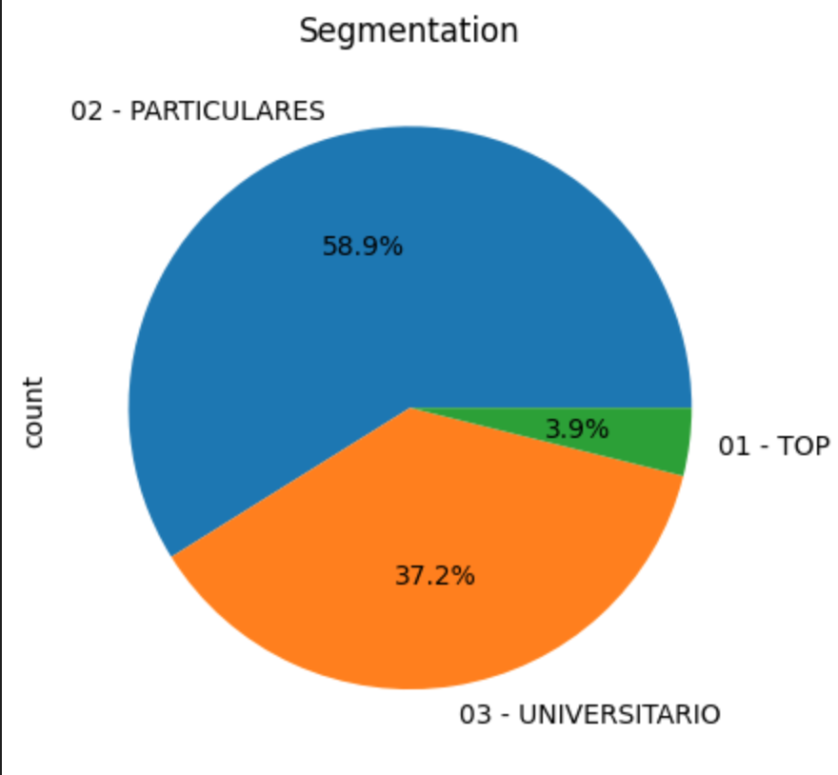
Segmentation
This is the overall segmentation of the customers

Slide 12
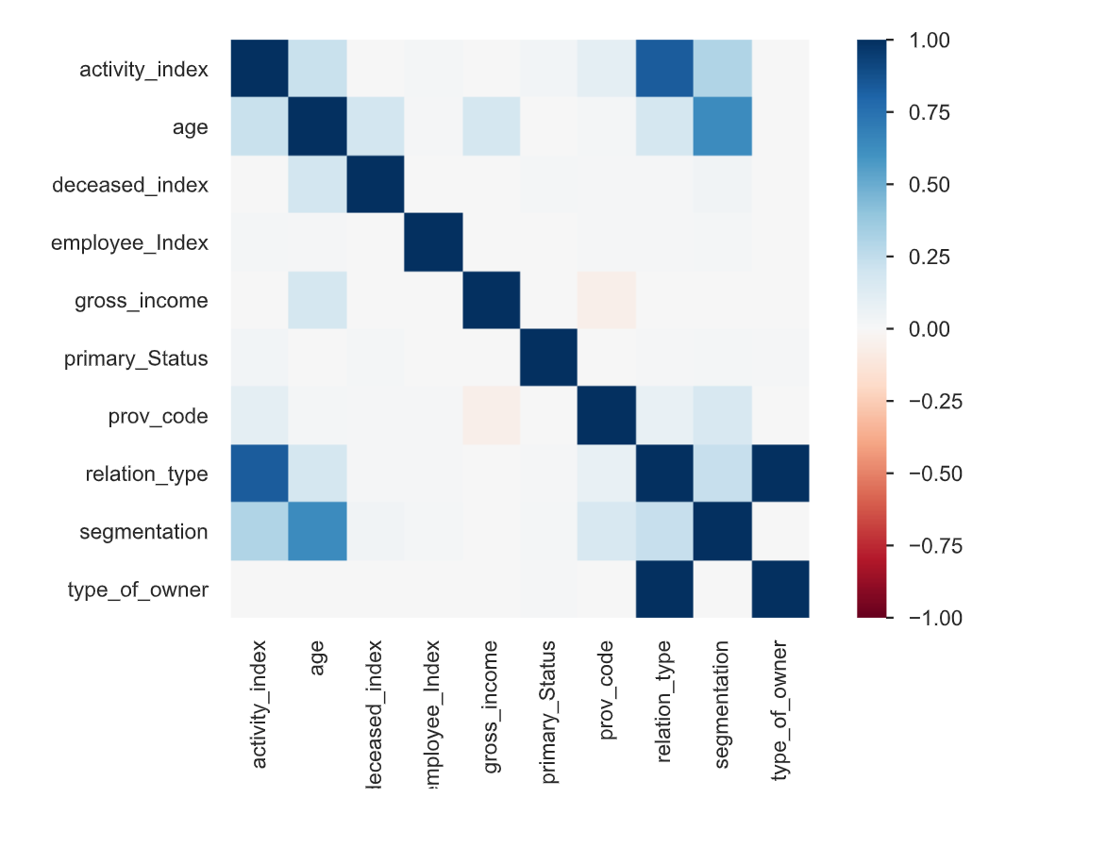
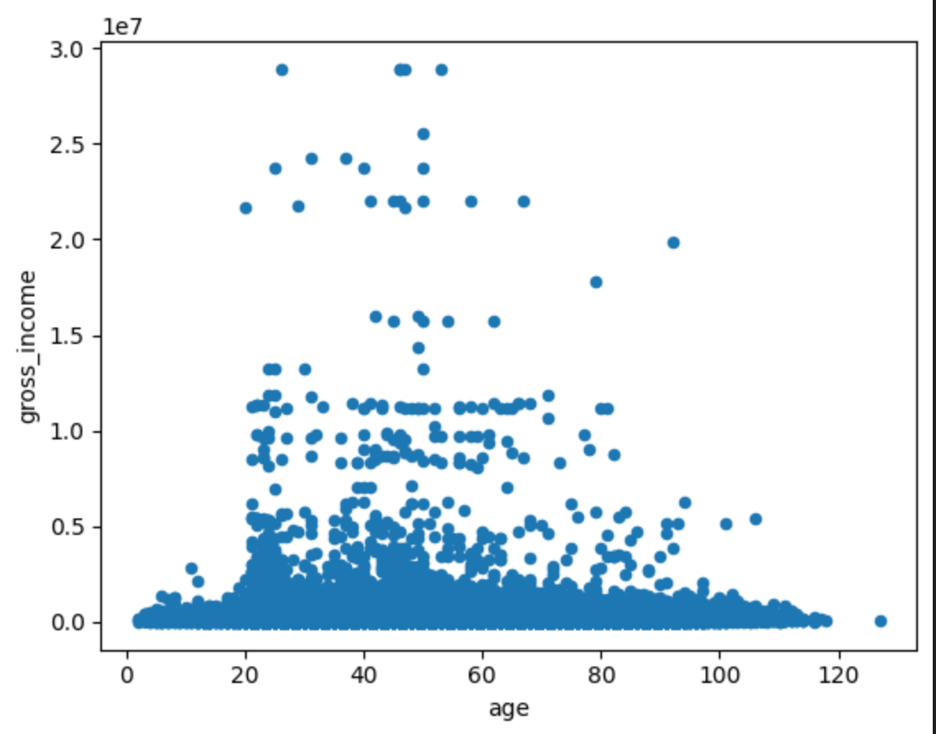
Overall Correlations

Slide 13
Model Recommendations
Gradient Boosting Models:These models are highly suitable for tabular data and are excellent at predicting which products a customer is likely to purchase. They are especially effective in managing imbalanced datasets, a frequent challenge in cross-selling situations.
Random Forest:This ensemble model captures complex relationships between features to predict customer behavior. It helps identify customers likely to purchase additional products while offering insights into feature importance, such as income or past purchases.

Slide 14
Conclusion
The company should take out deceased or inactive accounts and should tailor their marketing strategies towards the elderly such as by making retirement plans, to employed customers and to channels that customers aren't coming from in bigger numbers after doing these the company should see a boost in products purchased.

Slide 15
Thank You

