Slide 1

G2M Case Study
Virtual Internship
Furkan Ay
18-Sep-2024

Slide 2
Content
Background/Problem
Data Insights/EDA
Hypothesis testing

Slide 3
Background –G2M case study
Summit Arc Capital Partners is a private equity firm in US. Due to remarkable growth in the Cab Industry in last few years and multiple key players in the market, it is planning for an investment in Cab industry.
Objective : Provide actionable insights to help Summit Arc Capital Partners firm in identifying the right company for making investment.
The analysis has been divided into four parts:
Data Understanding
Visualization of the correlations
Hypothesis testing

Slide 4
Datasets
Cab_Data.csv- File includes the data on the different cab companies
Customer_ID.csv- File includes data on several details of the cab customers
Transaction_ID.csv- File includes data on the transaction details
City.csv- File includes data on different US cities and data on their cab users

Slide 5
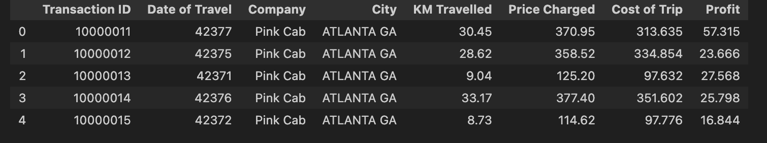
Coding in Profit
Added profit to make better inferences

Slide 6
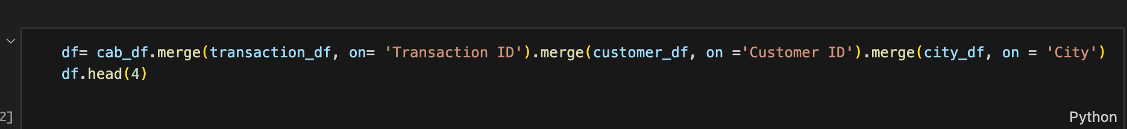
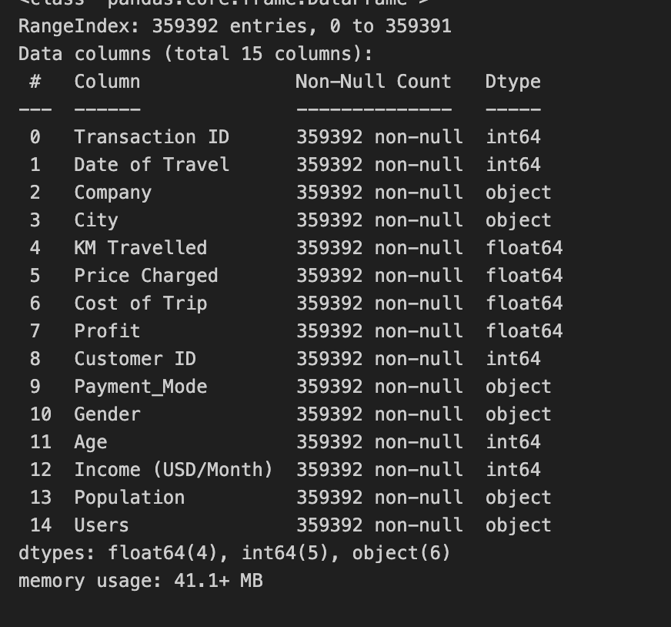
Merging Dataset
Merged all the datasets into one dataframe to compare and analyze better

Slide 7
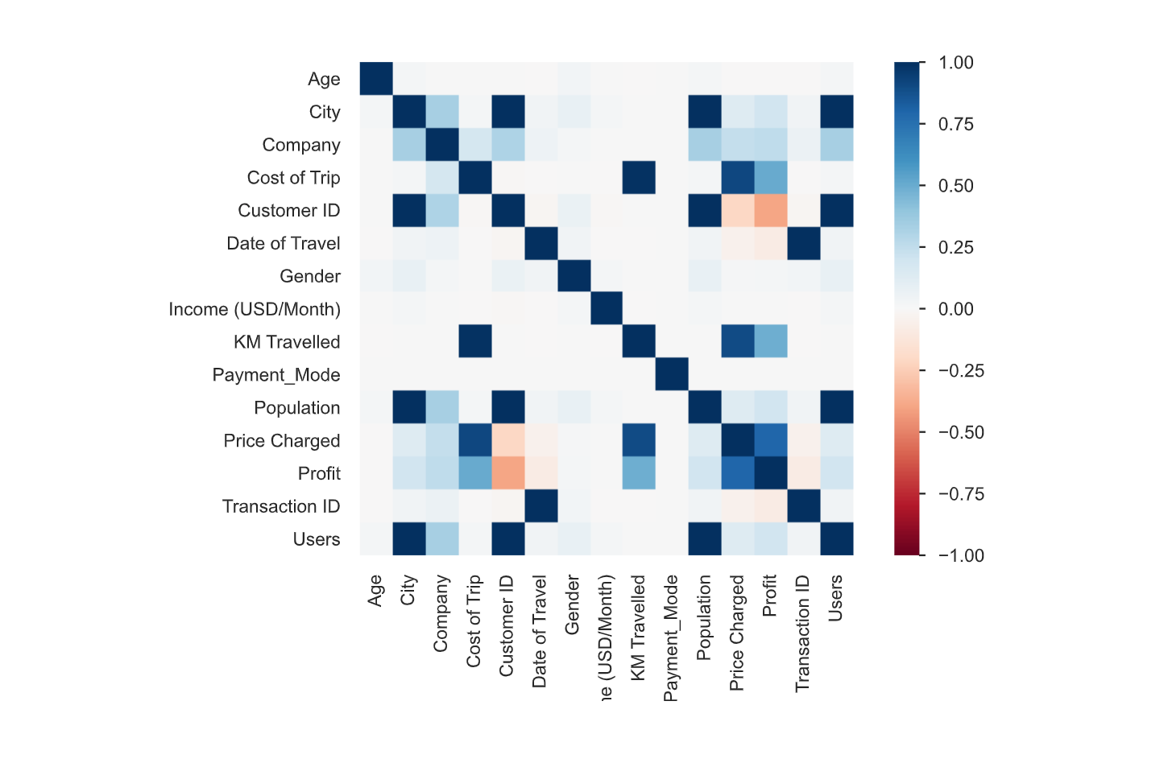
Analysis of Correlation
6 Highly Correlated Categories
City and Customer ID
Cost of trip and KM traveled
Date of Travel and Transaction ID
Price charged and Cost of trip
Population and City
Profit and Cost of trip

Slide 8
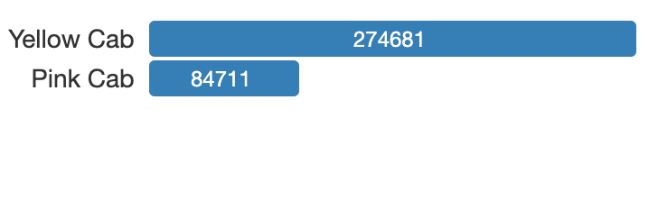
Distribution Cab Users
From the graph above we can tell that there are more Yellow cab users than there are Pink cab users

Slide 9
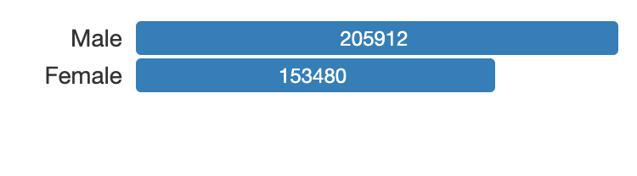
Distribution Of Gender
From the graph we can tell that there are more male users than female users
This is true for both cab companies

Slide 10
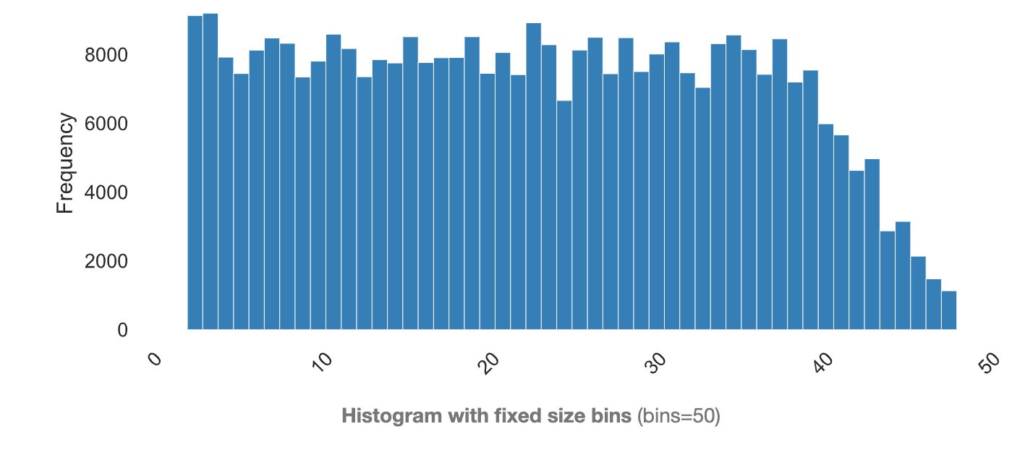
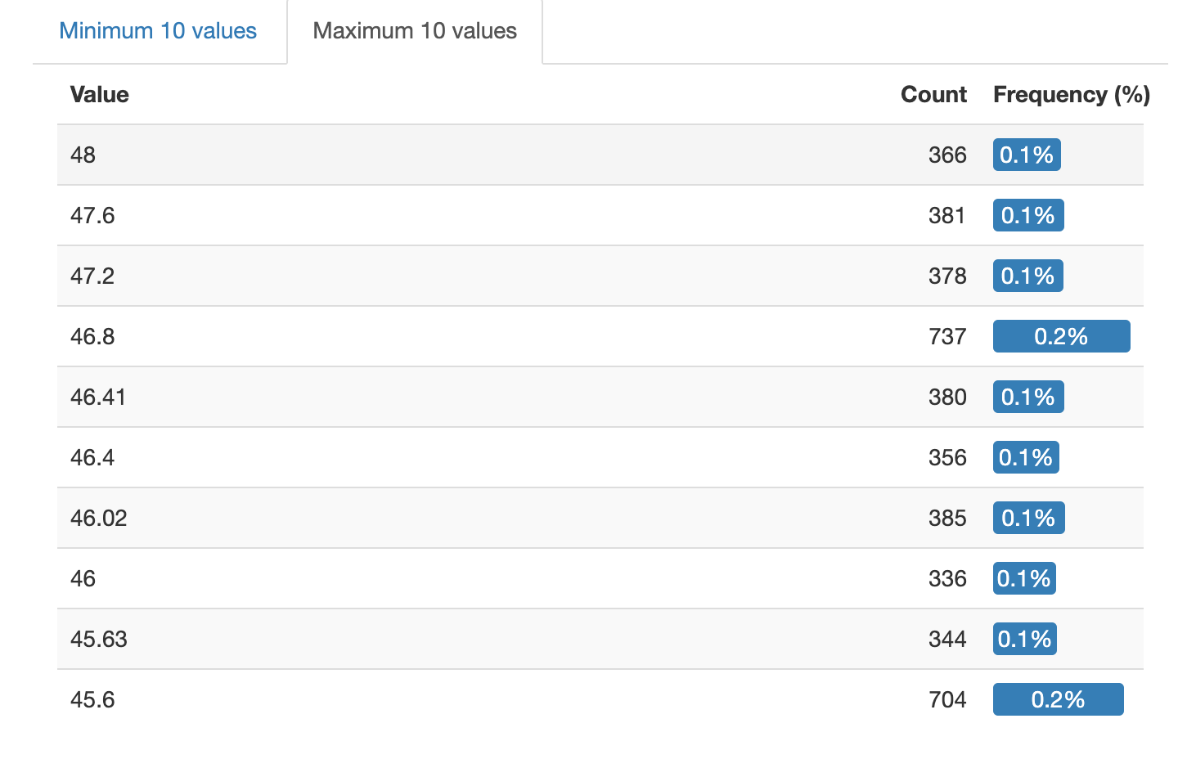
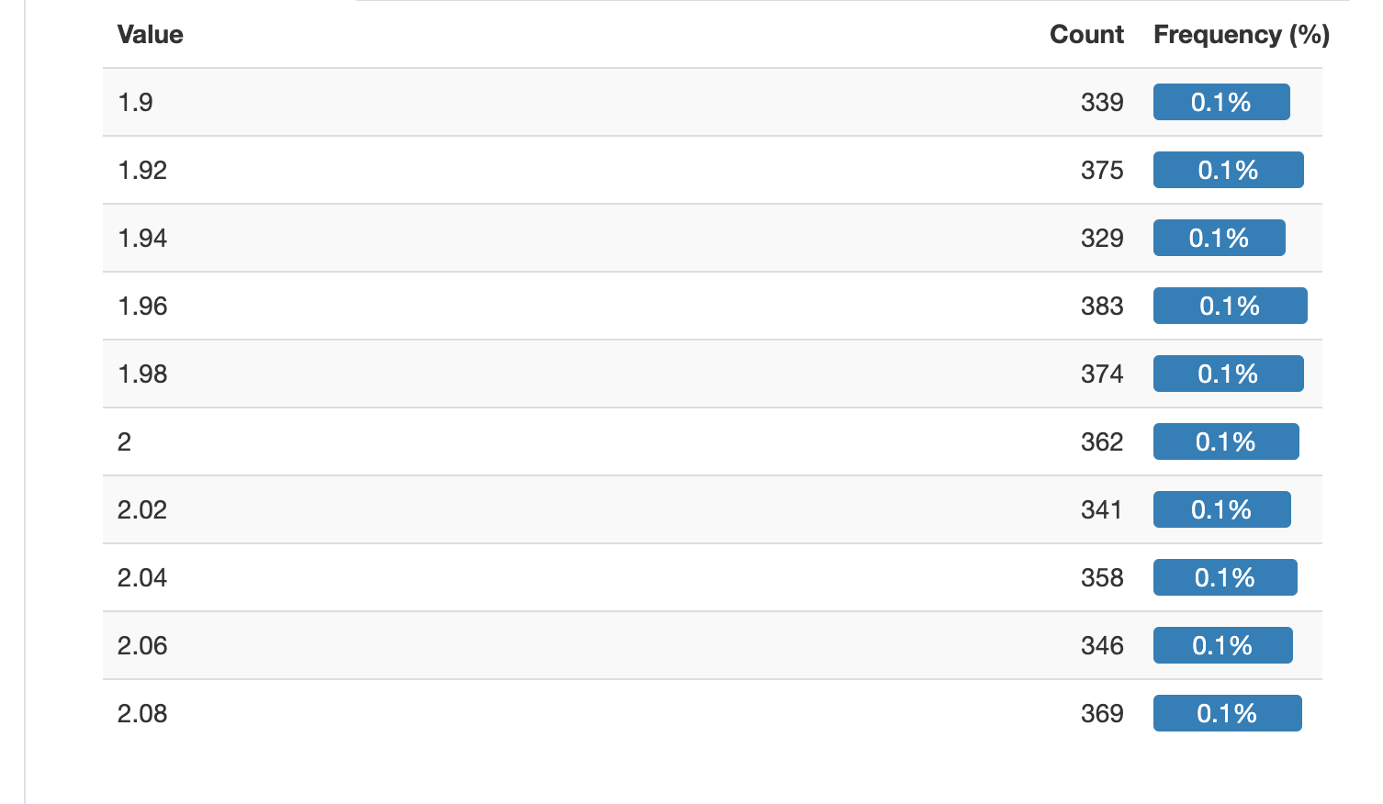
Distribution of KM Traveled
From These graphs we can tell that the common range of KM traveled would be from 2.10km to 45 km
We can see that 49 km is the maximum of extreme values
We can see that

Slide 11
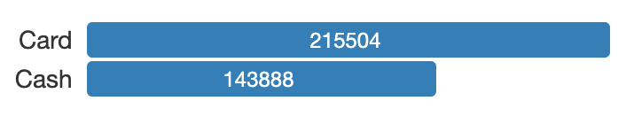
Distribution Of Payment Mode
From the figure we can tell that users use card than pay for it with cash
This si the case for both companies

Slide 12
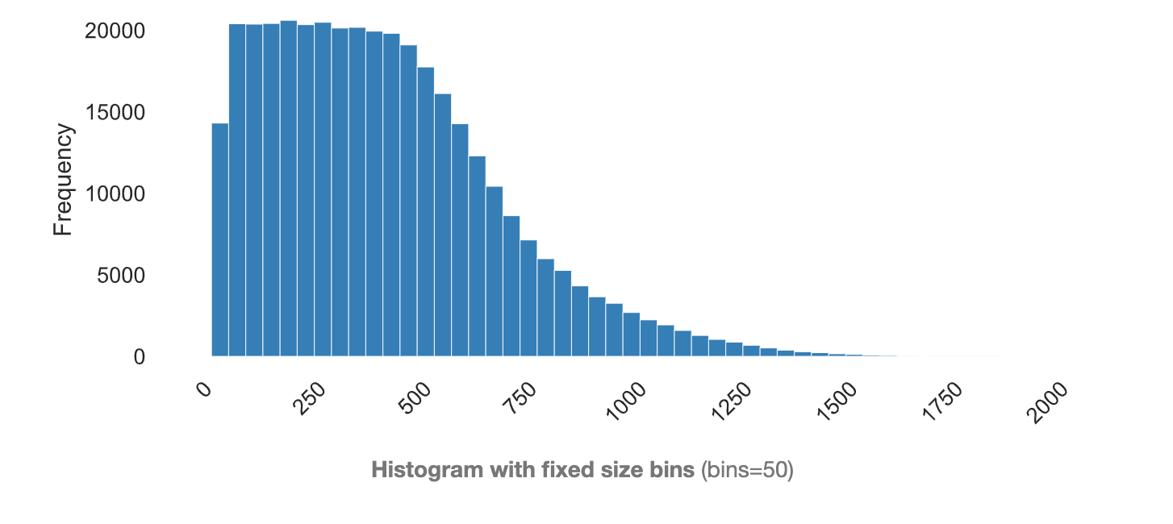
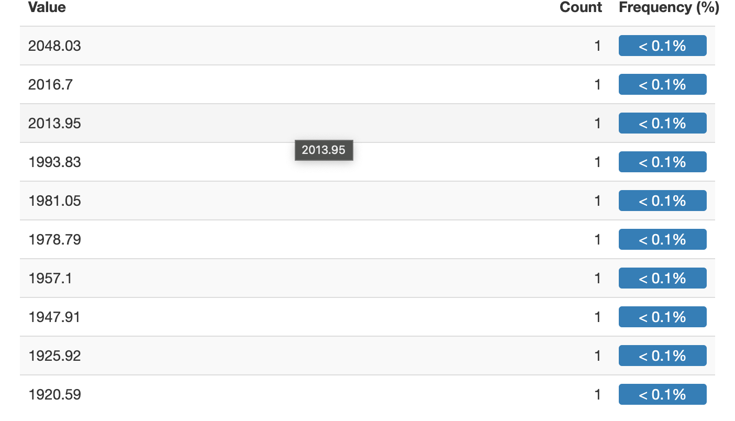
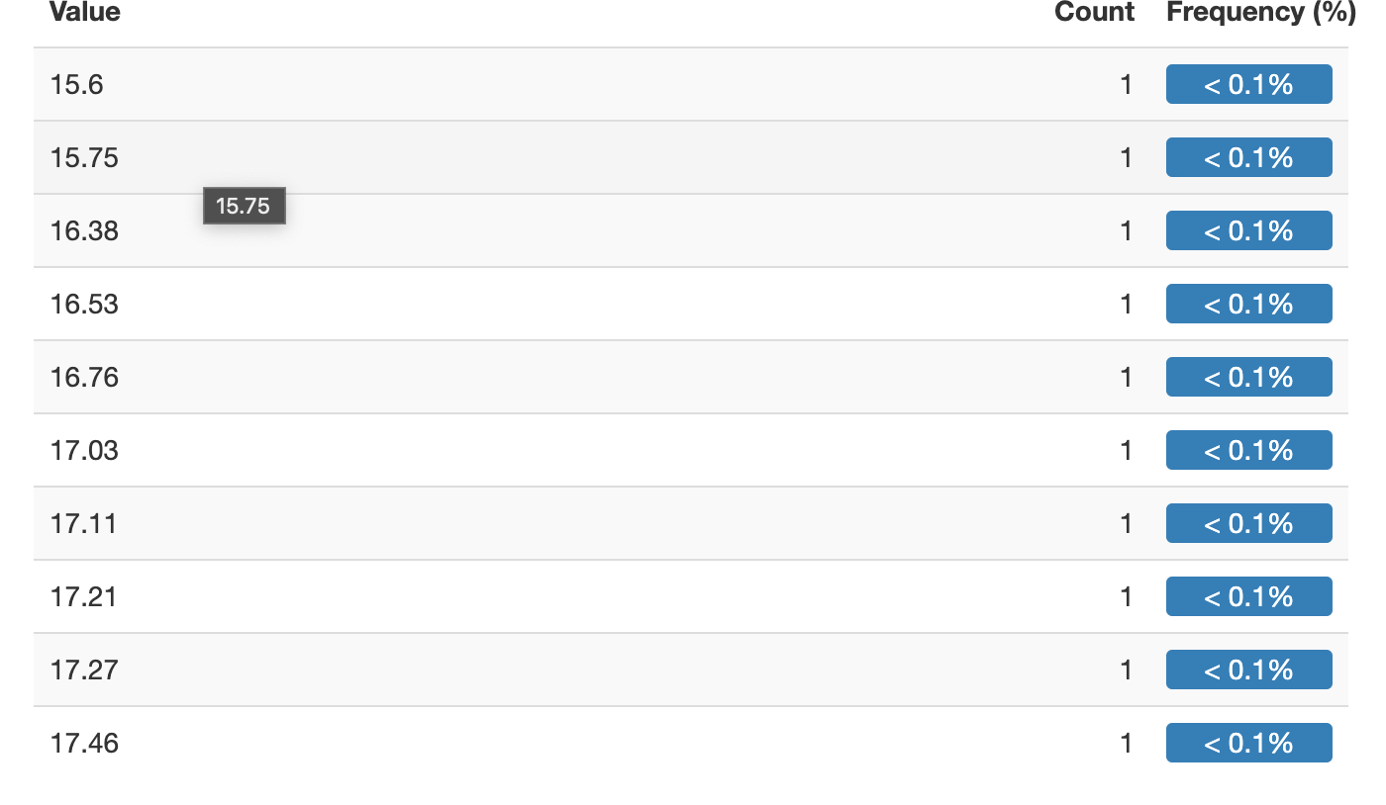
Distribution of price charged
From the graphs we can see that the range of the price charged is 17.50 to 1920 depending on the distance traveled
From the extreme values we see that the max is 2048.03
The minimum for the extreme values is 15.6

Slide 13
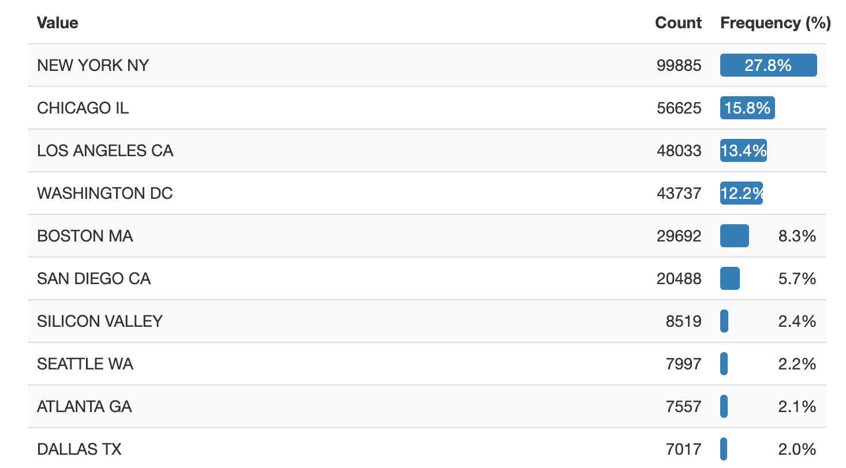
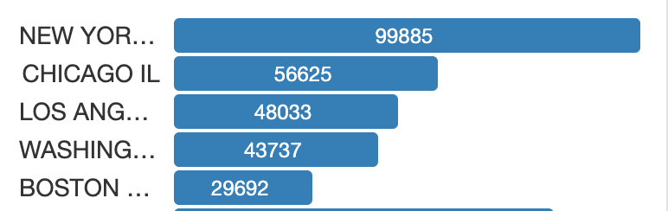
Distribution of Cities
From the graphs it is seen that the cab users are mostly in New York,Chicago,Los Angeles, Washington DC and Boston.

Slide 14
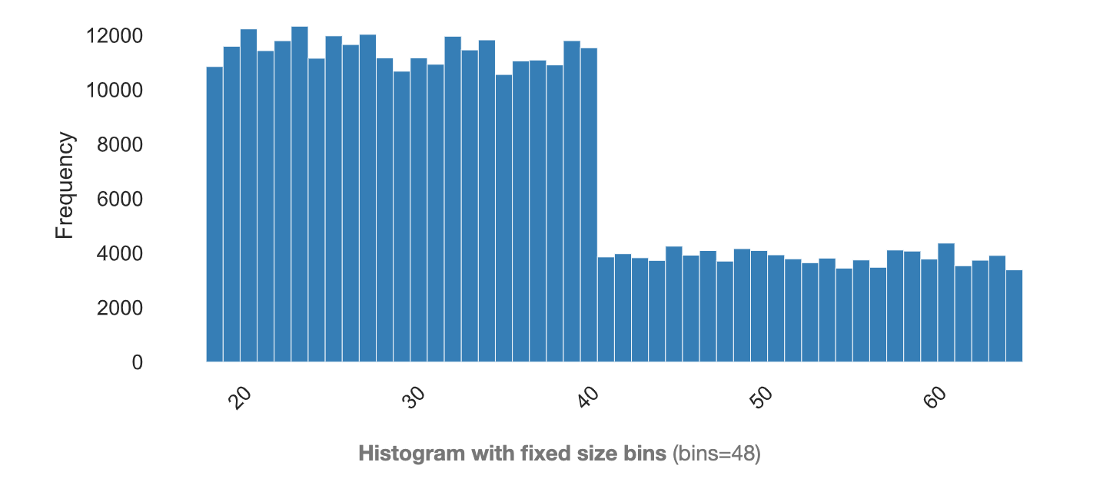
Distribution of Age
From this we can see that there is a younger distribution in cab drivers

Slide 15
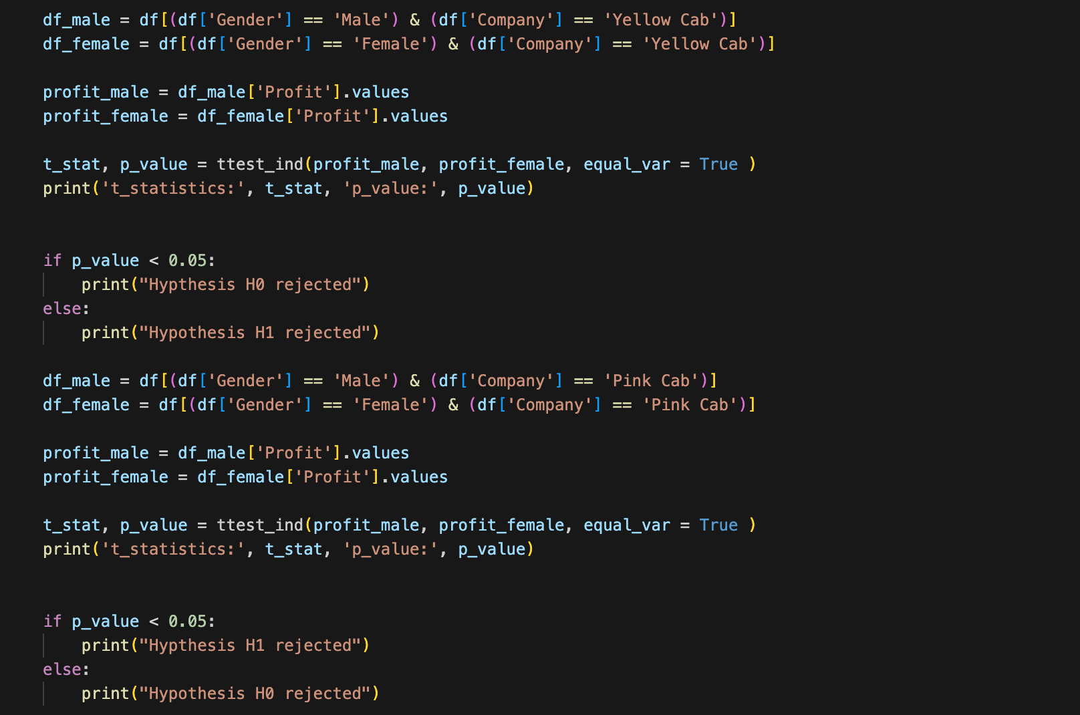
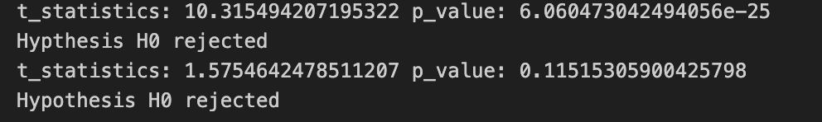
Hypothesis 1
From the hypothesis H0 being rejected we see that gender has the same impact

Slide 16
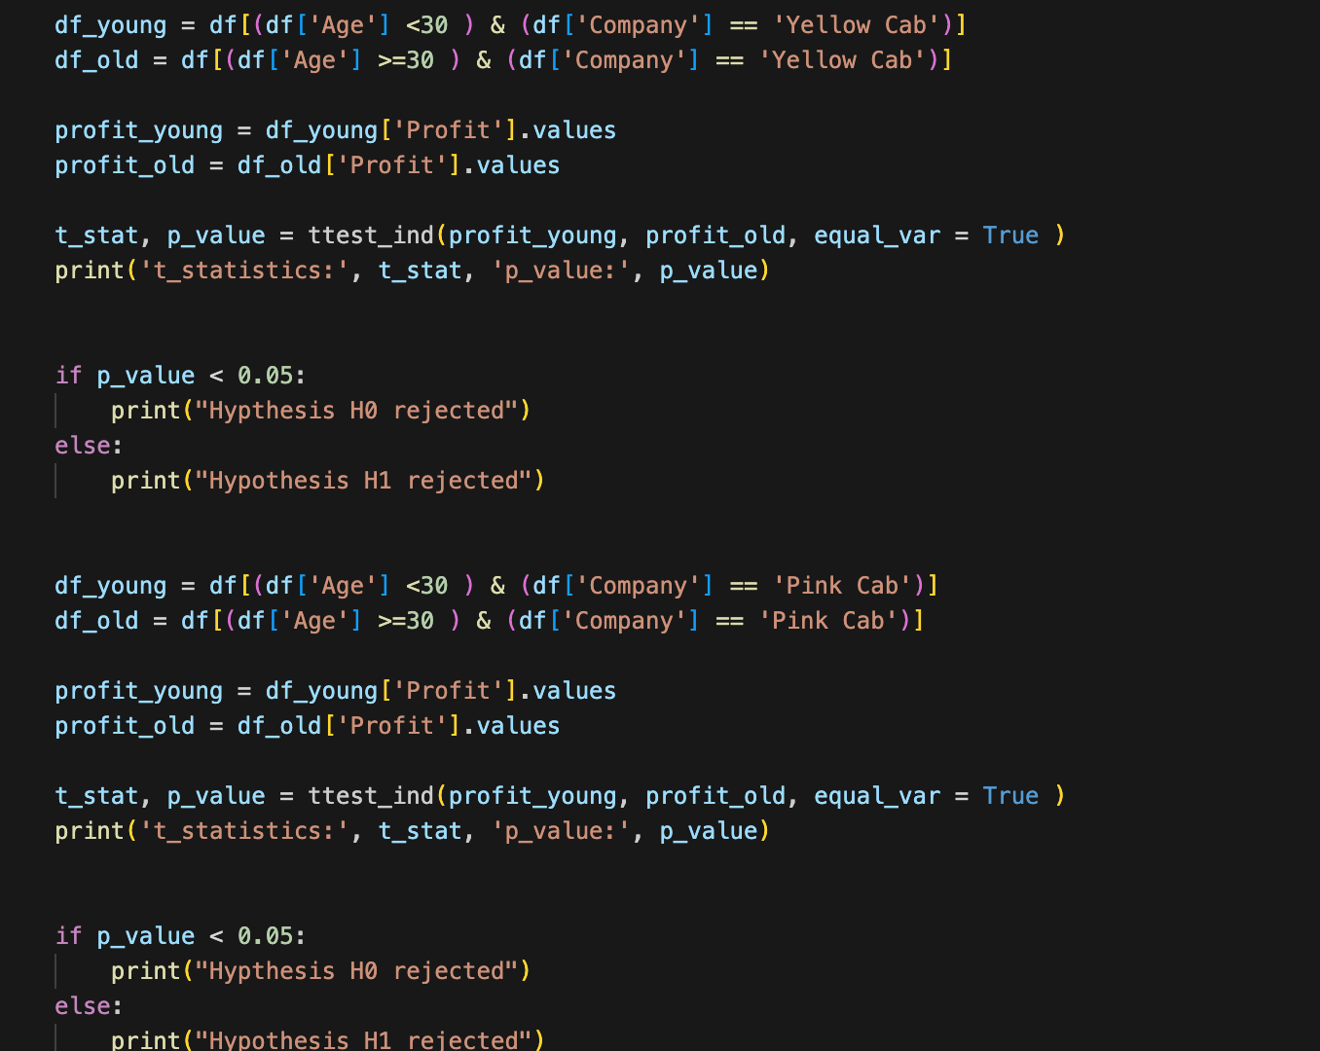
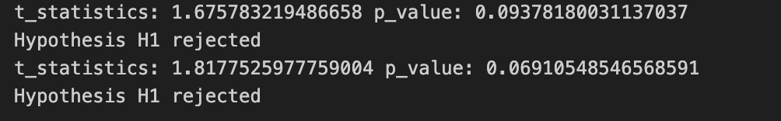
Hypothesis 2
From H1 being rejected we know that H0 is the correct hypothesis meaning younger people make more profit

Slide 17
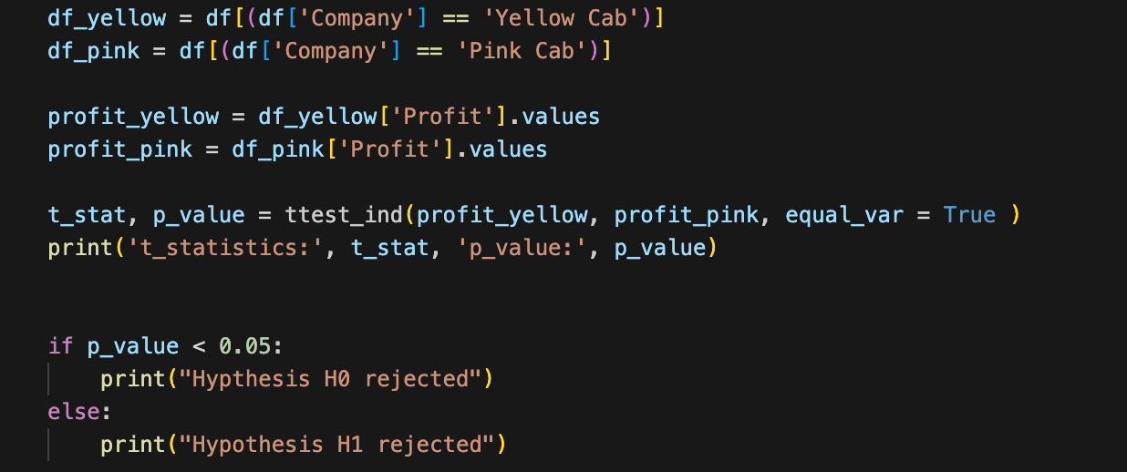

Hypothesis 3
From hypothesis H0 being rejected it can be shown that yellow cabs make more profit

Slide 18
Recommendation
Because the Yellow cabs have more users seen from my EDA and they generate more profit seen from my hypothesis testing I recommend that the Summit Arc Capital Partners firm invests in the Yellow cab company as there is more advantages when compared to the pink cabs
By doing so they will have a better return on investment as the yellow cabs can ensure more profit while the pink cabs may not

Slide 19
Thank You

