Slide 1
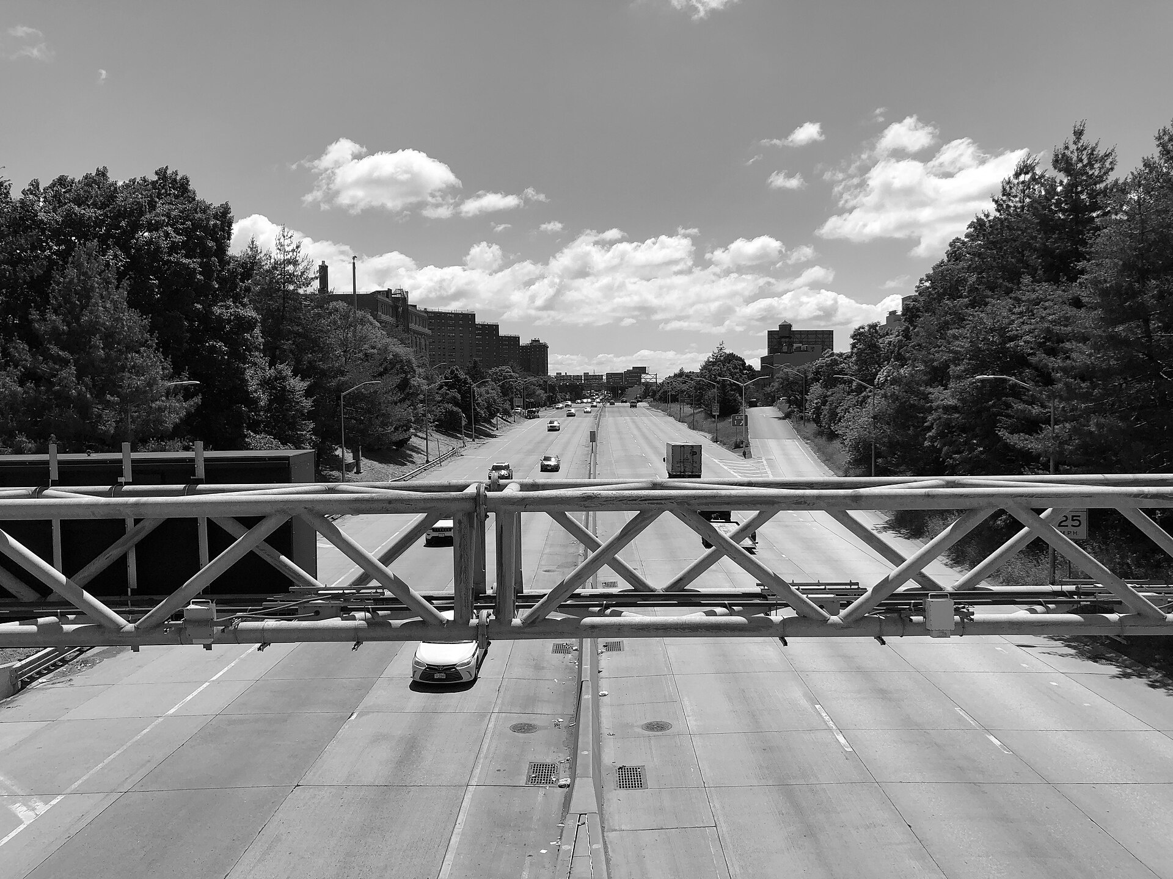
The Toll It Takes
Congestion pricing cleaned the air where it charges.
What about everyone else?
Furkan Beray · NYC Congestion Pricing Datathon 2026
Southbound traffic on the Major Deegan Expressway at Willis Avenue, Mott Haven, a few blocks from the NYCCAS monitor. Photo: Famartin, Wikimedia Commons, CC BY-SA 4.0; shown in monochrome.
Notes:
In January of 2025, New York started charging nine dollars to drive into Manhattan below 60th Street, and the city sold this as cleaner air, while the South Bronx heard it as the cars coming to them instead. My name is Furkan, and this project looks at whether either of those turned out to be true, and what that should change about where the city spends its money.

Slide 2

THE QUESTION
“Is congestion pricing eliminating pollution, or moving it? And if it’s moving, is it moving toward neighborhoods that were already the most vulnerable?”
— the datathon brief
THE HEADLINE
THE WORRY
PM₂.₅ down 22% inside the zone in the first six months (Cornell, npj Clean Air).
Increases at 12–14 of 19 South Bronx community sensors; traffic diverting to avoid the toll (South Bronx Unite).
Same policy, two claims. This project tests both with the same data.
The Toll It Takes · NYC Congestion Pricing Datathon 2026
Photo: Joey Zhou, Unsplash
2 / 36
Notes:
Both sides have data. A Cornell study measured PM two-point-five going down 22 percent inside the zone, while a South Bronx community network measured increases at most of their sensors and blamed diverted traffic. Nobody had held both claims to the same standard, so that is what I built, one analysis with one set of controls applied to every monitor the same way.

Slide 3

THE ANSWER
Three findings
−0.6 to −1.6 µg/m³
Inside the zone, the air got cleaner.
Confirmed at the Manhattan and Williamsburg Bridge landings, both inside the zone, both in designated tracts.
No measurable change
Outside the zone, nothing moved.
Not the Bronx, not Brooklyn, not the non-EJ neighborhoods we added to check.
Zone, not EJ
The line is what matters.
Whether a neighborhood is designated disadvantaged doesn’t explain the pattern. Which side of 60th Street does.
The Toll It Takes · NYC Congestion Pricing Datathon 2026
Photo: Lerone Pieters, Unsplash; monochrome
3 / 36
Notes:
I want to give the answer up front. Inside the zone the air got cleaner by about one microgram at the bridge landings, and that holds under every test I ran, while outside the zone nothing I can measure changed, including neighborhoods that are neither poor nor near a highway. Through this, the question of whether disadvantaged neighborhoods were treated worse turns out to be the wrong cut, because the line that matters is 60th Street and not the designation.

Slide 4

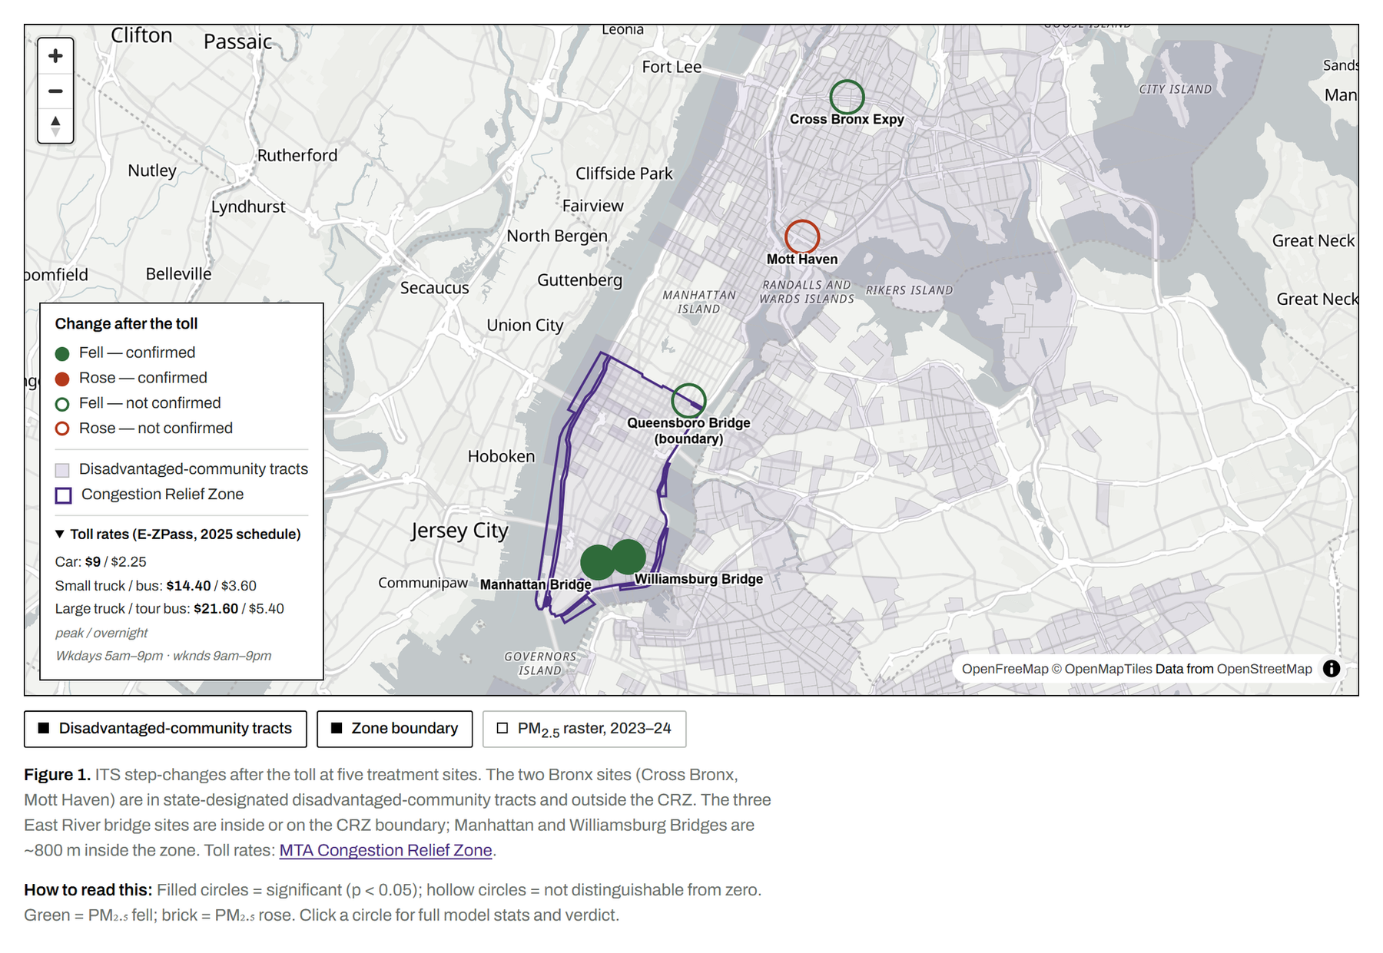
PART I · SECTION 1
The data
11 NYCCAS monitors, hourly PM₂.₅, 2019–2026
2 control monitors in Queens: Queens College and Van Wyck
MTA counts at every bridge and tunnel
Toll-zone geofence and the state’s disadvantaged-community tracts
Hunts Point is omitted: its monitor was offline across the toll date, so no before/after comparison exists.
The Toll It Takes · NYC Congestion Pricing Datathon 2026
Photo: Famartin, Wikimedia Commons, CC BY-SA 4.0; monochrome
4 / 36
Notes:
Here is what I worked with. Eleven city monitors reading PM two-point-five every hour since 2019, rolled into daily averages with at least 18 valid hours, and two Queens monitors as controls, which sit far enough from the zone that whatever they do reflects the city and not the toll, plus MTA counts at every crossing, the zone geofence, and the state's disadvantaged tracts, which is what I mean by EJ.

Slide 5

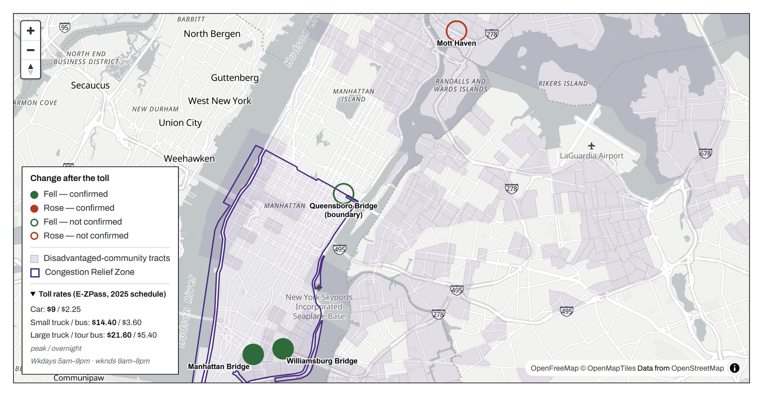
PART I · SECTION 1
Two filled dots, both inside the line
Manhattan Bridge
Chinatown. Inside the zone. Confirmed cleaner.
Mott Haven
South Bronx. Outside the zone. Hollow: no measurable change.
Filled = significant (p < 0.05).
Hollow = not distinguishable from zero.
The two filled green dots are both in state-designated tracts. The toll’s benefit reached poor neighborhoods — the ones inside the line.
The Toll It Takes · NYC Congestion Pricing Datathon 2026
Photo: Hieu Vu Minh, Unsplash; monochrome
5 / 36
Notes:
This map is the whole argument in one picture. Green means the air fell and brick means it rose, while filled means I am confident and hollow means the change is too small to separate from zero. The only two filled green dots are inside the line, at the Manhattan and Williamsburg Bridge landings, and both are designated tracts, so the benefit did reach poor neighborhoods, just the ones inside. Cross into the Bronx and every dot goes hollow, and the rest of this talk is making sure that picture is not an accident.

Slide 6

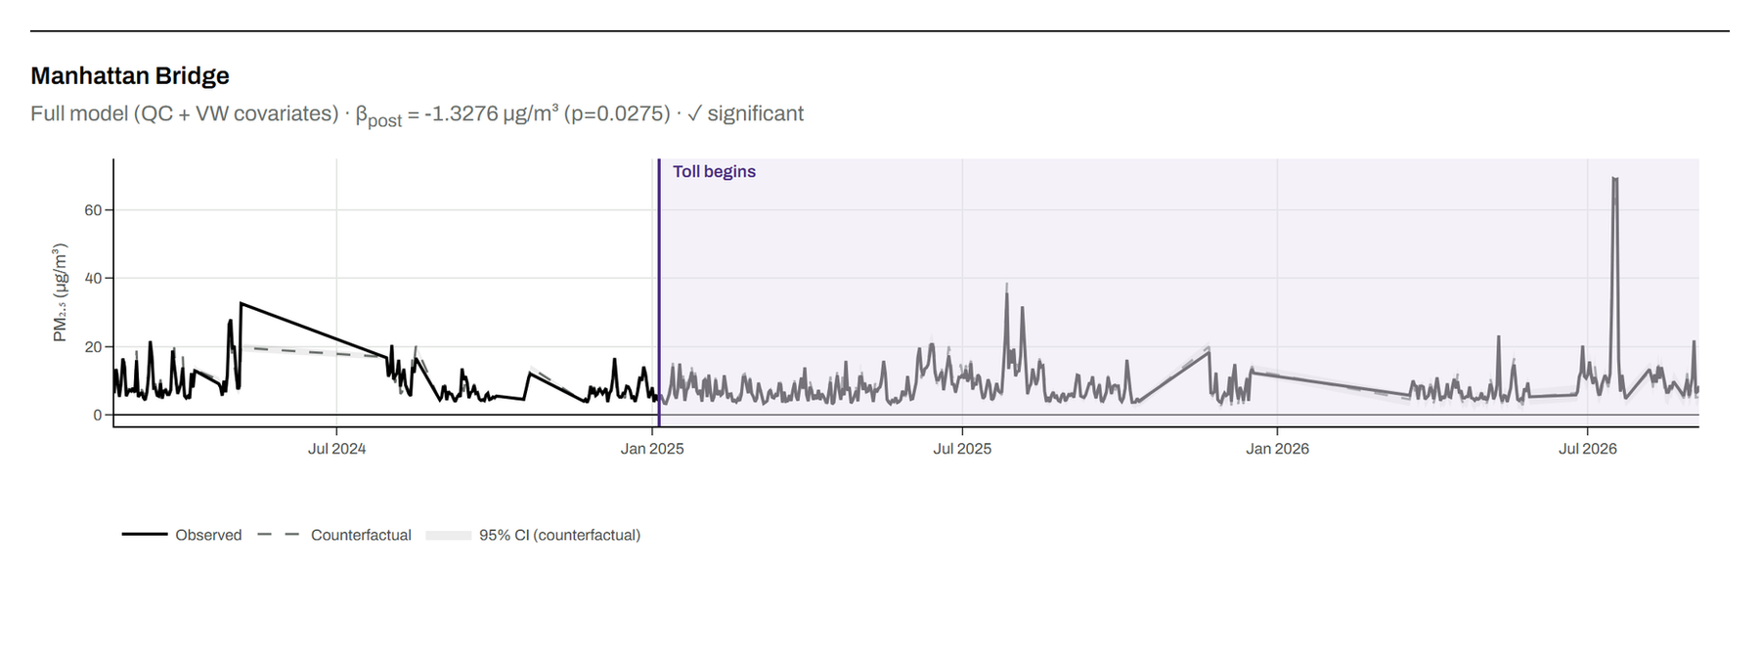
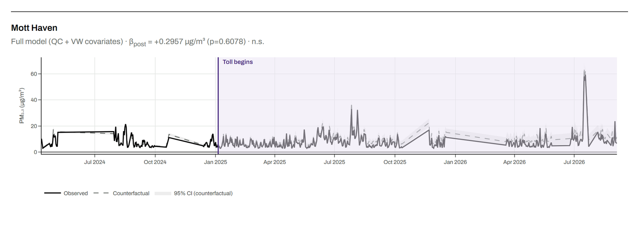
PART I · SECTION 2
How the test works
Dashed line: what would have happened without the toll.
Solid line: what happened.
Two Queens control monitors absorb weather, smoke, and anything citywide.
Interrupted time series with HAC standard errors. The jump at January 5, 2025 is the estimate.
Manhattan Bridge — the lines separate
Mott Haven — the lines sit on top of each other
The Toll It Takes · NYC Congestion Pricing Datathon 2026
Photo: Joey Zhou, Unsplash
6 / 36
Notes:
To trust the dots you have to trust the method. For each monitor I fit the pre toll readings with a trend, a seasonal cycle, and the two Queens controls, which projects what it would have read with no toll, the dashed line, and then I measure the jump at the toll date. If smoke or a mild winter moved the entire city, the controls moved too and get subtracted, so the toll only gets credit for what they cannot explain. At Manhattan Bridge the solid line drops below the dashed one and stays there, while at Mott Haven the two lines sit on top of each other.

Slide 7

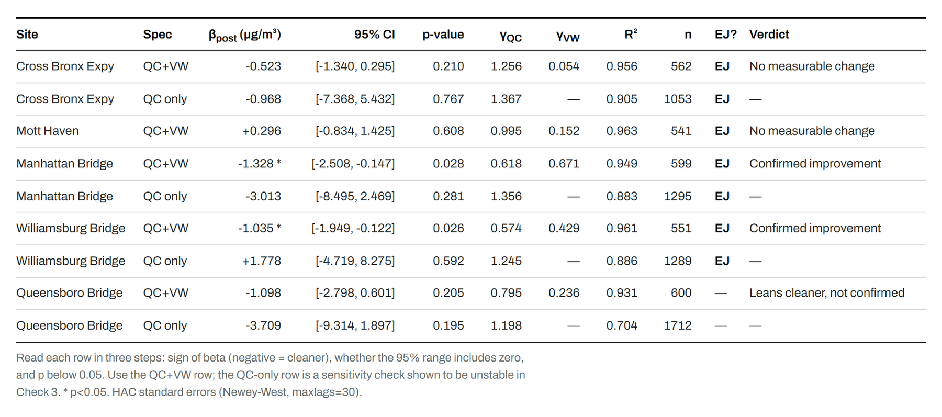
PART I · SECTION 3
The numbers
−1.33
Manhattan Bridge · p = 0.03 · confirmed
+0.30
Mott Haven · p = 0.61 · a coin flip
Read each row in three steps: sign of β (negative = cleaner), whether the 95% range includes zero, and p below 0.05.
For scale: NYC air averages about 7 µg/m³. A 1-unit drop at a bridge landing is real, and it matches the Health Department’s own evaluation.
The Toll It Takes · NYC Congestion Pricing Datathon 2026
Photo: Hieu Vu Minh, Unsplash; monochrome
7 / 36
Notes:
These are the numbers behind the picture. Manhattan Bridge came out at minus 1.33 with the entire range below zero, so there is no version of the data where it did not fall, and Williamsburg came out at minus 1.04 with the same story. Mott Haven came out at plus 0.30 with a p value of 0.61, which means a number that size shows up six times out of ten when nothing is going on, so I do not call that a result.

Slide 8

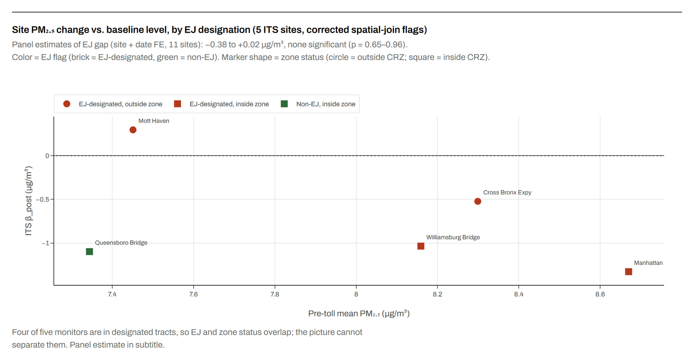
PART I · SECTION 4
The equity question can’t be separated from the zone
Every in-zone monitor but one sits in a designated tract.
Every outside-zone monitor with a full record does too.
So “EJ” and “outside the zone” are nearly the same list of monitors.
−0.38 to +0.02
EJ gap holding the zone constant · not significant
Color = designated tract. Shape = inside/outside the zone. No fitted line: five points can’t carry one.
The Toll It Takes · NYC Congestion Pricing Datathon 2026
Photo: Lerone Pieters, Unsplash; monochrome
8 / 36
Notes:
Now the equity question, and why it is the wrong cut. Four of these five monitors sit in designated tracts, including the two that improved the most, so the EJ label and the inside the zone label describe nearly the same monitors, and no statistical method can separate two labels that point at the same dots. Holding the zone constant in a larger model, the EJ gap lands between minus 0.4 and zero and is not significant, which tells us a toll draws a line on a map, whoever is inside gets the benefit, and income never enters into it.

Slide 9
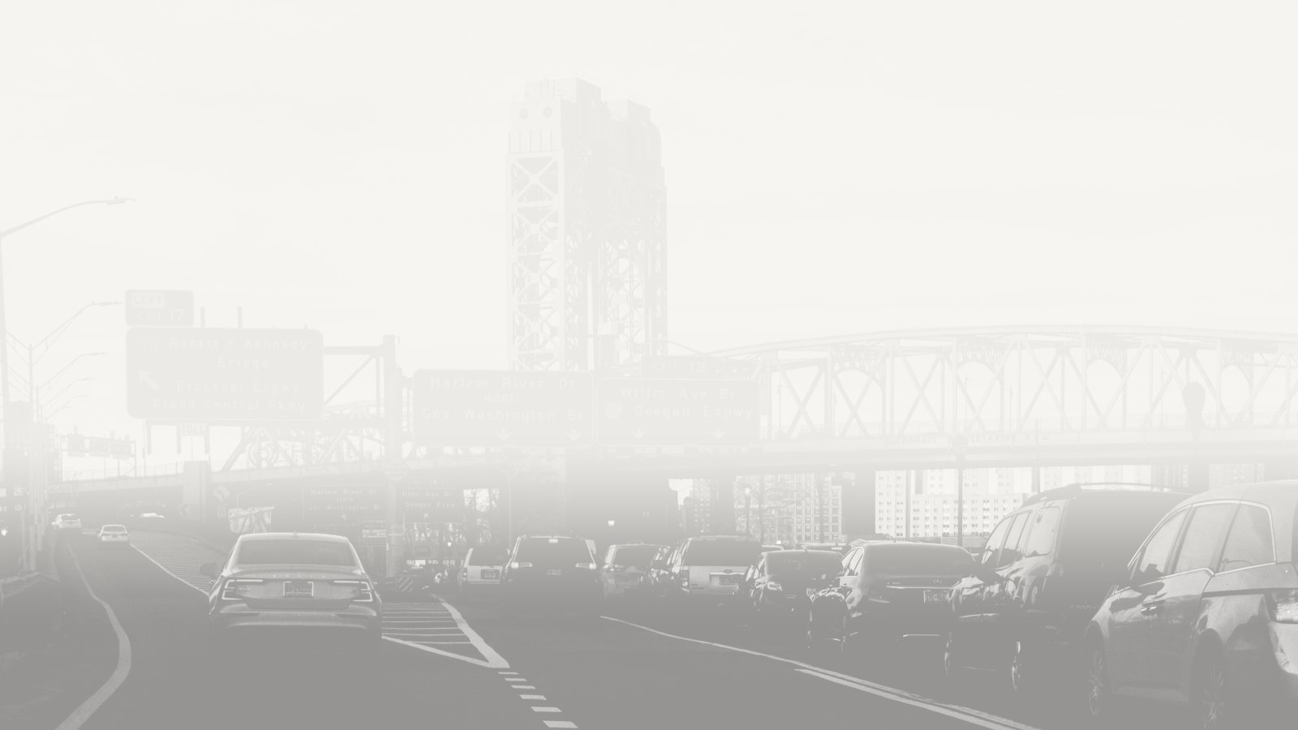
PART I · SECTION 5
Nine ways I tried to break it
The doubt | The check | The answer
Weather drove it? | Weather-adjusted model (wind, temperature, rain, humidity, wind sector) | Signs unchanged at all 11 sites; ranges shorter at 8 of 11.
Rush hour would show diversion? | Daytime-minus-nighttime gap, before vs after | 1 of 16 bars significant (Cross Bronx, weekdays). Mott Haven: nothing.
The model invents effects? | Fake toll dates in pre-toll data | Inconclusive: the long-baseline model makes fake effects of ±30 µg/m³. Discarded.
Bad control monitors? | All sites in one model; every day gets its own baseline | Same gap. EJ effect −0.38 to +0.02, not significant.
Could diversion physically cause it? | Traffic–pollution slope × extra Throgs Neck cars | 0.018 × 2,041 = 0.04 µg/m³. One-eighth of the number in question.
Wrong pollutant? | NO₂ at state monitors in the Bronx | Moved with the Queens control. No traffic signal.
It’s just the model? | Plain subtraction, 2025 vs 2024, minus the control | Bridges inside the zone −0.6 to −0.8. Bronx flat or up.
One modeling choice? | Simpler model, one term removed | Manhattan Bridge survives. Mott Haven flips sign: no direction.
Missing the comparison? | Added outside-zone volunteer sensors in non-designated neighborhoods | EJ gap still zero. Bay Ridge moved like the Bronx.
The Toll It Takes · NYC Congestion Pricing Datathon 2026
Photo: Clay LeConey, Unsplash; monochrome
9 / 36
Notes:
The weak spot in my own result is that it says nothing happened in the Bronx, and nothing is the easiest thing to claim and the hardest to prove. So I attacked it nine different ways, each aimed at a doubt a skeptic would raise, and I will show you four of them while the rest are in the appendix.

Slide 10

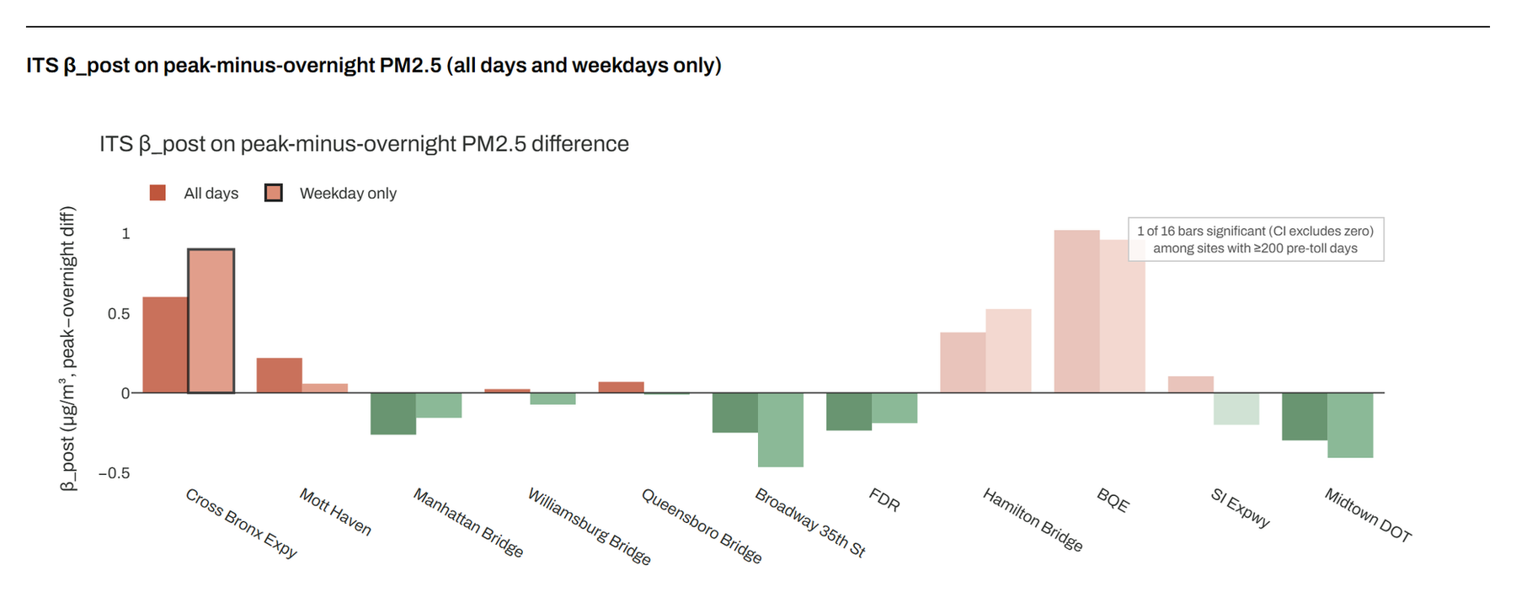
CHECK 2
Rush hour
The toll is 75% cheaper overnight. If drivers were dodging it through the Bronx, Bronx air would get worse by day.
Each bar: how much the day-minus-night gap changed after the toll.
Mott Haven: nothing.
Cross Bronx, weekdays: one hit out of sixteen. A hint, not a finding.
Black outline = significant. Faded bars = monitors with under 200 pre-toll days; not interpreted.
The Toll It Takes · NYC Congestion Pricing Datathon 2026
Photo: Pexels, free license
10 / 36
Notes:
The first doubt is that diversion might be hiding inside the daily average. The toll is 75 percent cheaper overnight, so dodging it happens by day, which is why I ran the model on each day's daytime reading minus its nighttime reading, since weather hits both equally and cancels while traffic does not. At Mott Haven the gap did not move, and at Cross Bronx on weekdays it widened by 0.9, which is the one bar out of sixteen that clears the bar, so it is a hint. Inside the zone the daytime air got slightly better, which is exactly what fewer daytime cars looks like.

Slide 11

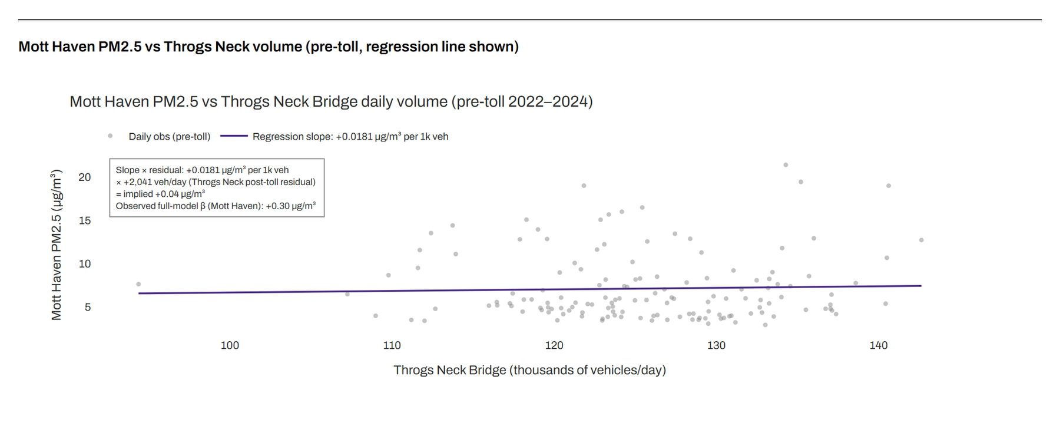
CHECK 5
Could diverted traffic even cause it?
0.018 × 2,041 = 0.04 µg/m³
Pollution per extra 1,000 cars on the Throgs Neck × extra cars after the toll = one-eighth of the +0.30 at Mott Haven.
Each dot is one pre-toll day. A steep line would mean bridge traffic drives Mott Haven air. The line is nearly flat.
The Toll It Takes · NYC Congestion Pricing Datathon 2026
Photo: New York Public Library, public domain
11 / 36
Notes:
The second doubt is about the mechanism itself. The critics' story is a chain where the toll makes cars reroute, the Bronx bridges get busier, and Mott Haven's air gets worse, and this chart tests the last link. Each dot is one pre toll day with Throgs Neck traffic across and Mott Haven air up, and the slope is only 0.018 micrograms per thousand vehicles. After the toll the Throgs Neck ran 2,041 vehicles a day above forecast, which comes out to 0.04 against the 0.30 people worry about, so diverted traffic explains one eighth of it and the chain breaks at the last link.

Slide 12

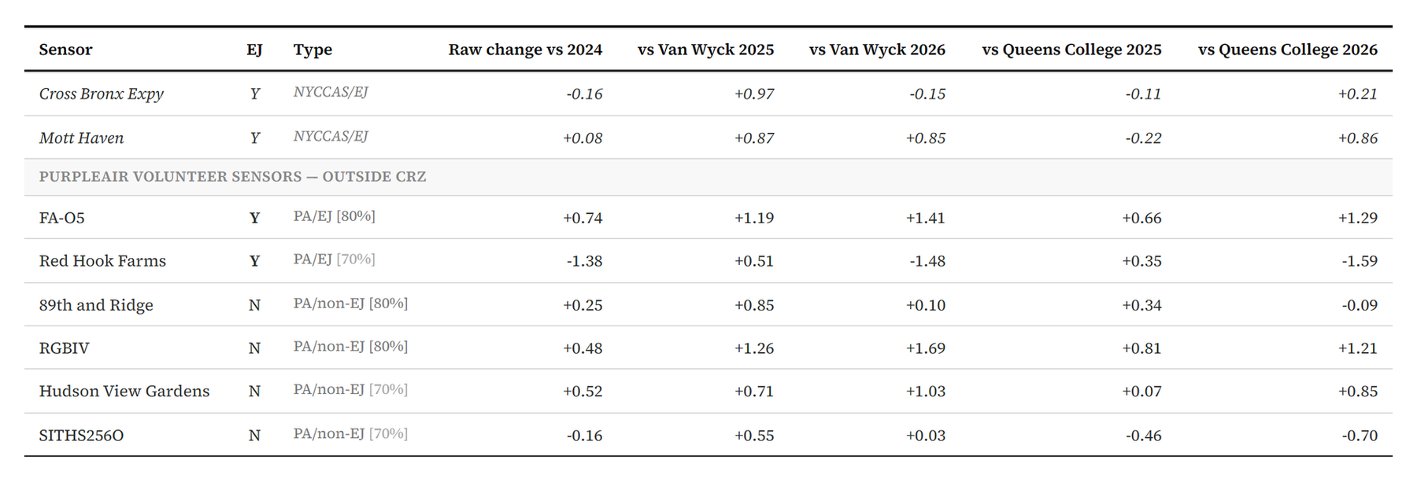
CHECK 9 · THE SLIDE THAT SETTLES IT
The missing comparison
+0.87
+0.85
+1.26
Mott Haven
Bay Ridge
Brooklyn Heights
South Bronx · designated · expressway at 44 m
Brooklyn · not designated · no expressway
Brooklyn · not designated · no expressway
Change in 2025 vs 2024, relative to the Van Wyck control, µg/m³
No highway, no designation, same change. Outside the zone, everyone moved together.
The Toll It Takes · NYC Congestion Pricing Datathon 2026
Photo: Lerone Pieters, Unsplash; monochrome
12 / 36
Notes:
This is the slide that settles it, because it fixes the problem from slide eight. The city has no outside the zone monitor in a neighborhood that is not designated, so I found some by pulling volunteer PurpleAir sensors, correcting them with the EPA's formula, and screening twelve of them, of which three passed. Then I ran the simplest comparison there is, 2025 minus 2024 on matched days, minus the same change at the control. Mott Haven came out at plus 0.87, Bay Ridge, which is middle class and not designated and nowhere near an expressway, came out at plus 0.85, and Brooklyn Heights at plus 1.26. A neighborhood with no highway and no designation moved exactly as much as the South Bronx, so this is not a Bronx story or an EJ story, it is a zone story.

Slide 13

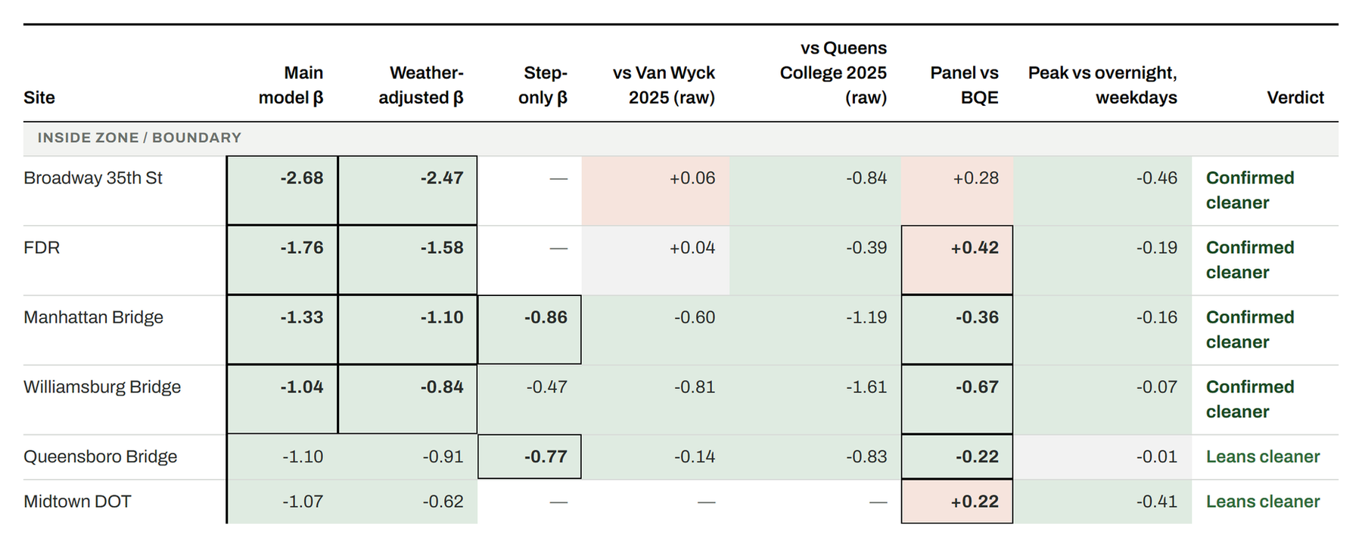
CHECK 1–9
Every monitor, every check — inside and on the boundary
Green = cleaner, brick = dirtier, bold = significant on its own. Verdict uses the five level-change columns; panel and rush-hour columns are shown for reference.
The Toll It Takes · NYC Congestion Pricing Datathon 2026
Photo: Joey Zhou, Unsplash
13 / 36
Notes:
Here are all nine checks on one table, where each row is a monitor, each column is a check, green says cleaner, brick says dirtier, and bold means that check is significant on its own, and this half, inside or on the edge of the zone, is green almost everywhere.

Slide 14

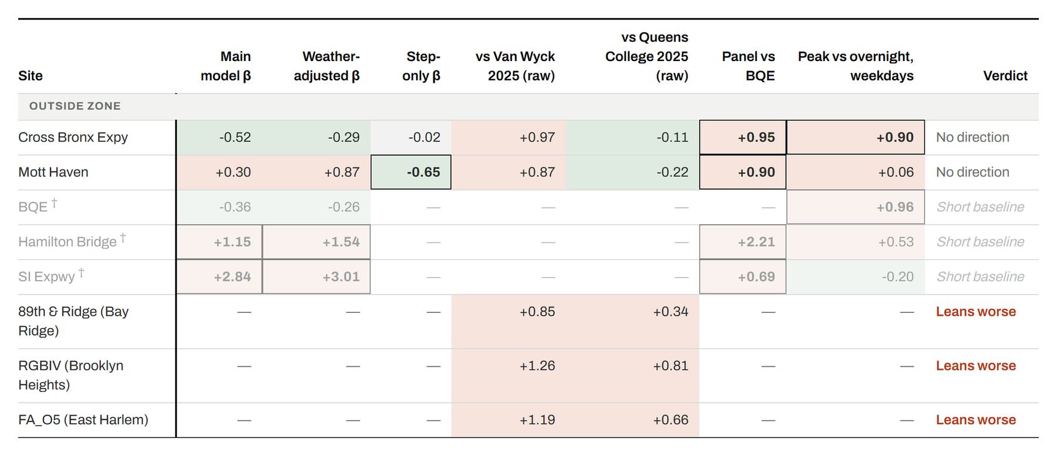
CHECK 1–9
Every monitor, every check — outside the zone
The Bronx rows mix green and brick: no direction. Faded rows have under 200 pre-toll days. Volunteer sensors carry only the subtraction columns.
The Toll It Takes · NYC Congestion Pricing Datathon 2026
Photo: Clay LeConey, Unsplash; monochrome
14 / 36
Notes:
This half is outside the zone, where the Bronx rows mix green and brick with no pattern, and the volunteer sensors look just like the Bronx rows. Same nine tests, same answer.

Slide 15

RECONCILING
Same data as the community study. Different comparison.
SOUTH BRONX UNITE
THIS STUDY
12–14 of 19 sensors up
Average +0.22 µg/m³, up to +1.29 near expressways
Reports raw year-over-year change
Raw Bronx changes agree: small and mixed
Subtract a control monitor, and Bay Ridge shows the same increase
Asks “more than everywhere else?”, not “up?”
Their expressway sensors and our Cross Bronx rush-hour hint point the same way. We don’t disagree about what was measured — only about what to compare it to.
The Toll It Takes · NYC Congestion Pricing Datathon 2026
Photo: New York Public Library, public domain
15 / 36
Notes:
On the community study the brief cites, they found small increases at their Bronx sensors and so did I in the raw numbers, so we only disagree about what to compare it to. When I subtract a control, the same increase shows up in Bay Ridge, so Bronx air went up but it did not go up more than everywhere else.

Slide 16
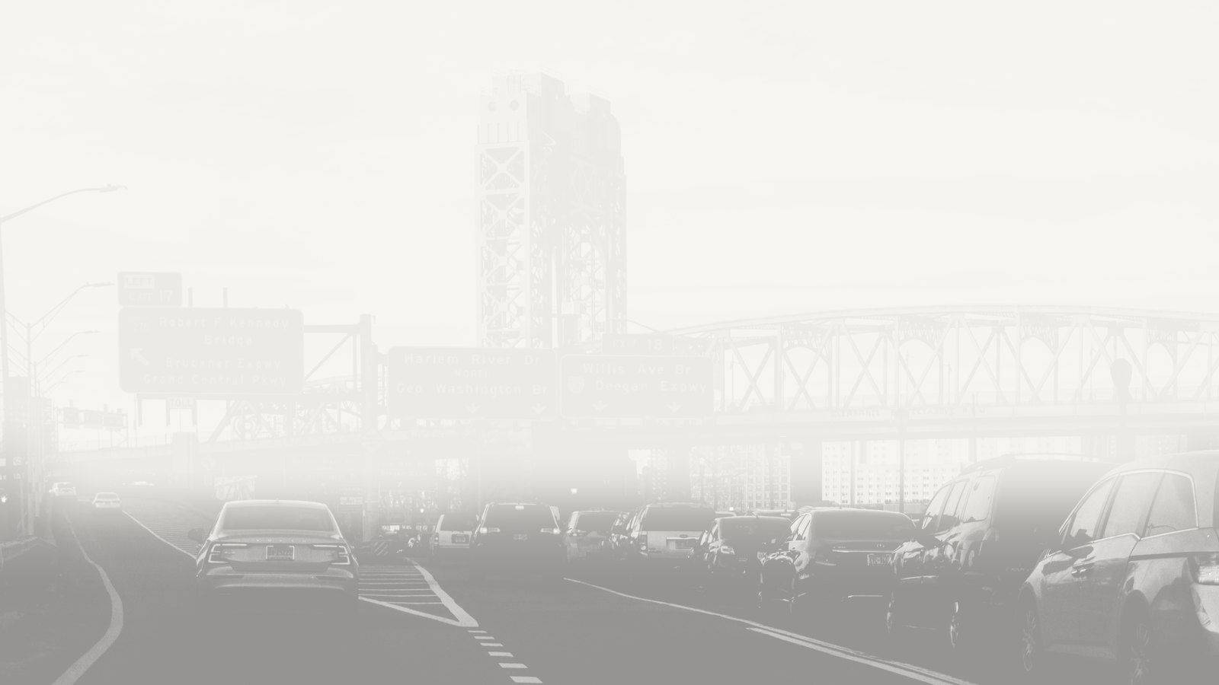
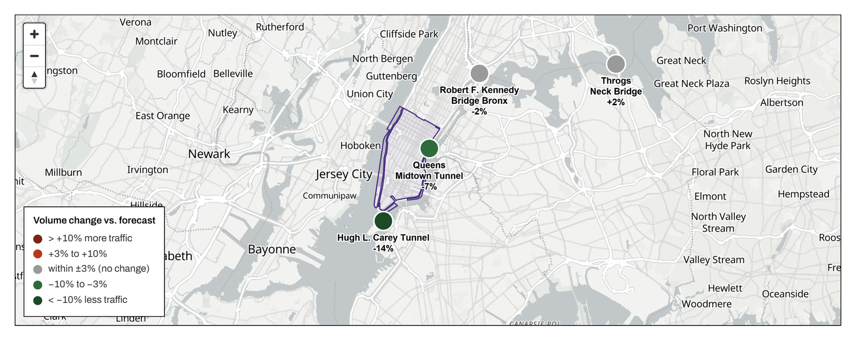
PART I · SECTION 6
Where the cars went
−14% · −7%
Tunnels into the zone, vs forecast
±2%
Bronx bridges, vs forecast
~73,000
fewer entries a day. Not rerouted. Mostly gone.
Residual = actual 2025 traffic minus what the pre-toll trend predicted. Grey = within ±3%.
The Toll It Takes · NYC Congestion Pricing Datathon 2026
Photo: Clay LeConey, Unsplash; monochrome
16 / 36
Notes:
The traffic data says the same thing. The tunnels into the zone lost 14 and 7 percent against forecast, while the Bronx bridges, where diverted cars would have to show up, stayed within two percent. About 73,000 fewer vehicles a day enter the zone, and they did not go around, they mostly went away, which is the mechanism behind cleaner air inside and the reason there is nothing to find outside.

Slide 17

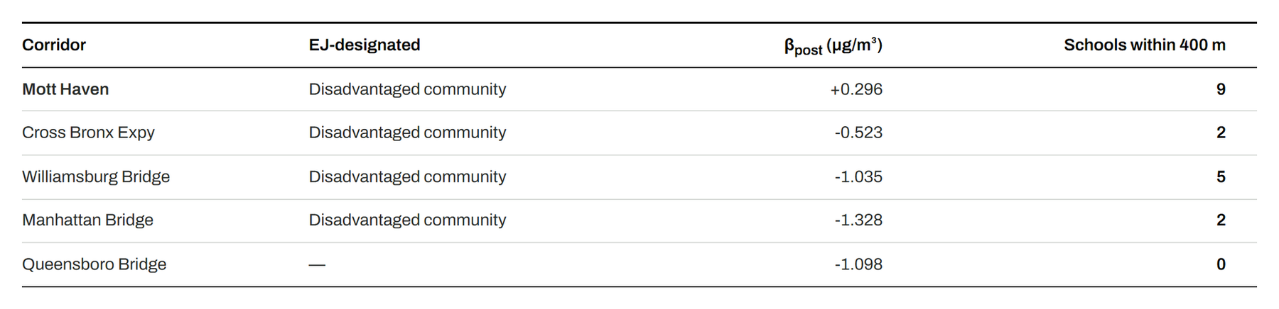
PART I · SECTION 8
Who breathes this air
44 m
6 km
9
to the Major Deegan Expressway
to the toll zone
school entries within 400 m
The monitor reads about 7.5 µg/m³ before the toll and after. A Manhattan toll has no lever here; the expressway next door does.
The Toll It Takes · NYC Congestion Pricing Datathon 2026
Photo: Famartin, Wikimedia Commons, CC BY-SA 4.0; monochrome
17 / 36
Notes:
So the toll did not hurt the Bronx, and here is why that is not good news. The Mott Haven monitor sits 44 meters from the Major Deegan and six kilometers from the zone, with nine school entries within 400 meters, and it read about 7.5 before the toll and reads 7.5 now, because a toll on Manhattan has no lever on an expressway next door. The Health Department estimates traffic is about 14 percent of the city's PM, which is one to two micrograms here, so cutting the expressway's volume in half would plausibly remove half a unit to a full unit, more than the toll achieved anywhere outside the zone. That is a back of the envelope calculation, but it tells you the fix is on this street and not downtown.

Slide 18

URBAN POLICY
The policy point
1
The toll worked where it charges
including the designated neighborhoods inside the line.
2
It didn’t do the harm its critics feared
nine tests and a second sensor network found no diversion effect.
3
It was never going to reach the Bronx
the worst air and highest asthma rates in the city, before the toll and after.
The money is already on the table. The toll’s mitigation package names about $125 million in measures, including $10 million for roadside vegetation and $10 million for air filtration in schools near highways. Hunts Point–Mott Haven is one of its thirteen target communities. The MTA now says the diversion it was meant to offset has not materialized. That turns compensation for a harm into an open budget for a burden that was already there.
Sources: NY Governor’s Office, Nov 2024 release; MTA Congestion Pricing mitigation page.
The Toll It Takes · NYC Congestion Pricing Datathon 2026
Photo: New York Public Library, public domain
18 / 36
Notes:
This brings me to the policy point. The toll worked where it charges, including for designated neighborhoods inside the line, it did not do the harm its critics feared, and it was never going to reach the Bronx, which had the worst air and asthma rates in the city before the toll and still does. The state attached about 125 million dollars in mitigation, including 10 million for roadside vegetation and 10 million for school air filtration, with Hunts Point and Mott Haven among the target communities, and it was justified as compensation for diverted traffic that the MTA now says did not materialize. So the question is what to do with a budget that is already there for a problem that was already there, and Part II is my answer.

Slide 19
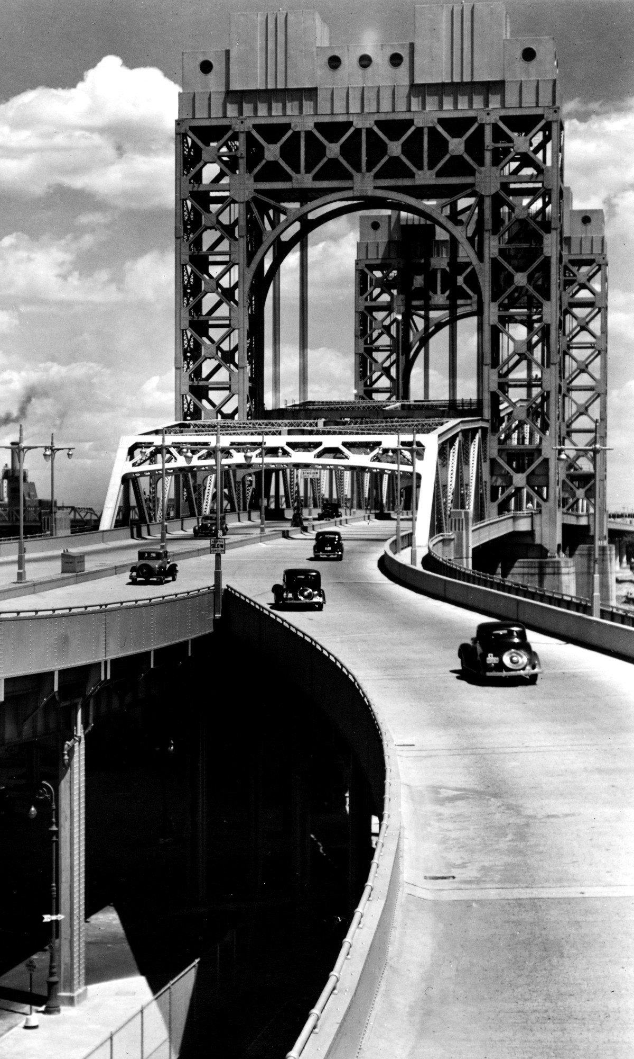
TRANSITION TO PART II
[Du Bois quote — paste from the datathon brief, with the attribution: W.E.B. Du Bois, “AD 2150”]
Inside the zone, the toll made room. In Mott Haven, nothing did. So the design has to.
Right: the Triborough Bridge, which lands in Mott Haven, in the 1930s. Photo: New York Public Library, public domain.
The Toll It Takes · NYC Congestion Pricing Datathon 2026
19 / 36
Notes:
The brief quotes Du Bois imagining a New York with forests where the concrete used to be, and argues you cannot get there until something stops needing the land at street level. Inside the zone the toll did exactly that, but in Mott Haven nothing did, so the design has to work with the street as it is.

Slide 20

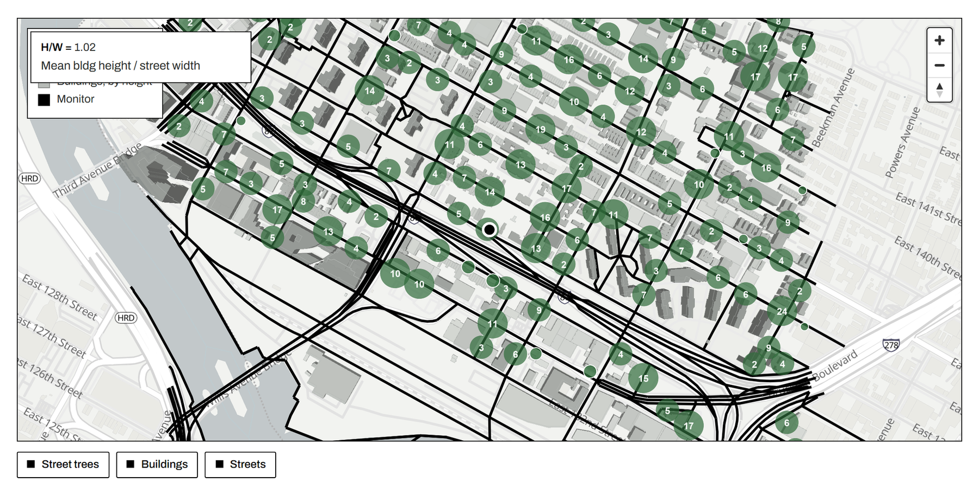
PART II · SECTION 1
The corridor as it is
1.02
height-to-width ratio: a street canyon
4%
tree canopy · city average 22%
26
street trees per mile · city average 142
Building heights from the city footprint file; street widths from the centerline file; canopy from the 2015 tree census scaled by trunk diameter.
The Toll It Takes · NYC Congestion Pricing Datathon 2026
Photo: Pexels, free license
20 / 36
Notes:
I start with the street as it is. From the city's footprint and centerline files, the buildings average 33 feet tall and the streets are 32 feet wide, a height to width ratio of about one, which makes this a street canyon. From the 2015 tree census the canopy is 4 percent against 22 citywide, so the gap is large, but the canyon means you cannot simply close it with trees.

Slide 21

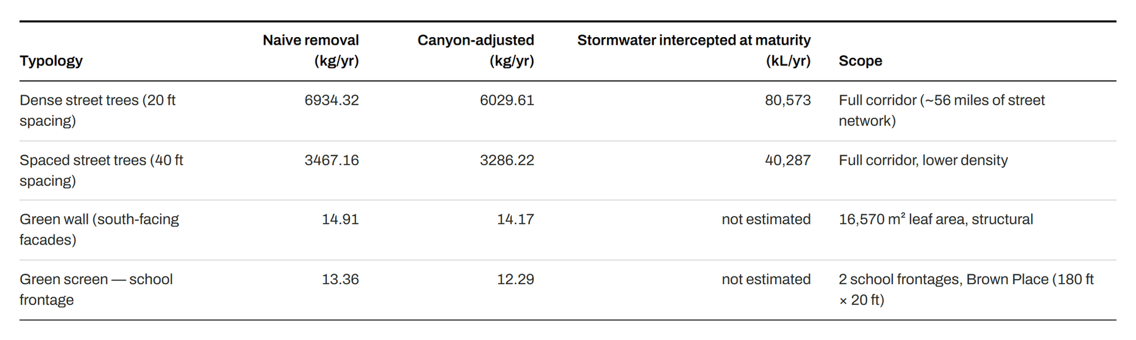
PART II · SECTION 2
The trade-off the brief asked us to face
In a canyon above 0.5, dense canopy can trap pollution at street level instead of catching it. So the removal number is discounted by the geometry: 13% for dense planting, 5% for spaced.
Dense trees still win — about 6,000 kg of PM₂.₅ a year at maturity — if the canopy stays high enough not to close the canyon. Plus about 80 million liters of stormwater intercepted a year.
Removal rates from i-Tree (Nowak et al.); canyon discount from street-canyon simulation studies; stormwater per-tree figure from the city’s own analysis.
The Toll It Takes · NYC Congestion Pricing Datathon 2026
Photo: Famartin, Wikimedia Commons, CC BY-SA 4.0; monochrome
21 / 36
Notes:
There are three ways to plant here, and this is the trade off the brief asked us to face. Dense trees at 20 foot spacing means about 15,000 trees, spaced at 40 feet means about 7,400, and the third option is a green wall. The Forest Service's i-Tree rates say dense planting removes about 6,900 kilograms a year at maturity, but in a canyon above a ratio of 0.5 a dense canopy can trap pollution at street level, so I discount by the geometry, 13 percent for dense and 5 for spaced. Dense still wins at about 6,000 kilograms, but only if the species branch high enough to leave the canyon open, and it also intercepts about 80 million liters of stormwater a year.

Slide 22

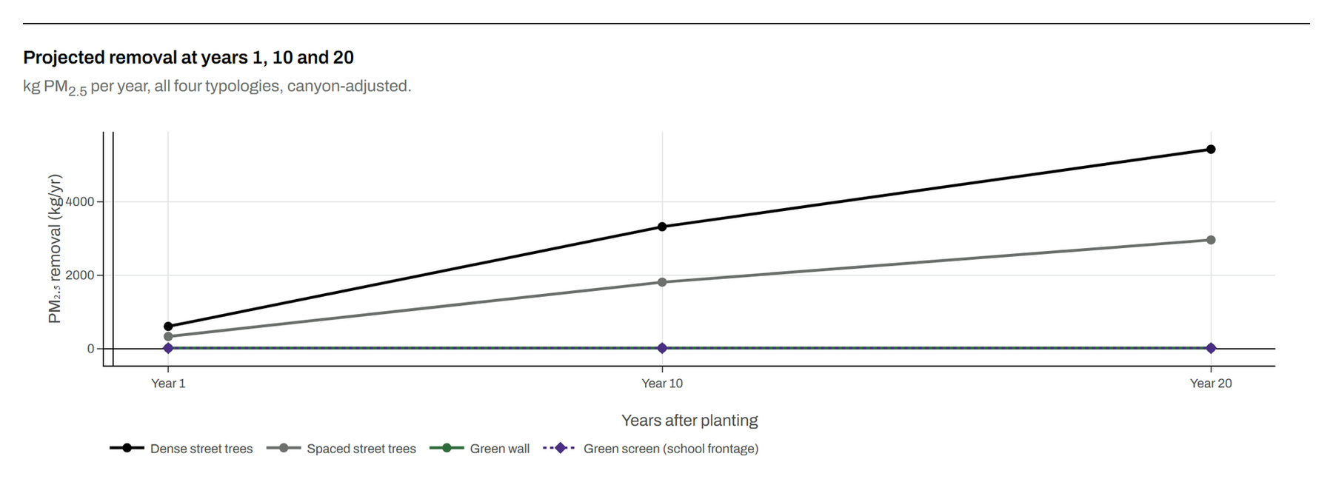
PART II · SECTION 3
It takes twenty years — unless it doesn’t
Trees deliver 10% of their mature removal in year one, 55% at year ten, 90% at year twenty.
Green walls and screens deliver fully from year one and never grow.
The honest plan is both: screens for the first decade, trees for the second.
Maturation curve applied to tree typologies only; flat lines are structural, not assumed.
The Toll It Takes · NYC Congestion Pricing Datathon 2026
Photo: Joey Zhou, Unsplash
22 / 36
Notes:
Timing is the catch, since trees deliver 10 percent of their mature removal in year one, 55 at year ten, and 90 at year twenty, while walls and screens deliver their full effect from day one, so it is screens now while the trees come up.

Slide 23

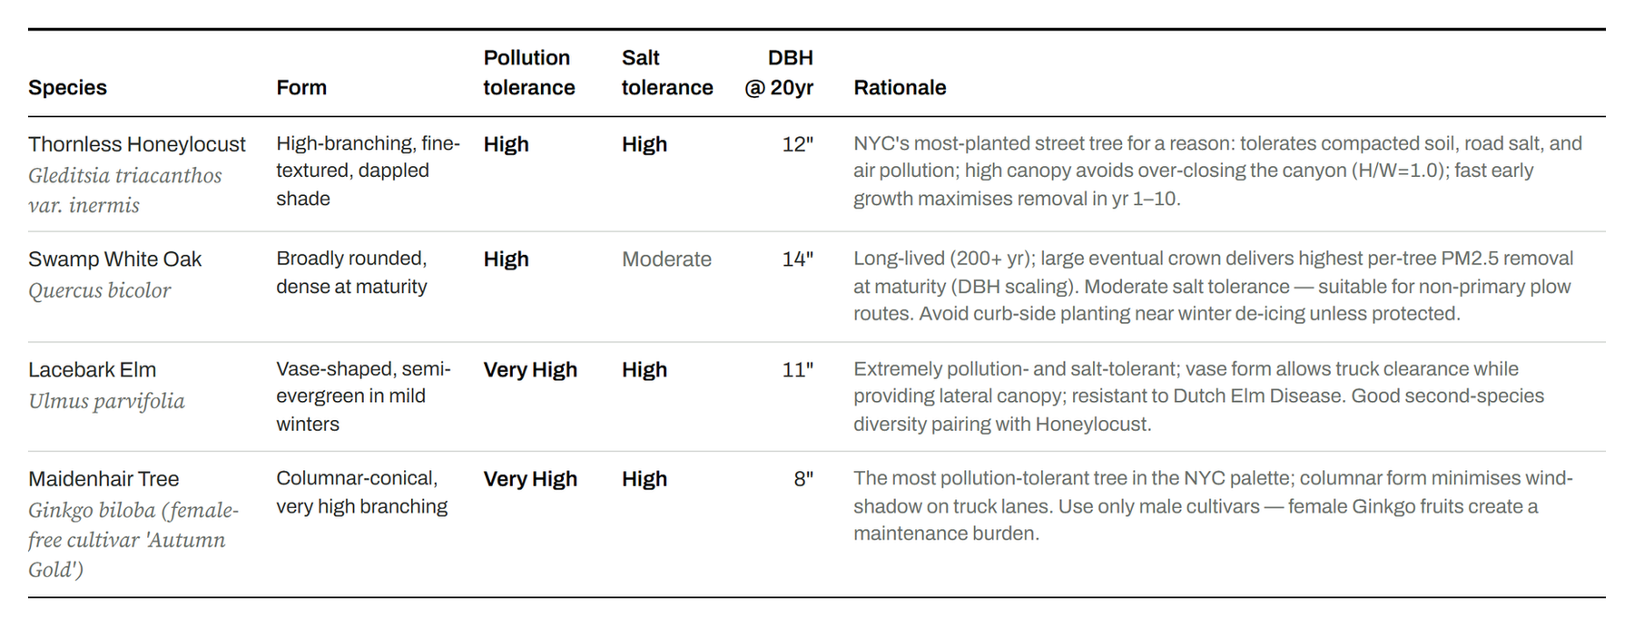
PART II · SECTION 4
Four species, chosen for this street
Thornless honeylocust leads: high-branching, so it shades without closing the canyon.
Lacebark elm clears truck height. Swamp white oak for the long run. Male ginkgo for the hardest spots.
All four tolerate road salt and pollution, which matters next to a plow route.
Species, form, tolerance, and 20-year trunk diameter from the site’s species table.
The Toll It Takes · NYC Congestion Pricing Datathon 2026
Photo: Pexels, free license
23 / 36
Notes:
These four species were chosen for this street rather than from a default list. Honeylocust leads because it branches high and shades without closing the canyon, lacebark elm clears truck height, swamp white oak is for the long run, and male ginkgo goes in the hardest spots, and all four tolerate road salt.

Slide 24

PART II · THE FIRST MOVE
Build this first
A vegetative screen along the shared frontage of P.S. 43 and Mott Haven Academy on Brown Place.
180 ft
20 ft
~12 kg/yr
of school frontage
screen height
PM₂.₅ removed, from year one
Small on a citywide scale. Concentrated at the exact place where several hundred children spend six hours a day — and it works in the first year, while the trees grow.
The Toll It Takes · NYC Congestion Pricing Datathon 2026
Photo: Famartin, Wikimedia Commons, CC BY-SA 4.0; monochrome
24 / 36
Notes:
This is the piece I would build first, because it is where the people are. P.S. 43 and Mott Haven Academy share 180 feet of frontage on Brown Place, and a 20 foot vegetative screen there removes about 12 kilograms a year, which is small citywide but sits exactly where several hundred children spend six hours a day and works in year one. If the mitigation money buys one thing, it should be this.

Slide 25

THE CLAIM
Congestion pricing is eliminating pollution, not moving it — but only inside the zone. Outside, nothing changed. The neighborhoods that need it most need something a toll can’t give them.
furkanberatay.github.io/The_Toll_it_Takes_Project
github.com/FurkanBeratAy/The_Toll_it_Takes_Project
The FDR Drive and Lower Manhattan, inside the zone. Photo: Lerone Pieters, Unsplash; shown in monochrome.
The Toll It Takes · NYC Congestion Pricing Datathon 2026
25 / 36
Notes:
So this is the claim. Congestion pricing is eliminating pollution and not moving it, but only inside the zone, and outside the zone nothing changed. It did not hurt the Bronx and it did not touch the Bronx either, because a toll on Manhattan has no lever on an expressway 44 meters from a school, so the city should spend the money already on the table on what actually reaches it, trees sized to the canyon and screens at the schools. Thank you, and I am happy to take questions.

Slide 26

Appendix
All nine checks, in order · Limitations
The Hell Gate Bridge, with the Triborough beyond. Photo: New York Public Library, public domain; duotone.
Notes:
These are backup slides that I will not present unless someone asks about them. They are all nine checks in order, followed by the limitations.

Slide 27

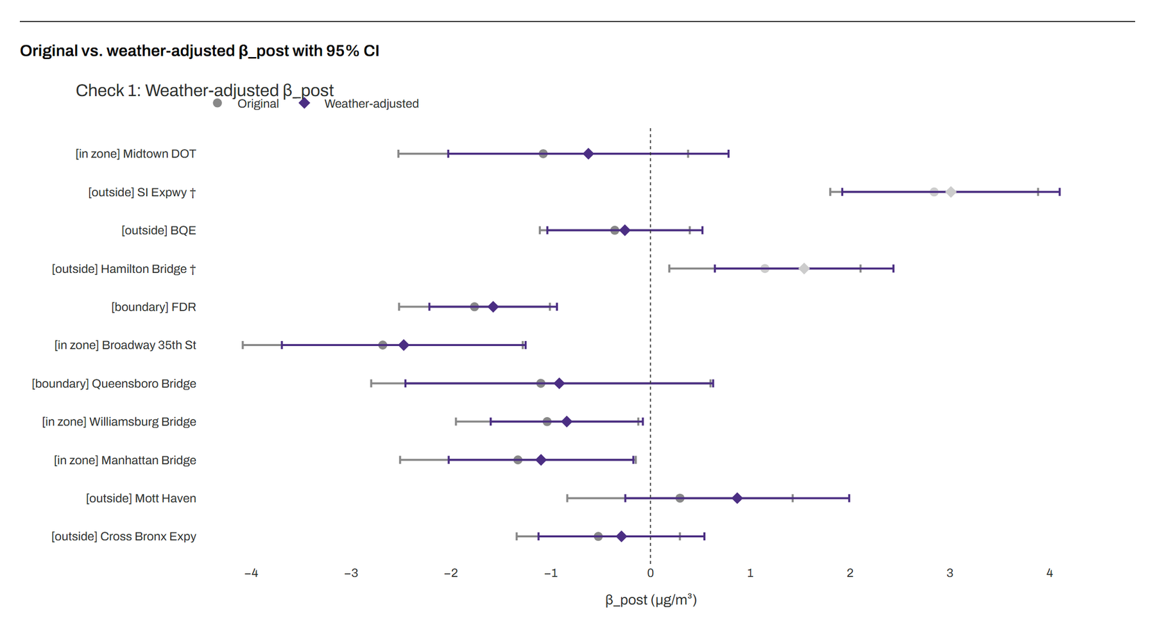
APPENDIX
Check 1 · weather-adjusted estimates
Grey dot = original estimate; purple diamond = after adding weather. A bar entirely on one side of zero is a confident result; a bar crossing it is not.
The Toll It Takes · NYC Congestion Pricing Datathon 2026
Photo: New York Public Library, public domain
27 / 36
Notes:
If someone asks about weather, I added wind speed, temperature, rain, humidity, and wind direction from LaGuardia to every model, and nothing flipped sign while the ranges got shorter at eight of eleven sites. The four bars entirely left of zero are all in or on the edge of the zone, and SI Expressway and Hamilton Bridge are greyed out because they have under 200 pre toll days in a single season, which means the seasonal terms cannot be identified.

Slide 28

APPENDIX
Check 2 · rush hour (daytime-minus-nighttime gap)
Each bar is how much the day-night gap changed after the toll. The toll is 75% cheaper overnight, so diversion would show by day. 1 of 16 bars significant among monitors with a full pre-toll year: Cross Bronx, weekdays. Faded bars have under 200 pre-toll days.
The Toll It Takes · NYC Congestion Pricing Datathon 2026
Photo: New York Public Library, public domain
28 / 36
Notes:
If someone asks about rush hour, each bar is the change in the daytime minus nighttime gap after the toll, and diversion would show up by day because the toll is 75 percent cheaper at night. Mott Haven is near zero, and Cross Bronx on weekdays is the one significant bar out of sixteen among the monitors with a full pre toll year.

Slide 29

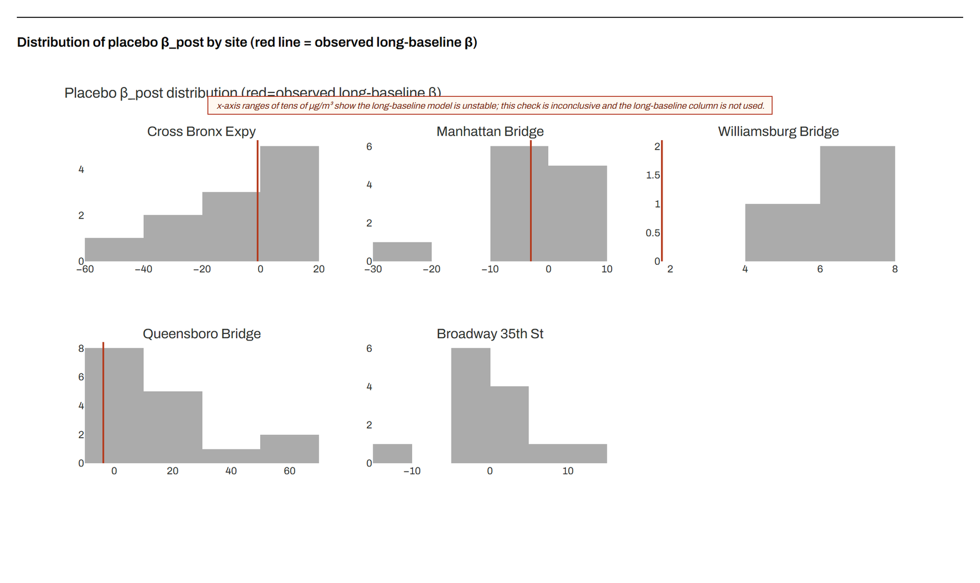
APPENDIX
Check 3 · fake toll dates
Grey bars = estimates from pretending the toll started on earlier months, long-baseline model. Red line = the real date. The x-axes span tens of µg/m³, which is why that model is discarded and this check is inconclusive.
The Toll It Takes · NYC Congestion Pricing Datathon 2026
Photo: New York Public Library, public domain
29 / 36
Notes:
If someone asks about the placebo test, I planted fake toll dates in the pre toll data to see whether the method finds effects that are not there. The long baseline model, which uses data back to 2019 with only one control, finds fake effects of plus or minus 30 units, so I discarded that model, and this chart is here to show why the main results do not use it.

Slide 30

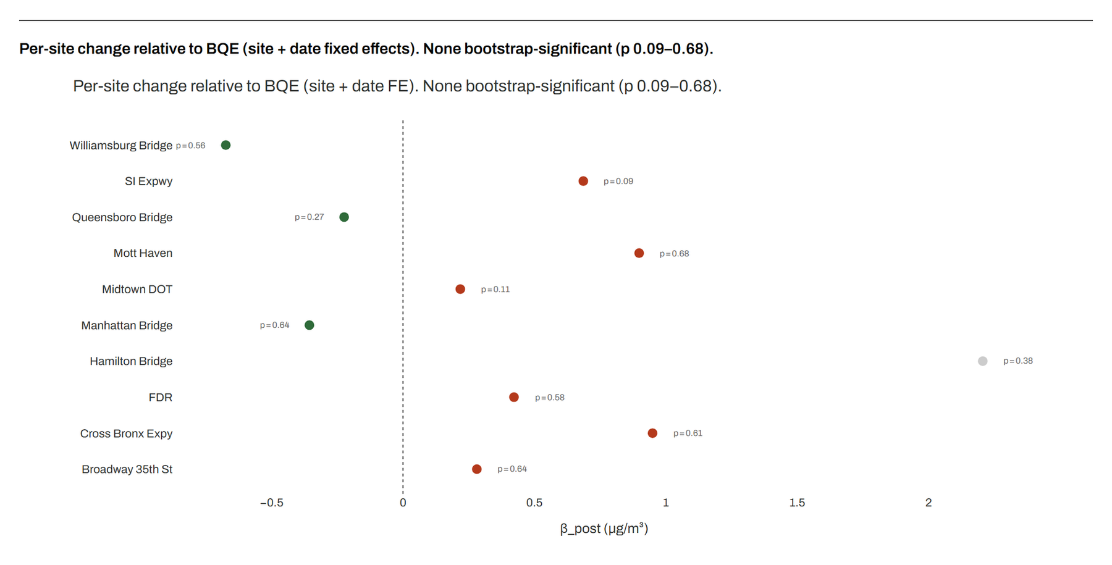
APPENDIX
Check 4 · all monitors in one model
Every day gets its own baseline, so citywide events cancel. Dots are relative to BQE; none is bootstrap-significant on its own (p 0.09–0.68). In-zone bridges sit left of the Bronx by about 1.3–1.6 µg/m³.
The Toll It Takes · NYC Congestion Pricing Datathon 2026
Photo: New York Public Library, public domain
30 / 36
Notes:
If someone asks about the controls, this model drops them entirely by putting all eleven monitors in one regression with a fixed effect for each site and each day, so that anything citywide cancels out. The dots are relative to BQE, the in zone bridges sit about 1.3 to 1.6 below the Bronx on the same days, and no single site is significant on its own under a wild cluster bootstrap. With both the EJ label and the zone label in the model, the EJ effect is minus 0.38 to plus 0.02.

Slide 31

APPENDIX
Check 5 · could diverted traffic cause it?
Each dot is one pre-toll day: Throgs Neck traffic vs Mott Haven PM₂.₅. Slope 0.018 µg/m³ per 1,000 vehicles; × 2,041 extra vehicles = 0.04 µg/m³, one-eighth of the +0.30 in question.
The Toll It Takes · NYC Congestion Pricing Datathon 2026
Photo: New York Public Library, public domain
31 / 36
Notes:
If someone asks whether diversion could cause it, the slope is 0.018 per thousand cars, times 2,041 extra cars, which equals 0.04 micrograms, or one eighth of the 0.30. The slope itself is not significant, which cuts the same way, since it means bridge traffic is only weakly tied to the air at Mott Haven.

Slide 32

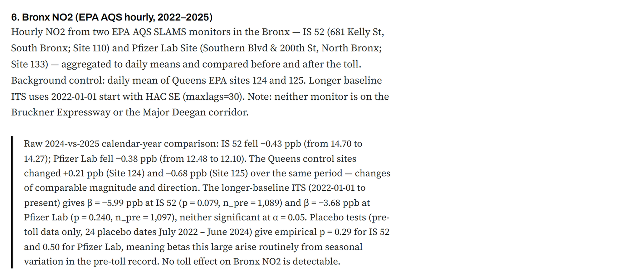
APPENDIX
Check 6 · Bronx NO₂
NO₂ comes almost entirely from engines. The two state monitors in the Bronx moved with the Queens control: no traffic signal.
The Toll It Takes · NYC Congestion Pricing Datathon 2026
Photo: New York Public Library, public domain
32 / 36
Notes:
If someone asks about NO2, it comes almost entirely from engines, which makes it a sharper fingerprint of traffic than particles are. The two state monitors in the Bronx fell 0.4 parts per billion in 2025, which is the same as the Queens control, and neither monitor is on the Deegan or the Bruckner, so this is borough level evidence rather than corridor level.

Slide 33

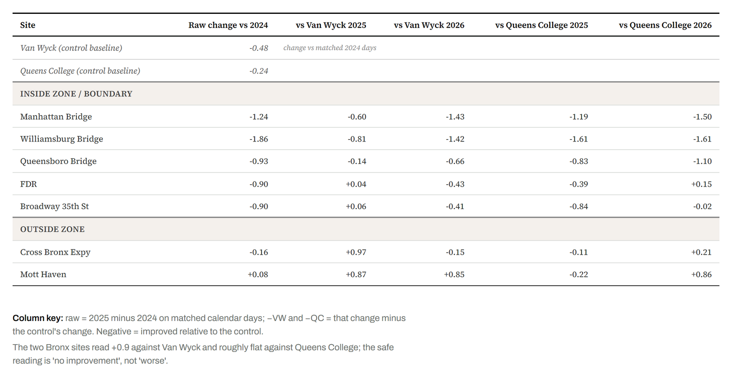
APPENDIX
Check 7 · plain subtraction, no model
2025 minus 2024 on matched calendar days, minus the control's change. Negative = improved relative to the control.
The Toll It Takes · NYC Congestion Pricing Datathon 2026
Photo: New York Public Library, public domain
33 / 36
Notes:
If someone asks to see it without a model, this is 2025 minus 2024 on matched days, minus the control. The bridges inside the zone are down 0.6 to 0.8 and still falling in 2026, while the Bronx is up about 0.9 against Van Wyck and roughly flat against Queens College. The choice of control shifts the Bronx by about a unit, so the safe reading is no improvement rather than worse.

Slide 34

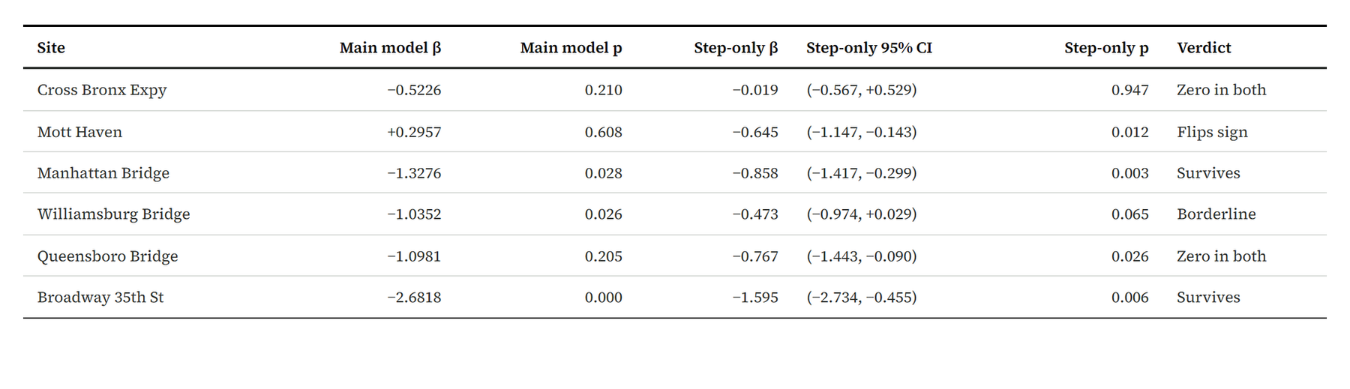
APPENDIX
Check 8 · simpler model, one term removed
A result that keeps its sign and significance is sturdy. Mott Haven flips from +0.30 to −0.65, so no direction is claimed for it. Queensboro becomes significant only in the simpler model.
The Toll It Takes · NYC Congestion Pricing Datathon 2026
Photo: New York Public Library, public domain
34 / 36
Notes:
If someone asks whether the model is driving the result, I removed the term that lets the effect change over time. Manhattan Bridge survives, Williamsburg goes borderline, and Mott Haven flips from plus 0.30 to minus 0.65, which is exactly why I claim no direction there. Queensboro is significant only in the simpler model.

Slide 35

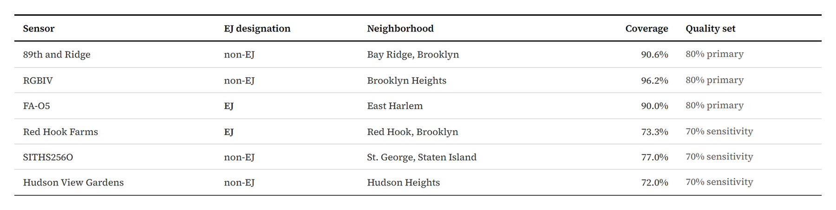
APPENDIX
Check 9 · outside-zone sensors (coverage; results on slide 12)
Twelve candidates screened; three pass the 80% coverage bar, six pass 70%. All require 200+ pre-toll days. Readings EPA-corrected (Barkjohn 2021).
The Toll It Takes · NYC Congestion Pricing Datathon 2026
Photo: New York Public Library, public domain
35 / 36
Notes:
If someone asks how the sensors were chosen, twelve were screened for two agreeing channels, physically plausible readings, humidity for the EPA correction, 80 percent coverage, and 200 pre toll days. Three passed, which were Bay Ridge, Brooklyn Heights, and East Harlem, and six pass a looser 70 percent bar as a sensitivity check.

Slide 36

APPENDIX
Limitations
1
Control drift: both Queens controls fell from 2024 to 2025, so outside-zone “increases” relative to them may be partly control drift, not site worsening.
2
Volunteer sensors: three primary sensors, all outside the zone. No non-designated outside-zone NYCCAS monitor exists.
3
Nine pre-toll months at Mott Haven in the main window; the step-only model flips its sign, so no direction is claimed.
4
Hunts Point: monitor offline September 2023 to March 2025; no valid estimate at the toll date.
5
Boulevard scenario: back-of-envelope. Traffic is about 14% of citywide PM₂.₅; at this monitor that is roughly 1 µg/m³.
The Toll It Takes · NYC Congestion Pricing Datathon 2026
Photo: New York Public Library, public domain
36 / 36
Notes:
If someone asks what could be wrong, both Queens controls fell in 2025, so the outside zone increases relative to them may partly be control drift, which makes no change the safer reading. Only three volunteer sensors passed, Mott Haven has nine pre toll months, Hunts Point was offline across the toll date, and the boulevard number is a back of the envelope calculation. All of that is written on the page.

