Slide 1
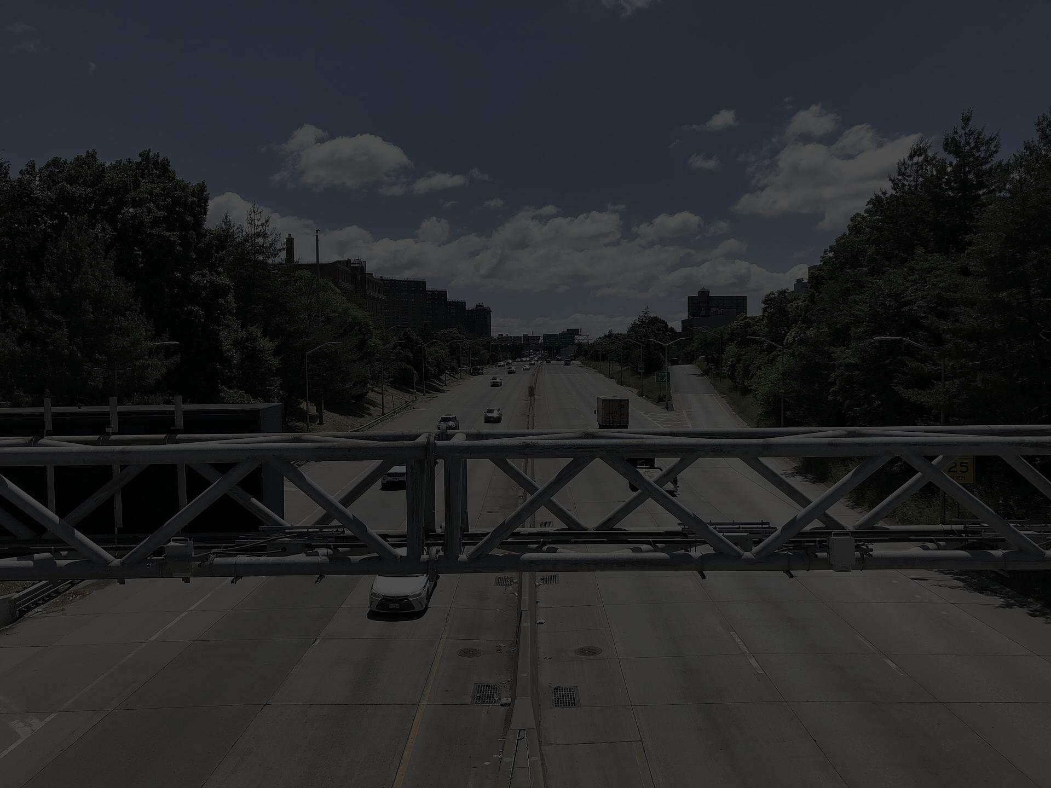
THE TOLL
IT TAKES
Congestion pricing cleaned the air where it charges.
What about everyone else?
Furkan Beray · NYC Congestion Pricing Datathon 2026
Notes:
Opening. The Deegan photo sets the scene: Mott Haven, 44 m from the highway, 6 km outside the toll zone. The question the deck answers is on this slide.

Slide 2
THE QUESTION
Is congestion pricing eliminating pollution, or moving it?
“Is congestion pricing eliminating pollution, or moving it? And if moving, toward neighborhoods already most vulnerable?”
−22% PM₂.₅ daily max
inside the zone
Increases near
Bronx expressways
Cornell / MTA headline: significant reduction in peak PM₂.₅ inside the Congestion Relief Zone after January 5, 2025.
South Bronx Unite community sensors: PM₂.₅ rising at 12–14 of 19 sensors, avg +0.22 µg/m³, up to +1.29 near expressways.
We tested both.
Notes:
Two credible claims in tension. Cornell/MTA documented a ~22% reduction in PM2.5 daily maximum inside the CRZ. South Bronx Unite documented increases at expressway-adjacent sensors in the same period. We tested both using interrupted time series with HAC standard errors, 11 NYCCAS monitors, 2019–2026, with MTA bridge/tunnel crossings as the mechanism check.

Slide 3
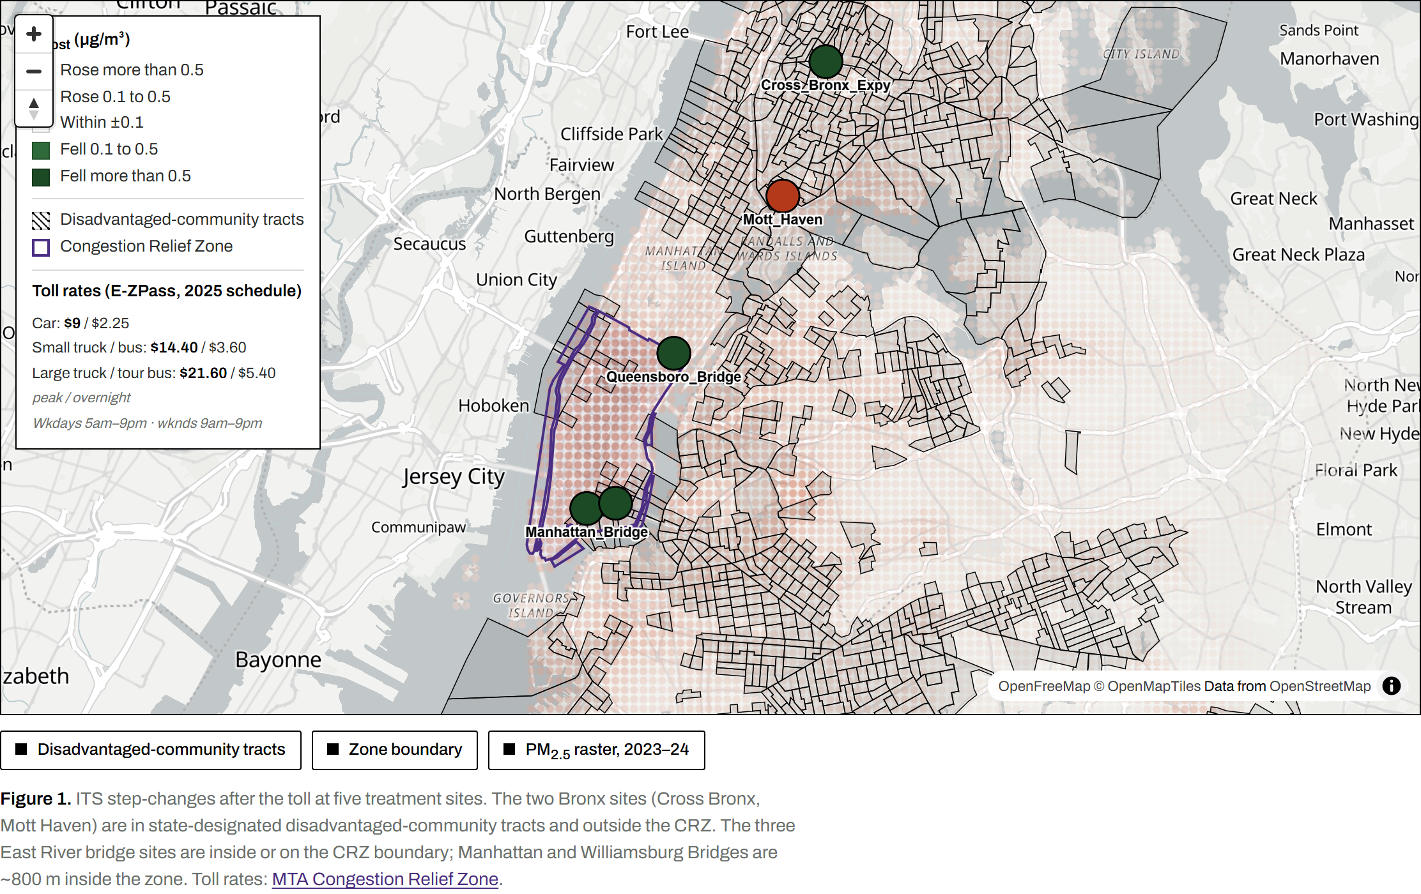
THE DATA
11 monitors · 2 controls · 2019–2026 · plus MTA crossings
Figure 1. ITS step-changes after the toll (ITS β_post) at 5 treatment sites. Green = improved. Brick = worsened. DAC-designated tracts shaded. CRZ boundary in purple. Controls: Queens College + Van Wyck (not shown). Source: NYCCAS hourly PM₂.₅ 2019–2026; MTA CRZ entries 2025–2026; NYS DAC tracts.
Notes:
11 monitors total; 5 treatment sites: Cross Bronx Expy, Mott Haven (both outside CRZ, both DAC-designated), Manhattan Bridge, Williamsburg Bridge, Queensboro Bridge (inside or on CRZ boundary). Plus Broadway 35th St, FDR, Hamilton Bridge, BQE, SI Expwy, Midtown DOT in the full panel. Controls: Queens College and Van Wyck. Hunts Point excluded: offline Sept 2023–Mar 2025, zero pre-toll observations at the VW-window start date — no valid step-change can be estimated.

Slide 4
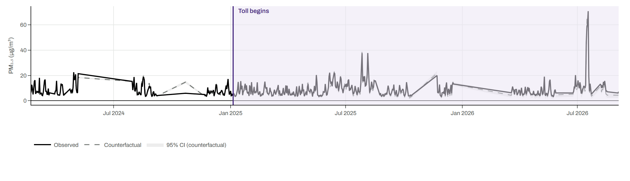
FINDING 1 — INSIDE THE ZONE
Inside the zone, it worked.
−1.33 µg/m³
p = 0.03 · Manhattan Bridge · significant in every specification tested
Section 2: Observed vs. counterfactual monthly mean PM₂.₅, Manhattan Bridge. Purple vertical line: toll launch Jan 5, 2025. Counterfactual anchored on Queens College + Van Wyck. Source: NYCCAS 2019–2026.
Notes:
Manhattan Bridge: β_post = −1.33 µg/m³ (SE 0.60, p = 0.028, n = 599). Holds in every spec: weather-adjusted −1.10 (p = 0.020), step-only −0.86 (p = 0.003), pooled panel same direction. Williamsburg Bridge similar: β = −1.04, p = 0.026 (model-dependent in step-only spec, p = 0.065). Both monitors ~800 m inside the CRZ on Manhattan landings of the East River bridges.

Slide 5
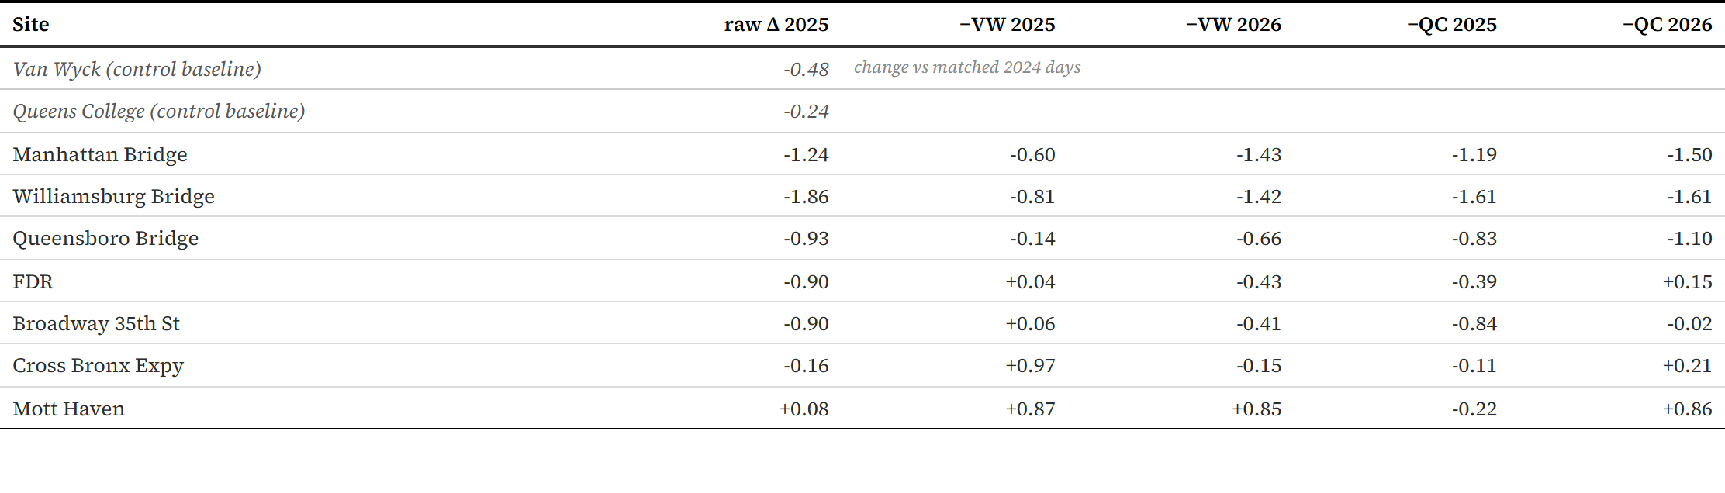
FINDING 2 — OUTSIDE THE ZONE
Outside the zone, nothing changed.
East River bridges → improved. South Bronx, Brooklyn, East Harlem → flat.
Check 7: Matched day-of-year DiD — site minus Van Wyck, 2025 vs. 2024. Bridges negative; every outside-zone site positive and similar. PurpleAir: EPA-corrected Barkjohn 2021. Source: NYCCAS + PurpleAir 2024–2026.
Notes:
Matched day-of-year DiD (Check 7): Van Wyck fell 0.48 µg/m³ vs. 2024; QC fell 0.24 µg/m³. After removing the VW trend: Manhattan −0.60, Williamsburg −0.81, Queensboro −0.14. Bronx: Cross Bronx +0.97, Mott Haven +0.87. PurpleAir: Bay Ridge +0.85, Brooklyn Heights +1.26, East Harlem +1.19. Bay Ridge and Brooklyn Heights look exactly like the Bronx — the organizing variable is inside vs. outside the zone, not borough or EJ status.

Slide 6
ROBUSTNESS
Did we look hard enough?
Check
Description
Verdict
1
Weather adjustment
Robust
2
Peak / overnight differencing
One hint
3
Placebo-in-time
Inconclusive
4
Pooled panel (site + date FE)
Same direction, not sig.
5
Mechanism check (Throgs Neck slope)
Bounded
6
Bronx NO₂ (EPA AQS 2022–2025)
No change
7
Matched-day DiD
Consistent
8
Step-only ITS
Mixed
9
Outside-zone PurpleAir sensors
No EJ gap
Notes:
Nine robustness checks. Two highlighted:
Check 2 (peak/overnight): Cross Bronx weekday-only β = +0.90 (p = 0.04). One significant result among 22 tests — a hint, consistent with the Throgs Neck diversion route.
Check 5 (mechanism): Throgs Neck slope +0.018 µg/m³ per 1k veh × +2,041 veh/day residual = +0.04 µg/m³ implied — about 1/8 of the observed +0.30 at Mott Haven.
Check 3 (placebo): SD of placebo distributions 7–17 µg/m³; observed effects of 1–3 µg/m³ are not exceptional against that baseline.
Check 8 (step-only): Mott Haven sign reverses (full +0.30, step-only −0.65); Williamsburg model-dependent (p = 0.026 full, p = 0.065 step-only).

Slide 7
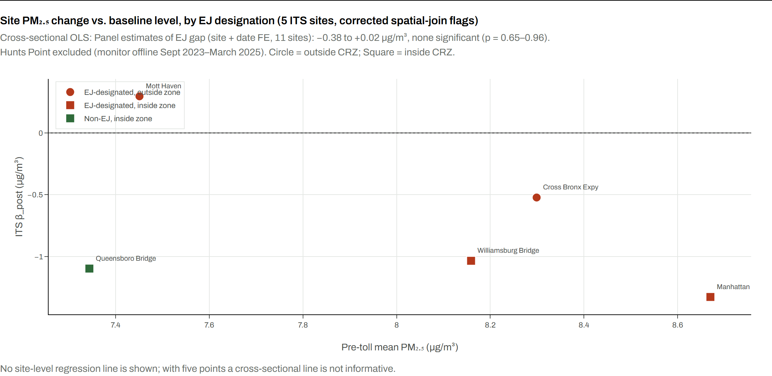
FINDING 3 — EQUITY
EJ can’t be separated from the zone.
β_EJ −0.38 to +0.02 µg/m³
None significant (p = 0.65–0.96) across all three EJ-flag definitions
Section 4: β_post by EJ status and zone membership. No fitted line. EJ flag: NYS DAC point-in-polygon. Panel: 11 sites, site + date FE, wild-cluster bootstrap. Source: ITS results × DAC spatial join. NYCCAS 2019–2026.
Notes:
Every in-zone monitor except Queensboro sits in a DAC-designated tract. Every outside-zone monitor with a full pre-toll record is also in a DAC tract. The missing cell (outside-zone, non-EJ) was filled with PurpleAir (Check 9): Bay Ridge, Brooklyn Heights, East Harlem — they moved the same as the Bronx. Panel EJ estimates: B1 −0.07 (p=0.77), B2 −0.38 (p=0.65), B3 +0.02 (p=0.96). Geography explains everything. Inside the zone improved; outside did not — EJ or not.

Slide 8
RECONCILING WITH SOUTH BRONX UNITE
Same data. Different counterfactual.
South Bronx Unite (raw)
This study (control-adjusted)
Sensors showing increase
12–14 of 19
Mott Haven raw 2025 vs 2024
+0.08 µg/m³
Average year-over-year
+0.22 µg/m³
Mott Haven ITS β_post
+0.30 (p = 0.61)
Near expressways (max)
+1.29 µg/m³
Cross Bronx peak-hour (wkday) ★
+0.90 (p = 0.04)
Counterfactual
Raw 2024 → 2025
Counterfactual
QC + Van Wyck trend
South Bronx Unite’s increases are real. Our control-adjusted estimates show the same underlying signal — but the regional PM₂.₅ trend moved every outside-zone site identically, regardless of borough or EJ status.
Check 2 (peak-hour ITS) and Check 7 (matched-day DiD). ★ = one significant result among 22 peak/overnight tests.
Notes:
South Bronx Unite documented real increases. So did we in the raw numbers. The difference is the counterfactual: when we subtract a control monitor, Bay Ridge, Brooklyn Heights, and East Harlem show the same upward shift as the Bronx. That points to a regional PM2.5 background trend, not a toll-specific Bronx effect. Our Cross Bronx peak-hour hint (p=0.04) agrees with SBU's expressway sensors — one result among 22 tests.

Slide 9
SO WHAT REACHES THE BRONX?
The leverage is in the boulevard, not the toll.
44 m
6 km
9
from the Major Deegan
to the Mott Haven monitor
from Mott Haven
to the nearest CRZ toll point
school entries within
400 m of the monitor
Traffic → PM₂.₅ at Mott Haven (back-of-envelope, honest about it)
Current traffic contribution at this monitor
~1–2 µg/m³
Effect of halving corridor traffic
~0.5–1 µg/m³ reduction
Largest toll effect measured outside the zone
~0 (statistically null)
Mechanism slope: +0.018 µg/m³ per 1,000 veh/day at Throgs Neck (p=0.27, 2022–2024). Halving estimate is back-of-envelope. Schools: NYC DOE geocoded within 400 m of monitor.
Notes:
The Mott Haven monitor sits 44 m from the Major Deegan Expressway and 6 km outside the CRZ. Nine school entries are within 400 m (6 physical locations); nearest: P.S. 043 Jonas Bronck at 76 m. The pre-toll mechanism regression gives a slope of +0.018 µg/m³ per 1,000 veh/day at Throgs Neck (p=0.27, n=144). Traffic contribution ~1–2 µg/m³. Halving corridor traffic → ~0.5–1 µg/m³ reduction — more than any toll effect measured outside the zone. This is a back-of-envelope and being honest about that is the point.

Slide 10
PART II — THE GREEN CORRIDOR
What the mitigation money already on the table should buy.
Mott Haven · H/W 1.02 · existing canopy 4% vs. 22% citywide · canyon discount 13%
Typology
PM₂.₅ removed (canyon-adj., maturity)
Stormwater (maturity)
Trees
Dense street trees (20 ft spacing)
6,030 kg/yr
80,573 kL/yr
14,864
Spaced street trees (40 ft spacing)
3,286 kg/yr
40,287 kL/yr
7,432
Green wall (south-facing, 2 m height)
14.2 kg/yr
not est.
n/a
Dense canopy in a street canyon traps more particulates than open canopy — hence the 13% discount. Year-1 removal is 10% of maturity; year-20 is 90%.
Best typology at maturity: 6,030 kg PM₂.₅/yr · 80,573 kL stormwater/yr
PM₂.₅ removal: Nowak et al. 2006/2018; DBH scaling Hirabayashi 2012. Canyon discount: Li et al. 2019 LES (H/W ramp 0.5–2.5, max 60%). Stormwater: Peper et al. 2007 (i-Tree Streets / USDA). Street-tree census: NYC Parks 2015.
Notes:
H/W 1.02 means building height ≈ street width — a deep urban canyon. 25 trees/mile existing vs. 142 citywide. Canyon discount 13% because continuous canopy reduces vertical ventilation in a deep canyon, limiting dry deposition. Dense typology (14,864 trees at 20-ft spacing): 6,030 kg/yr canyon-adjusted PM2.5, 80,573 kL/yr stormwater. Year-1 = 10% of maturity; year-10 = 55%; year-20 = 90%. Species: Thornless Honeylocust (primary), Swamp White Oak, Lacebark Elm, Ginkgo (male cultivar only). The mitigation funding from congestion pricing revenues should prioritise this corridor.

Slide 11
THE CLAIM
“Congestion pricing is eliminating pollution, not moving it — but only inside the zone. Outside, air quality is unchanged everywhere we can measure, and the most burdened neighborhoods are exactly where they were.”
furkanberatay.github.io/The_Toll_it_Takes_Project/
github.com/furkanberatay/The_Toll_it_Takes_Project
−1.33 µg/m³
+0.30 µg/m³
−0.38 to +0.02
Manhattan Bridge (p = 0.03)
Mott Haven (p = 0.61, n.s.)
EJ gap (none significant)
Notes:
The one-sentence takeaway. Congestion pricing is doing exactly what it was designed to do inside the zone. It is not moving the pollution. But it is also not reaching outside the zone. The EJ question dissolves into the geography question: zone membership and EJ status are nearly collinear in this monitoring network. The policy implication: inside the zone, celebrate the win. Outside, the leverage is in the corridor — the boulevard, the trees, the schools.

Slide 12
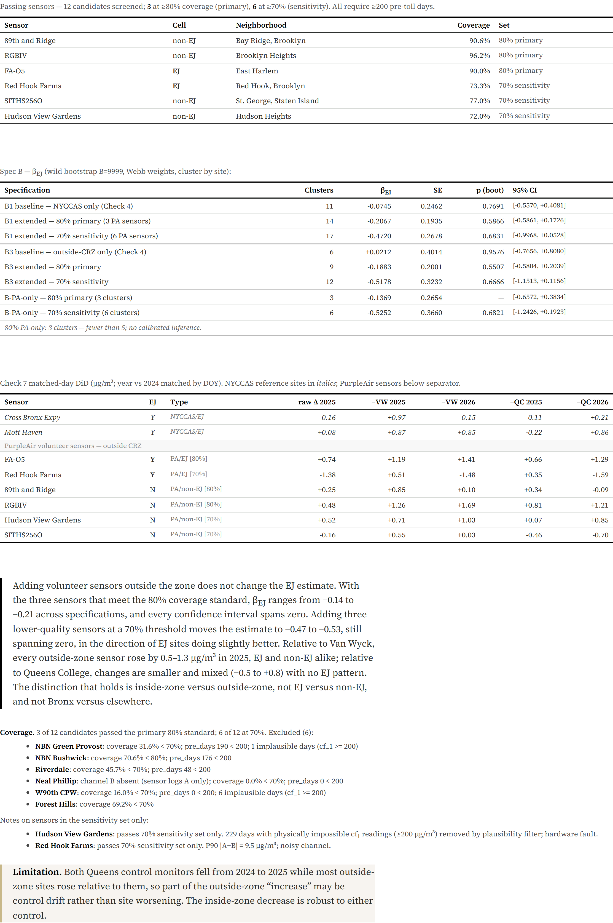
APPENDIX — not presented
ITS full results · Check 9 sensor QC · Limitations
Limitations
• Control drift: Van Wyck trend differs from QC by ~0.2 µg/m³ — choice of control shifts outside-zone estimates.
• PurpleAir coverage: three primary-set sensors (Bay Ridge, Brooklyn Heights, East Harlem); none in the Bronx outside NYCCAS.
• Nine pre-toll months at Mott Haven in the VW window (monitor online Apr 2024, nine months before the toll).
Notes:
ITS full table: all 11 sites, both specs (full and long-baseline), β_post, SE, p, 95% CI. Check 9 sensor QC: 12 PurpleAir candidates; 3 passed coverage gate for primary set (89th & Ridge Ave / Bay Ridge, RGBIV / Brooklyn Heights, FA_O5 / East Harlem). Key limitation: nine pre-toll months at Mott Haven in the VW window; long-baseline QC-only spec uses 2019 data but is exposed to COVID distortions.

