Slide 1

Autonomous Landing of NASA GTM Aircraft
Agah Enes SOYALP
Ebubekir DENİZHAN
Furkan ÇİFTLİKCİ
Assoc. Prof. İlker ÜSTOĞLU

Slide 2

Table of Contents
1. Introduction
2. Modelling of GTM Aircraft
3. Trim and Linearization
4. Aircraft Modes
5. Landing Phases
6. Open-Loop Analysis
7. Flight Controller Design
8. Simulation and Results
Figure 1: Overview of an aircraft from bottom

Slide 3
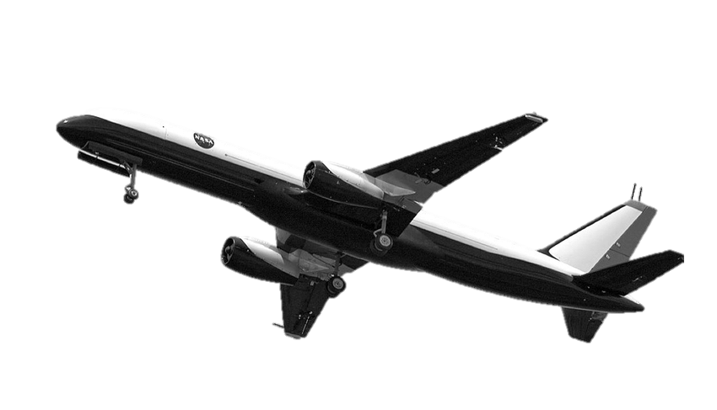

Introduction
Mathematical Modelling and Linearization
Controller Design
Simulation and Performance Analysis
Results and Evaluation
Figure 2: NASA GTM T-2 Model Aircraft
Figure 3: Accidents by phase of flight

Slide 4
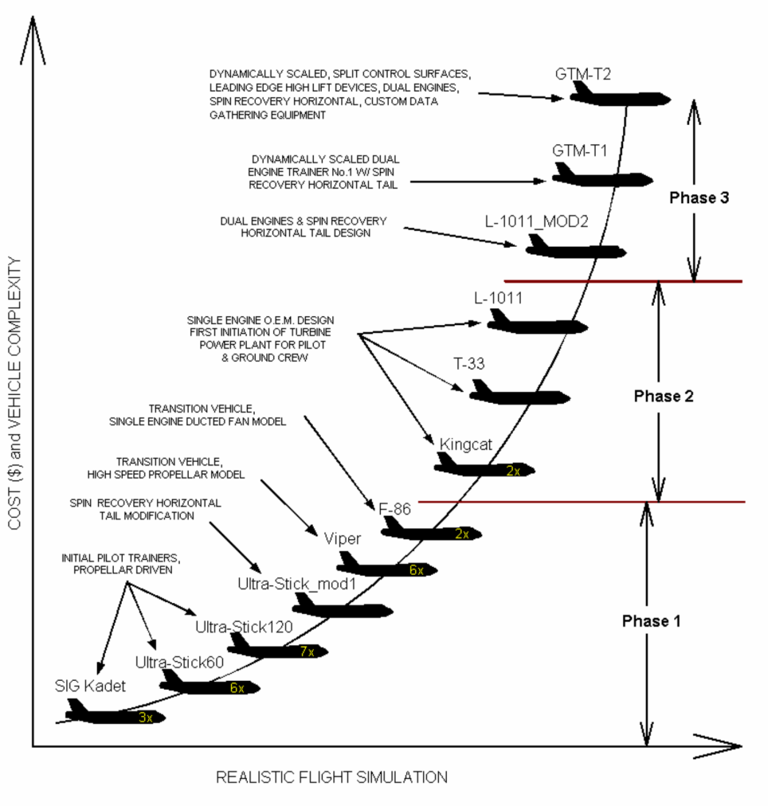
Modelling of GTM Aircraft
The most complex and expensive model!
The SIMULINK model is almost completely close to reality.
Flight Dynamics literature review!
Figure 5 & 6: SIMULINK Model of GTM T-2
Figure 4: All aircrafts developed for simulation

Slide 5
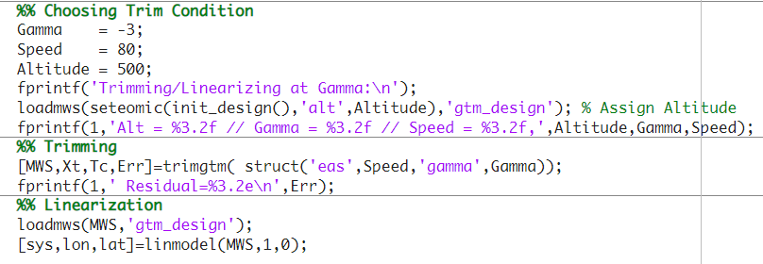
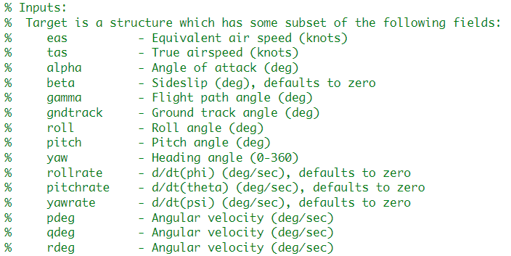
Trim and Linearization
Definition: A trim point of an Aircraft is the state where all resultant forces and moment are equalst to zero
Figure 7: Trim & Lineerization
Trim Conditions:
Straight and Level Flight
Pull-up / Push-over Maneuvers
Steady-state Turn
Steady Heading Sideslip

Slide 6
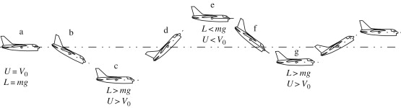
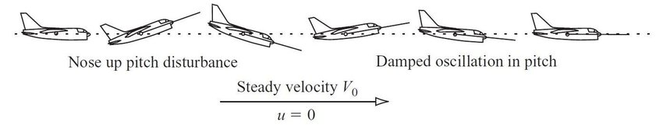
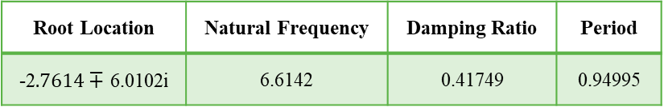
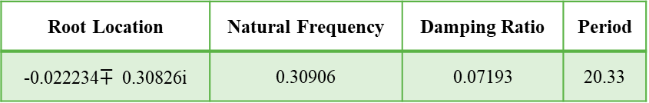
Aircraft Modes
Longitudinal Modes
Phudoid Mode
Short-Period Mode
Root Location | Natural Frequency | Damping Ratio | Period
-0.022234$∓$ 0.30826i | 0.30906 | 0.07193 | 20.33
Root Location | Natural Frequency | Damping Ratio | Period
-2$.7614∓$ 6.0102i | 6.6142 | 0.41749 | 0.94995
Figure 8: Phugoid Mode
Figure 9: Short-Period Mode

Slide 7
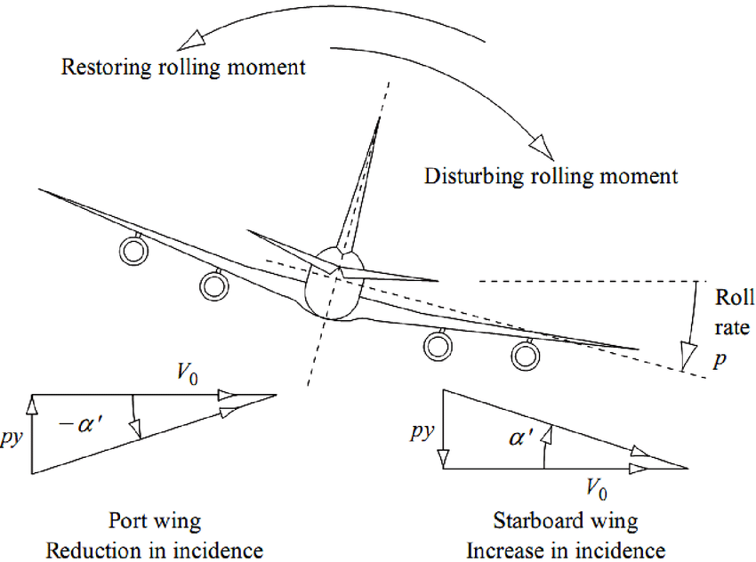
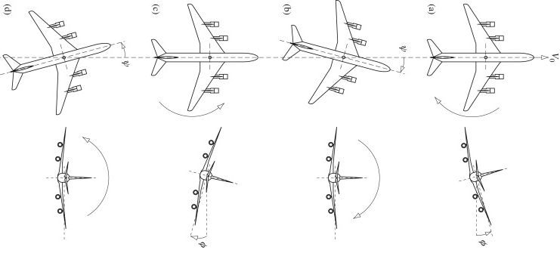
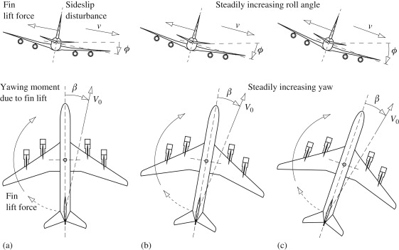
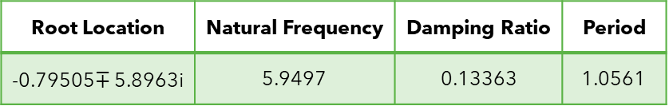
Aircraft Modes
Lateral Modes
Roll Mode
Root Location | Natural Frequency | Time Constant
-5.8107 | 5.8107 | 0.1721
Dutch-Roll Mode
Root Location | Natural Frequency | Damping Ratio | Period
-0.79505$∓$ 5.8963i | 5.9497 | 0.13363 | 1.0561
Spriral Mode
Root Location | Natural Frequency | Time Constant
-0.039425 | 0.039425 | 25.364
Figure 10: Lateral Modes

Slide 8
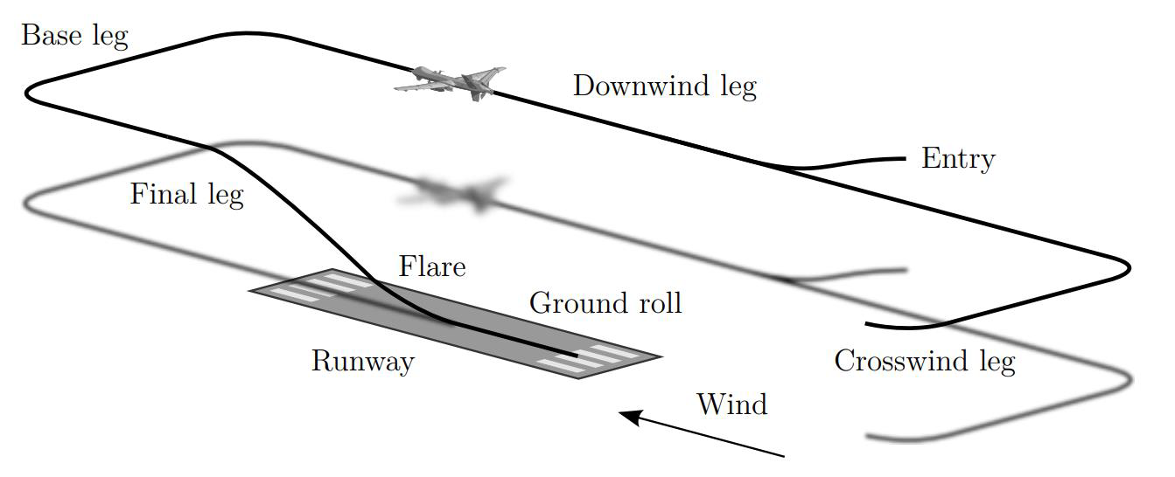
Landing Phases
Base Leg
Final Approach
Flare
Touchdown
Figure 11: Landing Phases

Slide 9
Open-Loop Analysis
Angular velocities and rates according to control surfaces doublets
Figure 12: Elevator - q - theta
Figure 13: Rudder - r - psi
Figure 14: Aileron – p - phi

Slide 10
Open-Loop Analysis
Linear velocities and rates according to control surfaces doublets
Figure 15: Elevator – u - v - w
Figure 16: Aileron – u – v - w
Figure 17: Rudder - u – v - w

Slide 11
Flight Controller Design
Longitudinal Controllers
Inner Loop, Pitch Attitude Hold
Outer Loop, Altitude Hold
True Airspeed (TAS) Control
Lateral Controllers
Inner Loop, Wing Leveler
Outer Loop, Heading Angle Hold
Sideslip Angle Control

Slide 12
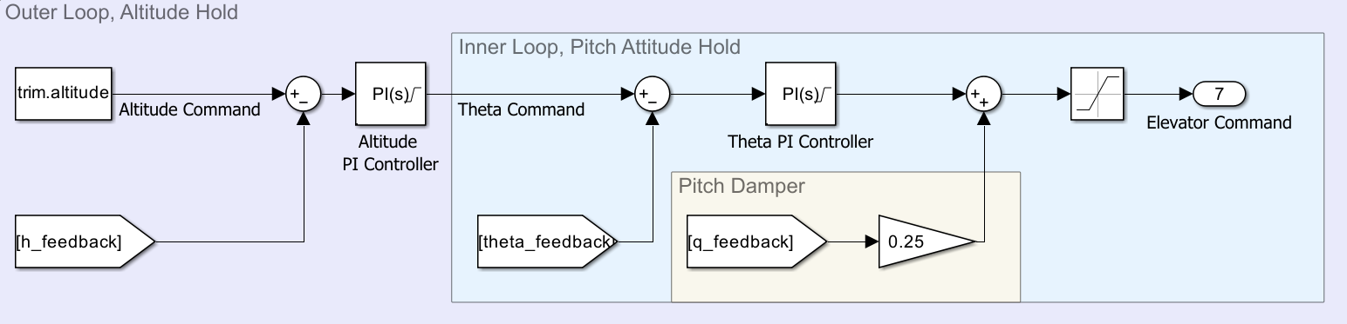
Altitude Controller
Figure 18: Longitudinal Controller

Slide 13
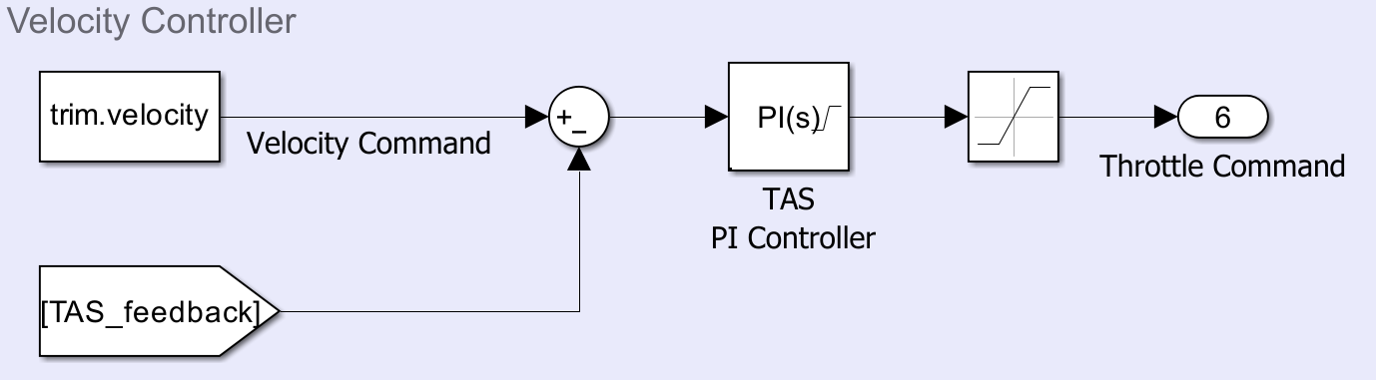
TAS Controller
Figure 19: True Airspeed Control

Slide 14
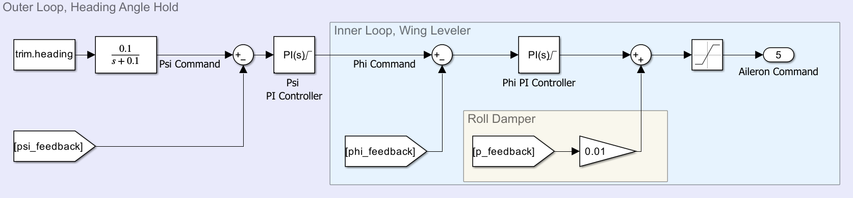
Heading Angle Controller
Figure 20: Lateral Controller

Slide 15
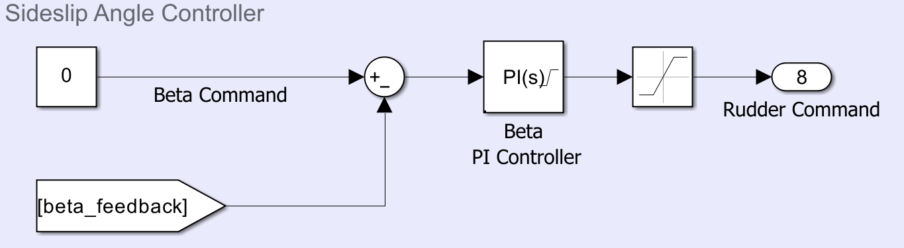
Sideslip Angle Controller
Figure 21: Sideslip Control

Slide 16
Simulation and Results
Base Leg
Heading Angle Arrangement
Speed Adjustment
Flaps Extension
Glide Phase
Flare Phase
Touchdown

Slide 17
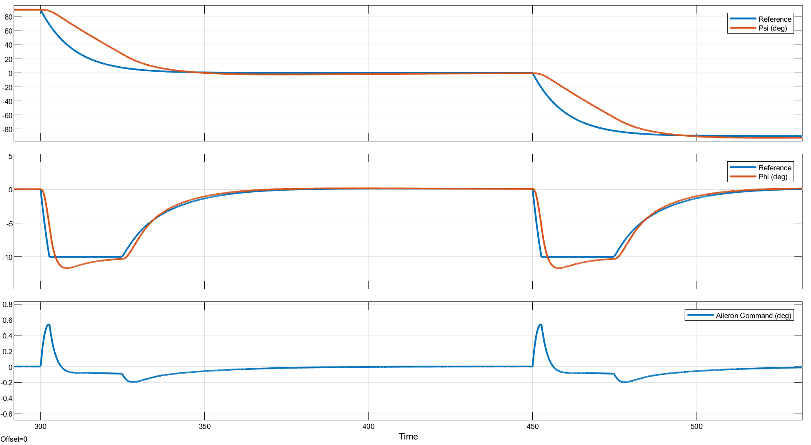
Heading Angle Arrangement
Figure 22: Lateral controller graphics during roll maneuver
Base Leg

Slide 18
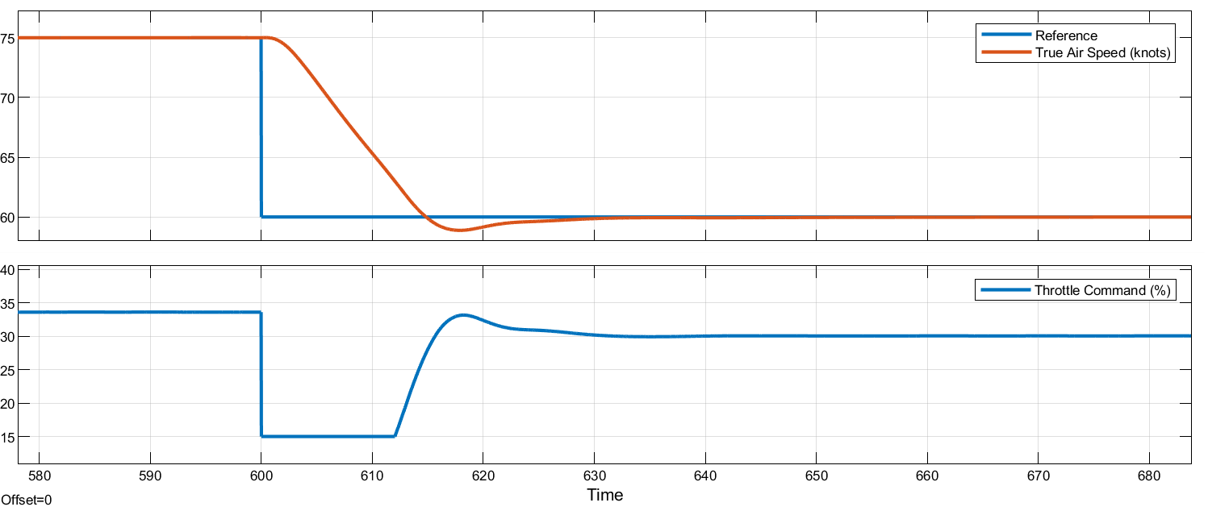
Speed Adjustment
Figure 23: Velocity controller graphics during speed adjustment
Base Leg

Slide 19
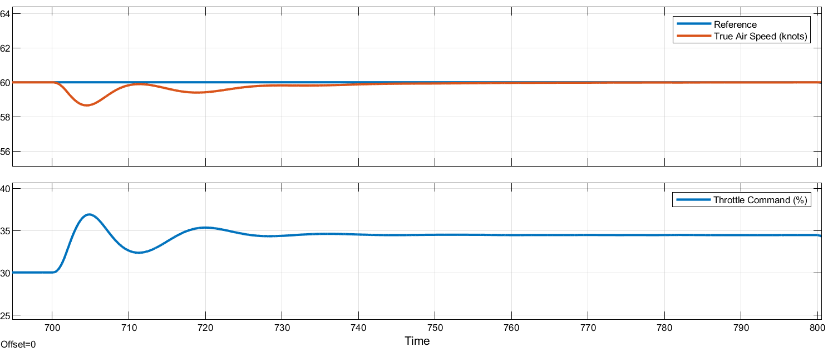
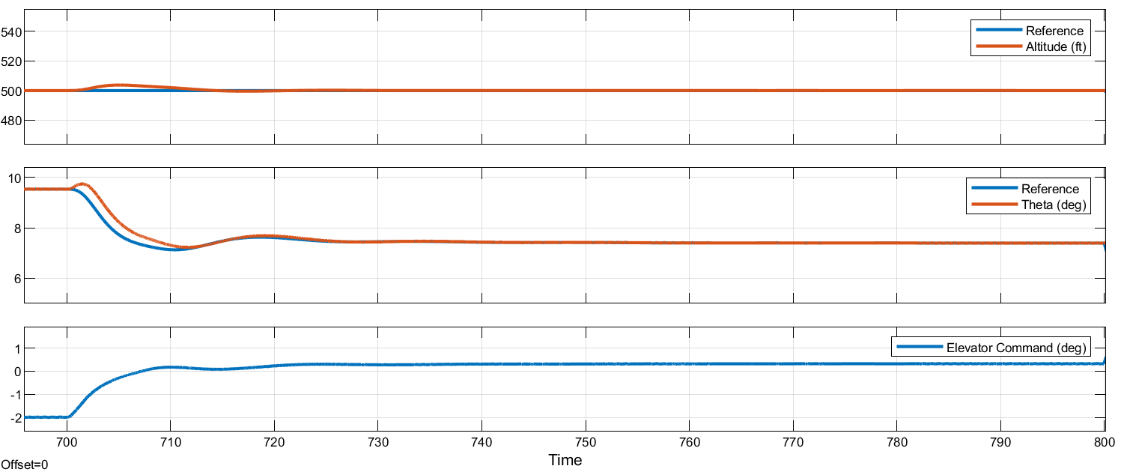
Flaps Extension - 15°
Figure 24: Velocity and longitudinal controller graphics during flaps extension
Base Leg

Slide 20
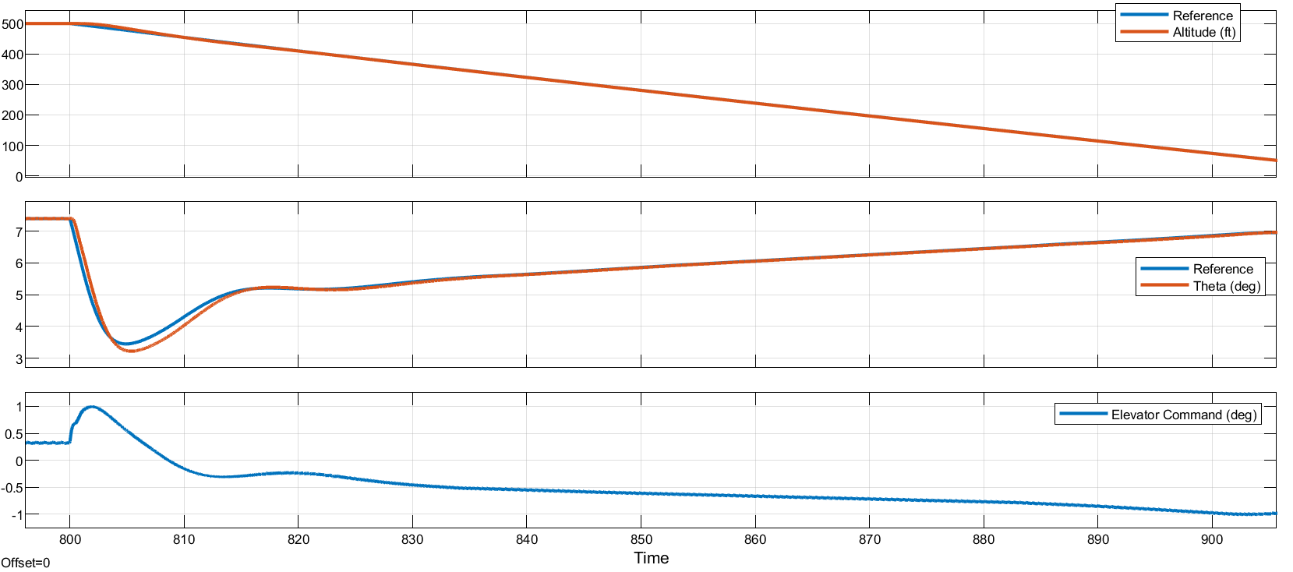
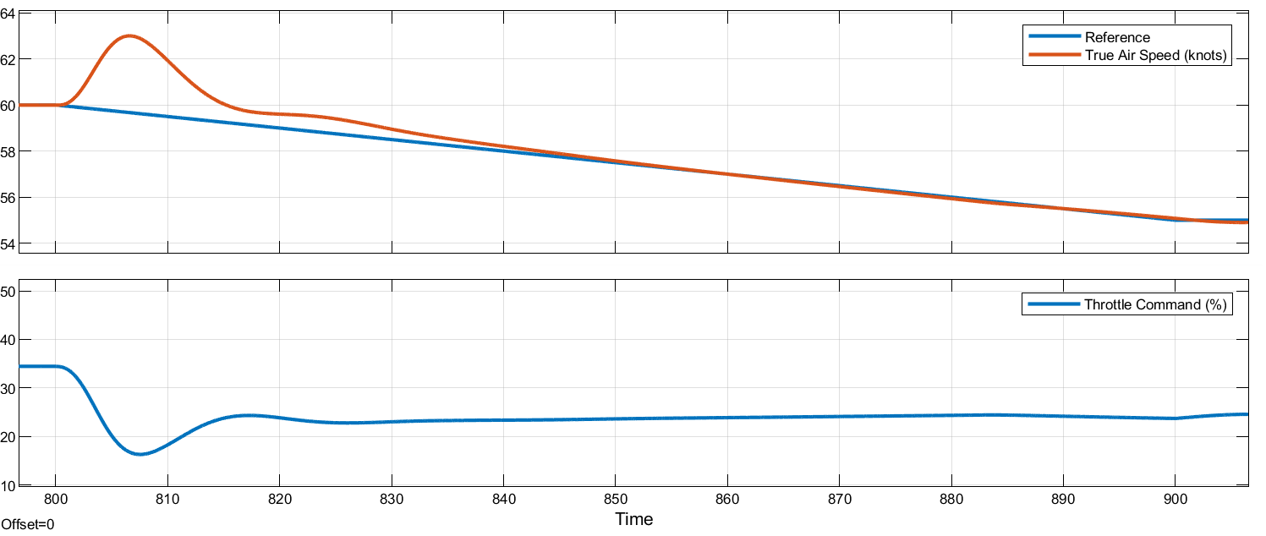
Glide Phase
Figure 25: Longitudinal and velocity controller graphics

Slide 21
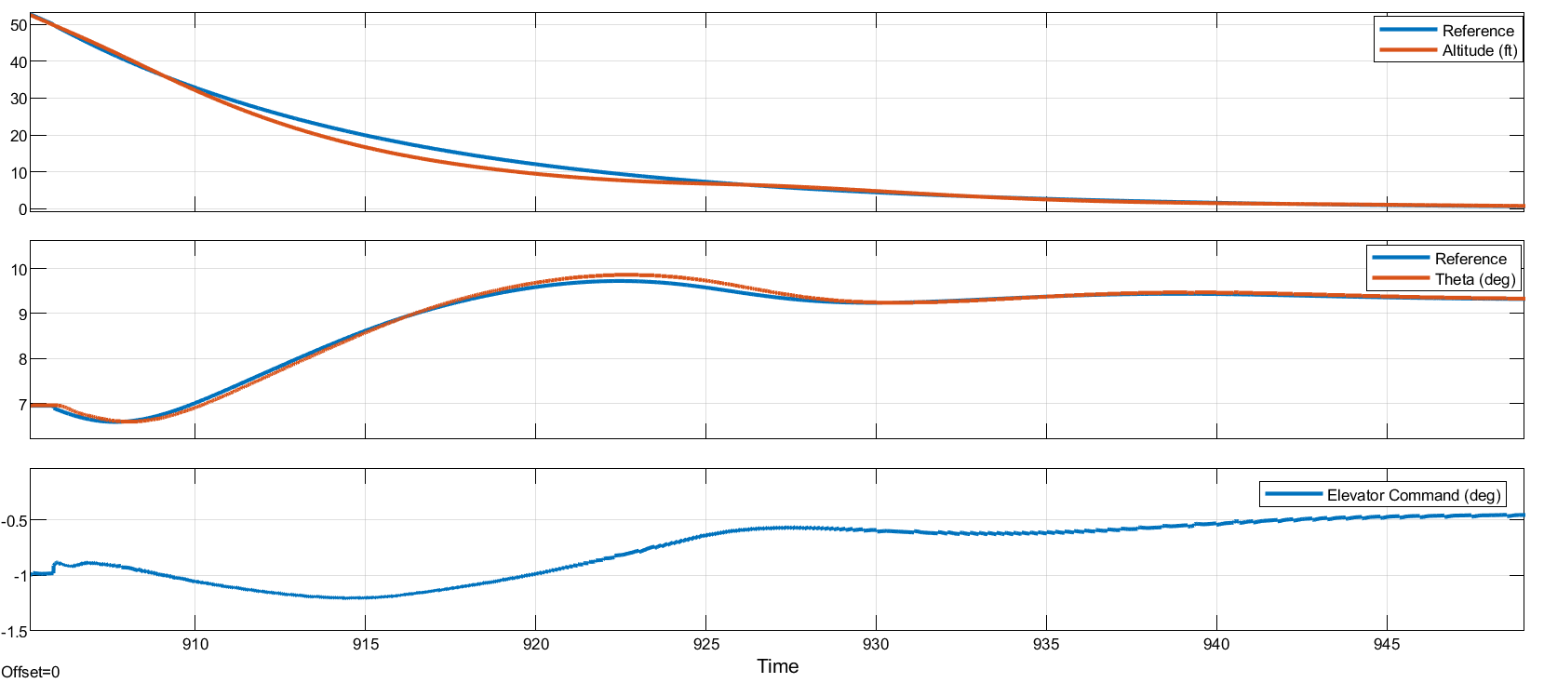
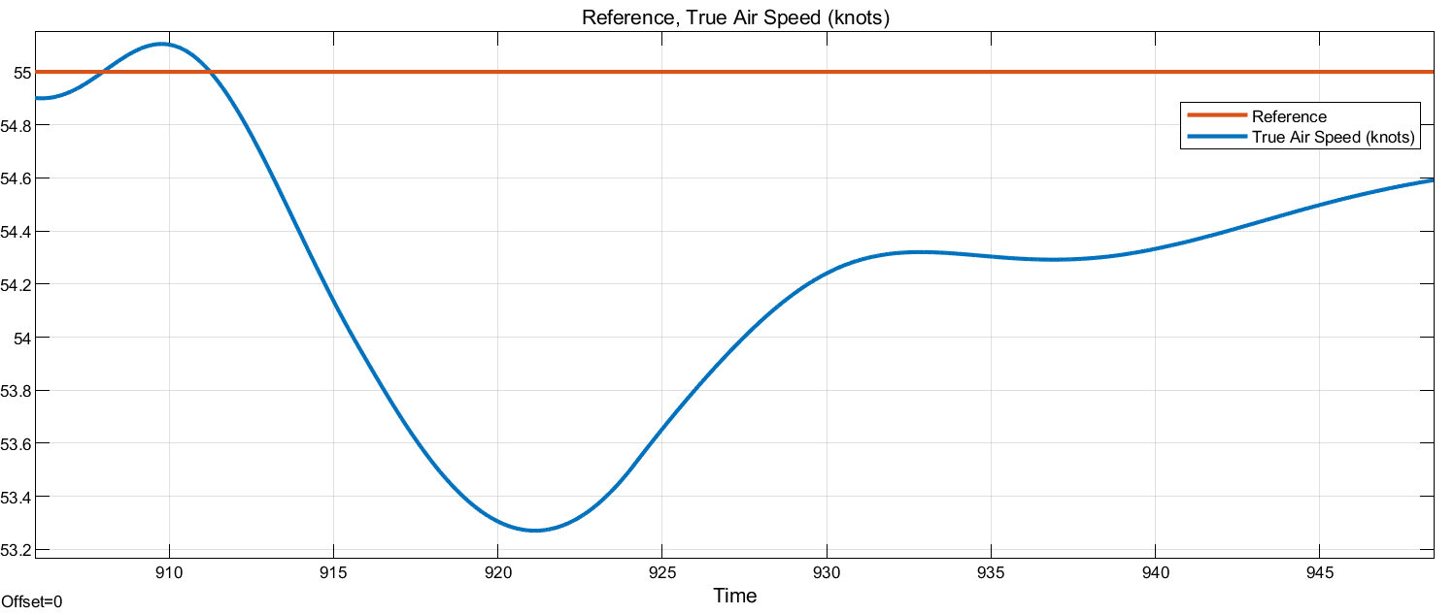
Flare Phase and Touchdown
Figure 26: Longitudinal and velocity controller graphics

Slide 22
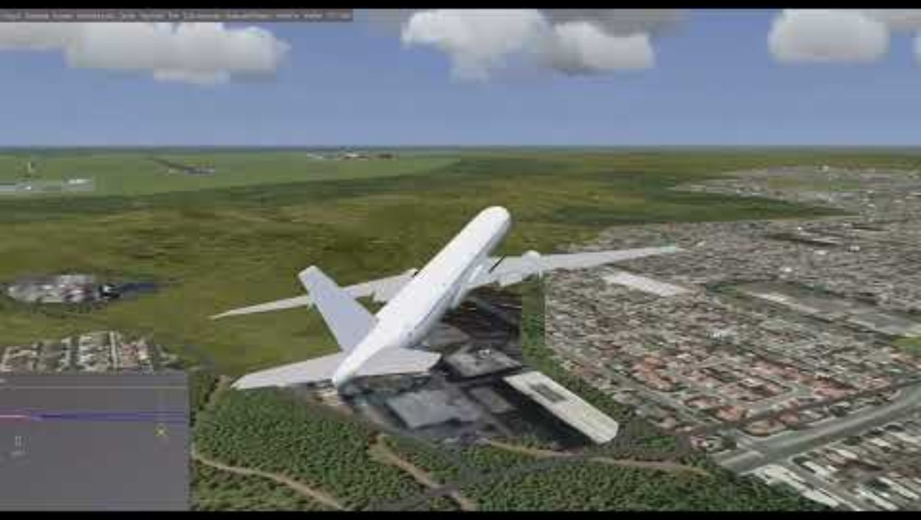
FlightGear

Slide 23

Thank you...
Agah Enes SOYALP
Ebubekir DENİZHAN
Furkan ÇİFTLİKCİ
Assoc. Prof. İlker ÜSTOĞLU

