Slide 1

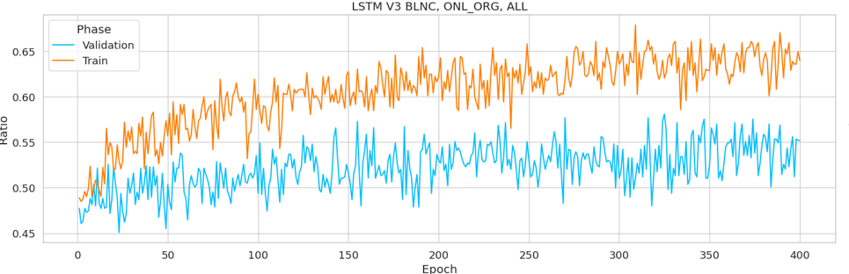
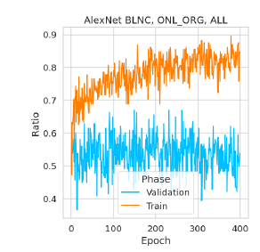
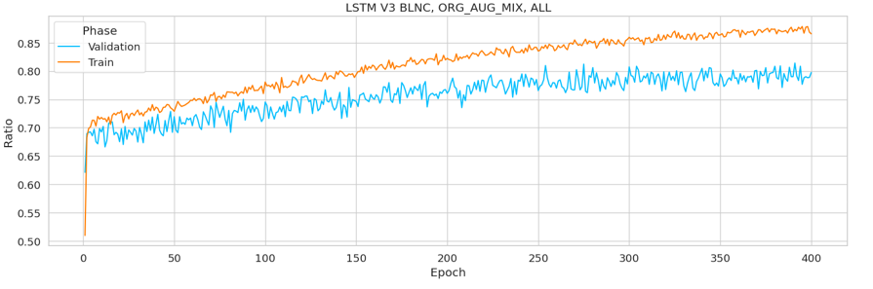
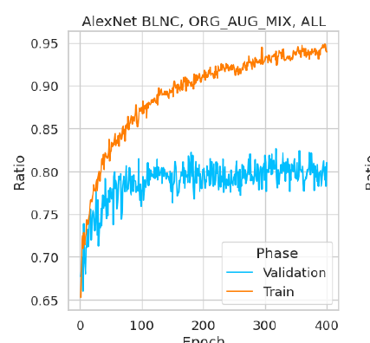
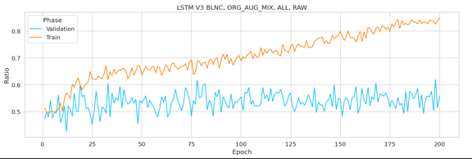
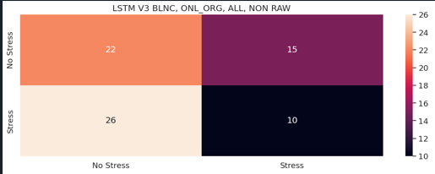
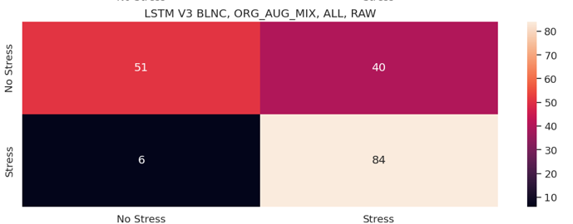
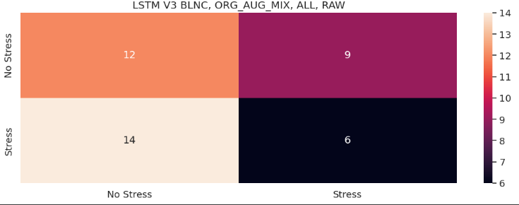
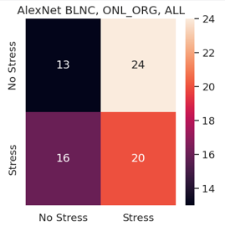
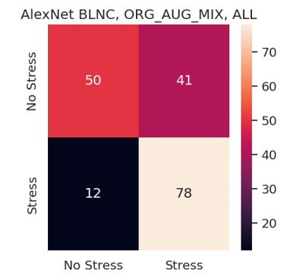
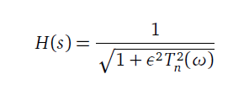
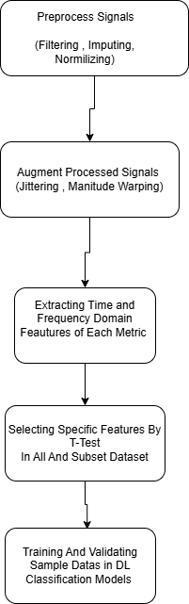
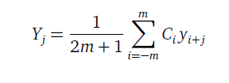
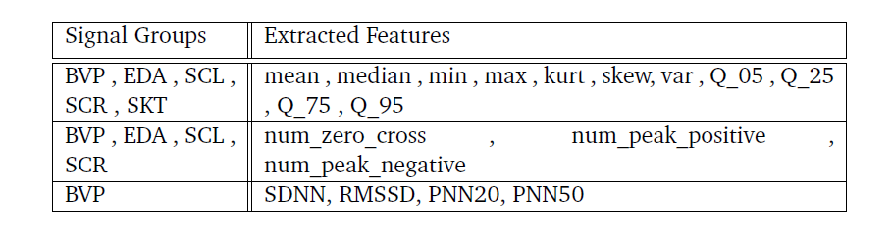
STRESS DETECTION IN PHYSIOLOGICAL SIGNALS OF NEURODIVERSE PEOPLE USING DEEP LEARNING METHODS
YILDIZ TECHNICAL UNIVERSITY
FACULTY OF ELECTRICAL AND ELECTRONICS
DEPARTMENT OF COMPUTER ENGINEERING
furkan.ercelebi@std.yildiz.edu.tr, irem@yildiz.edu.tr
Özet
Stresi ve çevresel tetikleyicilerini yönetmek, özellikle nöro-çeşitli çocuklarda terapistler ve psikologlar için büyük bir zorluktur. Stres durumlarını belirlemek zordur ve bu durumların ne zaman ve neden meydana geldiğini anlamak çok önemlidir. Erken tespit, zaman içinde fizyolojik kalıpları tanımaya dayanır. Stres, solunum hızı, terleme ve kalp hızı gibi bedensel değişikliklerle ölçülebilir. Bu sinyalleri sayısal verilere dönüştürmek, makine öğrenimi ve derin öğrenme teknikleri kullanılarak etkili bir şekilde işlenen kalıp tanımayı mümkün kılar. Bu çalışma, derin öğrenme yöntemlerini kullanarak nörotipik ve nöro-farklılığa sahip çocuklarda stres tanımayı araştırmaktadır. Performanslarını karşılaştırarak, stresi tespit etmek için en etkili yöntemi belirlemeyi ve daha iyi terapatik müdahalelere katkıda bulunmayı amaçlıyoruz.
III. Experimental Results
As seen below , train accuracy of two phase as train and validation and confusion matrix give different result and generally give low level of true-true result in Stress class. Possible reason is extracted features are not indicative to stress state . Same results also occure in raw time series of signal. Other possible reason is selecting samples more robust principle such as . Accuracy of validation change also unstable.
Abstract
Managing stress and its environmental triggers is a major challenge for therapists and psychologists, especially in neurodivergent children. Identifying stress states is difficult, making it crucial to understand when and why they occur. Early detection relies on recognizing physiological patterns over time. Stress is measurable through bodily changes like breathing rate, sweating, and heart rate. Converting these signals into numerical data enables pattern recognition, which is effectively handled using machine learning and deep learning techniques. This study explores stress recognition in neurotypical and neurodivergent children using deep learning methods. By comparing their performance, we aim to determine the most effective method for detecting stress, contributing to better therapeutic interventions.
I. Introduction / Giriş
Metabolic responses to environmental factors, such as stress, can be measured and are often linked to physiological reactions like increased heart rate and sweating, primarily regulated by the sympathetic nervous system. Recognizing stress states is valuable in therapeutic treatments, particularly for neurodiverse children, where assessing emotional stability during therapy is a key challenge. Automated detection using machine learning and human-computer interaction techniques, including interactive game systems with sensors, offers promising solutions for improving these treatments.
Figure 3 AlexNet Accuracy Results.
Figure 3 LSTM Accuracy Results.
Machine and deep learning methods are widely applied in pattern recognition, including stress detection and medical diagnostics like early cancer detection.As solution for taking early stress diagnose in this context is our goal. There are four number related works in stress detection that we eşll mention. First study is detecting drivers’s stress conditions by heart related physiologic signals using Machine Learning methods[2]. Second study is detecting pilot’s stress conditions by collecting heart and skin related physiologic signals using Deep Learning Methods[3]. Third study is detecting stress condition in interview session of autistic adults using Machine Learning methods[4]. Forth study is detecting stress conditions of children under playing therapeutic games by Machine Learning methods [1].
In comparing augmentation and original samples mixed in validation , validation change more stable and smooth and class distribution of true-true values in confusion matrix more high tha only original ones. This gives clear sign that original dataset has not sufficient sample for feature extracted dataset. On the other hand , in context of comparing between model , AlexNet is more quicker to reach top level accuracy than LSTM , but validation-train difference is more than LSTM. This is clear example of long term dependency in current and previous input of time-series sequence unlike simple forward propogation.
These result will be helpful for further analysis and system insight of developing stress detection . This models are trained in child with typical developed and neuro-diverged ones. So this model only restricted to identify stress in child group.
II. System Design
The study utilizes an existing dataset, incorporating three physiological signals (EDA, BVP, ST, and ACC) in a time-series format. The outputs consist of classification results (stress/no stress) and performance metrics like sensitivity, specificity, precision, and recall. The classification process is iterative, refining feature selection until an optimized set is determined, based on established criteria from prior studies [1]. Process flow is seeen in Figure 1.
BVP and EDA signals are filtered by sequentially Chebyshev II filter as seen in Formula 1 and Fifth Order Savitzky Golay filter as seen in Formula 2. For BVP , outliers are removed by Z-score , and replcade them by KNN Imputing in five number of neighbourhood. For BVP and EDA , Signals are normalized in range of 0 and 100.
Two augmentation method are used for insufficient original data and inbalanced class distribution. These are Jittering and Magnitude Warping. From original and augmented signals , metric general and metric specific specific features extracted as seen in Figure 2. These featurea are input as 1D array to Deep Learning models used in this study called AlexNet and LSTM.
Figure 6. Confusion Matrix Of LSTM.
Figure 5. Confusion Matrix Of AlexNet.
Conclusion / Sonuç
In result , with preprocessed , augmented and feature extracted physiological metrics dataset model accuracy give usefull result for investigating stress detection in deuro-diverged childs. Real results is less successfull than we excpected from start but this gives us information on how should evaluated in developing models. For future related studies , more sample must be collected and evaluted.
(1)
(2)
References
[1] B. Co¸skun, D. E. Barkana, ˙I. Uzun, H. Bostancı, and D. Tarakçı, “Classification of stress and participation using physiological signals of children during serious game-based therapy,” in 2023 Medical Technologies Congress (TIPTEKNO), IEEE, 2023, pp. 1–4.
[2] Y. Li, K. Li, J. Chen, S. Wang, H. Lu, and D. Wen, “Pilot stress detection through physiological signals using a transformer-based deep learning model,” IEEE Sensors Journal, vol. 23, no. 11, pp. 11 774–11 784, 2023.
[3] R. R. Singh, S. Conjeti, and R. Banerjee, “A comparative evaluation of neural network classifiers for stress level analysis of automotive drivers using physiological signals,” Biomedical Signal Processing and Control, vol. 8, no. 6, pp. 740–754, 2013.
[4] M. Migovich, D. Adiani, M. Breen, A. Swanson, T. J. Vogus, and N. Sarkar, “Stress detection of autistic adults during simulated job interviews using a novel physiological dataset and machine learning,” ACM Trans. Access. Comput.,vol. 17, no. 1, Mar. 2024, ISSN: 1936-7228. DOI: 10.1145/3639709.
[Online]. Available: https://doi.org/10.1145/3639709.
Figure 2
Figure 1

