Slide 1
Module 0 : Introduction
Digital Signal Controller
TMS320F2812
Texas Instruments Incorporated
European Customer Training Center
University of Applied Sciences Zwickau (FH)
Notes:
1

Slide 2
What is a Digital Signal Controller ?
Microprocessor (µP):
  Central Device of a multi chip Micro Computer System
  Two basic architectures:
    „Von Neumann“- Architecture
    „Harvard“ – Architecture
  „Von Neumann“ - Architecture:
    Shared memory space between code and data
    Shared memory busses between code and data
    Example: Intel‘s x86 Pentium Processor family
  „Harvard“ – Architecture:
    Two independent memory spaces for code and data
    Two memory bus systems for code and data
  A µP to operate needs additional devices

Slide 3
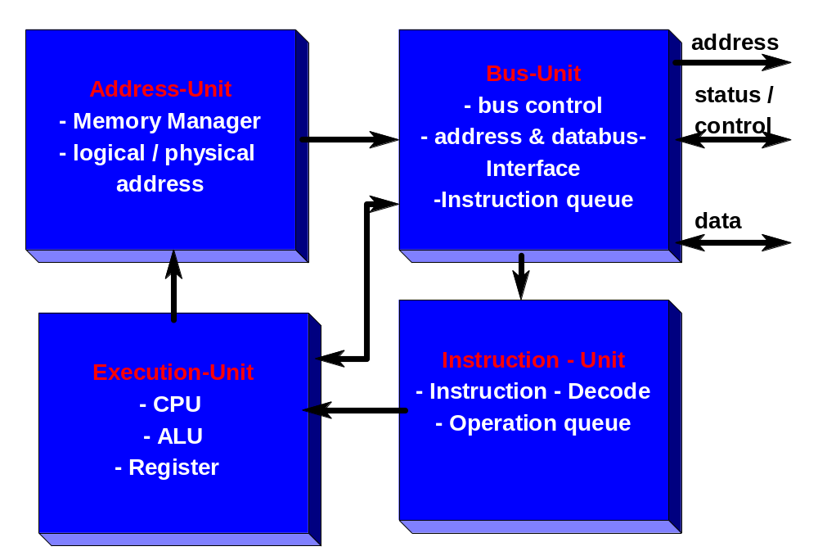
History (1984): Microprocessor Intel 80x86

Slide 4
Your Desktop – PC is a...
Micro Computer
  Micro Computer = Microprocessor(µP) + Memory + Peripherals
  Example: your Desktop -PC
Code - Memory
Data - Memory
Memory Bus
Clock
Microprocessor
Timer/Counter
Peripheral Bus
Digital In
Digital In
Analogue In
Analogue Out

Slide 5
Computer Peripherals
Peripherals include:
  Digital Input / Output Lines
  Analogue to Digital Converter (ADC)
  Digital to Analogue Converter (DAC)
  Timer / Counter units
  Pulse Width Modulation ( PWM) Output Lines
  Digital Capture Input Lines
  Network Interface Units:
    Serial Communication Interface (SCI) - UART
    Serial Peripheral Interface ( SPI)
    Inter Integrated Circuit ( I²C) – Bus
    Controller Area Network (CAN)
    Local Interconnect Network (LIN)
    Universal Serial Bus (USB)
    Local / Wide Area Networks (LAN, WAN)
  Graphical Output Devices
  and more …

Slide 6
System on Chip
Microcontroller (µC)
  Nothing more than a Micro Computer as a single silicon chip!
  All computing power AND input/output channels that are required to design a real time control system are „on chip“
  Guarantee cost efficient and powerful solutions for embedded control applications
  Backbone for almost every type of modern product
  Over 200 independent families of µC
  Both µP – Architectures („Von Neumann“ and „Harvard“) are used inside Microcontrollers

Slide 7
Digital Signal Processor
Digital Signal Processor (DSP)
  Similar to a Microprocessor(µP), e.g. core of a computing system
  Additional Hardware Units to speed up computing of sophisticated mathematical operations:
    Additional Hardware Multiply Unit(s)
    Additional Pointer Arithmetic Unit(s)
    Additional Bus Systems for parallel access
    Additional Hardware Shifter for scaling and/or multiply/divide by 2^{n}

Slide 8
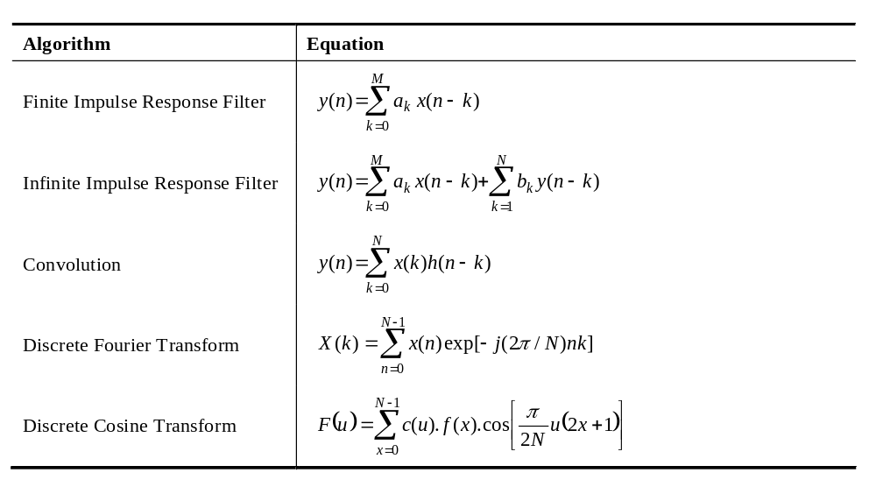
What are the typical DSP algorithms?
The Sum of Products (SOP) is the key element in most DSP algorithms:

Slide 9
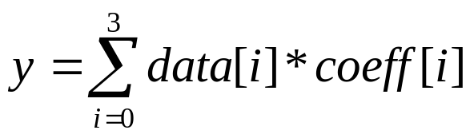
Doing a SOP with a µP
Task : use a Desktop - PC and code the equation into a common C-compiler system, e.g. Microsoft Visual Studio.Net
A C-Code Solution could look like this:
  #include <stdio.h>
  int data[4]={1,2,3,4};
  int coeff[4]={8,6,4,2};
  int main(void)
  {
  int i;
  int result =0;
  for (i=0;i<4;i++)
  result += data[i]*coeff[i];
  printf("%i",result);
  return 0;
  }

Slide 10
6 Basic Operations of a SOP
What will a Pentium be forced to do?
  Set a Pointer1 to point to data[0]
  Set a second Pointer2 to point to coeff[0]
  Read data[i] into core
  Read coeff[i] into core
  Multiply data[i]*coeff[i]
  Add the latest product to the previous ones
  Modify Pointer1
  Modify Pointer2
  Increment I;
  If i<3 , then go back to step 3 and continue
Steps 3 to 8 are called “6 Basic Operations of a DSP”
A DSP is able to execute all 6 steps in one single machine cycle!

Slide 11
SOP machine code of a µP
Address M-Code Assembly - Instruction
10: for (i=0;i<4;i++)
00411960 C7 45 FC 00 00 00 00 mov dword ptr [i],0
00411967 EB 09 jmp main+22h (411972h)
00411969 8B 45 FC mov eax,dword ptr [i]
0041196C 83 C0 01 add eax,1
0041196F 89 45 FC mov dword ptr [i],eax
00411972 83 7D FC 04 cmp dword ptr [i],4
00411976 7D 1F jge main+47h (411997h)
11: result += data[i]*coeff[i];
00411978 8B 45 FC mov eax,dword ptr [i]
0041197B 8B 4D FC mov ecx,dword ptr [i]
0041197E 8B 14 85 40 5B 42 00 mov edx,dword ptr[eax*4+425B40h]
00411985 0F AF 14 8D 50 5B 42 00 imul edx,dword ptr[ecx*4+425B50h]
0041198D 8B 45 F8 mov eax,dword ptr [result]
00411990 03 C2 add eax,edx
00411992 89 45 F8 mov dword ptr [result],eax
00411995 EB D2 jmp main+19h (411969h)

Slide 12
Doing a SOP with a DSP
Now: use a DSP-Development System and code the equation into a DSP C-compiler system, e.g. Texas Instruments Code Composer Studio
C-Code Solution is identical:
  int data[4]={1,2,3,4};
  int coeff[4]={8,6,4,2};
  int main(void)
  {
  int i;
  int result =0;
  for (i=0;i<4;i++)
  result += data[i]*coeff[i];
  printf("%i",result);
  return 0;
  }

Slide 13
DSP-Translation into machine code
Address MCode Assembly Instruction
0x8000 FF69 SPM 0
0x8001 8D04 0000R MOVL XAR1,#data
0x8003 76C0 0000R MOVL XAR7,#coeff
0x8005 5633 ZAPA
0x8006 F601 RPT #1
0x8007 564B 8781 || DMAC ACC:P,*XAR1++,*XAR7++
0x8009 10AC ADDL ACC,P<<PM
0x800A 8D04 0000R MOVL XAR1,#y
0x800B 1E81 MOVL *XAR1,ACC
Example: Texas Instruments TMS320F2812
Space : 12 Code Memory ; 9 Data Memory
Execution Cycles : 10 @ 150MHz = 66 ns

Slide 14
Digital Signal Controller (DSC)
Digital Signal Controller (DSC)
  recall: a Microcontroller(µC) is a single chip Microcomputer with a Microprocessor(µP) as core unit.
  Now: a Digital Signal Controller(DSC) is a single chip Microcomputer with a Digital Signal Processor(DSP) as core unit.
  By combining the computing power of a DSP with memory and peripherals in one single device we derive the most effective solution for embedded real time control solutions that require lots of math operations.
  DSC –Example: Texas Instruments C2000 family.

Slide 15
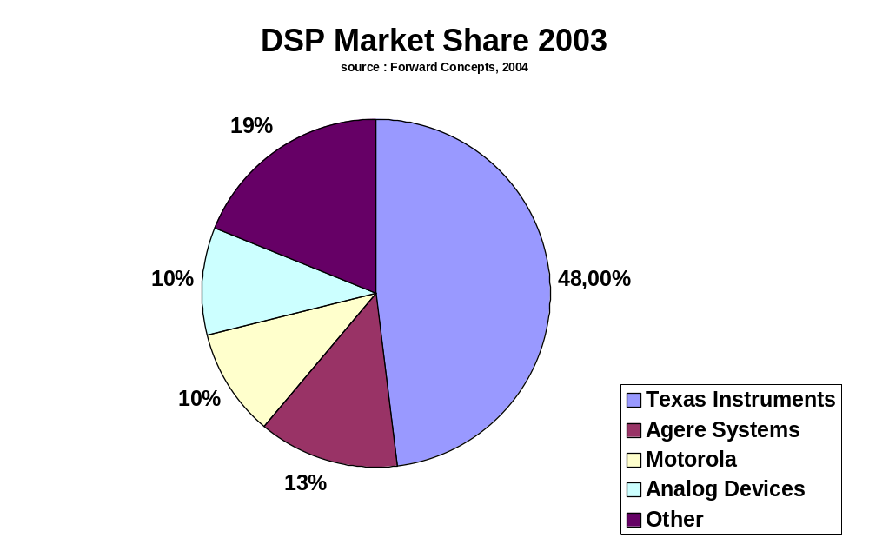
DSP Market Share in 2003
Total Revenue: 6,130 Million US-$

Slide 16
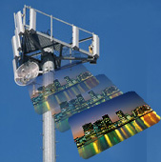
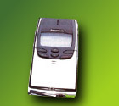
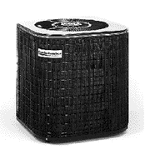
Texas Instruments DSP/DSC - Portfolio
TMS320 – Family Branches
C6000
C5000
C2000
High Performance
‘C’ Efficiency
DSP
Power Efficient
Performance
DSP
Efficient Integration
for Control
DSC

Slide 17
Texas Instruments’ TMS320 family
Different families and sub-families exist to support different markets.
C2000
C5000
C6000
Lowest Cost
Control Systems
Motor Control
Storage
Digital Ctrl Systems
Efficiency
Best MIPS per
Watt / Dollar / Size
Wireless phones
Internet audio players
Digital still cameras
Modems
Telephony
VoIP
Performance &
Best Ease-of-Use
Multi Channel and Multi Function App's
Comm Infrastructure
Wireless Base-stations
DSL
Imaging
Multi-media Servers
Video

Slide 18
Roadmap of TMS320C2000™ DSC’s
Software Compatible
Future of Control: Improved Industrial Drive, Improved System Density for ONET, etc.
Higher performance
Greater integration
High-Precision Uni-processor Control for Applications from Industrial Drives to Automotive
F2812
150 MIPS
R2812
150 MIPS
F2811
150 MIPS
C2812
150 MIPS
Control Performance
R2811
150 MIPS
F2810
150 MIPS
C2811
150 MIPS
C2810
150 MIPS
F2808
100 MIPS
Multi-Function, Appliance
& Consumer Control
F2801
100 MIPS
F2806
100 MIPS
F24x
LF240xA
Samples December 04
C24x
LC240xA
In Silicon
Announced

Slide 19
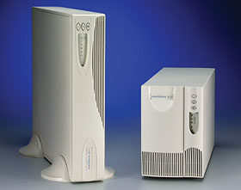

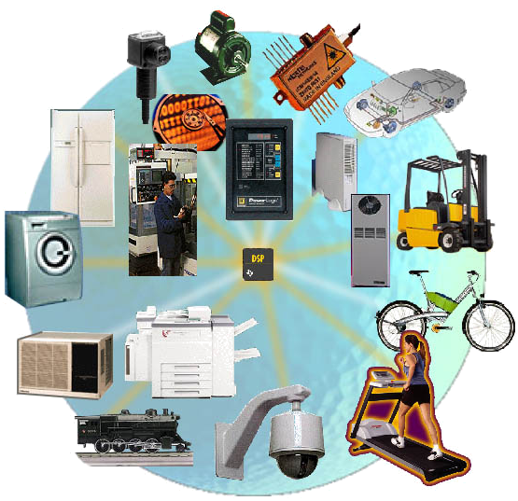


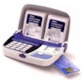
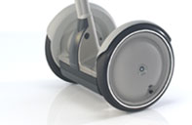

Broad C28x™ Application Base
Optical Networking
Control of laser diode
Digital Power Supply
Provides control, sensing, PFC, and other functions
Printer
Print head control
Paper path motor control
Evaluating
Other Segments e.g.. Musical Instruments
Non-traditional
Motor Control
Many new cool
applications to
come

Slide 20
TI C2000: Portfolio for Embedded Applications
F2812 F2810 LF2407A LF2406A LF2403A LF2402A LF2401A LC2406A LC2404A LC2402A LC2401A F243 F241 F240 C242
CPU
32bit 32 bit 16 bit 16 bit 16 bit 16 bit 16 bit 16 bit 16 bit 16 bit 16 bit 16 bit 16 bit 16bit 16bit
MIPS
150 150 40 40 40 40 40 40 40 40 40 20 20 20 20
RAM (words)
18K 18K 2.5K 2.5K 1.0K 1.0K 1.0K 2.5K 1.5K 544 1.0K 544 544 544 544
ROM (words)
32K 16K 6K 8K 4K
Flash (words)
128K 64K 32K 32K 16K 8K 8K 8K 8K 16K
BootROM (words)
4K 4K 256 256 256 256 256
Event Manager
CAP/QEP
6/6 6/6 6/4 6/4 3/2 3/2 1/0 6/4 6/4 3/2 1/0 3/2 3/2 4/2 3/2
TIMER
PWM(CMP)
16 16 16 16 8 8 7 16 16 8 7 8 8 12 8
TIMER
7 7 4 4 2 2 2 4 4 2 2 2 2 3 2
ADC
12-bit 12-bit 10-bit 10-bit 10-bit 10-bit 10-bit 10 bit 10-bit 10-bit 10-bit 10-bit 10-bit 10-bit 10-bit
Resolution
# ofChan
16 16 16 16 8 8 5 16 16 8 5 8 8 16 8
Conv time
200ns 200ns 500ns 500ns 500ns 500ns 500ns 375ns 375ns 425ns 500ns 900ns 900ns 6.1us 900ns
McBSP
EXMIF
Watch Dog
SPI
SCI (UART)
2 2 1 1 1 1 1 1 1 1 1 1 1 1 1
CAN
Volts (V)
1.8 core 1.8core 3.3 3.3 3.3 3.3 3.3 3.3 3.3 3.3 3.3 5.0 5.0 5.0 5.0
3.3 I/O 3.3 I/O
# I/O
56 56 41 41 21 21 13 41 41 21 13 32 26 28 26
Package
176LQFP 128LQFP 144LQPF 100LQPF 64LQFP 64PQFP 32LQFP 100LQFP 100LQFP 64PQFP 32LQFP 144LQFP 64PQFP 132PQFP 64PQFP
179u*BGA 68PLCC 68PLCC
Notes:
TI C2000 DSP product portfolio offers many derivatives from low end, low pin count, lost cost ROM versions all the way up to the new F2812 and F2810 32-bit flash devices.

