Slide 1

Module 7 : Serial Peripheral Interface C28x
32-Bit-Digital Signal Controller
TMS320F2812
Texas Instruments Incorporated
European Customer Training Centre
University of Applied Sciences Zwickau (FH)

Slide 2
SPI Data Flow
Simultaneous transmits and receive
SPI Master provides the clock signal
SPI Device #1 - Master
SPI Device #2 - Slave
shift
shift
SPI Shift Register
SPI Shift Register
clock

Slide 3
SPI Block Diagram
C28x - SPI Master Mode Shown
SPISIMO
RX FIFO_0
RX FIFO_15
SPIRXBUF.15-0
MSB
SPIDAT.15-0
LSB
SPISOMI
SPITXBUF.15-0
TX FIFO_0
TX FIFO_15
LSPCLK
baud
rate
clock
polarity
clock
phase
SPICLK

Slide 4
SPI Data Character Justification
Programmable data length of 1 to 16 bits
Transmitted data of less than 16 bits must be left justified
  MSB transmitted first
Received data of less than 16 bits are right justified
User software must mask-off unused MSB’s
SPIDAT - Processor #1
11001001XXXXXXXX
SPIDAT - Processor #2
XXXXXXXX11001001

Slide 5
SPI-A Registers
Address Register Name
0x007040 SPICCR SPI-A configuration control register
0x007041 SPICTL SPI-A operation control register
0x007042 SPISTS SPI-A status register
0x007044 SPIBRR SPI-A baud rate register
0x007046 SPIEMU SPI-A emulation buffer register
0x007047 SPIRXBUF SPI-A serial receive buffer register
0x007048 SPITXBUF SPI-A serial transmit buffer register
0x007049 SPIDAT SPI-A serial data register
0x00704A SPIFFTX SPI-A FIFO transmit register
0x00704B SPIFFRX SPI-A FIFO receive register
0x00704C SPIFFCT SPI-A FIFO control register
0x00704F SPIPRI SPI-A priority control register

Slide 6
SPI-A Configuration Control Register
SPICCR @ 0x007040
15-8
7
6
5-4
3
2
1
0
reserved
reserved
SPI CHAR.3-0
character length = number + 1
e.g. 0000b ⇒ length = 1
1111b ⇒ length = 16
CLOCK POLARITY
0 = rising edge data transfer
1 = falling edge data transfer
SPI SW RESET
0 = SPI flags reset
1 = normal operation

Slide 7
SPI-A Operation Control Register
SPICTL @ 0x007041
OVERRUN INT ENABLE
0 = disabled
1 = enabled
MASTER/SLAVE
0 = slave
1 = master
SPI INT ENABLE
0 = disabled
1 = enabled
15-5
4
3
2
1
0
reserved
CLOCK PHASE
0 = no CLK delay
1 = CLK delayed 1/2 cycle
TALK
0 = transmission disabled,
output pin hi-Z’d
1 = transmission enabled

Slide 8
SPI-A Baud Rate Register
SPIBRR @ 0x007044
Need to set this only when in master mode!
15-7
6-0
reserved
SPI BIT RATE
LSPCLK
(SPIBRR + 1)
, SPIBRR = 3 to 127
SPICLK signal =
LSPCLK
4
, SPIBRR = 0, 1, or 2

Slide 9
SPI-A Status Register
SPISTS @ 0x007042
15-8
7
6
5
4-0
reserved
reserved
TX BUF FULL (read only)
Set to 1 when char written
to SPITXBUF
Cleared when char in SPIDAT
SPI INT FLAG (read only)
Set to 1 when transfer completed
Interrupt requested if SPI INT ENA
bit set (SPICTL.0)
Cleared by reading SPIBRXUF
RECEIVER OVERRUN (read/clear only)
Set to 1 if next reception completes before SPIRXBUF read
Interrupt requested if OVERRUN INT ENA bit set (SPICTL.4)
Cleared by writing a 1

Slide 10
SPI-A FIFO Transmit Register
SPIFFTX @ 0x00704A
TX FIFO Status (read-only)
SPI FIFO
Enhancements
TX FIFO Reset
00000 TX FIFO empty
00001 TX FIFO has 1 word
00010 TX FIFO has 2 words
00011 TX FIFO has 3 words
10000 TX FIFO has 16 words
0 = reset (pointer to 0)
1 = enable operation
0 = disable
1 = enable
.
.
.
.
.
.
.
.
.
15
14
13
12
11
10
9
8
reserved
SPIFFEN
TXFIFO
RESET
TXFFST4
TXFFST3
TXFFST2
TXFFST1
TXFFST0
7
6
5
4
3
2
1
0
TXFFINT
TXFFINT
CLR
TXFFIEN
TXFFIL4
TXFFIL3
TXFFIL2
TXFFIL1
TXFFIL0
TX FIFO
Interrupt
Flag (read-only)
TX FIFO
Interrupt
Flag Clear
TX FIFO
Interrupt
(on match)
Enable
TX FIFO Interrupt Level
Interrupt when TXFFST4-0
and TXFFIL4-0 match
0 = not occurred
1 = occurred
0 = no effect
1 = clear
0 = disable
1 = enable

Slide 11
SPI-A FIFO Receive Register
SPIFFRX @ 0x00704B
RX FIFO Status (read-only)
RX FIFO
Overflow
Flag (read-only)
RX FIFO
Overflow
Flag Clear
RX FIFO Reset
00000 RX FIFO empty
00001 RX FIFO has 1 word
00010 RX FIFO has 2 words
00011 RX FIFO has 3 words
10000 RX FIFO has 16 words
0 = reset (pointer to 0)
1 = enable operation
0 = no overflow
1 = overflow
0 = no effect
1 = clear
.
.
.
.
.
.
.
.
.
15
14
13
12
11
10
9
8
RXFF-
OVF
RXFF-
OVF CLR
RXFIFO
RESET
RXFFST4
RXFFST3
RXFFST2
RXFFST1
RXFFST0
7
6
5
4
3
2
1
0
RXFFINT
RXFFINT
CLR
RXFFIEN
RXFFIL4
RXFFIL3
RXFFIL2
RXFFIL1
RXFFIL0
RX FIFO
Interrupt
Flag (read-only)
RX FIFO
Interrupt
Flag Clear
RX FIFO
Interrupt
(on match)
Enable
RX FIFO Interrupt Level
Interrupt when RXFFST4-0
and RXFFIL4-0 match
0 = not occurred
1 = occurred
0 = no effect
1 = clear
0 = disable
1 = enable

Slide 12
SPI Summary
Provides synchronous serial communications
  Two wire transmit or receive (half duplex)
  Three wire transmit and receive (full duplex)
Software configurable as master or slave
  C28x provides clock signal in master mode
Data length programmable from 1-16 bits
125 different programmable baud rates

Slide 13
SPI Example 1: DAC TLV 5617
Texas Instruments Digital to Analogue Converter (DAC) TLV 5617A
  10 MBPS SPI Data Communication
  Dual Channel Analogue Output ( Out A + B)
  10 Bit resolution
  /CS is connected to C28x GPIO – D0 at the Zwickau Adapter Board
  REF – Voltage defines Analogue Range / 2
  SOIC-8
  Operating Voltage : 0 to 3.3V

Slide 14
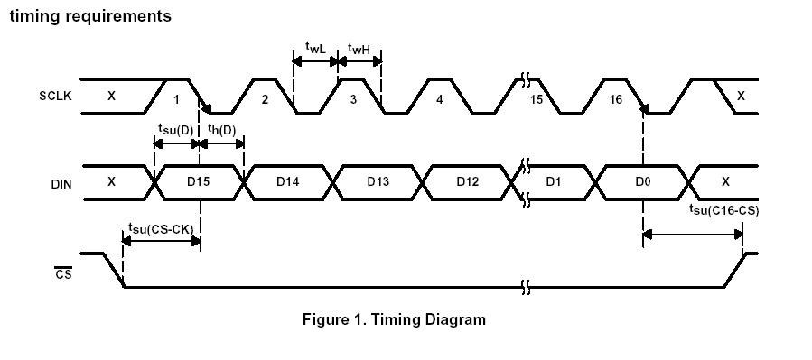
SPI Example : DAC TLV 5617
Timing Diagram:
© Texas Instruments SLAS234F – JULY 1999 – REVISED JULY 2002 ; page 6

Slide 15
SPI Example : DAC TLV 5617
Serial Data Format:
SPD
Speed Control
PWR
Power Control
0 = slow mode
1 = fast mode
0 = normal operation
1 = power down
15
14
13
12
11
10
9
8
R1
SPD
PWR
R0
DATA9
DATA8
DATA7
DATA6
7
6
5
4
3
2
1
0
DATA5
DATA4
DATA3
DATA2
DATA1
DATA0
0
0
R1 , R0 Register Select
00: Write to DACB and Buffer
01: Write to Buffer
10: Write to DACA and update
DACB with Buffer
11: reserved

Slide 16
Lab 7: DAC TLV 5617
Objective:
  Generate a rising saw-tooth (0V…3.3V) at channel OUTA and a falling saw-tooth (3.3V…0V) at channel OUTB
  GPIO – D0 is DAC’s chip select (/CS) at the Zwickau Adapter Board
  To measure the DAC outputs:
    Use JP7 for OUTA
    Use JP8 for OUTB ( Zwickau Adapter Board)
  REF = 3.3V
  Feedback the voltages into the C28x ADC:
    JP7 closed: OUTA ➔ ADCINA1
    JP8 closed: OUTB ➔ ADCINB1

Slide 17
SPI Example 2: EEPROM M95080
ST Microelectronics EEPROM M95080
  10 MBPS SPI Data Communication
  Capacity: 1024 x 8 Bit
  /CS is connected to C28x GPIO – D5 (Zwickau Adapter Board)
  6 Instructions:
    Write Enable, Write Disable
    Read Status Register, Write Status Register
    Read Data, Write Data
  SOIC-8
  Single Power Supply : 3.3V

Slide 18
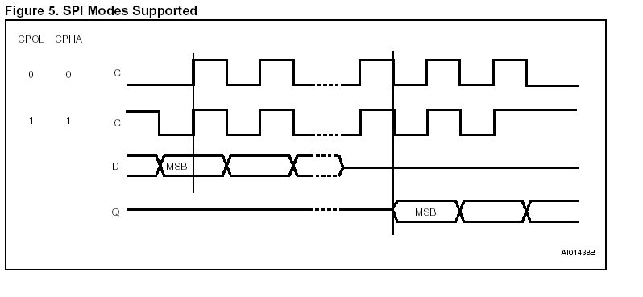
SPI Example : EEPROM M95080
Timing Diagram:
© ST Microelectronics Datasheet M95080 – November 2002, page 4

Slide 19
SPI Example : EEPROM M95080
M95080 Status Register:
7
6
5
4
3
2
1
0
SRWD
0
0
0
BP1
BP0
WEL
WIP
Block protect select
Write in progress
0 = no write cycle
1 = write in progress
00 = no protection
01 = 0x300 – 0x3FF protected
10 = 0x200 – 0x3FF protected
11 = 0x000 – 0x3FF protected
Write Enable Latch
Status Register Write Protect
1 = no write access to SR
0 = normal operation
0 = write disabled
1 = write enabled

Slide 20
SPI Example : EEPROM M95080
M95080 Instruction Set:
Instruction | Description | Code
WREN | Write Enable | 0000 0110
WRDI | Write Disable | 0000 0100
E | Read Status Register | 0000 0101
WDSR | Write Status Register | 0000 0001
READ | Read Data | 0000 0011
WRITE | Write Data | 0000 0010

Slide 21
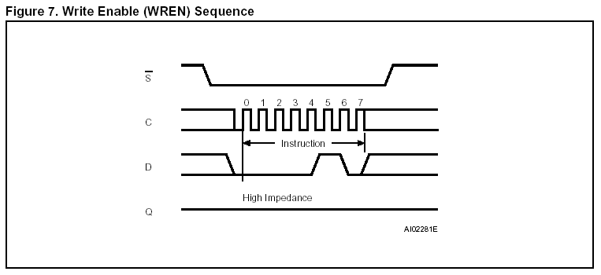
SPI Example : EEPROM M95080
Timing Diagram WREN:
© ST Microelectronics ; Datasheet (8028.pdf) – November 2002; Page 8

Slide 22
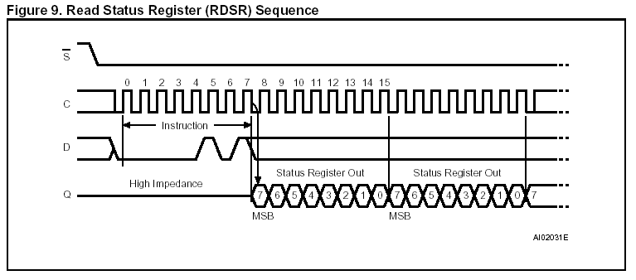
SPI Example : EEPROM M95080
Timing Diagram RDSR:
© ST Microelectronics ; Datasheet (8028.pdf) – November 2002; Page 10

Slide 23
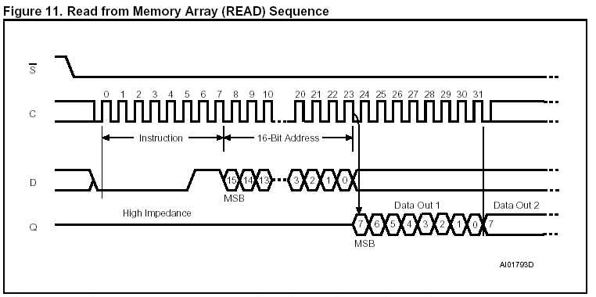
SPI Example : EEPROM M95080
Timing Diagram READ:
© ST Microelectronics ; Datasheet (8028.pdf) – November 2002; Page 13

Slide 24
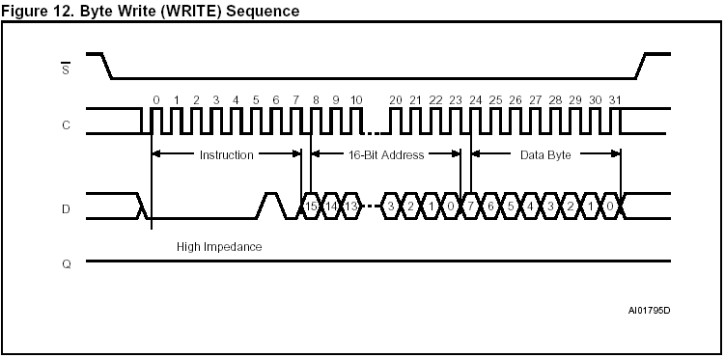
SPI Example : EEPROM M95080
Timing Diagram WRITE:
© ST Microelectronics ; Datasheet (8028.pdf) – November 2002; Page 14

Slide 25
Lab 7B: EEPROM M95080
Objective:
  Based on hardware of Zwickau Adapter Board
  Store the value of 8 input switches (GPIO – B15…B8) into EEPROM – Address 0x40 when command input button GPIO-D1 is pressed (low active).
  Read EEPROM-Address 0x40 and show its content on 8 LED’s ( GPIO-B7…B0) when command input button GPIO-D6 is pressed (low active).
  GPIO – D5 is EEPROM’s chip select (/CS) at the Zwickau Adapter Board

