Slide 1

Module 9 : Controller Area Network C28x
32-Bit-Digital Signal Controller
TMS320F2812
Texas Instruments Incorporated
European Customer Training Centre
University of Applied Sciences Zwickau (FH)

Slide 2
What is “CAN”
➔ what does CAN mean ?
it stands for : Controller Area Network
    it is a dedicated development of the automotive electronic industry
    it is a digital bus system for the use between electronic systems inside a car
    it uses a synchronous serial data transmission
➔ why is it important to know about CAN ?
among the car network systems it is the market leader
    it is the in car backbone network of BMW, Volkswagen , Daimler-Chrysler , Porsche and more manufacturers
    CAN covers some unique internal features you can’t find elsewhere..
    there is an increasing number of CAN-applications also outside the automotive industry

Slide 3
Why a car network like CAN?
➔ what are typical requirements of an in car network?
  low cost solution
  good and high performance with few overhead transmission
  high volume production in excellent quality
  high reliability and electromagnetic compatibility (EMC)
  data security due to a fail-safe data transmission protocol
  short message length, only a few bytes per message
  an ‘open system’
➔ what are customer demands ?
  reduce pollution
  reduce fuel consumption
  increase engine performance
  higher safety standards , active & passive systems
  add more & more comfort into car
    lots of electronic control units (ECU) necessary !!!
    lots of data communication between ECU’s.

Slide 4

ECU’s of a car
The number of microcontrollers inside a car :
break control ABS ( 1 + 4)
keyless entry system(1)
active wheel drive control (4)
engine control (2)
airbag sensor(6++)
seat occupation sensors(4)
automatic gearbox(1)
electronic park brake(1)
diagnostic computer(1)
driver display unit(1)
air conditioning system(1)
    adaptive cruise control(1)
radio / CD-player(2)
collision warning radar(2)
rain/ice/snow sensor systems (1 each)
dynamic drive control(4)
active damping system (4)
driver information system(1)
GPS navigation system(3)

Slide 5
Features of CAN
developed by Robert Bosch GmbH, Stuttgart in 1987
licensed to most of the semiconductor manufacturers
meanwhile included in most of the microcontroller-families
today the most popular serial bus for automotive applications
competitors are : VAN ( France) , J1850 ( USA) and PALMNET ( Japan)
a lot of applications in automation & control ( low level field bus)
Features :
    multi master bus access
    random access with collision avoidance
    short message length , at max. 8 Bytes per message
    data rates 100KBPS to 1MBPS
    short bus length , depending on data rate
    self-synchronised bit coding technology
    optimised EMC-behaviour
    build in fault tolerance
    physical transmission layers : RS485, ISO-high-speed(differential voltage), ISO-low-speed (single voltage), fibre-optic, galvanic isolated

Slide 6

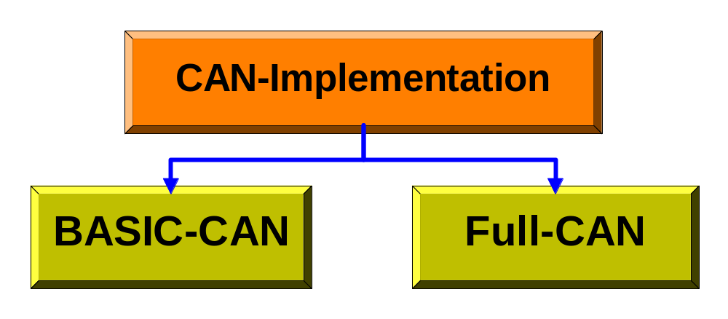
Implementation / Classification of CAN
The Implementation of CAN in Silicon
Don’t get confused !
Communication is identical for all implementations of CAN. However, there are two principal hardware implementations and two additional versions of data formats :

Slide 7


BASIC-CAN and FULL-CAN
Close loop between MCU-core and CAN
only one transmit buffer
only two receive buffer
only one filter for incoming messages
Software routines are needed to select between incoming messages
provide a message server
extensive acceptance filtering on incoming messages
user configurable mailboxes
mailbox memory area , size of mailbox areas depends on manufacturer
advanced error recognition

Slide 8


The Data Format of CAN
    CAN-Version 2.0A
    messages with 11-bit-identifiers
    CAN-Version 2.0B
    messages with 29-bit-identifiers
==> Suitably configured, each implementation ( BASIC or FULL) can handle both standard and extended data formats.

Slide 9
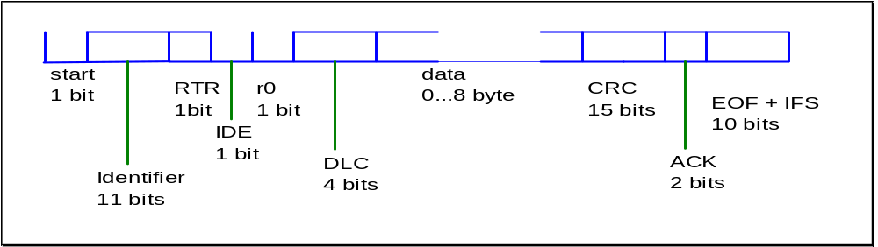
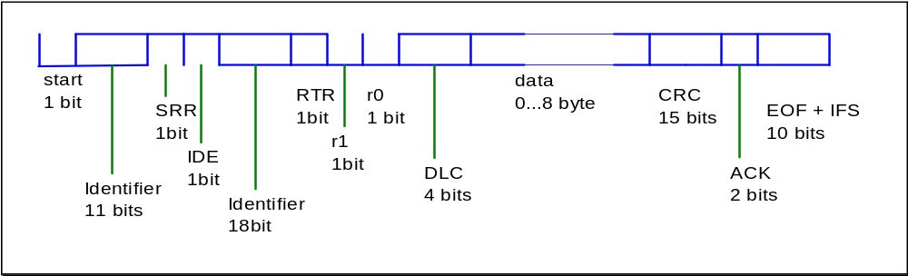
The CAN Data Frame (cont.)
DATA-Frame CAN 2.0A ( 11-bit-identifier )
DATA-Frame CAN 2.0B ( 29-bit-identifier )

Slide 10
The CAN Data Frame
each data frame consists of four segments :
(1) arbitration-field :
  denote the priority of the message
  logical address of the message ( identifier )
  Standard frame , CAN 2.0A : 11 bit-identifier
  Extended frame ( CAN 2.0B ) : 29 bit-identifier
(2) data field :
  up to 8 bytes per message ,
  a 0 byte message is also permitted
(3) CRC field:
  cyclic redundancy check ; contains a checksum generated by a CRC-polynomial
(4) end of frame field:
  contains acknowledgement , error-messages, end of message

Slide 11
The CAN Data Frame (cont.)
start bit (1 bit - dominant ): flag for the begin of a message; after idle-time falling-edge to synchronise all transmitters
identifier (11 bit) : mark the name of the message and its priority ;the lower the value the higher the priority
RTR (1 bit) : remote transmission request ; if RTR=1 ( recessive) no valid data’s inside the frame - it is a request for receivers to send their messages
IDE (1 bit) : Identifier Extension ; if IDE=1 then extended CAN-frame
r0 (1 bit) :reserved
CDL (4 bit) : data length code, code-length 9 to 15 are not permitted !
data (0..8 byte ) : the data’s of the message
CRC (15 bit ) : cyclic redundancy code ; only to detect errors, no correction ; hamming-distance 6 (up to 6 single bit errors )
ACK (2 bit) : acknowledge ; each listener, which receive a message without errors ( including CRC !) has to transmit an acknowledge-bit in this time-slot !!!
EOF (7 bit = 1 , recessive ) : end of frame ; intentional violation of the bit-stuff-rule ; normally after five recessive bits one stuff-bit follows automatically
IFS ( 3 bit = 1 recessive ) : inter frame space ; time space to copy a received message from bus-handler into buffer
Extended Frame only :
SRR (1 bit = recessive) : substitute remote request ; substitution of the RTR-bit in standard frames
r1 (1 bit ): reserved

Slide 12
The Automotive Classification of CAN
There are four classes of CAN-systems in use :
  Class A: chassis electronics, e.g. mirror adjust, light & bulb control
10 KBPS ; 1 data transmission line , chassis used for ground
  Class B: distribution of information, e.g. central driver-display; 40 KBPS
  Class C: real-time information exchange in and between control-loops e.g. engine-control( ignition, injection), brake-systems (ABS, ASR); dynamic drive control, damping ; steering-control ; 1 MBPS
  Class D: network with large number of data’s ( > 10KB/frame) , e.g. radio, telephone, navigation-systems

Slide 13
The Standardisation of CAN
The CAN is an open system
The European ISO has drafted equivalent standards
The CAN-Standards follow the ISO-OSI seven layer model for open system interconnections
In automotive communication networks only layer 1, 2 and 7 are implemented
Layer 7 is not standardised
The ISO-Standards :
CAN : ISO 11519 - 2 : layer 2 , layer 1 (top)
CAN : ISO 11898 : layer 1 (bottom)
VAN : ISO 11519 - 3 : layer 2 , layer 1
J1850 : ISO 11519 - 4 : layer 2 , layer 1

Slide 14
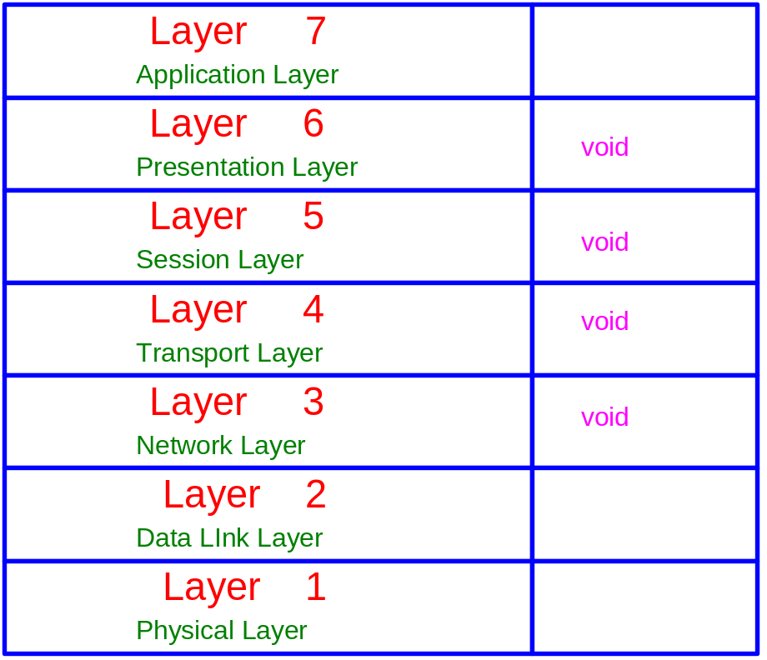
ISO Reference Model
Open Systems Interconnection (OSI):
Layer 1 : Interface to the transmission lines
  differential two-wire-line, twisted pair with/without shield
  IC's as integrated transceiver
  Optional fibre optical lines ( passive coupled star, carbon )
  Optional Coding : PWM, NRZ, Manchester Code
Layer 2 : Data Link Layer
  message format and transmission protocol
  CSMA/CA access protocol
Layer 7 : Application Layer
  a few different standards for industry, no for automotive
  but a must : interfaces for communication, network management and real-time operating systems

Slide 15
CAN Layer 7
1. CAN Application Layer (CAL):
  European CAN user group ”CAN in Automation (CiA)”
  originated by Philips Medical Systems 1993
  CiA DS-201 to DS-207
  standardised communication objects, -services and -protocols (CAN-based Message Specification)
  Services and protocols for dynamic attachment of identifiers (DBT)
  Services and protocols for initialise, configure and obtain the net (NMT)
  Services and protocols for parametric set-up of layer 2 &1 (LMT)
  Automation, medicine, traffic-industry
2. CAN Kingdom
    Swedish , Kvaser ;
    toolbox
    ”modules serves the net , not net serves for the modules”
    off-road-vehicles ; industrial control , hydraulics
3. OSEK/VDX
    European automotive industry , supplier standard
    include services of a standardised real-time-operating system

Slide 16
CAN Layer 7(cont.)
4. CANopen :
  European Community funded project “ESPRIT”
  1995 : CANopen profile :CiA DS-301
  1996 : CANopen device profile for I/O : CiA DS-401
  1997 : CANopen drive profile
  industrial control , numeric control in Europe
5. DeviceNet :
  Allen-Bradley, now OVDA-group
  device profiles for drives, sensors and revolvers
  master-slave communication as well as peer to peer
  industrial control , mostly USA
6. Smart Distributed Systems (SDS)
  Honeywell , device profiles
  only 4 communication functions , less hardware resources
  industrial control , PC-based control
  US-food industry
  Motorola 68HC05 with SDS on silicon available now
7. other profile systems
    J1939 US truck and bus industry
    LBS Agricultural bus system, Germany, DIN)
    M3S : European manufacturers of wheelchairs

Slide 17
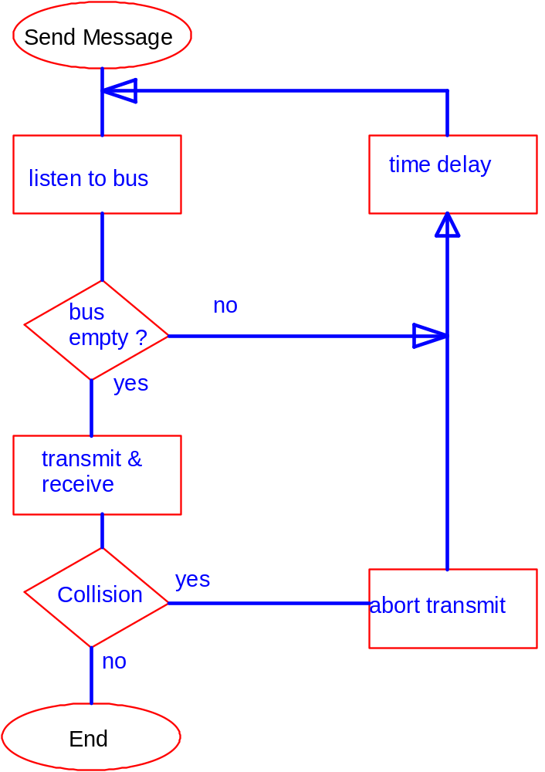
Bus Access Procedures
The “Ethernet” : CSMA / CD
CSMA /CD:
Carrier
    Sense
    Multiple
    Access with
    Collision
Detection
Note : This Procedure is NOT used for CAN !
Why ?

Slide 18
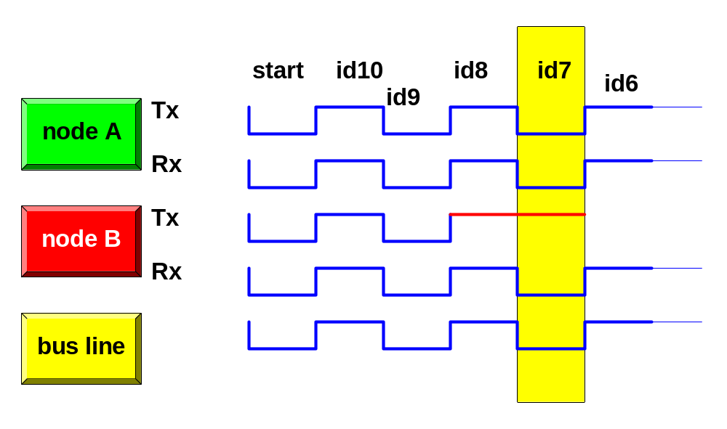
CAN Access Procedure: CSMA/CA
CSMA/ CA = Carrier Sense Multiple Access with Collision Avoidance
access-control with non destructive bit-wide arbitration
if there is a collision , ”the winner takes the bus”
the message with higher priority is not delayed !
real-time capability for high prioritised messages
the lower the identifier, the higher the priority

Slide 19
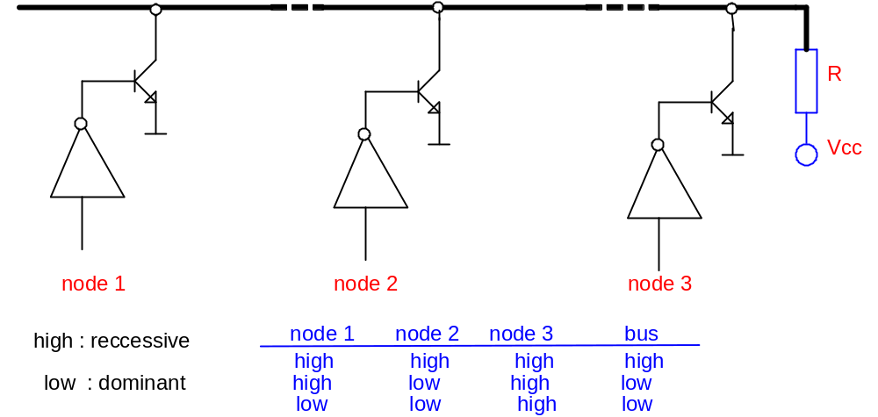
CSMA/CA (cont.)
CSMA / CA =
"bit - wide arbitration during transmission with simultaneous receiving and comparing of the transmitted message"
means :
  if there is a collision within the arbitration-field, only the node with the lower priority cancels its transmission.
  The node with the highest priority continues with the transmission of the message.

Slide 20
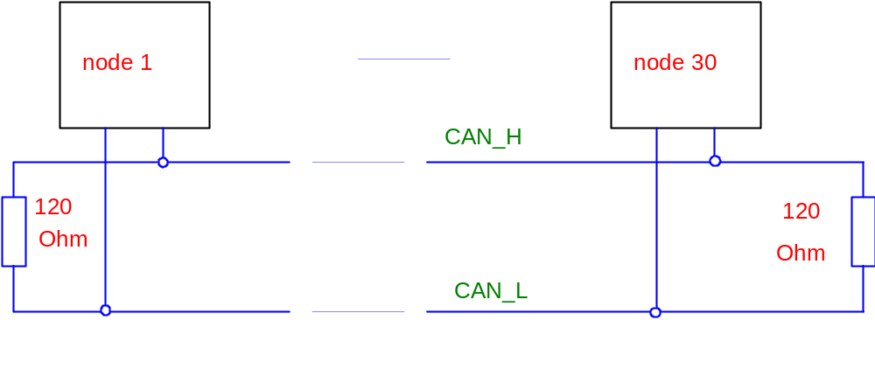
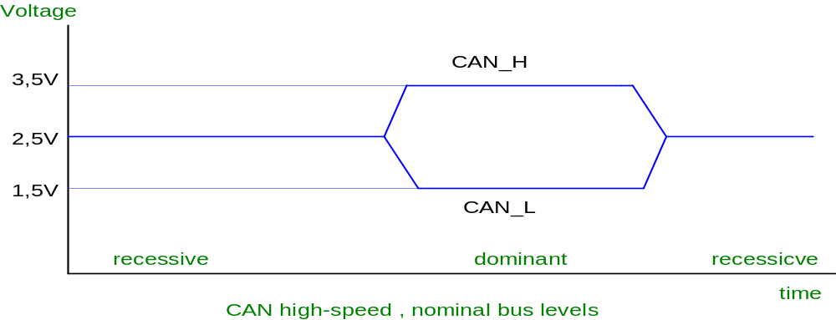
CAN Physical Layers
CAN - High - Speed ( ISO 11898 ) :

Slide 21
CAN High speed Node
DSP with on-chip
CAN module
Rxd
Txd
CAN Transceiver
SN65HVD23X
CAN_H
CAN_L
CAN BUS
Notes:
TI transceiver: SN75LBC031
- interfaces the single ended CAN controller with the differential CAN bus.
- transmission rate up to 1Mbit/s
2 states on the bus:
recessive: CAN_H = CAN_L = 2.5V
dominant: CAN_H = 3.5V and CAN_L = 1.5V

Slide 22
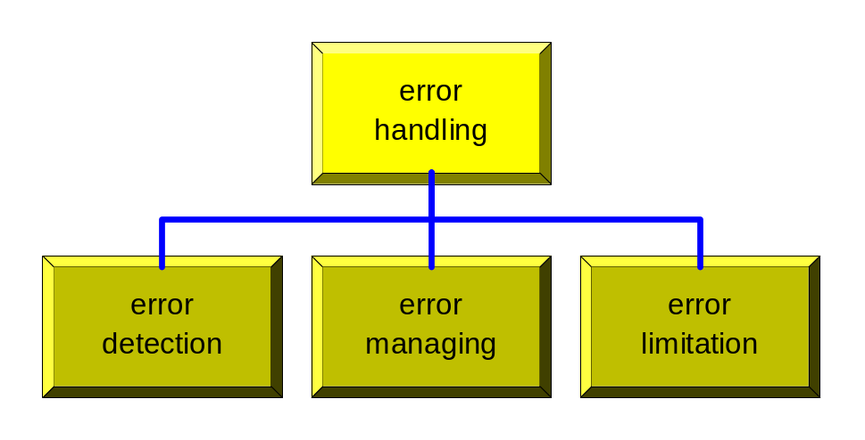
CAN Error & Exception Management
How does it work ?
  - most of errors should be detected and self-corrected by the CAN-Chip itself
  - automatic notification to all other nodes, that an error has been seen :
Error-Frame = deliberate violation of code-law’s )
    ( 6-bit dominant = passive error frame )
    ( 12-bit dominant = active error frame )
  - all nodes have to cancel the last message they have received
  - transmission is repeated automatically by the bus - handler

Slide 23
CAN Error Recognition
Bit-Error
  the transmitted bit doesn’t read back with the same digital level ( except arbitration and acknowledge- slot )
Bit-Stuff-Error
  more than 5 continuous bits read back with the same digital level ( except ‘end of frame’-part of the message )
CRC-Error
  the received CRC-sum doesn’t match with the calculated sum
Format-Error
  Violation of the data-format of the message , e.g.: CRC-delimiter is not recessive or violation of the ‘end -of-frame’-field
Acknowledgement-Error
  transmitter receives no dominant bit during the acknowledgement slot, i.e. the message was not received by any node.

Slide 24
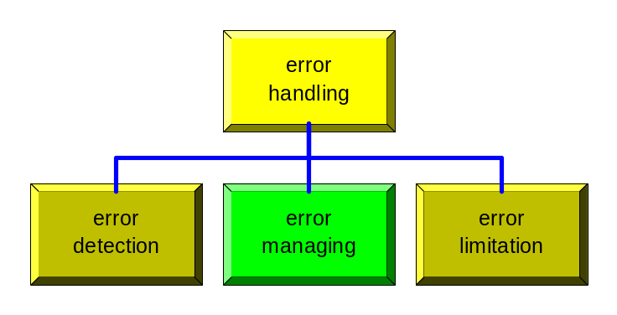

CAN Error Sequence
After detection of an error by a node every other node receives a particular frame , the Error -Frame :
This is the violation of the stuff-bit-rule by transmission of at least 6 dominant bits.
The Error-Frame causes all other nodes to recognise an Error Status of the bus.
Error Management Sequence :
error is detected
error-frame will be transmitted by all nodes, which have detected this error
The last message received will be cancelled by all nodes
Internal hardware error-counters will be increased
The original message will be transmitted again.

Slide 25
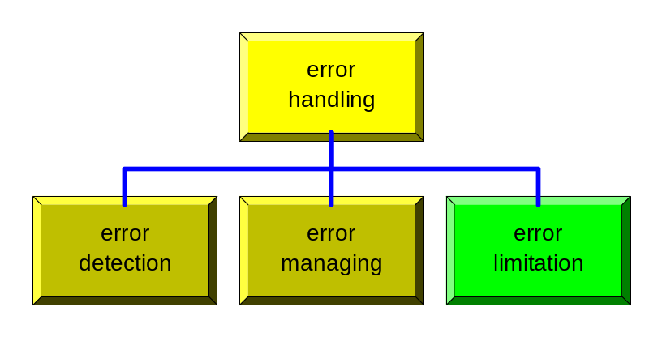
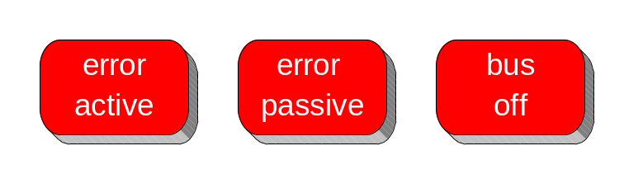
CAN Error Status
* Purpose: avoid persistent disturbances of the CAN by switching off defective nodes
* three Error States :
Error Active : normal mode, messages will be received and transmitted. In case of error an active error frame will be transmitted
Error Passive : after detection of a fixed number of errors , the node reaches this state. messages will be received and transmitted, in case of error the node sends a passive error frame.
Bus Off : the node is separated from CAN , neither transmission nor receive of messages is allowed, node is not able to transmit error frame’s .
leaving this state is only possible by reset !

Slide 26
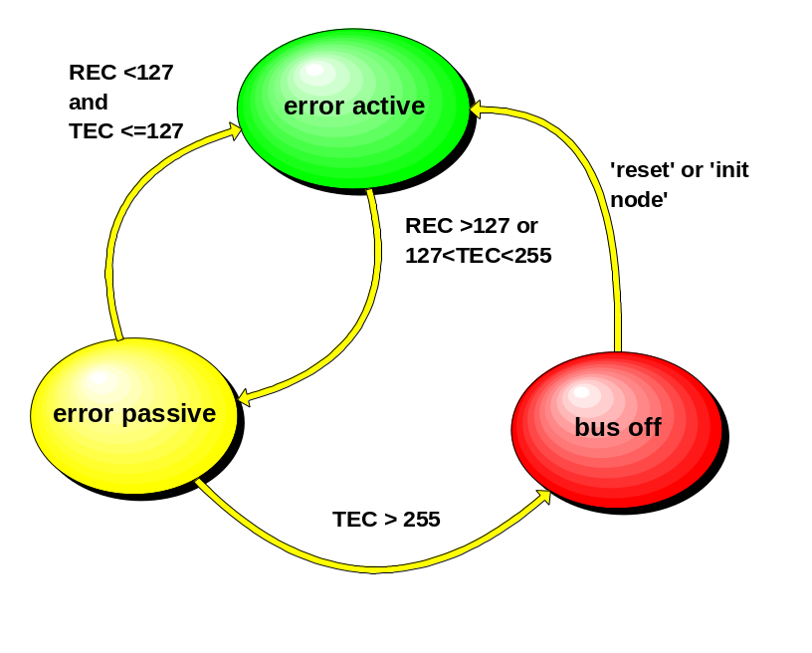
CAN Error Counter
State - Diagram :
transitions will be carried out automatically by the CAN-chip
states are managed by 2 Error Counters :
Receive Error Counter (REC)
Transmit Error Counter (TEC)
Possible situations :
a) a transmitter recognises an error:
TEC:=TEC + 8
b) a receiver sees an error : REC:=REC + 1
c) a receiver sees an error, after transmitting an error frame: REC:=REC + 8
d) if an ‘error active’-node find’s a bit-stuff-error during transmission of an error frame: TEC:=TEC+ 1
e) successful transmission: TEC:=TEC - 1
f) successful receive : REC:=REC - 1

Slide 27
C28x CAN Features
Fully CAN protocol compliant, version 2.0B
Supports data rates up to 1 Mbps
Thirty-two mailboxes
  Configurable as receive or transmit
  Configurable with standard or extended identifier
  Programmable receive mask
  Supports data and remote frame
  Composed of 0 to 8 bytes of data
  Uses 32-bit time stamp on messages
  Programmable interrupt scheme (two levels)
  Programmable alarm time-out
Programmable wake-up on bus activity
Self-test mode

Slide 28
CAN Block Diagram
Address
Data
eCAN0INT
eCAN1INT
32
Mailbox RAM
(512 Bytes)
32-Message Mailbox
of 4 x 32-Bit Words
Memory Management
Unit
CPU Interface,
Receive Control Unit
Timer Management Unit
eCAN Memory
(512 Bytes)
Register and Message
Object Control
32
32
32
Receive Buffer
Transmit Buffer
Control Buffer
Status Buffer
SN65HVD23x
3.3-V CAN Transceiver
.
.
CAN Bus

Slide 29
CAN Memory
Data Space
0x00 0000
Control and
Status Register
6040
Local
Acceptance
Masks
6080
Message
Object
Time Stamps
0x00 6000
CAN
0x00 61FF
60C0
Message
Object
Time Out
6100
Mailbox 0
6108
Mailbox 1
61FF
Mailbox 31
0x 3F FFFF

Slide 30
CAN Control & Status Register
31
0
31
0
6000
CANME
6020
CANGIM
6002
CANMD
6022
CANGIF1
6004
CANTRS
6024
CANMIM
6006
CANTRR
6026
CANMIL
6008
CANTA
6028
CANOPC
600A
CANAA
602A
CANTIOC
600C
CANRMP
602C
CANRIOC
600E
CANRML
602E
CANLNT
6010
CANRFP
6030
CANTOC
6012
CANGAM
6032
CANTOS
6014
CANMC
6034
reserved
6016
CANBTC
6036
reserved
6018
CANES
6038
reserved
601A
CANTEC
603A
reserved
601C
CANREC
603C
reserved
601E
CANGIF0
603E
reserved

Slide 31
CAN Mailbox Enable Register (CANME) – 0x006000
31
16
CANME[31:16]
15
0
CANME[15:0]
Mailbox Enable Bits
0 = corresponding mailbox is disabled
1 = The corresponding mailbox is enabled. A mailbox must be disabled before
writing to the contents of any mailbox identifier field.
CAN Mailbox Direction Register (CANMD) – 0x006002
31
16
CANMD[31:16]
15
0
CANMD[15:0]
Mailbox Direction Bits
0 = corresponding mailbox is defined as a transmit mailbox.
1 = corresponding mailbox is defined as a receive mailbox.

Slide 32
CAN Transmission Request Set Register (CANTRS) – 0x006004
31
16
CANTRS[31:16]
15
0
CANTRS[15:0]
Mailbox Transmission Request Set Bits (TRS)
0 = no operation. NOTE: Bit will be cleared by CAN-Module logic after successful transmission.
1 = Start of transmission of corresponding mailbox. Set to 1 by user software;
OR by CAN –logic in case of a Remote Transmit Request.
CAN Transmission Request Reset Register (CANTRR) – 0x006006
31
16
CANTRR[31:16]
15
0
CANTRR[15:0]
Mailbox Transmission Reset Request Bits (TRR)
0 = no operation.
1 = setting TRRn cancels a transmission request, if not currently being processed.

Slide 33
CAN Transmission Acknowledge Register (CANTA) – 0x006008
31
16
CANTA[31:16]
15
0
CANTA[15:0]
Mailbox Transmission Acknowledge Bits (TA)
0 = the message is not sent.
1 = if the message of mailbox n is sent successfully, the bit n of this register is set.
Note: To reset a TA bit by software: write a ‘1’ into it!!
CAN Abort Acknowledge Request Register (CANAA) – 0x00600A
31
16
CANAA[31:16]
15
0
CANAA[15:0]
Mailbox Abort Acknowledge Bits (AA)
0 = The transmission is not aborted.
1 = The transmission of mailbox n is aborted.
Note: To reset a AA bit by software: write a ‘1’ into it!!

Slide 34
CAN Receive Message Pending Register (CANRMP) – 0x00600C
31
16
CANRMP[31:16]
15
0
CANRMP[15:0]
Mailbox Receive Message Pending Bits (RMP)
0 = the mailbox does not contain a message.
1 = the mailbox contains a valid message.
Note: To reset a RMP bit by software: write a ‘1’ into it!!
CAN Receive Message Lost Register (CANRML) – 0x00600E
31
16
CANRML[31:16]
15
0
CANRML[15:0]
Mailbox Receive Message Lost Bits (RML)
0 = no message was lost.
1 = an old unread message has been overwritten by a new one in that mailbox.
Note: To reset a RML bit by software: write a ‘1’ into it!!

Slide 35
CAN Remote Frame Pending Register (CANRFP) – 0x006010
31
16
CANRFP[31:16]
15
0
CANRFP[15:0]
Mailbox Remote Frame Pending Bits (RFP)
0 = no remote frame request was received.
1 = a remote frame request was received by the CAN module.
Note: To reset a RFP bit by software: write a ‘1’ into the corresponding TRR bit!!

Slide 36
CAN Global Acceptance Mask Register (CANGAM) – 0x006012
31
30-29
28
16
AMI
reserved
CANGAM[28:16]
15
0
CANGAM[15:0]
Note : This Register is used in SCC mode only for mailboxes 6 to 15, if the AME bit (MID.30)
of the corresponding mailbox is set. It is a “don’t care” for HECC – Mode!
Acceptance Mask Identifier Bit (AMI)
0 = the identifier extension bit in the mailbox determines which messages shall be received.
Filtering is not applicable.
1 = standard and extended frames can be received. In case of an extended frame all 29 bits of the identifier
and all 29 bits of the GAM are used for the filter. In case of a standard frame only bits 28-18 of the identifier
and the GAM are used for the filter.
Note: The IDE bit of a receive mailbox is a “don’t care” and is overwritten by the IDE bit
of the transmitted message.
Global Acceptance Mask (GAM)
0 = bit position must match the corresponding bit in register CANMIDn.
1 = bit position of the incoming identifier is a “don’t’ care”.
Note: To reset a RFP bit by software: write a ‘1’ into the corresponding TRR bit!!

Slide 37
CAN Master Control Register (CANMC) – 0x006014
31
16
reserved
15
14
13
12
11
10
9
8
7
6
5
4
0
MBCC
TCC
SCB
CCR
PDR
DBO
WUBA
CDR
ABO
STM
SRES
MBNR
Change Configuration Request (CCR)
0 = software requests normal operation
1 = software requests write access to CANBTC, CANGAM, LAM[0] and LAM[3].
A request is granted by the CAN module with flag CCE ( CANES) = 1.
NOTE: SCC Mode only !
SCC Compatibility bit (SCB)
0 = SCC mode
1 = high end CAN (HECC) mode
Timestamp counter MSB clear (TCC)
0 = no operation
1 = timestamp counter MSB is reset to 0
Mailbox Timestamp counter clear (MBCC)
0 = no operation
1 = timestamp counter is reset to 0 after a successful transmission or reception of mailbox 16.

Slide 38
CAN Master Control Register (CANMC) – 0x006014 (cont.)
Power Down Mode Request (PDR)
0 = normal operation
1 = power down mode is requested.
NOTE: bit is automatically cleared
upon wakeup from power down!
Auto bus on (ABO)
0 = “bus off’ state is permanent.
1 = “bus off” state is left into “bus on”
after 128*11 recessive bits have been received.
Wake up on bus activity (WUBA)
0 = Module leaves power down only
after writing a 0 to PDR
1 = Module leaves power down on
any bus activity
Software Reset(SRES)
0 = no effect
1 = CAN Module reset
15
14
13
12
11
10
9
8
7
6
5
4
0
MBCC
TCC
SCB
CCR
PDR
DBO
WUBA
CDR
ABO
STM
SRES
MBNR
Mailbox Number(MBNR)
Number , used for CDR
Data Byte Order (DBO) in Mailbox Registers
MDH[31:0] and MDL[31:0]
0 = MDH[31:0] : Byte 4,5,6,7 ; MDL[31:0] : Byte 0,1,2,3
1 = MDH[31:0] : Byte 7,6,5,4 ; MDL[31:0] : Byte 3,2,1,0
Change data field request (CDR)
0 = normal operation
1 = software requests access to the data field in 2MBNR”.
NOTE: software must clear this bit after access is done.
Self Test Mode (STM)
0 = normal mode
1 = Module generates its own ACK

Slide 39
CAN Bit-Timing Configuration
CAN protocol specification splits the nominal bit time into four different time segments:
  SYNC_SEG
    Used to synchronize nodes
    Length : always 1 Time Quantum (TQ)
  PROP_SEG
    Compensation time for the physical delay times within the net
    Twice the sum of the signal’s propagation time on the bus line, the input comparator delay and the output driver delay.
    Programmable from 1 to 8 TQ
  PHASE_SEG1
    Compensation for positive edge phase shift
    Programmable from 1 to 8 TQ
  PHASE_SEG2
    Compensation time for negative edge phase shift
    Programmable from 2 to 8 TQ

Slide 40
CAN Bit-Timing Configuration
CAN Nominal Bit Time
SYNCSEG
sjw
sjw
tseg1
tseg2
TQ
Transmit Point
Sample Point
tseg1 : PROP_SEG + PHASE_SEG1
tseg2 : PHASE_SEG2
TQ : SYNCSEG
CAN Nominal Bit Time = TQ + tseg1 + tseg2

Slide 41
CAN Bit-Timing Configuration
According to the CAN – Standard the following bit timing rules must be fulfilled:
  tseg1 ≥ tseg2
  3/BRP ≤ tseg1 ≤ 16 TQ
  3/BRP ≤ tseg2 ≤ 8 TQ
  1 TQ ≤ sjw ≤ MIN[ 4*TQ , tseg2]
  BRP ≥ 5 ( if three sample mode is used)

Slide 42
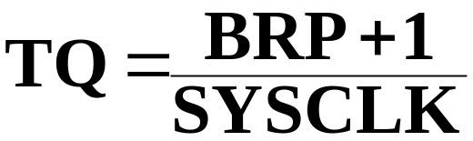
CAN Bit-Timing Configuration Register (CANBTC) – 0x006016
31
24
23
16
reserved
BRP.7
BRP.6
BRP.5
BRP.4
BRP.3
BRP.2
BRP.1
BRP.0
Baud Rate Prescaler (BRP)
Defines the Time Quantum (TQ):
Note: with an external clock of 30MHz and a PLL * 5:
SYSCLK = 150MHz

Slide 43
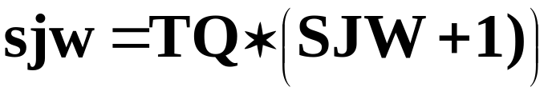
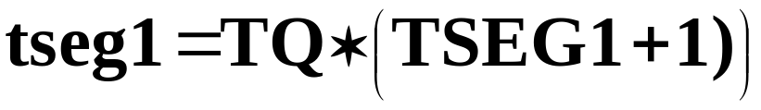
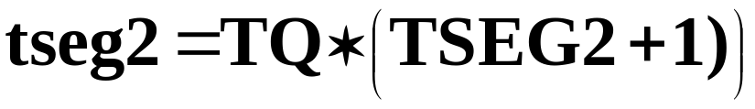
CAN Bit-Timing Configuration Register (CANBTC) – 0x006016
15
11
10
9
8
7
6
3
2
0
reserved
SBG
SJW
SAM
TSEG1
TSEG2
Time Segment 1( tseg1)
Synchronisation Jump Width (SJW)
Time Segment 2( tseg2)
Synchronisation Edge Select (SBG)
0 = re synchronisation with falling edge only
1 = re-sync. with rising & falling edge
Sample Points (SAM)
0 = one sample at sample point
1 = 3 samples at sample point – majority vote

Slide 44
CAN Bit-Timing Examples
Bit Configuration for SYSCLK = 150 MHz
Sample Point at 80% of Bit Time :
Example 50 KBPS:
  TQ = (199+1)/150 MHz = 1.334 ns
  tseg1 = 1.334 ns ( 10 + 1) = 14.674 ns ➔ t_{CAN} = 20.010 ns
  tseg2 = 1.334 ns ( 2 + 1) = 4.002 ns
CAN-Baudrate | BRP | TSEG1 | TSEG2
1 MBPS | 9 | 10 | 2
500 KBPS | 19 | 10 | 2
250 KBPS | 39 | 10 | 2
125 KBPS | 79 | 10 | 2
100 KBPS | 99 | 10 | 2
50 KBPS | 199 | 10 | 2

Slide 45
CAN Error and Status Register (CANES) – 0x006018
31
24
23
22
21
20
19
18
17
16
reserved
FE
BE
SA1
CRCE
SE
ACKE
BO
EP
EW
Form Error (FE)
0 = normal operation
1 = one of the fixed form bit fields of a message was wrong.
Bit Error (BE)
0 = no bit error detected
1 = a received bit does not match a transmitted bit
(outside of the arbitration field).
Acknowledgement Error (ACKE)
0 = normal operation
1 = CAN module has not received an ACK.
Bus Off State (BO)
0 = normal operation
1 = CANTEC has reached the limit of 256. Module
has been switched of the bus.
Stuck at dominant Error (SA1)
0 = The CAN module detected a recessive bit
1 = The CAN module never detected a recessive bit.
Cyclic Redundancy Check Error (CRCE)
0 = normal operation
1 = a wrong CRC was received.
Error Passive State (EP)
0 = CAN is in Error Active Mode
1 = CAN is in Error Passive Mode
Stuff Bit Error (SE)
0 = normal operation
1 = a stuff bit error has occurred.
Warning Status (EW)
0 = values of both error counters are less than 96
1 = one error counter has reached 96

Slide 46
CAN Error and Status Register (CANES) – 0x006018
15
6
5
4
3
2
1
0
reserved
SMA
CCE
PDA
Res.
RM
TM
Power Down Mode Acknowledge (PDA)
0 = normal operation
1 = CAN module has entered power down mode.
Change Configuration Enable (CCE)
0 = CPU is denied write access into
configuration registers.
1 = CPU has write access into
configuration registers.
Receive Mode (RM)
0 = CAN protocol kernel is not receiving a message.
1 = CAN protocol kernel is receiving a message.
Suspend Mode Acknowledge (SMA)
0 = normal operation
1 = CAN module has entered suspend mode.
Note: Suspend mode is activated by the debugger
when the DSP is not in run mode.
Transmit Mode (TM)
0 = CAN protocol kernel is not transmitting a message.
1 = CAN protocol kernel is transmitting a message.

Slide 47
CAN Transmit Error Counter Register (CANTEC) – 0x00601A
31
16
reserved
15
0
reserved
TEC
Transmit Error Counter (TEC)
Value TEC is incremented or decremented according to the CAN protocol specification
CAN Receive Error Counter Register (CANREC) – 0x00601C
31
16
reserved
15
0
reserved
REC
Receive Error Counter (REC)
Value REC is incremented or decremented according to the CAN protocol specification

Slide 48
CAN Global Interrupt Mask Register (CANGIM) – 0x006020
31
18
17
16
reserved
MTOM
TCOM
15
14
13
12
11
10
9
8
7
3
2
1
0
Res.
AAM
WDIM
WUIM
RMLIM
BOIM
EPIM
WLIM
reserved
GIL
I1EN
I0EN
Interrupt Mask Bits:
MTOM = Mailbox Timeout Mask
TCOM = Timestamp Counter Overflow Mask
AAM = Abort Acknowledge Interrupt Mask
WDIM = Write Denied Interrupt Mask
WUIM = Wake-up Interrupt Mask
RMLIM = Receive message lost Interrupt Mask
BOIM = Bus Off Interrupt Mask
EPIM = Error Passive Interrupt Mask
WLIM = Warning level Interrupt Mask
Interrupt Mask Bits
0 = Interrupt disabled
1 = Interrupt enabled
Global Interrupt Level (GIL)
For Interrupts TCOF,WDIF,WUIF,BOIF and WLIF
0 = mapped into HECC_INT_REQ[0] line – GIF0
1 = mapped into HECC_INT_REQ[1] line – GIF1
Interrupt 1 Enable (I1EN)
0 = HECC_INT_REQ[1] line is disabled
1 = HECC_INT_REQ[1] line is enabled
Interrupt 0 Enable (I0EN)
0 = HECC_INT_REQ[0] line is disabled
1 = HECC_INT_REQ[0] line is enabled

Slide 49
CAN Global Interrupt Flag 0 Register (CANGIF0) – 0x00601E
31
18
17
16
reserved
MTOF0
TCOF0
15
14
13
12
11
10
9
8
7-5
4
3
2
1
0
GMIF0
AAIF0
WDIF0
WUIF0
RMLIF0
BOIF0
EPIF0
WLIF0
Res.
MIV0.4
MIV0.3
MIV0.2
MIV0.1
MIV0.0
Interrupt Flag Bits:
MTOF0 = Mailbox Timeout Flag
TCOF0 = Timestamp Counter Overflow Flag
GMIF0 = Global Mailbox Interrupt Flag
AAIF0 = Abort Acknowledge Interrupt Flag
WDIF0 = Write Denied Interrupt Flag
WUIF0 = Wake-up Interrupt Flag
RMLIF0 = Receive message lost Interrupt Flag
BOIF0 = Bus Off Interrupt Flag
EPIF0 = Error Passive Interrupt Flag
WLIF0 = Warning level Interrupt Flag
Interrupt Flag Bits
0 = Interrupt has not occurred
1 = Interrupt has occurred
Mailbox Interrupt Vector (MIV0)
Indicates the number of the message object that set the
global mailbox interrupt flag (GMIF0)

Slide 50
CAN Global Interrupt Flag 1 Register (CANGIF1) – 0x006022
31
18
17
16
reserved
MTOF1
TCOF1
15
14
13
12
11
10
9
8
7-5
4
3
2
1
0
GMIF1
AAIF1
WDIF1
WUIF1
RMLIF1
BOIF1
EPIF1
WLIF1
Res.
MIV1.4
MIV1.3
MIV1.2
MIV1.1
MIV1.0
Interrupt Flag Bits:
MTOF1 = Mailbox Timeout Flag
TCOF1 = Timestamp Counter Overflow Flag
GMIF1 = Global Mailbox Interrupt Flag
AAIF1 = Abort Acknowledge Interrupt Flag
WDIF1 = Write Denied Interrupt Flag
WUIF1 = Wake-up Interrupt Flag
RMLIF1 = Receive message lost Interrupt Flag
BOIF1 = Bus Off Interrupt Flag
EPIF1 = Error Passive Interrupt Flag
WLIF1 = Warning level Interrupt Flag
Interrupt Flag Bits
0 = Interrupt has not occurred
1 = Interrupt has occurred
Mailbox Interrupt Vector (MIV1)
Indicates the number of the message object that set the
global mailbox interrupt flag (GMIF1)

Slide 51
CAN Mailbox Interrupt Mask Register (CANMIM) – 0x006024
31
16
CANMIM[31:16]
15
0
CANMIM[15:0]
Mailbox Interrupt Mask Bits (MIM)
0 = mailbox interrupt is disabled.
1 = mailbox interrupt is enabled. An Interrupt is generated if a
message has been transmitted successfully or if a message has
been received without an error.
CAN Mailbox Interrupt Level Register (CANMIL) – 0x006026
31
16
CANMIL[31:16]
15
0
CANMIL[15:0]
Mailbox Interrupt Level Bits (MIL)
0 = mailbox interrupt is generated on HECC_INT_REQ[0] line.
1 = mailbox interrupt is generated on HECC_INT_REQ[1] line.

Slide 52
CAN Overwrite Protection Control Register (CANOPC) – 0x006028
31
16
CANOPC[31:16]
15
0
CANOPC[15:0]
Overwrite Protection Control Bits (MIM)
0 = the old message in mailbox n may be overwritten by a new one.
This will be notified by the receive message lost bit RML[n].
1 = an old message in mailbox n is protected against being overwritten
by a new one.
Thus, the next mailboxes are checked for a matching ID.
If no other mailbox is found, the new message is lost.

Slide 53
CAN I/O Control Register (CANTIOC) – 0x00602A
31
16
reserved
15
3
2
1
0
reserved
TXFUNC
TXDIR
TXOUT
TXIN
TXFUNC
0 = CANTX pin is a normal I/O pin.
1 = CANTX is used for CAN transmit functions.
TXDIR
0 = CANTX pin is an input pin if configured as a normal I/O pin.
1 = CANTX pin is an output pin if configured as a normal I/O pin.
TXOUT
Output value for CANTX pin, if configured as normal output pin
TXIN
0 = Logic 0 present on pin CANTX.
1 = Logic 1 present on pin CANTX.

Slide 54
CAN I/O Control Register (CANRIOC) – 0x00602C
31
16
reserved
15
3
2
1
0
reserved
RXFUNC
RXDIR
RXOUT
RXIN
RXFUNC
0 = CANRX pin is a normal I/O pin.
1 = CANRX is used for CAN receive functions.
RXDIR
0 = CANRX pin is an input pin if configured as a normal I/O pin.
1 = CANRX pin is an output pin if configured as a normal I/O pin.
RXOUT
Output value for CANRX pin, if configured as normal output pin
RXIN
0 = Logic 0 present on pin CANRX.
1 = Logic 1 present on pin CANRX.

Slide 55
CAN Local Network Time Register (CANLNT) – 0x00602E
31
16
LNT[31:16]
15
0
LNT[15:0]
LNT is a Free Running Counter, Clocked from the bit clock of the CAN module.
LNT is written into the time stamp register (MOTS ) of the corresponding mailbox when a received message has been stored or a message has been transmitted.
LNT is cleared when mailbox #16 is transmitted or received. Thus mailbox #16 can be used for a global network time synchronization.

Slide 56
CAN Time Out Control Register (CANTOC) – 0x006030
31
0
TOC[31:0]
Time Out Control Bits (TOC)
0 = Time Out function is disabled for mailbox n.
1 = Time Out function is enabled for mailbox n.
If the corresponding MOTO register is greater
than LNT a time out event will be generated
CAN Time Out Status Register (CANTOS) – 0x006032
31
0
TOS[31:0]
Time Out Status Flags (TOS)
0 = No Time Out occurred for mailbox n.
1 = The value in LNT is greater or equal to the value
in the corresponding MOTO register

Slide 57
CAN Local Acceptance Mask Register
0x00 6040 - 0x00 607F
0 = IDE bit of mailbox determines which message shall be received
1 = extended or standard frames can be received.
extended: all 29 bit of LAM are used for filter against all 29 bit of mailbox .
standard: only first eleven bits of mailbox and LAM [28-18] are used.
31
30-29
28
16
LAMI
reserved
LAMn[28:16]
15
0
LAMn[15:0]
LAMn[28-0]: Masking of identifier bits of incoming messages
1 = don’t care ( accept 1 or 0 for this bit position ) of incoming identifier.
0 = received identifier bit must match the corresponding message identifier bit (MID).
Note: There are two operating modes of the CAN module : “HECC” and “SCC”.
In “SCC” (default after reset ) LAM0 is used for mailboxes 0 to 2, LAM3 is used for mailboxes 3 to 5
and the global acceptance mask (CANGAM) is used for mailboxes 6 to 15.
In “HECC” ( CANMC:13 = 1) each mailbox has its own mask register LAM0 to LAM31.

Slide 58
CAN Message Object Time Stamp
0x00 6080 - 0x00 60BF
31
16
MOTSn[31:16]
15
0
MOTSn[15:0]
A free running counter ( register CANLNT) is used to get an indication
of the time of reception or transmission of a message.
CANLNT is a 32 bit timer that is driven from the bit clock of the CAN bus line.
The content of CANLNT is written into MOTSn when a received message
is stored or a message has been transmitted.

Slide 59
CAN Message Object Time-Out
0x00 60C0 - 0x00 60FF
31
16
MOTOn[31:16]
15
0
MOTOn[15:0]
A free running counter ( register CANLNT) is used to get an indication
of the time of reception or transmission of a message.
CANLNT is a 32 bit timer that is driven from the bit clock of the CAN bus line.
If the value in CANLNT is equal or greater than the value in MOTOn, the
appropriate bit in register CANTOS will be set , assuming this feature
was allowed in CANTOC.

Slide 60
CAN Mailbox Memory
0x00 6100 - 0x00 61FF
Message Identifier Register (MID) Mailbox n
31
30
29
28
16
15
0
IDE
AME
AAM
IDn[28:16]
IDn[15:0]
Message Identifier
Standard Frames : IDn[28:18] are used
Extended Frames : IDn[28:0] are used
Auto Answer Mode Bit ( transmitter only)
0 = mailbox does not reply to remote requests.
1 = if a matching Remote Request is received, the contents of this mailbox will be sent.
Acceptance Mask Enable Bit ( receiver only)
0 = no Acceptance Mask used. All identifier bits must match to receive the message
1 = the corresponding Acceptance Mask is used)
Identifier Extension Bit
0 = Standard Identifier (11 Bits)
1 = Extended Identifier (29 Bits)
MID0[15:0] = address 0x00 6100
MID0[31:16] = address 0x00 6101

Slide 61
CAN Mailbox Memory
0x00 6100 - 0x00 61FF
Message Control Field Register (MCF) Mailbox n
31
16
15
13
12
8
7
5
4
3
0
reserved
reserved
TPL
reserved
RTR
DLC
Transmit Priority Level
Priority compared to the other 31 mailboxes.
Highest number has highest priority.
Data Length Code
Valid numbers are 0 to 8.
Remote Transmission Request
0 = no RTR requested.
1 = for receiver mailboxes:
if TRS bit is set, a remote frame is transmitted and the corresponding
data frame will be received in the same mailbox.
1 = for transmit mailboxes:
if TRS bit is set, a remote frame is transmitted but the corresponding
data frame has to be received in another mailbox.
MCF0[15:0] = address 0x00 6102
MCF0[31:16] = address 0x00 6103

Slide 62
CAN Mailbox Memory
0x00 6100 - 0x00 61FF
Message Data Low (MDL) Register with DBO = 0 Mailbox n
31
24
23
16
15
8
7
0
Data Byte 0
Data Byte 1
Data Byte 2
Data Byte 3
Message Data Low (MDL) Register with DBO = 1 Mailbox n
31
24
23
16
15
8
7
0
Data Byte 3
Data Byte 2
Data Byte 1
Data Byte 0
MDL0[15:0] = address 0x00 6104
MDL0[31:16] = address 0x00 6105

Slide 63
CAN Mailbox Memory
0x00 6100 - 0x00 61FF
Message Data High (MDH) Register with DBO = 0 Mailbox n
31
24
23
16
15
8
7
0
Data Byte 4
Data Byte 5
Data Byte 6
Data Byte 7
Message Data High (MDH) Register with DBO = 1 Mailbox n
31
24
23
16
15
8
7
0
Data Byte 7
Data Byte 6
Data Byte 5
Data Byte 4
MDL0[15:0] = address 0x00 6106
MDL0[31:16] = address 0x00 6107

Slide 64
CAN Example : transmit a frame
Lab 9: Transmit a CAN message
  CAN baud rate : 100 KBPS ( CAN low speed )
  Transmit a one byte message every second
  Message Identifier 0x 1000 0000 ( extended frame)
  Use Mailbox #5 as transmit mailbox
  Message content: status of the input switches ( GPIO B15-B8)
  CAN transceiver SN 65 HVD 230 ( Zwickau Adapter Board) :
    Set jumper JP5 and JP6 to 1-2
    Set jumper JP4 to 2-3 ( enables on board line terminator of 120 Ohm)
  DB9 (male) to connect the Adapter Board to CAN
    Pin 2 : CAN_L ; Pin 7 : CAN_H ; Pin 3 : GND

Slide 65
CAN Example : receive a frame
Lab 10: Receive a CAN message
  CAN baud rate : 100 KBPS ( can low speed )
  Receive a one byte message and show it on GPIO-Port B7…B0 ( 8 LED’s)
  Message Identifier 0x 1000 0000 ( extended frame)
  Use Mailbox #1 as receive mailbox
  CAN Transceiver SN 65 HVD 230 ( Zwickau Adapter Board) :
    Set jumper JP5 and JP6 to 1-2
    Set jumper JP4 to 2-3 ( enables on board line terminator of 120 Ohm)
  DB9 (male) to connect the Adapter Board to CAN
    Pin 2 : CAN_L ; Pin 7 : CAN_H ; Pin 3 : GND

