Slide 1

Module 12 : Real Time OS: DSP/BIOS
32-Bit-Digital Signal Controller
TMS320F2812
Texas Instruments Incorporated
European Customer Training Centre
University of Applied Sciences Zwickau (FH)

Slide 2
Real Time Operating Systems (RTOS)
What is a RTOS?
Particular class of operating systems for digital processor systems
Capable of serving multiple user tasks at one time ( “multi-task OS”)
For all tasks in a running system it is guaranteed, that random external events in the environment of each individual task will be serviced in a given time ( “Worst Case Response Time”).
All tasks must be served simultaneously (“multi-task OS”) AND timely (“RTOS”)
RTOS are very popular in embedded control

Slide 3
Real Time Operating Systems (RTOS)
What is a Task?
A running or executable program object, that:
  is controlled by a portion of machine code
  ‘owns’ a given set of operating resources to start/resume its course of actions
  is characterized by a set of state variables ( registers, program counter, local stack variables, semaphores, mailboxes)
Tasks are programmed and debugged independently from each other
Accesses to peripherals or data transfers between tasks are performed by RTOS -system functions calls.

Slide 4
Real Time Operating Systems (RTOS)
What is a Task- State - Model?
Each task can reside in one of the following states:
1
existent
ready
5
7
2
3
blocked
completed
4
6
running
8
not existent
For explanation of arrows 1-8 see next slide

Slide 5
Real Time Operating Systems (RTOS)
When does the task – state change?
A task is created by an initialization function
A task is selected by the scheduler to use the CPU
The scheduler performs a task change according to the scheduling rules of the RTOS
The running task is waiting for an external event , a message from another task or for a signal
The event that was blocking a task has occurred
The task has completed its program
The task is re-activated by another task or by an event
The task will never be used again ( as long as the embedded system is not switched off)
All other task state transitions are illegal.

Slide 6
Real Time Operating Systems (RTOS)
What is a Task - Scheduler?
An important part of the RTOS that schedules the sequence of task execution phases and the change of task states
Two basic operating modes for schedulers:
  time slice mode - computing time is assigned to tasks in a predefined amount of processor time
  priority mode – computing time is assigned to tasks according to the priority of each task in the system. If a task with higher priority gets into status ‘ready’ the running task will be pre-empted.
  combined versions between pre-emptive and time slice schedulers are also possible

Slide 7
Texas Instruments DSP/BIOS
What is DSP/BIOS?
BIOS = “Build In Operating System”
Texas Instruments firm ware RTOS kernel for the TMS320 family of DSP’s
A full-featured, scalable real-time kernel
  System configuration tools
  Preemptive multi-threading scheduler
  Real-time analysis tools

Slide 8
Texas Instruments DSP/BIOS
Why use DSP/BIOS?
Helps manage complex C28x system resources
Allows to develop and test tasks in a multiple task control environment independently
Reduces software project development time
Eases software maintenance & documentation
Integrated with Code Composer Studio IDE
  Requires no runtime license fees
  Fully supported by TI and is a key component of TI’s eXpressDSP™ real-time software technology
Uses minimal MIPS and memory (2-8K)

Slide 9
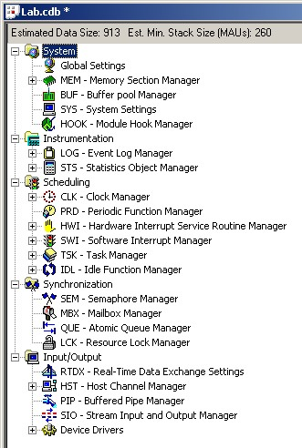
DSP/BIOS Configuration Tool (file .cdb)
System Setup Tools
Handles memory configuration (builds .cmd file), run-time support libraries, interrupt vectors, system setup and reset, etc.
Real-Time Analysis Tools
Allows application to run uninterrupted while displaying debug data
Real-Time Scheduler
Preemptive tread manager kernel
Real-Time I/O
Allows two way communication between threads or between target and PC host

Slide 10
Design Problem: Add a new Function
TI DSP
Function 1
Existing Function
New Function
Issues:
  Do we have enough remaining computing power to add another function?
  Are there possible resource conflicts between the new function and the existing system?
  Will the new system meet all time restrictions in a real-time embedded control system?
Function 2
What are some possible solutions?

Slide 11
Solution 1: extend the main-loop
Main()
{
while(1)
{
}
}
Call each function from an
endless loop within main
  Potential Problems:
  What if Algorithms run at different rates:
  - motor current loop at 20 kHz
  - respond to keypad input at 2 Hz
  What if one algorithm consumes enough MIPS to force the other algorithm to miss its real-time deadlines / delays its response?
Function 1
Function 2

Slide 12
Solution 2: use interrupts
TI DSP
An interrupt driven system places
each function in its own ISR
main
{
while(1);
}
Function1_ISR
{
}
Function2_ISR
{
}
Period Compute CPU Usage
Function 1: 0.05 ms 1 μs 2%
Function 2: 500 ms 3 μs ~ 0%
2%
Function 1
running
Function 1
idle
Function 2
Function 2
Time
0
1
2
3
4
5
6
7
Only one ISR can run at a time: Function 1 will be delayed,
eventually missing its deadline…

Slide 13
Solution 3: nested hardware interrupts (HWI)
main
{
return;
}
Function1_ISR
{
}
Function2_ISR
{
}
Nested interrupts allow hardware
interrupts to preempt each other
running
idle
Function 1
Time
0
1
2
3
4
5
6
7
Use DSP/BIOS HWI dispatcher for context save/restore, and allow preemption
Reasonable approach if you have limited number of interrupts/functions
one HWI function for each interrupt
Function 2

Slide 14
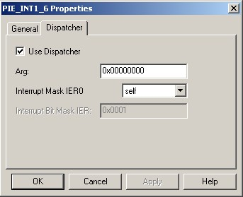
DSP/BIOS - HWI Dispatcher for ISRs
For non-BIOS code, we use the interrupt keyword to declare an ISR
tells the compiler to perform context save/restore
interrupt void MyHwi(void)
{
}
For DSP/BIOS code, the dispatcher will perform the save/restore
Remove the interrupt keyword from the MyHwi()
Check the “Use Dispatcher” box when you configure the interrupt vector in the DSP/BIOS config tools

Slide 15
DSP/BIOS - Software Interrupts (SWI)
Make each algorithm an independent software interrupt
SWI scheduling is handled by DSP/BIOS
  HWI function triggered by hardware
  SWI function triggered by software
  e.g. a call to SWI_post()
Why use a SWI?
  No limitation on number of SWIs, and priorities for SWIs are user-defined
  SWI can be scheduled by hardware or software event(s)
  Relocate task processing from HWI to SWI
main
{ …
// return to O/S;
}
DSP/BIOS
Function 1
Function 2

Slide 16
DSP/BIOS - Periodic Functions
tick
DSP/BIOS
CLK
period
LED
LED
LED
Periodic functions run at a specific rate in your system:
- e.g. LED blink requires 0.5 Hz
Use the CLK Manager to specify the DSP/BIOS CLK rate in microseconds per “tick”
Use the PRD Manager to specify the period (for the function) in ticks
Allows multiple periodic functions with different rates

Slide 17
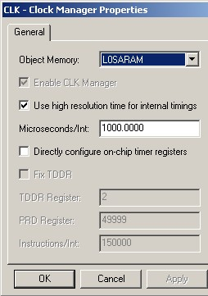
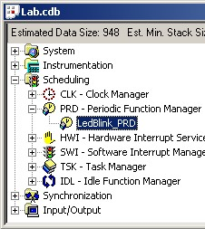
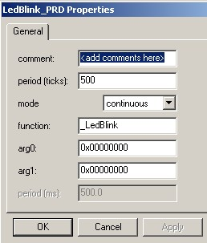
Creating a Periodic Function
tick
DSP/BIOS
CLK
period
func1
func1
func1

Slide 18
Enabling BIOS – Return from main()
main
{ …
// return to BIOS
}
DSP BIOS
Must delete the endless while() loop
main() returns to BIOS IDLE thread,
allowing BIOS to schedule events,
transfer info to host, etc.
An endless while() loop in main() will not allow BIOS to activate
Function 1
Function 2

Slide 19
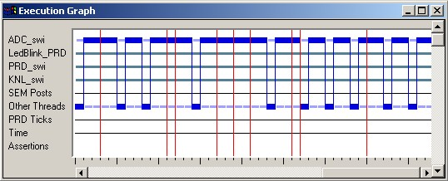
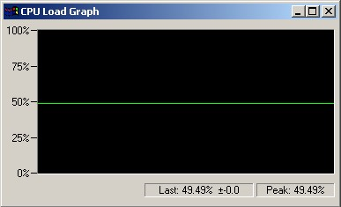
Built-in Real-Time Analysis Tools
Gather data on target (3-10 CPU cycles)
Send data during BIOS IDL (100s of cycles)
Format data on host (1000s of cycles)
Data gathering does NOT stop target CPU
Execution Graph
Software logic analyzer
Debug event timing
and priority
CPU Load Graph
Shows amount of CPU- power being consumed

Slide 20
DSP/BIOS - API Modules
TSK Communication/Synchronization
SEM Semaphores manager
MBX Mailboxes manager
LCK Resource lock manager
Device-Independent Input/Output
PIP Data pipe manager
HST Host input/output manager
SIO Stream I/O manager
DEV Device driver interface
Memory and Low-Level Primitives
MEM Memory manager
SYS System services manager
QUE Queue manager
ATM Atomic functions
GBL Global setting manager
Instrumentation/Real-Time Analysis
LOG Message log manager
STS Statistics accumulator manager
TRC Trace manager
RTDX Real-Time Data eXchange manager
Thread Types
HWI Hardware interrupt manager
SWI Software interrupt manager
TSK Multi-tasking manager
IDL Idle function & process loop manager
Clock and Periodic Functions
CLK System clock manager
PRD Periodic function manager

Slide 21
Lab 12: Modify Lab 2 to use BIOS
  Use your solution for Lab2 to begin with
  Modify the project to use DSP/BIOS functionality
  Let DSP/BIOS create the necessary Linker Command Files
  Replace the software delay loop from Lab2 by a periodic function (“PRD”) of DSP/BIOS
  Create a new function “led_runner()” that will activate the next state of the LED-line
  Call this function every 500ms with a PRD-function out of DSP/BIOS
  For a detailed procedure see textbook!

