Slide 1

Module 14 : C28x FIR - Filter
32-Bit-Digital Signal Controller
TMS320F2812
Texas Instruments Incorporated
European Customer Training Centre
University of Applied Sciences Zwickau (FH)

Slide 2
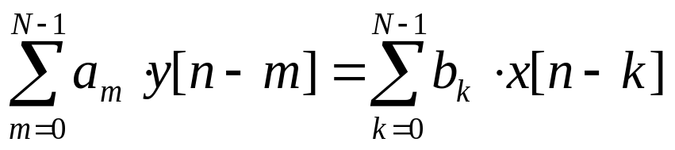
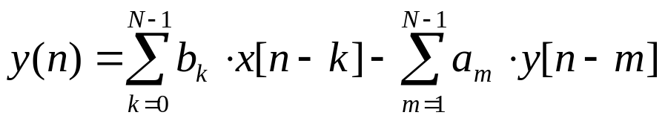
Basics of Digital Filter Theory
Digital Filter Algorithms are probably the most used numerical operations of a Digital Signal Processor
Digital Filters are based on the common difference equation for Linear Time-Invariant (LTI) – systems:
  y(n) = output signal
  x(n) = input signal
  a_{m}, b_{k} = coefficients
  N = number of coefficients ( order of system)
Normalized to a₀ = 1 we derive the basic equation in time domain:

Slide 3
Time Domain Chart of a Digital Filter
x(n)
b₀
y(n)
+
+
x
d
d
b₁
-a₁
x(n-1)
x
x
y(n-1)
d
d
b₂
-a₂
x
y(n-2)
x(n-2)
x
x(n-k)
y(n-m)
d
= delay 1 of sample period
gain = 1

Slide 4
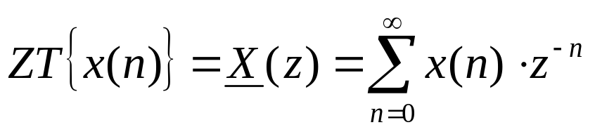
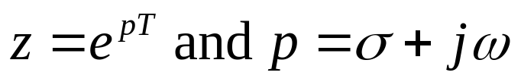
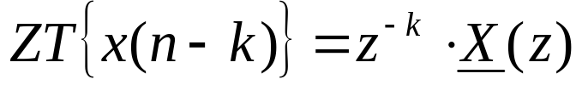
Transfer Function of a Digital Filter
The Z-Transform of the original input signal x(n) is defined as:
with
One property of the Z-Transform is that the ZT of a time-shifted signal is equal to the ZT of the original signal except of a factor z^{-k}:
p = complex angular frequency

Slide 5
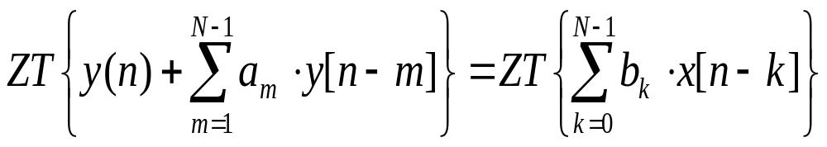
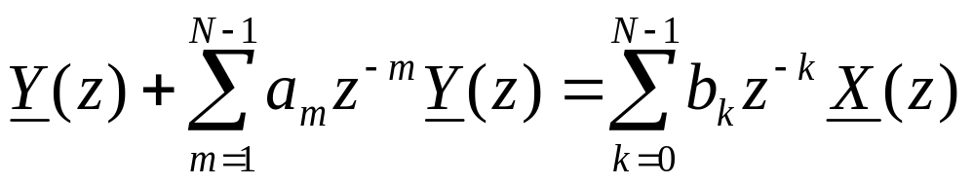
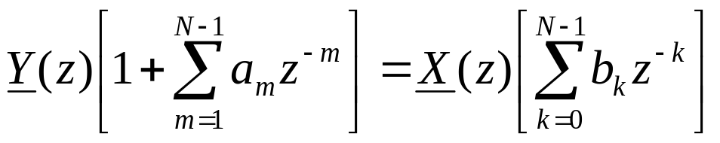
Transfer Function of a Digital Filter
Z-Transform is applied to both sides of the time domain equation of a Digital Filter :

Slide 6
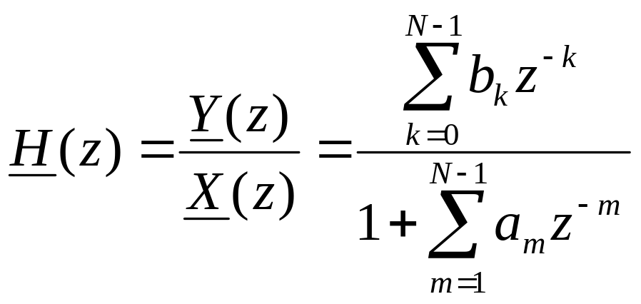
Transfer Function of a Digital Filter
Finally we derive the Transfer Function of a Digital Filter of order N in frequency domain:

Slide 7
Frequency Domain Flow of a Digital Filter
X(z)
b₀
Y(z)
+
+
x
d
d
b₁
-a₁
x
x
d
d
= z⁻¹
d
b₂
-a₂
x
x
Multiply by z⁻¹ in Frequency Domain =
Unit delay by one sample period in Time Domain

Slide 8
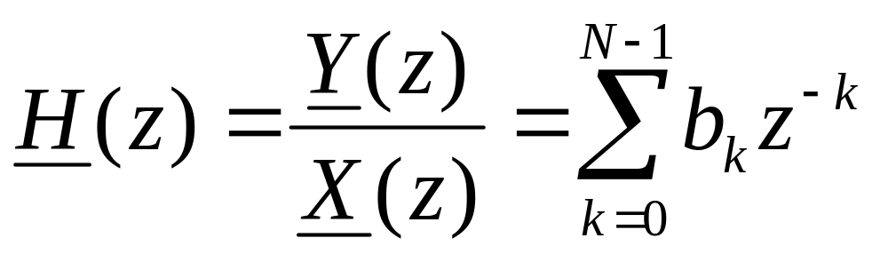
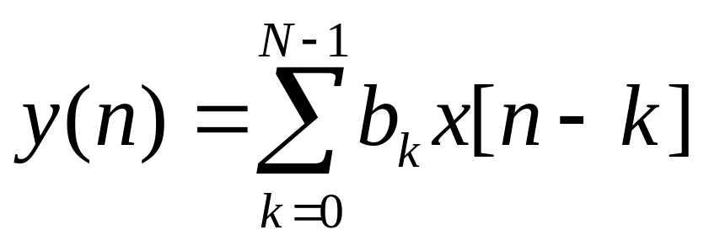
Finite Impulse Response (FIR) - Filter
If all feedback coefficients a_{m} are equal to zero we derive the equation system for a “Finite Impulse Response (FIR)” – Filter:
and:
Frequency Domain
Time Domain

Slide 9
Infinite Impulse Response (IIR) - Filter
If coefficients a_{m} are present we call this type of filter “Infinite Impulse Response (IIR). In this case the equation with feedback part must be used for the filter calculation.
Obviously the “feedback” terms a_{m}*y(n-m) deliver some amount of energy back into the calculation.
Under particular circumstances this feedback system will respond to an input impulse infinite – hence the name.
IIR – Filter

Slide 10
Simple FIR Diagram
X0
X1
X2
x
z^{–1}
z^{–1}
in
b0
×
b1
×
b2
×
+
y
out
y(n) = b0 × x(n) + b1 × x(n–1) + b2 × x(n–2)

Slide 11

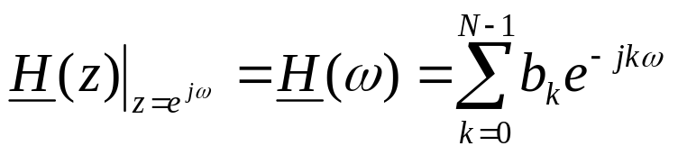
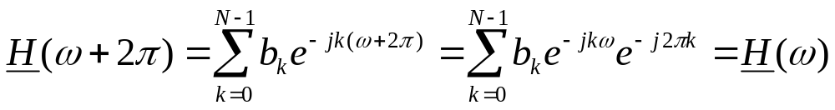
Properties of a FIR Filter
Replacing z by it’s original definition:
disregarding σ (loss – less filter) and normalizing to T=1:
Since e^{-j2πk} = 1:
FIR filters have a periodic frequency response of 2π !
We need to limit the spectrum!

Slide 12
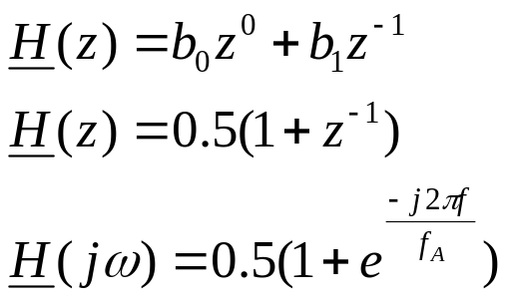
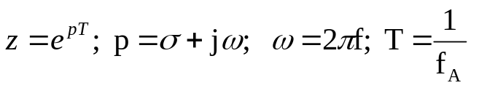
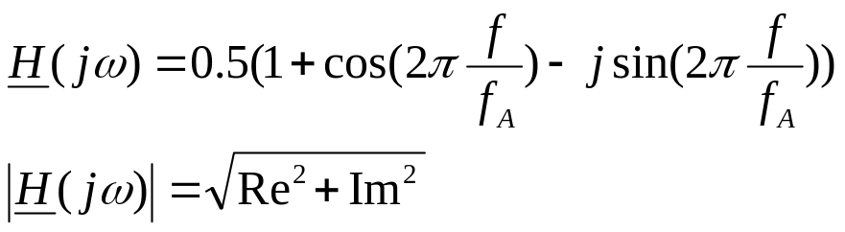
FIR – Example 1
x(n-1)
Frequency Response ?
Type of Filter ?
x(n)
Z⁻¹
0.5
0.5
+
y(n)
b₀ = 0.5 b₁ = 0.5
f_{A} = sampling frequency
Notes:
11

Slide 13
FIR – Example 1 (cont.)
f = 0 : |H(jω)| = 1
f = 0.125 * f_{A} : |H(jω)| = 0.92
f = 0.25 * f_{A} : |H(jω)| = 0.707
f = 0.375 * f_{A} : |H(jω)| = 0.382
f = 0.5 * f_{A} : |H(j ω)| = 0
|H(jω)|
1
Filter – Type: Low-pass
0.5
f/f_{A}
0.25
0.5
Notes:
11

Slide 14
FIR – Example 1 (cont.)
f = 0.625 *f_{A} : |H(jω)| = 0.382
f = 0.75 * f_{A} : |H(jω)| = 0.707
f = 0.875 * f_{A} : |H(jω)| = 0.92
f = f_{A} : |H(jω)| = 1
Aliasing, if f > 0.5 f_{A}
Input Frequencies must be limited to 0.5*f_{A} by an additional Low Pass input filter
|H(jω)|
1
0.5
0.25
0.5
f/f_{A}
Notes:
11

Slide 15
FIR – Example 1 (cont.)
Solution: Use an anti-aliasing filter at input to limit all input frequencies to f_{A}/2.
x[n]
x(t)
ADC
FIR
y[n]
Analogue Anti-Aliasing
Notes:
11

Slide 16
FIR – Example 2
x(n-1)
x(n)
Z⁻¹
b₀ = 0.5 b₁ = - 0.5
0.5
-0.5
Frequency Response ?
Type of Filter ?
+
y(n)
Note : We only changed b₁ from +0.5 to -0.5 !
|H(jω)|
1
Filter Type: High Pass
0.5
0.25
0.5
f/f_{A}
Notes:
11

Slide 17
FIR – Example 3
x(n-1)
x(n-2)
Assume no previous inputs
x(n)
Z⁻¹
Z⁻¹
X(0) = 20; X(-1) = 0; X(-2) = 0
0.25
0.5
0.25
And let
b₀ = 0.25 b₁ = 0.5 b₂ = 0.25
Σ
Σ
y(n)
$
Input
y(0) = 0.25*x(0) + 0.5*x(-1) + 0.25*x(-2) = 5
40
30
40
y(1) = 0.25*20 + 0.5*20 + 0.25*0 = 15
20
y(2) = 0.25*20 + 0.5*20 + 0.25*20 = 20
10
12
time
y(3) = 0.25* + 0.5* + 0.25* =
mon
tue
wed
thu
fri
sat
sun
$
y(4) = 0.25* + 0.5* + 0.25* =
Output
40
y(5) = 0.25*20 + 0.5*40 + 0.25*12 = 28
30
y(6) = 0.25*20 + 0.5*20 + 0.25*40 = 25
20
10
Moving average calculation
mon
tue
wed
thu
fri
sat
sun
time
Notes:
11

Slide 18
Periodic FIR - Filter Calculation
before we can calculate the FIR a second time:
LOWER
MEMORY
ADDRESS
X₀
X₀ is used for latest sample
X₀
old X₀ becomes new X₁
X₁
X₁
old X₁ becomes new X₂
X₂
HIGHER
MEMORY
ADDRESS
X₂
“Delay Line update”
Which movement should you perform first?

Slide 19
FIR Filter Implementation in C
  /***************************************************************
  * Function: IQssfir()
  * Description: IQmath n-tap single-sample FIR filter.
  *
  * y(k) = a(0)*x(k) + a(1)*x(k-1) + ... + a(n-1)*x(k-n+1)
  *
  * DSP: TMS320F2812, TMS320F2811, TMS320F2810
  * Include files: DSP281x_Device.h, IQmathLib.h
  * Function Prototype: _iq IQssfir(_iq*, _iq*, Uint16)
  * Useage: y = IQssfir(x, a, n);
  * Input Parameters: x = pointer to array of input samples
  * a = pointer to array of coefficients
  * n = number of coefficients
  * Return Value: y = result
  * Notes:
  * 1) This is just a simple filter example, and completely
  * un-optimized. The goal with the code was clarity and
  * simplicity,
  * not efficiency.
  * 2) The filtering is done from last tap to first tap. This
  * allows
  * more efficient delay chain updating.
  *****************************************************************/

Slide 20
FIR Filter Implementation in C
  _iq IQssfir(_iq *x, _iq *a, Uint16 n)
  {
  Uint16 i; // general purpose
  _iq y; // result
  _iq *xold; // delay line pointer
  /*** Setup the pointers ***/
  a = a + (n-1); // a points to last coefficient
  x = x + (n-1); // x points to last buffer element
  xold = x; // temporary buffer
  /*** Last tap has no delay line update ***/
  y = _IQmpy(*a--, *x--);
  /*** Do the other taps from end to beginning ***/
  for(i=0; i<n-1; i++)
  {
  y = y + _IQmpy(*a--, *x); // filter tap
  *xold-- = *x--; // delay line update
  }
  return(y);
  }

Slide 21
FIR Filter Implementation in ASM
FIR Filter Optimization:
  Previous C solution is a generic one, coded in standard ANSI-C, can be compiled for every microprocessor or embedded microcomputer. Works well.
  But is not optimized for Digital Signal Processors like the C28x. In case more computing power for the real time calculation of a FIR is needed, one can take advantage of internal parallel hardware resources of a DSP.
  ASM-coding of a FIR allows to reduce the number of clock cycles needed to calculate one loop of the FIR algorithm.
  A new Addressing Mode is used to avoid the shift operations of the delay-line for input samples: “Circular Addressing Mode”
  Describe the Circular Addressing function
  Implement FIR filters using Circular Addressing Mode

Slide 22
Circular Addressing Usage
Delay
Delay line
Xin = X0
X1
X2
X0
X1
X2
*AR6%++
z^{–1}
z^{–1}
×
×
×
A0
A1
A2
Yout = A0*Xin + A1∗X1 + A2∗X2
+
Finite Impulse Response (FIR) Filter
Sum Of Product
MAC P,*XAR6++,*XAR7++
Sum Of Product + Delay
MAC P,*AR6%++,*XAR7++
Samples coming in: X_{in}
Time (T)
x(0)
x(1)
x(2)
x(3)
x(4)
On recursion,
X2 = X1
X1 = X0
X0 = new X_{in}
X2
X1
(T = 2)
X0
(T = 3)
X2
X1
(T = 3)
?
?
X0
?
(T = 4)
X2
X1
X0
x[n-2]
x(n-2)
x[n-1]
x(n-1)
x[n]
x(n)

Slide 23
Delay Line with a Circular Buffer
oldest
oldest
JUN
JAN
JUN
JUL
JUN
JUL
MAY
FEB
MAY
FEB
MAY
AUG
APR
MAR
APR
MAR
APR
MAR
oldest
Linear Memory storage
@input
JUL
*AR6%++
JAN
JAN
JUL
FEB
@input
AUG
FEB
*AR6%++
FEB
MAR
MAR
*AR6%++
MAR
APR
APR
APR
MAY
MAY
MAY
JUN
JUN
JUN

Slide 24
Circular Addressing Hardware
start of buffer
Buffer Size N
AAAA … AAAA
AAAA AAAA
0000 0000
Element 0
(align on 256 word boundary)
access pointer
XAR6 (32)
circular
buffer
range
AAAA … AAAA
AAAA AAAA
xxxx xxxx
AR1 Low (16)
end of buffer
---- ----
N-1
Element N-1
AR1 Low is set to buffer size - 1
All 32 bits of XAR6 are used
MAC P,*AR6%++,*XAR7++
LINKER.CMD
SECTIONS
{ D_LINE: align(256) { } > RAM PAGE 1
. . .
}

Slide 25
FIR Filter – Dual MAC - Operation
TAPS .set 4 ; FIR – Order +1
xn .usect “D_LINE”,TAPS ; sample array in I1Q15
.data ; FIR – Coeffs in I1Q15
tbl .word 32768*707/1000 ; 0.707
.word 32768*123/1000 ; 0.123
.word 32768*(-175)/1000 ; -0.175
.word 32768*345/1000 ; 0.345
.text
FIR: SETC SXM ; 2’s complement math
CLRC OVM ; no clipping mode
SPM 1 ; fractional math
MOVL XAR7,#tbl ; coefficient pointer
MOVL XAR6,#xn ; circular buffer pointer
MOV AR1,#TAPS-1 ; buffer offset
MOV *XAR6%++,*(0:adc) ; get new sample ( x(n) )
ZAPA ; clear ACC,P,OVC
RPT #(TAPS/2)-1 ; RPT next instr.(#+1)times
|| DMAC ACC:P,*XAR6%++,*XAR7++ ; multiply & accumulate 2pairs
ADDL ACC:P ; add even & odd pair-sums
MOV *(0:dac),AH ; update output ( y(n) )
RET

Slide 26
Circular Addressing Summary
Buffer Size
Up to 256 words
Break larger arrays into <= 256 word blocks.
Buffer Alignment
Always align on 256-word boundaries, regardless of size. Unused space can be used for other purposes.
Let the linker assign addresses. Link largest blocks first.
Usage
XAR6 is the only circular pointer.
AR1 must be set to the size minus one (0 - 255).
Pointer update is post-increment by one (*XAR6%++) .
32-bit access causes post-increment by two. Make sure XAR6 and AR1 are even to avoid jumping past end of buffer.

Slide 27
Texas Instruments C28x Filter Library
MATLAB script to calculate Filter Coefficients for FIR and IIR, includes windowing
Filter Modules:
  FIR16: 16-Bit FIR-Filter
  IIR5BIQ16: Cascaded IIR-Filter (16bit-biquad)
  IIR5BIQ32: Cascaded IIR-Filter (32bit-biquad)
C-callable Assembly (“CcA”) Functions
  Adapted to internal Hardware features of the C28x
  Uses the Dual –MAC instruction
  Interface according to ANSI-C standard
Available from TI-web as document “sprc082.zip”

Slide 28
MATLAB Filter Script
FIR Filter Design Example: Low-pass Filter of Order 50
LPF Specification:
FIR Filter Order : 50
Type of Window : Hamming
Sampling frequency : 20KHz
Filter Corner Frequency : 3000Hz
ezFIR FILTER DESIGN SCRIPT
Input FIR Filter order(EVEN for BS and HP Filter) : 50
Low Pass : 1
High Pass : 2
Band Pass : 3
Band Stop : 4
Select Any one of the above Response : 1
Hamming : 1
Hanning : 2
Bartlett : 3
Blackman : 4
Select Any one of the above window : 1
Enter the Sampling frequency : 20000
Enter the corner frequency(Fc) : 3000
Enter the name of the file for coeff storage : lpf50.dat

Slide 29
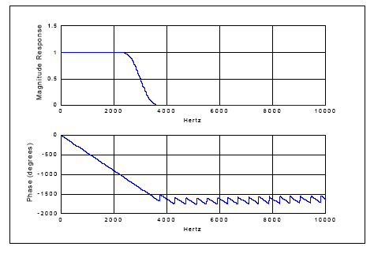
MATLAB Filter Script
MATLAB – Output File for Filter Coefficients:
#define FIR16_COEFF {\
9839,-2219809,-1436900,853008,3340889,3668111,-896,\
-5963392,-8977456,-3669326,8585216,18152991,13041193,\
-8257663,-30867258,-31522540,131,45285320,64028535,\
25231269,-58654721,-124846025,-94830542,68157453,\
320667626,551550942}

Slide 30
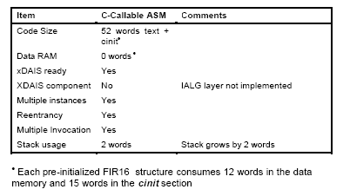
FIR16 Library Function
input
FIR16
output

Slide 31
FIR16 Library Function
Object Definition:
typedef struct {
long *coeff_ptr; /* Pointer to Filter coeffs */
long *dbuffer_ptr; /* Delay buffer pointer */
int cbindex; /* Circular Buffer Index */
int order; /* Order of the Filter */
int input; /* Latest Input sample */
int output; /* Filter Output */
void (*init)(void *); /* Pointer to Init function */
void (*calc)(void *); /* Pointer to calc function */
}FIR16;
coeff_ptr: Pointer to the Filter coefficient array.
dbuffer_ptr: Pointer to the Delay buffer.
cbindex: Circular buffer index, computed internally by initialization function based on the order of the filter.
order: Order of the Filter. Q0-Format, range 1 – 255
input: Latest input sample to the Filter. Q15-Format (8000-7FFF)
output: Filter output value. Q15-Format (8000-7FFF)

Slide 32
FIR16 Library Usage Example
#define FIR_ORDER 50 /* Filter Order */
#pragma DATA_SECTION(lpf, "firfilt");
FIR16 lpf = FIR16_DEFAULTS;
#pragma DATA_SECTION(dbuffer,"firldb");
long dbuffer[(FIR_ORDER+2)/2];
const long coeff[(FIR_ORDER+2)/2]= FIR16_LPF50;
main()
{
  lpf.dbuffer_ptr=dbuffer;
  lpf.coeff_ptr=(long *)coeff;
  lpf.order=FIR_ORDER;
  lpf.init(&lpf);
}
void interrupt isr20khz()
{
  lpf.input=xn;
  lpf.calc(&lpf);
  yn=lpf.output;
}

Slide 33
Lab 14: LP -Filter of a square wave
Objective:
Generate a square wave signal of 2 KHz at EVA-T1PWM
Asymmetric PWM , duty cycle 50%
Use T1-Compare Interrupt Service to serve the watchdog
Wire - Connect T1PWM to ADC-input ADCIN2
Sample the square wave signal at 50KHz
Sample period generated by EVA-Timer 2
Store samples in buffer “AdcBuf”
Filter the input samples with a FIR – Low pass 4th order
Store filtered output samples in buffer “AdcBufFiltered”
Visualize “AdcBuf” and “AdcBufFiltered” graphically by Code Composer Studio’s Graph Tool

