Slide 1

Module 15 : C28x Digital Motor Control
32-Bit-Digital Signal Controller
TMS320F2812
Texas Instruments Incorporated
European Customer Training Centre
University of Applied Sciences Zwickau (FH)

Slide 2
Electrical Motor families
Motor Classification:
Direct Current Motors (DC)
Alternating Current Motors (AC)
  Asynchronous Induction Motor (ACI)
  Permanent Magnet Synchronous Motor (PMSM)
  Synchronous Brushless DC Motor (BLDC)

Slide 3
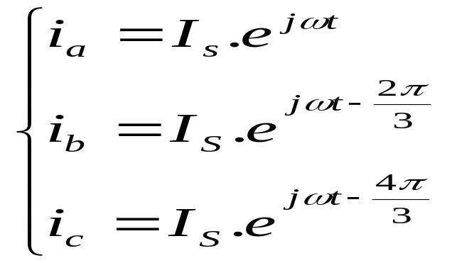
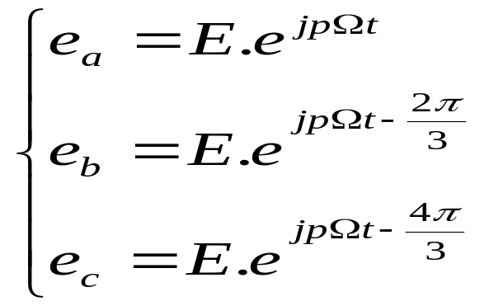
3 – Phase - Motor (PMSM)
c
i_{c}
N
S
a
i_{b}
i_{a}
b
For most three phase machines, the winding is stationery, and magnetic field is rotating
Three phase machines have three stator windings, separated 120° apart physically
Three phase stator windings produce three magnetic fields, which are spaced 120°in time

Slide 4
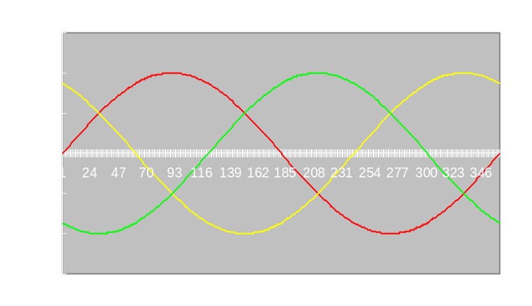

3 – Phase - Motor
Three stationary pulsating magnetic fields
ia
A`
The three phase winding produces three magnetic fields, which are spaced 120° apart physically.
When excited with three sine waves that are a 120° apart in phase, there are three pulsating magnetic fields.
Fc
C
B
Fa
C`
Fb
B`
A
Phase currents
ia
ib
ic
The resultant of the three magnetic fields is a rotating magnetic field.

Slide 5
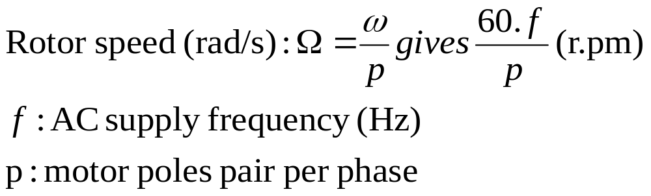
Synchronous Motor
A`
Rotor field
Rotor is carrying a constant magnetic field created either by permanent magnets or current fed coils
The interaction between the rotating stator flux, and the rotor flux produces a torque which will cause the motor to rotate.
φ
C
F
N
B
N
S
C`
F
S
Stator field
B`
A
The rotation of the rotor in this case will be at the same exact frequency as the applied excitation to the rotor.
This is synchronous operation.
Example: a 2 poles pair synchronous motor will run at 1500 r.pm for a 50Hz AC supply frequency

Slide 6
Synchronous Motors: BLDC and PMSM
A`
Both (typically) have permanent-magnet rotor and a wound stator
BLDC (Brushless DC) motor is a permanent-magnet brushless motor with trapezoidal back EMF
PMSM (Permanent-magnet synchronous motor) is a permanent-magnet brushless motor with sinusoidal back EMF
C
F
N
B
C`
S
F
B`
A
Back EMF of BLDC Motor
Back EMF of PMSM
0⁰
30⁰
60⁰
90⁰
150⁰
210⁰
270⁰
330⁰
30⁰
90⁰
120⁰
180⁰
240⁰
300⁰
360⁰
60⁰
E_{a}
ea
eb
ec
Phase A
i_{a}
θ_{e}
1,50
Hall A
1,00
0,50
Phase B
i_{b}
θ_{e}
0,00
-0,50
1
24
47
70
93
116
139
162
185
208
231
254
277
300
323
346
Hall B
Phase C
θ_{e}
-1,00
i_{c}
-1,50
Hall C

Slide 7
3 – Phase Voltage Inverter
Upper & lower
devices can not
be turned on
simultaneously
(dead band)
DC - Voltage
+
Six PWM signals
to control
Power Switches
−
3 - phase
outputs to motor
terminals
Power
Switching
Devices

Slide 8
Scalar Control Scheme ( “ V/f ” )
ω*
Σ
PI
V
PWM1
+
PWM2
PWM
Command
PWM3
3-Phase
Inverter
PWM4
PWM5
V/f profile
f
PWM6
Speed scaling
Speed calculator
Simple to implement: All you need is three sine waves feeding the motor
Position information not required (optional).
Doesn’t deliver good dynamic performance.
Torque delivery not optimized for all speeds

Slide 9
Field Oriented Control (FOC)
Field Oriented Control (FOC) or Vector Control, is a control strategy for 3-phases induction motors where the torque producing and magnetizing components of the stator flux are separately controlled.
The approach consists in imitating the DC motors’ operation
FOC will be possible with system information: currents, voltages, flux and speed.

Slide 10
FOC control scheme
Inverse Park
ω
I_{Q}
V_{Q}
V_{q}
Σ
PID
Σ
PID
D,Q
Space
Vector
PWM
PWM1
+
+
PWM2
V_{D}
V_{d}
PWM3
3-Phase
Inverter
I_{D}
PWM4
Σ
PID
d,q
PWM5
+
PWM6
Field Weakening Controller
q_{r}
ω_{r}
I_{Q}
I_{q}
i_{a}
D,Q
d,q
i_{b}
I_{D}
I_{d}
i_{c}†
d,q
a,b,c
Park T
Clarke T
Speed Calculator
q_{r}
†: i_{a} + i_{b} + i_{c} = 0
Some key mathematical components are required!

Slide 11
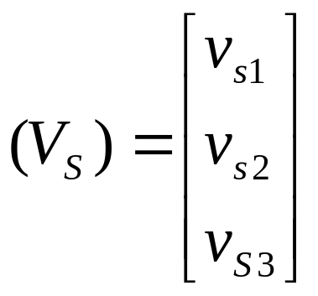


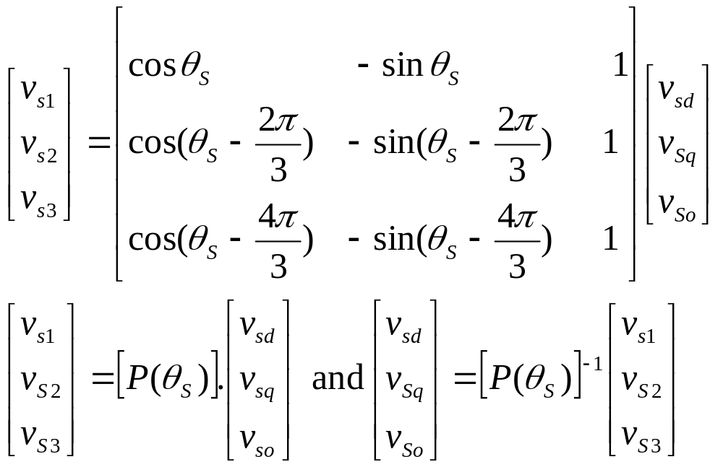





PARK transform (1929):
(Vs): voltage vector applied to motor stator (index s)
Park transform is a referential change

Slide 12
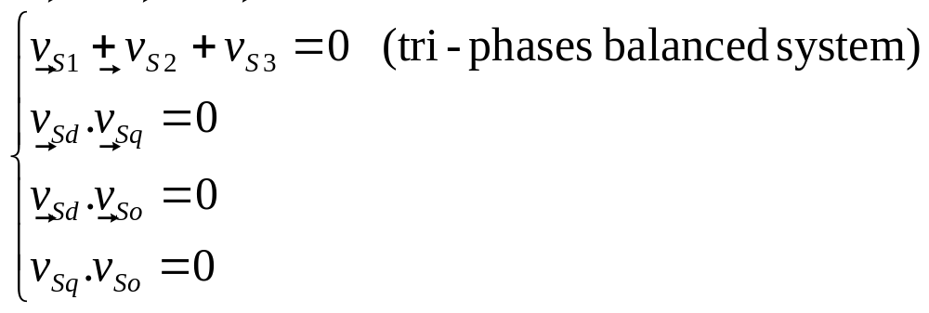
Park Transform key components
(v_{sd,} v_{sq,} v_{so}) are called the Park coordinates
v_{sd}: direct Park component
v_{sq}: squaring Park component
v_{so}: homo-polar Park component
V_{so} is null for a three-phases balanced system
Each pair of components is perpendicular to each other

Slide 13
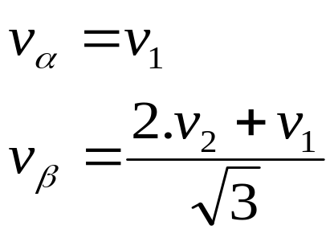
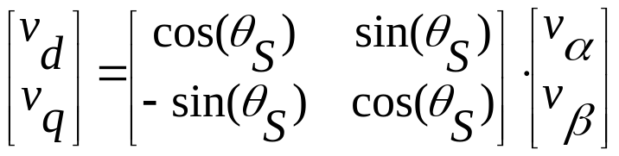
CLARKE – Transformation
Transform is usually split into CLARKE transform and one rotation
CLARKE converts balanced three phase quantities into balanced two phase orthogonal quantities
CLARKE
v_{β}
v₂
v_{d}
v_{q}
+
v₁= v_{α}
Rotation
v₃
PARK TRANSFORM

Slide 14





PARK Transform summary
v_{α}
v₁
V_{d}
v₂
Clarke
Park
v_{β}
v₃
V_{q}
Three phase rotating domain
Two phase rotating domain
Stationary domain
I_{S}
β
d
Stator phase current example: I_{s} is moving at θ_{S} and its PARK coordinates are constant in (d,q) rotating frame.
Can be applied on any three-phase balanced variables (flux…)
I_{Sd}
q
I_{Sq}
α

Slide 15
Texas Instruments Motor Control Solution
“C2000 - Digital Motor Control Library (DMC)” :
Single Phase ACI Motor Control Using Constant V/Hz
3-Phase ACI Motor Constant V/Hz Control
3-Phase ACI Motor Field Oriented Control
3-Phase Sensored Field Oriented Control (PMSM)
3-Phase Sensorless Field Oriented Control (PMSM)
3-Phase Sensored Trapezoidal Control (BLDC)
3-Phase Sensorless Trapezoidal Control (BLDC)

Slide 16
Digital Motor Control Library (DMC-Lib)
The DMC-Library is a collection of most commonly used algorithms and function blocks for motor control systems
For every algorithm and function:
  Essential theoretical background information
  Data types for input/output parameters with numerical range and precision
  Function prototypes and calling conventions
  code size (program and data memory)
  Build Level based code examples

Slide 17
Digital Motor Control Library (DMC-Lib)
The DMC-Lib contains
PID regulators,
Clarke transformers,
Park transformers,
Ramp generators,
Sine generators,
Space Vector generators,
Impulse generators,
and more…

Slide 18
Laboratory: FOC for PMSM
T_{a}
PWM1
i_{qs}*
v_{qs}*
v_{αs}*
PWM2
PI
PI
Space
Vector
Gen.
PWM3
Inv.
Park
T_{b}
PWM
Driver
v_{ds}*
PWM4
i_{ds}*
v_{ds}*
v_{βs}*
T_{c}
PWM5
PI
PWM6
Voltage
Source
Inverter
θ_{λr}
i_{ds}
i_{αs}
i_{as}
ADCIN1
Ileg2_
Bus
Driver
Park
Clarke
ADCIN2
i_{qs}
i_{βs}
i_{bs}
ADCIN3
Encoder
PMSM
SPEED
FRQ
QEP_A
ω_{r}
θ_{e}
QEP
THETA
DRV
QEP_B
dir
QEP_inc
TMS320F28x controller

Slide 19
TI Library Solution “PMSM 3-1” (sprc129)
Hardware for Laboratory setup:
Spectrum Digital eZdsp TMS320F2812
Spectrum Digital DMC550 drive platform
3-phase PMSM with a QEP encoder
  Applied Motion 40mm Alpha Motor
  Type: A0100-104-3-100
24V DC power supply ( DC bus voltage )
load , e.g. DC Motor as Generator
PC parallel port to JTAG
5V DC ( eZdsp )
RS232 ( optional )
Oscilloscope

Slide 20
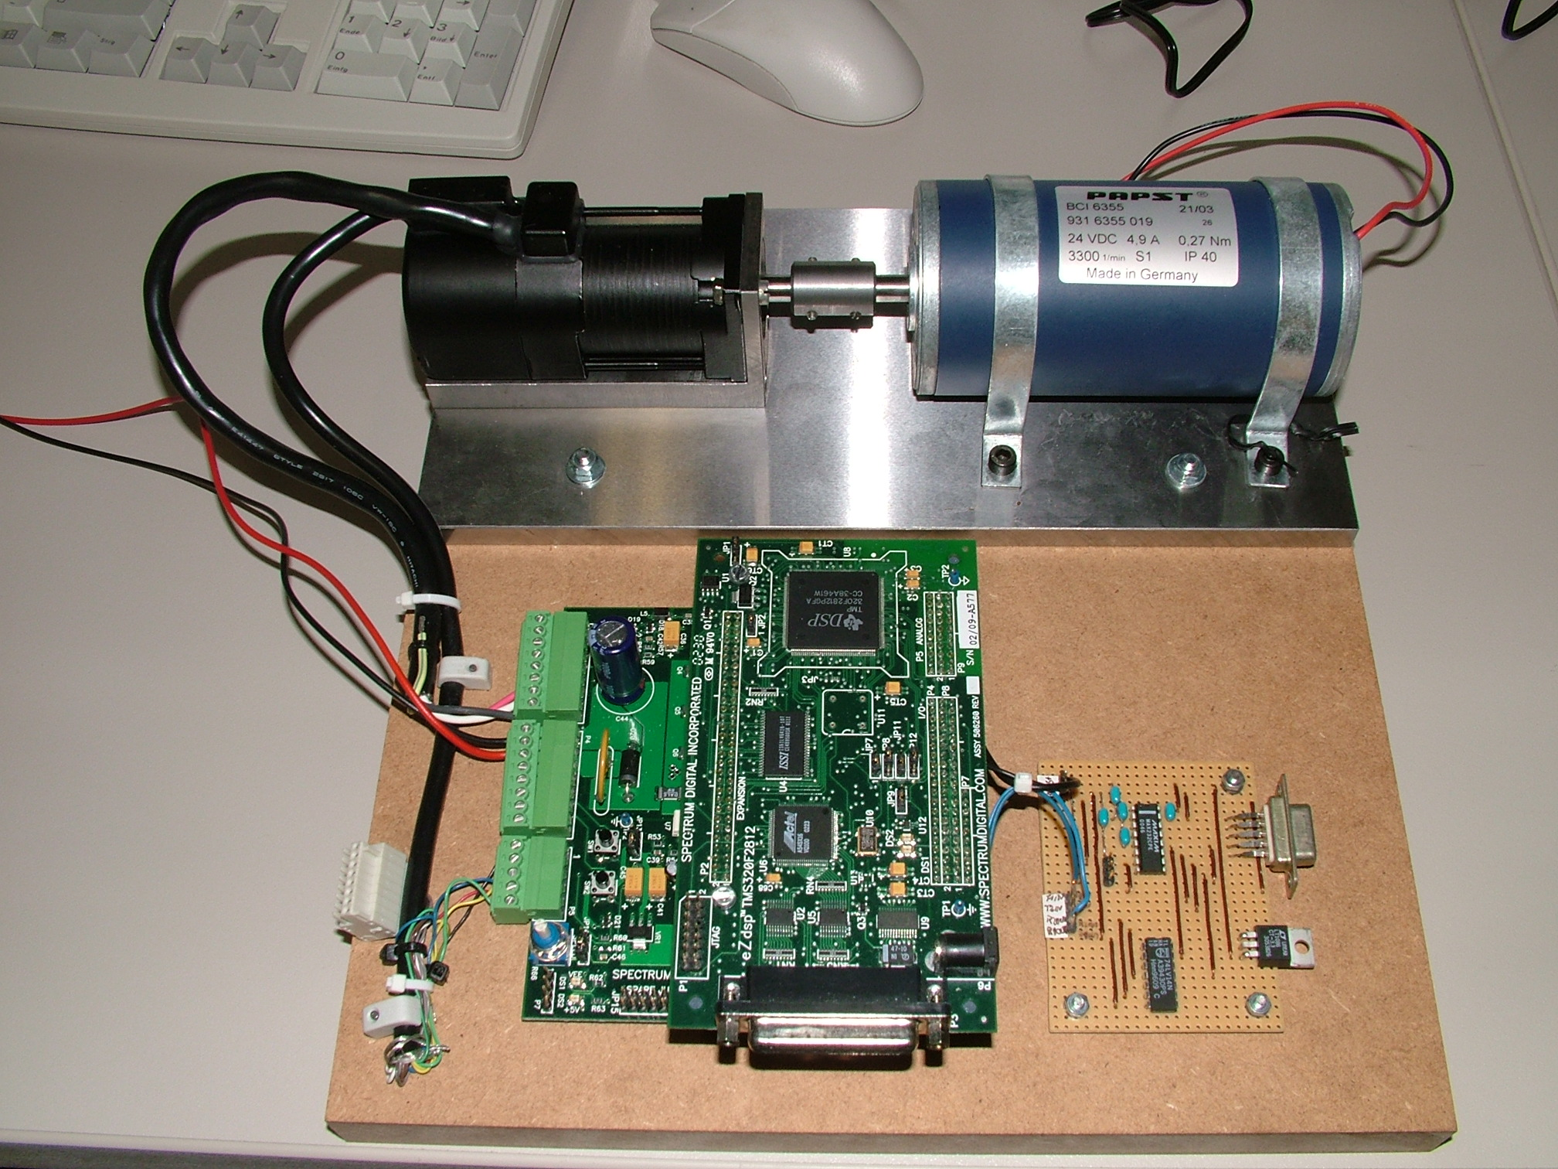
TI Library Solution “PMSM 3-1” (sprc129)
PMSM 3-1
Load
24V
eZdsp
RS232
(optional)
DMC 550
5V DC
PC- parallel port

Slide 21
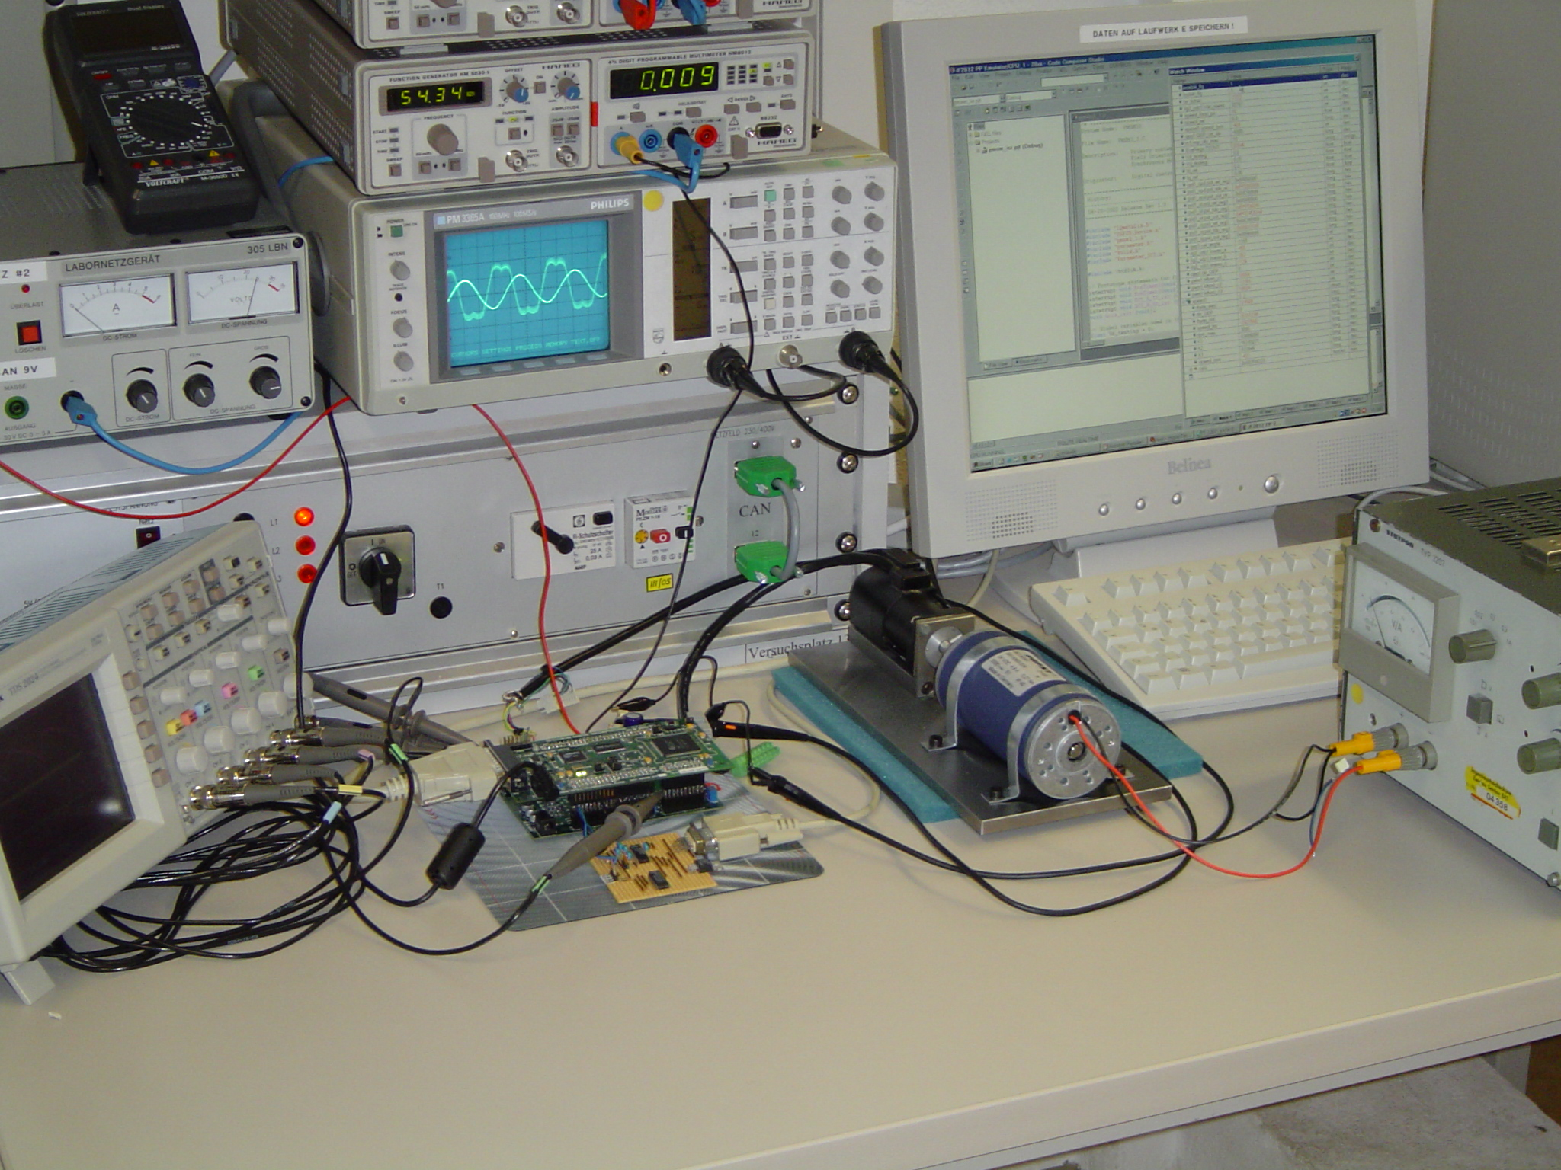
PMSM 3-1 Laboratory
Student Workbench

Slide 22
TI DMC Library Modules
v_{αs}
v_{qs}
v_{qs}
v_{αs}
i_{as}
i_{αs}
Inv.
Park
v_{βs}
Park
v_{ds}
v_{ds}
v_{βs}
i_{bs}
Clarke
i_{βs}
θ_{λr}
θ_{λr}
Variable transformation from
phase ab-axis to
stationary αβ-axis
Variable transformation from
stationary αβ-axis to
synchronously rotating dq-axis
Variable transformation from
synchronously rotating dq-axis to
stationary αβ-axis
v_{αs}
T_{a}
Space
Vector
Gen.
T_{b}
v_{βs}
T_{c}
Space-vector generator producing
the duty cycle ratio of PWM signals

Slide 23
TI DMC Library Modules
i_{qs}*
θ_{e}
θ_{e}
v_{qs}*
QEP_A
SPEED
FRQ
ω_{r}
QEP
THETA
DRV
θ_{m}
i_{qs}
PI
QEP_B
dir
QEP_ind
dir
QEP driver and
shaft position and rotor direction
Proportional-Integral
controller
Speed estimation from
rotor position and rotor direction
T_{a}
PWM1
i_{as}
ADCIN1
Ileg2_
Bus
Driver
PWM
Driver
PWM2
i_{bs}
T_{b}
PWM3
ADCIN2
PWM4
V_{dc}
T_{c}
PWM5
ADCIN3
PWM6
ADC driver for two line currents
and DC-bus voltage measurement
PWM generation

Slide 24
Build Level 1
T_{a}
PWM1
Vq_testing
v_{αs}*
PWM2
Space
Vector
Gen.
T_{b}
PWM
Driver
PWM3
Inv.
Park
PWM4
Vd_testing
v_{βs}*
T_{c}
PWM5
PWM6
rmp_out
speed_ref
Ramp
control
Ramp
Gen.
key modules under test
TMS320F28x controller

Slide 25

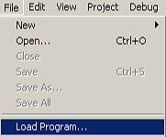
Code Composer Studio with
Real Time Mode
Load a workspace file ‘pmsm3_1.wks’
In build.h, #define BUILDLEVEL LEVEL1
Rebuild all
Load program to target (..\pmsm3_1.out)

Slide 26
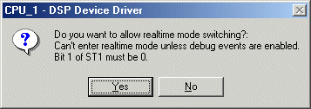
Code Composer Studio with
Real Time Mode
5. In Debug menu, “Reset CPU” and then set
“Real-time Mode”. Then, click “Yes” when the message box pops up.
6. Click “Run” icon

Slide 27
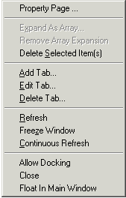
Code Composer Studio with
Real Time Mode
7. Right click on watch window. Then, check “Continuous Refresh”.
8. Set “enable_flg” to 1 in watch window.
(to enable T1UF interrupt and PWM drive on DMC550)

Slide 28
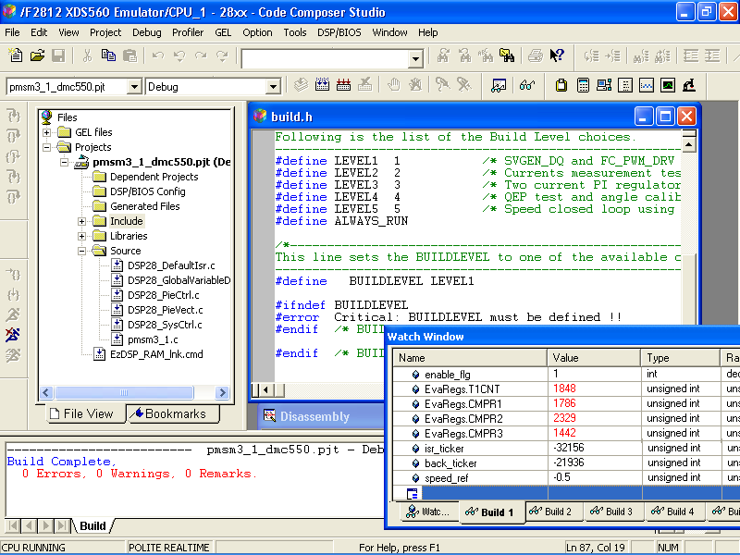
Code Composer Studio Level 1
Changing !!
watch window
for build 1

Slide 29
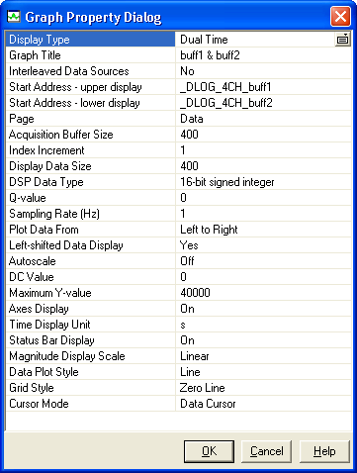
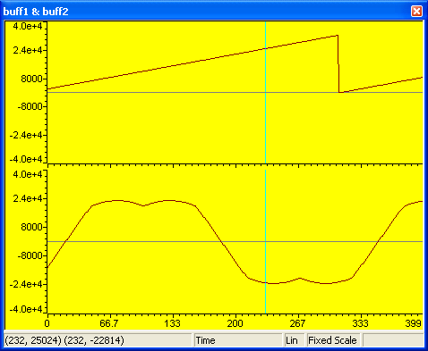
Results: Build Level 1
rmp_out
Ta

Slide 30
Build Level 2 – Current verification
T_{a}
PWM1
Vq_testing
v_{αs}*
PWM2
Space
Vector
Gen.
T_{b}
PWM
Driver
PWM3
Inv.
Park
PWM4
Vd_testing
v_{βs}*
T_{c}
PWM5
PWM6
Voltage
Source
Inverter
θ_{e}
i_{ds}
i_{αs}
i_{a}
ADCIN1
Ileg2_
Bus
Driver
Park
Clarke
ADCIN2
i_{qs}
i_{βs}
i_{b}
ADCIN3
key module under test
Encoder
PMSM
Speed_ref
Ramp
control
Ramp
Gen.
rmp_out
TMS320F28x controller

Slide 31
Instructions: Build Level 2
Tune the 24V Power Supply to 10 Volts with 1 Amp limit
Load a workspace file ‘pmsm3_1.wks’
In build.h, #define BUILDLEVEL LEVEL2
Reset CPU, Compile, Load, start RTM and Run
Switch on 24V Power Supply
Set variable “enable_flg” to 1 in watch window.
Try to change motor speed by setting “speed_ref” (p.u.) in watch window. Then, motor should change its speed accordingly.

Slide 32
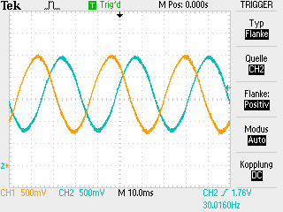
Results: Build Level 2
PMSM should run open-loop smoothly
The currents in the motor phases should be sinusoidal.

Slide 33
Build Level 3 - Tuning of dq-axis current closed loops
key modules under test
T_{a}
PWM1
Iq_ref
v_{qs}*
v_{αs}*
PWM2
PI
Space
Vector
Gen.
T_{b}
PWM3
Inv.
Park
PWM
Driver
PWM4
Id_ref
i_{ds}*
v_{ds}*
v_{βs}*
PWM5
T_{c}
PI
PWM6
Voltage
Source
Inverter
rmp_out
i_{ds}
i_{αs}
i_{a}
ADCIN1
Ileg2_
Bus
Driver
Park
Clarke
ADCIN2
i_{qs}
i_{βs}
i_{b}
ADCIN3
Encoder
PMSM
Speed_ref
Ramp
control
Ramp
Gen.
TMS320F28x controller

Slide 34
Instructions: Build Level 3
In build.h, #define BUILDLEVEL LEVEL3
Compile, Load, start RTM and Run
Set “enable_flg” to 1 in watch window.
Tune-up the PI
  Observe dq-axis current regulations at PI inputs (i.e., reference and feedback). For example, “pid1_iq.pid_ref_reg3” and “pid1_iq.pid_fdb_reg3”.
  Try to change motor speed by setting “speed_ref” (p.u.) in watch window . Then, observe dq-axis current regulations.
ref
P
I
D
out
fdb

Slide 35
Build Level 4 – Encoder verification
T_{a}
PWM1
Iq_ref
v_{qs}*
v_{αs}*
PWM2
PI
Space
Vector
Gen.
T_{b}
PWM3
Inv.
Park
PWM
Driver
PWM4
v_{ds}*
Id_ref
v_{ds}*
v_{βs}*
T_{c}
PWM5
PI
PWM6
Voltage
Source
Inverter
rmp_out
i_{ds}
i_{αs}
i_{a}
ADCIN1
Ileg2_
Bus
Driver
Park
Clarke
ADCIN2
i_{qs}
i_{βs}
i_{b}
ADCIN3
Speed_ref
Ramp
control
Ramp
Gen.
Encoder
PMSM
Theta_elec
QEP_A
θ_{m}
QEP
THETA
DRV
QEP_B
dir
QEP_inc
TMS320F28x controller

Slide 36
Instructions: Build Level 4
In build.h, #define BUILDLEVEL LEVEL4
Compile, Load, start RTM and Run
Set the DC-bus to 24 Volts 1 Amp
Set “enable_flg” to 1 in watch window.

Slide 37
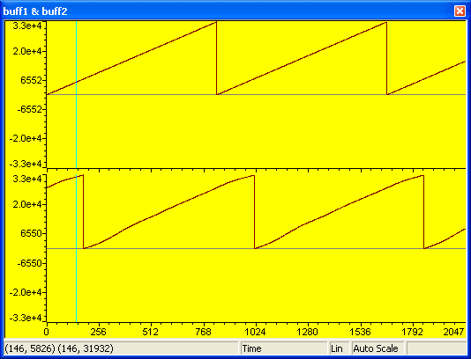
Results: Build Level 4
Emulated angle VS sensed angle

Slide 38
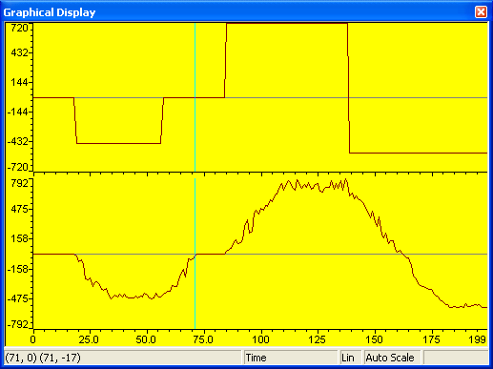
Results: Build Level 4
Speed reference VS real speed

Slide 39
Build Level 5 – close speed loop
T_{a}
PWM1
i_{qs}*
v_{qs}*
v_{αs}*
PWM2
PI
PI
Space
Vector
Gen.
PWM3
Inv.
Park
T_{b}
PWM
Driver
v_{ds}*
PWM4
i_{ds}*
v_{ds}*
v_{βs}*
T_{c}
PWM5
PI
PWM6
Voltage
Source
Inverter
θ_{λr}
i_{ds}
i_{αs}
i_{as}
ADCIN1
Ileg2_
Bus
Driver
Park
Clarke
ADCIN2
i_{qs}
i_{βs}
i_{bs}
ADCIN3
Encoder
PMSM
SPEED
FRQ
QEP_A
ω_{r}
θ_{e}
QEP
THETA
DRV
QEP_B
dir
QEP_inc
TMS320F28x controller

Slide 40
Instructions: Build Level 5
In build.h, #define BUILDLEVEL LEVEL5
Compile, Load, start RTM and Run
Set the DC-bus to 24 Volts
Set “enable_flg” to 1 in watch window.

Slide 41
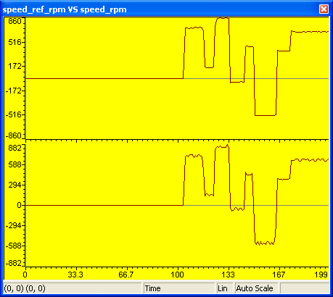
Results: Build Level 5
Fastest response time with the closed loop!

Slide 42
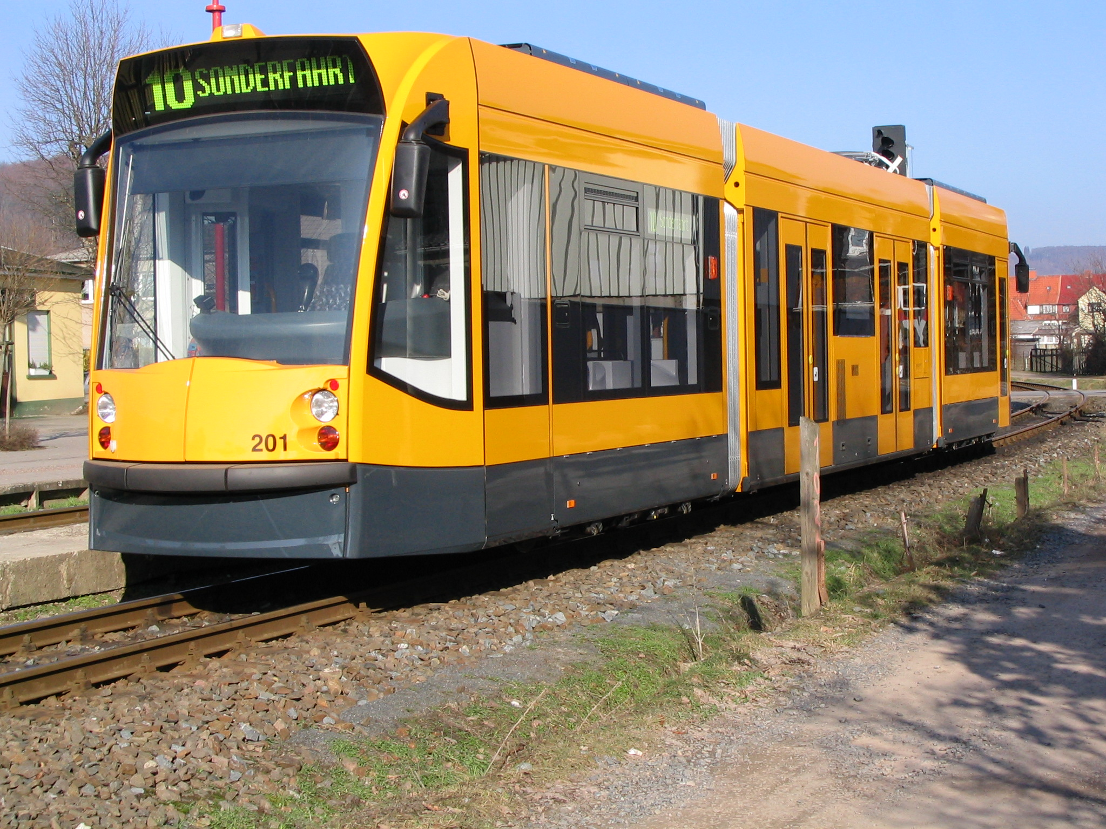
Application of PMSM 3-1:
img GmbH Nordhausen

