Slide 1
Module 3: Program Development Tools
Digital Signal Controller
TMS320F2833x
Texas Instruments Incorporated
European Customer Training Centre
University of Applied Sciences Zwickau
Notes:
1

Slide 2
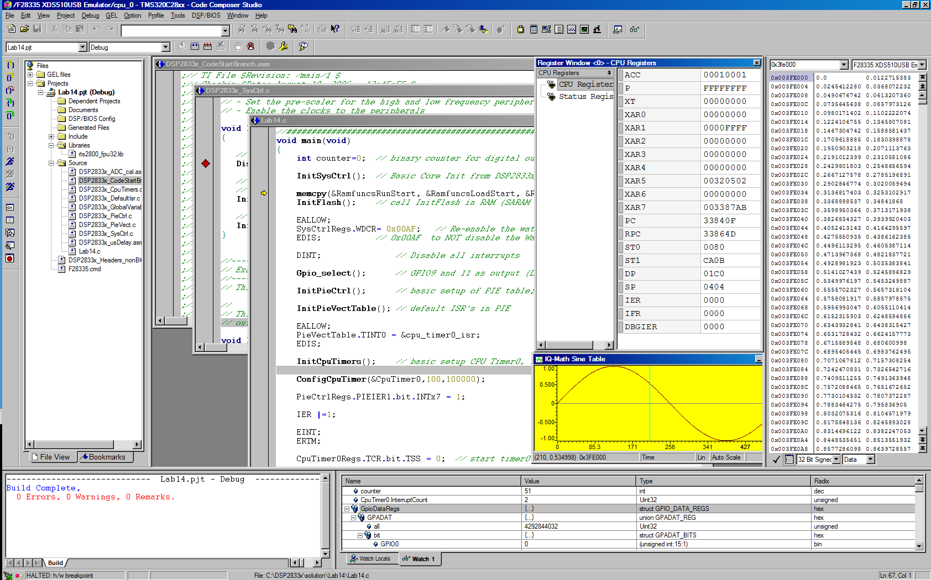
Code Composer Studio
Menus or Icons
Help
CPU Window
Project Manager:
Source & object files
File dependencies
Compiler, Assembler & Linker build options
Full C/C++ & Assembly
Debugging:
C & ASM Source
Mixed mode
Disassembly (patch)
Set Break Points
Set probe Points
Productive Editor:
Structure Expansion
Status window
Watch window
Memory window
Graph window

Slide 3
Code Composer Studio
Build
Code
Simulator
Compile
lnk.cmd
eZdsp™
Asm
Link
Debug
Editor
Emulator
(XDS100)
Libraries
Graphs,
Profiling
MCU
Board
Code Composer Studio includes:
  Integrated Edit/Debug Graphical User Interface
  Code Generation Tools
  Real – Time Operating System (DSP/BIOS)

Slide 4
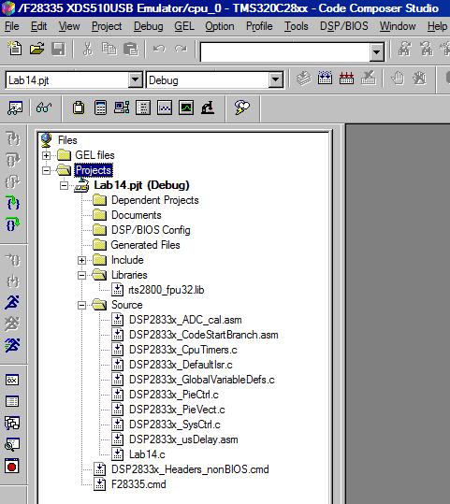
Code Composer Studio: IDE
Integrates: edit, code generation, and debug
Single-click access using buttons
Powerful graphing/profiling tools
Automated tasks using GEL scripts
Built-in access to BIOS functions
Support TI or 3rd party plug-ins

Slide 5
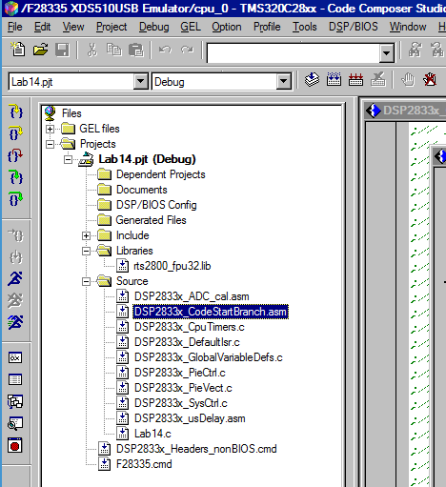
The Project - File
Project (.pjt) files contain:
Source files (by reference)
  Source (C, assembly)
  Libraries
  DSP/BIOS configuration
  Linker command files
Project settings:
  Build Options (compiler and assembler)
  Build configurations
  DSP/BIOS
  Linker

Slide 6
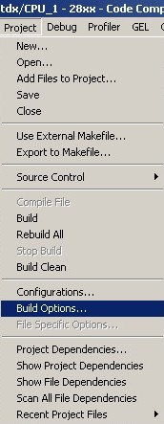
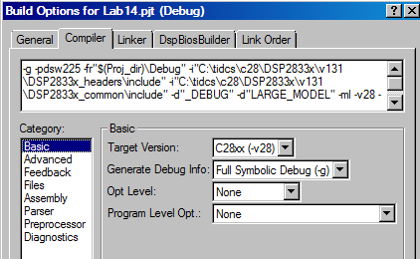
Build Options GUI - Compiler
GUI has 8 pages of categories for code generation tools
Controls many aspects of the build process, such as:
  Optimization level
  Target device
  Compiler/assembly/link options

Slide 7
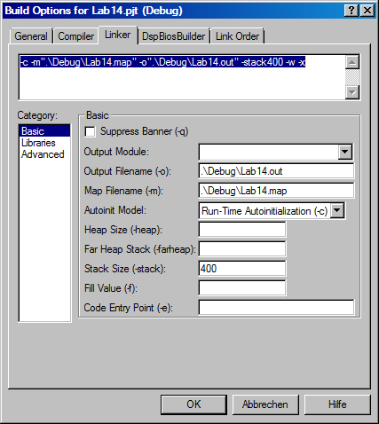
Build Options GUI - Linker
GUI has 3 categories for linking
Specifies various link options
“.\Debug\” indicates on subfolder level below project (.pjt) location

Slide 8
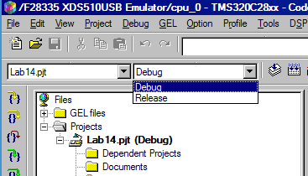
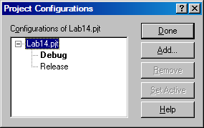
Default Build Configurations
For new projects, CCS automatically creates two build configurations:
  Debug (unoptimized)
  Release (optimized)
Use the drop-down menu to quickly select the build configuration
Add/Remove your own custom build configurations using Project Configurations
Edit a configuration:
  Set it active
  Modify build options
  Save project

Slide 9
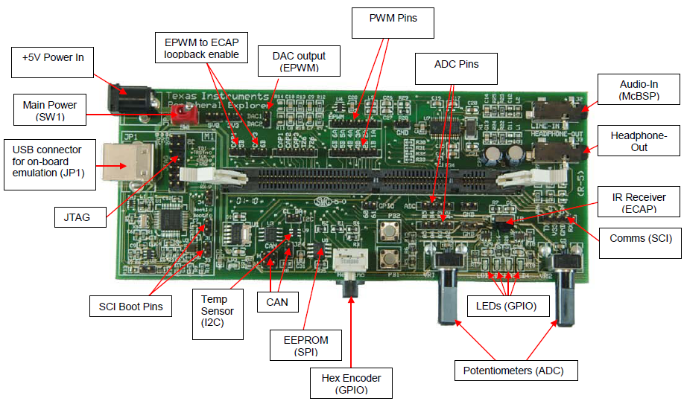
Peripheral Explorer Board

Slide 10
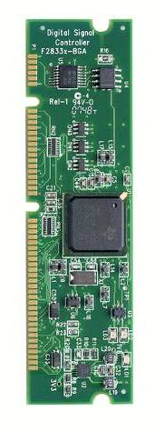
F28335 Control Card
Low cost single-board controllers
  perfect for initial development and small volume system builds.
Small form factor with standard 100-pin DIMM interface
F28x analog I/O, digital I/O, and JTAG signals available at DIMM interface
Isolated RS-232 interface
Single 5V power supply required
Versions:
  “Piccolo” F28027 (TMDXCNCD28027)
  “Piccolo” F28035 (TMDXCNCD28035)
  F28044 (TMDSCNCD28044)
  F2808 (TMDSCNCD2808)
  “Delfino” F28335 (TMDSCNCD28335)
  “Delfino” C28343 (TMDXCNCD28343)

Slide 11
Learning by doing - Step by Step
Code Composer Studio® - The Basics
  The Start - up – Window
  Create a F2833x - project, based on C language
  Debug your program
  Watch your variables
  Perform a Single Step Debug
  Use Breakpoints
  Real – Time – Debug
  CPU Register Set
  Memory Window
  Graph Window
  Mixed Mode Display
  Assembly Single Step
  GEL - General Extension Language

Slide 12
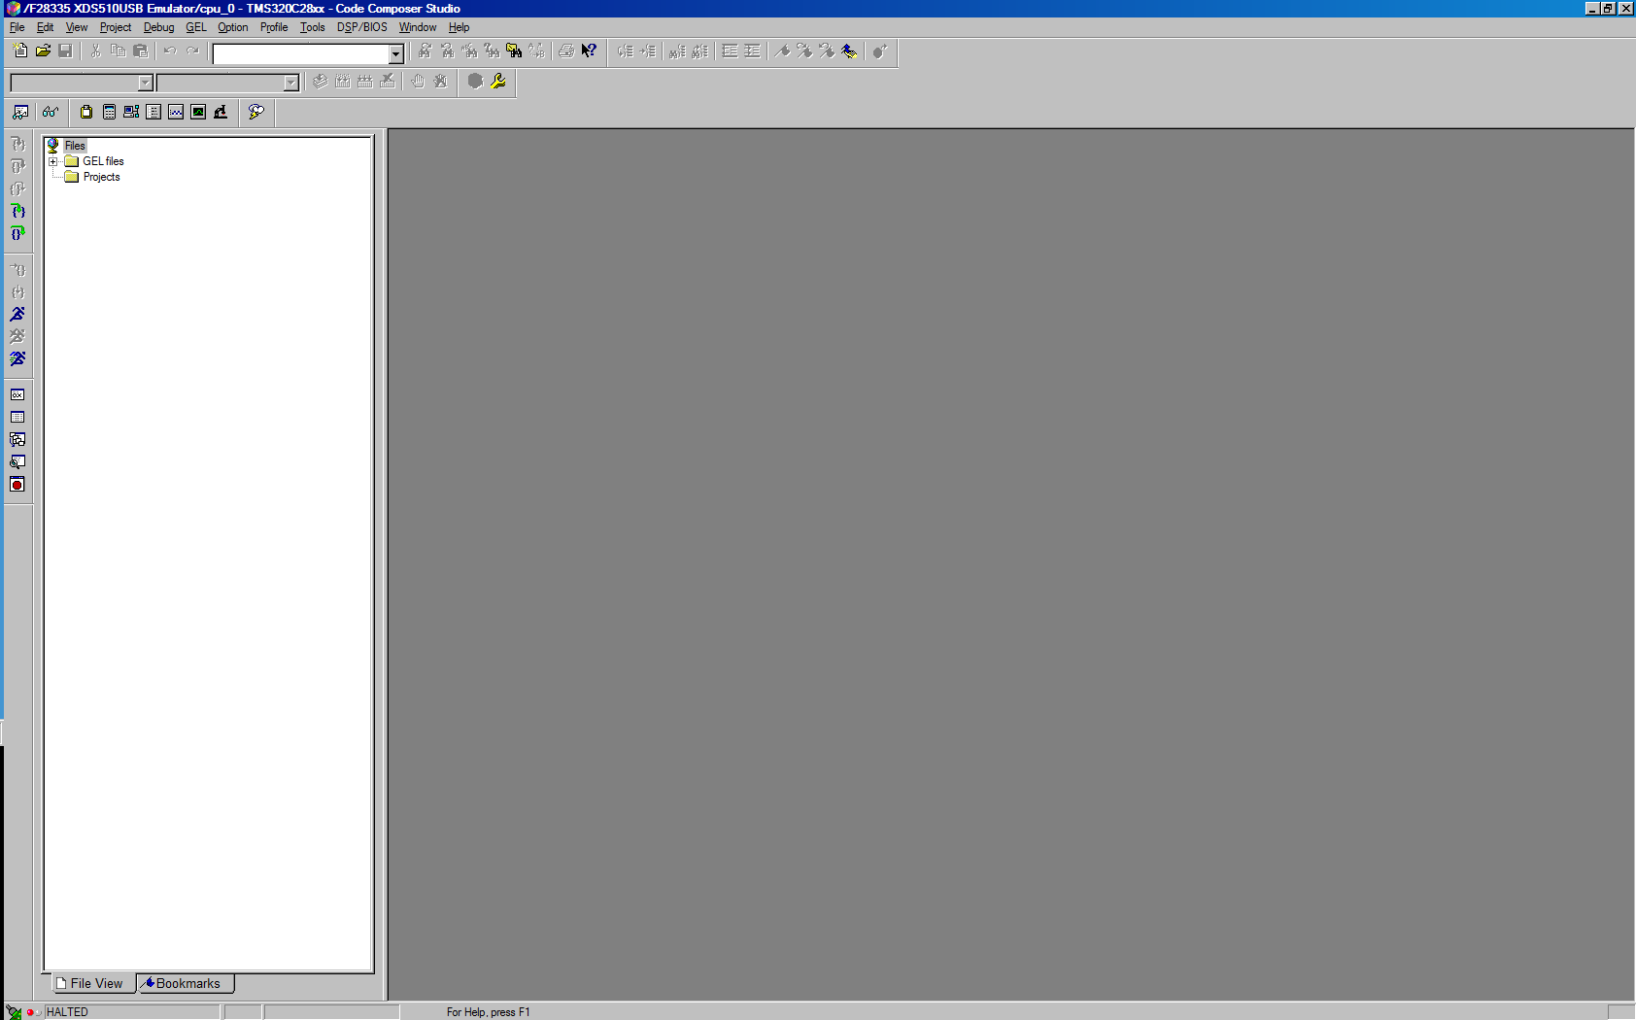
1. The Start up - Window
Workspace
Project-
tree

Slide 13
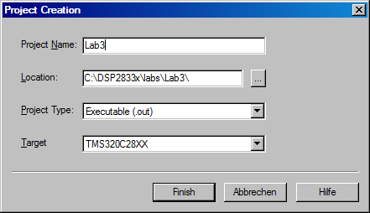
2. Create a F2833x - project
  Project ==> New
  give your project a name: “Lab3”, select a target and a suitable location on your hard disk:
  Note : the project file (“Lab3.pjt”) is a simple ASCII-text file and stores
  the set-up and options of the project. This is very useful for a revision management.

Slide 14
2. Create a F2833x - project (cont.)
Write a C-Source Code :
    ➔File ➔New ➔Source File
    unsigned int k = 0;
    void main(void)
    {
    unsigned int i;
    while(1)
    {
    for(i=0;i<100;i++)
    {
    k=i*i;
    }
    }
    }
  ➔ File ➔Save as : “lab3.c”

Slide 15
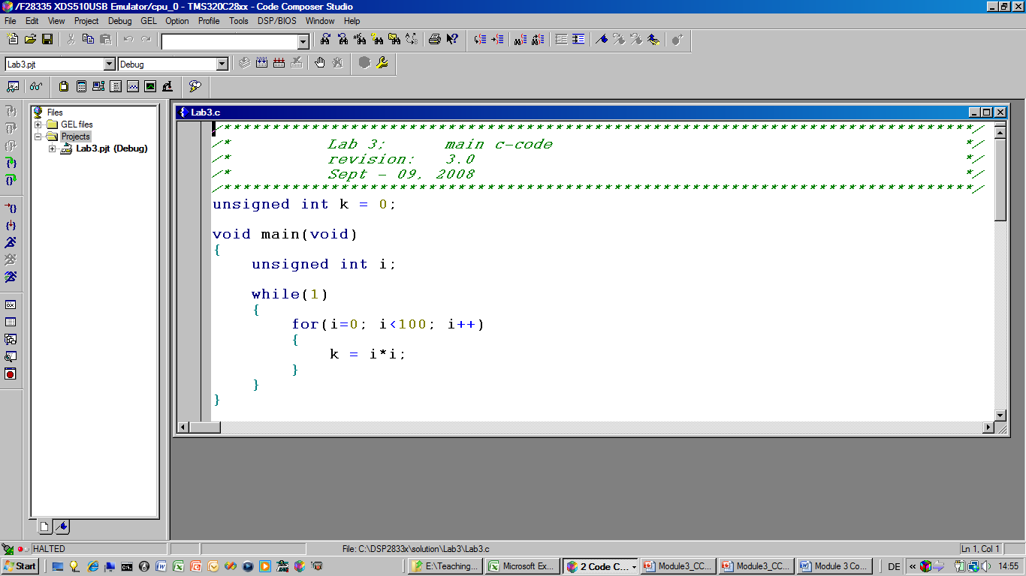
2. Create a F2833x - project (cont.)

Slide 16
2. Create a F2833x - project (cont.)
Add your file to the project :
    ➔ Project ➔ Add files to project:
    Add: “lab3.c”
Compile your source code :
    ➔ Project ➔ Compile File
  The active window will be compiled. In the event of syntax errors: modify your source code as needed.
Add the C-runtime-library to your project :
  ➔ Project ➔ Add files to project:
  C:\CCStudio_v3.3\C2000\cgtools\lib\rts2800_ml.lib
Add the stack - size of 0x400
  ➔ Project ➔ Build Options ➔ Linker ➔ Stack Size : 0x400

Slide 17
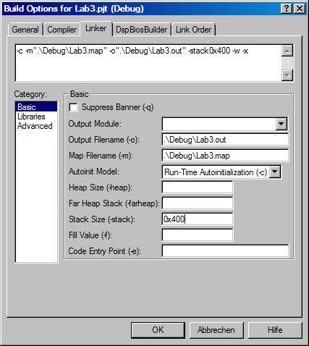
2. Create a F2833x - project (cont.)
Close the build-window by ‘OK’

Slide 18
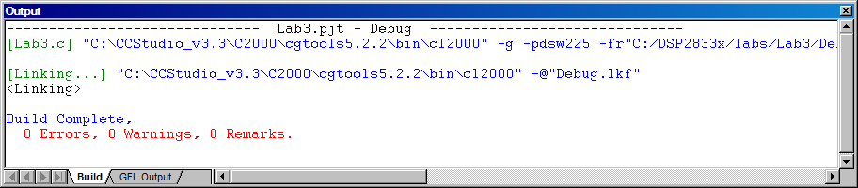
2. Create a F2833x - project (cont.)
Add the Linker - Command File to your project:
  Project ➔ Add Files to Project:
C:\tidcs\c28\DSP2833x\v131\DSP2833x_common\cmd\28335_RAM_lnk.cmd
Finally, build the code (compile / assemble / link):
  ➔ Project ➔ Build
Watch the tools running:

Slide 19
C – Compiler Sections
Global vars (.ebss)
Init values (.cinit)
unsigned int k = 0;
void main(void)
{
unsigned int i;
while(1)
{
for(i=0;i<100;i++)
{
k=i*i;
}
}
}
Local vars (.stack)
Code (.text)

Slide 20
Compiler Section Names
Initialized Sections
Name | Description | Link Location
.text | code | FLASH*
.cinit | initialization values for global and static variables | FLASH*
.econst | constant variables (e.g. const int m=3;) | FLASH*
.switch | tables for addresses in “switch – case” lines | FLASH*
.pinit | tables for global constructors (C++) | FLASH*
Uninitialized Sections
Name | Description | Link Location
.ebss | global and static variables | RAM
.stack | stack memory area | RAM (lower 64K)
.esysmem | heap memory for dynamic memory allocation. | RAM
Note: (*)During development initialized sections could be linked to RAM since the emulator can be used to load the RAM

Slide 21
Placing Sections in Memory
Memory
Sections
0x00 0000
M0SARAM
(0x400)
.ebss
0x00 0400
M1SARAM
(0x400)
.stack
0x30 0000
.cinit
FLASH
(0x40000)
.text

Slide 22
Linking
Memory description
How to place Software
Sections into Memory
name.cmd
.obj
Linker
.out
.map

Slide 23
Linker Command File
MEMORY
{
PAGE 0: /* Program Space */
FLASH: org = 0x300000, len = 0x40000
PAGE 1: /* Data Space */
M0SARAM: org = 0x000000, len = 0x400
M1SARAM: org = 0x000400, len = 0x400
}
SECTIONS
{
.text: > FLASH PAGE 0
.ebss: > M0SARAM PAGE 1
.cinit: > FLASH PAGE 0
.stack: > M1SARAM PAGE 1
}

Slide 24
2. Create a F2833x - project (cont.)
Make sure the USB is connected to the board
Connect CCS to your Target
  ➔ Debug ➔ Connect
Load the binary code into the DSP :
  File ➔ Load Program ➔ Debug\Lab3.out
Note: a new binary code can be downloaded automatically into the target. This is done by:
  ➔ Option ➔ Customize ➔ Program/Project/CIO ➔ Program Load ➔Load Program after Build.
Run the program until the beginning of “main()”. Perform:
  ➔ Debug ➔ Reset CPU <CTRL + R>
  Debug ➔ Restart <CTRL + SHIFT + F5>
  Debug ➔ Go main <CTRL +M>

Slide 25
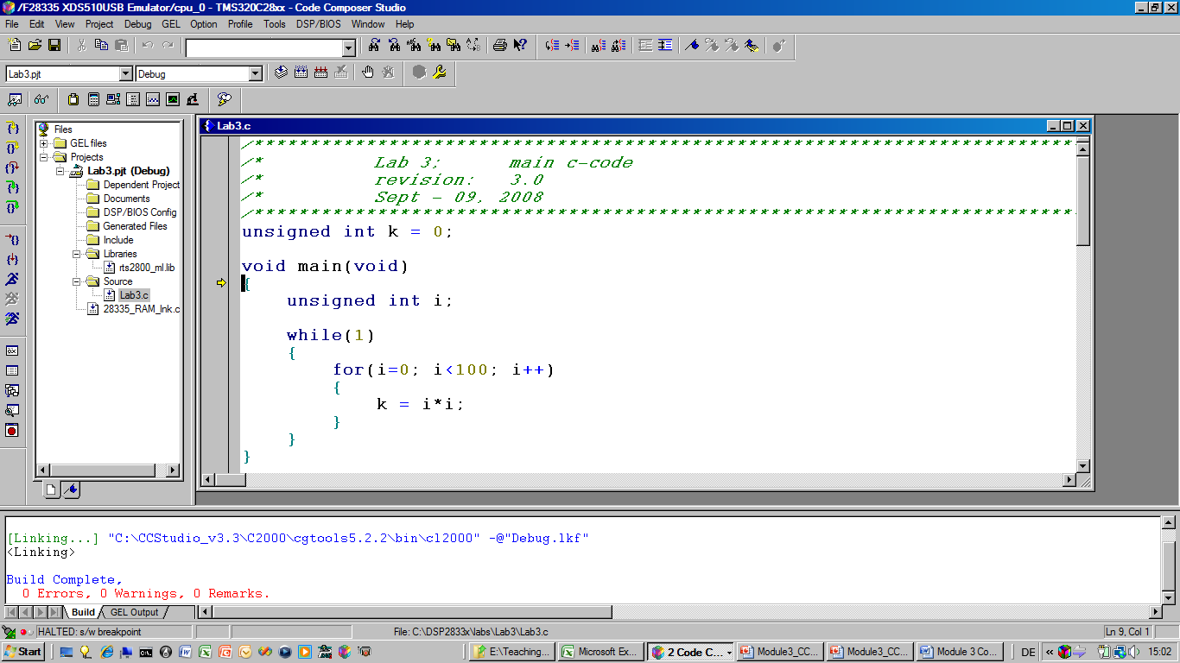
2. Create a F2833x - project (cont.)
yellow arrow:
current position
of PC

Slide 26
3. Run and Halt
Perform a real time run:
  ➔ Debug ➔ Run (F5)
  Note 1: the bottom left corner will be marked as : “Running”.
  You’ll see no activity at the Peripheral Explorer Board, because the first example program does not use any of them!
  Note 2: the yellow arrow is no longer visible, because the F2833x runs at full speed.
Stop the real time run:
  ➔ Debug ➔ Halt <SHIFT + F5>
Repeat the steps to reach “main()” again:
  ➔ Debug ➔ Reset CPU <CTRL + R>
  Debug ➔ Restart <CTRL + SHIFT + F5>
  Debug ➔ Go main <CTRL +M>

Slide 27
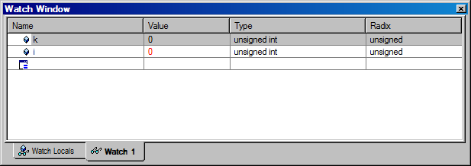
4. Watch your variables
Open the Watch Window: ➔ View ➔ Watch Window
The variable ‘i’ is automatically added to the “Watch Locals”- window.
To inspect the global ‘k’ we need to add this variable manually. This can be done inside window ‘Watch 1’. In the column ‘name’ we just enter ‘k’ and in the second line ‘i’.
Another convenient way is to mark the variables inside the source code with the right mouse button and then select “Add to watch window”
In column “radix” we can change the data format between decimal, hexadecimal, binary, etc.

Slide 28
5. Perform a Single Step Debug
Perform a single step through the program:
  ➔ Debug ➔ Step Into (or use function key “F11”)
Watch the current PC (yellow arrow) and the values of variables ‘i’ and ‘k’ in Watch Window while you single step through the code !
More debug - commands are shown at the following slide:

Slide 29
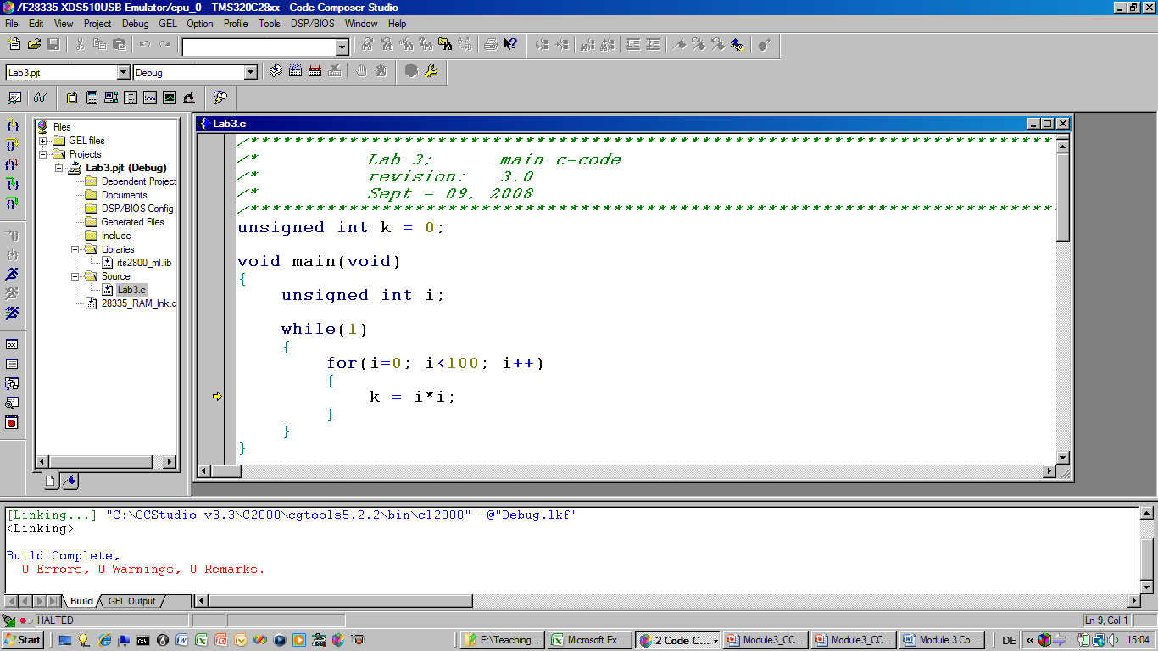
5. Perform a Single Step Debug
Source Single Step
Source Step Over
Step Out
Assembly Single Step
Assembly Step Over
Run to
cursor
Halt
Run

Slide 30
6. Adding a Breakpoint
Set a Breakpoint :
  Place the Cursor in Lab3.c at line: k = i * i;
  Click right mouse and select ‘Toggle Software Breakpoint’
  the line is marked with a red dot to indicate an active breakpoint.
  Another option to toggle a breakpoint is the “hand” – icon on the top menu of CCS.
  Or, use a left mouse double click at the grey left hand side of window “Lab3.c” to toggle the breakpoint.
Reset the Program
  ➔ Debug ➔ Reset CPU <CTRL+R>
  ➔ Debug ➔ Restart <CTRL + SHIFT + F5>
Perform a real time run
  ➔ Debug ➔ Run < F5>
  The F2833x stops after hitting an active breakpoint
repeat ‘Run’ and watch your variables
remove the breakpoint (Toggle again) when you’re done.

Slide 31
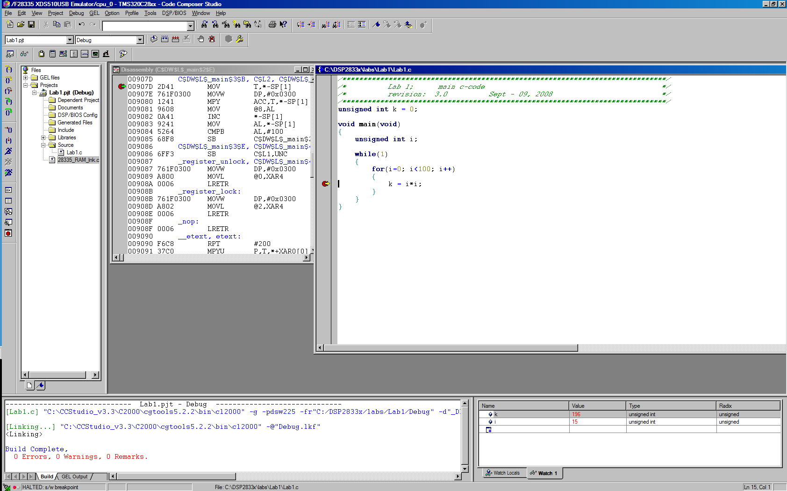
6. Adding a Breakpoint (cont. )
Toggle
Breakpoint
Remove all
Breakpoints
Red dot:
active
Breakpoint
yellow arrow:
current position
of PC

Slide 32
7. Real – Time - Debug
Reset F2833x:
  ➔ Debug ➔ Reset CPU
Watchdog – Timer:
  active after Reset.
  if not serviced, it will cause another Reset after 4.3 milliseconds.
  normally, watchdog is cleared by “Key”-instructions
  for the first lab, let us disable the watchdog:
    GEL ➔ Watchdog ➔ Disable Watchdog
Start “Real – Time – Debug”:
  ➔ GEL ➔ Realtime Emulation Control ➔ Run_Realtime_with_Restart

Slide 33
7. Real – Time – Debug (cont.)
Watch – Window:
  right mouse click into watch window and select “Continuous Refresh”.
  The variables k and i are updated in the background, while the code is running
  The execution speed of the control code is not delayed by monitoring variables.
  Note: The USB – emulator is too slow to update the watch window as fast as the F2833x executes the for-loop. That is why you will not see each iteration of i and k.
Stop Real - Time – Debug:
  ➔ GEL ➔ Realtime Emulation Control ➔ Full_Halt

Slide 34
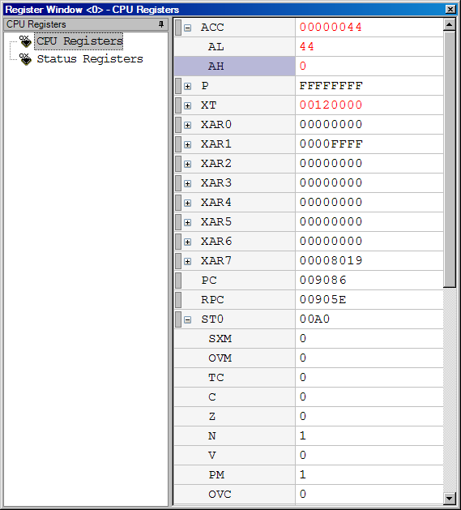
8. CPU Register Set
  View ➔ Registers ➔ CPU Registers
  right mouse click in the new window and enable: “Float in Main Window” and “Tree View”:
Allows to monitor all internal CPU registers
Register ST0 combines math status flags, such as:
  C (carry)
  Z (zero)
  N (negative)
  V (overflow)
  SXM (sign extension mode)
  OVM (overflow mode)
  TC (test control flag)
  PM (product mode shifter)
  OVC ( overflow counter)
Register ST1 combines CPU control flags.

Slide 35
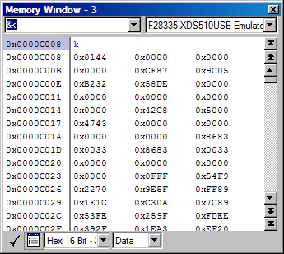
9. Memory Window
  View ➔ Memory
  make sure to inspect data space (bottom centre box)
  enter address &k in the top left corner box:
the current value in memory location of variable k is displayed
change the display type from “Hex – 16 bit” to “16 Bit Unsigned Integer”
change the display type into “16 Bit Binary”

Slide 36
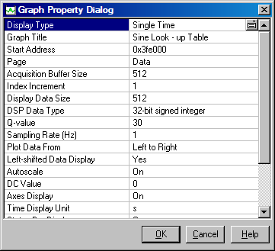
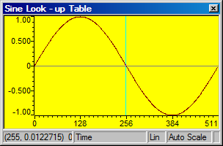
10. Graph Window
  View ➔ Graph ➔ Time/Frequency...
  View of sine-value look-up table
  in BOOT - ROM (0x3FE000)
  512 values (32 – bit signed, I2Q30)

Slide 37
11. Mixed Mode Visualization
To view both the C – source - code and the resulting Assembler – Code:
  click right mouse inside “Lab3.c” and select “Mixed Mode”
  the Assembler Instruction Code generated by the C - Compiler is added and printed in grey colour
Single Step ( ‘Assembly Step Into’ ) is now possible on instruction level
  Perform: ➔ Debug ➔ Reset CPU
  ➔ Debug ➔ Restart
  ➔ Debug ➔ Go Main
  ➔ Debug ➔ Assembly/Source Stepping ➔ Assembly Step Into (ALT + SHIFT + F11)
  You will see two arrows, a yellow one at a C-line and a green one at the current assembler instruction-line
  “Assembly Single Step” allows to monitor the internal machine code flow.

Slide 38
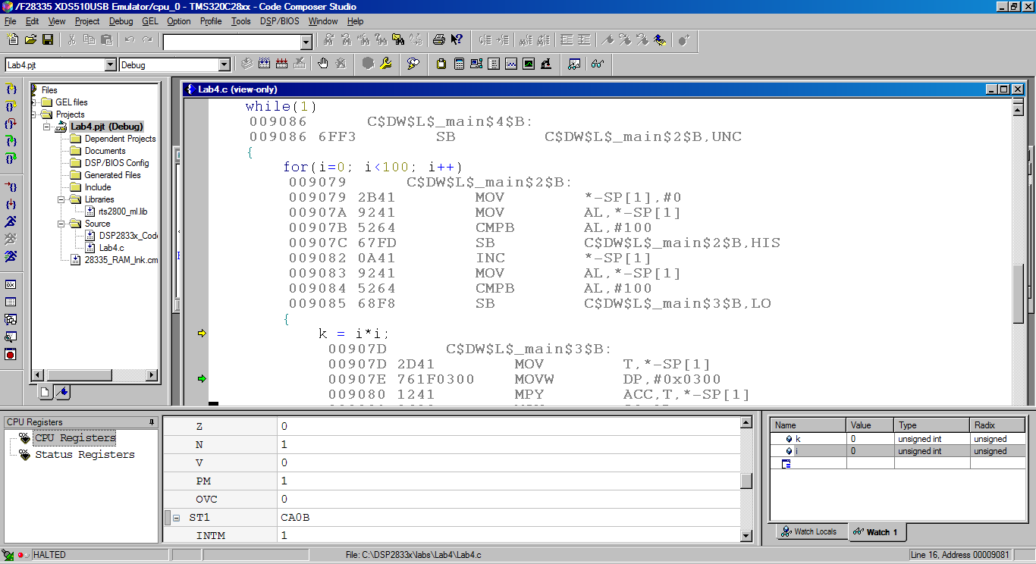
12. Assembly Single Step
ASM –
single step
Current
C - line
Current
ASM -
Instruction
Note: When you are done with mixed mode, switch the visualization
back to „Source Mode“ (right mouse click).

Slide 39
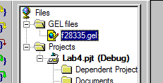
13. GEL - “General Extension Language”
High level language similar to C
Used to extend Code Composer Studio’s features
to create GEL functions use the GEL grammar
load GEL-files into Code Composer Studio
With GEL, you can:
  access actual/simulated target memory locations
  add options to Code Composer’s GEL menu
GEL is useful for automated testing and user workspace adjustment .
In project “Lab3.pjt”, open and inspect file “f28335.gel”:

Slide 40




