Slide 1

Module 12: Inter Integrated Circuit F2833x
32-Bit-Digital Signal Controller
TMS320F2833x
Texas Instruments Incorporated
European Customer Training Centre
University of Applied Sciences Zwickau

Slide 2
Inter Integrated Circuit(I²C, IIC)
Philips I2C-bus specification compliant, version 2.1
Data transfer rate from 10 kbps up to 400 kbps
Each device can be considered as a Master or Slave
Master initiates data transfer and generates clock signal
Device addressed by Master is considered a Slave
Multi-Master mode supported
Standard Mode – send exactly n data values (specified in register)
Repeat Mode – keep sending data values (use software to initiate a stop or new start condition)
V_{DD}
Pull-up
Resisters
2833x
I2C
2nd - I2C
Controller
Serial Data (SDA)
Serial Clock (SCL)
I2C
EPROM
TMP101
I2C

Slide 3
I2C Block Diagram
I2CXSR
I2CDXR
TX FIFO
SDA
RX FIFO
I2CRSR
I2CDRR
Clock
Circuits
SCL

Slide 4
I2C Clock Generation
I2C – Clock Module
IPSC
ICCL, ICCH
SYSCLKOUT
SCL (*)
÷
÷
I2C Module Clock
(*) SCL is output in master – mode only

Slide 5
I2C Operating Modes
Operating Mode Description
Slave-receiver mode Module is a slave and receives data from a master
(all slaves begin in this mode)
Slave-transmitter mode Module is a slave and transmits data to a master
(can only be entered from slave-receiver mode)
Master-receiver mode Module is a master and receives data from a slave
(can only be entered from master-transmit mode)
Master-transmitter mode Module is a master and transmits to a slave
(all masters begin in this mode)

Slide 6
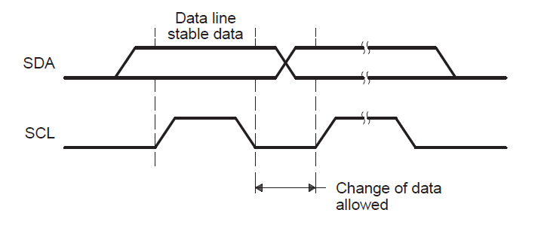
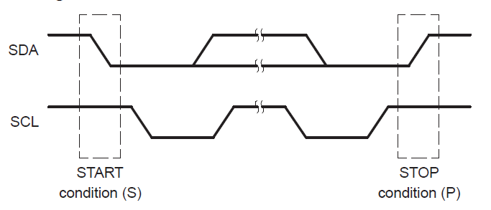
I2C Data Validity

Slide 7
I2C Serial Data Formats
7-Bit Addressing Format
1
7
1
1
n
1
n
1
1
S
Slave Address
R/W
ACK
Data
ACK
Data
ACK
P
10-Bit Addressing Format
1
7
1
1
8
1
n
1
1
S
11110AA
R/W
ACK
AAAAAAAA
ACK
Data
ACK
P
Free Data Format
1
n
1
n
1
n
1
1
S
Data
ACK
Data
ACK
Data
ACK
P
R/W = 0 – master writes data to addressed slave
R/W = 1 – master reads data from the slave
n = 1 to 8 bits
S = Start (high-to-low transition on SDA while SCL is high)
P = Stop (low-to-high transition on SDA while SCL is high)

Slide 8
I2C Arbitration
Arbitration procedure invoked if two or more master-transmitters simultaneously start transmission
  Procedure uses data presented on serial data bus (SDA) by competing transmitters
  First master-transmitter which drives SDA high is overruled by another master-transmitter that drives SDA low
  Procedure gives priority to the data stream with the lowest binary value
SCL
Device #1 lost arbitration and switches to slave-receiver mode
Data from device #1
1
0
Data from device #2
Device #2 drives SDA
1
0
0
1
0
1
SDA
1
0
0
1
0
1

Slide 9
I2C Interrupts
Interrupt Source | Description
XRDYINT | Transmit ready condition: The data transmit register (I2CDXR) is ready to accept new data because the previous data has been copied from I2CDXR to the transmit shift register (I2CXSR).
RRDYINT | Receive ready condition: The data receive register (I2CDRR) is ready to be red because data has been copied from the receive shift register (I2CRSR) to I2CDRR.
ARDYINT | Register-access ready condition: The I2C module registers are ready to be accessed because the previously programmed address, data, and command values have been used.
NACKINT | No-acknowledgment condition: The I2C module is configured as a master-transmitter and did not received acknowledgment from the slave-receiver.
ALINT | Arbitration-lost condition: The I2C module has lost an arbitration contest with another master-transmitter.
SCDINT | Stop condition detected: A STOP condition was detected on the I2C bus.
AASINT | Addressed as slave condition: The I2C has been addressed as a slave device by another master on the I2C bus.
I2CFIFO | see FIFO - Registers

Slide 10
I2C Registers
Register Name | Description
I2COAR | I2C own address register
I2CIER | I2C interrupt enable register
I2CSTR | I2C status register
I2CCLKL | I2C clock low-time divide register
I2CCLKH | I2C clock high-time divide register
I2CCNT | I2C data count register
I2CDRR | I2C data receive register
I2CSAR | I2C slave address register
I2CDXR | I2C data transmit register
I2CMDR | I2C mode register
I2CISRC | I2C interrupt source register
I2CEMDR | I2C extended mode register
I2CPSC | I2C prescaler register
I2CFFTX | I2C FIFO transmit register
I2CFFRX | I2C FIFO receive register

Slide 11
I2C Mode Register (I2CMDR)
I2caRegs.I2CMDR
NACKMOD
(receiver mode only)
0 = I2C sends ACK
1 = I2C sends NACK
FREE
0 = I2C stop on EMULCK
1 = no I2C stop on EMUL
STT
0 = no START
1 = generate a START
15
14
13
12
11
10
9
8
NACKMOD
FREE
STT
reserved
STP
MST
TRX
XA
STP
0 = no STOP
1 = generate a STOP
TRX
0 = Receiver Mode
1 = Transmitter Mode
MST
0 = Slave Mode
1 = Master Mode
XA
0 = 7 Bit Address
1 = 10 Bit Address

Slide 12
I2C Mode Register (I2CMDR)
I2caRegs.I2CMDR
RM
0 = no repeat mode
1 = repeat mode
DLB
0 = no loopback
1 = loopback mode
IRS
0 = I2C in RESET
1 = I2C enabled
7
6
5
4
3
2 - 0
RM
DLB
IRS
STB
FDF
BC
STB
0 = no START byte mode
1 = START byte mode
BC
0 = 8 bit per data
1 = 1 bit per data
2 = 2 bit per data
…
7 = 7 bit per data
FDF
0 = no free data format
1 = free data format

Slide 13
I2C Interrupt Enable Register
I2caRegs.I2CIER
15
14
13
12
11
10
9
8
reserved
reserved
reserved
reserved
reserved
reserved
reserved
reserved
7
6
5
4
3
2
1
0
reserved
AAS
SCD
XRDY
RRDY
ARDY
NACK
AL
1 = enable interrupt source 0 = disable
AAS: an I2C - master has addressed the DSC as slave
SCD: Stop condition detected
XRDY: Transmit data ready for new data
RRDY: Receive data available
ARDY: I2C register access ready
NACK: No – Acknowledge received
AL: Arbitration lost during competition

Slide 14
I2C Status Register
I2caRegs.I2CSTR
15
14
13
12
11
10
9
8
reserved
SDIR
NACKSNT
BB
RSFULL
XSMT
AAS
AD0
7
6
5
4
3
2
1
0
reserved
reserved
SCD
XRDY
RRDY
ARDY
NACK
AL
SDIR: 1 = I2C is addressed as a slave transmitter; 0 = as receiver
NACKSNT: 1 = a NACK was sent as receiver from I2C
BB: 1 = Bus is busy, a START has been sent
RSFULL: 1 = Overrun of the receiver detected
XSMT: 0 = underflow of transmit shift register detected
AAS: 1 = I2C was addressed a s slave
AD0: 1 = a general call (address 0) has been detected
SCD: 1 = a STOP condition has been detected
XRDY: 1 = Transmit register I2CDXR ready for new data
RRDY: 1 = Receive data available in I2CDRR
ARDY: 1 = a previous cycle has completed
NACK: 0 = ACK received; 1 = NACK received
AL: 1 = Arbitration lost during competition by 2 masters

Slide 15
I2C Interrupt Source Register
I2caRegs.I2CISRC
15 - 3
2 - 0
reserved
INTCODE
INTCODE | Event
000 | None
001 | Arbitration lost
010 | No-acknowledgment
011 | Registers ready to be accessed
100 | Receive data ready
101 | Transmit data ready
110 | Stop condition detected
111 | Addressed as slave
Note: A CPU read of INTCODE will clear this field. If another lower priority interrupt is pending and enabled, the value corresponding to that interrupt will then be loaded. Otherwise, the value will stay cleared.

Slide 16
I2C Clock Register
I2caRegs.I2CPSC
15 - 8
7 - 0
reserved
IPSC
I2C module clock frequency = SYSCLKOUT / (IPSC + 1)
Note: should be 7…12 MHz
I2caRegs.I2CCLKL
15
0
ICCL
I2caRegs.I2CCLKH
15
0
ICCH
T_{I2C_MASTER_CLOCK} = T_{I2C_MODULE_CLOCK} * [ (ICCL +d ) + (ICCH + d ) ]

Slide 17
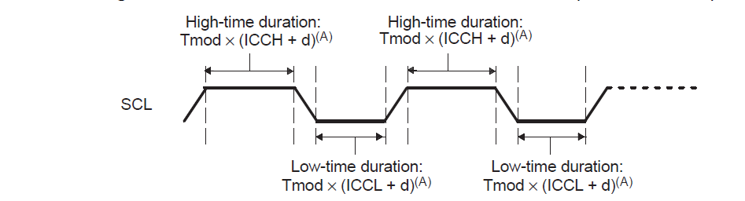
I2C Master Clock
(A):
IPSC | Value for d
0 | 7
1 | 6
greater than 1 | 5

Slide 18
I2C Slave Address Register
I2caRegs.I2CSAR
15 - 10
9 - 0
reserved
SAR
SAR: next slave address that will be transmitted
  Bits 6…0 in 7 Bit - Address - Mode (XA = 0 in I2CMDR)
  Bits 9…0 in 10 Bit - Address _ Mode (XA = 1)

Slide 19
I2C Own Address Register
I2caRegs.I2COAR
15 - 10
9 - 0
reserved
OAR
OAR: F2833x address in case of slave mode
  Bits 6…0 in 7 Bit - Address - Mode (XA = 0 in I2CMDR)
  Bits 9…0 in 10 Bit - Address _ Mode (XA = 1)

Slide 20
I2C Data Count Register
I2caRegs.I2CCNT
15
0
ICDC
ICDC: Data Count Value
ICDC indicates the number of data bytes to transfer or receive.
0x0000: The start value loaded to the internal data counter is 65536.
00001-0xFFFF: The start value loaded to internal data counter is 1-65535.

Slide 21
I2C Data Receive Register
I2caRegs.I2CDRR
15 - 8
7 - 0
reserved
DATA
I2C Data Transmit Register
I2caRegs.I2CDXR
15 - 8
7 - 0
reserved
DATA

Slide 22
I2C Transmit FIFO Register
I2caRegs.I2CFFTX
15
14
13
12 – 8
reserved
I2CFFEN
TXFFRST
TXFFST
7
6
5
4 - 0
TXFFINT
TXFFINTCLR
TXFFIENA
TXFFIL
I2CFFEN: 1 = enable TXFIFO - mode
TXFFRST: 0 = reset TXFIFO; 1 = enable TX – FIFO - operation
TXFFST: Filling level of TXFIFO (0 – 16 )
TXFFINT: TXFIFO Interrupt flag
1 = TX FIFO interrupt condition has occurred.
0 = TX FIFO interrupt condition has not occurred.
cleared by writing a 1 into bit TXFFINTCLR
TXFFINTCLR: 1 = clear flag TXFFINT
TXFFIENA: 1 = enabled. TXFFINT generates an interrupt when set.
TXFFIL: TX FIFO Interrupt level. If TXFFST is equal or less than
TXFFIL, the flag TXFFINT is set.

Slide 23
I2C Receive FIFO Register
I2caRegs.I2CFFRX
15
14
13
12 – 8
reserved
reserved
RXFFRST
RXFFST
7
6
5
4 - 0
RXFFINT
RXFFINTCLR
RXFFIENA
RXFFIL
RXFFRST: 0 = reset RXFIFO; 1 = enable RX – FIFO - operation
RXFFST: Filling level of RXFIFO (0 – 16 )
RXFFINT: RXFIFO Interrupt flag
1 = RX FIFO interrupt condition has occurred.
0 = RX FIFO interrupt condition has not occurred.
cleared by writing a 1 into bit RXFFINTCLR
RXFFINTCLR: 1 = clear flag RXFFINT
RXFFIENA: 1 = enabled. RXFFINT generates an interrupt when set.
RXFFIL: RX FIFO Interrupt level. If RTXFFST is equal or greater
than RXFFIL, the flag RXFFINT is set.

Slide 24
I2C Summary
Compliance with Philips I2C-bus specification (version 2.1)
7-bit and 10-bit addressing modes
Configurable 1 to 8 bit data words
Data transfer rate from 10 kbps up to 400 kbps
Transmit FIFO and receive FIFO

Slide 25
Temperature Sensor TMP101
Digital Interface: I2C Serial 2-Wire
Resolution: 9- to 12-Bits, User-Selectable
  9 – Bit: 0.5 °C; 12 – Bit:0.0625 °C
Accuracy:
  ±2.0°C from −25°C to +85°C (max)
  ±3.0°C from −55°C to +125°C (max)
Low quiescent current of 45μA, 0.1μA Standby
Power supply range: 2.7V to 5.5V
Tiny SOT23-6 package

Slide 26
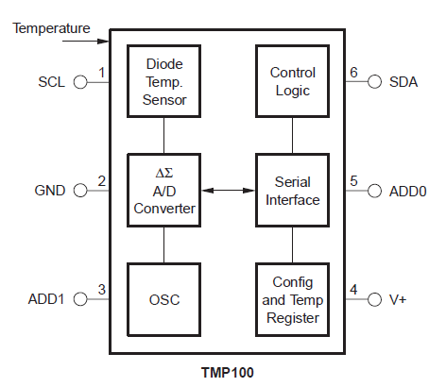
Temperature Sensor TMP100

Slide 27
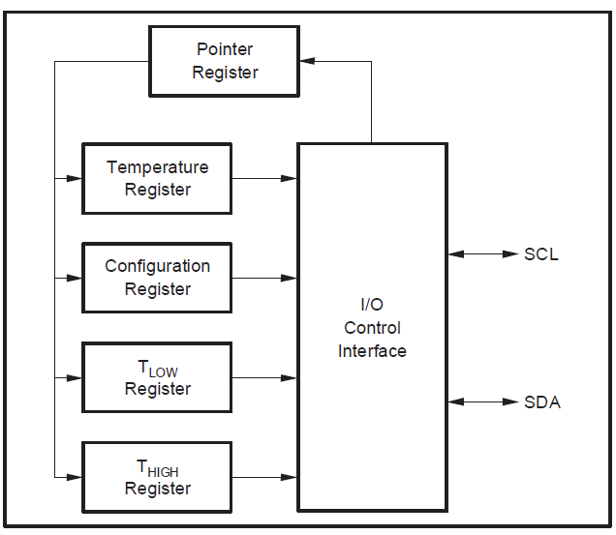
Temperature Sensor TMP100
Pointer:
00
01
10
11

Slide 28
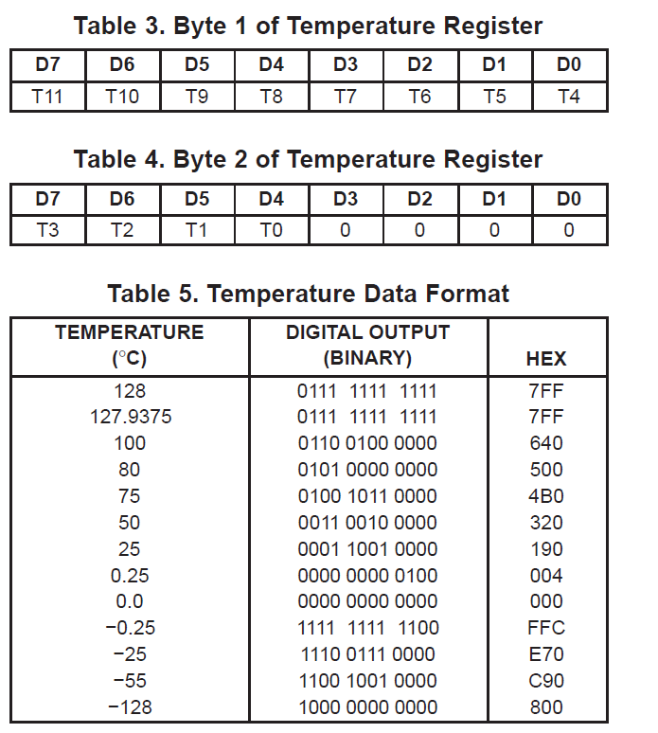
Temperature Sensor TMP100

Slide 29
TMP100 Configuration Register
7
6
5
4
3
2
1
0
OS/ALERT
R1
R0
F1
F0
POL
TM
SD
OS/ALERT: write 1: single temperature conversion
write 0: continuous temperature conversion
read 1: temperature above THIGH
read 0: temperature below TLOW
R1, R0: Resolution 9 bit (0,0) … 12 bit (1,1)
F1,F0: activate ALERT after number of consecutive faults (1,2,4,6)
POL: Polarity of ALERT (0 or 1)
TM: write 0: Comparator Mode
(ALERT stays active as long as condition is true)
write 1: Interrupt Mode
( ALERT is cleared by a read instruction of any reg)
SD: write 1: shutdown
write 0: active mode

Slide 30
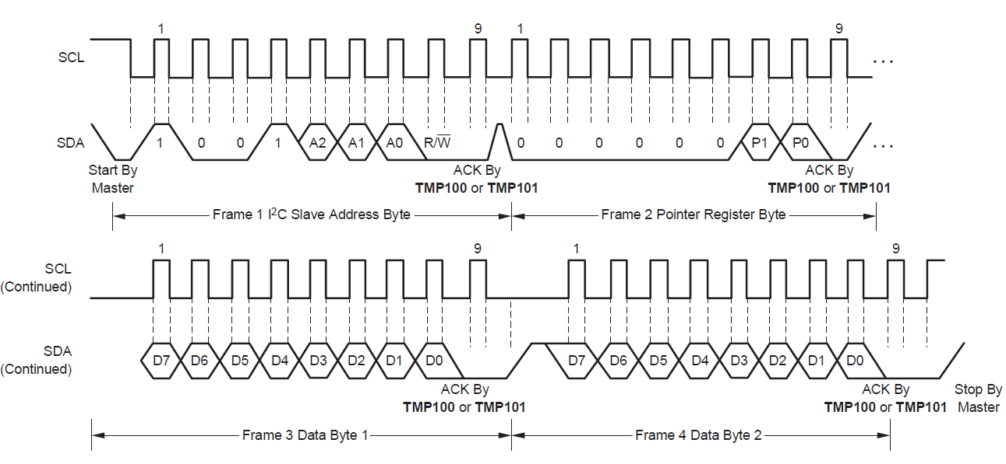
TMP101 Write Timing

Slide 31
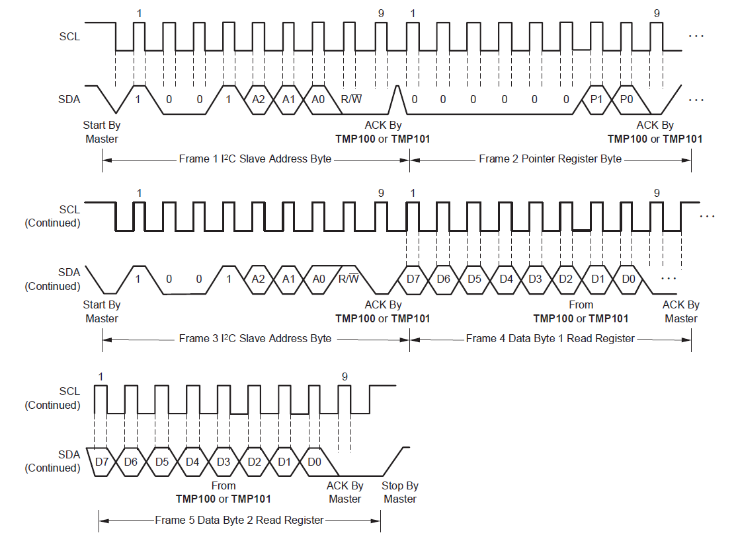
TMP101 Read Timing

Slide 32




