Slide 1

Module 13: Multichannel Buffered Serial Port F2833x
32-Bit-Digital Signal Controller
TMS320F2833x
Texas Instruments Incorporated
European Customer Training Centre
University of Applied Sciences Zwickau

Slide 2
Multichannel Buffered Serial Port (McBSP)
Introduction:
Two High – Speed multichannel synchronous serial ports (McBSP-A and McBSP-B)
Maximum data rate: 20 MHz
Each McBSP consists of a data - flow – path and a control - path
Six Pins per channel
  MDX: data transmit
  MDR: data received
  MCLKX: transmit clock
  MCLKR: receive clock
  MFSX: frame sync transmit
  MFSR: frame sync receive

Slide 3
McBSP Block Diagram
Peripheral / DMA Bus
MFSXx
16
16
MCLKXx
DXR2 TX Buffer
DXR1 TX Buffer
16
16
XSR2
XSR1
MDXx
CPU
RSR2
RSR1
MDRx
16
16
RBR2 Register
RBR1 Register
16
16
DRR2 RX Buffer
DRR1 RX Buffer
MCLKRx
16
16
Peripheral / DMA Bus
MFSRx

Slide 4
Features of McBSP
Full - duplex communication
Double-buffered transmission and triple-buffered reception, allowing a continuous data stream
Independent clocking and framing for reception and transmission
send interrupts to the CPU and send DMA events to the DMA - controller
128 channels for transmission and reception
Multichannel selection modes that enable or disable block transfers in each of the channels
Direct interface to industry-standard CODECs, analog interface chips (AICs), and other serially connected A/D and D/A devices
Support for external generation of clock signals and frame -synchronization signals
A programmable sample rate generator for internal generation and control of clock signals and frame - synchronization signals

Slide 5
Features of McBSP
Direct interface to:
  T1/E1 framers
  IOM-2 compliant devices
  AC97-compliant devices with multiphase frame capability
  I2S compliant devices
  SPI devices
Variable data sizes: 8, 12, 16, 20, 24, and 32 bits
A-law (Europe) and µ-law (US & Japan) hardware compression / expanding

Slide 6
Definition: Word and Frame
FS
D
w6
w7
w0
w1
w2
w3
w4
w5
w6
w7
Frame
Word
“Frame” - contains one or multiple words
Number of words per frame: 1-128

Slide 7
Definition: Bit and Word
CLK
FS
D
a1
a0
b7
b6
b5
b4
b3
b2
b1
b0
Word
Bit
“Bit” - one data bit per serial clock period
“Word” or “channel” contains number of bits (8, 12, 16, 20, 24, 32)

Slide 8
Multi-Channel Selection
Multi-channel
Ch0-0
Frame
TDM Bit Stream
Ch0-1
M
c
B
S
P
Transmit
&
Receive
only selected
Channels
C
O
D
E
C
Ch31
...
Ch1
Ch0
0
Ch5-0
1
Ch31
...
Ch1
Ch0
Ch5-1
Ch27-0
Ch27-1
Allows multiple channels (words) to be independently selected for transmit
and receive (e.g. only enable Ch0, 5, 27 for receive, then process via CPU)
The McBSP keeps time sync with all channels, but only “listens” or “talks”
if the specific channel is enabled (reduces processing/bus overhead)
Multi-channel mode controlled primarily via two registers:
Multi-channel Control Reg
Rec/Xmt Channel Enable Regs
MCR
R/XCER (A-H)
(enables Mc-mode)
(enable/disable channels)
Up to 128 channels can be enabled/disabled

Slide 9
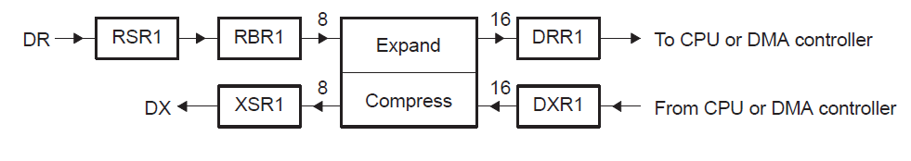
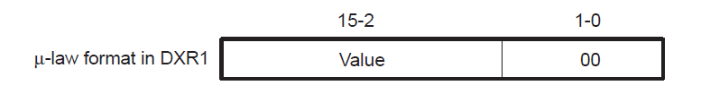
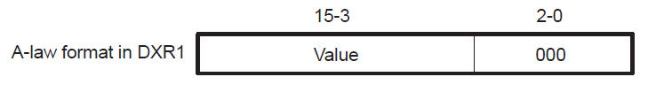
Compression & Expanding Data

Slide 10
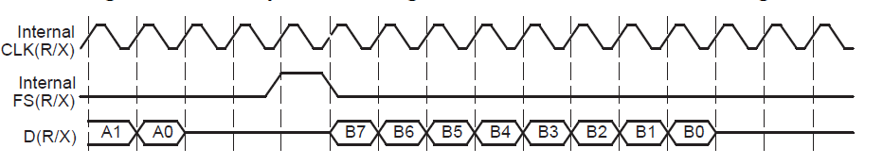
McBSP - Clocking
Data is shifted one bit at a time
  from the DR pin to the RSR(s) or
  from the XSR(s) to the DX pin.
The receive clock signal (CLKR) controls bit transfers from the DR pin to the RSR(s).
The transmit clock signal (CLKX) controls bit transfers from the XSR(s) to the DX pin.

Slide 11
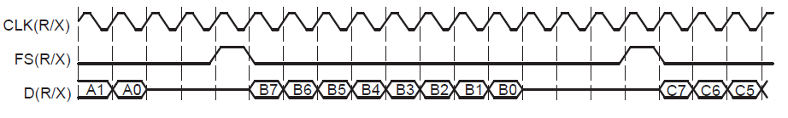
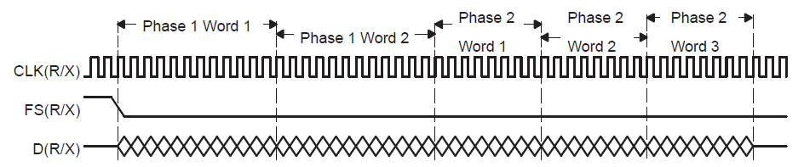
McBSP – Frame Phases
Single Phase Frame, 8 bits per word
Dual Phase Frame
Phase 1: 2 words of 12 bits each
Phase 2: 3 words of 8 bit each

Slide 12
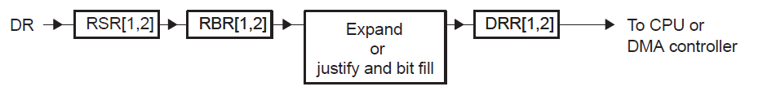
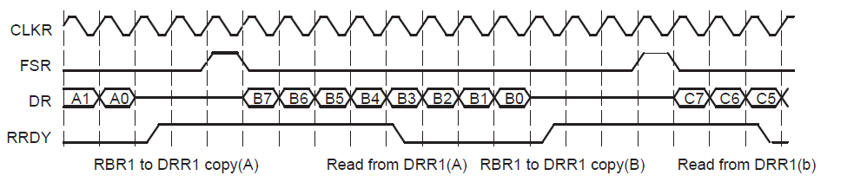
McBSP – Reception
Reception physical data path
Reception signal activity
DRR = Data Receive Register
RRDY = status bit “Receiver Ready”

Slide 13
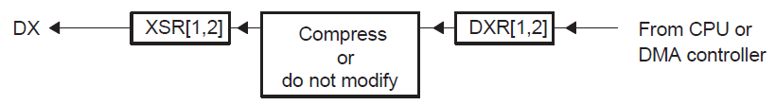
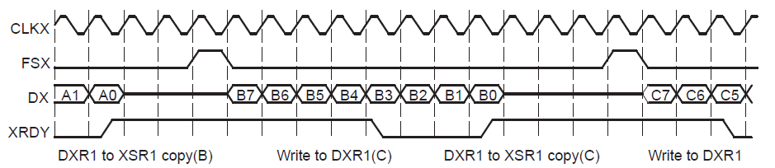
McBSP – Transmission
Transmission physical data path
Transmission signal activity
DXR = Data Transmit Register
XRDY = status bit “Transmitter Ready”

Slide 14
McBSP – Interrupts and DMA
Internal Signals from McBSP to CPU or DMA:
Internal Signal | Description
RINT | Receiver Interrupt from McBSP to CPU; based on a selected condition in the receiver
XINT | Transmitter Interrupt from McBSP to CPU; based on a selected condition in the transmitter
REVT | Receive synchronization event from McBSP to DMA; triggered when data has been received in DRR.
XEVT | Transmit synchronization event from McBSP to DMA; triggered when DXR is ready to accept new data.

Slide 15
McBSP – Register Set
McBSP Control & Data Registers:
Register | Description
DRR2 | Data Receive Register 2 (high)
DRR1 | Data Receive Register 1 (low)
DXR2 | Data Transmit Register 2 (high)
DXR1 | Data Receive Register 1 (low)
SPCR2 | Serial Port Control Register 2
SPCR1 | Serial Port Control Register 1
RCR2 | Receive Control Register 2
RCR1 | Receive Control Register 1
XCR2 | Transmit Control Register 2
XCR1 | Transmit Control Register 1
SRGR2 | Sample Rate Generator Register 2
SRGR1 | Sample Rate Generator Register 1

Slide 16
McBSP – Register Set
McBSP Multi Channel Control Registers:
Register | Description
MCR2 | Multichannel Control Register 2
MCR1 | Multichannel Control Register 1
RCERx | Receive Channel Enable Register Partition x
XCERx | Transmit Channel Enable Register Partition x
PCR | Pin Control Register
XCERB | Transmit Channel Enable Register Partition B
PCR | Pin Control Register
MFFINT | Interrupt Enable Register
Partition | Channels
A | 0 - 1 5
B | 16 – 31
C | 32 – 47
D | 48 – 63
E | 64 – 79
F | 80 – 95
G | 96 – 111
H | 112 - 127
x = Partition A, B, C, D, E, F, G, H

Slide 17
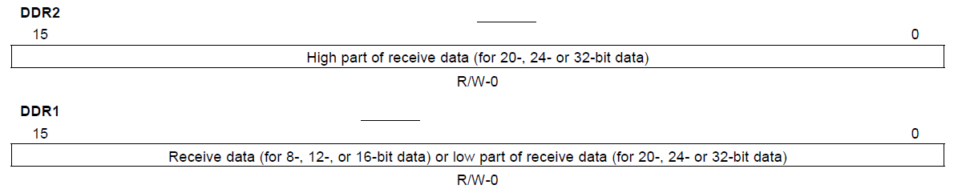
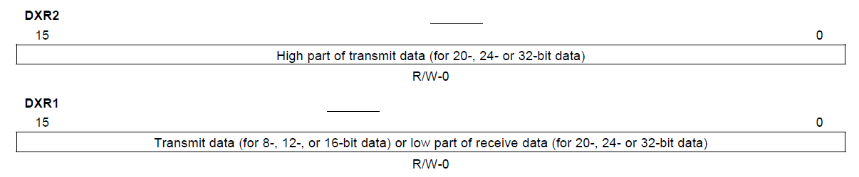
McBSP – Data Register
McBSP Data Receive Register (DRR2 and DRR1):
McBSP Data Transmit Register (DXR2 and DXR1):

Slide 18
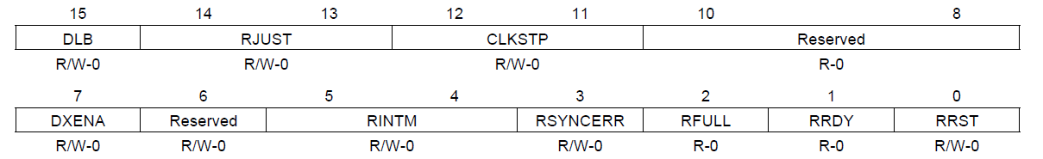
McBSP – Serial Port Control Register (SPCR1)
DLB: Digital Loopback Mode 0 = disabled; 1 = enabled
RJUST: Receive Justification Mode 0 = Right justify data and zero fill MSBs
1 = Right justify data and sign – extend MSBs
2 = Left justify data and zero fill LSBs
CLKSTP: Clock Stop Mode 0 and 1 = disabled
2 = enabled, without clock delay (SPI – Mode)
3 = enabled, with half-cycle clock delay (SPI – Mode)
DXENA: DX Delay Enable 0 = OFF
1 = ON; extra delay for turn – ON - time
RINTM: Receiver Interrupt Mode 0 = INT when RRDY = 1
1 = INT after 16 channels (multichannel mode)
2 = INT of frame sync pulse
3 = INT on Receive Frame Sync Error
RSYNCERR: Receive Frame Sync Error 0 = no error; 1 = error
RFULL: Receiver Full Status bit 1 = Receiver Full condition (RSR, RBR and DRR full)
RRDY: Receiver Ready Status bit 1 = Receiver Ready; new data in DRR
RRST: Receiver Reset Control Bit 0 = Reset Receiver; 1 = release Receiver from Reset

Slide 19
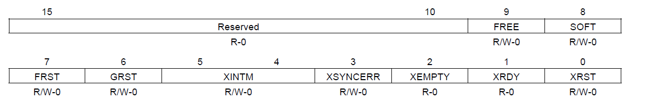
McBSP – Serial Port Control Register (SPCR2)
FREE: Free Run JTAG Mode 0 = Stop at breakpoint; 1 = Free Run
Soft: Soft Stop JTAG Mode 0 = if FREE = 0, stop immediately in case of breakpoint
1 = if FREE = 0, stop at end of frame
FRST: Frame Sync Logic Reset 0 = Reset; 1 = release Frame Logic from Reset
GRST: Sample Rate Generator Reset 0 = Reset; 1 = release SRG from Reset
XINTM: Transmit Interrupt Mode 0 = INT when XRDY = 1
1 = INT after 16 channels (multichannel mode)
2 = INT of frame sync pulse
3 = INT on Transmit Frame Sync Error
XSYNCERR: Receive Frame Sync Error 0 = no error; 1 = error
XEMPTY: Transmitter Empty Status bit 0 = Transmitter empty (DXR1); 1 = not empty
XRDY: Transmitter Ready Status bit 1 = Transmitter ready (DXR1,2) to accept new data XRST: Transmitter Reset Control Bit 0=Reset Transmitter; 1=release Transmitter from Reset

Slide 20
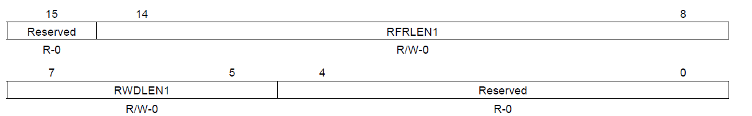
McBSP – Receive Control Register 1 (RCR1)
RFRLEN1: Receive Frame Length1(0…0x7F)
Single Phase Frame: Number of Words in a frame (1…128)
Dual Phase Frame: Number of Words in frame – phase 1 (1...128)
RWDLEN1: Receive Word Length1 (0…7)
Single Phase Frame: Number of Bits in a Word
Dual Phase Frame: Number of Bits in a Word of frame - phase 1
0 = 8 Bit
1 = 12 Bit
2 = 16 Bit
3 = 20 Bit
4 = 24 Bit
5 = 32 Bit
6 and 7: reserved

Slide 21
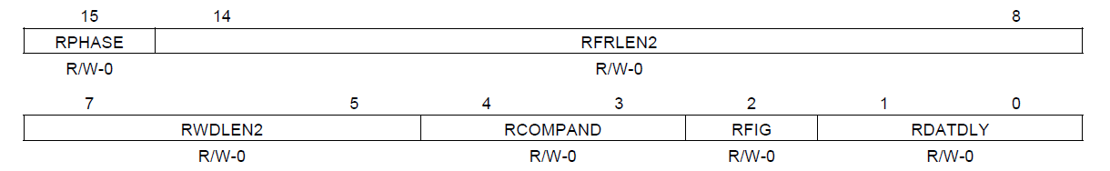
McBSP – Receive Control Register 2 (RCR2)
RPHASE: Receive Phase Number 0 = Single Phase Frame
1 = Dual Phase Frame
RFRLEN2: Receive Frame Length 2 (0…0x7F)
Single Phase Frame: don’t care
Dual Phase Frame: Number of Words in frame – phase 2 (1...128)
RWDLEN2: Receive Word Length 2 (0…7)
Single Phase Frame: don’t care
Dual Phase Frame: Number of Bits in a Word of frame - phase 2
0 = 8 Bit, 1 = 12 Bit, 2 = 16 Bit, 3 = 20 Bit, 4 = 24 Bit, 5 = 32 Bit
RCOMPAND: Receive Companding Mode 0 = no companding, MSB received first
1 = no companding, 8-bit-data, LSB first
2 = µ-law; 8-bit-data, MSB received first
3 = A-law; 8-bit-data, MSB received first
RFIG: Receive Frame Sync Ignore 1 = unexpected Frame Sync ignored
RDATDLY: Receive Data Delay 0 = 0 clock cycles delay after frame Sync
1 = 1 cycle; 2 = 2 cycles; 3 =reserved

Slide 22
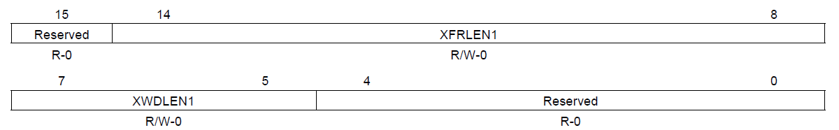
McBSP – Transmit Control Register 1 (XCR1)
XFRLEN1: Transmit Frame Length1(0…0x7F)
Single Phase Frame: Number of Words in a frame (1…128)
Dual Phase Frame: Number of Words in frame – phase 1 (1...128)
XWDLEN1: Transmit Word Length1 (0…7)
Single Phase Frame: Number of Bits in a Word
Dual Phase Frame: Number of Bits in a Word of frame - phase 1
0 = 8 Bit
1 = 12 Bit
2 = 16 Bit
3 = 20 Bit
4 = 24 Bit
5 = 32 Bit
6 and 7: reserved

Slide 23
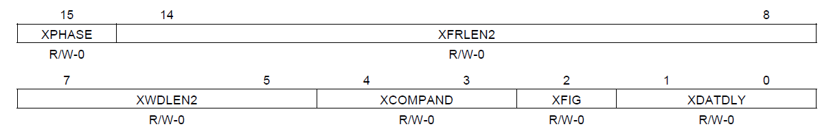
McBSP – Transmit Control Register 2 (XCR2)
XPHASE: Transmit Phase Number 0 = Single Phase Frame
1 = Dual Phase Frame
XFRLEN2: Transmit Frame Length 2 (0…0x7F)
Single Phase Frame: don’t care
Dual Phase Frame: Number of Words in frame – phase 2 (1...128)
XWDLEN2: Transmit Word Length 2 (0…7)
Single Phase Frame: don’t care
Dual Phase Frame: Number of Bits in a Word of frame - phase 2
0 = 8 Bit, 1 = 12 Bit, 2 = 16 Bit, 3 = 20 Bit, 4 = 24 Bit, 5 = 32 Bit
XCOMPAND: Transmit Companding Mode 0 = no companding, MSB transmitted first
1 = no companding, 8-bit-data, LSB first
2 = µ-law; 8-bit-data, MSB transmitted first
3 = A-law; 8-bit-data, MSB transmitted first
XFIG: Transmit Frame Sync Ignore 1 = unexpected Frame Sync ignored
XDATDLY: Transmit Data Delay 0 = 0 clock cycles delay after frame Sync
1 = 1 cycle; 2 = 2 cycles; 3 =reserved

Slide 24
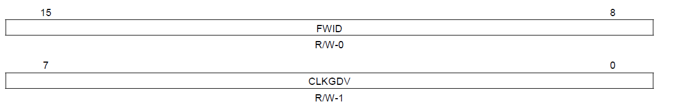
McBSP – Sample Rate Generator (SRGR1)
FWID: Frame Sync Pulse Width 0…255
Pulse Width of Frame Sync Signal in McBSP clock cycles
CLKGDV: Divide Down Value for Clock-Generator 0…255
CLKG frequency = (Input clock frequency)/ (CLKGDV + 1)
The input clock is selected by the SCLKME (Register PCR) and CLKSM (Register SRGR) bits:
SCLKME | CLKSM | Input Clock Source
0 | 0 | Reserved
0 | 1 | LSPCLK
1 | 0 | Signal on pin MCLKR
1 | 1 | Signal on pin MCLKX

Slide 25
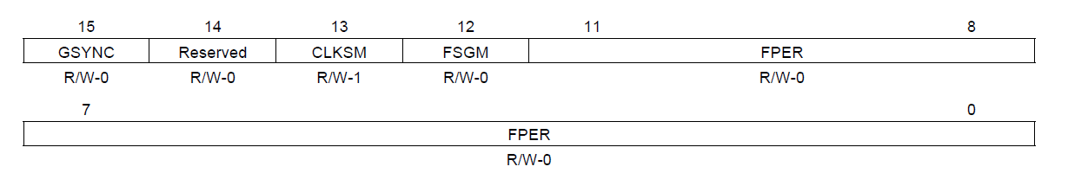
McBSP – Sample Rate Generator (SRGR2)
GSYNC: Clock Sync Mode only used, if clock source is external
1 = Clock Synchronization;
CLKG is adjusted to MCLKR / MCLKX
0 = no clock sync;
CLKG free running, FSG every FPER-cycles
CLKSM: Sample Clock Mode
FSGM: Frame Sync Mode; Frame Pulse from pin FSX (if FSXM = 0)
0: if FSXM = 1, generate frame pulse when DXR is copied into XSR
1: if FSXM = 1, generate frame pulse based on FPER and FWID
FPER: Frame Sync Period (1…4096); Number of CLKG cycles between frame pulses
SCLKME | CLKSM | Input Clock Source
0 | 0 | Reserved
0 | 1 | LSPCLK
1 | 0 | Signal on pin MCLKR
1 | 1 | Signal on pin MCLKX

Slide 26
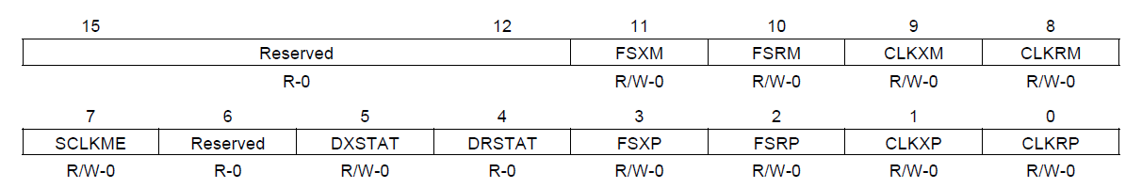
McBSP – Pin Control Register (PCR)
FSXM: Transmit Frame Sync Mode 0 = Frame Pulse is supplied externally via pin FSX
1 = Frame Pulse generated internally by Sample Rate Generator (bit FSGM of register SRGR2)
FSRM: Receive Frame Sync Mode 0 = Frame Pulse is supplied externally via pin FSR
1 = Frame Pulse generated internally by Sample Rate Generator (bit FSGM of register SRGR2)
CLKXM: Transmit Clock Mode if CLKSTP = 0 or 1:
0 = external transmit clock from pin MCLKX
1 = internal transmit clock; MCLKX is output
if CLKSTP = 2 or 3:
0 = McBSP is slave in SPI – Protocol; MCLKX is input
1 = McBSP is master in SPI – Mode; MCLKX is output
SCLKME: Sample Rate Generator Input Mode (see CLKSM in Register SRGR2)
DXSTAT: DX pin Status Bit 1 = drive DX pin high; 0 = DX pin low (GPIO mode)
DRSTAT: DR pin Status Bit 1 = drive DR pin high; 0 = DR pin low (GPIO mode)
FSXP: Transmit Frame Sync Polarity 0 = active high; 1 = active low
FSRP: Receive Frame Sync Polarity 0 = active high; 1 = active low
CLKXP: Transmit Clock Polarity data valid on rising (0) or falling (1) edge of CLKX
CLKRP: Receive Clock Polarity data sampled on rising (1) or falling (0) edge

Slide 27
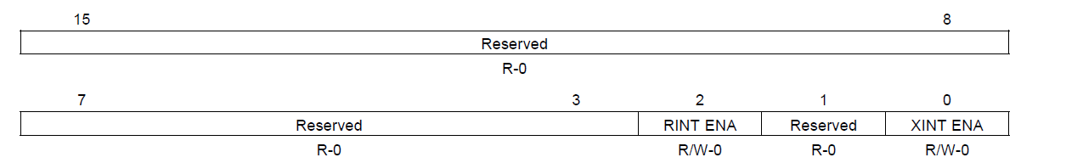
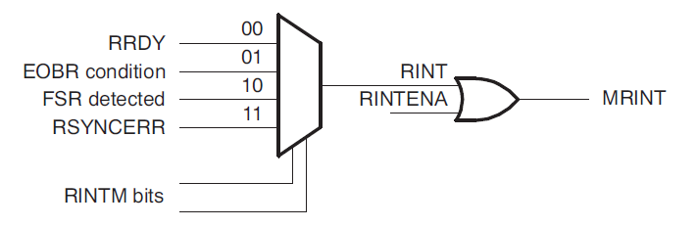
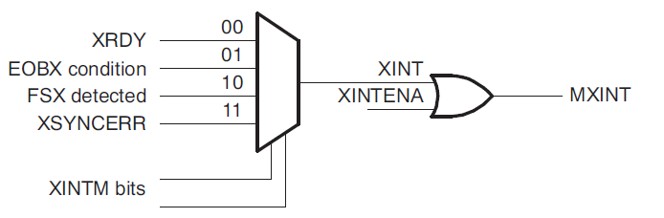
McBSP – Interrupt Enable Register (MFFINT)
RINT ENA: 0 = disable McBSP Receive Interrupts
1 = enable McBSP Receive Interrupts
XINT ENA: 0 = disable McBSP Transmit Interrupts
1 = enable McBSP Transmit Interrupts

Slide 28
Stereo Audio Codec TLV320AIC23B
Main Features:
90dB SNR Multibit Sigma-Delta ADC
100-dB SNR Multibit Sigma-Delta DAC
8 kHz …96 kHz Sampling-Frequency
SPI- Interface for Control Channel Compatible Serial-Port Protocols
2 - Phase Audio - Data Input/Output via McBSP
Standard I2S, MSB, or LSB Justified-Data Transfers
16/20/24/32-Bit Audio Data Word Length
Volume Control With Mute on Input and Output
ADC Multiplexed Input for Stereo-Line Inputs and Microphone
Highly Efficient Linear Headphone Amplifier (30 mW into 32 Ohm from a 3.3-V Analogue Supply Voltage

Slide 29
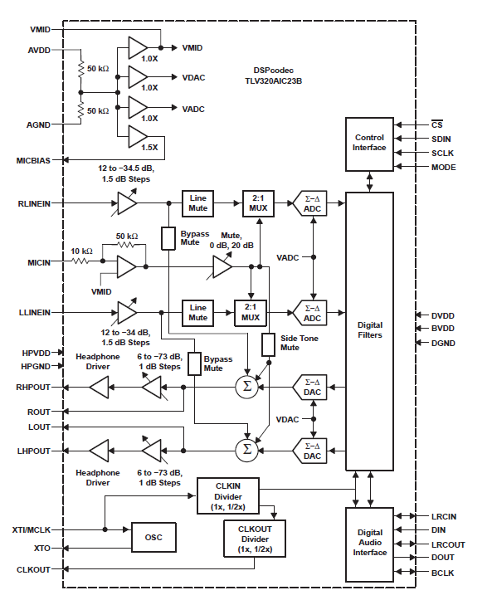
Stereo Audio Codec TLV320AIC23B
Functional Block
Diagram:
Signals:
RHPOUT =
right headphone out
LHPOUT =
left headphone out
© Document Number : SLWS106H,
page 1-3 (www.ti.com)

Slide 30
Stereo Audio Codec TLV320AIC23B
GPIO -MUX | F2833x – Function | Description | AIC23–signal
GPIO20 = 2 | McBSPA – MDXA | Audio data out | DIN
GPIO21 = 2 | McBSPA – MDRA | Audio data in | DOUT
GPIO22 = 2 | McBSPA – MCLKXA | Transmit clock | BCLK
GPIO23 = 2 | McBSPA – MFSXA | Transmit frame sync | LRCIN
GPIO58 = 1 | McBSPA – MCLKRA | Receive Clock | BCLK
GPIO59 = 1 | McBSPA – MFRA | Receive frame sync | LRCOUT
GPIO16 = 1 | SPIA – SPISIMO | Control data out | SDIN
GPIO18 = 1 | SPIA – SPICLK | Control data clock | SCLK
GPIO19 = 1 | SPIA – SPISTE | Slave trans. enable | /CS

Slide 31
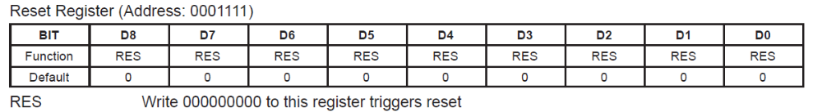
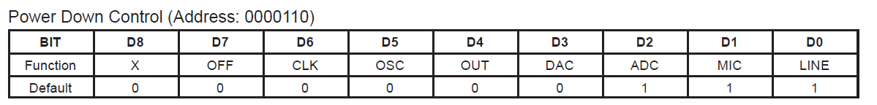
Stereo Audio Codec TLV320AIC23B
Reset Register:
Power Down Control Register:
LINE = Line Input
MIC = Microphone Input
ADC = Internal ADC
DAC = Internal DAC
OUT = Output Signals
OSC = Oscillator
CLK = CLOCK
OFF = Device Power
0 = ON; 1 = OFF

Slide 32
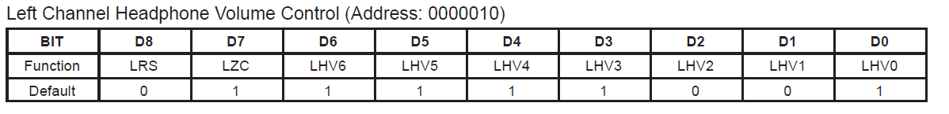
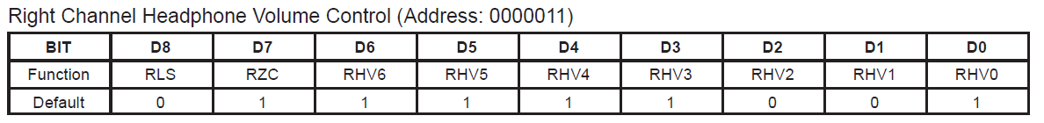
Stereo Audio Codec TLV320AIC23B
Left Channel Headphone Volume Control Register:
LRS = Left / Right simultaneous update volume ( 0 = OFF, 1 = ON)
LZC = Left channel zero cross (0 = OFF, 1 = ON). If ON, volume updates only at zero crossings
LHV = Left Headphone Volume (0x7F = +6dB; 0x79 = 0dB; 0x30 = -73dB (mute)
Right Channel Headphone Volume Control Register:
RLS = Right / Left simultaneous update volume ( 0 = OFF, 1 = ON)
RZC = Right channel zero cross (0 = OFF, 1 = ON). If ON, volume updates only at zero crossings
RHV = Right Headphone Volume (0x7F = +6dB; 0x79 = 0dB; 0x30 = -73dB (mute)

Slide 33
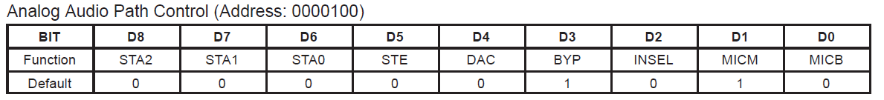
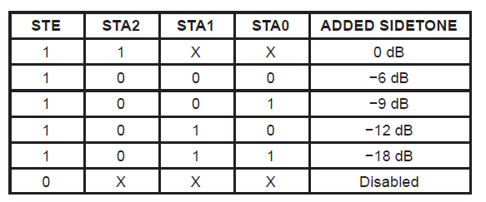
Stereo Audio Codec TLV320AIC23B
Analogue Audio Path Control Register:
MICB = Microphone boost (0 = 0dB; 1 = 20dB)
MICM = Microphone mute (0 = normal; 1 = muted)
INSEL = Input Select for Audio (0 = line; 1 = Microphone)
BYP = Bypass (0 = disabled; 1 = enabled (line in to line out))
DAC = DAC select ( 0 = DAC OFF; 1 = DAC ON)
STE = Added Side Tone ( 0 = OFF; 1 = ON)
STA = Side Tone Volume (If STE = ON, MIC is routed both to headphone & line out ).

Slide 34
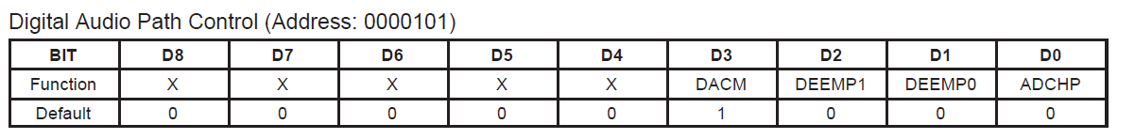
Stereo Audio Codec TLV320AIC23B
Digital Audio Path Control Register:
ADCHP = ADC High Pass Filter (0 = enabled; 1 = disabled)
DEEMP = De-emphasis control (0 = disabled, 1 = 32kHz, 2 = 44.1kHz, 3 = 48kHz)
DACM = DAC soft mute (0 = disabled; 1 = enabled)

Slide 35
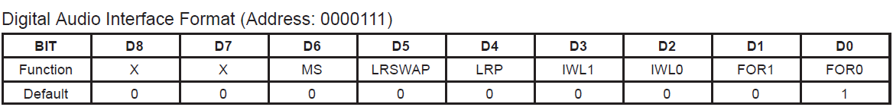
Stereo Audio Codec TLV320AIC23B
Digital Audio Interface Format Register:
FOR = Data Format 0 = MSB first, right aligned
1 = MSB first, left aligned
2 = I2S – Format, MSB first, left -1 aligned
3 = DSP – Format; Frame sync followed by 2 words
IWL = Input word length 0 = 16 bit
1 = 20 bit
2 = 24 bit
3 = 32 bit
LRP = DAC left /right phase 0 = right channel on and LRCIN = high
1 = right channel on and LRCIN = low
LRSWAP = DAC left / right swap (0 = NO, 1 = YES)
MS = Master Mode ( 0 = Slave; 1 = Master)

Slide 36
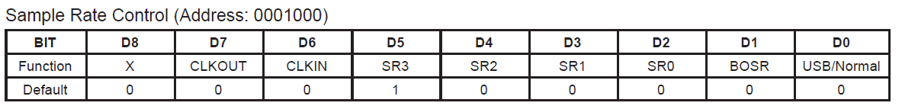
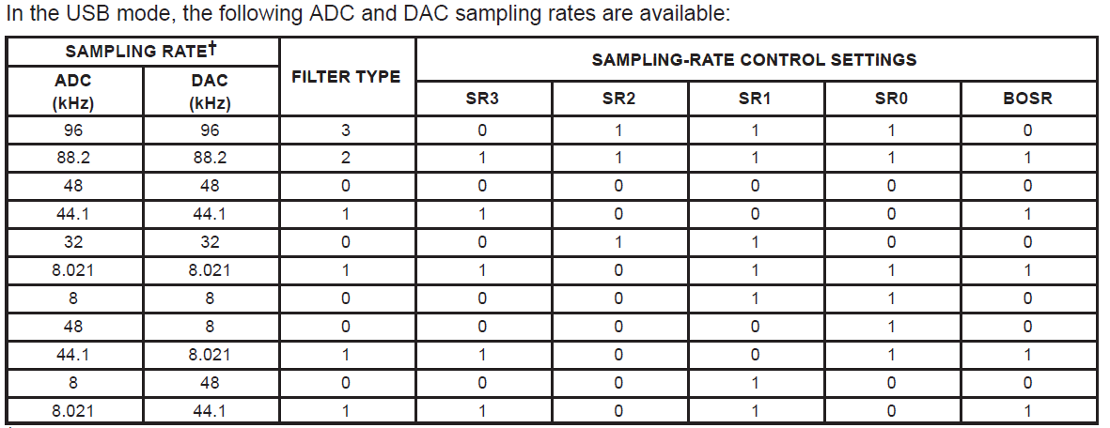
Stereo Audio Codec TLV320AIC23B
Sample Rate Control Register:
USB = Clock Mode Select (0 = Normal, 1 = USB)
BOSR = Base Oversampling Rate
USB – Mode: 0 = 250fs, 1 = 272fs;
Normal – Mode: 0 = 256fs; 1 = 384fs
SR = Sampling Rate
CLKIN = Clock Input Divider (0 = MCLK; 1 = MCLK/2)
CLKOUT = Clock Output Divider (0 = MCLK; 1 = MCLK/2)

Slide 37
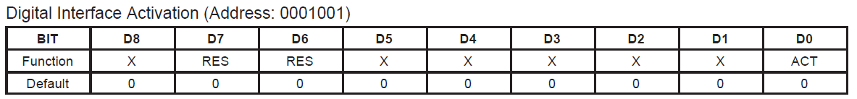
Stereo Audio Codec TLV320AIC23B
Digital Interface Activation Register:
ACT = Activate Interface (0 = NO, 1 = YES)
RES = reserved

Slide 38
AIC23B Exercises:
Lab13_1:
Initialize SPI-A as control channel for AIC23B
Initialize McBSP-A as data channel for AIC23B
AIC23B is master and sends the 12MHz base clock
AIC23B sends a 44.1 kHz frame sync signal to McBSP
Send a sinusoidal signal, based on the BOOT-ROM look-up table to the DAC of the AIC23B; sample rate is 44.1 kHz
Lab13_2:
Send two different signals to left and right audio channel
Add volume control
Lab13_3:
Improvement of Lab13_2; reduce Interrupt Service time

Slide 39
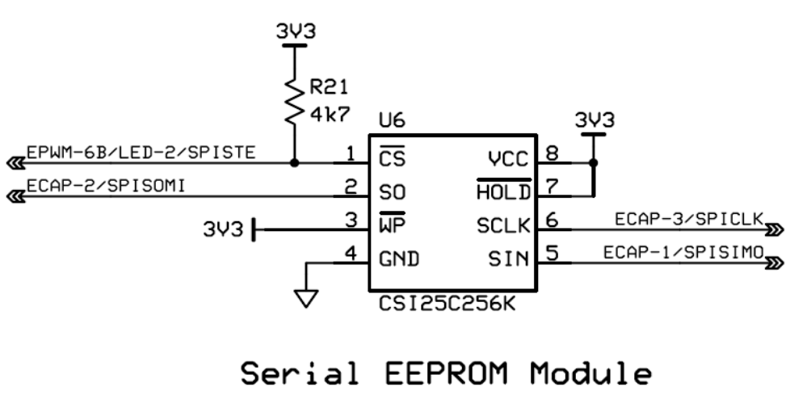
EEPROM AT25256 Exercise:
Lab13_4:
Initialize McBSP-B in SPI-Mode for AT25256
Write data to EEPROM, if button PB1 (GPIO17) is pushed. Read the current value from Hex-Encoder (GPIO12…15) and store it into EEPROM-address 0x0040, bits 3…0.
Read data from EEPROM-address 0x0040, when button PB2 (GPIO48) is pushed and display bits 2…0 at LEDs LD4 (GPOI49), LD3 (GPIO34) and LD1 (GPIO9).

Slide 40
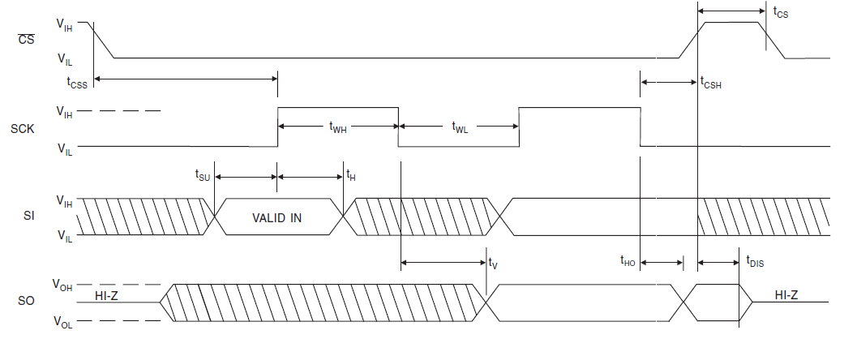
EEPROM AT25256
Timing Diagram:

Slide 41
EEPROM AT25256
Access Status Register:
7
6
5
4
3
2
1
0
WPEN
0
0
0
BP1
BP0
WEN
/RDY
Block protect select
Write in progress
0 = no write cycle
1 = write in progress
00 = no protection
01 = 0x6000 – 0x7FFF protected
10 = 0x4000 – 0x7FFF protected
11 = 0x0000 – 0x7FFF protected
Write Enable Latch
Write Protect Enable
1 = no write access
0 = normal operation
0 = write disabled
1 = write enabled

Slide 42
EEPROM AT25256
Instruction Register:
Instruction | Description | Code
WREN | Write Enable | 0000 0110
WRDI | Write Disable | 0000 0100
RDSR | Read Status Register | 0000 0101
WDSR | Write Status Register | 0000 0001
READ | Read Data | 0000 0011
WRITE | Write Data | 0000 0010

Slide 43
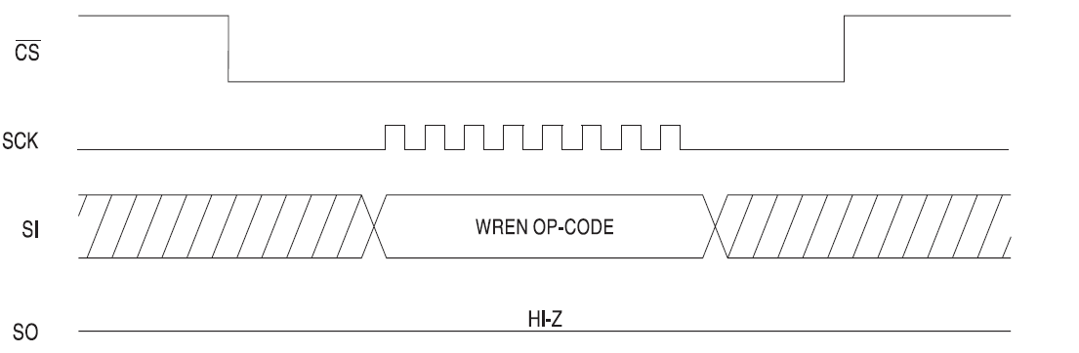
EEPROM AT25256
Write – Enable (WREN) Timing:
© Atmel Corporation; Datasheet AT25256 (doc0872.pdf) – 2005; Page 10

Slide 44
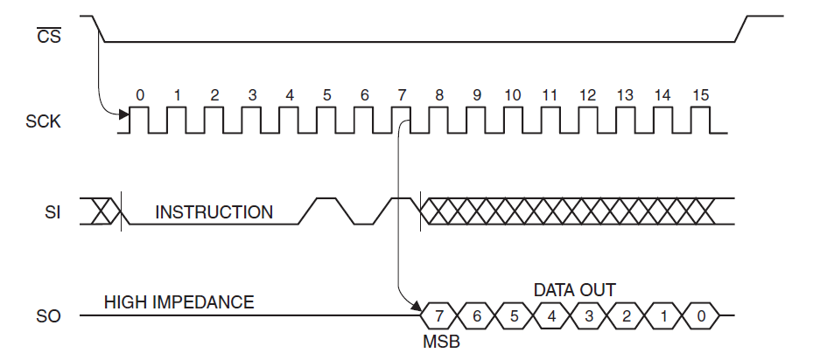
EEPROM AT25256
Read Status Register (RDSR) Timing:
© Atmel Corporation; Datasheet AT25256 (doc0872.pdf) – 2005; Page 10

Slide 45
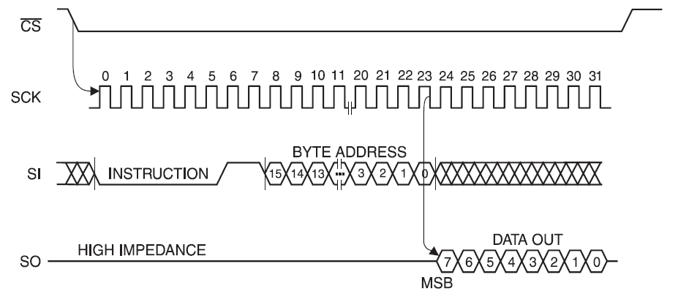
EEPROM AT25256
Read (READ) Timing:
© Atmel Corporation; Datasheet AT25256 (doc0872.pdf) – 2005; Page 11

Slide 46
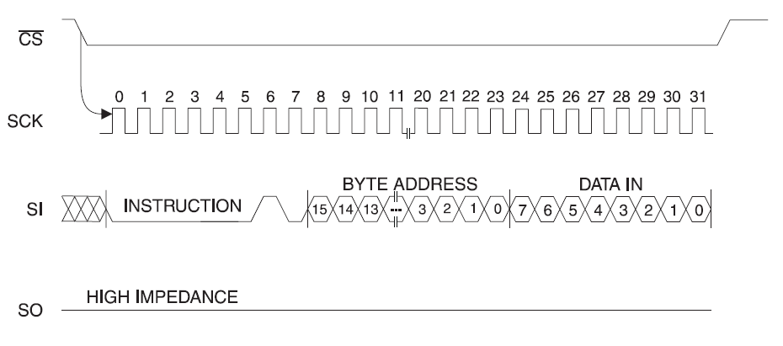
EEPROM AT25256
Write (WRITE) Timing:
© Atmel Corporation; Datasheet AT25256 (doc0872.pdf) – 2005; Page 11

Slide 47




