Slide 1

Module 17: IQ – Math library
32-Bit-Digital Signal Controller
TMS320F2833x
Texas Instruments Incorporated
European Customer Training Centre
University of Applied Sciences Zwickau

Slide 2
Fractional Representation
31
0
S IIIIIIII
fffffffffffffffffffffff
32 bit mantissa
-2^{I} + 2^{I-1} + … + 2¹ + 2⁰ . 2⁻¹ + 2⁻² + … + 2^{-Q}
“IQ” – Format
“I” ⇒ INTEGER – Fraction
“Q” ⇒ QUOTIENT – Fraction
Advantage ⇒ Precision same for all numbers in an IQ format
Disadvantage ⇒ Limited dynamic range compared to floating point

Slide 3
IQ – Range and Resolution
4-bit number:
Format | Most Negative | Most Positive | Resolution (step size)
I1Q3 | 1.000 -1 | 0.111 +0.875 | 0.001 0.125
I2Q2 | 10.00 -2 | 01.11 +1.75 | 00.01 0.25
I3Q1 | 100.0 -4 | 011.1 +3.5 | 000.1 0.5
I4Q0 | 1000 -8 | 0111 +7 | 0001 1
Trade - Off between Range and Resolution
Note: Integer Format (I4Q0) is a subset of IQ-Math

Slide 4
F28x Signal Processing Libraries
Signal Processing Libraries & Applications Software Literature #
ACI3-1: Control with Constant V/Hz SPRC194
ACI3-3: Sensored Indirect Flux Vector Control SPRC207
ACI3-3: Sensored Indirect Flux Vector Control (simulation) SPRC208
ACI3-4: Sensorless Direct Flux Vector Control SPRC195
ACI3-4: Sensorless Direct Flux Vector Control (simulation) SPRC209
PMSM3-1: Sensored Field Oriented Control using QEP SPRC210
PMSM3-2: Sensorless Field Oriented Control SPRC197
PMSM3-3: Sensored Field Oriented Control using Resolver SPRC211
PMSM3-4: Sensored Position Control using QEP SPRC212
BLDC3-1: Sensored Trapezoidal Control using Hall Sensors SPRC213
BLDC3-2: Sensorless Trapezoidal Drive SPRC196
DCMOTOR: Speed & Position Control using QEP without Index SPRC214
Digital Motor Control Library (F/C280x) SPRC215
Communications Driver Library SPRC183
DSP Fast Fourier Transform (FFT) Library SPRC081
DSP Filter Library SPRC082
DSP Fixed-Point Math Library SPRC085
DSP IQ Math Library SPRC087
DSP Signal Generator Library SPRC083
DSP Software Test Bench (STB) Library SPRC084
C28x FPU Fast RTS Library SPRC664
C2833x C/C++ Header Files and Peripheral Examples SPRC530
Available from TI Website ⇒ http://www.ti.com/c2000
Notes:
We don’t have a lot of time in this section, so quickly point out the web address, and hit home this important location for their next step!!!
This shows them where to get additional info.
Highlight the DMC applications area, the designer notebook pages, and the development tools section.

Slide 5
So how do we really use all this fraction stuff?
The Fixed-Point Development Dilemma
Simulation
Platform
(i.e. MatLab)
Natural development starts with simulation in floating-point
Takes many days/weeks to convert (one way process)
Fixed-Point Algorithm
(ASM, C, C++)
Floating-Point
Algorithm
(C or C++)
Can be easily ported to floating-point device
Floating-Point DSP
Fixed-Point DSP

Slide 6
Traditional 16-bit “Q” Math Approach y = mx + b
s Q15
M
ss Q30
s Q15
X
sssssssssssss Q15
s Q15
B
Align Binary
Point For Add
<< 15
ss Q30
sI Q30
Align Binary
Point For Store
>> 15
ssssssssssssI Q15
s Q15
Y
in C:
Y = ((i32) M * (i32) X + (i32) B << Q) >> Q;

Slide 7
Traditional 32-bit “Q” Math Approach y = mx + b
I8 Q24
M
I16 Q48
I8 Q24
X
ssssssssssssssssssI8 Q24
I8 Q24
B
Align Decimal
Point for Add
<< 24
ssssI8 Q48
I16 Q48
Align Decimal
Point for Store
>> 24
sssssssssssssssssI16 Q24
I8 Q24
Y
in C:
Y = ((i64) M * (i64) X + (i64) B << Q) >> Q;
Note: Requires support for 64-bit integer data type in compiler

Slide 8
32-bit IQmath Approach y = mx + b
I8 Q24
M
I16 Q48
Align Decimal
Point Of Multiply
I8 Q24
X
>> 24
sssssssssssssssssI16 Q24
I8 Q24
B
I8 Q24
I8 Q24
Y
in C:
Y = ((i64) M * (i64) X) >> Q + B;

Slide 9
IQmath Approach
Multiply Operation
Y = ((i64) M * (i64) X) >> Q + B;
Redefine the multiply operation as follows:
_IQmpy(M,X) == ((i64) M * (i64) X) >> Q
This simplifies the equation as follows:
Y = _IQmpy(M,X) + B;
C28x compiler supports “_IQmpy” intrinsic; assembly code generated:
MOVL XT,@M
IMPYL P,XT,@X ; P = low 32-bits of M*X
QMPYL ACC,XT,@X ; ACC = high 32-bits of M*X
LSL64 ACC:P,#(32-Q) ; ACC = ACC:P << 32-Q
; (same as P = ACC:P >> Q)
ADDL ACC,@B ; Add B
MOVL @Y,ACC ; Result = Y = _IQmpy(M*X) + B
; 7 Cycles

Slide 10
IQmath Approach
It looks like floating-point!
Floating-Point
float Y, M, X, B;
Y = M * X + B;
Traditional
Fix-Point Q
long Y, M, X, B;
Y = ((i64) M * (i64) X + (i64) B << Q)) >> Q;
“IQmath”
In C
_iq Y, M, X, B;
Y = _IQmpy(M, X) + B;
“IQmath”
In C++
iq Y, M, X, B;
Y = M * X + B;
“IQmath” code is easy to read!

Slide 11
IQmath Approach
GLOBAL_Q simplification
User selects “Global Q” value for the whole application
GLOBAL_Q
based on the required dynamic range or resolution, for example:
GLOBAL_Q
Max Val
Min Val
Resolution
28
7.999 999 996
-8.000 000 000
0.000 000 004
24
127.999 999 94
-128.000 000 00
0.000 000 06
20
2047.999 999
-2048.000 000
0.000 001
#define GLOBAL_Q 18 // set in “IQmathLib.h” file
_iq Y, M, X, B;
Y = _IQmpy(M,X) + B; // all values are in Q = 18
The user can also explicitly specify the Q value to use:
_iq20 Y, M, X, B;
Y = _IQ20mpy(M,X) + B; // all values are in Q = 20

Slide 12
IQmath Provides Compatibility Between Floating-Point and Fixed-Point
1) Develop any mathematical function
Y = _IQmpy(M, X) + B;
2) Select math type in IQmathLib.h
#if MATH_TYPE == IQ_MATH
#if MATH_TYPE == FLOAT_MATH
3) Compiler automatically converts to:
Y = (float)M * (float)X + (float)B;
Fixed-Point Math Code
Floating-Point Math Code
Compile & Run
on Fixed-Point
F282xx
Compile & Run
on Floating-Point
F283xx *
All “IQmath” operations have an equivalent floating-point operation
* Can also compile floating-point code on any floating-point compiler (e.g., PC, Matlab, fixed-point w/ RTS lib, etc.)

Slide 13
IQmath Library: Math & Trig Functions
Operation
Floating-Point
“IQmath” in C
“IQmath” in C++
type
float A, B;
_iq A, B;
iq A, B;
constant
A = 1.2345
A = _IQ(1.2345)
A = IQ(1.2345)
multiply
A * B
_IQmpy(A , B)
A * B
divide
A / B
_IQdiv (A , B)
A / B
add
A + B
A + B
A + B
substract
A - B
A - B
A – B
boolean
>, >=, <, <=, ==, |=, &&, ||
>, >=, <, <=, ==, |=, &&, ||
>, >=, <, <=, ==, |=, &&, ||
trig
and
power
functions
sin(A),cos(A)
sin(A*2pi),cos(A*2pi)
asin(A),acos(A)
atan(A),atan2(A,B)
atan2(A,B)/2pi
sqrt(A),1/sqrt(A)
sqrt(A*A + B*B)
exp(A)
_IQsin(A), _IQcos(A)
_IQsinPU(A), _IQcosPU(A)
_IQasin(A),_IQacos(A)
_IQatan(A), _IQatan2(A,B)
_IQatan2PU(A,B)
_IQsqrt(A), _IQisqrt(A)
_IQmag(A,B)
_IQexp(A)
IQsin(A),IQcos(A)
IQsinPU(A),IQcosPU(A)
IQasin(A),IQacos(A)
IQatan(A),IQatan2(A,B)
IQatan2PU(A,B)
IQsqrt(A),IQisqrt(A)
IQmag(A,B)
IQexp(A)
saturation
if(A > Pos) A = Pos
if(A < Neg) A = Neg
_IQsat(A,Pos,Neg)
IQsat(A,Pos,Neg)
Accuracy of functions/operations approx ~28 to ~31 bits

Slide 14
IQmath Library: Conversion Functions
Operation
Floating-Point
“IQmath” in C
“IQmath” in C++
iq to iqN
A
_IQtoIQN(A)
IQtoIQN(A)
iqN to iq
A
_IQNtoIQ(A)
IQNtoIQ(A)
integer(iq)
(long) A
_IQint(A)
IQint(A)
fraction(iq)
A – (long) A
_IQfrac(A)
IQfrac(A)
iq = iq*long
A * (float) B
_IQmpyI32(A,B)
IQmpyI32(A,B)
integer(iq*long)
(long) (A * (float) B)
_IQmpyI32int(A,B)
IQmpyI32int(A,B)
fraction(iq*long)
A - (long) (A * (float) B)
_IQmpyI32frac(A,B)
IQmpyI32frac(A,B)
qN to iq
A
_QNtoIQ(A)
QNtoIQ(A)
iq to qN
A
_IQtoQN(A)
IQtoQN(A)
string to iq
atof(char)
_atoIQ(char)
atoIQ(char)
IQ to float
A
_IQtoF(A)
IQtoF(A)
IQ to ASCII
sprintf(A,B,C)
_IQtoA(A,B,C)
IQtoA(A,B,C)
IQmath.lib > contains library of math functions
IQmathLib.h > C header file
IQmathCPP.h > C++ header file

Slide 15
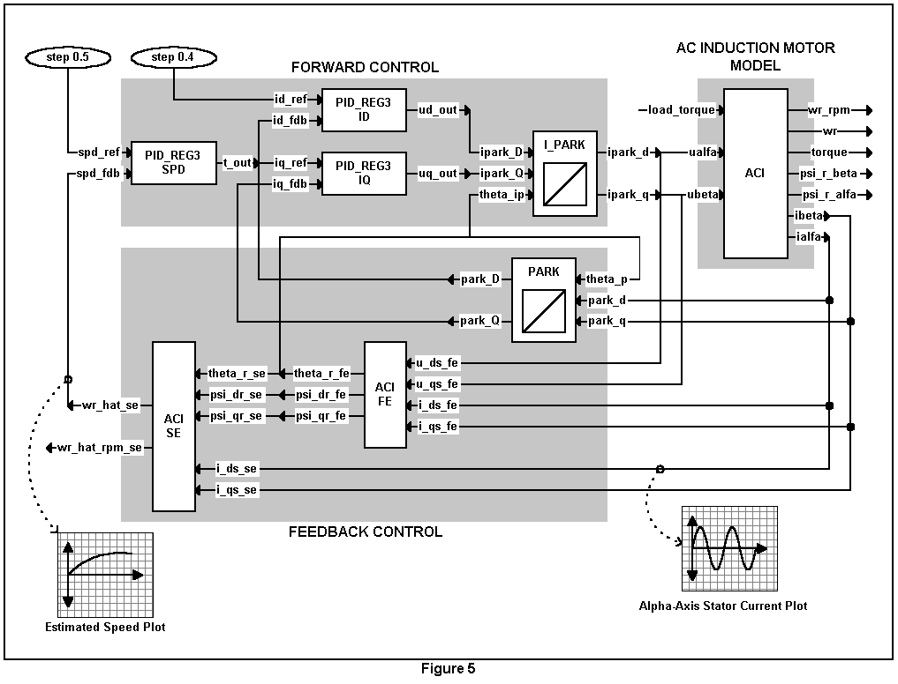
AC Induction Motor Example
One of the more complex motor control algorithms
Sensorless, ACI induction machine direct rotor flux control
Goal: motor speed estimation & alpha-axis stator current estimation

Slide 16
AC Induction Motor Example
Park Transform – floating-point C code
#include “math.h”
#define TWO_PI 6.28318530717959
void park_calc(PARK *v)
{
float cos_ang , sin_ang;
sin_ang = sin(TWO_PI * v->ang);
cos_ang = cos(TWO_PI * v->ang);
v->de = (v->ds * cos_ang) + (v->qs * sin_ang);
v->qe = (v->qs * cos_ang) - (v->ds * sin_ang);
}

Slide 17
AC Induction Motor Example
Park Transform - converting to “IQmath” C code
#include “math.h”
#define TWO_PI 6.28318530717959
void park_calc(PARK *v)
{
float cos_ang , sin_ang;
sin_ang = sin(TWO_PI * v->ang);
cos_ang = cos(TWO_PI * v->ang);
v->de = (v->ds * cos_ang) + (v->qs * sin_ang);
v->qe = (v->qs * cos_ang) - (v->ds * sin_ang);
}
#include “IQmathLib.h”
_IQ(6.28318530717959)
_iq
_IQsin(_IQmpy(TWO_PI , v->ang));
_IQcos(_IQmpy(TWO_PI , v->ang));
_IQmpy(v->ds , cos_ang) + _IQmpy(v->qs , sin_ang);
_IQmpy(v->qs , cos_ang) - _IQmpy(v->ds , sin_ang);

Slide 18
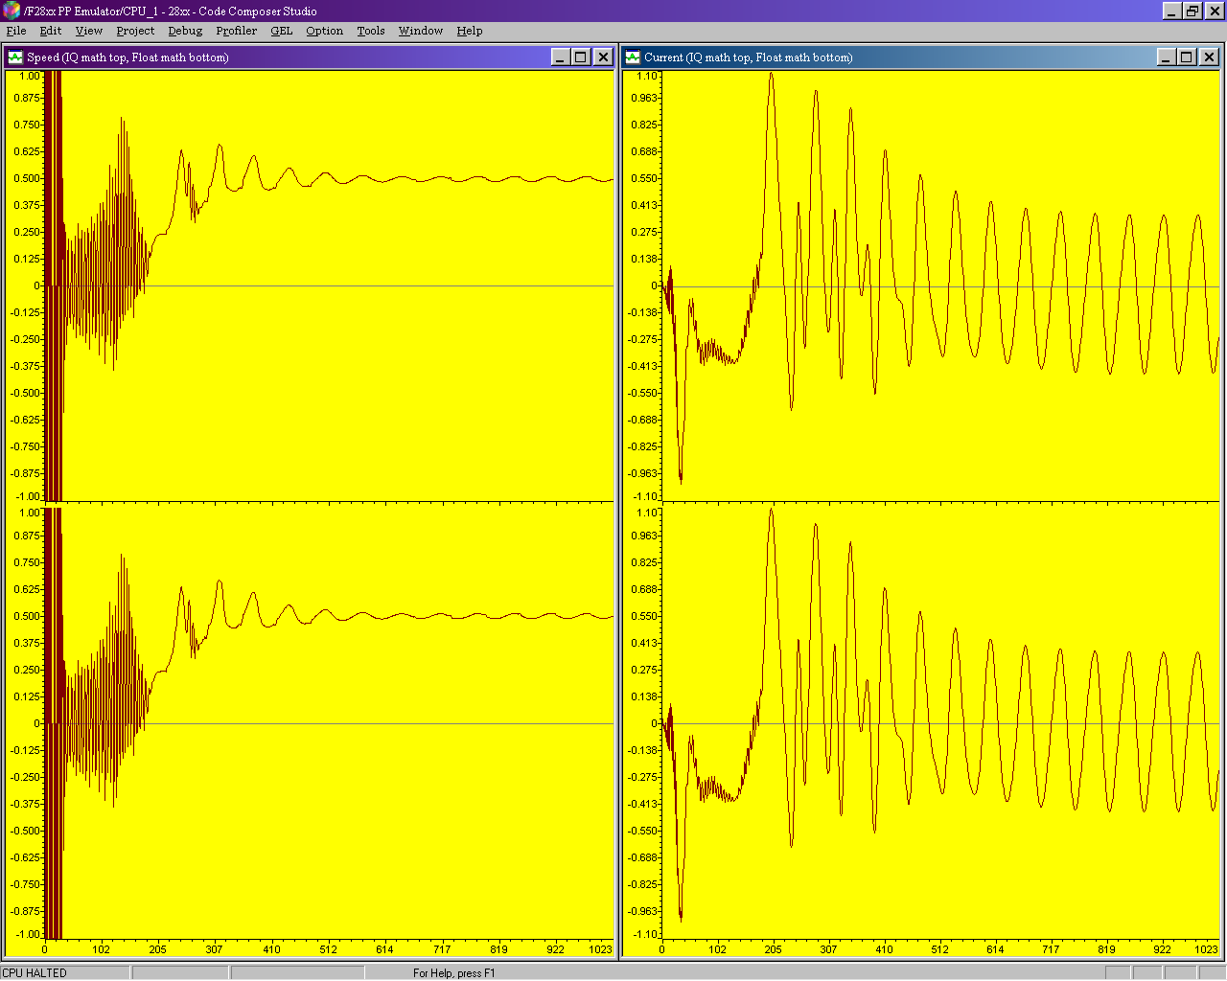
AC Induction Motor Example
GLOBAL_Q = 24, system stable
IQmath: speed
IQmath: current
Floating-Point: speed
Floating-Point: current

Slide 19
What’s Happening Here?
Equal Precision in the Computation Region
Floating-Point:
+∞
0
-∞
Same precision as I8Q24
I8Q24 Fractions:
+∞
0
-∞
In the region where these particular computations occur, the precision of single-precision floating-point just happens to equal the precision of the I8Q24 format.
So, both produce similar results!
Notes:
We are using an I8Q24 format. For this particular system, the variable ranges happen to fall such that the precision of floating-point in that range is pretty much the same as the precision of I8Q24. Remember that both single-precision floating-point and IQmath are 32-bit math.
Now there is no doubt some difference in the floating-point and IQmath computations. But, those differences are too small to affect the AC induction motor system in this example.
As we’ll see next, changing the IQ format can dramatically change the results.

Slide 20
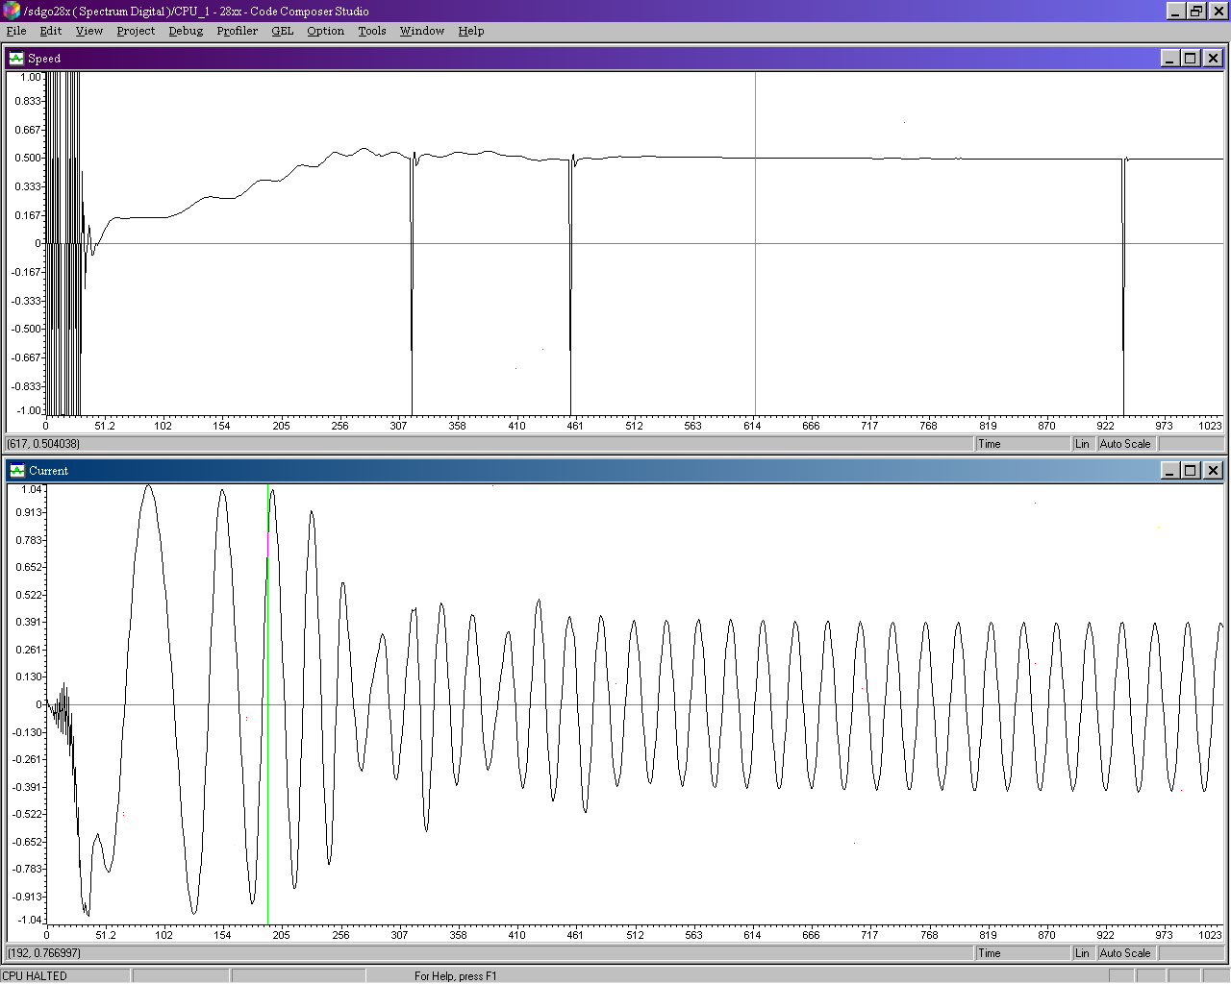
AC Induction Motor Example
GLOBAL_Q = 27, system unstable
IQmath: speed
IQmath: current

Slide 21
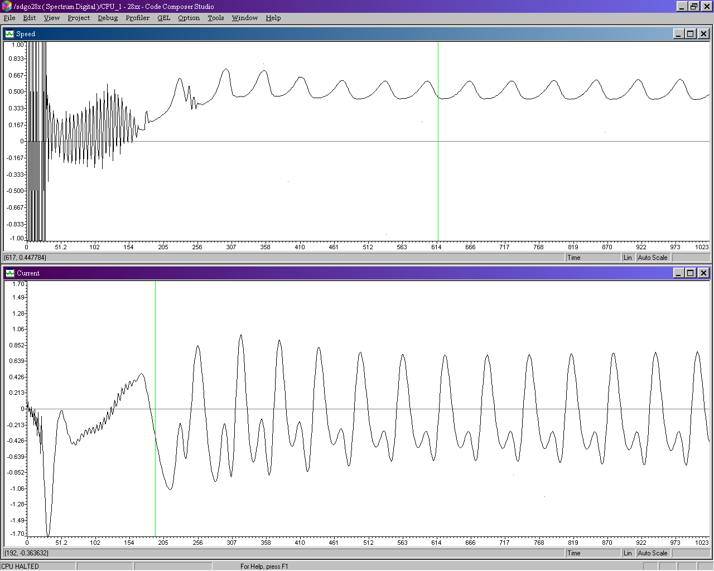
AC Induction Motor Example
GLOBAL_Q = 16, system unstable
IQmath: speed
IQmath: current

Slide 22
AC Induction Motor Example
Q stability range
Q range
Stability Range
Q31 to Q27
Unstable
(not enough dynamic range)
Q26 to Q19
Stable
Q18 to Q0
Unstable
(not enough resolution, quantization problems)
The developer must pick the right GLOBAL_Q value!

Slide 23
AC Induction Motor Example
Performance comparisons
Benchmark C28x C C28x C C28x C
floating-point floating-point IQmath
std. RTS lib fast RTS lib v1.4d
(150 MHz) (150 MHz) (150 MHz)
B1: ACI module cycles 401 401 625
B2: Feedforward control cycles 421 371 403
B3: Feedback control cycles 2336 792 1011
Total control cycles (B2+B3) 2757 1163 1414
% of available MHz used 36.8% 15.5% 18.9%
(20 kHz control loop)
Notes: C28x compiled on codegen tools v5.0.0, -g (debug enabled), -o3 (max. optimization)
fast RTS lib v1.0beta1
IQmath lib v1.4d

Slide 24
IQmath Approach Summary
“IQmath” + fixed-point processor with 32-bit capabilities =
Seamless portability of code between fixed and floating-point devices
  User selects target math type in “IQmathLib.h” file
    #if MATH_TYPE == IQ_MATH
    #if MATH_TYPE == FLOAT_MATH
One source code set for simulation vs. target device
Numerical resolution adjustability based on application requirement
  Set in “IQmathLib.h” file
    #define GLOBAL_Q 18
  Explicitly specify Q value
    _iq20 X, Y, Z;
Numerical accuracy without sacrificing time and cycles
Rapid conversion/porting and implementation of algorithms
IQmath library is freeware - available from TI DSP website
http://www.ti.com/c2000

Slide 25
Lab17: IQ – Math FIR - Filter
ePWM1
ADC
TB Counter
Compare
Action Qualifier
RESULT0
ADCINA0
FIR Filter
connector
wire
ePWM2 triggering ADC on period match using SOC A trigger every 20µs (50 kHz)
data
memory
ePWM2
CPU copies
result to
buffer during
ADC ISR
pointer rewind
...
Display using CCS

Slide 26
Lab17: IQ – Math FIR - Filter
  Objective:
  Generate a symmetrical 2 kHz PWM signal with 25% duty cycle
  Measure the signal with ADC at a 50 kHz sample rate
  Store the ADC results in a circular result buffer
  Compute the ADC results in a digital finite impulse response (FIR) filter with low-pass characteristics. The Filter is calculated by IQ-Math functions
  Plot the graphs of the filtered and unfiltered signal with Code Composer Studios graph tool
  Compare the results

Slide 27
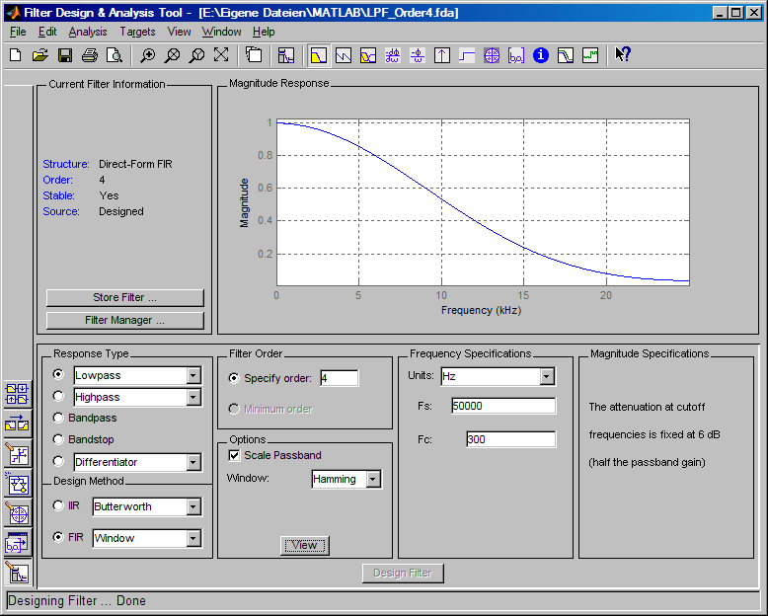
MATLAB FDATOOL

Slide 28
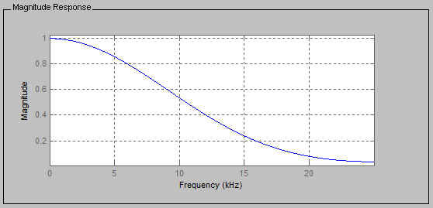
MATLAB FDATOOL
FIR – Lowpass; 4th –order
Corner Frequency: 300 Hz
Sampling Frequency: 50 kHz
Hamming - Window

Slide 29
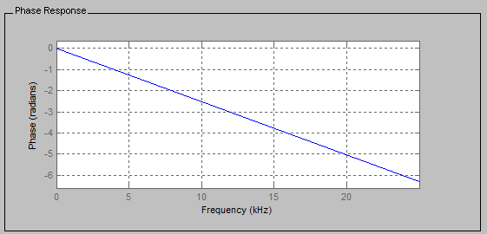
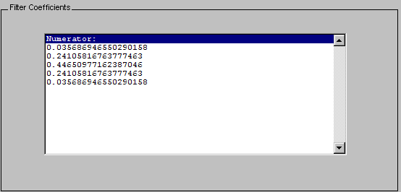
MATLAB FDATOOL

Slide 30




