Slide 1
TI’s C2000 Real-Time MCU for
Digital Motor Control
August 2009

Slide 2
Table of Contents
Motor Control Overview
  Types of Motors
  Controlling the Motor
  Controlling the Power Stage
  Typical Systems
Solution Features for DMC
  Software Solutions
    Libraries
    IQMath
    DMC Frameworks
  Real-Time Debug
  Addition of Digital Power-Factor Correction
  Open Source Hardware
  Lowering Cost of Manufacturing
  Simulation and Graphical Development
Device Features for DMC
  CPU
  Peripherals
  System Robustness
  Safety & Reliability

Slide 3
Motor Control Overview

Slide 4
Motor Types

Slide 5
Common Motors & C2000 Applicability
Motor Type | Torque Curve | Applications | Strengths | Weaknesses
Universal |  | Power Tools, Vacuums, Fans | Cheap, Simple Control | Low reliability Poor torque and limited control
DC Brushed |  | Power Tools, Battery Operated | Cheap, Simple Control | Low reliability, EMI, Noisy, Feedback required
Stepper |  | Printers, Automation | Constant torque, Precise position control, High speed | Control complexity can vary; Speed control or High Load
AC – Asynch AC Induction |  | White Goods, Pumps, Fans | Low cost, Efficient at fixed speeds, | Poor at low speeds, Feedback (f,i) and complex control for high efficiency
AC – Synch BLDC PMSM IPM |  | Automation, Traction, Precision, White Goods | Efficient, reliable, smooth operation; Combustible environments; High torque | Demanding control for highest efficiency; Historically expensive but prices dropping
Reluctance SR |  | Traction, White Goods (still not widely used) | Low cost, highly reliable | Complex control to eliminate noise and torque ripple
T
Low
S
T
S
T
Control Complexity (generally)
S
T
S
High
Growth
T
S
High
T
S

Slide 6
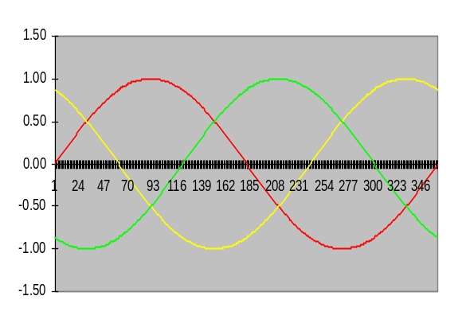







Asynchronous Motor: ACI
Phase currents
ia
ib
ic
ia
A`
Rotor rotation
Rotor flux
C
B
Im
Stator flux
Current Phasors
C`
120º
B`
Re
A
Aluminum bar
Theory of Operation:
  Rotor placed in a moving magnetic field (flux) will have current induced – which produces another magnetic field
  The interaction of these two magnetic fields produces the rotational torque
Stator flux is variably controlled by feeding current
Rotor flux is induced by the stator flux
Rotor and Stator rotate at different speeds = Asynchronous
Angle between rotor and stator flux can be regulated to determine torque
Rotor position is never known

Slide 7
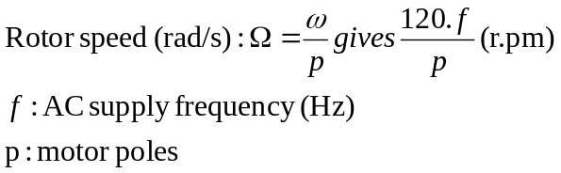
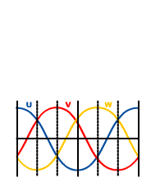
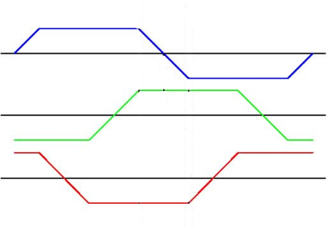
Synchronous Motors: BLDC & PMSM
A`
Rotor field
φ
C
F
N
B
N
S
C`
F
S
Stator field
B`
A
BLDC Back EMF
PMSM Back EMF
Theory of Operation:
  Fixed rotor flux (magnetic field) and a produced stator flux
  The interaction between the two fields produces a torque which will cause the motor to rotate
Stator flux is variably controlled by feeding current
Rotor flux is constant by permanent magnets or current fed coils
Rotor rotation is at same frequency as supplied excitation = Synchronous
Angle between rotor and stator flux can be regulated to determine torque
Rotor position can be measured or estimated

Slide 8
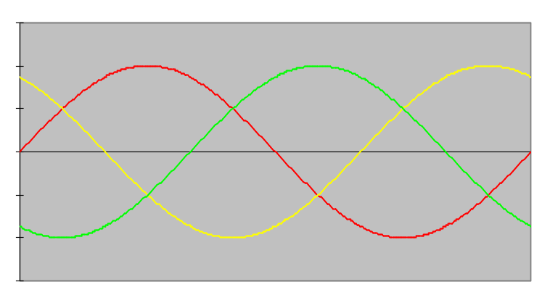
Which Synchronous? BLDC vs. PMSM
Continuous States = More Complex
Back EMF of BLDC Motor
Back EMF of PMSM
e_{a}
ea
eb
ec
e_{b}
e_{c}
1
2
3
4
5
6
1
CONTINUOUS
BLDC Motors
  Easier to control (6 Trapezoidal states)
  Torque ripple at commutations
  Better for lower speed
  Noisy
  Doesn’t work with distributed winding
  Not as efficient, lower Torque
  Lower cost
PMSM Motors
  More complex control (continuous 3Ph Sine Wave)
  No torque ripple at commutation
  Higher max achievable speed
  Low noise
  Work with low-cost distributed winding
  Higher efficiency, higher Torque
  Higher cost

Slide 9
Controlling the Motor

Slide 10
Trapezoidal Control (BLDC only) - Simple
e_{a}
Trapezoidal Step by Step
Sample the System
  Position: Hall sensors (3 Square wave outputs correspond to rotor position)
  3 Ph Voltages (sensorless)
  Current through a shunt (optional)
Calculate
  Speed = Frequency of positions
Estimations (Sensorless)
  Voltage Back EMF easily gives position of rotor
Regulate the Loop
  Simple proportional PID speed control
  Optional Current/Voltage Monitor
Stimulate the System
  Simple PWM trapezoidal patterns (1-6)
e_{b}
e_{c}
1
2
3
4
5
6
1
Trapezoidal Control
Fed with direct current
Stator Flux commutation only each 60º (1-6)
Two phases ON at the same time
Torque ripple at commutations
Communication at high speed difficult
Noisy
Doesn’t work with distributed winding

Slide 11


V/f Control (ACI or PMSM) – Simple
MAXIMUM
TORQUE
Model:
VOLTAGE
R_{s}
L_{s}
R_{r}/s
L_{r}
V
Φ_{m}
L_{m}
R(s)
NOMINAL
TORQUE
TORQUE
Vo
At low speed: Rs is no longer negligible: Vm < V
A large portion of energy is now wasted.
LOW SPEED
NOM SPEED
SPEED
+ Simple Proportional Control: Three sine waves feeding the motor
+ Position information not required (optional)
– Poor dynamic performance
– Torque delivery not optimized for all speeds
Torque oscillation
generates uncontrolled
current overshoot:
TORQUE
TIME

Slide 12

FOC Control (ACI or PMSM) – Complex
A`
Maintain the ‘load angle’ at 90°
q=90°
C
F
N
B
C`
S
F
B`
A
Torque = Cross Product of Fields
Maximized when Sin q = 1 = 90 Degrees
Field Orientation
+ Reduced torque ripple
+ Better dynamic response
+ Good performance at lower speeds
- Need to measure angle between rotor and stator
- Requires independent control of flux and torque in real-time
Measure & Control
Torque, Flux
Angle, Speed
Notes:
Even if explanation of the theory of the FOC control will focus and base itself on the ACI machine, presenting the PMSM motor to highlight the FOC spirit is simple and should help. On the synchronous motor, as shown in the chapter 2, we have flux source on the rotor and we feed stator coils with a rotating magnetic filed. If the stator and rotor flux are physically maintained orthogonal, then, as the produced torque is equal to the vector cross product of these two variables, it is obvious that we get the maximum performances when we are able to maintain the load at 90 degrees. This ensure a better control with advantages such a reduced torque ripple and a better dynamic response if we are able to do it in real-time thanks to C2000. Again we start here to see that wee need information on the system we wish to control such as the rotor position information.

Slide 13
FOC: Torque & Flux Deduced from Currents
a
3PH
Currents
α
Clarke
Transformation
Q
Park
Transformation
MEASURE
CURRENTS
MATH
TRANSFORM
MATH
TRANSFORM
I_{s}
ω_{stator}
I_{s}
I_{s}
D
I_{q}
π/2
I_{d}
2π/3
Torque Component
Flux Component
2π/3
β
b
c
2π/3
Ια
t
Torque Component
I_{Q}
i_{c}
i_{a}
i_{b}
t
t
Ιβ
t
Flux Component
I_{D}
t
Two phase orthogonal
reference frame
Rotating
reference frame
Three phase reference frame

Slide 14
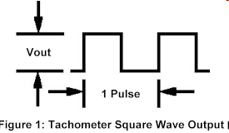
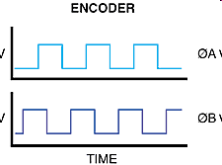
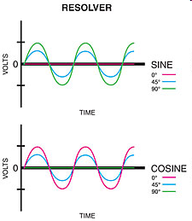
FOC: Angle & Speed are Measured or Estimated
ACI
  Measured
    Tachometer: Square wave output proportional to speed
  Estimations
    Angle estimated from Integral of Sinusoidal Back EMF Voltage with closed loop voltage compensation
    Speed estimated from Estimated Flux, measured current, and motor model
PMSM
  Measured
    Encoder: 2 Square waves give position, speed calculated by change over time
    Resolver: SIN + COS waves give position, speed calculated by change over time
  Estimations
    Angle estimated from Integral of Sinusoidal Back EMF Voltage with Sliding Mode Observer technique
    Speed calculated from change in angle over time

Slide 15
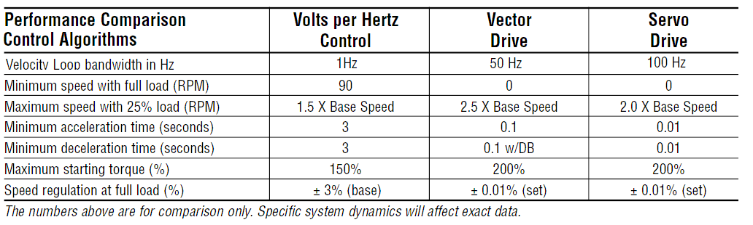
Why FOC? Performance Comparison
FOC
FOC
  System responds faster to changes in set point or load change
  Minimum speed at full load is now essentially zero
  Starting torque is increased
  Very little torque ripple
  Reduces Cost
    Optimally size motor for the task at hand
    Current controlled, so the inverter can be optimized

Slide 16
FOC: Step By Step
Measure & Control
Torque, Flux
Angle, Speed
Sample the System
  Current
  Voltage (Sensorless)
  Speed (ACI Sensored)
  Speed & Position/Angle (PMSM Sensored)
Transform sampled data and calculate useful quantities
  Measure Currents → Use Clarke/Parke Transform → Torque & Flux
  ACI Sensored
    Measure Speed + Torque & Flux Components → Angle
  ACI Sensorless
    Measure Voltage + Stator Current (Clarke) → Angle Estimation
    Angle Estimation + Stator Current (Clarke) → Speed Estimation
  PMSM Sensored
    Measured Speed and Measured Angle
  PMSM Sensorless
    Measured Voltage + Stator Current (Clarke) → Angle Estimation
    Angle Estimation → Speed Estimation
Regulate the Loop
  PID techniques are most common; Controls to a reference value
  Regulate speed, position/angle, current, flux and maximize torque
Stimulate the System
  Inverse transforms of Park and Clarke
  PWM Pattern generation to drive the voltage/current source

Slide 17
Controlling the Power Stage

Slide 18
Controlling the 3PH Voltage Source Inverter (VSI)
Upper & lower
devices can not
be turned on
simultaneously
(dead band)
PWM signal is
applied between
gate and source
+
DC bus
capacitor
−
Three phase
outputs which
go to the motor
terminals
Power
Switching
Devices

Slide 19
Traditional (Old) Sine PWM VSI Control
Inputs
  Triangular Switching Frequency (5-25 kHz typically)
  Sine wave = Carrier Trying to match (V or I Reference, 0-1000 Hz typically)
  Image not to scale; Typically 100s of triangle periods in each Sine wave
Output
  When they cross, you switch the PWM

Slide 20
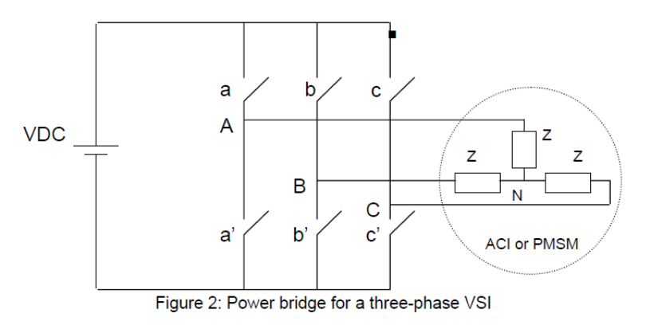
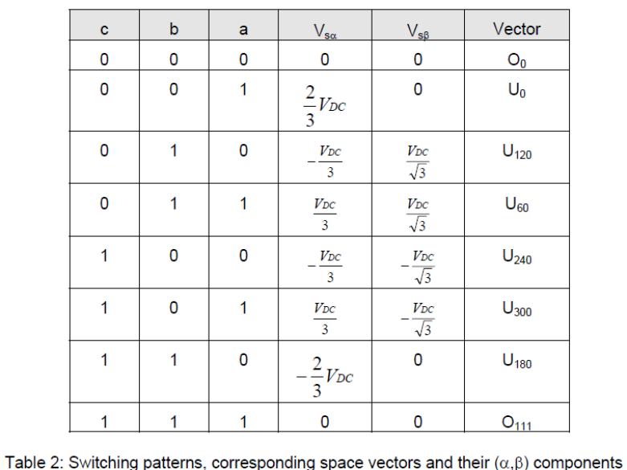
Space Vector PWM VSI Control
Theory: A special switching sequence of the upper three power devices of a VSI results in 3 pseudo-sinusoidal currents in the stator phases. Calculate the appropriate duty cycle – every period - needed to generate a given stator reference voltage.
q
V₁₂₀ (010)
V₆₀ (011)
V₀ (100)
S2
V_{an}*
S3
θ
S1
V₁₈₀ (110)
0 (111)
0 (000)
0
d
S4
S6
Zero Vectors (000) & (111)
S5
V₂₄₀ (100)
V₂₇₀ (101)
For review of the calculations, please see detailed theory in SVGEN documentation from DMC Library (SPRC080 or SPRC125).
Notes:
In recent years, the space vector theory demonstrated some improvement for both the output crest voltage and the harmonic copper loss. The maximum output voltage based on the space vector theory is 1.155 times as large as the conventional sinusoidal modulation. It makes it possible to feed the motor with a higher voltage than the easier sub-oscillation modulation method. This modulator enables higher torque at high speeds, and a higher efficiency. Torque distortion is reduced as well.

Slide 21
SVPWM Benefits vs Traditional Sine PWM
15% boost in torque
30% less switching losses (higher efficiency)
30% reduced EMI due to fewer transistor commutations
Reduced harmonic copper losses
Capacitor reduction
  The use of smaller DC link capacitor will introduce DC bus ripple
  Controllers with processing overhead can digitally compensate for the ripple on the DC bus, allowing for a greater ripple limit
  This smaller capacitor size can reduce system cost

Slide 22
Typical System Implementations

Slide 23
ACI System for FOC
MCU
+
DC Bus
Tx
Serial coms
(UART)
Timers and PWM Compare Units
PWM1
PWM2
Rx
PWM3
PWM4
PWM5
PWM6
AC Induction Motor
PWM1
PWM3
PWM5
SIMO
SPI
Serial coms
Capture
Unit
CAP/QEP
SOMI
CLK
STE
ADCIN0
PWM2
PWM4
PWM6
CAP/QEP
ADC
ADCIN1
Shunt
resistor
Tacho
Or Resolver
ADCIN2
ADCIN3
Signal Conditioning
Sensor is removed with sensorless FOC

Slide 24
BLDC System – Sensored, Trapezoidal
Back EMF of BLDC
e_{a}
MCU
e_{b}
+
DC Bus
e_{c}
Tx
Serial
(UART)
Timers and PWM Compare Units
PWM1
PWM2
Rx
PWM3
PWM4
PWM5
PWM6
PWM1
PWM3
PWM5
Three-phase BLDC machine
SIMO
SPI
(Synch
Serial)
Capture
Unit
CAP1
SOMI
CAP2
CLK
CAP3
STE
PWM2
PWM4
PWM6
CAP1
ADC
ADCIN0
CAP2
CAP3
0 / 120 / 240 deg position information (e.g., Hall sensors )
DC Shunt
Signal Conditioning

Slide 25
BLDC System – Sensorless, Trapezoidal
Back EMF of BLDC
e_{a}
MCU
+
DC Bus
e_{b}
Tx
Serial coms
(UART)
Timers and PWM Compare Units
PWM1
e_{c}
PWM2
Rx
PWM3
PWM4
PWM5
PWM6
PWM1
PWM3
PWM5
Three-phase BLDC machine
SIMO
SPI
Serial coms
Capture
Unit
SOMI
CLK
STE
ADCIN1
PWM2
No
sensors !
ADC
ADCIN2
PWM4
PWM6
ADCIN3
ADCIN0
DC Shunt
ADCIN1
Phase
Voltage
Meas
Signal Conditioning
ADCIN2
ADCIN3

Slide 26
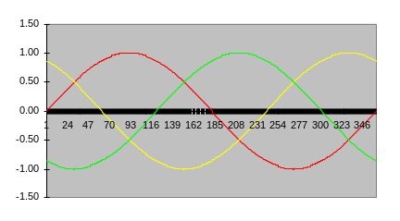
PMSM System – FOC/Vector
MCU
Back EMF of PMSM
+
DC Bus
e_{a}
e_{b}
e_{c}
Tx
Serial coms
(UART)
Timers and PWM Compare Units
PWM1
PWM2
Rx
PWM3
PWM4
PWM5
PWM6
PWM1
PWM3
PWM5
SIMO
SPI
Serial coms
Capture
Unit
QEP1
SOMI
QEP2
CLK
CAP3
STE
ADCIN0
PWM2
PWM4
PWM6
QEP1
ADC
ADCIN1
QEP2
CAP3 (index)
Shunt
resistor
Encoder Optional
Signal Conditioning
Sensor is removed with sensorless FOC

Slide 27
C2000 MCU
Solution Features for DMC
- Software
- Libraries
- IQMath
- DMC Frameworks
- Addition of Digital Power-Factor Correction
- Real-Time Debug
- Modular, Open Source Hardware
- Lowering Cost of Manufacturing
- Simulation and Graphical Development

Slide 28
Software for Real-Time Controllers
  Header Files
    Init routines and functions
    Named bit fields
    Peripheral Examples
  CCS v4 Sample Projects and Workspaces
    Eclipse-based code editor and debugger
    Tool kit demonstration workspaces show how to set up watch windows and graphs for real-time analysis
    General Purpose GUI ready for customization
    Demonstration GUIs
    Peripheral Explorer
    Renewable Energy Kit
    Digital Power Kits
  Foundation Libraries
    Math primitives
    Signal Processing
    Floating-point
    Control Law Accelerator
    Flash API
    IQMath
  Application Libraries
    Digital Motor Control
    Digital Power
  System Examples
  Robust Modular Frameworks
  Multiple Digital Power Conversion Types
  Multiple Motor Types
  Power Line Communication
  3rd Party Resources
    Diagram-based code generation
    Software libraries
  CCS Debug Tools
    Real-time Debug
    Graphical Analysis
    DSP/BIOS RTOS and scheduler
    Plug-ins and add-ons
  3rd Party Tools
    Modeling and Simulation
    Debug tools
    Emulators
Device Evaluation
Application Development
Debug and Productization
Notes:
All of these things are available for our devices, but let’s focus on the solutions most important for DMC (in green)

Slide 29
C2000 Software for DMC Concept
Methodology
- Highest precision & most numerically accurate
- Modular libraries (C source) for easiest re-use and customization
- Removal of fixed point scaling and saturation burden
- Easiest to tune for your custom motor
- Documentation: DMC theory, software, BOM, schematics
Customers can self serve and achieve high productivity!
Achieved by
- IQMath
- Application Frameworks: DMC Library & Incremental Build
- Partner Tools for simulation, GUI programming, and auto code gen

Slide 30
IQMath
Library and Compiler Intrinsic
  Move your decimal point to where you need it
  Write in floating point, compiler does all the work
Start-up, tuning, and debug effort are reduced
  Change numerical range on the fly, global or local
  Tune for best resolution and dynamic range
  Remove quantization effects
  Scaling and saturation are a thing of the past
  Better integration with simulation and code gen tools
  Single source set to move between fixed and floating point processors
  Easy re-use and re-tuning for new systems

Slide 31
IQmath: Choose your decimal
Range or Resolution?
Based On The Required Dynamic Range Or Resolution
31
0
S I I I I I I I I I I I I I I I I . Q Q Q Q Q Q Q Q Q Q Q Q Q Q Q (Q15)
GLOBAL_Q | Max Val | Min Val | Resolution
28 | 7.999 999 996 | -8.000 000 000 | 0.000 000 004
24 | 127.999 999 94 | -128.000 000 00 | 0.000 000 06
20 | 2047.999 999 | -2048.000 000 | 0.000 001
The user selects a “Global Q” value for the entire application:
#define GLOBAL_Q 24 // set in “IQmathLib.h” file
_iq Y, M, X, B;
Y = _IQmpy(M,X) + B; // all values are in I8Q24
The user can also explicitly specify the IQ value to use:
_iq20 Y, M, X, B;
Y = _IQ20mpy(M,X) + B; // all values are in I12Q20
Notes:
The IQmath library offers a global Q value that greatly simplifies coding and system implementation. While one could use a number of different IQ formats in their application code, it is easiest to select a single format, and use that one throughout the entire application. This makes coding simple, as one does not need to worry about the range of each individual variable (similar to how one codes in floating point!). The task of the user is to determine a global Q value that works, and we will see an example of this in a few minutes.
The GLOBAL_Q value is set in the header file for the IQmath library. When writing code using GLOBAL_Q variables, you do not need to explicitly specify the format in your code. For example, _IQmpy(M,X) means that both M and X are in the GLOBAL_Q format. In this example, that is I8Q24. A nice feature is that you can experiment with different GLOBAL_Q values, in other words, different precision and dynamic range trade-offs, without changing your code. You need only adjust the value of GLOBAL_Q in the header file, and re-build your code.
While most of your variables may fit well into the GLOBAL_Q format, you may have a few that require different precision or range. In that case, you can explicitly specify the IQ format of variables when you use them. For example, _IQ20mpy(M, X) means that both M and X are I12Q20 numbers. Note that you cannot mix the IQ format of parameters in a single library function. In this example, if M and X were of different IQ types, you would use one or more format conversion functions from the IQmath library to make them the same type before calling the multiply function.

Slide 32
IQMath: One source set from Simulation to Production
Simulation
Or IQMath Algorithm
Y = _IQmpy(M, X) + B;
Configure Math Type In IQmath Header File
#if MATH_TYPE == IQ_MATH
#if MATH_TYPE == FLOAT_MATH
Automatically Converts To:
Y = (float)M * (float)X + (float)B;
Fix-Point Math Code
Floating-Point Math Code
Compiler Intrinsic
Run On
F28x Fixed-Point
Compile & Run
On any Floating-Point
Device
Gives Up And Down Code Mobility

Slide 33

Real-time Debug (RTDX)
Control systems must be debugged while running!
Halt in non-critical code for debug while time-critical interrupts continue to be serviced
Access memory and registers without stopping the processor
Implemented in silicon, not by a software debug monitor
  No CPU cycles required
  RTDX always available, real-time debug on customer returns
Real-time
Debug
Halt and single step non-time critical code
Time-critical interrupts are still serviced.
Main()
{
……
}
function()
{
……
}
Interrupt void ISR_1()
{
………
}

Slide 34
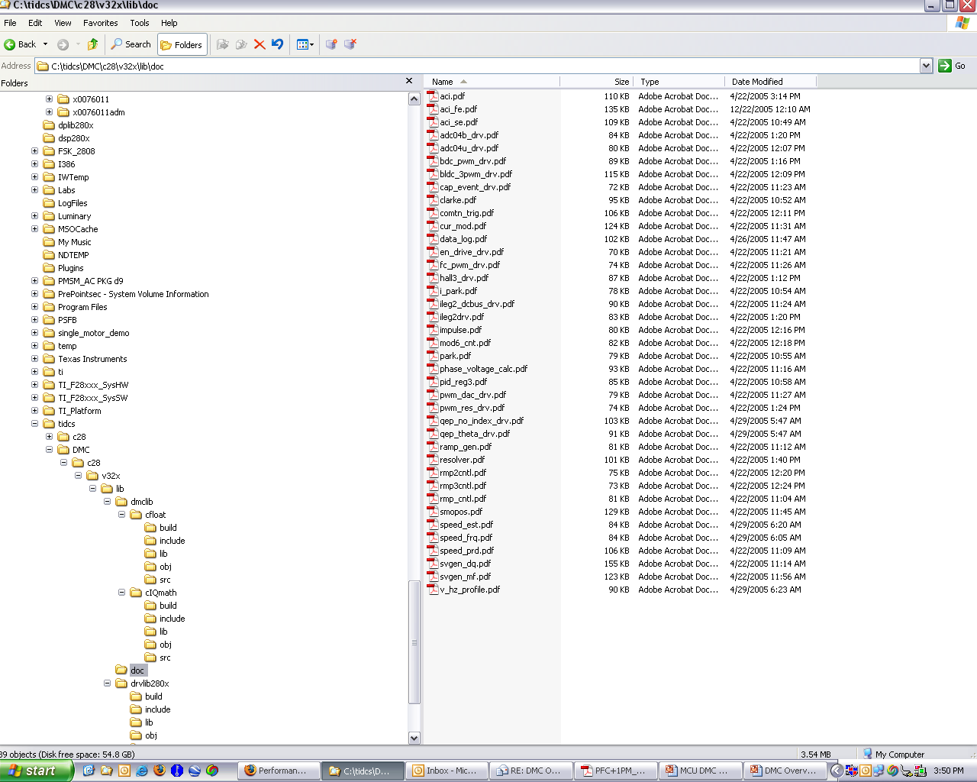
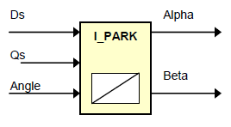
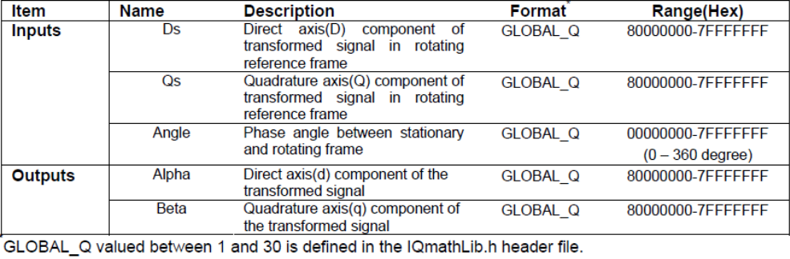
DMC Library
Blocks are Modular C functions
- Variables as Inputs, Variables as Outputs
- Library of Source Code
- Most are IQ based, tune to your stability needs!
Multi-page Documentation & Theory of Operation for each module
Other Libraries Available
- FFT (32-bit Complex & Real)
- Filters (FIR, IIR)
- QMath (Trig, SQRT, INV, LOG, DIV)
- IQMath Virtual Floating Point
(Conversion, Arithmetic, Trig, Math)
- Signal Generation (Sine, Ramp, Trapezoidal)
- Digital Power

Slide 35
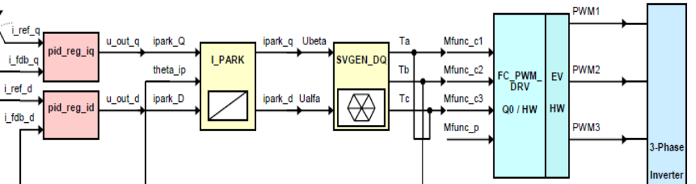
Application Frameworks
Connect the Blocks
- Tie output variables to input variables in C code
- Yellow = Transforms
- Pink = Control
- Green = Peripheral
ex: Instead of user configuring all ePWM registers, the
FC_PWM_DRV module uses variable inputs from
SVGEN_DQ to create the proper PWM register
settings for proper duty cycle and pattern generation
Complete Solutions from TI
- 20+ Motor Type and Control Technique Specific Solutions
- DC, BLDC, ACI, PMSM, SR, Stepper
- Sensored or Sensorless, V/Hz or Vector/FOC
- Download Includes
- CCStudio IDE Workspace and Project
- Source Code
- Documentation
- System Overview
- Control Theory of Operation
- Software Flow Diagram
- Hardware Configuration
- Step by Step Instructions
- Screen Captures
- Verification & Debug Techniques - Incremental Build Methodology
- Step by Step System Verification
Connect Blocks In C:
// Connect SVGEN Block:
svgen_dq1.Ualpha = ipark1.Alpha;
svgen_dq1.Ubeta = ipark1.Beta;
// Execute SVGEN Block:
svgen_dq1.calc(&svgen_dq1);
This module abstracts all the PWM registers. Does all the work for you – every period – based on the changing duty cycle calculations from SVGEN and your system frequency. You don’t even need to write to the peripheral registers!

Slide 36
Application Frameworks, Hardware, and Application Notes
 |  |  | C2000
MOTOR TYPE | CONTROL | FEEDBACK | SOLUTION
STEPPER | Microstepping | Sensorless | SPRAAU7
DC | Speed & Position | Sensored | SPRC177, SPRC214
 | V/F | Sensored | SPRC130, SPRC194
ACI | FOC | Sensored | SPRC077, SPRC207
 | FOC | Sensorless | SPRC078, SPRC195, SPRC922
BLDC | Trapezoidal | Sensored | SPRC175, SPRC213
 | Trapezoidal | Sensorless | SPRC176, SPRC196
 | V/F | Sensored | SPRC129, SPRC210
 | FOC - Resolver | Sensored | SPRC178, SPRC211
PMSM | FOC | Sensored | SPRC179, SPRC212
 | FOC | Sensorless | SPRC128, SPRC197, SPRC922, TMDS1MTRPFCKIT, TMDS2MTRPFCKIT
SWITCHED RELUCTANCE | Two Quadrant | Sensorless | SPRA600
OTHER |  |  | DMC Library: SPRC080, SPRC215 Designing High Performance DMC: SPRT528

Slide 37
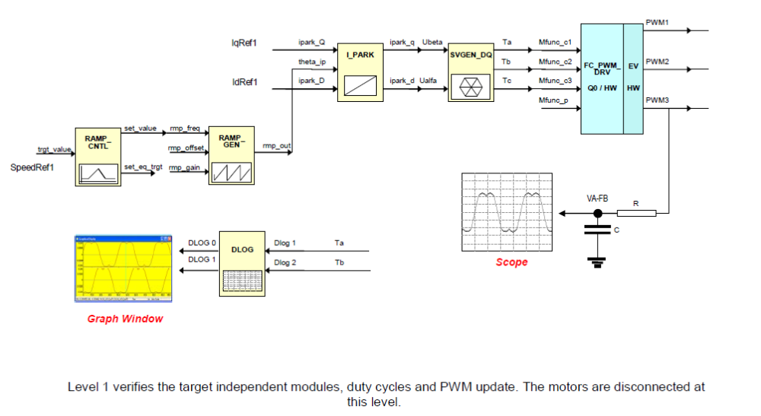
Incremental Build Methodology
Dual Sensorless FOC PMSM Example

Slide 38
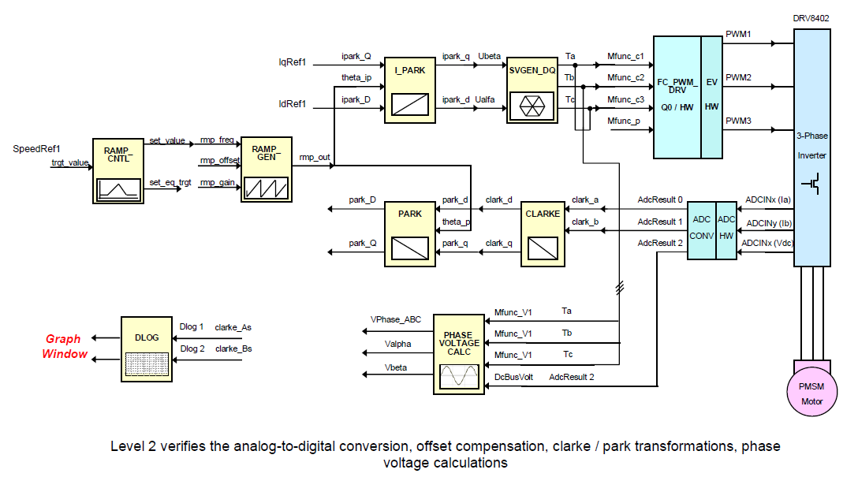
Incremental Build Methodology
Dual Sensorless FOC PMSM Example

Slide 39
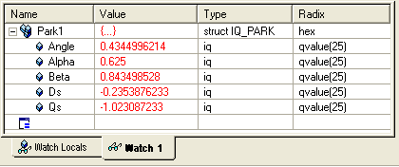
Incremental Build Methodology
Dual Sensorless FOC PMSM Example
Connect IQmath Blocks In C:
Watch/Modify Variables In Real-Time:
// Connect Park Block:
PARK.theta_p = RAMP_GEN.mp_out;
PARK.d = CLARKE.d;
PARK.q = CLARKE.q;
// Execute Park Block:
_IQparkPU(&PARK);
// Result in PARK.D and PARK.Q

Slide 40
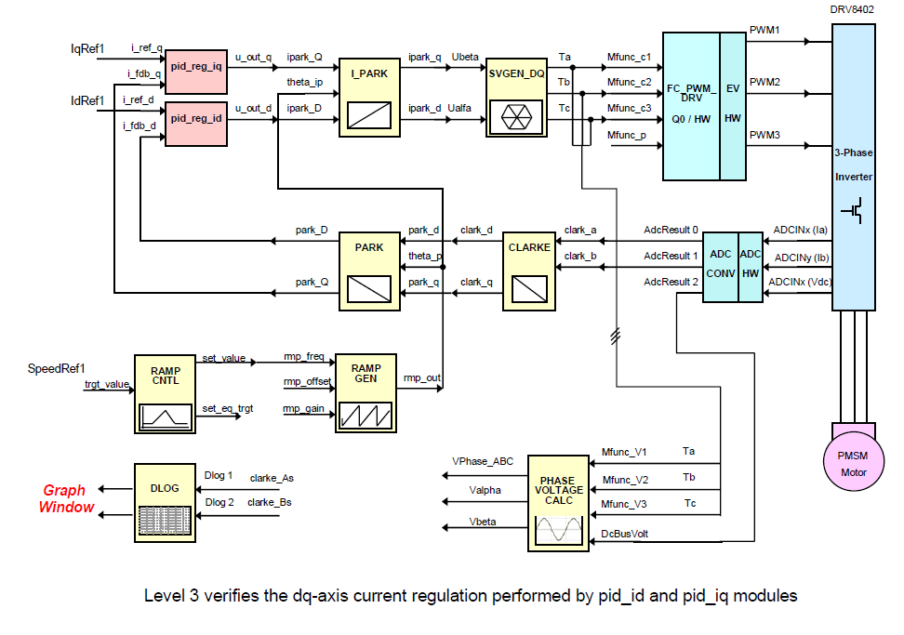
Incremental Build Methodology
Dual Sensorless FOC PMSM Example

Slide 41
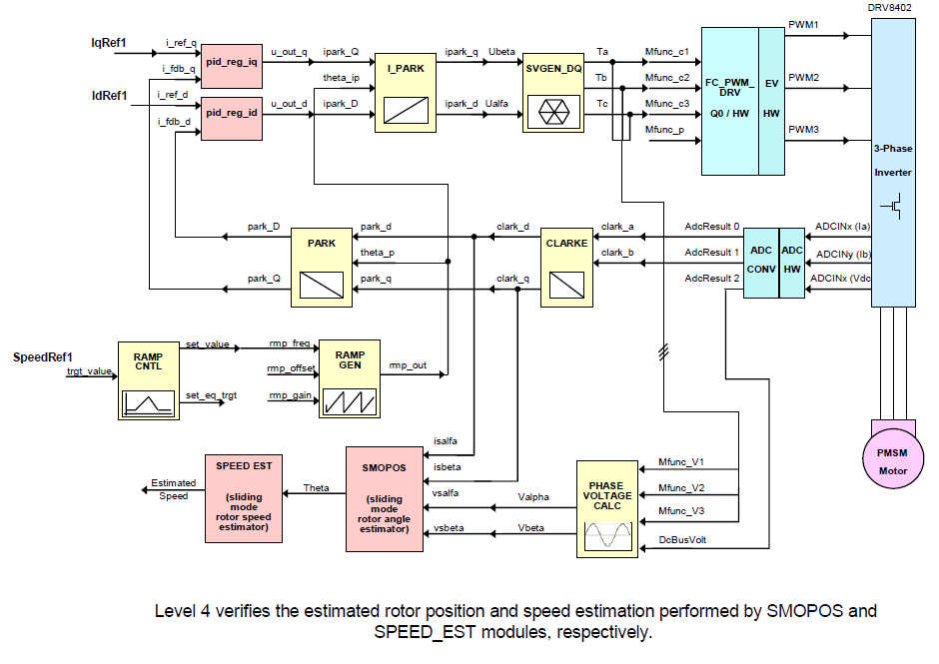
Incremental Build Methodology
Dual Sensorless FOC PMSM Example

Slide 42
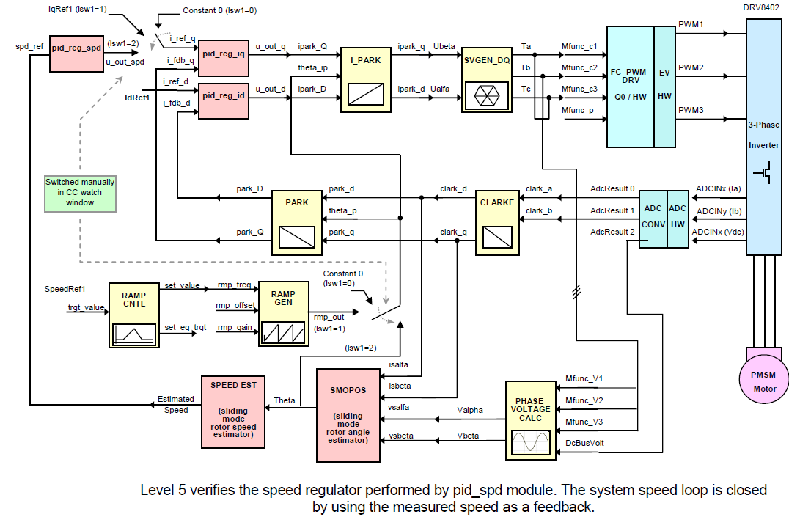
Incremental Build Methodology
Dual Sensorless FOC PMSM Example

Slide 43
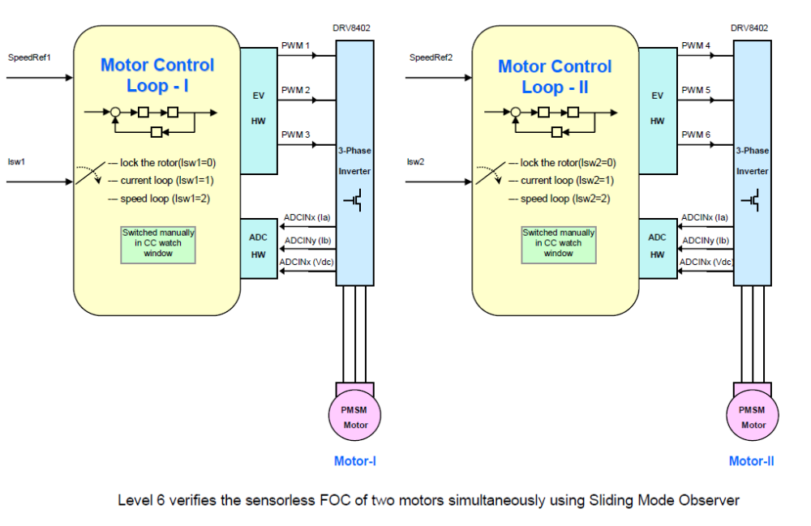
Incremental Build Methodology
Dual Sensorless FOC PMSM Example

Slide 44
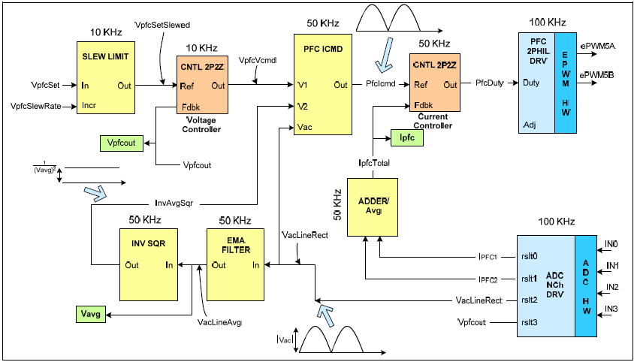
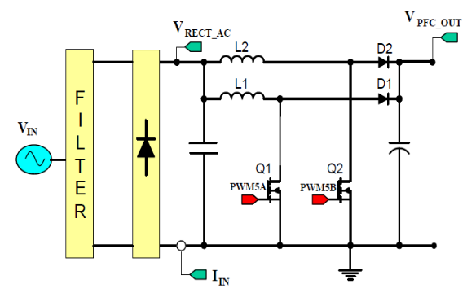
MIPS leftover…integrate digital PFC!
We achieve PFC by controlling the duty cycle such that the rectified input current is made to follow the rectified input voltage while providing load and line regulation .

Slide 45
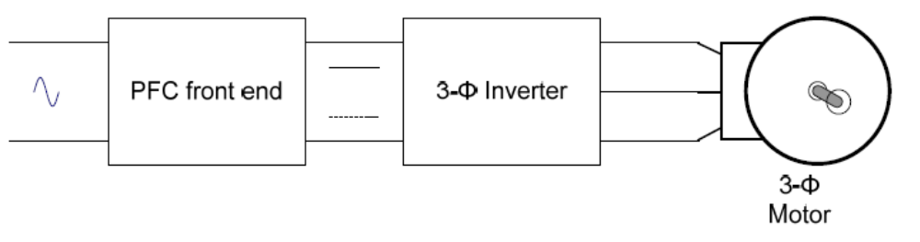
Why add Power Factor Correction?
Why: In an AC-Rectifier, the 3-phase inverter stage and the motor act as a non-linear load and will draw harmonic currents from the line. These harmonics result in losses and such currents can distort the line voltage.
Some countries and regulatory bodies limit the distortion to the line a product can inject (see IEC 61000-3-2).
How: Generate an intermediate DC Bus from an AC source while drawing a sine wave input current that is exactly in phase with the line voltage
A PFC stage has become an integral part of most power supply designs…usually done with a standalone PFC chip…why not have the MCU control this digitally!

Slide 46
C2000 Hardware Tools Overview
controlSTICK
controlCARD
controlKIT
  Device Evaluation
    Experimenter’s Kits
    Peripheral Explorer
  Application Development
    Digital Power Experimenter’s Kit
    Digital Power Developer’s Kit
    Resonant DC/DC Developer’s Kit
    Renewable Energy Developer’s Kit
    AC/DC Developer’s Kit
    Sensorless FOC DMC with Digital PFC Developer’s Kit

Slide 47

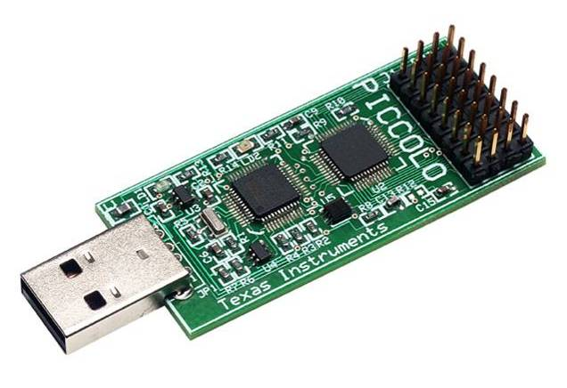
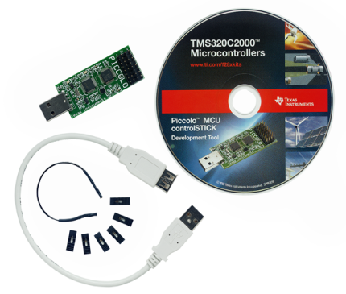
controlSTICK: Low Cost Evaluation
$39 Kit includes
Simple USB memory stick form factor evaluation tool
  Piccolo F28027
  Onboard USB JTAG emulation
  Header pins provides access to most Piccolo pins
11 example projects explain most Piccolo peripherals
Jumpers and patch cords to easily connect pins together
USB extension cable
Code Composer Studio V3.3 with 32KB code size limit
Complete hardware documentation
  Gerbers, schematics, etc

Slide 48
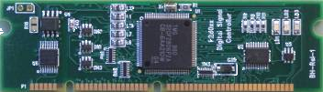
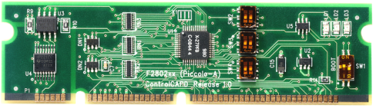


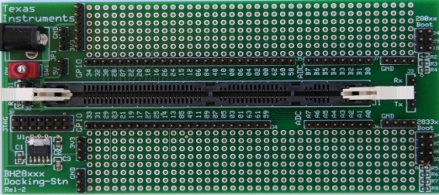
controlCARD: Modular, Robust, Standard
controlCARD
Low cost, small form factor
Standard DIMM interface
  Includes analog I/O, digital I/O, and JTAG signals available at DIMM interface
Robust design
  Noise filter at ADC input pins
  Ground plane
  Isolated UART communication
  Supply pin decoupling
All life support circuitry
  Clock, Power Supply, LDO, etc
Multiple versions available
  Piccolo F28027
  Piccolo F28035
  Delfino F28335
  Delfino C28436
  F2808
  F28044
  $49-69
Pin compatible across the C2000 family!

Slide 49
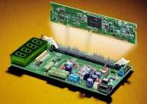
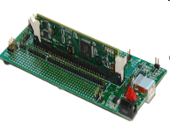
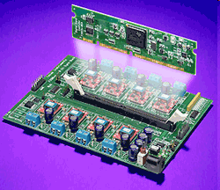
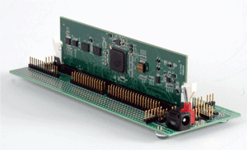

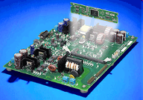
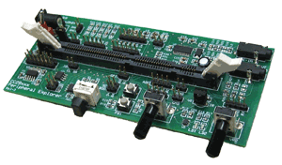
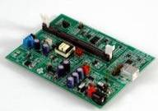
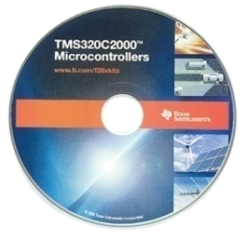
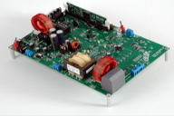
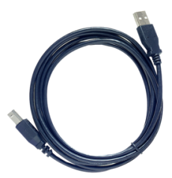
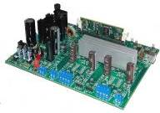
controlKIT: controlCARD + base board
Device Evaluation
Application Development
Experimenter’s Kit - Flash
TMDXDOCK28027
TMDXDOCK28035
TMDSDOCK2808
TMDSDOCK28335
$79-$159
Digital Power Experimenter’s Kit
TMDSDCDC2KIT
$229
Digital Power Developer’s Kit
TMDSDCDC8KIT
$325
Experimenter’s Kit - RAM
TMDXDOCK28343
TMDXDOCK28346-168
$189
AC/DC Developer’s Kit
TMDSACDCKIT
$695
Peripheral Explorer
TMDSPREX28335
$179
Resonant DC/DC Developer’s Kit
TMDSRESDCKIT
$229
controlKITs Include
controlCARD + Base Board
CCStudio IDE v3.3 32KB code size limit
Example Software with lab document
Power Supply and Cables
Renewable Energy Developer’s Kit
TMDSENRGYKIT
$349
Developer’s Package
Schematics (source and .PDF files)
Bill of materials (BOM)
Gerber files to freely use or modify
Pin-out table showing all key signals
DIMM100 pin/socket mechanical details
Sensorless FOC DMC +
PFC Developer’s Kit
TMDS1MTRPFCKIT 1 Motor
TMDS2MTRPFCKIT 2 Motor
$369/$399

Slide 50
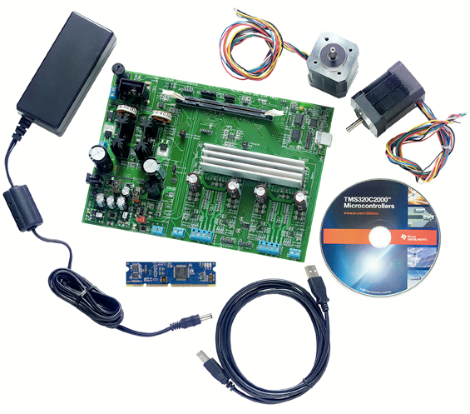
Sensorless FOC and PFC Developer’s Kit
$399 Motor Control and PFC Kit Includes
  Piccolo F28035 controlCARD
  Sensorless Sinusoidal SVPWM based Field Oriented Control
  Single or Dual Axis Operation
  Integrated Digital Power Factor Correction
  Hardware Features
    100W 2 phase interleaved power factor correction stage
    2 x 60 W motor driver stages based on TI DRV8402 motor driver chips
    On board isolated XDS100 JTAG emulation
  Software Lab Projects
    Standalone PFC
    Dual Axis
    Single Axis + PFC
    Dual Axis + PFC (coming soon)
No external emulator required!
TMDS2MTRPFCKIT(2 motors)
TMDS1MTRPFCKIT(1 motor)

Slide 51

Benefits of C2000 for Motor Control
AC Input
Bridge Rectifier
Power Converter
Motor
Load
High energy efficiency via advanced Control
  Variable speed Real-time control
  Better dynamic and transient control
Overall System performance optimization
  High Level of Integration
  Provides Control and Supervision
Quicker Return on Investment
  Portfolio of compatible devices from lowest cost to highest performance
  Long term SW and tools compatibility
  System Cost Optimization
Low System Cost
  Integrated OSC, Watchdogs
  Analog Comparators
  Fault Detection
  Limited life support
  No external GPIO filters needed
DC link
I and V Sense
MOSFET Driver
I Sense
Isolation Products
Power Supply
LDO
PFC
SVS
PWM
C28xTM MCU
Controller
High
Accuracy
ADC’s
and
DAC’s
Driver
Buffer
Level- Shifter
Resolver
Optical encoder
Hall effect
Network interface
4-20mA interface
Data line
ADC Interface
DAC Interface
Ethernet
4-20mA loop
CAN
RS232
RS485
+/- 10V
+/- 10V

