Slide 1
Module 1: Introduction
Digital Signal Controller
TMS320F28335
Texas Instruments Incorporated
European Customer Training Centre
University of Applied Sciences Zwickau
Notes:
1

Slide 2
1. what is a microprocessor?
microprocessor (µP, mp):
  Central Device of a multi chip Micro Computer System
  Two basic architectures:
    “von Neumann”- Architecture
    “Harvard” – Architecture
  “von Neumann” - Architecture:
    Shared memory space between code and data
    Shared memory busses between code and data
    Example: Intel‘s x86 Pentium Processor family
  “Harvard” – Architecture:
    Two independent memory spaces for code and data
    Two memory bus systems for code and data
  A µP needs additional external devices to operate properly

Slide 3
Microprocessor block diagram
code
memory
Control Unit
input
module
Central
Processing Unit
CPU
output –
module
process
process
Microprocessor
data
memory

Slide 4
Microprocessor execution flow
program counter (PC) in control unit addresses
first (next) instruction in code memory
instruction read (“fetch”) from code memory
into microprocessors instruction register (IR)
decode instruction and do 1 of the following actions:
read input
& compute
read data memory
& compute
internal
operation
update
output
write data
memory
increment or modify program counter

Slide 5
CPU of a microprocessor
CPU = Central Processing Unit
Consists of:
  few internal memory cells (“Register”) for operands
  calculation unit: “Arithmetic Logic Unit” (ALU)
  instruction register (IR) and instruction decoder
  address unit
Address unit:
  read data and instruction from memory
  write data into memory
Instruction decoder:
  analyses current instruction and controls subsequent actions of other modules
Register:
  store data for instantaneous instruction and computation
Note: today's microprocessors have a much finer granularity and sometimes parallel units. However, the basics are still the very same.

Slide 6
ALU (Arithmetic Logic Unit) of a microprocessor
calculates arithmetical and / or logical functions:
At least:
  arithmetical : Addition (ADD)
  logical: Negation (NEG)
  Conjunction (AND)
typical:
  arithmetical: Subtraction (SUB)
  Multiplication (MUL)
  logical: Comparison (CMP)
  Disjunction (OR)
  Antivalence (EXOR)
  miscellaneous: Right- and Left Shift (ASR,ASL)
  Rotation (ROL, ROR)
  Register-Bit-Manipulation (set, clear, toggle, test)
a ALU is able to process two binary values with equal length (N)
➔ N-Bit ALU with N = 4,8,16,32 or 64
most ALU’s process Fixed Point Numbers
A few ALU’s, used especially in Digital Signal Processors and desktop processors, are capable to operate on Floating Point Numbers or on both formats.

Slide 7
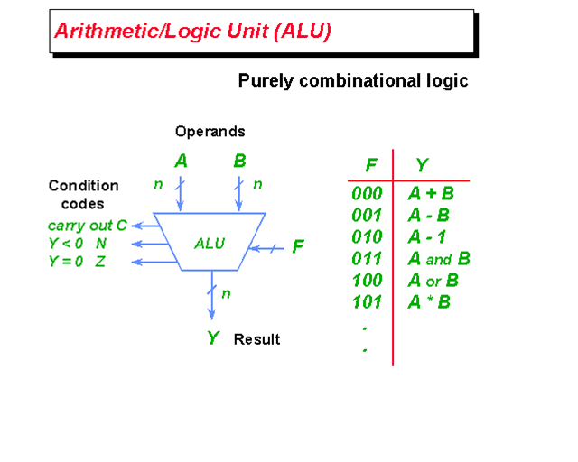
Example: a simple ALU structure
A, B, Y: Internal register
F: Functional code
C: Carry – Bit
N: Negative – Bit
Z: Zero - Bit
ALU’s are also available
as standalone ICs:
SN 74 LS 181
Note : most ALU will generate a size of 2*n for register Y
in case of a multiply operation Y = A * B

Slide 8
History (1984): Microprocessor Intel 80x86
Address – Unit
Bus - Unit
address
control/
status
- Memory Manager
- logical / physical
address
- Bus Control
Address & Data Bus –
Interface
Instruction Queue
data
Execution - Unit
Instruction – Unit
- CPU
ALU
Register
- Decode Instruction
Operation Queue

Slide 9
2. our Desktop – PC is a?
Microcomputer
  Micro Computer = microprocessor (µP) + memory + peripherals
  Example: your Desktop -PC
Code - Memory
Data - Memory
Memory Bus
Clock
Microprocessor
Timer/Counter
Peripheral Bus
Digital In
Digital Out
Analogue In
Analogue Out

Slide 10
microcomputer - peripherals
Peripherals include:
  Digital Input / Output Lines
  Analogue to Digital Converter (ADC)
  Digital to Analogue Converter (DAC)
  Timer / Counter units
  Pulse Width Modulation (PWM) Digital Output Lines
  Digital Capture Input Lines
  Network Interface Units:
    Serial Communication Interface (SCI) - UART
    Serial Peripheral Interface (SPI)
    Inter Integrated Circuit ( I²C) – Bus
    Controller Area Network (CAN)
    Local Interconnect Network (LIN)
    Universal Serial Bus (USB)
    Local / Wide Area Networks (LAN, WAN)
  Graphical Output Devices
  and more …

Slide 11
3. System on Chip
Microcontroller (µC, MCU)
  Nothing more than a Microcomputer as a single silicon chip!
  All computing power and input/output channels that are required to design a real time control system are “on chip”
  Guarantee cost efficient and powerful solutions for embedded control applications
  Backbone for almost every type of modern product
  Over 200 independent families of µC
  Both µP – Architectures (“Von Neumann” and “Harvard”) are used inside Microcontrollers

Slide 12
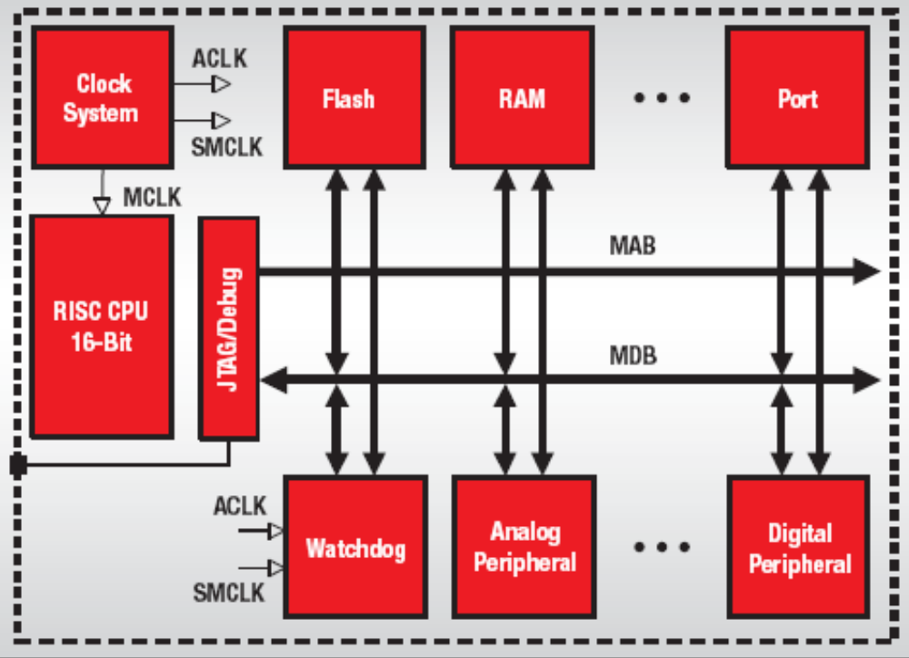
3. Example: Microcontroller MSP430
Texas Instruments MSP430
von-Neumann architecture — all program, data memory and peripherals share a common bus structure.

Slide 13
4. Digital Signal Processor
A Digital Signal Processor (DSP) is:
  Similar to a micro processor (µP), e.g. core of a computing system
  Additional Hardware Units to speed up computing of sophisticated mathematical operations:
    Additional Hardware Multiply Unit(s)
    Additional Pointer Arithmetic Unit(s)
    Additional Bus Systems for parallel access
    Additional Hardware Shifter for scaling and/or multiply/divide by 2^{n}

Slide 14
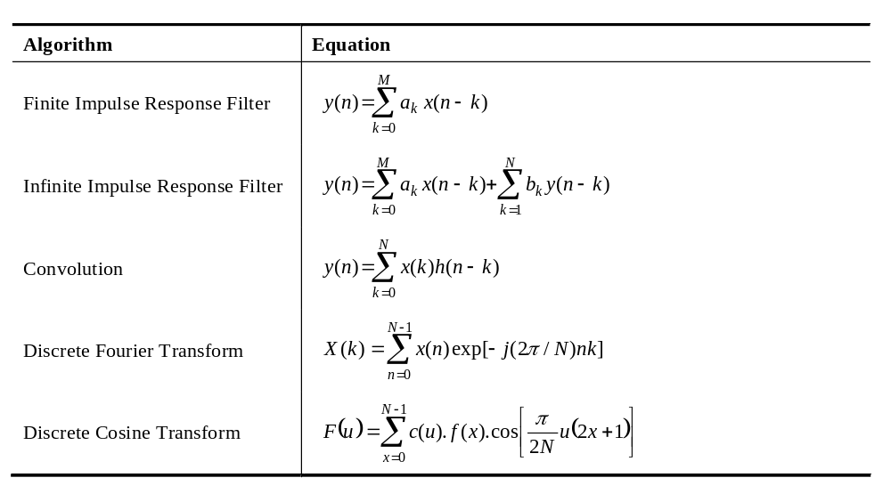
What are typical DSP algorithms?
An equation, called “Sum of Products” (SOP) is the key element in most DSP algorithms:

Slide 15
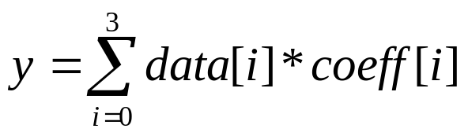
Doing a SOP with a µP
Task : use a Desktop - PC and code the equation into any common C-compiler system, e.g. Microsoft Visual Studio 2008
A C-Code Solution would probably look like:
  #include <stdio.h>
  int data[4]={1,2,3,4};
  int coeff[4]={8,6,4,2};
  int main(void)
  {
  int i;
  int result =0;
  for (i=0;i<4;i++)
  result += data[i]*coeff[i];
  printf("%i",result);
  return 0;
  }

Slide 16
6 Basic Operations of a SOP
What will a Pentium be forced to do?
  Set a Pointer1 to point to data[0]
  Set a second Pointer2 to point to coeff[0]
  Read data[i] into core
  Read coeff[i] into core
  Multiply data[i]*coeff[i]
  Add the latest product to the previous ones
  Modify Pointer1
  Modify Pointer2
  Increment i;
  If i<4 , then go back to step 3 and continue
Steps 3 to 8 are called “6 Basic Operations of a DSP”
A DSP is able to execute all 6 steps in one single machine cycle!

Slide 17
SOP machine code of a µP
Address M-Code Assembly - Instruction
10: for (i=0;i<4;i++)
00411960 C7 45 FC 00 00 00 00 mov dword ptr [i],0
00411967 EB 09 jmp main+22h (411972h)
00411969 8B 45 FC mov eax,dword ptr [i]
0041196C 83 C0 01 add eax,1
0041196F 89 45 FC mov dword ptr [i],eax
00411972 83 7D FC 04 cmp dword ptr [i],4
00411976 7D 1F jge main+47h (411997h)
11: result += data[i]*coeff[i];
00411978 8B 45 FC mov eax,dword ptr [i]
0041197B 8B 4D FC mov ecx,dword ptr [i]
0041197E 8B 14 85 40 5B 42 00 mov edx,dword ptr[eax*4+425B40h]
00411985 0F AF 14 8D 50 5B 42 00 imul edx,dword ptr[ecx*4+425B50h]
0041198D 8B 45 F8 mov eax,dword ptr [result]
00411990 03 C2 add eax,edx
00411992 89 45 F8 mov dword ptr [result],eax
00411995 EB D2 jmp main+19h (411969h)
Note: The C-Compiler was used in basic setup mode using optimization level zero.

Slide 18
Doing a SOP with a DSP
Now: use a DSP-Development System and code the equation into a DSP C-compiler system, e.g. Texas Instruments Code Composer Studio
C-Code Solution is identical:
  int data[4]={1,2,3,4};
  int coeff[4]={8,6,4,2};
  int main(void)
  {
  int i;
  int result =0;
  for (i=0;i<4;i++)
  result += data[i]*coeff[i];
  printf("%i",result);
  return 0;
  }

Slide 19
DSP-Translation into machine code
Address M-Code Assembly Instruction
0x8000 FF69 SPM 0
0x8001 8D04 0000R MOVL XAR1,#data
0x8003 76C0 0000R MOVL XAR7,#coeff
0x8005 5633 ZAPA
0x8006 F601 RPT #1
0x8007 564B 8781 || DMAC ACC:P,*XAR1++,*XAR7++
0x8009 10AC ADDL ACC,P<<PM
0x800A 8D04 0000R MOVL XAR1,#y
0x800B 1E81 MOVL *XAR1,ACC
Example: Texas Instruments TMS320F28335
Space : 12 Code Memory ; 9 Data Memory
Execution Cycles : 10 @ 150MHz = 66 ns

Slide 20
5. Digital Signal Controller (DSC)
Digital Signal Controller (DSC)
  recall: a Microcontroller(MCU) is a single chip Microcomputer with a Microprocessor(µP) as core unit.
  Now: a Digital Signal Controller(DSC) is a single chip Microcomputer with a Digital Signal Processor(DSP) as core unit.
  By combining the computing power of a DSP with memory and peripherals in one single device we derive the most effective solution for embedded real time control solutions that require lots of math operations.
  DSC –Example: Texas Instruments C2000 DSC - family.

Slide 21
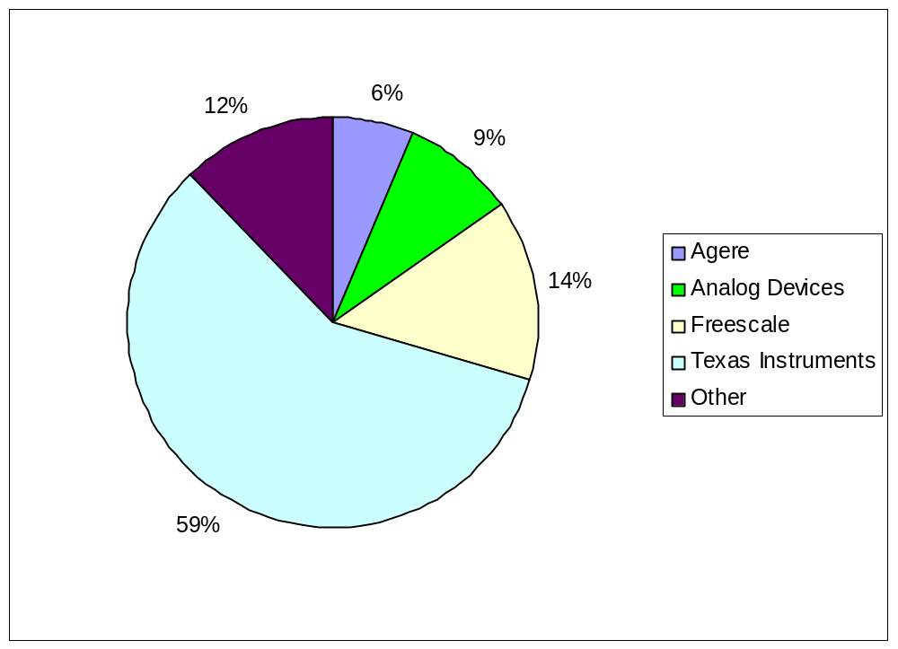
DSP Market Share in 2006
Total Revenue: 7635 Million US-$
Source: www.forwardconcepts.com

Slide 22
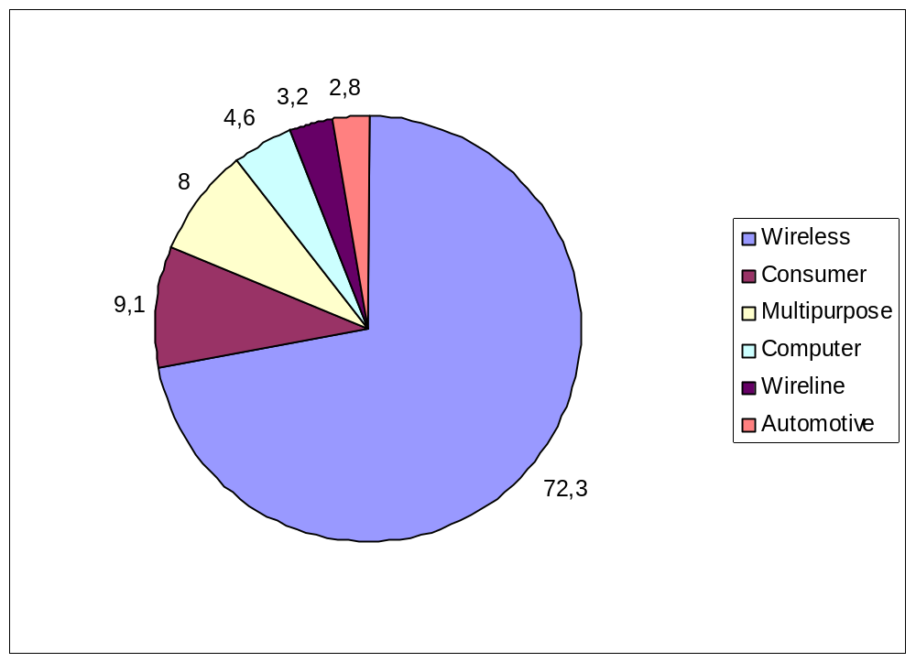
DSP Market Areas in 2006
Relative
Source: www.forwardconcepts.com

Slide 23









Texas Instruments Portfolio
Microcontrollers
Arm-Based
DSP
16-bit
MCU
32-bit
Real-time
32-bit
ARM
ARM+
ARM + DSP
DSP
MSP430
C2000™
Stellaris Cortex™ M3
ARM9
Cortex A-8
C64x+ plus
ARM9/Cortex A-8
C647x, C64x+,
C55x
Ultra-Low
Power
Up to 25MHz
Flash
1KB to 256KB
Analog I/O, ADC
LCD, USB, RF
Measurement,
Sensing, General
Purpose
$0.49 to $9.00
Fixed &
Floating Point
Up to 150MHz
Flash
32KB to 512KB
PWM, ADC,
CAN, SPI, I²C
Motor Control,
Digital Power,
Lighting
$1.50 to $20.00
Industry Std
Low Power
Up to 100MHz
Flash
8KB to 256KB
USB, ENET,
ADC, PWM, HMI
Host Control, general purpose, motor control
$2.00 to $8.00
Industry-Std Core,
High-Perf GPP
Accelerators
MMU
USB, LCD,
MMC, EMAC
Linux/WinCE
User Apps
$8.00 to $35.00
Industry-Std Core +
DSP for Signal Proc.
4800 MMACs/
1.07 DMIPS/MHz
MMU, Cache
VPSS, USB,
EMAC, MMC
Linux/Win +
Video, Imaging,
Multimedia
$12.00 to $65.00
Leadership DSP
Performance
24,000 MMACS
Up to 3MB
L2 Cache
1G EMAC, SRIO,
DDR2, PCI-66
Comm, WiMAX,
Industrial/
Medical Imaging
$4.00 to $99.00+

Slide 24
Texas Instruments TMS320 DSP/DSC
Dedicated families and sub-families to support different market needs
C2000
C5000
C6000
Lowest Cost
Control Systems
Motor Control
Storage
Digital Control Systems
Power Supply Control
Efficiency
Best MIPS per
Watt / Dollar / Size
Wireless phones
Internet audio players
Digital still cameras
Modems
Telephony
VoIP
Performance &
Ease-of-Use
Multi Channel and Multi Function App's
Communication Infrastructure
Wireless Base-stations
DSL
Imaging
Multi-media Servers
Video

Slide 25
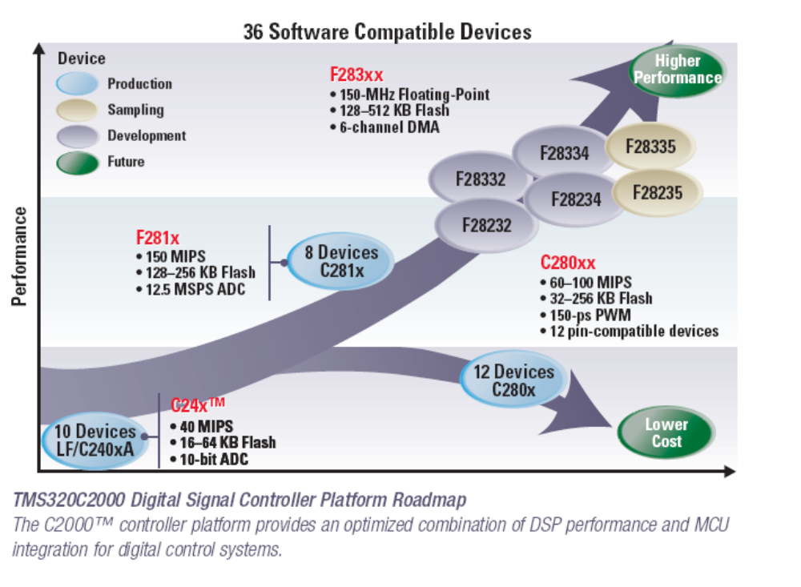
TMS320C2000™ DSC Family

Slide 26
C2000 32-bit Real-Time Controller
Next Gen
Production
C2834x
Sampling
Higher Performance
Connectivity
Safety Enhancements
F2833x
200-300MHz
196-516kB SRAM
External ADC
Low Active Power
Development
100-150MHz
128-512kB Flash
52-68kB SRAM
Future
F2823x
PERFORMANCE
F281x
F280x
Next Gen
F2803x
Performance
Memory
Connectivity
Fixed Point
(100-176 Pins)
60 – 150 MHz
32 – 512kB Flash
3Ph PWM/QEP
12-bit, 2 SH ADC
(Up to 12.5 MSPS)
CAN, McBSP
UART, SPI
F2802x
Next Gen
40-60MHz
16-64kB Flash
Analog Comp
60MHz
Control Law Accelerator
32-128kB Flash
CAN, LIN
Low Power
Small Package
TIME
100+ Code Compatible Devices

Slide 27


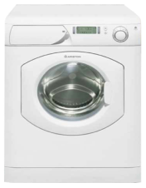


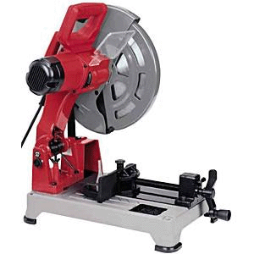

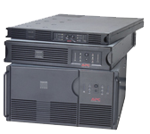

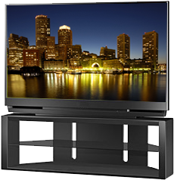

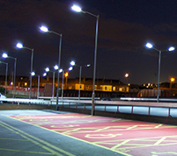
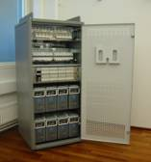
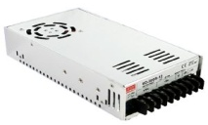
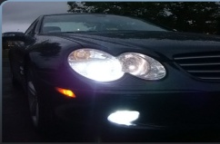
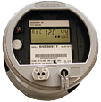


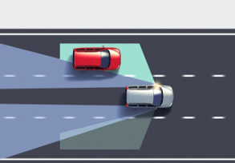
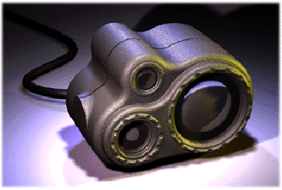
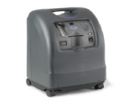

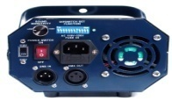
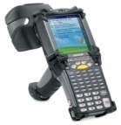
Versatile C2000 Application Areas
Renewable Energy
Digital Motor Control
E-bike
Wind Power Inverters
Power Tools
Solar Power Inverters
White Goods
Industrial Drives & Motion Control
Lighting
Digital Power
DC/DC Converters
C2000
LED Street Lighting
Uninterruptable Power Supplies
LED TV Backlighting
Telecom / Server
AC/DC Rectifiers
Auto HID
Radar / Collision Avoidance
Laser Ranging
Medical Oxygen Concentrators
Power Line Communication
Optical Networking
Hybrid Electric Vehicles
Electric Power Steering
RFID Readers
Automotive
Precision Sensing & Control

Slide 28
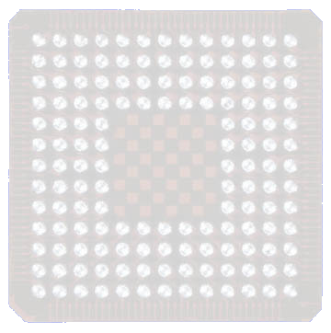

TMS320C28x DSC Block Diagram
Code security
TMS320F28335
512 KB
Flash
68 KB
RAM
Boot ROM
18 PWM
(6 HRPWM)
Memory Bus
6 CAP
DMA
2 QEP
Interrupt Management
12-bit ADC
88 GPIO
C28xTM 32-bit DSC
Peripheral Bus
16/32-bit
EMIF
32x32-bit
Multiplier
RMW
Atomic
ALU
SPI
32-bit
Timers (3)
3 SCI
32-bit
Floating-Point Unit
Real-Time
JTAG
2 McBSP
I²C
2 CAN
Notes:
TI C2000 DSP product portfolio offers many derivatives from low end, low pin count, lost cost ROM versions all the way up to the new F2812 and F2810 32-bit flash devices.

Slide 29




