Slide 1
Module 3: Program Development Tools
Digital Signal Controller
TMS320F2833x
Texas Instruments Incorporated
European Customer Training Centre
University of Applied Sciences Zwickau
Notes:
1

Slide 2
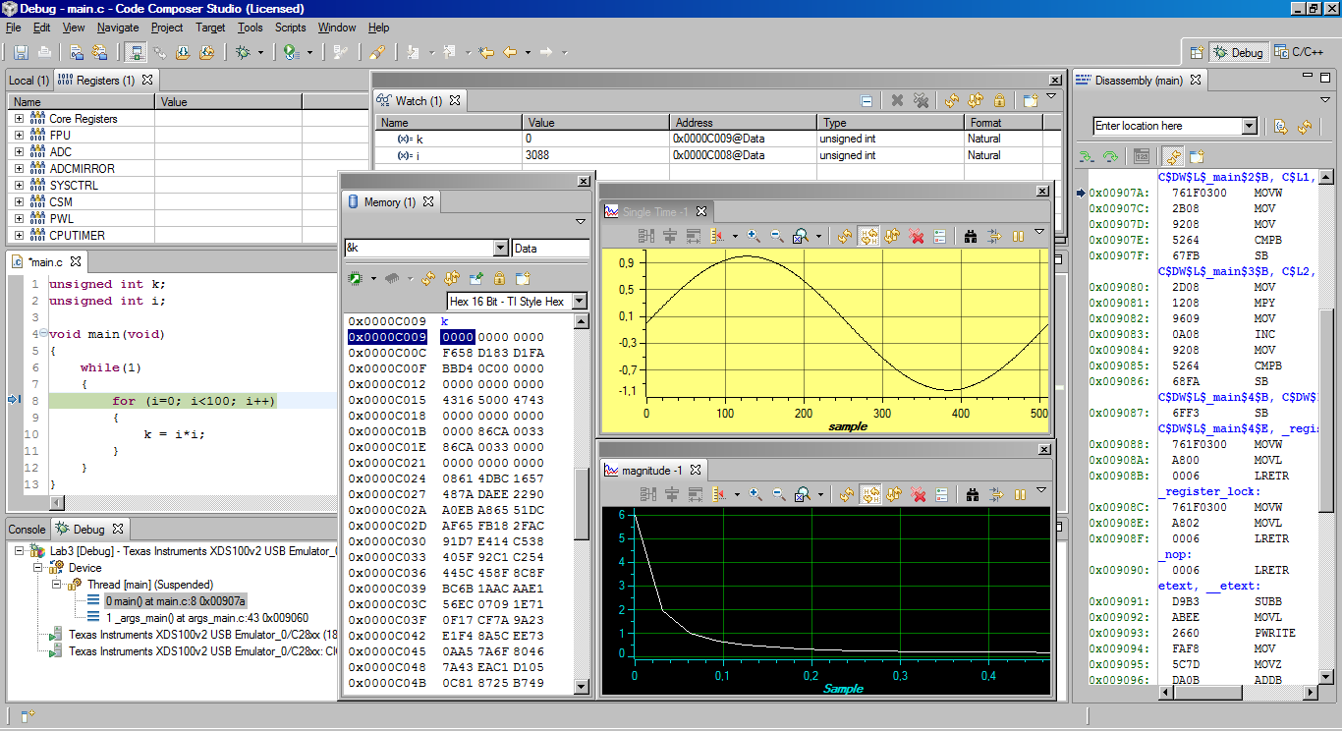
Code Composer Studio Version 4
Perspectives:
Debug or C/C++
Menus or Icons
Help
Watch window
CPU window
Source code
window
Status window
Full C/C++ & Assembly
Debugging:
C & ASM Source
Break Points
Debug
Configuration
Graph window
Memory window

Slide 3
CCS4 Eclipse Concepts
CCS 4 - based on Eclipse
  Open source framework (www.eclipse.org)
Commonly referenced categories:
  Workbenches
  Workspaces
  Perspectives
  Views
  Resources
    Projects
    Files

Slide 4
Code Composer Studio
Build
Code
Simulator
Compile
lnk.cmd
eZdsp™
Asm
Link
Debug
Editor
Emulator
(XDS100)
Libraries
Graphs,
Profiling
MCU
Board
Code Composer Studio includes:
  Integrated Edit/Debug Graphical User Interface
  Code Generation Tools
  Real – Time Operating System (DSP/BIOS)

Slide 5
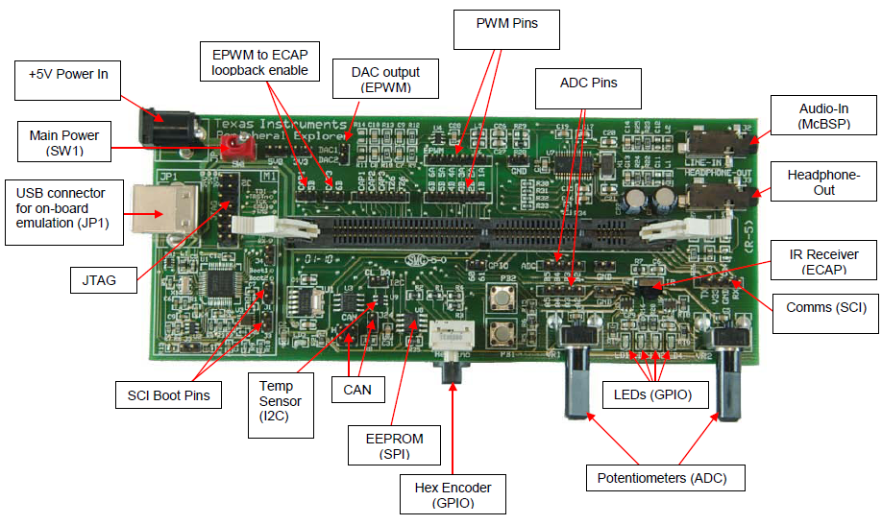
Peripheral Explorer Board

Slide 6
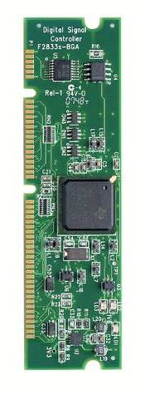
F28335 Control Card
Low cost single-board controllers
  perfect for initial development and small volume system builds.
Small form factor with standard 100-pin DIMM interface
F28x analog I/O, digital I/O, and JTAG signals available at DIMM interface
Isolated RS-232 interface
Single 5V power supply required
Versions:
  “Piccolo” F28027 (TMDXCNCD28027)
  “Piccolo” F28035 (TMDXCNCD28035)
  F28044 (TMDSCNCD28044)
  F2808 (TMDSCNCD2808)
  “Delfino” F28335 (TMDSCNCD28335)
  “Delfino” C28343 (TMDXCNCD28343)

Slide 7
Learning by doing - Step by Step
Code Composer Studio V4 - The Basics
  CCS workspace and welcome window
  Create a F2833x - project, based on C language
  Debug your program
  Watch your variables
  Perform a Single Step Debug
  Use Breakpoints
  Real – Time – Debug
  CPU Register Set
  Memory Window
  Graph Window
  Mixed Mode Display
  Assembly Single Step
  GEL - General Extension Language

Slide 8
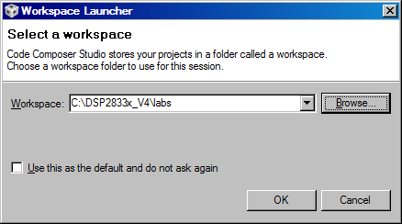
1. Start CCS Version 4
Code Composer Studio stores your projects in a folder called a workspace.
Select a workspace folder for this session, e.g.:
C:\DSP2833x_V4\labs

Slide 9
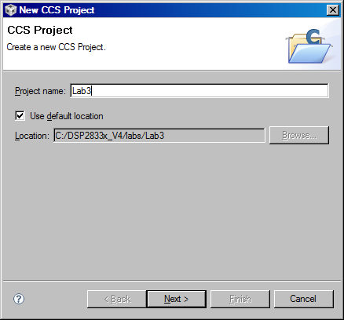
2. Create a F2833x - Project
  File ➔ New ➔ CCS Project
  give your project a name “Lab3” and select the default location , as shown below:

Slide 10
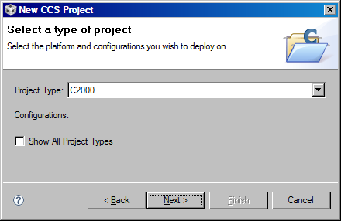
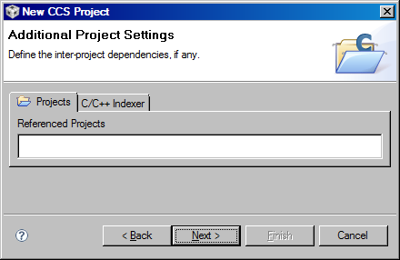
2. Create a F2833x - Project
  Select Type of Project: C2000

Slide 11
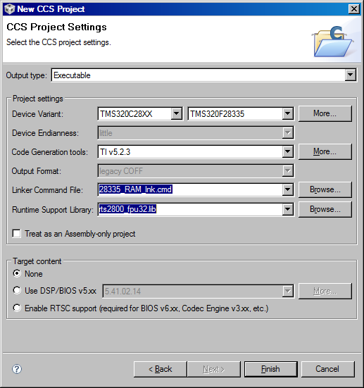
2. Create a F2833x - Project
Setup Properties:
Output Type :
  Executable
Device Variant: TMS320F28335
Code Generation Tools:
  TI v 5.2.3
Linker Command File: 28335_RAM_lnk.cmd
Runtime Support Library: rts2800_fpu32.lib
Target content:
  None

Slide 12
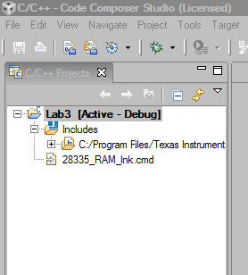
2. Create a F2833x - Project
Setup C- Stack Size:
    Right click at “Lab3” and select “Properties”
    Go to category:
      C/C++ Build, C2000 Linker, Basic Options
      Set C system stack size: 0x400

Slide 13
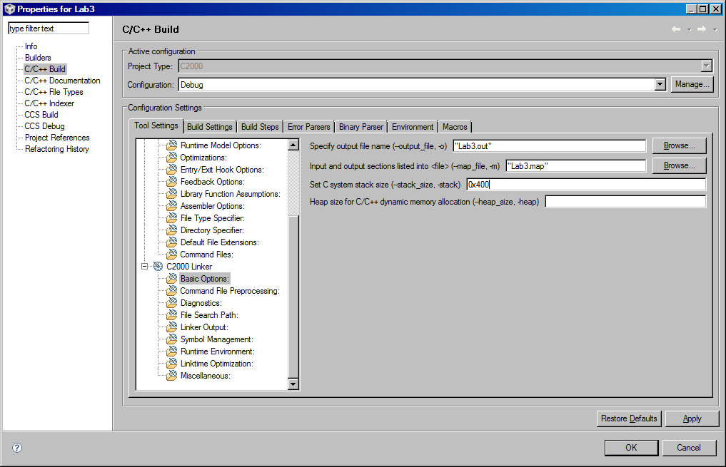
2. Create a F2833x - Project

Slide 14
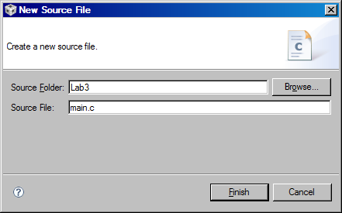
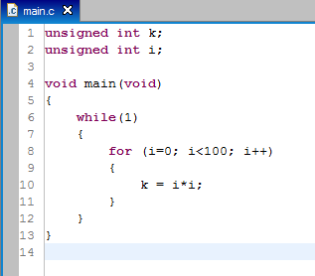
3. Write a C – code file
Write a C-Source Code :
    ➔File ➔New ➔Source File
In „main.c“, enter this code:

Slide 15
C – Compiler Sections
Global vars (.ebss)
Init values (.cinit)
unsigned int k = 0;
unsigned int i;
void main(void)
{
while(1)
{
for(i=0;i<100;i++)
{
k=i*i;
}
}
}
Local variables,
System Context (.stack)
Code (.text)

Slide 16
Compiler Section Names
Initialized Sections
Name | Description | Link Location
.text | code | FLASH*
.cinit | initialization values for global and static variables | FLASH*
.econst | constant variables (e.g. const int m=3;) | FLASH*
.switch | tables for addresses in “switch – case” lines | FLASH*
.pinit | tables for global constructors (C++) | FLASH*
Uninitialized Sections
Name | Description | Link Location
.ebss | global and static variables | RAM
.stack | stack memory area | RAM (lower 64K)
.esysmem | heap memory for dynamic memory allocation. | RAM
Note: (*)During development initialized sections could be linked to RAM since the emulator can be used to load the RAM

Slide 17
Placing Sections in Memory
Memory
Sections
0x00 0000
M0SARAM
(0x400)
.ebss
0x00 0400
M1SARAM
(0x400)
.stack
0x30 0000
.cinit
FLASH
(0x40000)
.text

Slide 18
Linking
Memory description
How to place Software
Sections into Memory
name.cmd
.obj
Linker
.out
.map

Slide 19
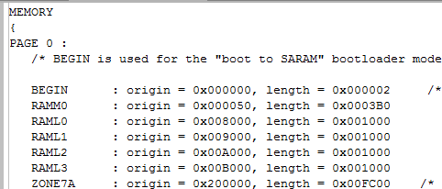
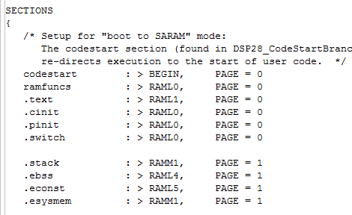
Linker Command File
Memory:
physical spaces
Sections:
Connect
Logical blocks to
physical spaces

Slide 20
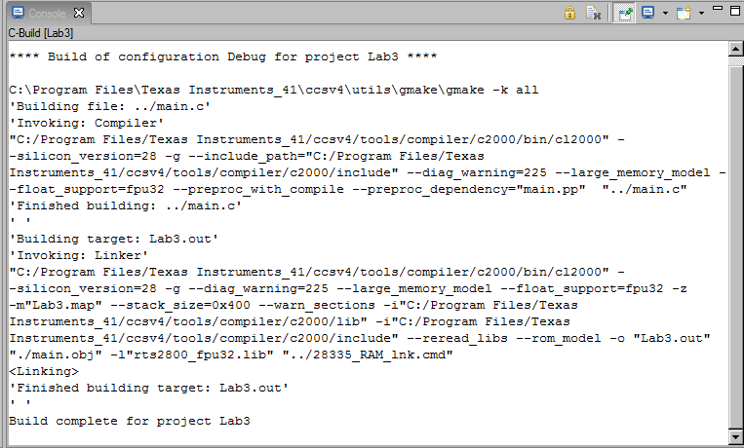
4. Build the Active Project
➔ Project ➔ Rebuild Active Project
Watch the tools running:

Slide 21
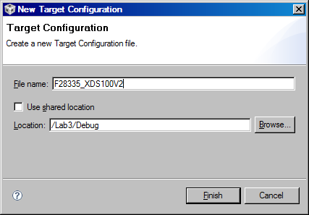
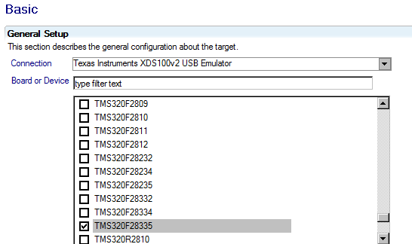
5. Create New Target Configuration
➔ Target ➔ New Target Configuration

Slide 22
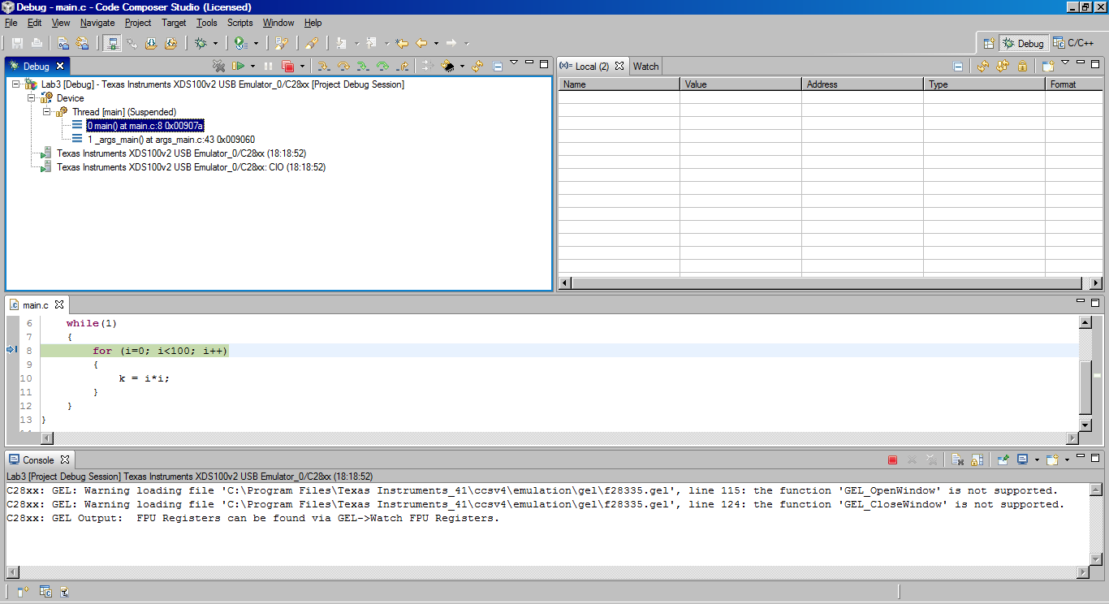
6. Download and Debug
➔ Target ➔ Debug Active Project

Slide 23
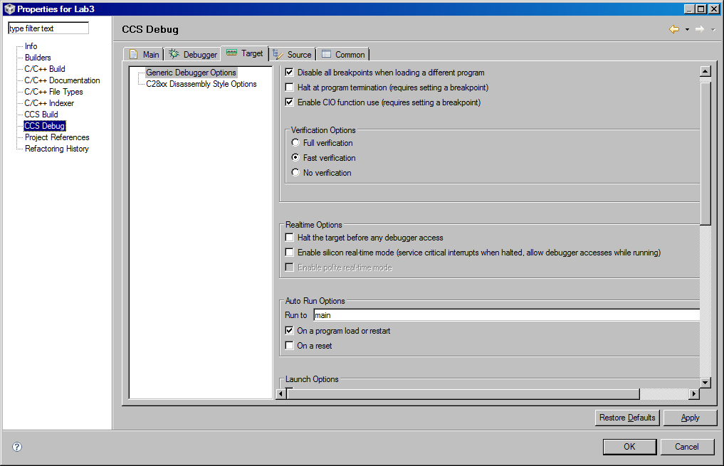
6. Download and Debug
Properties of Project “Lab3”:
Real time Options
Auto Run Options

Slide 24
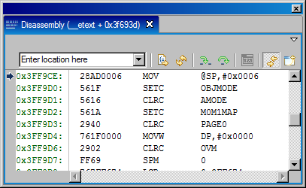
7. Test the code
Hardware Reset:
➔ Target ➔ Reset ➔ Reset CPU
Restart Code:
➔ Target ➔ Restart

Slide 25
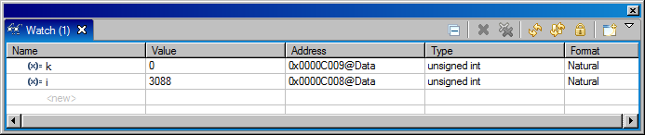
8. Watching variables
If not already open, open a Watch Window: ➔ View ➔ Watch
To inspect the global variables ‘i’ and ‘k’ we have to add this variables manually. This can be done inside window ‘Watch(1)’. In the column ‘name’ we just enter ‘k’ and in the second line ‘i’.
Another convenient way is to mark the variables inside the source code with the right mouse button and then select “Add Watch expression”
In column “Format” we can change the data format between decimal, hexadecimal, binary, etc.

Slide 26
9. Perform a Single Step Debug
Perform a single step of the target - code:
  ➔ Target ➔ Step Into (or use function key “F5”)
Watch the current PC (blue arrow) and the values of variables ‘i’ and ‘k’ in Watch Window while you single step the code !
More debug - commands are shown at the following slide:

Slide 27
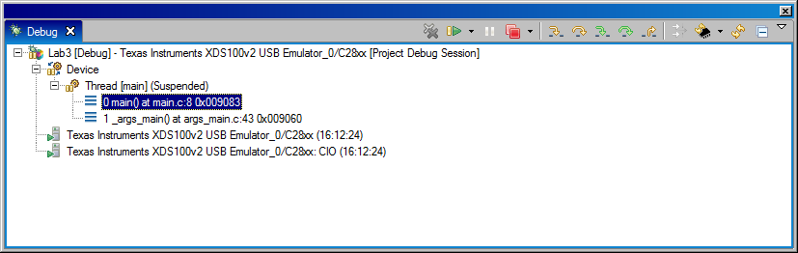
9. Perform Code Stepping
Run
Step Out
Halt
Source Single Step
Assembly Step Over
Source Step Over
Assembly Single Step

Slide 28
10. Set a Breakpoint
Set a Breakpoint:
  Place the Cursor in Lab3.c at line: k = i * i;
  Click right mouse and select “Toggle Breakpoint”
  the left hand side of the line is marked with a blue dot to indicate an active breakpoint.
  A 2nd option is to use a left mouse double click at the grey left hand side of window “Lab3.c” to toggle the breakpoint.
Reset the Program
  ➔ Target ➔ Reset ➔ Reset CPU
  ➔ Target ➔ Restart
Perform a real time run
  ➔ Target ➔ Run (or F8)
    The F2833x stops after hitting an active breakpoint
repeat ‘Run’ and watch your variables
remove the breakpoint (Toggle again) when you’re done.

Slide 29
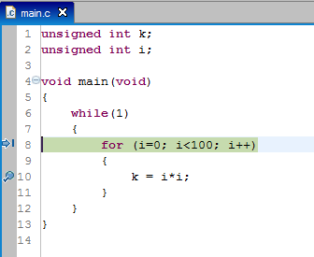
10. Set a Breakpoint (cont. )
blue and
enabled dot:
active Breakpoint
blue arrow:
current position
of PC

Slide 30
11. Real – Time - Debug
Reset F2833x:
  ➔ Target ➔ Reset ➔ Reset CPU
Watchdog – Timer:
  always active after a Reset
  if not serviced, it will cause another Reset after 4.3 milliseconds.
  normally, watchdog is cleared by “key”-instructions
  for the first lab, let us just disable the watchdog:
    Scripts ➔ Watchdog ➔ Disable Watchdog
Start “Real – Time – Debug”:
  ➔ Scripts ➔ Realtime Emulation Control ➔ Run_Realtime_with_Restart

Slide 31
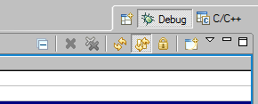
11. Real – Time – Debug (cont.)
In the Watch – Window:
  Enable Continuous Refresh
  In the “menu” open “Customize Continuous Refresh Interval” and change the “Continuous Refresh Interval” to 1 second.
  The variables k and i are updated in the background, while the code is running
  The execution speed of the control code is not delayed by monitoring variables.
  Note: The USB – emulator is too slow to update the watch window as fast as the F2833x executes the for-loop. That is why you will not see each iteration of i and k.
Stop the real time - Debug:
  ➔ GEL ➔ Realtime Emulation Control ➔ Full_Halt
Continuous
Refresh
Menu

Slide 32
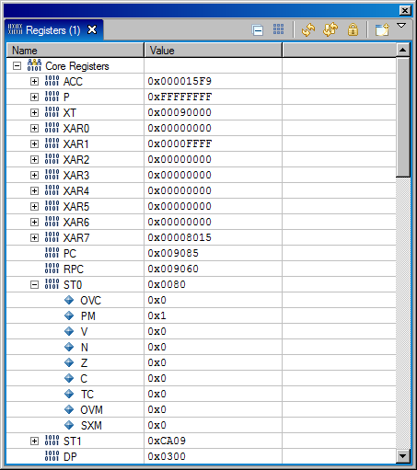
12. CPU Register Set
  View ➔ Registers
Allows to monitor all internal CPU registers
Register ST0 combines math status flags, such as:
  C (carry)
  Z (zero)
  N (negative)
  V (overflow)
  SXM (sign extension mode)
  OVM (overflow mode)
  TC (test control flag)
  PM (product mode shifter)
  OVC ( overflow counter)
Register ST1 combines CPU control flags.

Slide 33
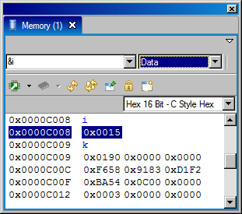
13. Memory Window
  View ➔ Memory
  make sure to inspect data space (top right hand side selection box)
  enter address &i in the top left corner box:
the current value in memory location of variable i (and k) is displayed
change the display type from “Hex – 16 bit” to “16 Bit Unsigned Integer”
change the display type into “16 Bit Binary”

Slide 34
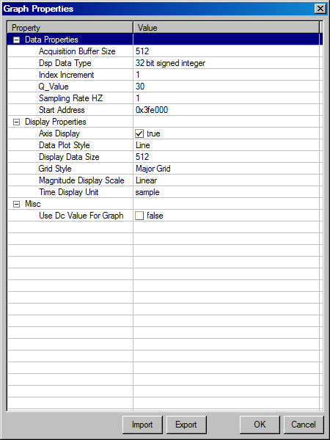
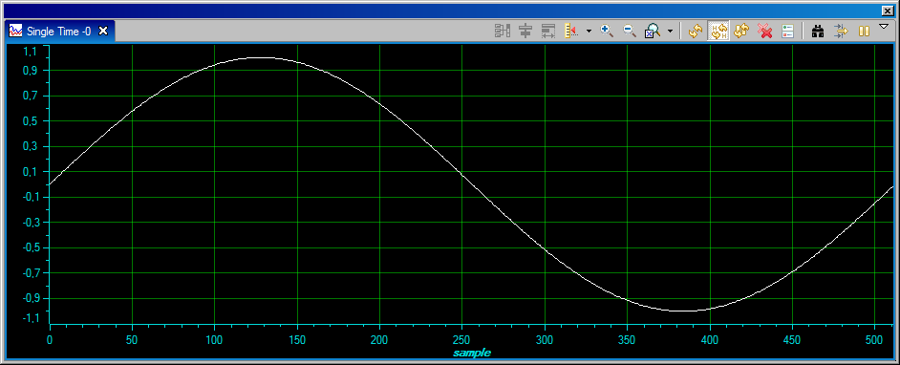
14. Graph Window
  Tools ➔ Graph ➔ Single Time
  View of sine-value look-up table
  in BOOT-ROM (0x3FE000)
  512 values (32-bit signed, I2Q30)

Slide 35
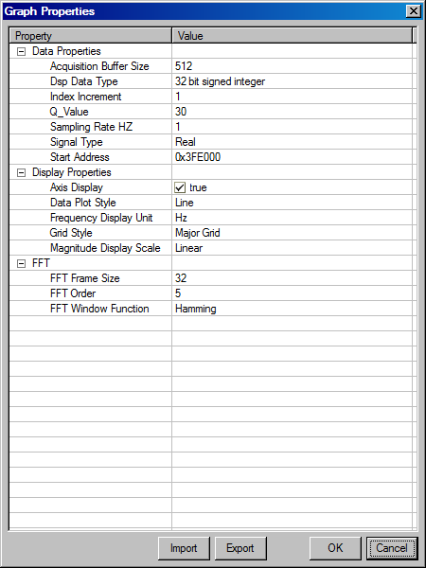
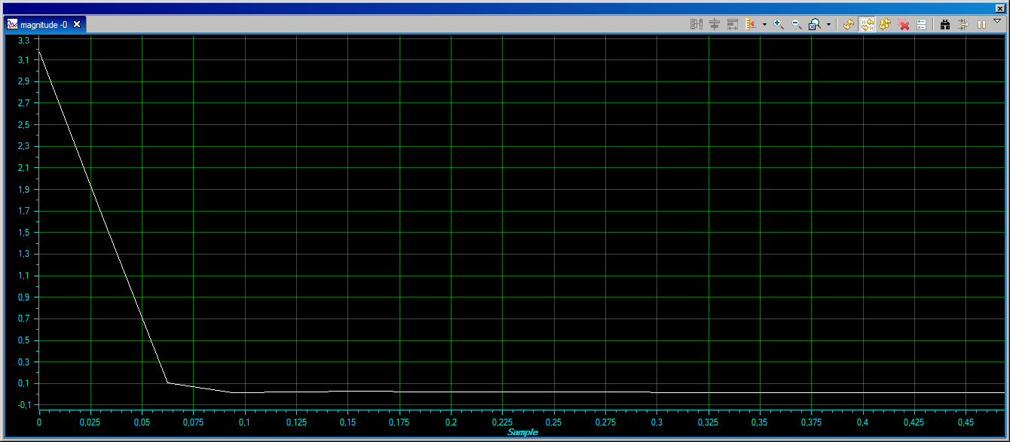
14. Graph Window
  Tools ➔ Graph ➔ FFT Magnitude
  View of sine – value look – up table
  in BOOT - ROM (0x3FE000)
  512 values ( 32 – bit signed, I2Q30)

Slide 36
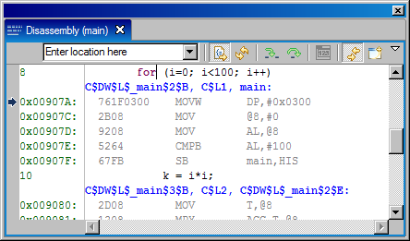
15. Mixed Mode Visualization
To view both the C – source - code and the resulting Assembler – Code:
  click right mouse inside window “Disassembly” and enable “Show Source”
  Both the C-source code (bold) and the Assembler Instruction Code generated by the C - Compiler (grey) are displayed

Slide 37
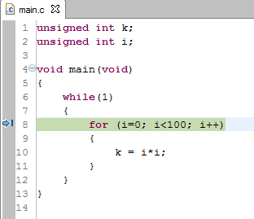
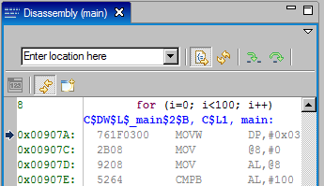
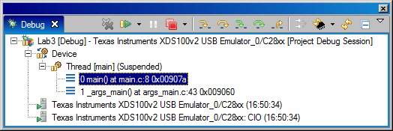
16. Assembly Single Step
Current
ASM -
Instruction
Current
C - line
ASM –
single step
ASM –
step over

Slide 38
17. GEL - “General Extension Language”
GEL = high level language, similar to C
Used to extend Code Composer Studio’s features
to create GEL functions use the GEL syntax
load GEL-files into Code Composer Studio
With GEL, you can:
  access actual/simulated target memory locations
  add options to Code Composer’s GEL menu
GEL is useful for automated testing and user workspace adjustment .
Startup GEL files defined in the target configuration file will be automatically loaded when a debug session is started
Additional GEL files can be loaded in the CCS from the 'GEL Files' dialog (via 'Tools->GEL Files' menu)

Slide 39
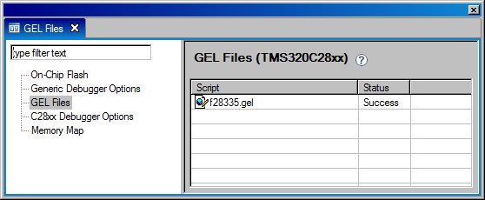
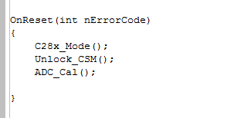
17. GEL - “General Extension Language”
Tools ➔ GEL files
Right-click in the view and select ‘Open’ to inspect the default GEL-File “F28335.gel”
Example Function: “OnReset”:

Slide 40




