Slide 1

Module 16: FLASH Memory API
32-Bit-Digital Signal Controller
TMS320F2833x
Texas Instruments Incorporated
European Customer Training Centre
University of Applied Sciences Zwickau

Slide 2
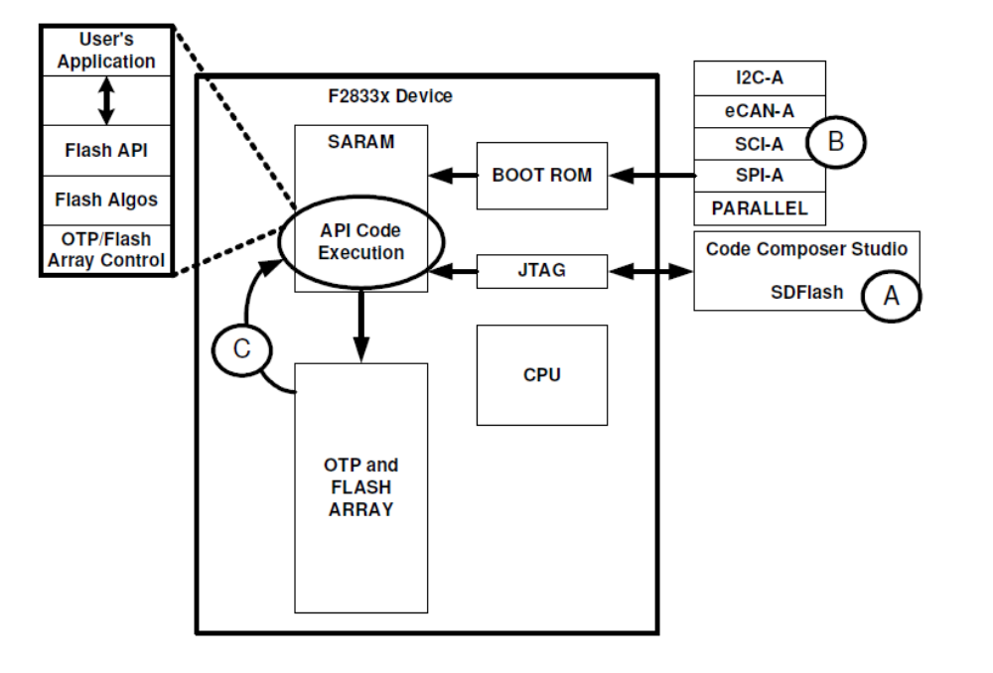
TMS320F2833x FLASH Load Options

Slide 3
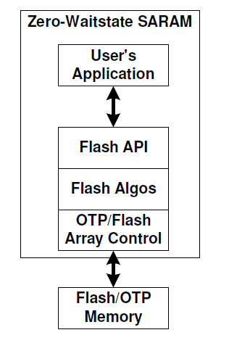
FLASH – API - Installation
Download from: www.ti.com:
  F2833x: “SPRC539”
  F2823x: “SPRC665”
Default Installation path:
  C:\tidcs\c28\FLASH28_API\
Read included documentation
  “Flash2833x_API_Readme.pdf”

Slide 4
FLASH – API – Fundamentals
Erase:
  Pre - Compact
    ensure that no bits are over erased
  Pre – Condition
    set all bits to ‘0’ to allow an even erase
  Erase
    set all memory bits to ‘1’ ( = Erased state)
  Post – Conditioning
    ensure that no bits are left in “over – erased”
Program:
  program selected bits from ‘1’ to ‘0’
Verify:
  CPU read to compare FLASH and image

Slide 5
FLASH – API Checklist
Project Preparation:
Modify file “Flash2833x_API_Config.h”
Include Flash2833x_API_Library.h in source – code
Add FLASH-API – library to your project
Source - Code Modification:
Initialize PLL and wait for lock
Make sure, that PLL is not in “limp” – mode
Copy all API – functions from FLASH into SARAM
Initialize global variable “Flash_CPUScaleFactor”
Initialize callback – pointer “Flash_CallbackPtr”
Call API - functions

Slide 6
FLASH – API function
A called FLASH – API – function will perform:
A disable of the Watchdog – Timer
A check of the registers CLASSID/PARTID
  Addresses 0x0882 and 0x380090)
A check of the content of 0x3FFFB9
  API – version versus silicon - revision
Start of the selected operation and:
  Disables and restores interrupts around time critical sections
  Invokes the callback – function
It returns an success - or error code

Slide 7
Lab16: Use of FLASH – API
  Run stand alone control code from FLASH – A
    “main()” - loop reads value “FLASH_Voltage_A0” from FLASH-B and display the four most significant bits at LEDs LD4…LD1.
  CPU – Timer 0 will start an ADC conversion of channel ADCINA0 (potentiometer VR1) each 50 milliseconds.
  The ADC interrupt service will store the result of the conversion in SARAM - variable “Voltage_A0”
  If button PB1 is pushed, FLASH – B variable “FLASH_Voltage_A0” is updated with “Voltage_A0” using FLASH – API functions “Erase”, “Program” and “Verify”.

Slide 8




