Slide 1
Laughing Owl sceloglaux albifacies
By Mikaela Furman

Slide 2
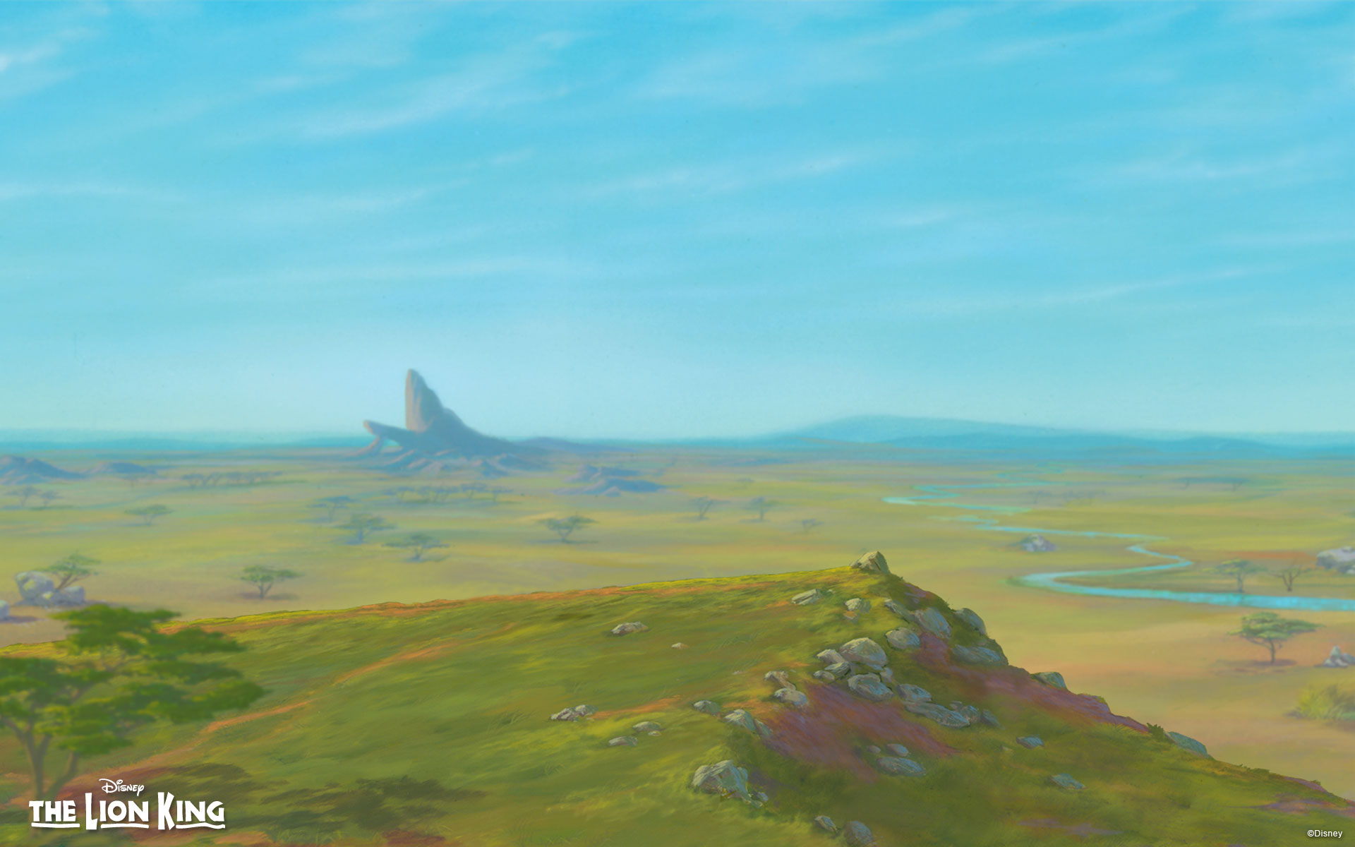
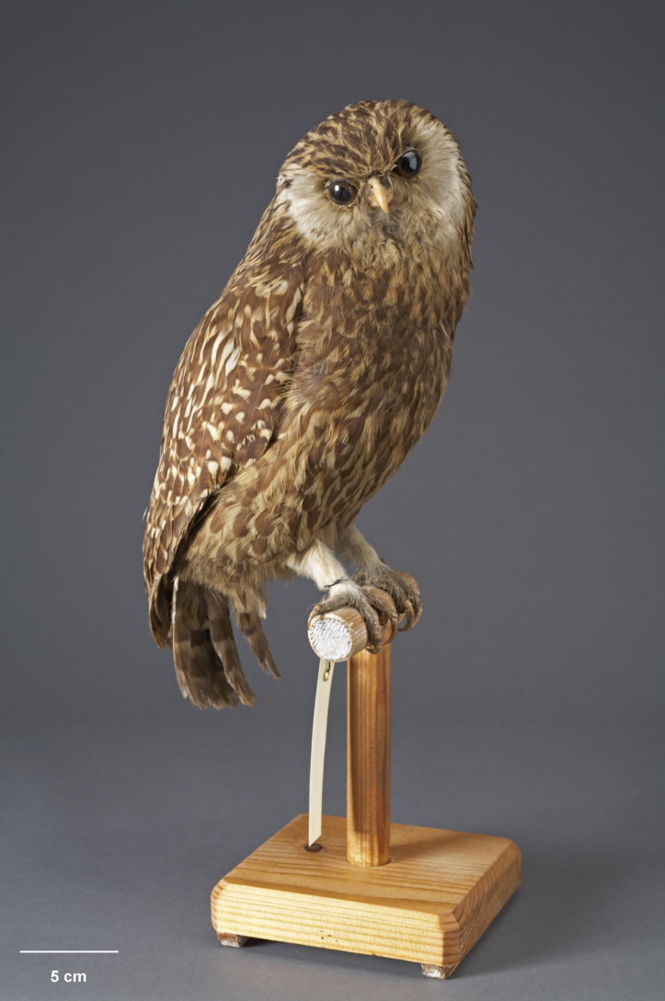
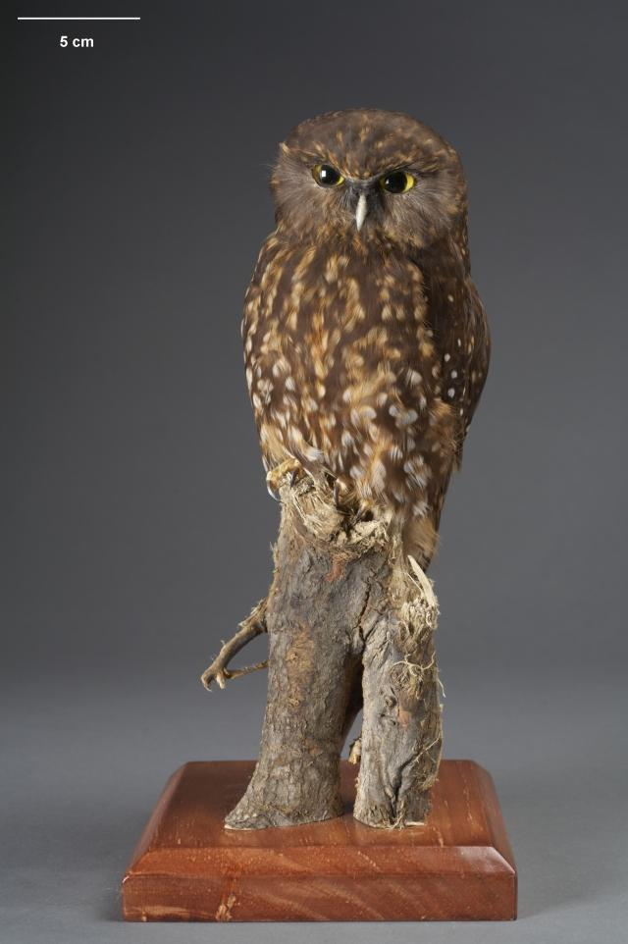
Kingdom: Animalia
Phylum: Chordata
Class: Aves
Order: Strigiformes
Family: Strigidae
Genus: Sceloglaux
Species: Sceloglaux albifacies
The laughing owl, locally known as the Whekau, had white around its eyes, brown feathers with darker brown stripes, and was one of the only species of predatory bird in its habitat. It is twice the size of a morepork (the bird on the right that is also local to new Zealand), and hunted beetles, lizards, small birds, rats and mice on foot. It lived on the north island of new Zealand, which contains temperate broadleaf and mixed forests, Breeding season began in September and October, female birds laying eggs in nests in rocky areas with low rainfall. Females lay two white eggs and incubation took 25 days, with the male feeding the female during this time. The bird had no natural predators until stoats, ferrets and weasels were introduced to control rabbit population. The laughing owl had a call which sounded like a barking dog and feathers that allowed it to blend in with its terrain. The last confirmed sighting of the sceloglaux albifacies was in 1914.The owl would run after its prey on foot as offense.

Slide 3
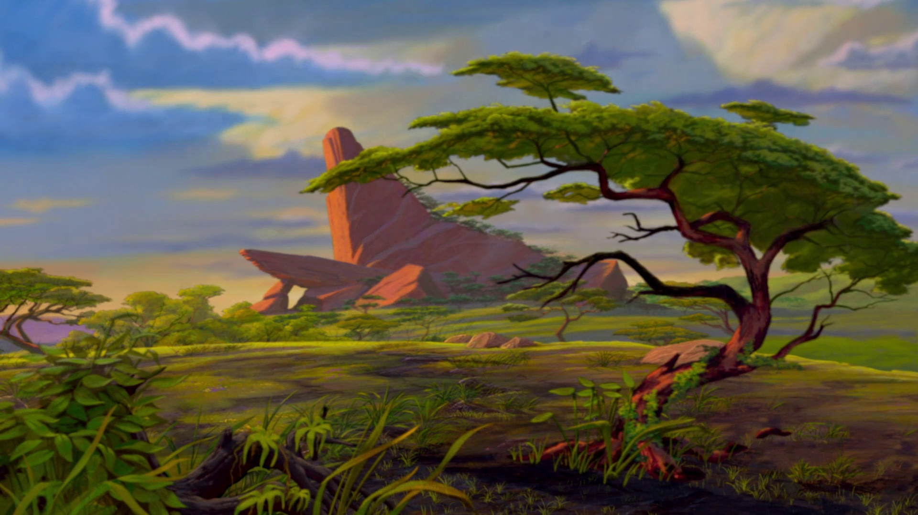
If humans had not introduced new predators that competed with the laughing owls their extinction could have been prevented, because the new animals were new competition for food that lead to the extinction of the laughing owls. Human action could prevent the extinction of animals if they could stop interfering with the circle of life.

Slide 4
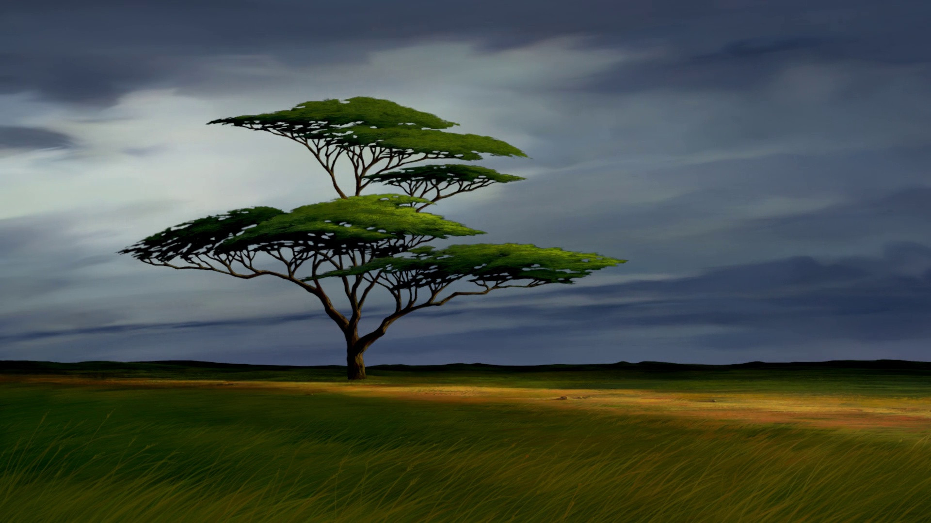
Mass extinctions are periods of time when a lot of species die at the same time. The worst mass extinction so far occurred at the end of the Permian period, when over 90% of all species died. Extinction of a single species is when only one species dies. In the past, mass extinctions were caused by asteroids, climate change and volcanoes. The next mass extinction could be caused by the disregard humans show toward nature.

Slide 5
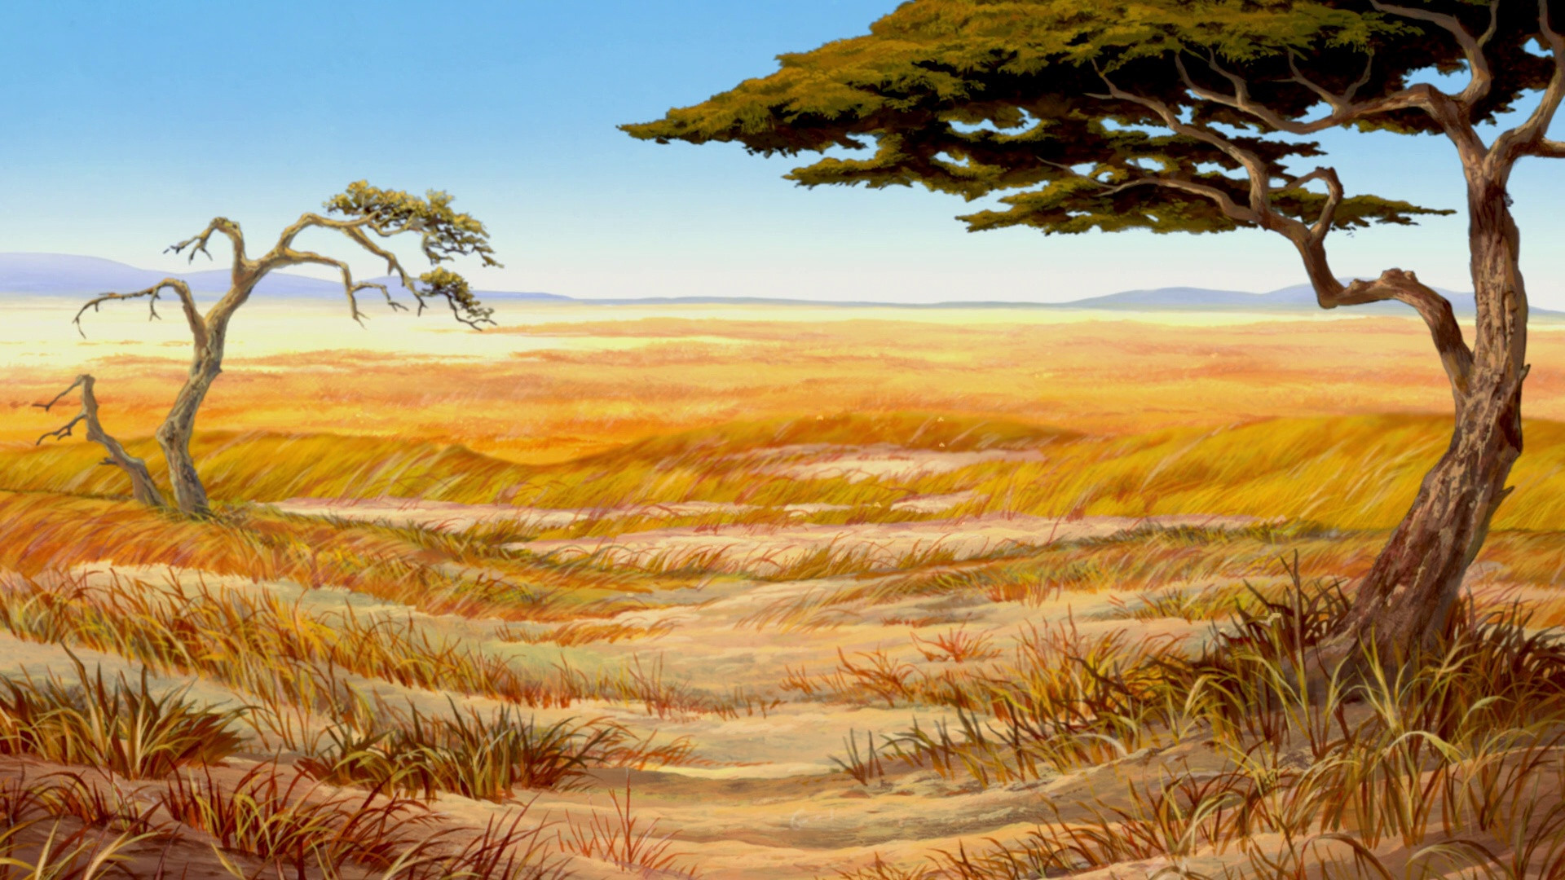
I think bringing my animal back to life could potentially assist in rebalancing the new Zealand ecosystem, but it would introduce competition to both the native species and to species that were introduced. It would probably be a bad idea to introduce the species because some of its prey is endangered and the new predator could hunt them into extinction. On the other side, it could form a balance with the rest of its ecosystem and help reform a stable environment like that which New Zealand previously had. Placing it in zoos adds to the chances of it escaping and ruining ecosystems (or just dying), so no, it should not be in zoos.

Slide 6
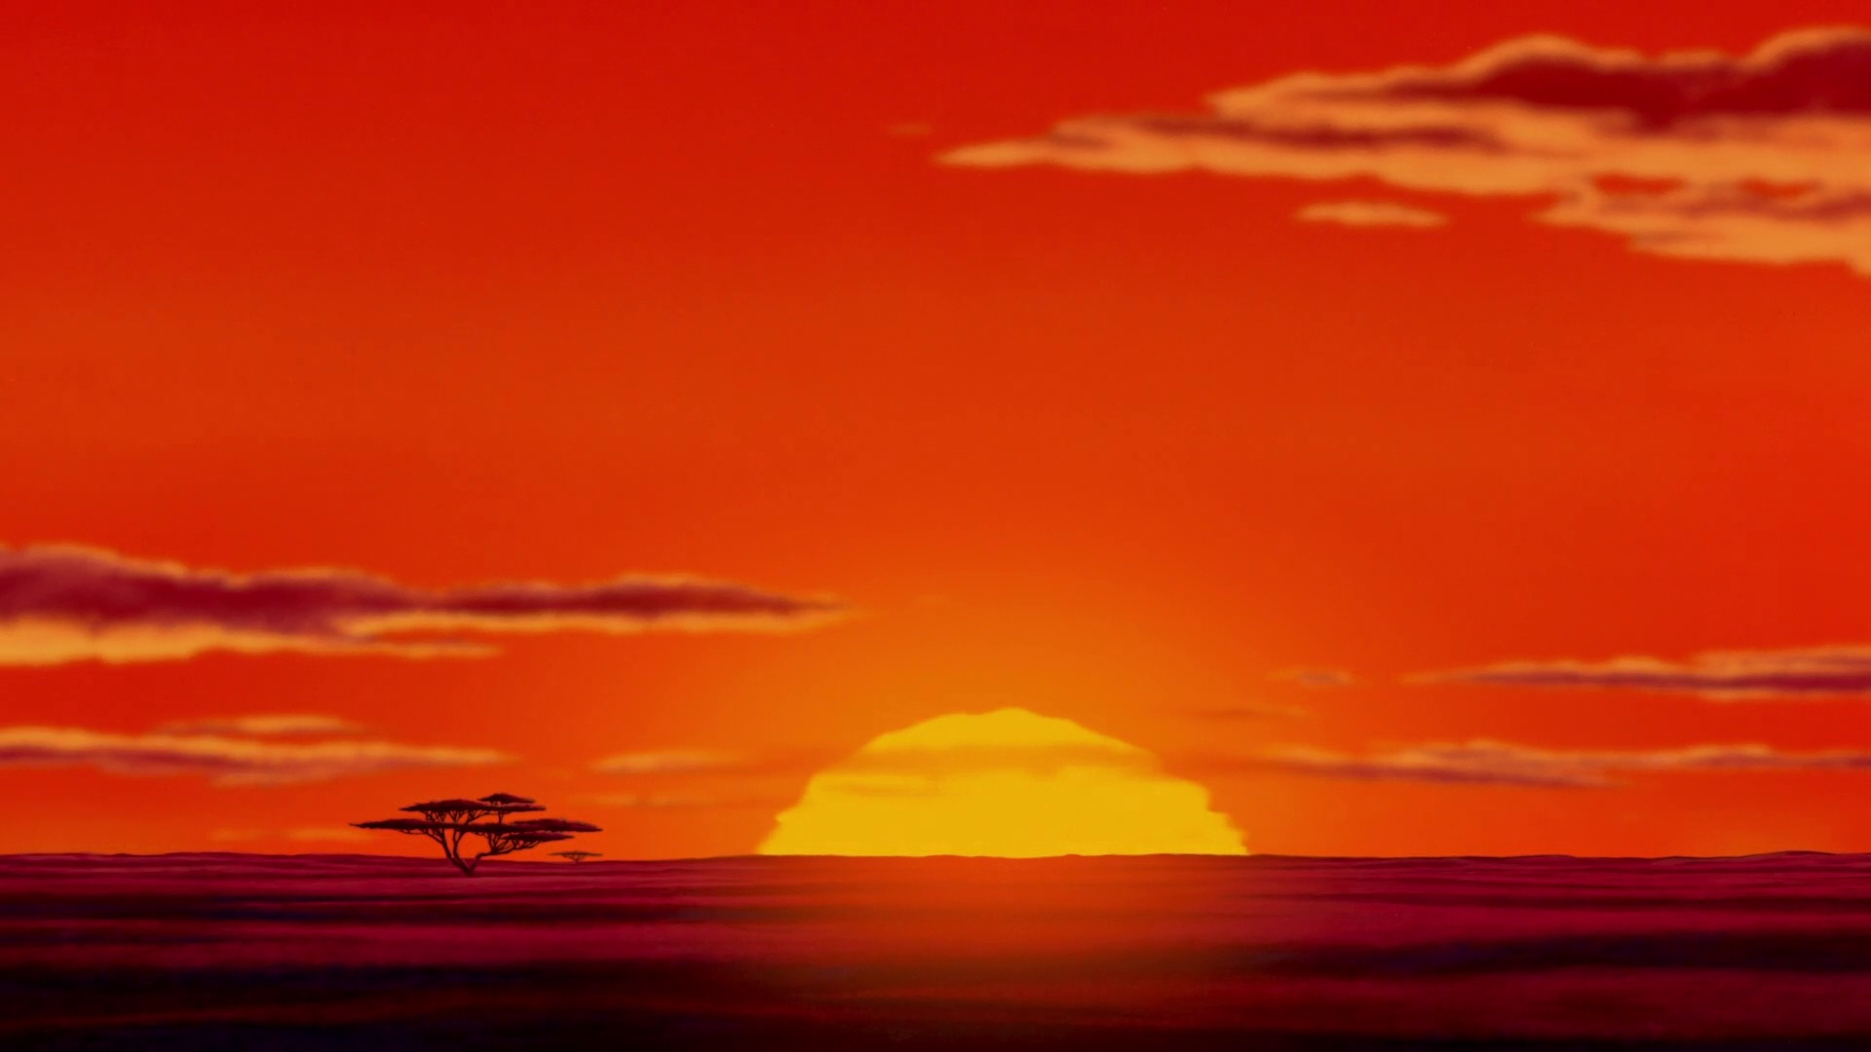
dictionary.com
www.iucnredlist.org
www.owlpages.com
www.birdlife.org
www.bbc.co.uk

