Slide 1



--SIGNAL LOST--
Gamebook
1

Slide 2

Objectives
Create a Gamebook.
C++ Language.
No Sound (Only Beep).
No Art.
2

Slide 3
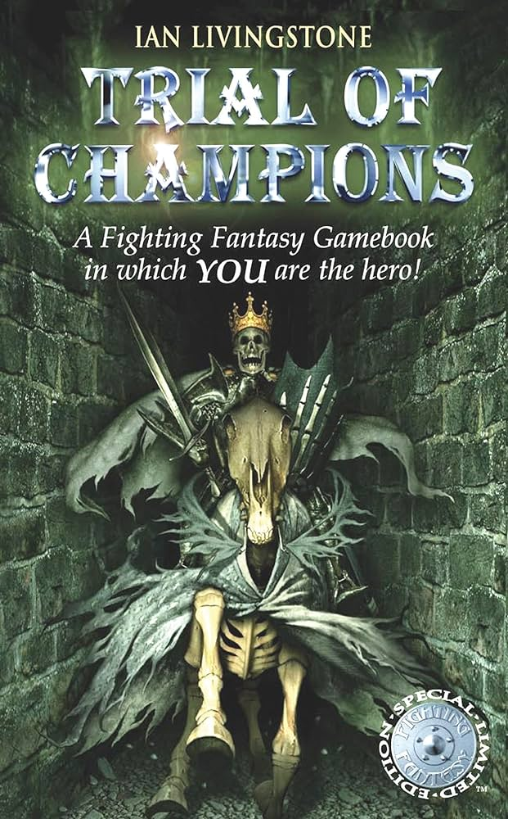
What is a Gamebook?
Video game version of the choose-your-own-adventure books.
Make Choices that affect the story.
It's an interactive stories with text and illustration.
Fixed plot and limited endings.
Explore different paths and scenarios.
3
Notes:
-genre de livre nédans les années 1960
-popularisé par les série des "défis fantastiques" édités par Gaillmard

Slide 4
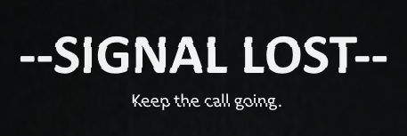
What is our Gamebook?
You receive the call from a stranger, and you're the only one who can help them.
Set on an abandoned island occupied by the ruins of a city.
The player is the protagonist’s advisor, who might act on their own.
4

Slide 5
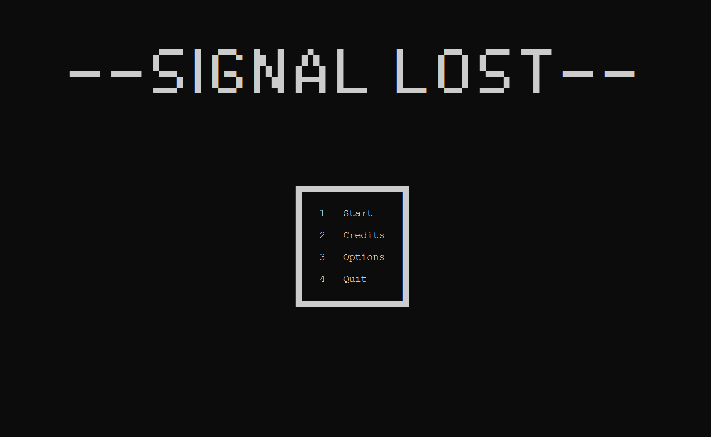
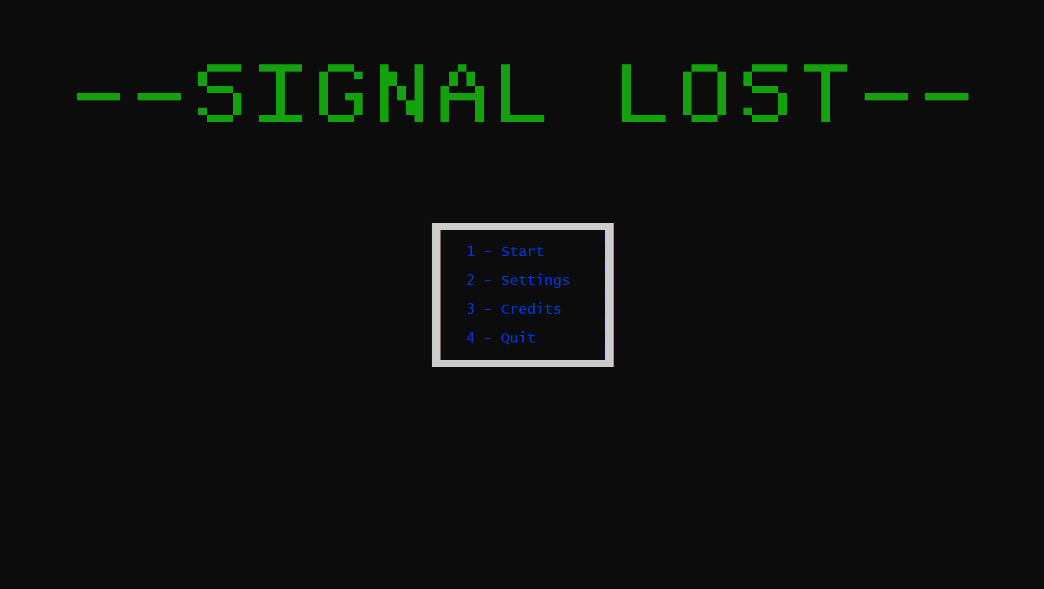
Main Menu Examples
5

Slide 6
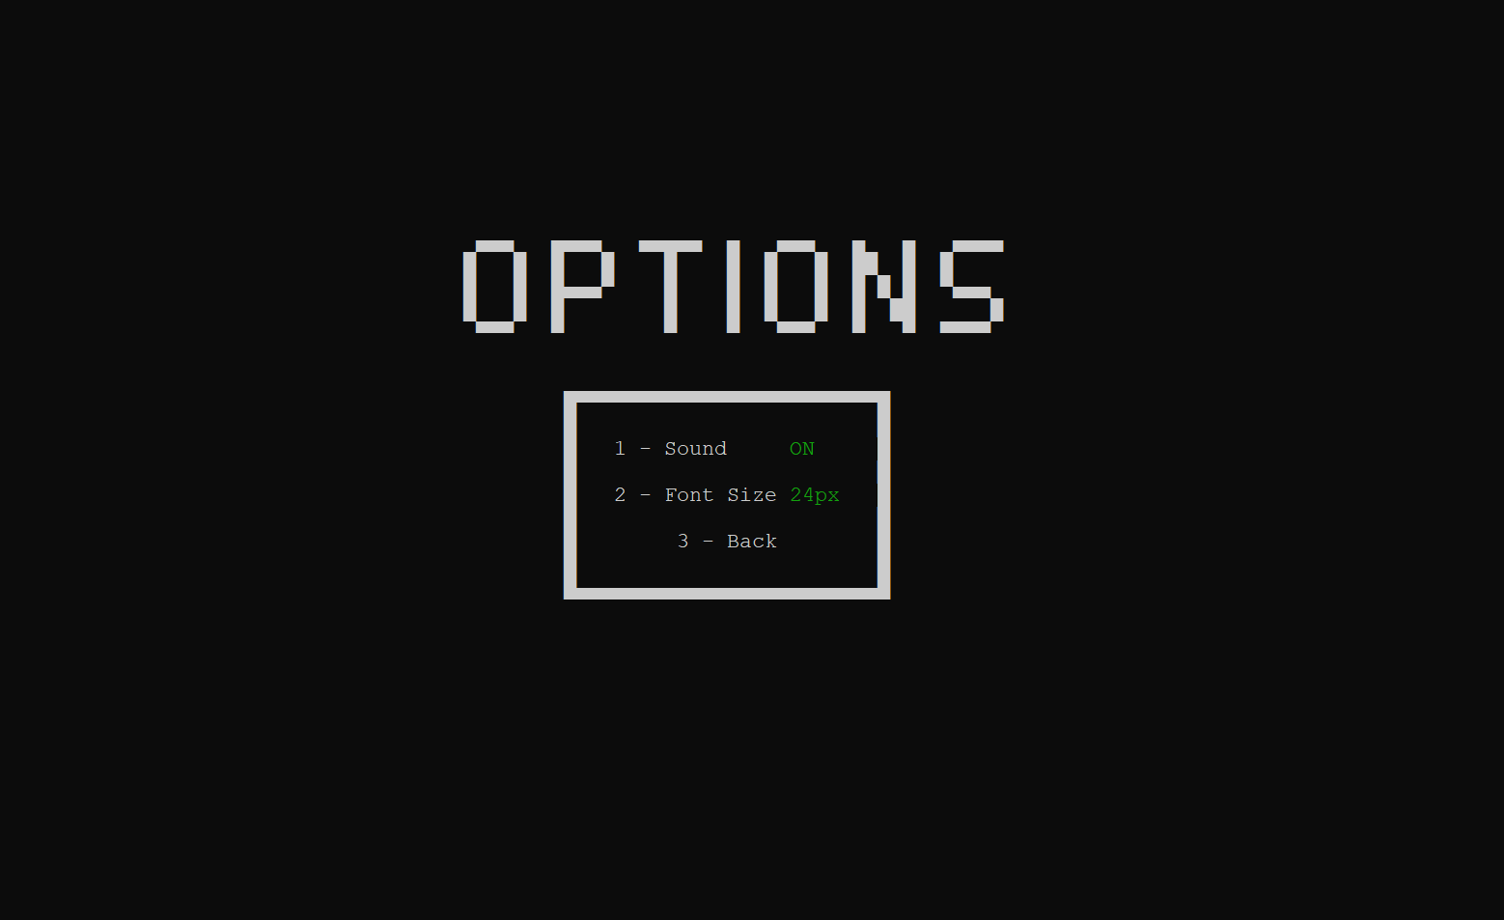
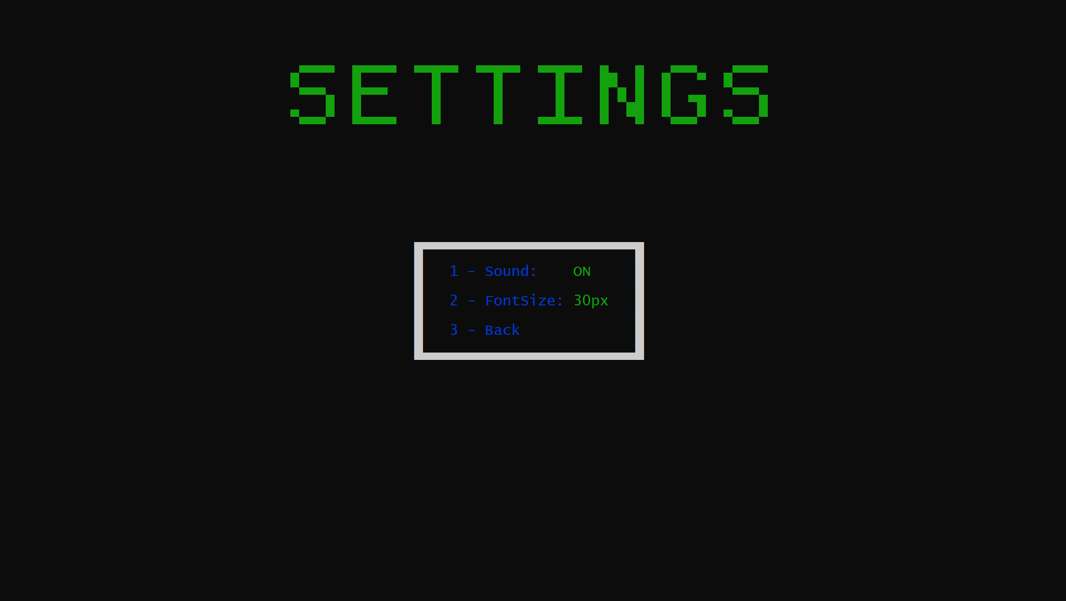
Main Menu Examples
6

Slide 7
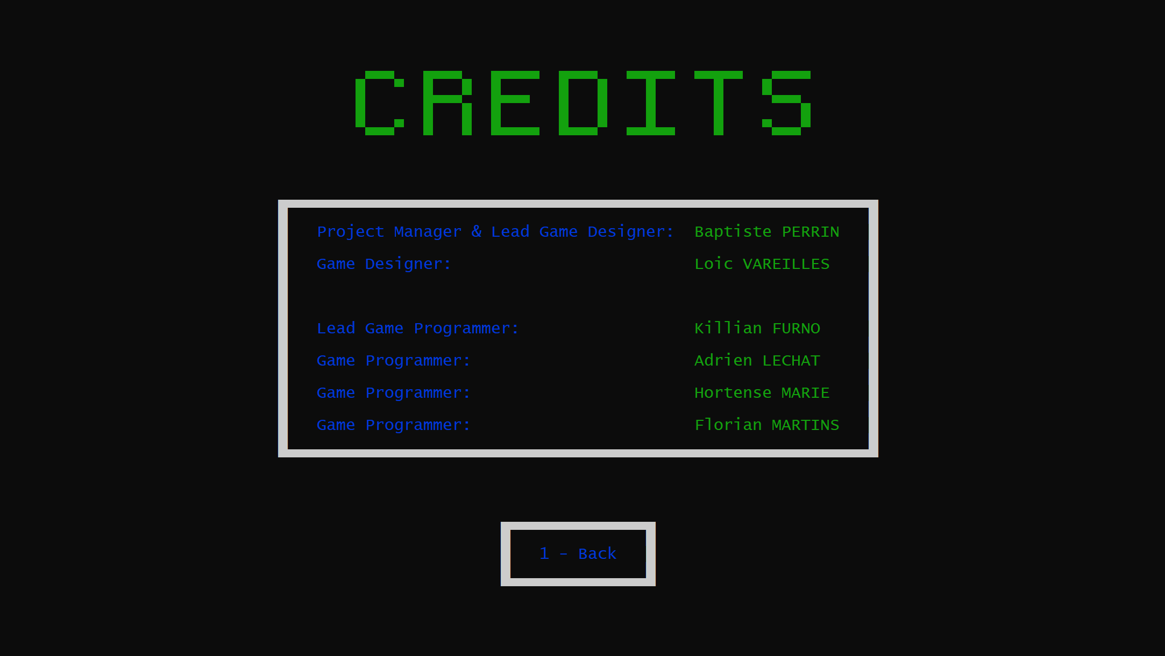
Main Menu Examples
7

Slide 8
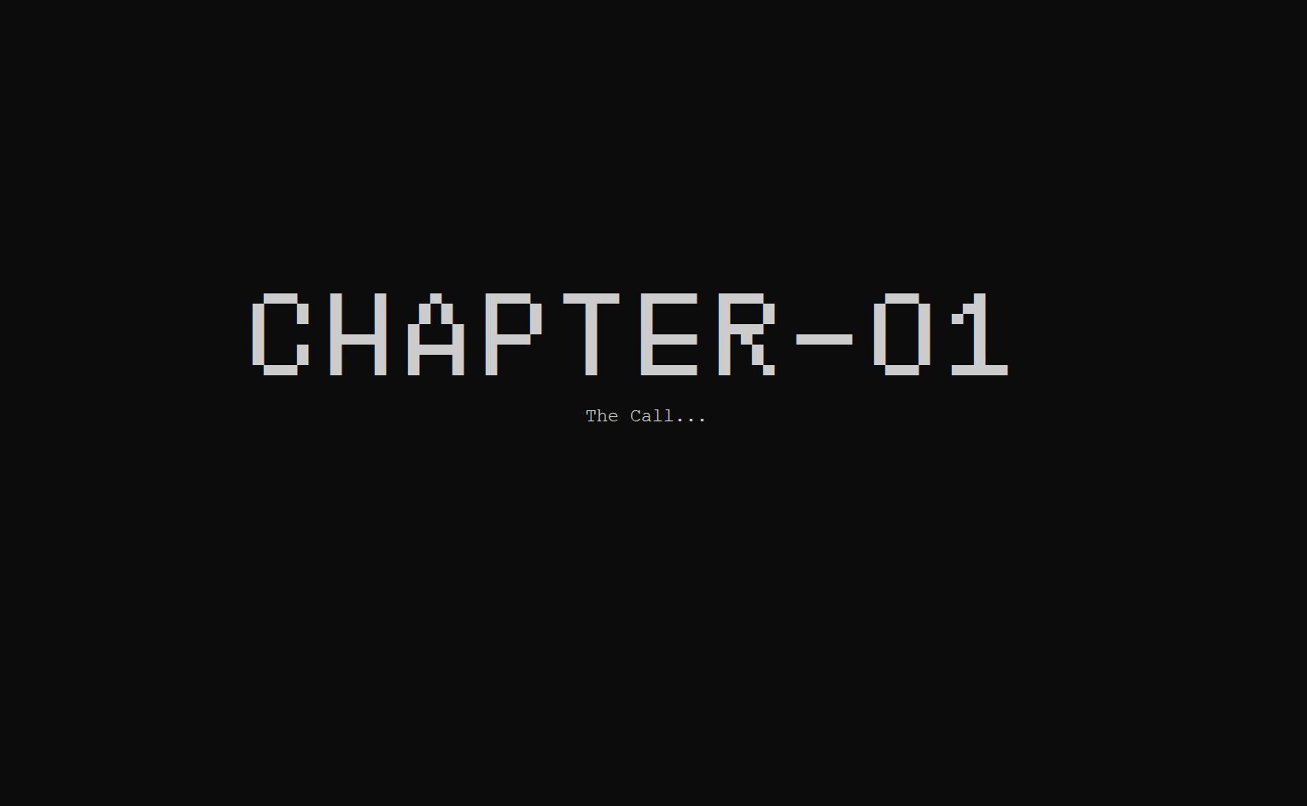
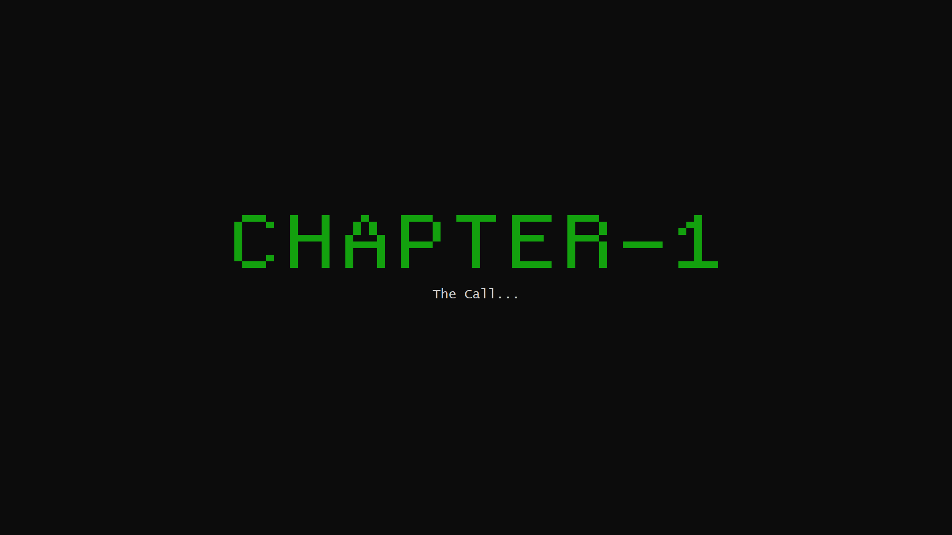
Transition Examples
8

Slide 9
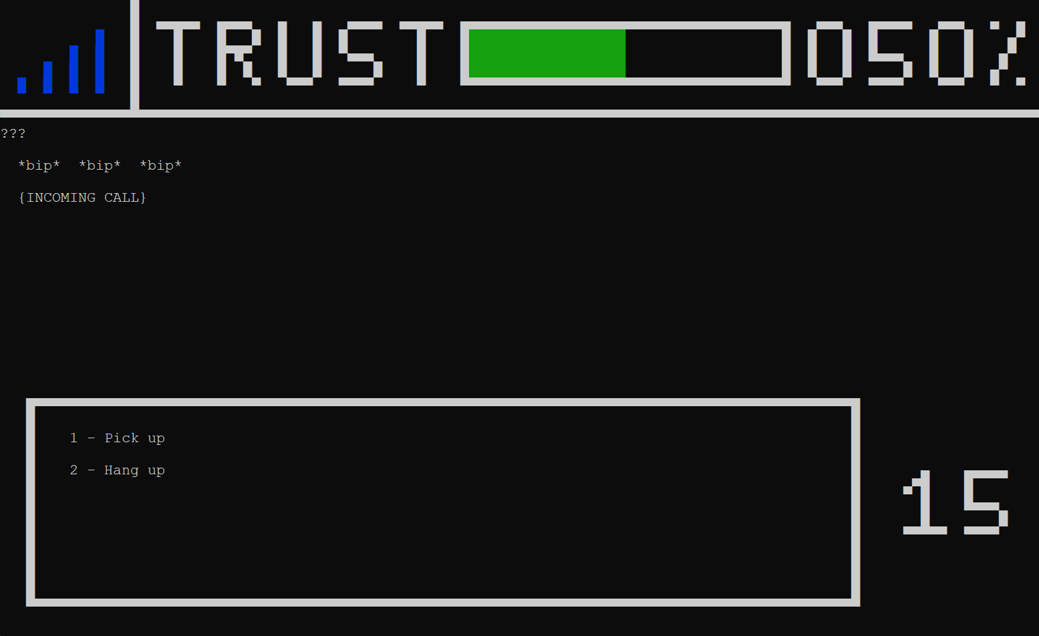
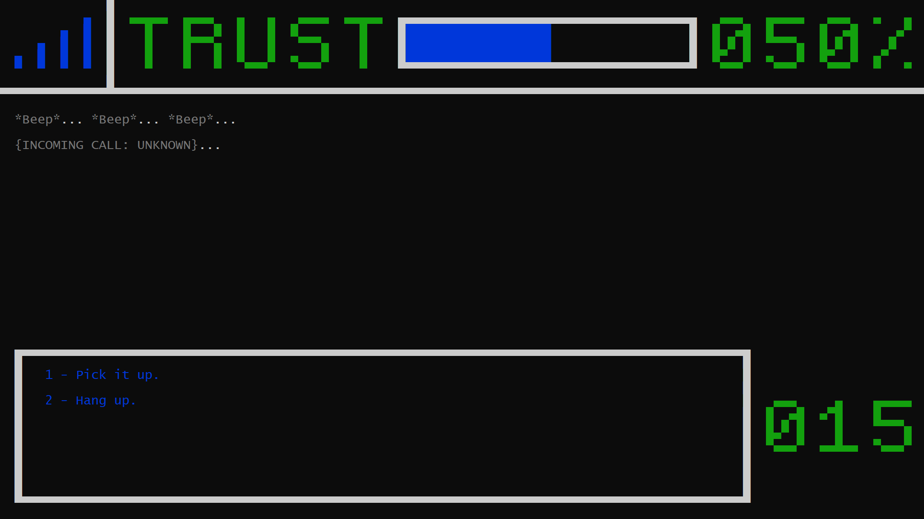
Game Examples
9

Slide 10
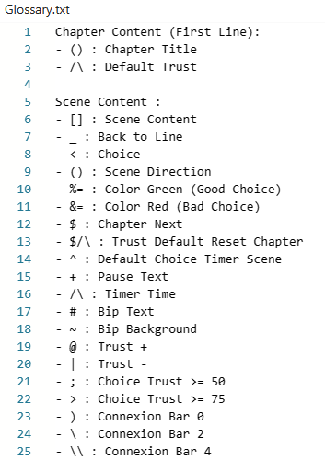
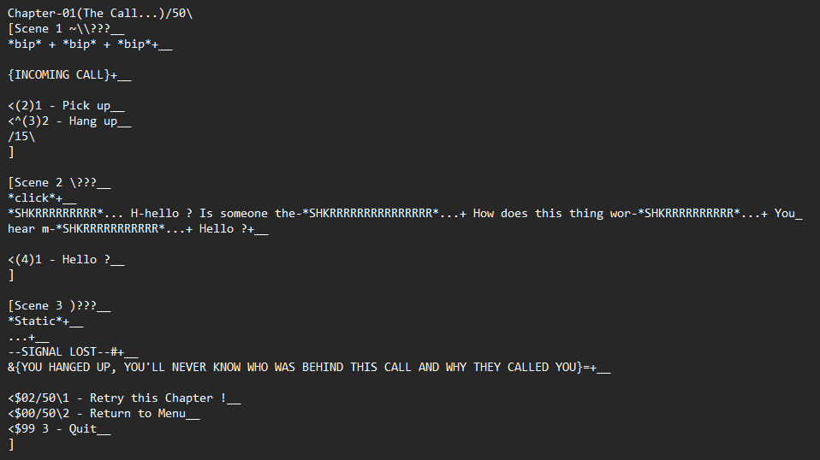
Old Methodology
Nomenclature:
Chapter Example:
10

Slide 11
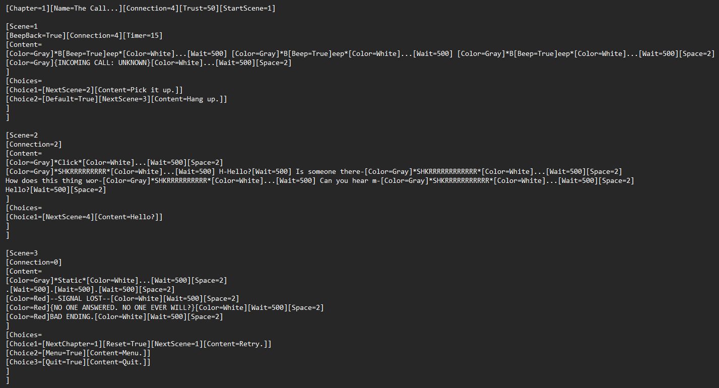
New Methodology
11

