Slide 1

AMD DEVELOPER HACKATHON
GEOCLUSTER 2.0
AI Geospatial Assistant
Satellite imagery retrieval, GIS processing, and a natural-language AI assistant — in one desktop application.
Built on Python · PyQt5 · Sentinel-2 · GPT-OSS-20B · AMD Developer Cloud
Notes:
Open with energy. State the name once, clearly. One sentence on what it does before moving on — don't over-explain the title slide.

Slide 2











THE PROBLEM
GIS software was built for specialists,
not for the people who need it fastest.
Steep learning curve
Menus, coordinate systems, and file formats stand between a question and an answer.
Manual data hunting
Finding and downloading the right satellite scene is its own multi-step chore.
Disconnected tools
Fetching imagery and processing it usually means switching between separate apps.
Too many tools.
Too many steps.
02
Notes:
Ground the audience in a real pain point before showing the fix. Keep this under 30 seconds — judges have seen GIS complexity before, don't over-justify it.

Slide 3


THE SOLUTION
Ask for what you need.
GEOCLUSTER does the rest.
1
NATURAL-LANGUAGE INTERFACE
GEOCLUSTER 2.0 wraps satellite retrieval and GIS processing behind a single natural-language assistant — so a plain English sentence replaces a whole workflow.
8
"Show me NUST imagery and cluster it into 5 zones."
GIS OPERATIONS UNIFIED
Fetching Sentinel-2 · running K-Means · rendering result
0
MANUAL DOWNLOADS NEEDED
03
Notes:
This is the pivot slide. Read the example prompt out loud, then point at the two response bubbles — that's the whole pitch in one visual.

Slide 4





KEY FEATURES
Everything a geospatial workflow needs,
unified behind one assistant.
AI Assistant
Sentinel-2 Retrieval
Natural Language Commands
GPT-OSS-20B answers GIS & remote sensing questions directly.
Pulls real satellite imagery for any named location, on demand.
Plain English replaces menus — "cluster this into 5 zones."
Image Processing
K-Means Clustering
Measurement Tools
Brightness, threshold, negative, and mean filtering, all built in.
GPU-ready unsupervised classification of imagery.
Distance and histogram analysis on any loaded image.
04
Notes:
Don't read all six cards. Call out 2-3 that are most novel (Sentinel-2 retrieval, K-Means clustering) and let the rest speak visually.

Slide 5




SYSTEM ARCHITECTURE
From a typed sentence to a rendered result.
User
Design principle
One router decides whether a prompt needs the AI assistant, an image operation, or a satellite fetch — then hands off to the right module.
PyQt5 Desktop UI
Command Router
AI Assistant / Image Processing
Sentinel Retrieval
Image Viewer
05
Notes:
Trace the flow top to bottom with your finger/cursor as you talk. Emphasize the Command Router — that's the technical decision judges will ask about.

Slide 6







TECHNOLOGY STACK
Built on a lean, production-ready stack.
Python
PyQt5
OpenCV
NumPy
Matplotlib
Pillow
GPT-OSS-20B
Sentinel-2
Docker
AMD Dev Cloud
06
Notes:
Move quickly here — this slide is for credibility, not explanation. Mention AMD Developer Cloud and Docker explicitly since judges are scoring platform usage.

Slide 7



DEMO WORKFLOW
One sentence, five automated steps.
User Prompt
AI Router
Retrieve Imagery
Process Image
Display Result
Example: "Show me NUST imagery and cluster it into 5 zones."
07
Notes:
Use this as the bridge into your live demo. Say the example prompt, then say 'let's watch this happen live' and switch to the actual app.

Slide 8
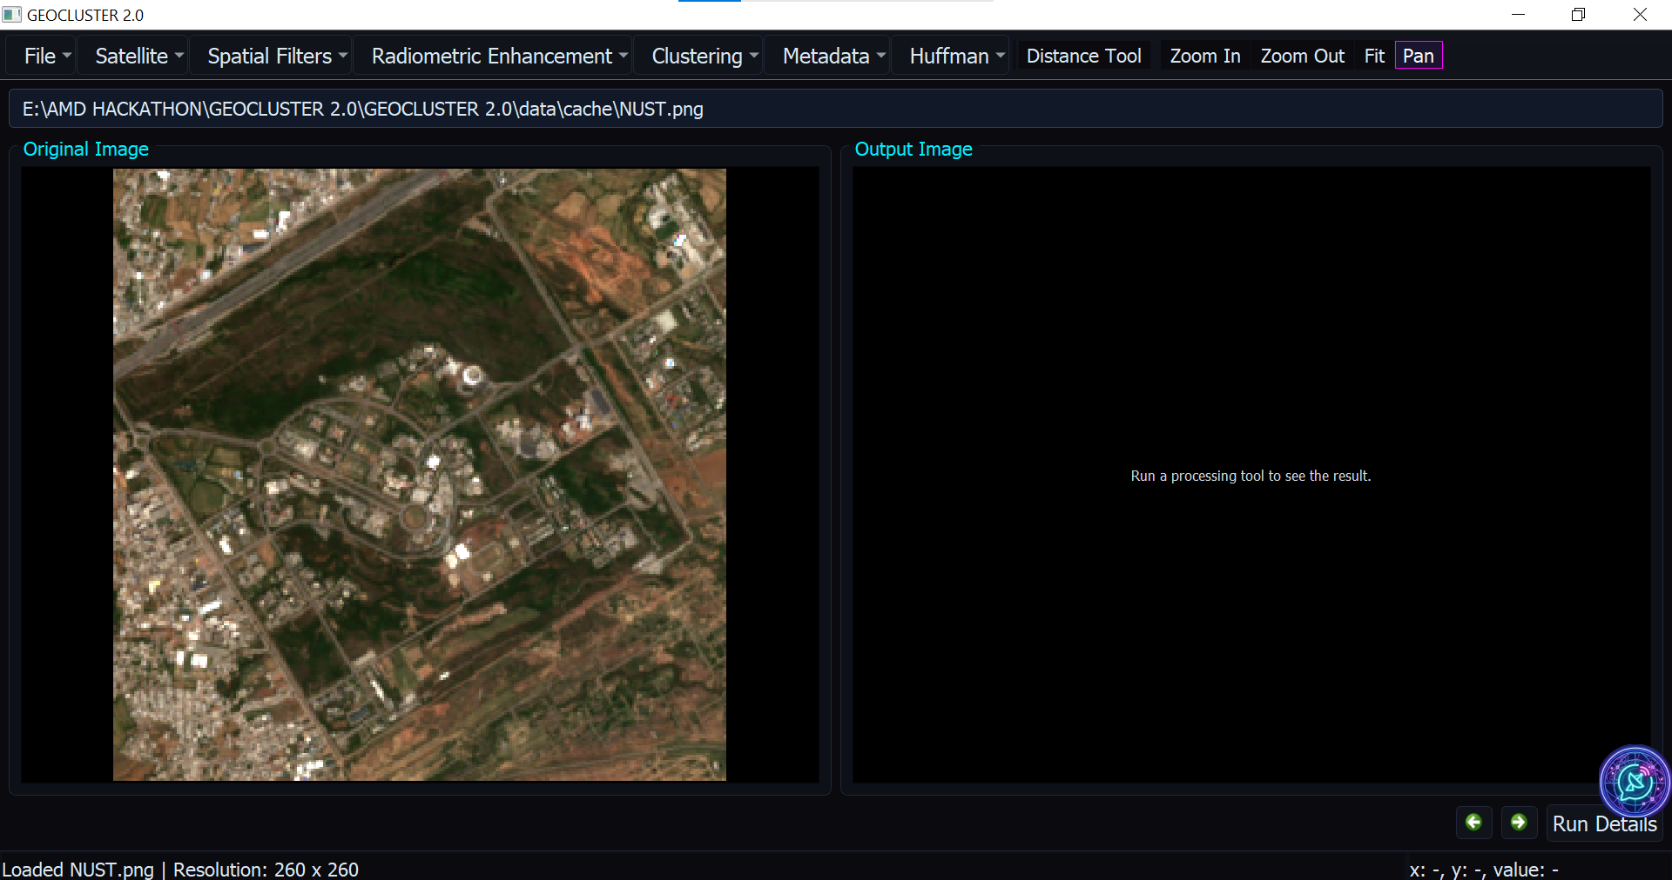

LIVE DEMO
See it in action.
SCREENSHOT PLACEHOLDER
Main Interface
08
Notes:
Replace these three placeholders with real screenshots before presenting: main interface, AI panel mid-conversation, and a clustering result.

Slide 9
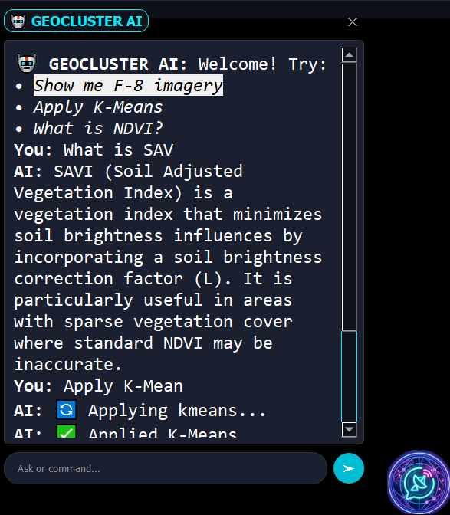
LIVE DEMO
See it in action.
AI Assistant Panel
SCREENSHOT PLACEHOLDER
08
Notes:
Replace these three placeholders with real screenshots before presenting: main interface, AI panel mid-conversation, and a clustering result.

Slide 10






FUTURE WORK
Where GEOCLUSTER goes next.
NDVI / SAVI
Land Cover Classification
Multi-Satellite Support
Built-in vegetation index calculations.
Automated supervised classification workflows.
Landsat and other sources alongside Sentinel-2.
Vector GIS Tools
Cloud Deployment
Web Version
Shapefile and vector layer support.
Run GEOCLUSTER without a local install.
Browser-based access for broader reach.
09
Notes:
Quick, energetic close-out of the roadmap — signals ambition without over-promising. 15 seconds max.

Slide 11

Thank You
GEOCLUSTER 2.0 — AI Geospatial Assistant
AMD Developer Hackathon · Built by Team Quantum_Coders
https://github.com/Furqan6701/GEOCLUSTER-2.0
Notes:
Replace the GitHub placeholder with your real repo URL before submission. End on a confident pause, not a rushed thank-you.

