Slide 1
INTRODUCTION TO PSYCHOLOGY
Psychology

Slide 2
Learning Outcomes
Definition of Psychology
Psychology then…History of Psychology
Structuralism……Introspection
Functionalism
Gestalt Psychology
Psychology Now…Modern Perspectives
Biological Perspective
Psychodynamic Perspective
Cognitive Perspective
Behavioral Perspective
Humanistic Perspective

Slide 3
PSYCHOLOGY
“The scientific study of behavior and mental processes”
It not only encompasses that what people do but also their thoughts, emotions, perceptions, reasoning processes, memories.
Behavior is overt, manifest, obvious, and easy to study
The mental processes that help carryout these behaviors are covert, underlying, hidden, and not easy to study.
Notes:
Besides behavior, what causes these behaviors to occur and the mental processes involved in it is an important area of interest for a psychologist.

Slide 4
Cont…
Psychology has four primary goals:
Describe
Explain
Predict
Control

Slide 5
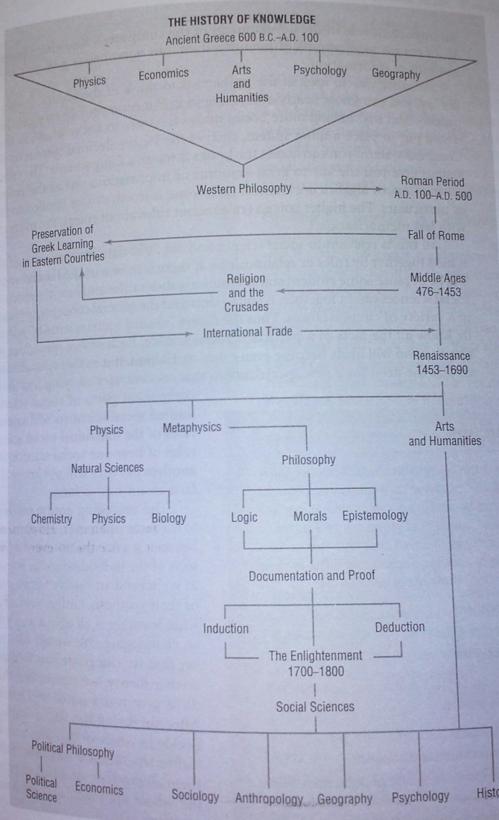

Slide 6
Roots of Psychology
We can trace psychology’s roots back to the ancient Greeks (430 BC), who considered the mind to be a suitable topic for scholarly examination.
In17th-century British philosopher John Locke (1637) believed that children were born into the world with minds like “blank slates” ( tabula rasa in Latin)
Their experiences determined what kind of adults they would become.
Plato and the 17th-century French philosopher René Descartes argued that some knowledge was inborn in humans.

Slide 7
History of Psychology
STRUCTURALISM
William Wundt is considered as the father of Psychology, first laboratory at University of Leipzig at Germany in 1879.
William Wundt’s approach focuses on studying structure of mind and uncovering the fundamental mental components i.e. nonphysical elements:
consciousness, thinking, emotions and other kinds of mental states and activities.
Physical consciousness into three parts
Physical sensation (What we see)
Feelings (Liking or disliking bananas)
Images (memories of other bananas)

Slide 8
Introspection
Students of William, Edward Titchener (1867-1927) advocated structuralism and practiced it at Cornell university New York.
“A procedure used to study the structure of the mind in which subjects were asked to describe in detail about their own thoughts and mental activities what they are experiencing when they are exposed to a stimulus.”
Participants were typically exposed to auditory tone, auditory illusions and visual stimuli under very controlled and systematically varied environment.

Slide 9
Functionalism
William James concentrated on what the mind does—the functions of mental activity—and the role of behavior in allowing people to adapt to their environments.
It concentrated on what the mind does and how behavior functions.
What role behavior plays in allowing people to adapt to their environments.
A functionalist might examine the function of the emotion of fear in preparing us to deal with emergency situations.
Focused on knowing how the mind allows people to function in the real world—how people work, play, and adapt to their surroundings, a viewpoint he called functionalism.

Slide 10
Gestalt Psychology
Max Wertheimer, Wolfgang Kohler and Kurt Koffka advocated this thought.
Gestalt means “unified form”, an “organized whole”
An approach to psychology that focuses on the organization of perception and thinking in a “whole” sense rather than on the individual elements of thinking, perception.

Slide 11
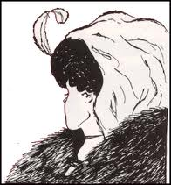

Slide 12
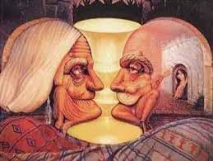

Slide 13
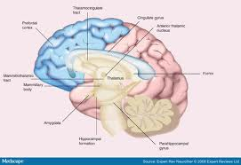
Modern Perspectives of Psychology
NEUROSCIENCE/BIOLOGICAL PERSPECTIVE
The approach that views behavior from the perspective of the brain, the nervous system, and other biological functions. It includes the study of heredity etc.
E.g. Schizophrenia, sleep, depression, blood pressure

Slide 14
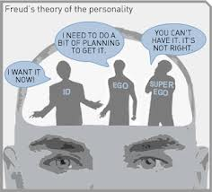
Cont…
PSYCHODYNAMICS PERSPECTIVE
Viennese physician Sigmund Freud in 1900s.
The approach based on the view that behavior is motivated by unconscious inner forces over which the individual has little control.
Psychoanalysis
e.g. dreams, slip of tongue

Slide 15
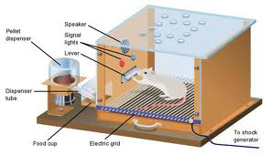
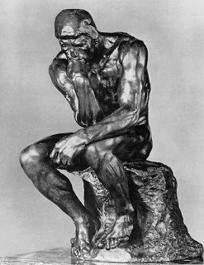
Cont…
BEHAVIORAL PERSPECTIVE
John B. Watson, B. F. Skinner
The approach that suggests that observable, measurable behavior should be the focus of study.
e.g. For example, a child who cries and is rewarded by getting his mother’s attention will cry again in the future.
COGNITIVE PERSPECTIVE
The approach that focuses on how people think, understand, and know about the world (1960s).
Information processing(memory, intelligence, thought process, problem solving)

Slide 16
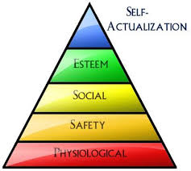
Cont…
HUMANISTIC PERSPECTIVE
Carl Rogers, Abraham Maslow.
The approach that suggests that all individuals naturally strive to grow, develop, and be in control of their lives and behavior.
The emphasis of the humanistic perspective is on free will , the ability to freely make decisions about one’s own behavior and life.

Slide 17
THANK YOU
HAPPY LEARNING STUDENTS!

