Slide 1
MOTIVATION
Psychology

Slide 2
Learning Outcomes
Review of previous session
Theories of Motivation
Incentive Theory
Cognitive Theory
Maslow’s Hierarchy

Slide 3
Incentive Theory: Motivation’s pull
The theory suggesting that motivation stems from the desire to obtain valued external goals, or Incentives”.
Incentive
An incentive is an external goal that has the capacity to motivate behavior.
Incentives work when we expect that we can gain the incentive and when we value the incentive.
Examples
Ice cream, a monetary prize, approval from friends, an appreciation from a teacher, A on an exam, promotions, vacations etc.

Slide 4
Cognitive Theory: The thoughts behind motivation
“The theory suggesting that motivation is a product of people’s thoughts , expectations and goals- their cognitions.”
Intrinsic motivation
Participate in an activity for own enjoyment
Extrinsic motivation
To do something for money, a grade or some other tangible reward
Example
The degree to which people are motivated to study for good grades is based on their own cognition.

Slide 5
Maslow’s Theory of Need: Ordering motivational needs
Maslow's hierarchy of needs is a theory proposed by Abraham Maslow in 1943.
His model considers different motivational needs to be ordered in a hierarchy.
Once lower order needs (physiological and safety) are meet, then higher needs (love, self-esteem and self actualization) can be satisfied

Slide 6
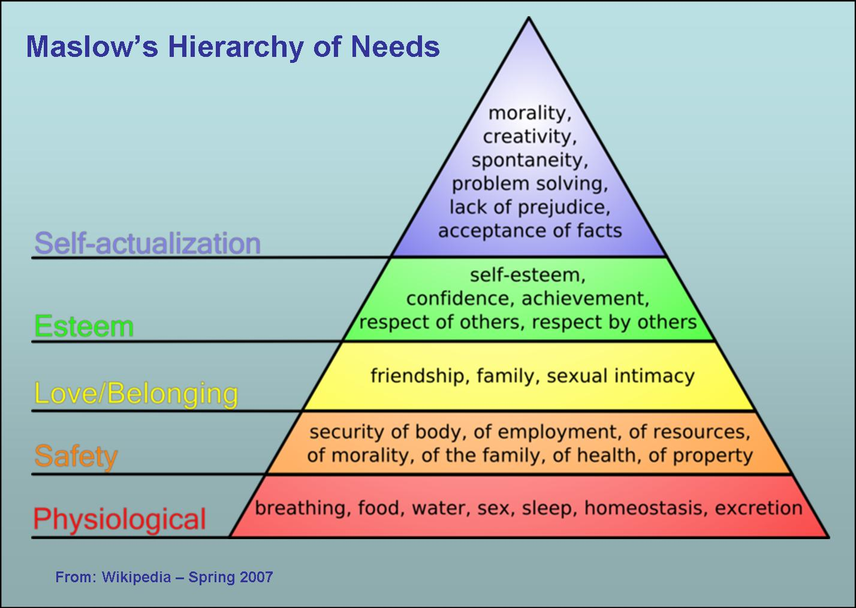

Slide 7
THANK YOU
HAPPY LEARNING STUDENTS!

