Slide 1
PERSONALITY
Psychology

Slide 2
Learning Outcomes
Definition of Personality
Theories of Personality
Psychodynamic Theories

Slide 3
Definition
Distinctive and relatively stable pattern of behaviors, thoughts, motives, and emotions that characterizes an individual throughout life.
“Unique, relatively consistent pattern of thinking, feeling and behaving is termed as personality”.
“Personality is the total organization of the inherited and acquired characteristics of an individual as evidenced by the individual’s behavior.”
The pattern of enduring characteristics that differentiates a person, patterns of behaviors that make each individual unique.

Slide 4
Psychodynamics Theory
This theory was presented by Sigmund Freud (1856-1939).
He termed his theory of personality as Psychoanalysis.
“Personality theories contending that behavior results from psychological dynamics that interact within the individual, often outside conscious awareness.”
Unconscious forces act as determinants of personality.
He believed that there are three levels of awareness in consciousness:
The unconscious
The preconscious
The conscious

Slide 5
Cont…
Unconscious (Id)
A part of the personality of which a person is not aware, and which is a potential determinant of behavior.
The primary motivating force of behavior, containing repressed memories as well as instincts and wishes that never have been conscious.
Preconscious (Superego)
The thoughts, feelings and memories that a person is not consciously aware but may be brought to consciousness.
Conscious (Ego)
The thoughts, feelings, sensations or memories of which a person is aware at any given moment.

Slide 6
Cont…
Id
The raw, unorganized, inborn part of personality whose sole purpose is to reduce tension created by primitive drives related to hunger, aggression and irrational impulses.
The unconscious system of personality, which contains the life and death instincts.
Functions on “pleasure principle”.
Immediate gratification of needs to reduce tension and discomfort regardless of consequences.

Slide 7
Superego
The final personality structure to develop; it represents society’s standards of right and wrong as handed down by a person’s parents, teachers and other important figures.
Functions on “idealistic principle”.
Our moral guide/conscience.
Influenced by internalizing our parents’ values and the voice of the society.
Works against the id by inflicting guilt.

Slide 8
Cont…
Ego
The rational largely conscious system of personality.
Functions on “reality principle”.
The part of the personality that serves to balance the demands of id and superego.
Assesses what is realistically possible in satisfying the id and/or superego (that is what society will consider acceptable).
Ego uses defense mechanism to protect itself.

Slide 9
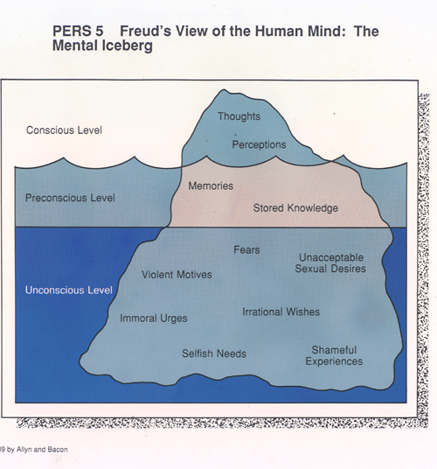

Slide 10
THANK YOU
HAPPY LEARNING STUDENTS!

