Slide 1
PERCEPTION
Psychology

Slide 2
Learning Outcomes
Top-Down and Bottom-Up Processing
Stages of Perceptual Process
The Gestalt Laws Of Organization

Slide 3
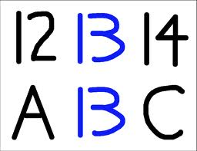
Top-Down and Bottom-Up Processing
Top-Down Processing
“Perception that is guided by higher level knowledge, experience, expectations and motivation.”
Ca- yo- re-d th-s –en-en-e w-ic- ha- ev-ry –hi-d l-tt-r m-ss-ng?
Bottom-Up Processing
“Perception that consist of recognizing and processing information about the individual components of the stimuli”.
Relies on current input of sensory information.

Slide 4
Stages of Perceptual Process
Information attention
Selective screening
Lets in only a tiny proportion of all the information that bombards a person
Organization of information
Schemas
Cognitive frameworks that represent organized knowledge about a given concept or stimulus developed through experience.

Slide 5
Cont…
Information interpretation
Uncovering the reasons behind the ways stimulus are grouped.
Information retrieval
Attention and selection, organization, and interpretation are part of memory.
Information stored in memory must be retrieved in order to be used.

Slide 6
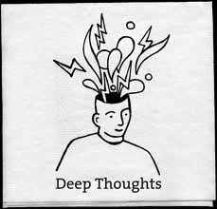
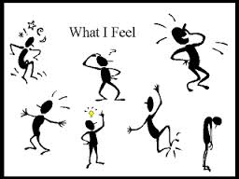

Response to a Perceptual Process
Thoughts
Feelings
Actions

Slide 7
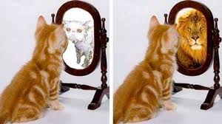
What matters most is how you see yourself
Self Perception

Slide 8


Slide 9

The Gestalt Laws of Organization
“A series of principles that describe how we organize bits and pieces of information into meaningful wholes”.
Closure
Proximity
Similarity
Simplicity

Slide 10
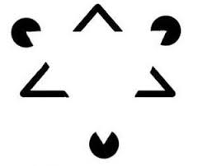
Cont…
Closure
Groupings are usually made in terms of enclosed or complete figures rather than open ones. We need to ignore the breaks and concentrate on overall form.

Slide 11


Slide 12

Cont…
Proximity
Elements that are close together in space and time tend to be perceived as forming a figure.
For example, elements that are closer together are grouped together. As a result, we tend to see pairs of dots rather than rows of single dots.

Slide 13


Cont…
Similarity
Elements that are similar in appearance tend to be perceived as forming a group.
Continuity
Items that continue a pattern or direction tend to be grouped together as part of the pattern.

Slide 14
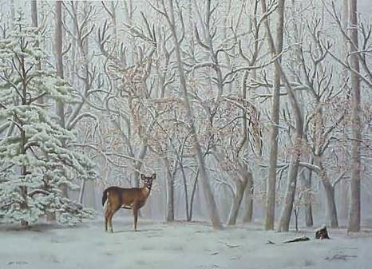

Slide 15
THANK YOU
HAPPY LEARNING STUDENTS!

