Slide 1
LEARNING
Psychology

Slide 2
Learning Outcomes
Operant Conditioning
Reinforcing desired behavior

Slide 3
Very good…what a clever idea…fantastic…i agree…thank you…excellent…super…right on…this is the best paper you’ve ever written; you get an A…you are really getting the hang of it…I’m impressed…let me give you a hug…you’re getting a raise…have a cookie…you look great…love you…

Slide 4
Operant Conditioning
The term “operant” refers to the fact that an organism learns through responding-through operating on the environment.
“Learning in which a voluntary response is strengthened or weakened, depending on its favorable or unfavorable consequences”.
e.g. working hard results in good grades.
“The type of learning in which behaviors are emitted (in the presence of specific stimuli) to earn rewards or avoid punishment”.

Slide 5
Thorndike's Law of Effect
Edward L. Thorndike in 1932:
“Responses that lead to satisfying consequences are more likely to be repeated, and responses followed by negative outcomes are less likely to be repeated.”
Hungry cat in puzzle box…..learning by trial and error.

Slide 6
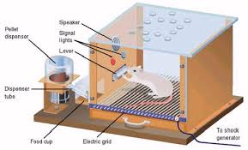
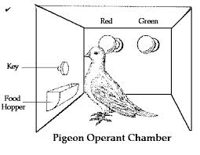
Skinner and Operant Behavior
Frederic Skinner championed the laboratory study of the law of effect and advocated the application of behavior analysis and its methods to solving human problems.
In case of humans, instead of giving their participant some food, points (like in a video game) or points exchangeable for money were given.
Operant Chamber

Slide 7
Reinforcing desired behavior
Reinforcement
“The process by which a stimulus increases the probability that a preceding behavior will be repeated”.
Reinforcer
“Any stimulus that increases the probability that a preceding behavior will occur again.”
Primary reinforcer
Secondary reinforcer

Slide 8
Primary reinforcer
Satisfies some biological need and works naturally, regardless of a person’s prior experience.
E.g. food
Secondary reinforcer
Is a stimulus thus becomes reinforcing because of its association with a primary reinforcer.
E.g. Money

Slide 9
Positive reinforcer
“A stimulus added to the environment that brings about an increase in a preceding response”.
e.g.
Enjoyment of the food ( pleasant stimulus) reinforces your going to restaurant and ordering dinner (the response).
Paycheck (pleasant stimuli) that workers get at the end of a year to work harder (response)

Slide 10
Negative reinforcer
“An unpleasant stimulus whose removal leads to an increase in the probability that a preceding response will occur again in future”.
e.g.
Lowering the volume of the speaker (unpleasant stimulus) relieves the problem (preceding response).

Slide 11
THANK YOU
HAPPY LEARNING STUDENTS!

